Slide 1



Strategia per ridurre la durata della terapia antitubercolare
G. B. Migliori
WHO Collaborating Centre for TB and Lung Disease,
Maugeri Institute, IRCCS Tradate, Italy
Queen Mary University, London
GTN (Global Tuberculosis Network)

Slide 2
Summary
Reducing duration and pill burden
The golden rules to design a regimen
DS-TB: 6 and 4 months
MDR-TB: 18-24, 9 and 6 months
To further reduce: Long-acting injectables (LAI)
What end-users want: a global study
Conclusions

Slide 3
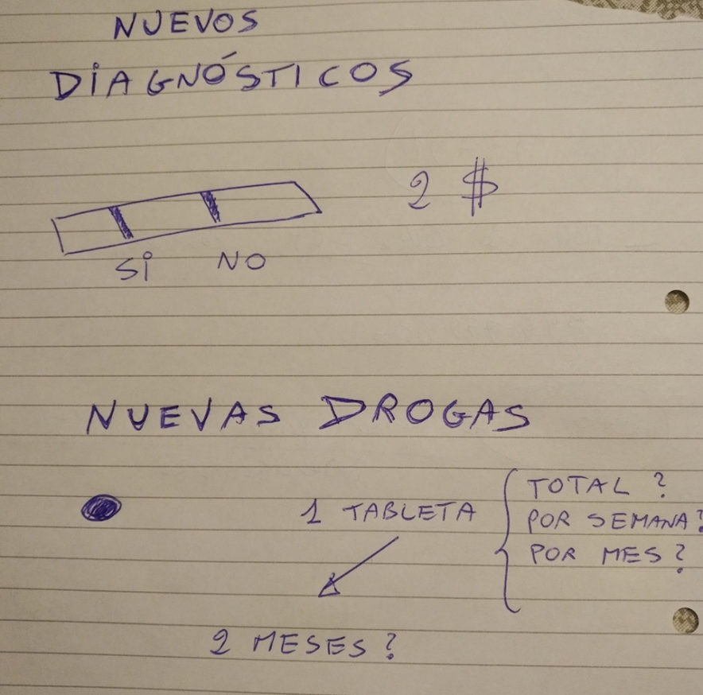
The future:
What would be ideal
1 pill?
1 day, 1 week or 1 month?
Cheap!!!

Slide 4
1880
Pyrazinamide/Clofazimine
1954
First sanatorium Germany, 1857
1890
Streptomycin
1943
PAS
1948
Koch, Mtb,
1882
1900
Cycloserine
1955
Ofloxacin
1982
1910
Thiacetazone
1951
Sutezolid/Linezolid
1990s
First Dispensary Scotland, 1897
1920
Isoniazid
1952
Kanamycin/Rifapentine/Rifampicin
1957
1930
1940
Ethionamide
1960
Pneumotorax,
Italy, 1907
BCG vaccination,
1921
1950
Capreomycin
1963
1960
Ethambutol
1961
Meropenem
1976
MMR,1950-1980
1970
Gatifloxacin
1992
Benzothiazinones/SQ109
2000s
1946: first randomized clinical controlled trial:streptomycin monotherapy caused rresistance
1980
Moxifloxacin
1996
Fox: Ambulatory treatment, 1968
1990
Pretomanid
2000
Bedaquiline
2005
2000
Delamanid
2006
1952: first regimen:streptomycin, aminosalicylic acid and isoniazid for 24 months
Styblo model,1978
2010
DOTS, 1991
2020
2030
1960s:aminosalicylic acid rwas eplaced byethambutol
streptomycin, isoniazid and ethambutol for 18 months
Post-2015 global TB strategy
2014 – WHO Framework for TB elimination, 2014
2040
2050
TB
elimination
1970s: streoptomycin, isoniazid, rifampicin and ethambutol for 9-12 months
1980s: isoniazid, rifampicin,pyrazinamide, ethambutol for 6-8 months (oral)
2020s: new universal and shorter regimen (2-4 months) for TB disease and infection?
Migliori GB, 2015

Slide 5
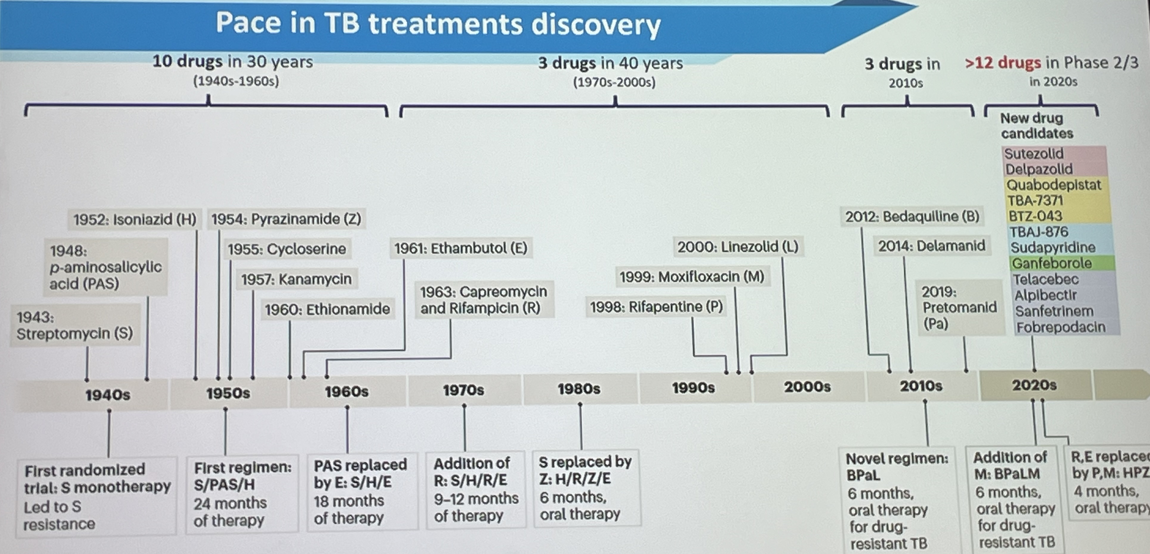
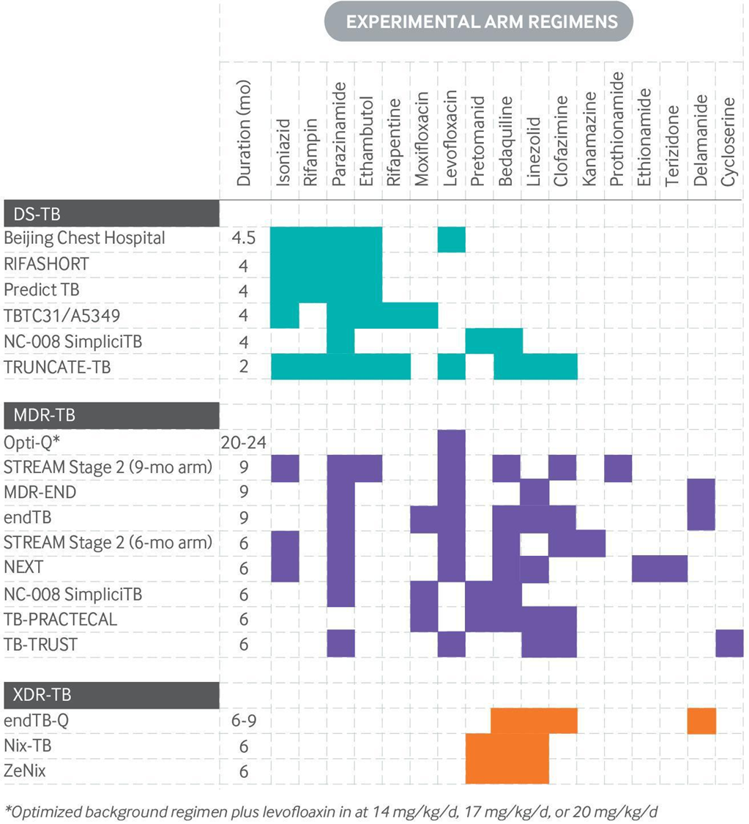
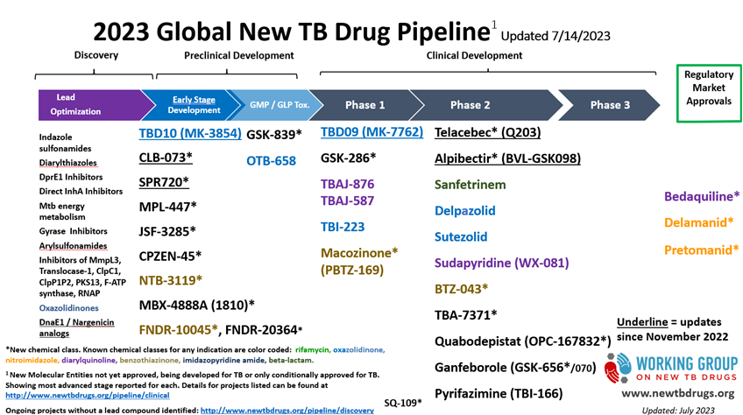
Ongoing trials
for DS (4 M) and DR-TB (6-9 M)
Shorter regimens

Slide 6
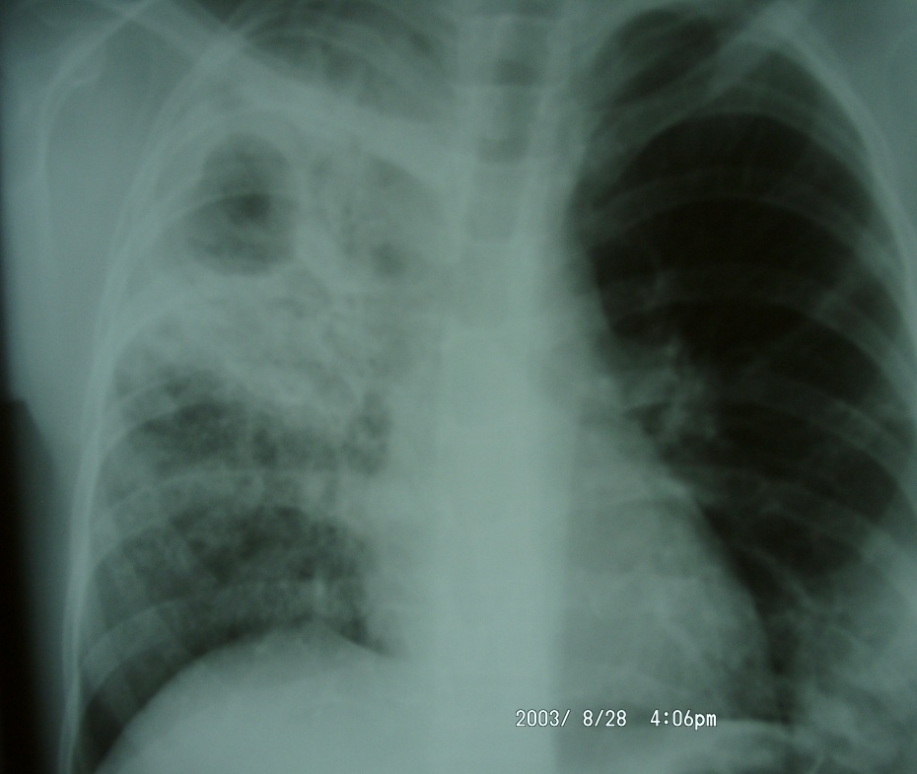
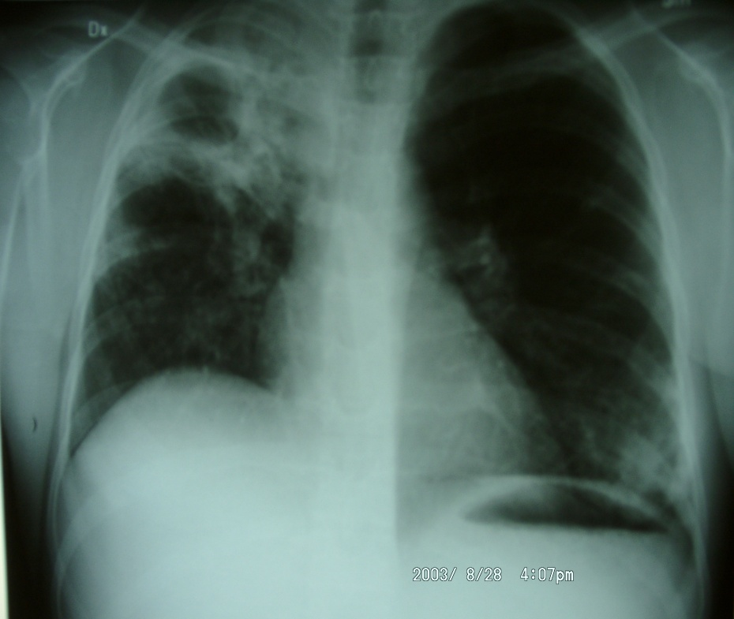
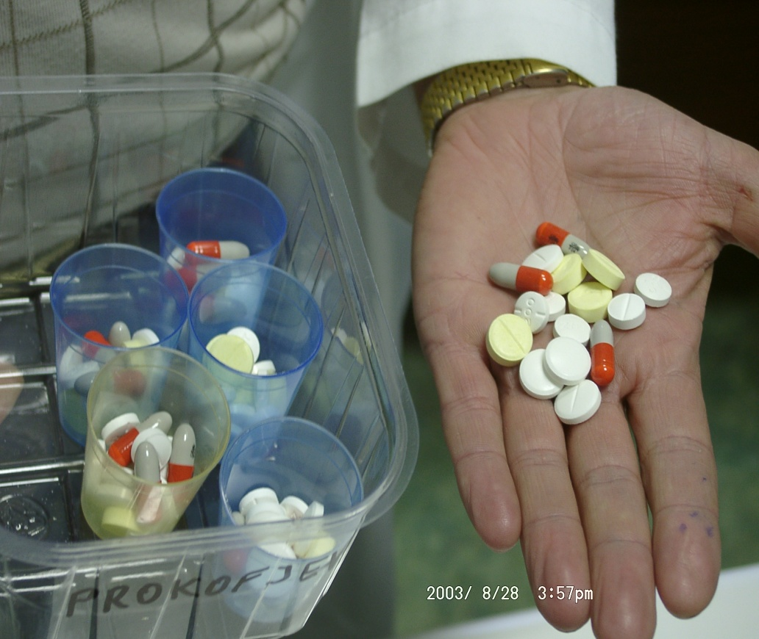
10 years ago 1 day of MDR-TB treatment was A TOXIC MEAL!!!

Slide 7
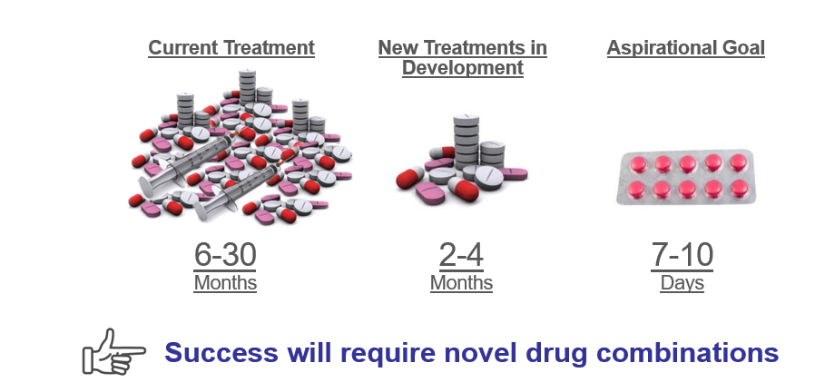

Slide 8
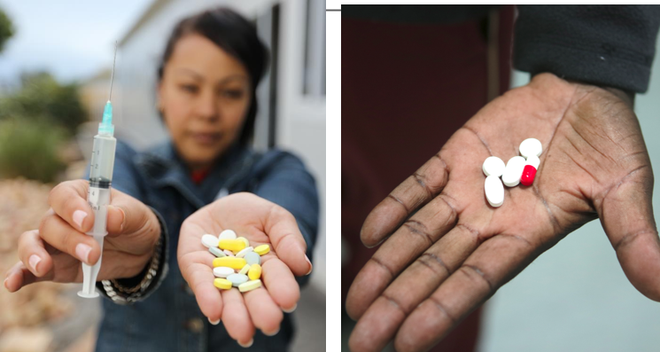
Reducing duration, number of drugs and dosage

Slide 9
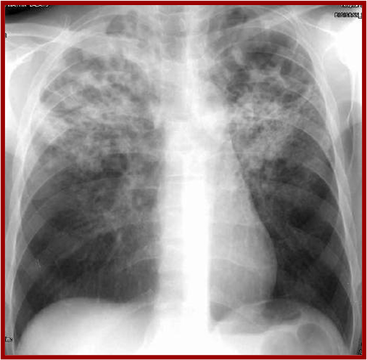
M. tuberculosis
Resistant mutants by population
INH 1 x 10⁵-10⁶ Bacilli
RIF 1 x 10⁷-10⁸ Bacilli
SM 1 x 10⁵-10⁶ Bacilli
EMB 1 x 10⁵-10⁶ Bacilli
PZA 1 x 10²-10⁴ Bacilli ?
FQ 1 x 10⁵-10⁶ Bacilli ?
Others 1 x 10⁵-10⁶ Bacilli ?
Different probability for each drug
Probability INH+RIF: 10⁶+10⁸⁼10¹⁴
MDR: human mistake---patient mismanagement!

Slide 10
Golden rules to design a TB regimen
Rule 1: multi-drug chemotherapy
To prevent MDR-TB we need the right number of effective drugs for a sufficient time when TB is susceptible (2HRZE/4RH). At least 2 Essential drugs (1 bactericidal and 1 sterilizing) for the entire duration of TX and 1/2 more to protect against drug resistance during the intensive phase.
Rule 2. Prolonged Tx
Rapidly multiplying bacilli in cavities: cause SS+. Symptoms, death.
We need bactericidal activity: INH, RIF,MX, AK, LZD, BQ, DM, Ethio/Prothio
Slowly multiplying bacilli in macrophages/acid environment: Z
Bacilli with intermittent growth in caseum: Cause relapse.
We need sterilizing activity: RIF, LV/MX, CFZ?, LZD, BQ, DM
Rule 3. Single dose

Slide 11
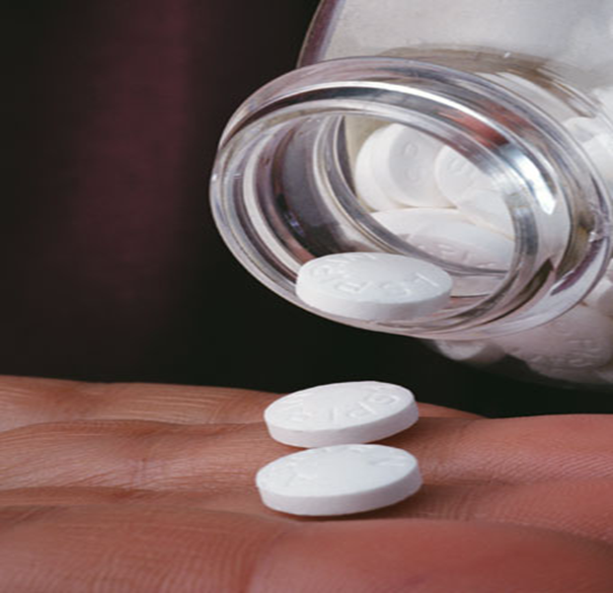
Ideal features of anti-TB drugs
1. Bactericidal activity – To eliminate rapidly the large volume of actively replicating bacilli
2. Sterilising activity – To kill dormant and intermittently replicating bacilli
3. Prevention of resistance (drug combination)
4. Low toxicity
5. Low cost

Slide 12
Minimum requirement to design a regimen
(Susceptible or DR-TB)
1. At least 4 new drugs, or likely to be active
2. 2 should be essential, 1 bactericidal and 1 sterilising, to be kept for the whole Tx
3. 2 additional drugs are accompanying to protect the essential drugs. Usually no need to continue after SS and C conversion
4. Sufficient time to cure without relapse→ Drugs with major sterilizing activity (RIF, PZ, Mx? Other new drugs?) can reduce the total Tx duration
The ideal historical regimen for new cases?
2 HRZ+E / 4 HR
The Union MDR-TB Guidelines. 2013

Slide 13
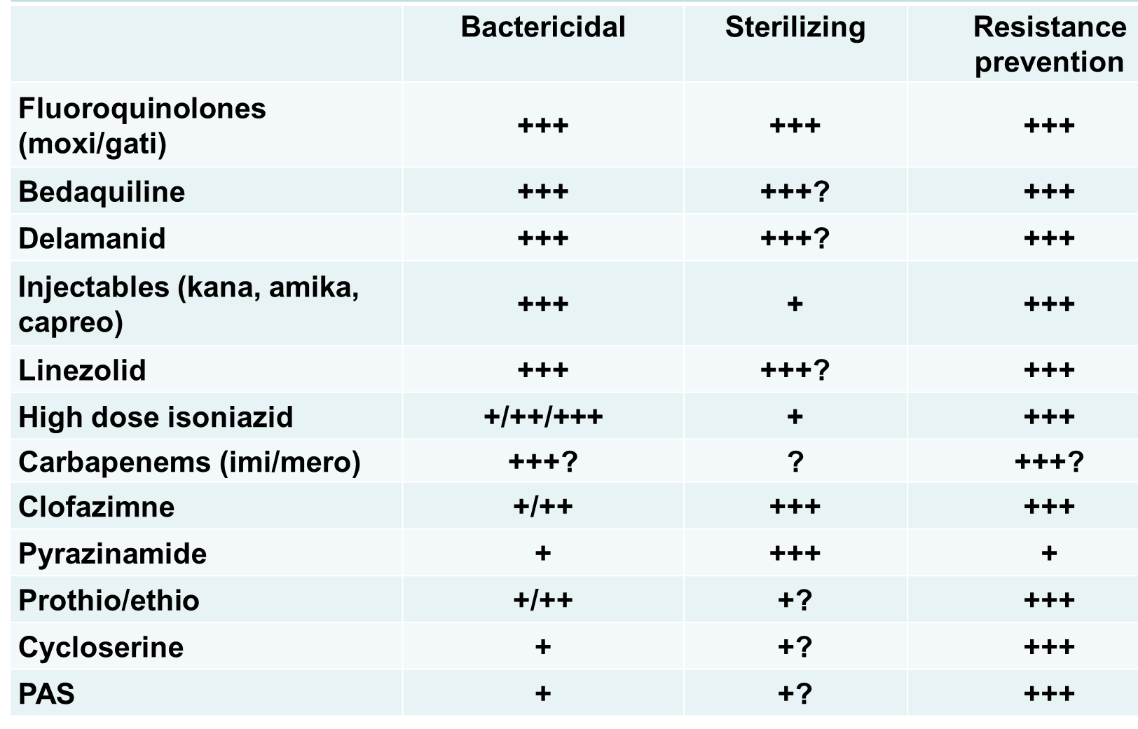
Features of second-line drugs
H: bactericidal
R: sterilizing

Slide 14
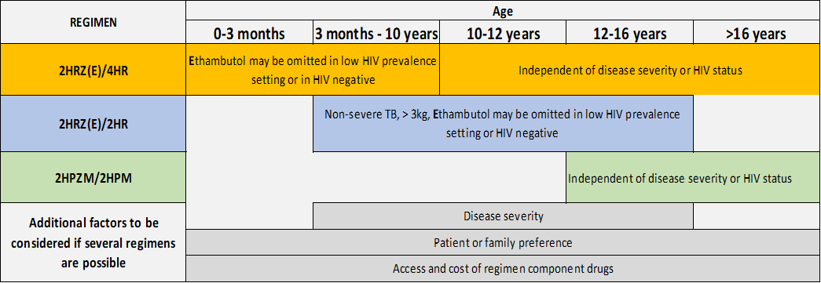
Guide for DS-TB regimen selection

Slide 15
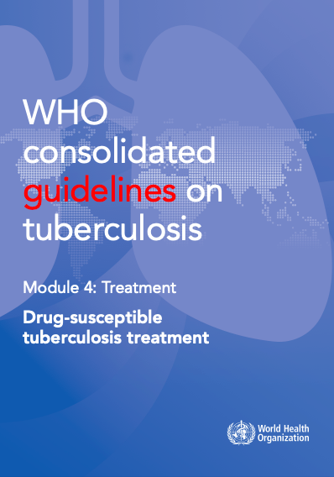
Treatment of drug-susceptible TB using
6-month regimen
New patients with PTB should receive a regimen containing 6 months of rifampicin:
2 HRZE/4 HR
(strong recommendation,
high certainty of evidence)
This recommendation also applies to EPTB except TB of the central nervous system, bone or joint for which some expert groups suggest longer therapy.
Pregnancy/children
Daily
Fixed dose combinations are preferrable
If sputum smears are found positive at the end of intensive phase, extension of intensive phase is not recommended

Slide 16
Treatment of drug-susceptible TB using
4-month regimen
People aged 12 years or older with drug-susceptible PTB, may receive a 4-month regimen
2HPMZ/2HPM
(conditional recommendation, moderate certainty of evidence) – new recommendation.
8 weeks HPMZ + 9 weeks HPM
Daily
Rifapentine dosage 1200 mg/day
Moxi: 400 mg/day
WHO does not recommend prolonging the regimen beyond the planned duration of 4 months.

Slide 17
Treatment of drug-susceptible TB using
4-month regimen
In children and adolescents between 3 months and 16 years of age with non-severe TB (without suspicion or evidence of MDR/RR-TB), a 4-month treatment regimen (2HRZ(E)/2HR) should be used
(strong recommendation, moderate certainty of evidence) – new recommendation.
mild symptoms, no hospitalization
CXR: non-severe TB (i.e. no cavities, no miliary)
Sputum smear negative or Xpert negative

Slide 18
August 2018:
New WHO classification of drugs to treat MDR-TB

Slide 19
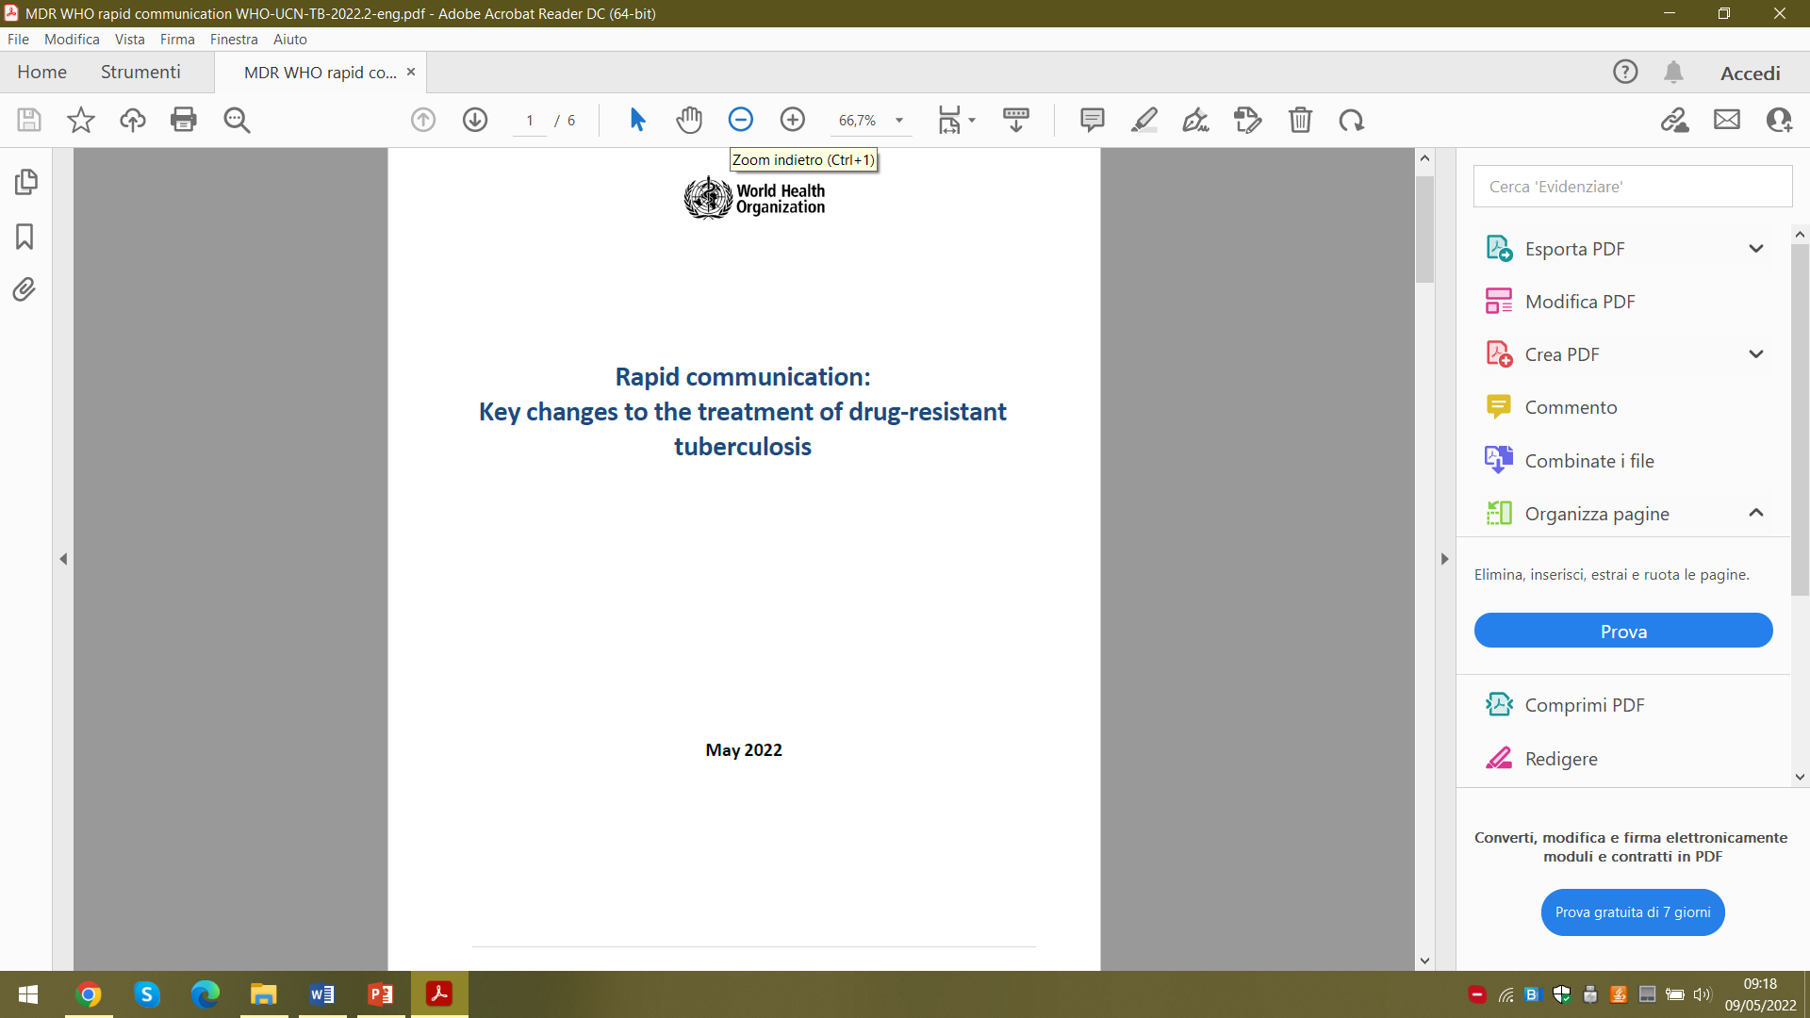
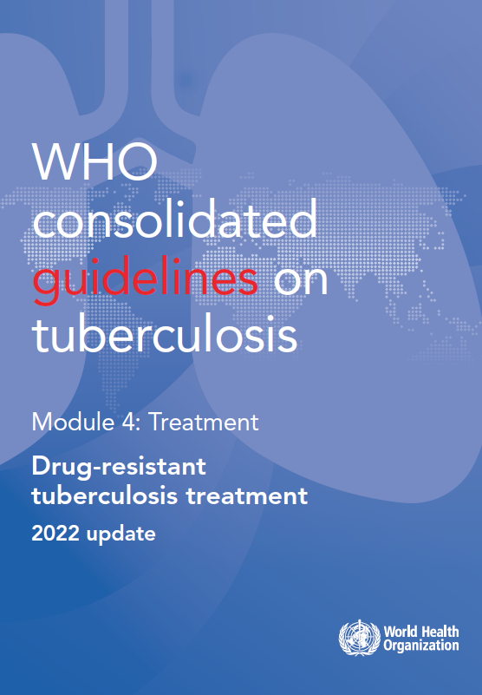
2022 MDR-TB Guidelines: regimen choice
Regimen | Duration (months) | Indications | Contraindications
BPaLM (bedaquiline, pretomanid, linezolid, moxifloxacin) BPaL (without moxifloxacin) | 6 | MDR/RR TB patients age 15 years or more. BPaL if documented resistance to fluoroquinolones | Exposure to any of the drugs composing the regimen for 30 days or more
All-oral, bedaquiline-containing regimens | 9 | Adults and children with MDR/RR-TB | Previous exposure to second-line treatment (including bedaquiline), fluoroquinolone resistance; extensive pulmonary TB disease; severe extrapulmonary TB
Individualized longer regimen | 18 or more | Patients with extensive forms of DR-TB (e.g. XDR-TB); or not eligible for the regimens described above or who previously failed shorter treatment regimens

Slide 20

6 BPaL
90% treatment success (CI 83-95%)
17% serious adverse events
3-6% for Linezolid
Hepatoxicity
No treatment interruptions due to QT prolongation

Slide 21
ZENIX trial
Linezolid 1200 mg or 600 mg for different durations

Slide 22
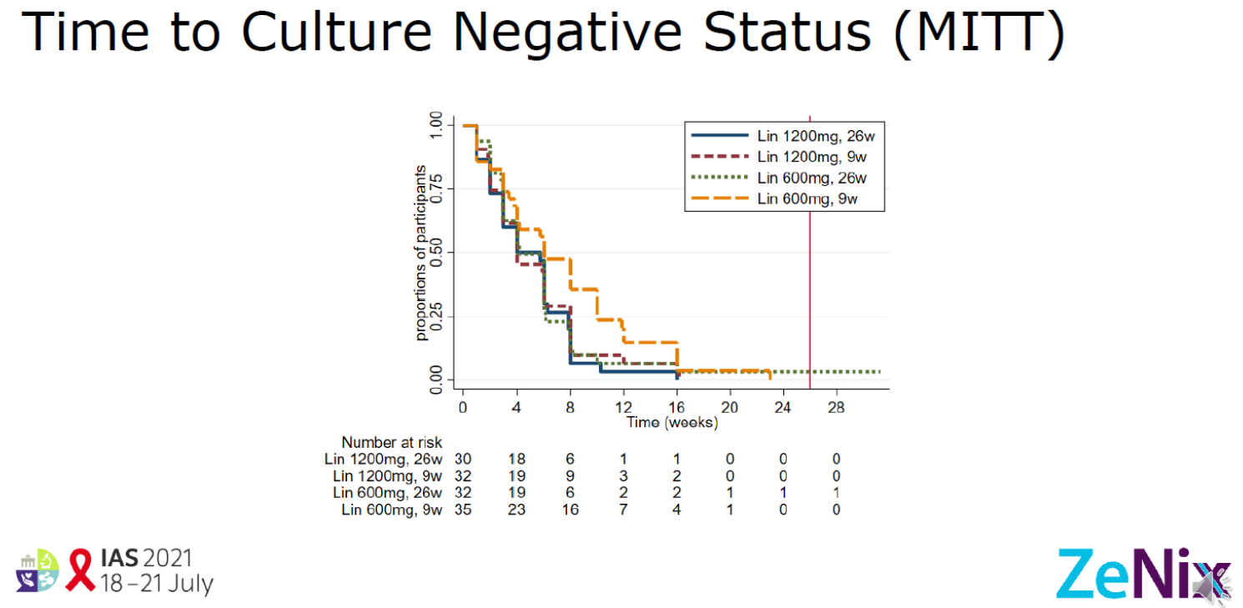
Extraordinary efficacy: 89-93% (9 w. a bit slower)

Slide 23
Less AEs with 600 mg

Slide 24
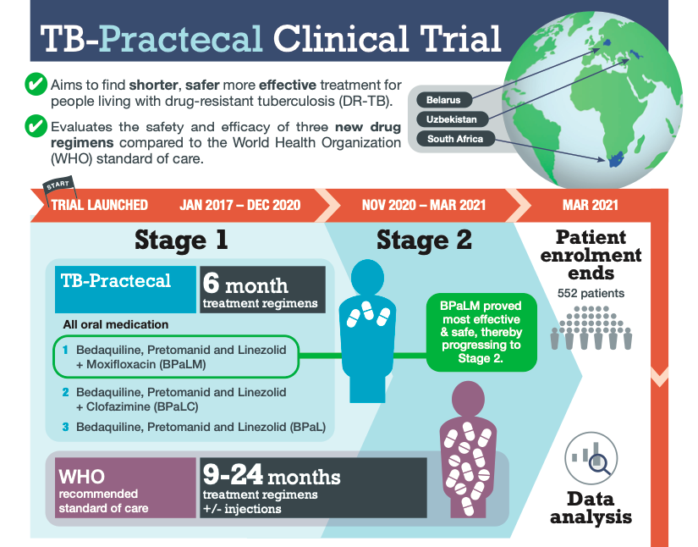
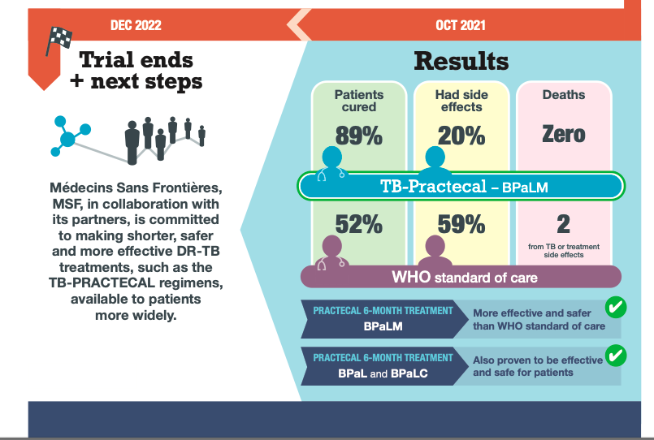
Reducing to 6 months: TB-Practecal
Notes:
Studio lanciato nel 2017 e chiuso a Dicembre 2022

Slide 25
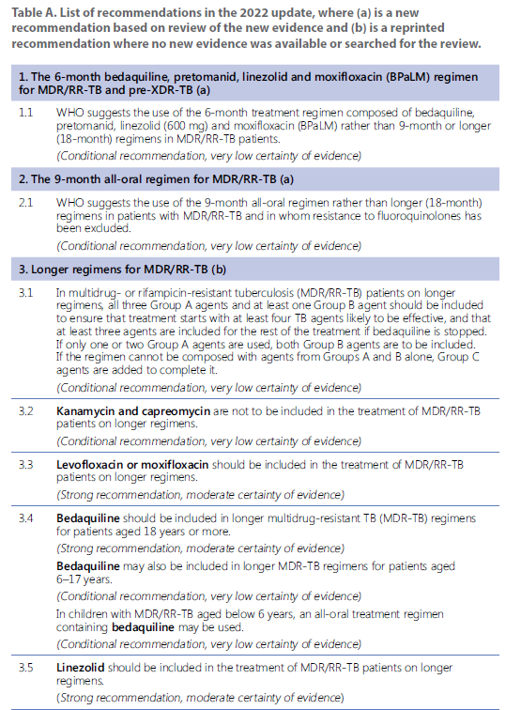
The 9 month regimen
The rationale for this recommendation is based on the evidence and considerations detailed in the next two subsections. The 9-month regimens can be used in patients not eligible for the shorter, 6-month regimens; also, they represent a preferred treatment option over the longer regimens

Slide 26
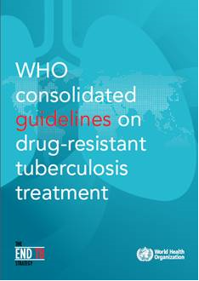
  Shorter MDR-TB regimen
  Main recommendation 2019 vs 2022
4–6 (Km)–Mfx–Cfz–(Eto)–Z–E–Hh/5Mfx–Cfz–Z–E
BQ
LZD
In MDR/RR-TB patients who have not been previously treated for more than 1 month with second-line medicines used in the shorter MDR-TB regimen or in whom resistance to fluoroquinolones and second-line injectable agents has been excluded, a shorter MDR-TB regimen of 9–12 months may be used instead of the longer regimens.
[conditional recommendation, low certainty in the estimates of effect]
What remains in 2022 of this regimen recommended in 2019??
Km replaced by BQ
Eto replaced by Linezolid

Slide 27
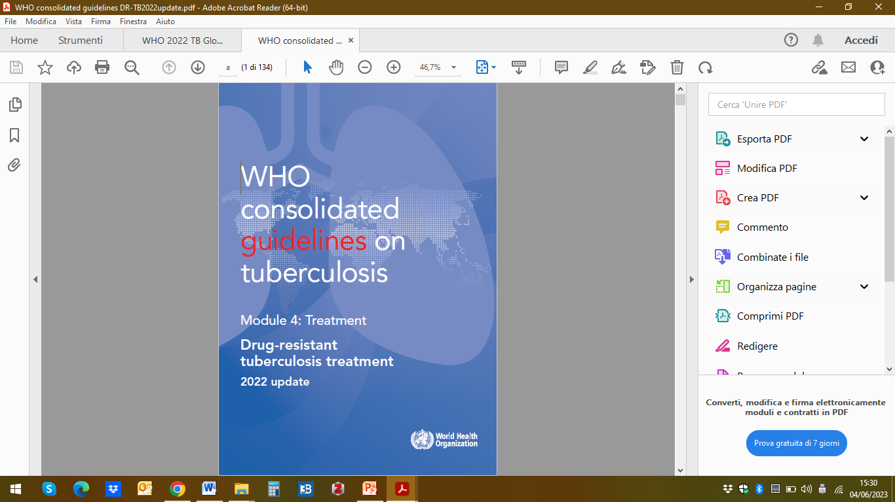
  Longer MDR-TB regimen composition
  Choice of drugs depends upon….
Expected balance of effectiveness and harms
Preference for oral over injectable agents
Results of drug-susceptibility testing (DST)
Reliability of DST methods
Population drug resistance levels
History of previous use of medicine in a patient
Drug tolerability
Potential drug-drug interactions

Slide 28
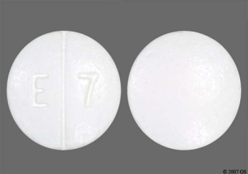
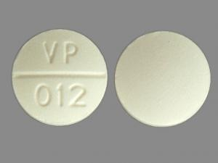
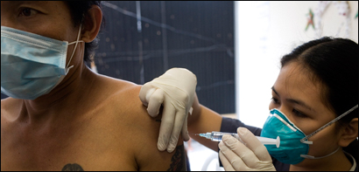
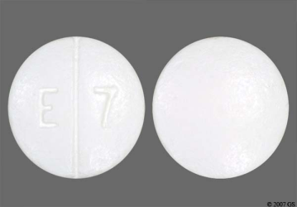
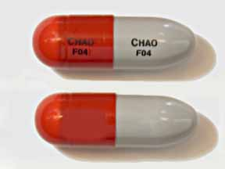
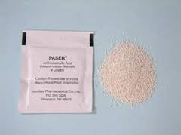
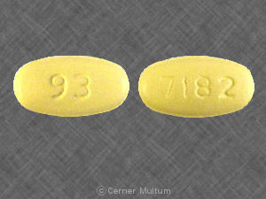
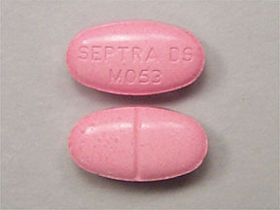
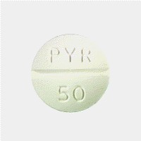
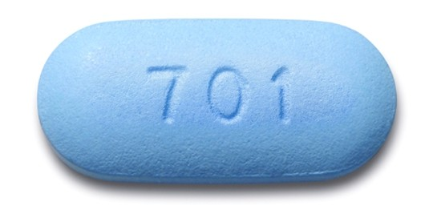
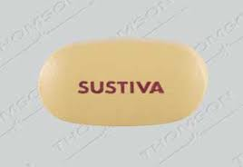
ethambutol
pyrazinamide
kanamycin (8+ months)
+
+
who.int/tb/challenges
+
minimum
20 months!
+
ofloxacin
cycloserine
PAS granules
+ ?
+
+
pyridoxine
truvada
efavirenz
TMP/sulfa

Slide 29
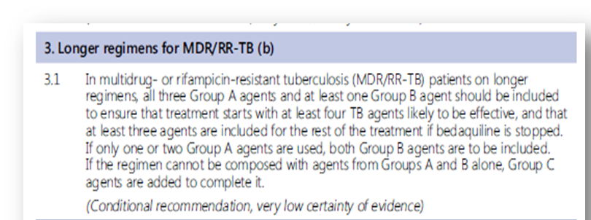
  Longer MDR-TB regimen composition
  Duration – conditional upon patient’s response
3 Group A and 1 Group B drugs if possible
At least 3 agents if BQ is stopped
If 1 or 2 Group A drugs both group B drugs included
If necessary, Group C drugs
Total length = 18-20 months
Time after conversion = 15-17 months
Injectable phase (if applicable) = 6-7 months

Slide 30
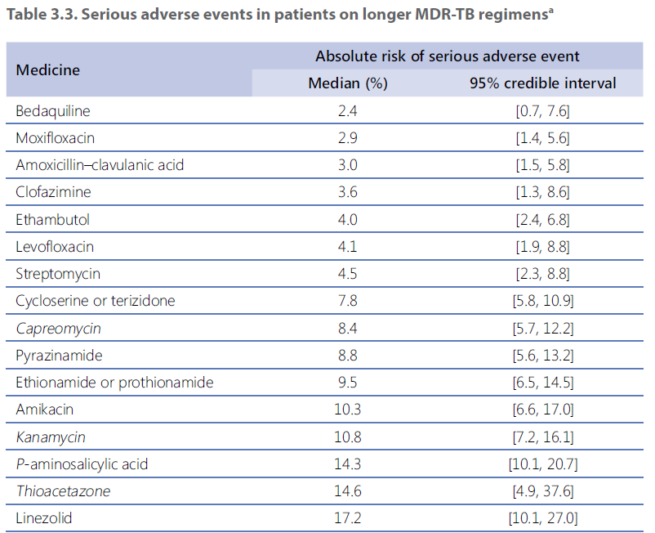
Median and 95% credible interval of SAE (Serious Adverse Events)

Slide 31
Regimen name | Drugs composing the regimen | Duration of treatment (months) | Indication/notes
BPaLM | BDQ, Pa, LZD (600 mg), Mfx | 6 | MDR/RR-TB patients aged 15 years or more; Most recommend regimen
BPaL | BDQ, Pa, LZD (600 mg) | 6 | MDR/RR-TB patients aged 15 years or more; documented resistance to FLQs Most recommend regimen
“Shorter”, all-oral, BDQ -containing regimen | BDQ (4 months; up to 6 months), Lfx or Mfx, Eto or Pto, E, Hh, Z, Cfz followed by 5 months of Lfx or Mfx, E, Z, Cfz | 9-12 | LZD instead of Eto may be used in pregnant women Preferred over longer regimen It can be used in children
Longer regimen | All three Group A agents (BDQ , LZD, Lfx or Mfx) and at least one Group B agent (Cfz or cycloserine/ terizidone) should be included If only one or two Group A agents are used, both Group B agents are to be included If the regimen cannot be composed with agents from Groups A and B alone, Group C agents (E, DLM, pyrazinamide, imipenem–cilastatin or meropenem, amikacin (or streptomycin), Eto or Pto, and p-aminosalicylic acid) are added to complete it. | 18-20 (modifiable based on response) | Obsolete; it contains injectables
BEAT | BDQ, DLM, LZD (600 mg), Lfx, and Cfz (BDLLfxC) | 6
endTB | BDQ, Lfx or Mfx, LZD, Cfz, DLM, and pyrazinamide (BLMZ, BLLfxCZ, BDLLfxZ, DCLLfxZ, and DCMZ) | 9 | No resistance to FLQs

Slide 32
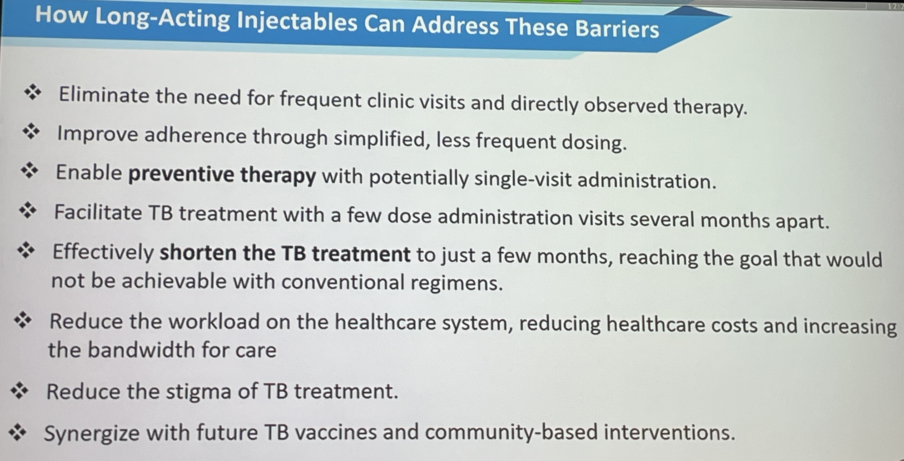
What LAI can ensure in the future

Slide 33
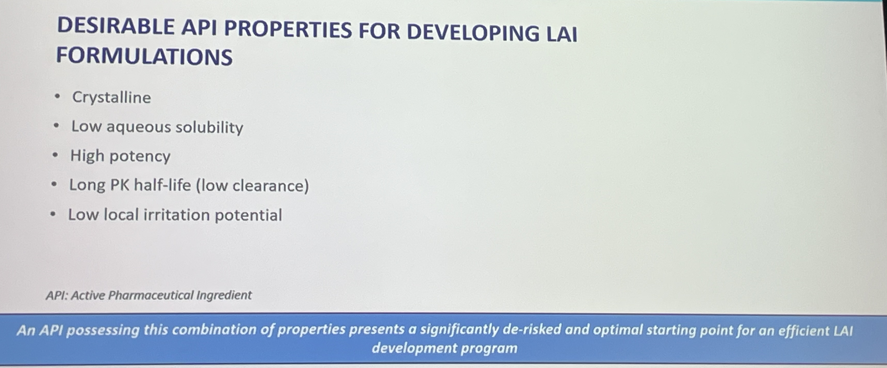
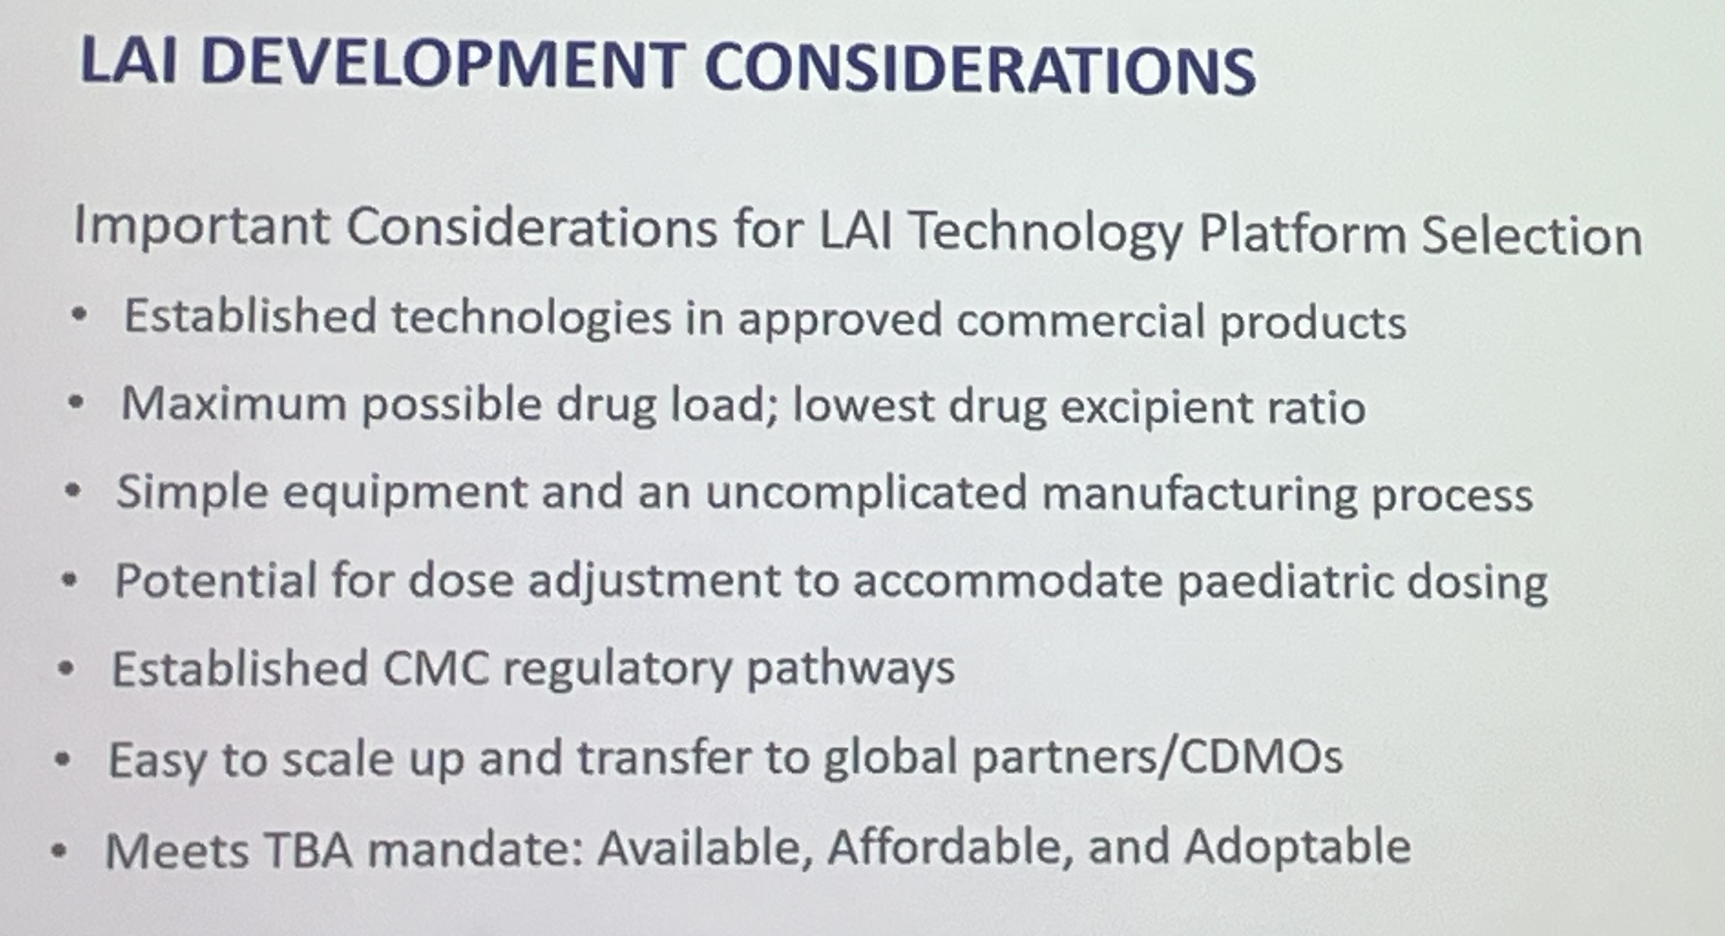
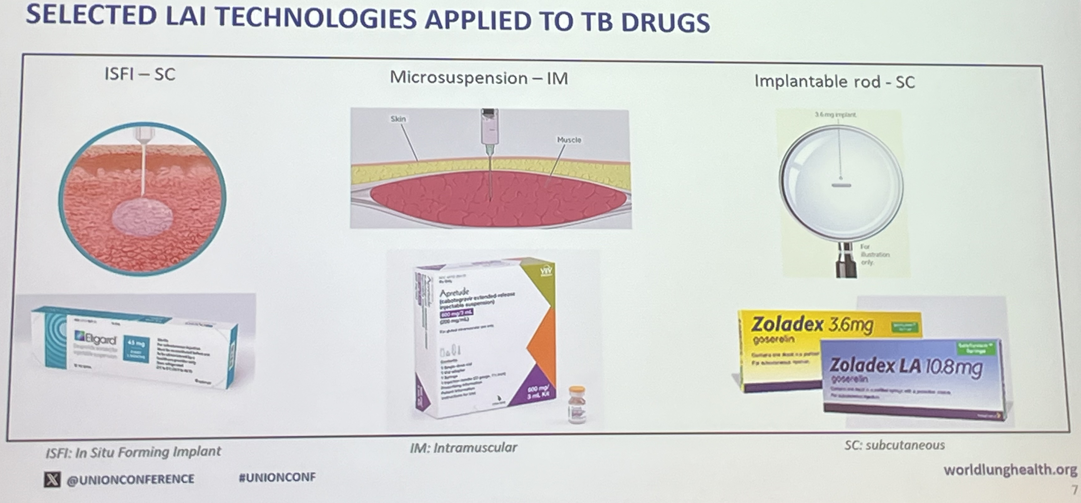
Source: Global TB Alliance,
UNION 2025, Copenhagen

Slide 34
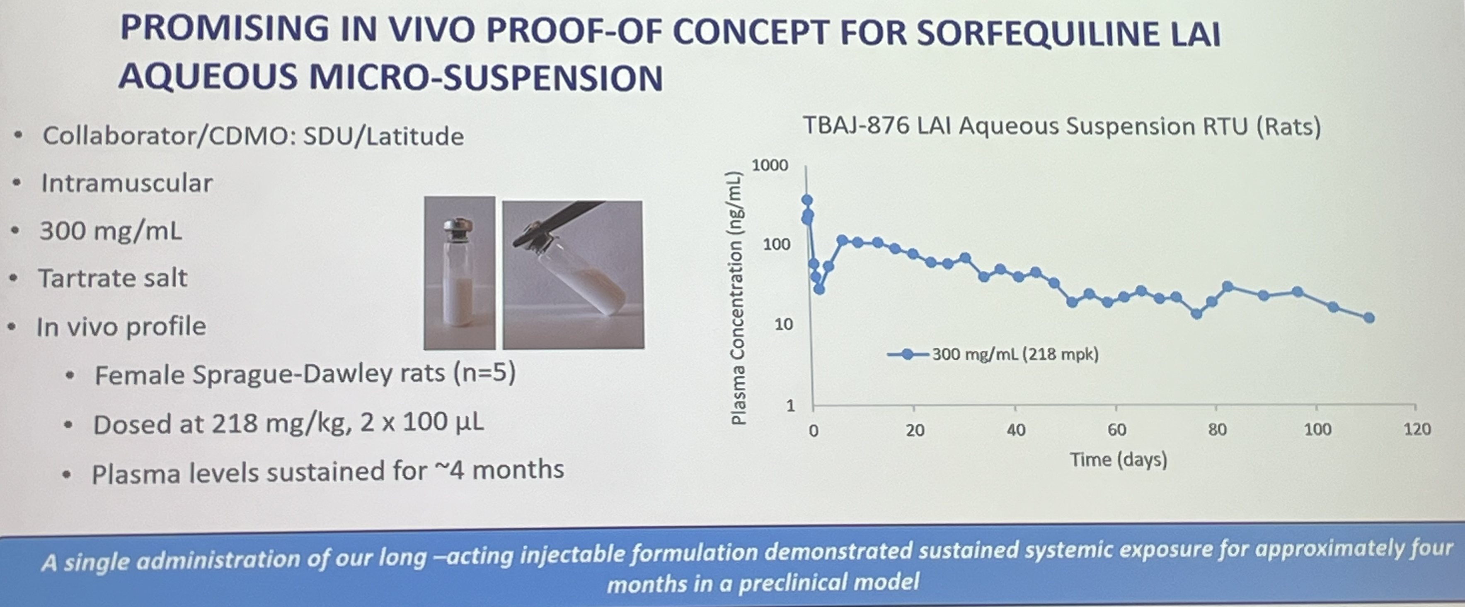
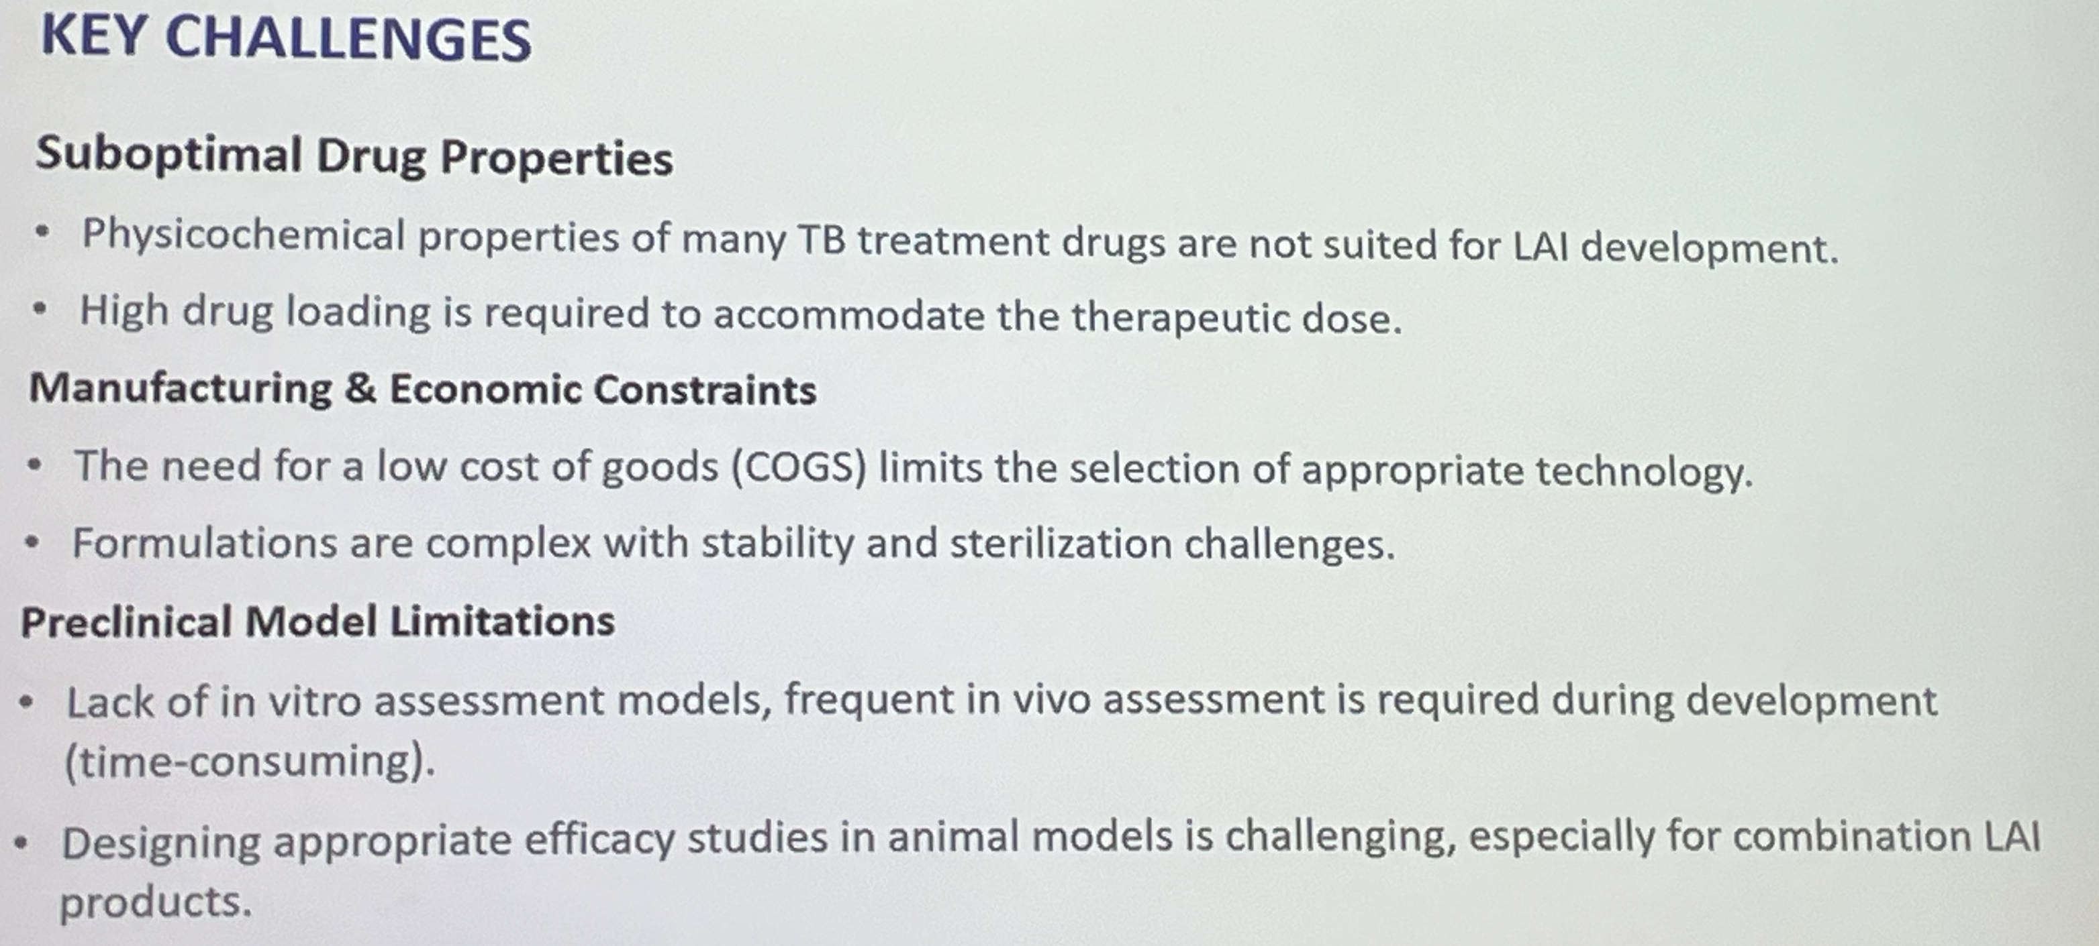
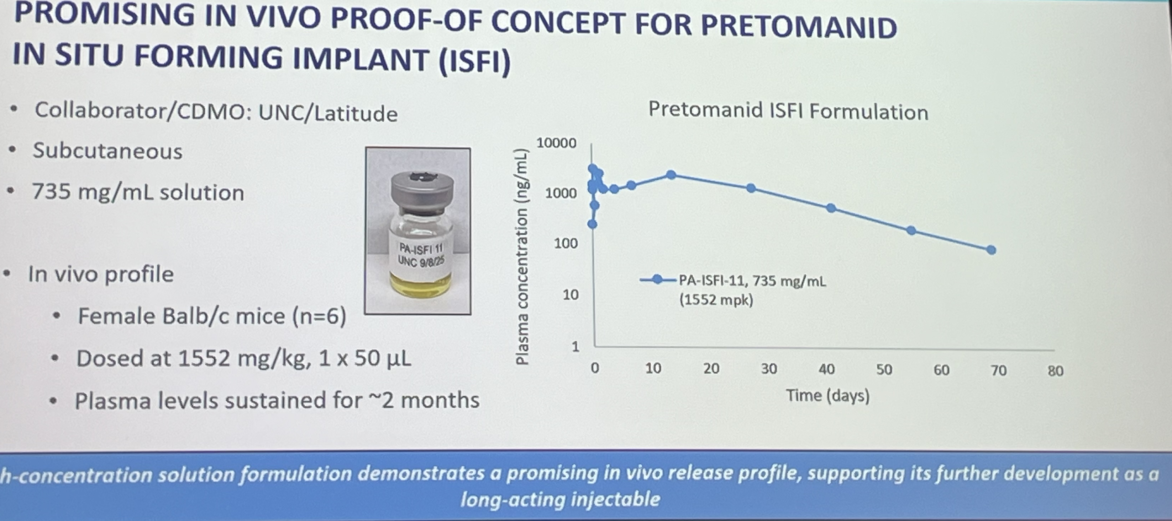
Source: Global TB Alliance,
UNION 2025, Copenhagen

Slide 35
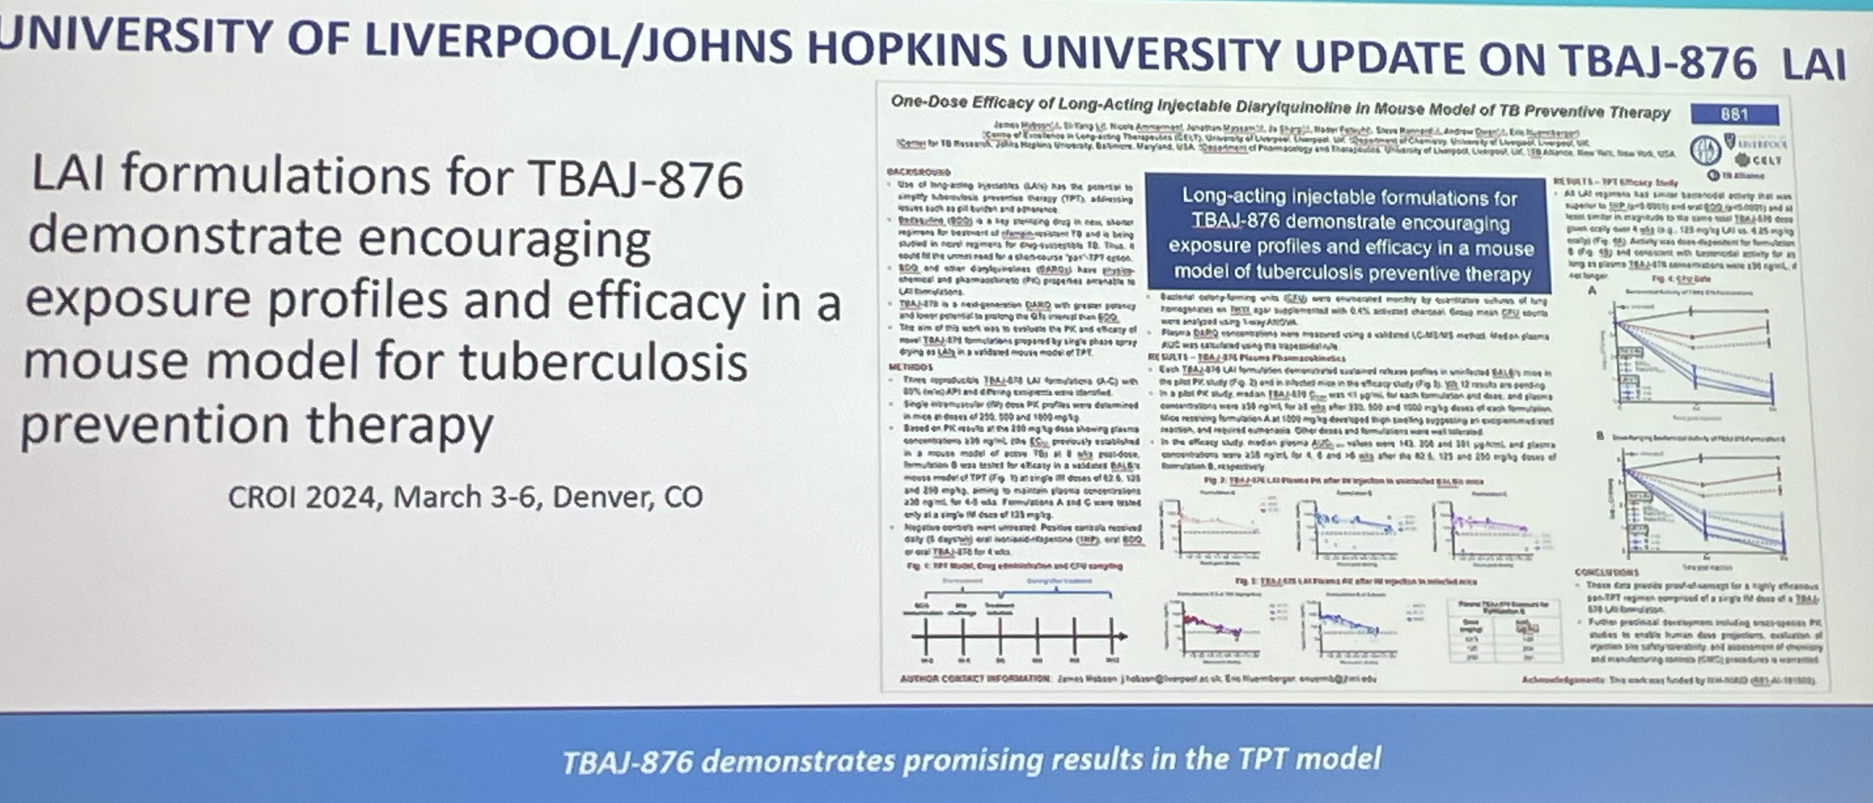
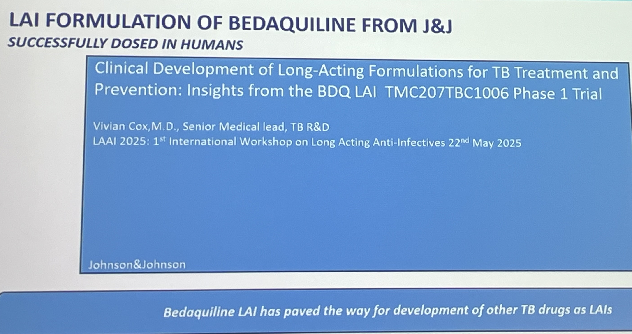

Slide 36
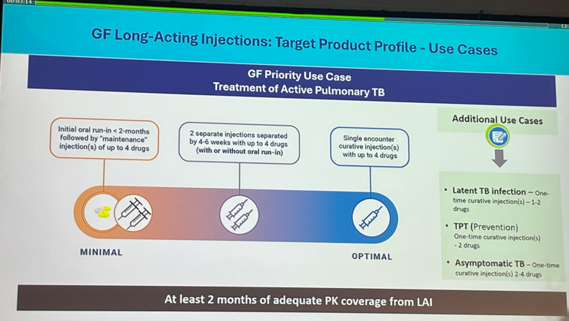
TPPs for LAIs

Slide 37
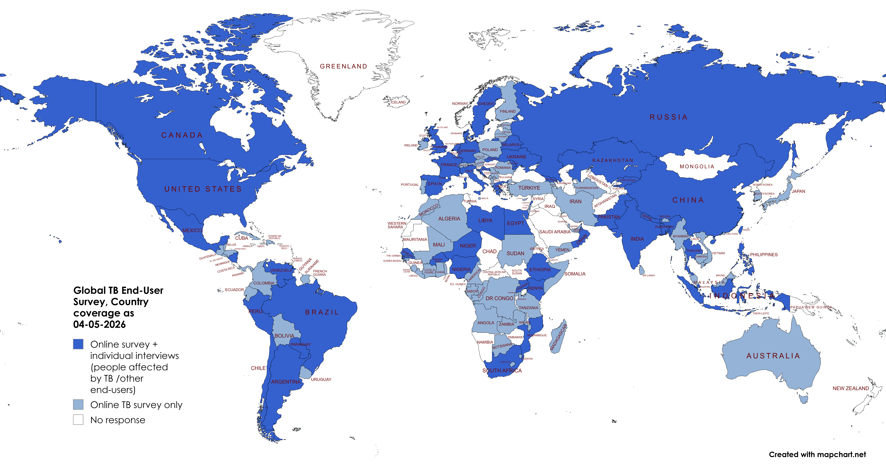


End-user Survey: Countries engaged
Questionnaire: ≈1400 respondents in 131 Countries
Patients’ interviews: >600 in 19 Countries
Frontline HCW interview; >600 in 11 countries
Interviews HCWs

Slide 38
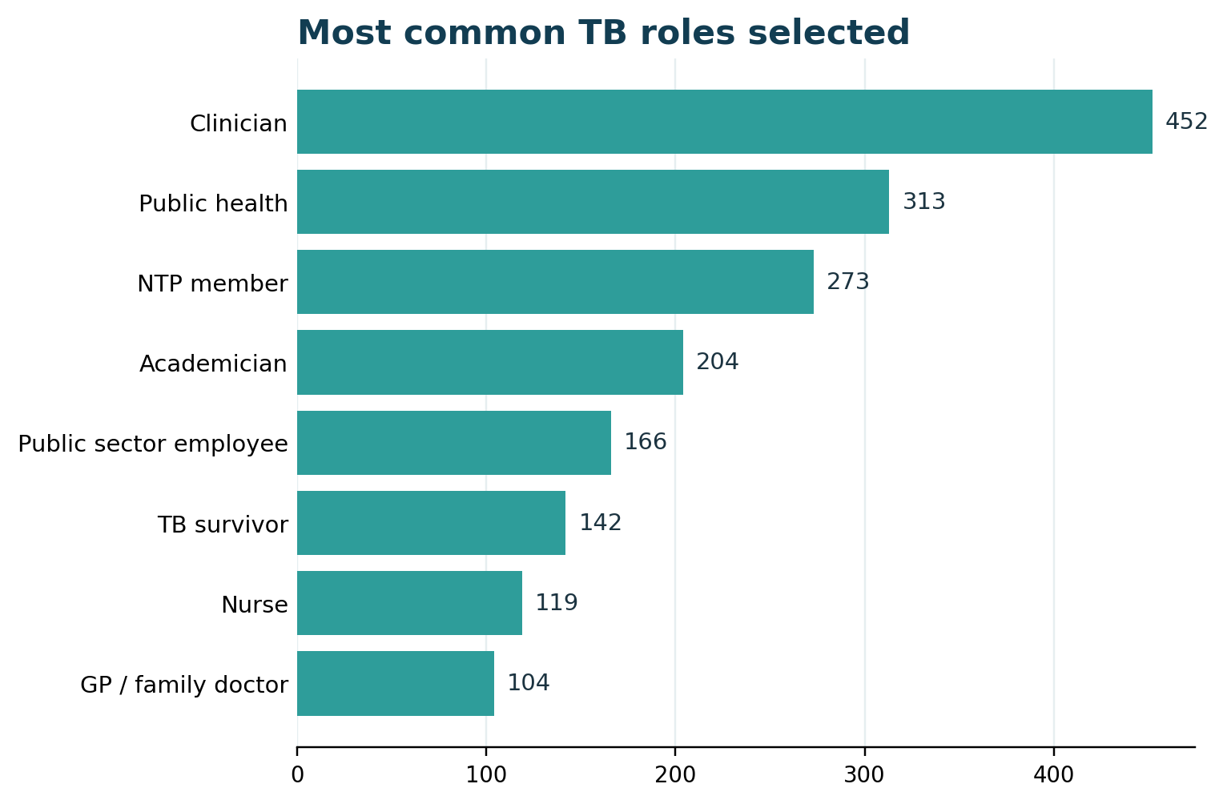
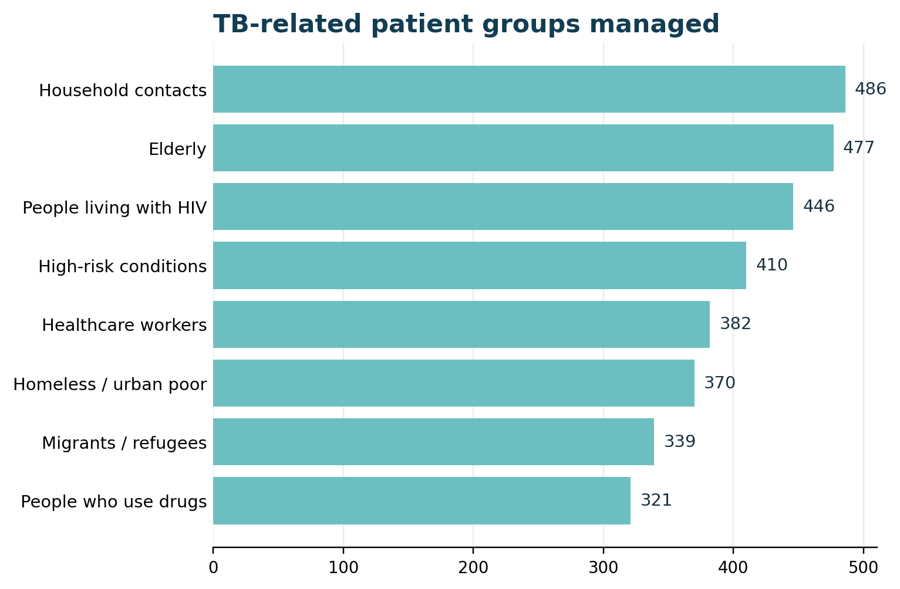
END-USER INVOLVEMENT
multi-select counts | China integrated
Females: 55%
Indigenous populations 34.5%
Urban residents: 90%
Updated survey results | All questionnaires + China dataset integrated
WHO Collaborating Centre for TB and Lung Disease, Maugeri

Slide 39
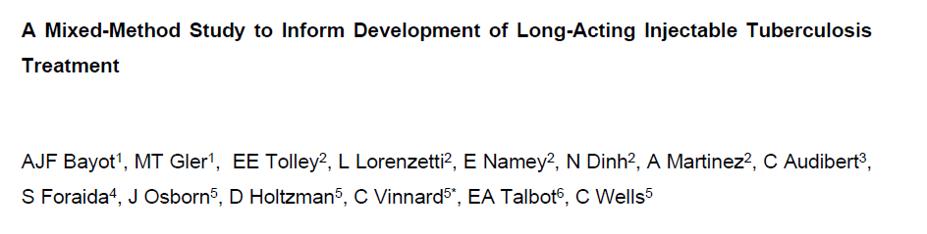
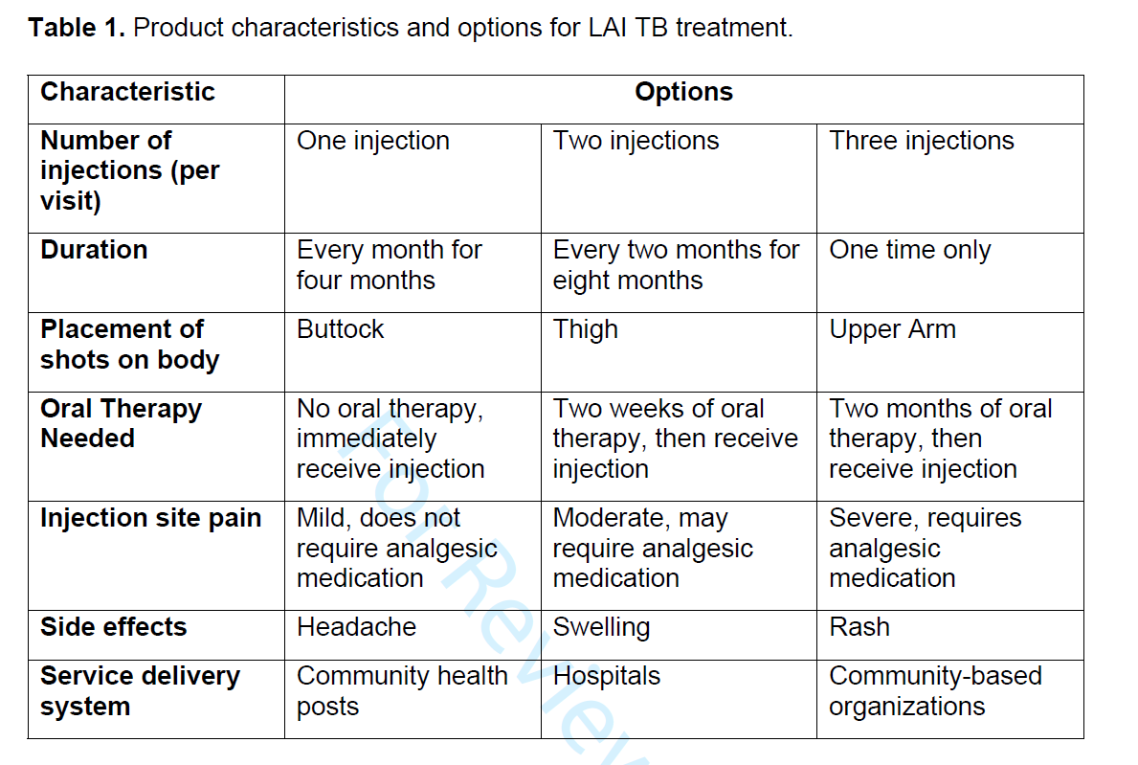

Slide 40



REGIMEN ACCEPTABILITY
scenario comparison | China integrated
1381
Updated survey results | All questionnaires + China dataset integrated
WHO Collaborating Centre for TB and Lung Disease, Maugeri

Slide 41


TPT INJECTION ACCEPTABILITY
willingness + configuration preferences | China integrated
1381
66%
willing to receive injections
Updated survey results | All questionnaires + China dataset integrated
WHO Collaborating Centre for TB and Lung Disease, Maugeri

Slide 42

Conclusions
With the traditional approach
we have reduced the duration of
treatment to 4 months for DS-TB
and 6 monts for MDR-TB
LAI will allow furher reductions
We need drugs which can be manipulated to be realeased slowly
We need to solve technical problems related to pharmaceutical and technical procedures
We need to ensure the amount injected is tolerated
So far Bedaquiline, Sorfequiline, TBAJ-587, Pretomanid, Telacebec and Rifabutin are promising
>50% of end users are open to their use

Slide 43

THANK YOU!!!
GRAZIE!!!!

