Slide 1


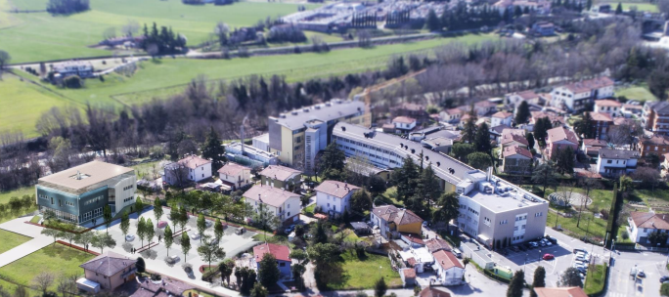
SOPRAVVIVENZA E QUALITÀ DI VITA CON I NUOVI TRATTAMENTI PER IL TUMORE DEL POLMONE
Prof. Lucio Crinò
SSD Oncologia Toracica
Notes:
NOTA: NON E’ CONSENTITO INSERIRE NELLE SLIDES I RIFERIMENTI TELEFONICI E DI POSTA ELETTRONICA

Slide 2
Cancer Statistics 2026, Siegel R. et al
Overall cancer mortality rate in the U.S.A. has fallen continuosly for 32 years, with an estimated 4,8 milion deaths averted since 1991.
5-year relative survival rate for all cancers combined has reached a milestone 70%.
Lung Cancer remains the leading cause of cancer-related deaths, but with an estimated 34% reduction in overall cancer mortality between 1991 and 2023.

Slide 3
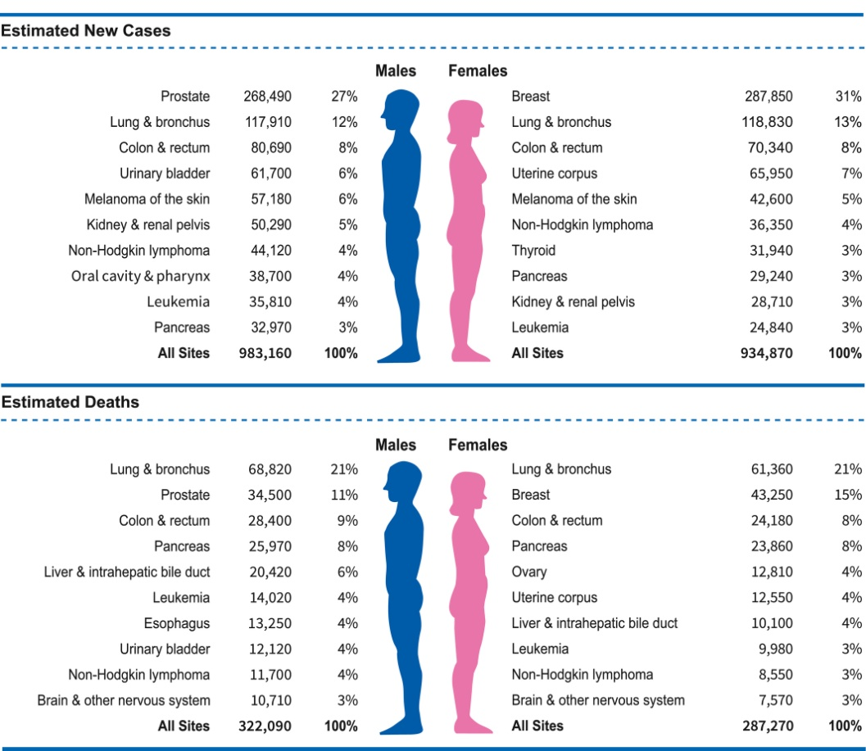
Ten Leading Cancer Types for the Estimated New Cancer Cases and Deaths by Sex, United States, 2022.

Slide 4
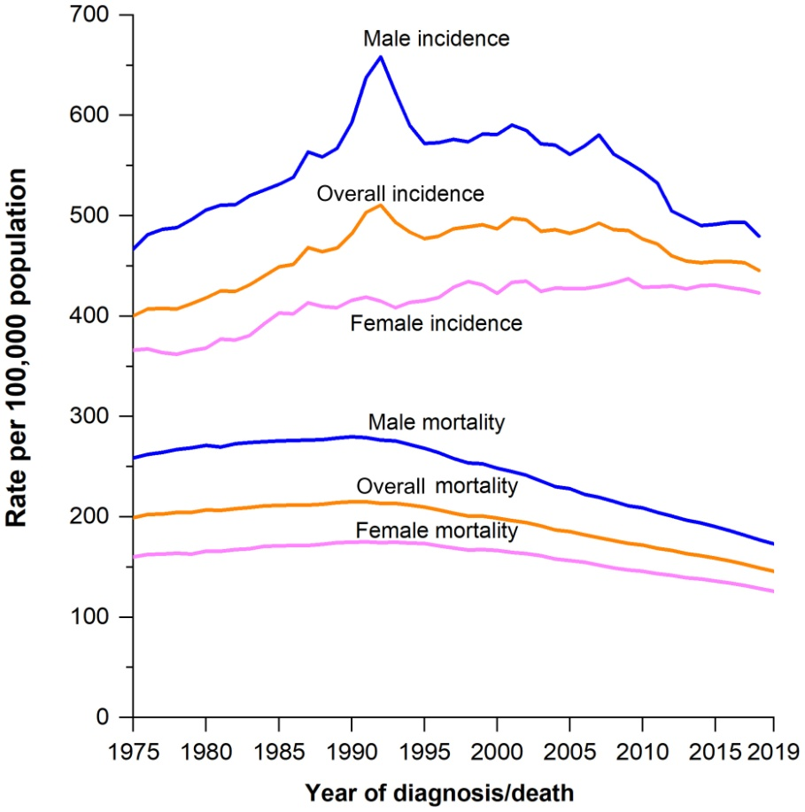
Trends in Cancer Incidence (1975‐2018) and Mortality (1975‐2019) Rates by Sex, United States.

Slide 5
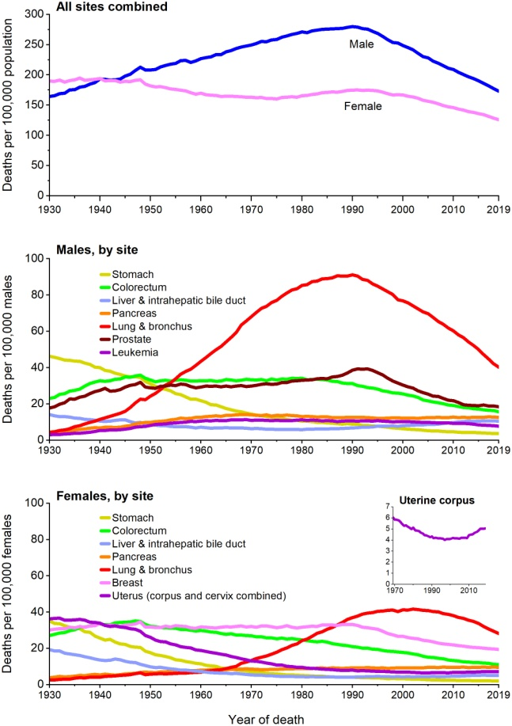
Trends in Cancer Mortality Rates by Sex Overall and for Selected Cancers, United States, 1930 to 2019.

Slide 6

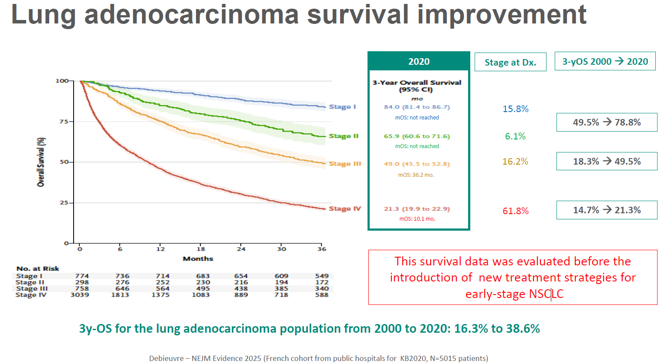

Slide 7
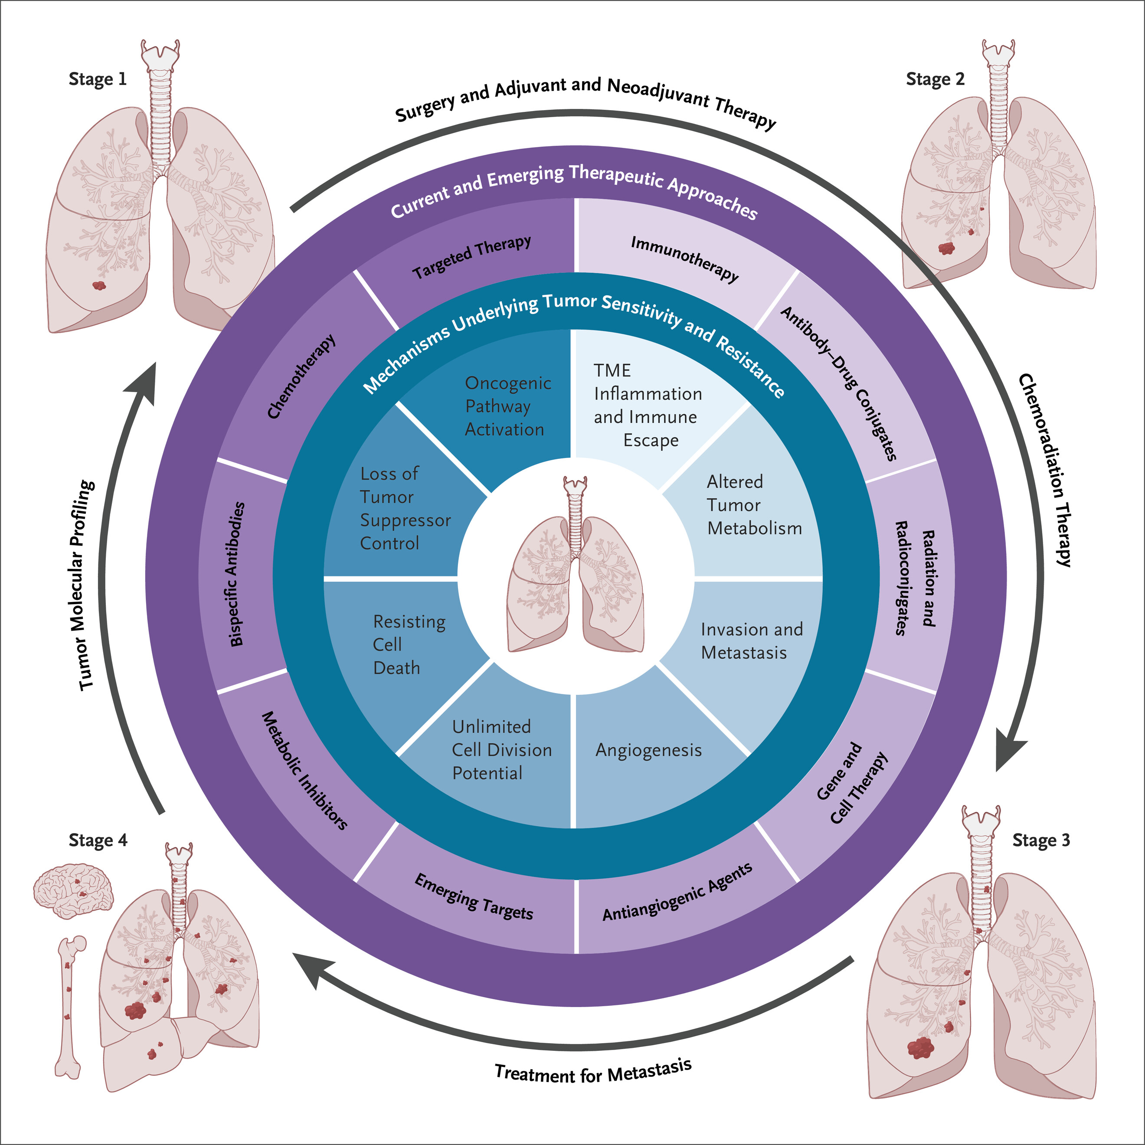
Hallmarks of Lung Cancer
Herbst R.S. New England Journal of Medicine 2026

Slide 8

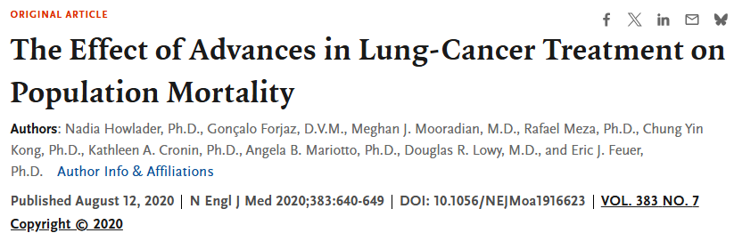
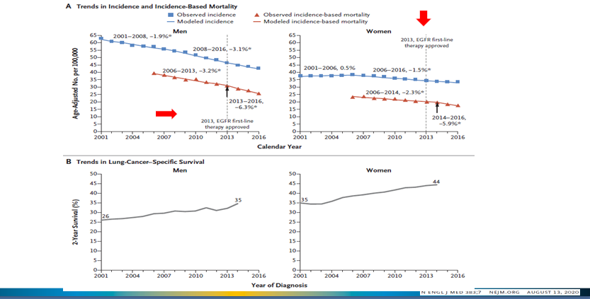

Slide 9

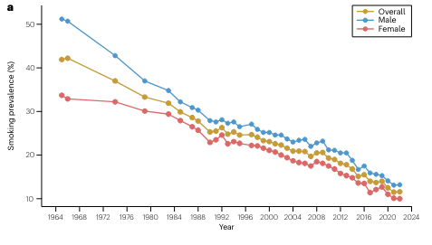

Slide 10
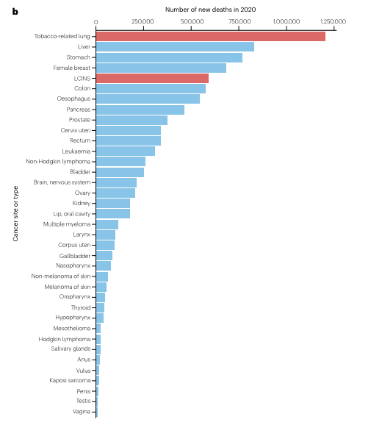

Slide 11
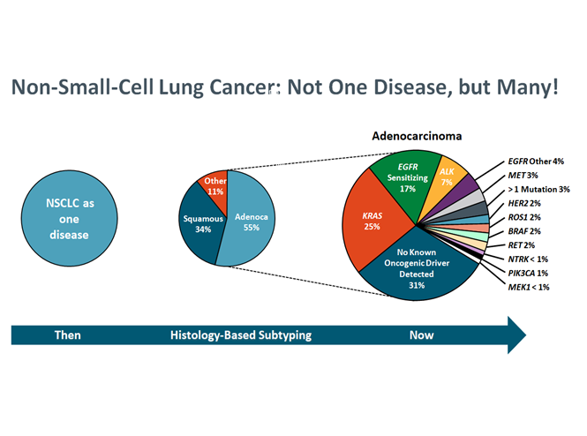

Slide 12
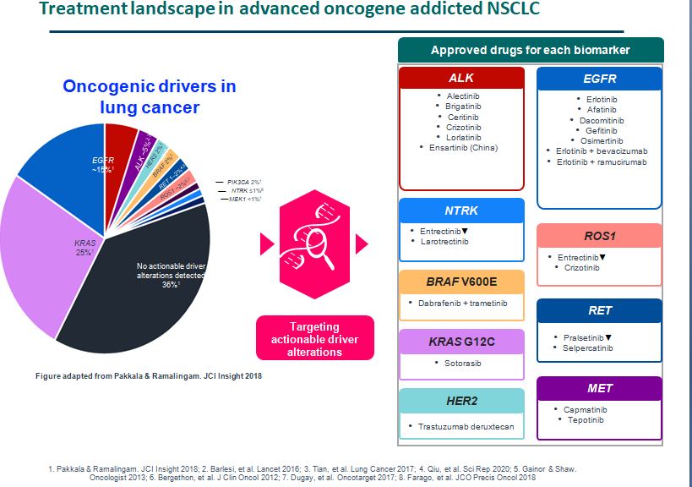

Slide 13
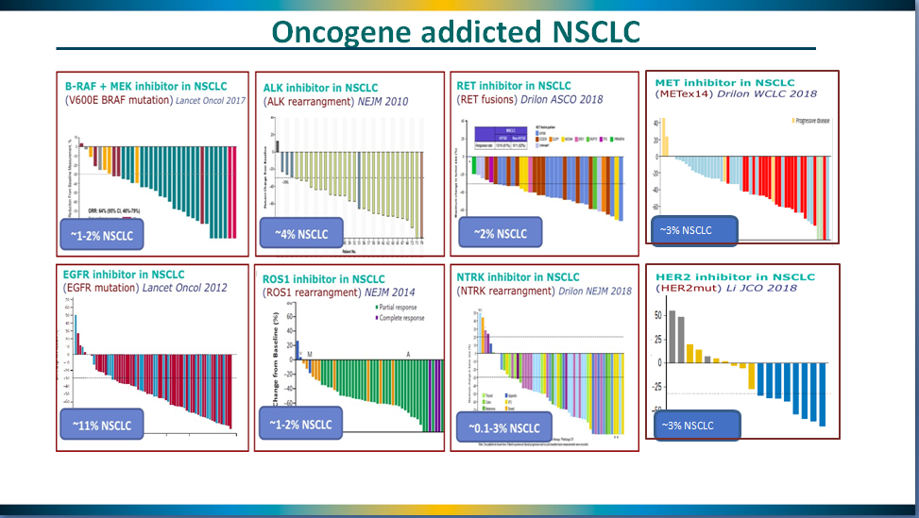

Slide 14
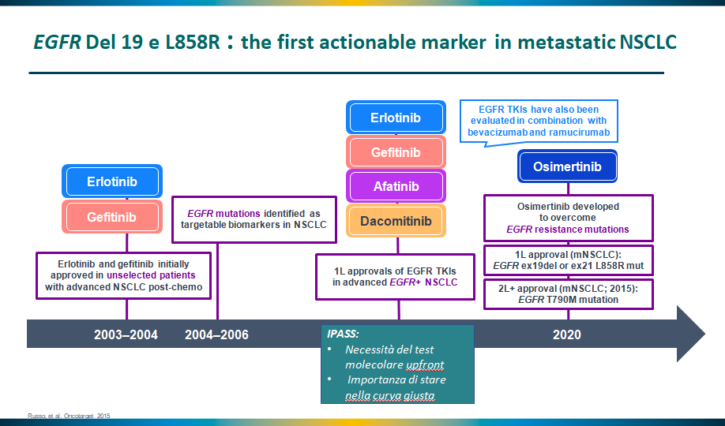

Slide 15
PL02.04: First-Line Osimertinib + Chemotherapy Versus Osimertinib Monotherapy in EGFRm Advanced NSCLC: FLAURA2 Final Overall Survival – Planchard D, et al
Study objective
  To evaluate the final OS with 1L osimertinib ± platinum-pemetrexed in patients with EGFRm advanced NSCLC in the phase 3 FLAURA2 study
Osimertinib 80 mg/day +
pemetrexed 500 mg/m² +
carboplatin AUC5 or cisplatin 75 mg/m²
q3w (4 cycles)
(n=279)
Osimertinib
80 mg/day +
pemetrexed
500 mg/m² q3w
Key patient inclusion criteria
Locally advanced or metastatic non-squamous NSCLC
Ex19del/L858R (local/central test)
No prior systemic therapy for advanced disease
Stable CNS metastases permitted
WHO PS 0–1
(n=557)
PD/other
withdrawal
R
1:1
Stratification
Race (Chinese Asian, non-Chinese Asian, non-Asian)
EGFRm (local, central test)
WHO PS (0, 1)
Osimertinib 80 mg/day
(n=278)
PD/other withdrawal
Primary endpoint
PFS (investigator assessed, RECIST v1.1)
Secondary endpoints
OS, TFST, DoR, DCR, PFS2, TSST, safety
Planchard D, et al. J Thorac Oncol 2025;20(suppl):Abstr PL02.04

Slide 16
LBA77: FLAURA2: exploratory overall survival (OS) analysis in patients (pts) with poorer prognostic factors treated with osimertinib (osi) ± platinum-pemetrexed chemotherapy (CTx) as first-line (1L) treatment (tx) for EGFR-mutated (EGFRm) advanced NSCLC – Jänne PA, et al
Key results
Overall survival
 | Osimertinib + chemotherapy (n=279) | Osimertinib (n=278)
Median follow-up, mo (range) | 51.2 (0.2–60.4) | 51.3 (0.1–60.1)
Events, n (%) | 144 (52) | 171 (62)
mOS, mo (95%CI) | 47.5 (41.0, NC) | 37.6 (33.2, 43.2)
HR (95%CI); p-value | 0.77 (0.61, 0.96); 0.02
1.0
0.8
80%
63%
0.6
72%
49%
OS probability
0.4
51%
41%
0.2
0
0
6
12
18
24
30
36
42
48
54
60
No. at risk
Time, months
Osi + plat-pem
279
267
258
253
245
240
236
226
218
202
196
183
170
158
143
123
105
71
36
16
1
0
Osimertinib
278
267
260
257
252
245
229
214
195
180
165
152
137
131
118
103
93
61
38
16
1
0
Jänne PA, et al. Ann Oncol 2025;36(suppl):Abstr LBA77

Slide 17
PL02.04: First-Line Osimertinib + Chemotherapy Versus Osimertinib Monotherapy in EGFRm Advanced NSCLC: FLAURA2 Final Overall Survival – Planchard D, et al
Key results (cont.)
Conclusions
  In patients with EGFRm advanced NSCLC, osimertinib + platinum-pemetrexed demonstrated a clinically meaningful and statistically significant 10-month OS benefit over osimertinib alone. The benefit was observed across all subgroups
n (%) | Osimertinib + chemo (n=276) | Osimertinib (n=275)
Any | 276 (100) | 269 (98)
Grade ≥3 | 193 (70) | 94 (34)
Serious | 126 (46) | 75 (27)
Led to death | 22 (8) | 10 (4)
Considered possibly related to treatment | 5 (2) | 2 (1)
Led to discontinuation of osimertinib | 34 (12) | 20 (7)
Led to discontinuation of pemetrexed | 137 (50) | NA
Led to discontinuation of platinum | 46 (17) | NA
Planchard D, et al. J Thorac Oncol 2025;20(suppl):Abstr PL02.04

Slide 18
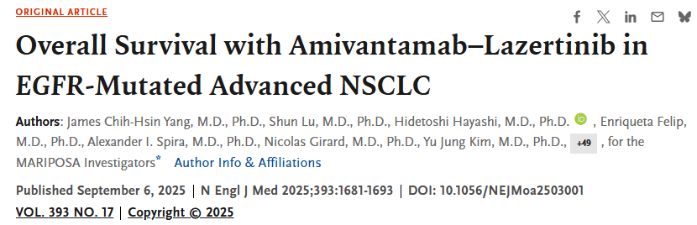
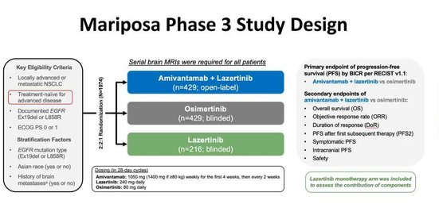

Slide 19
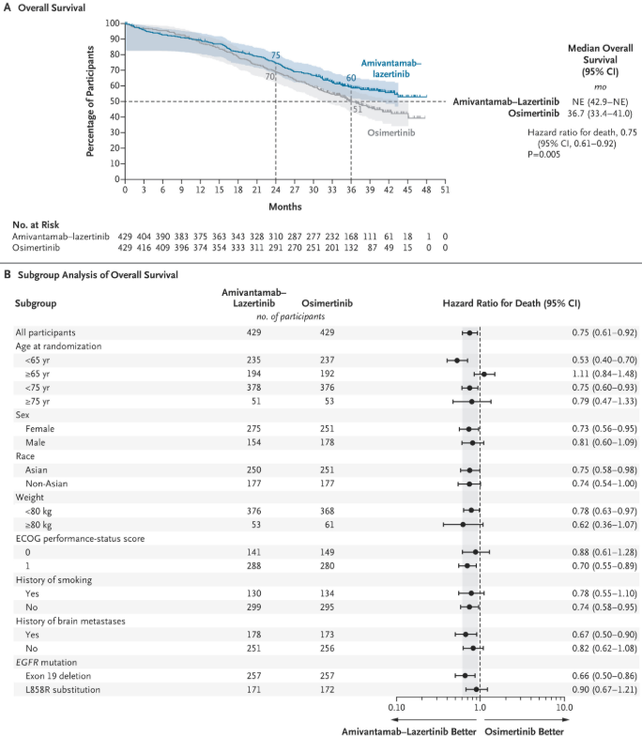

Slide 20
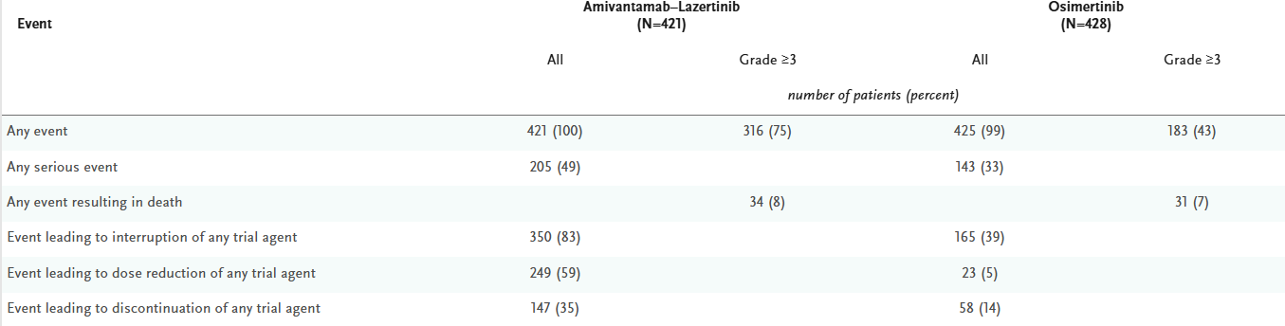

Slide 21
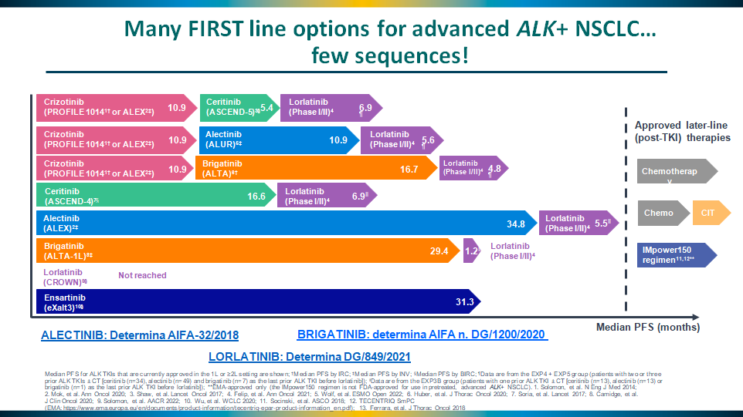

Slide 22
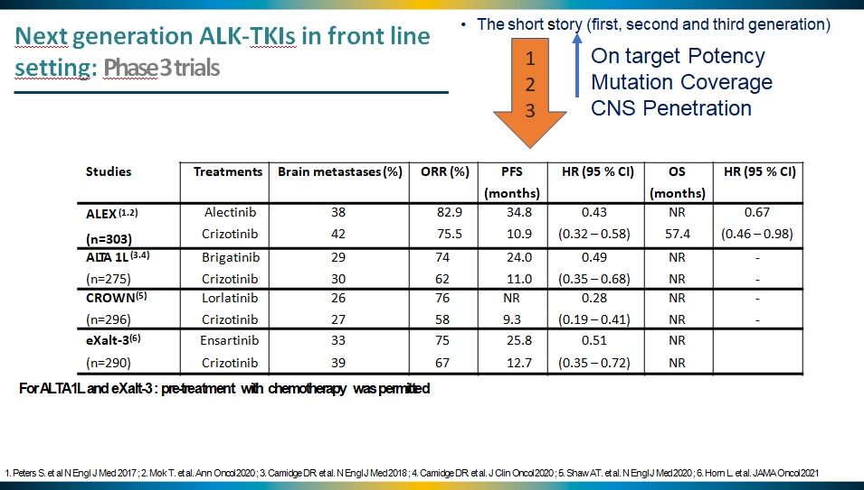

Slide 23
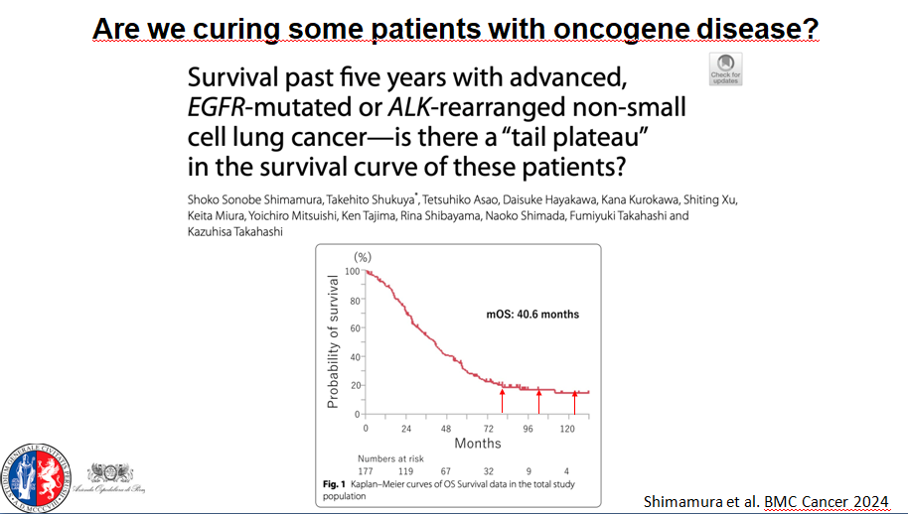

Slide 24
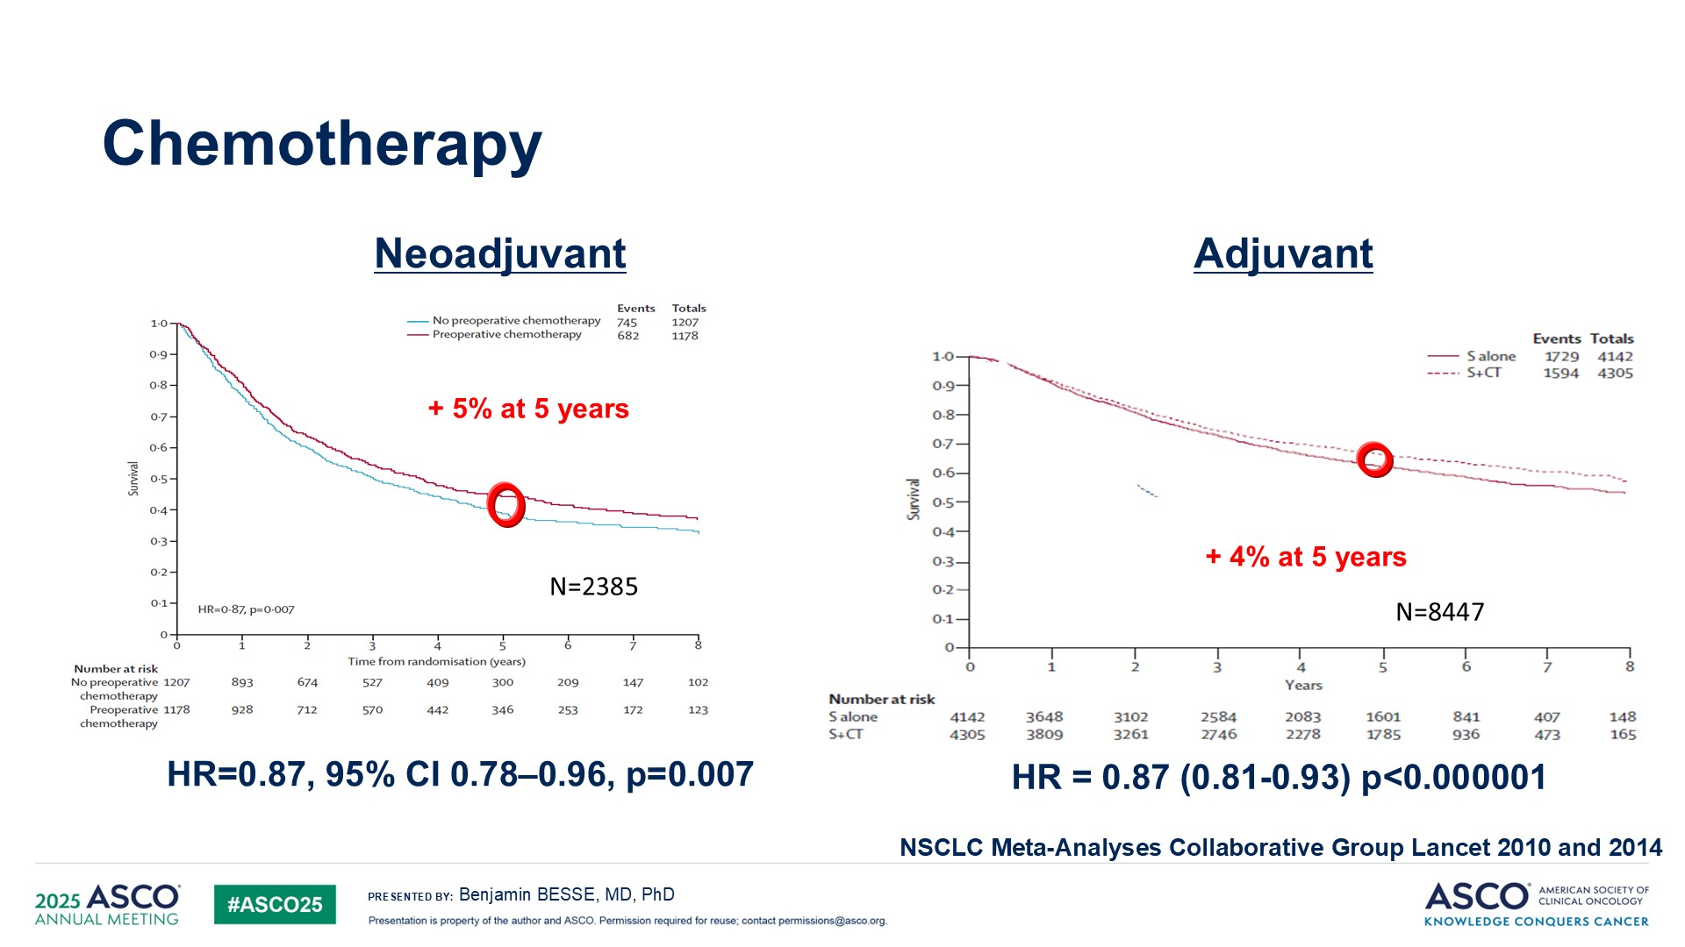

Slide 25



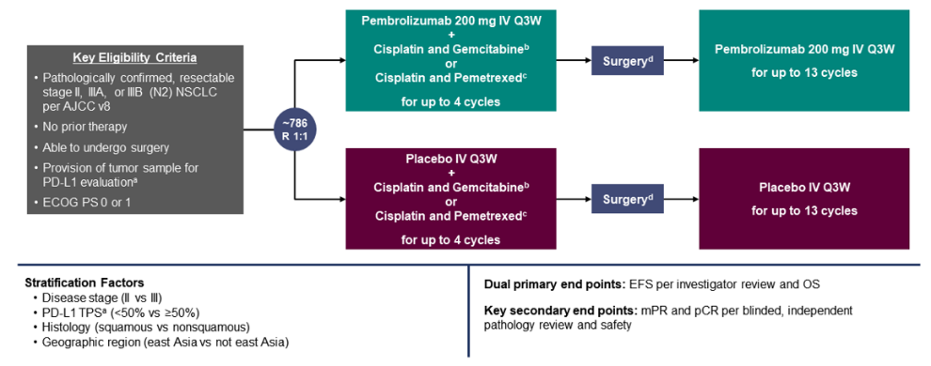
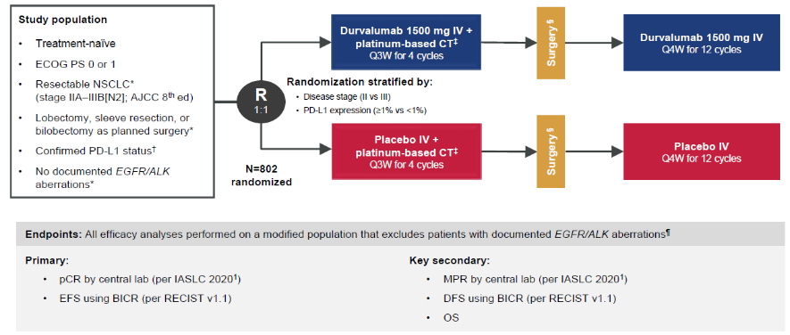
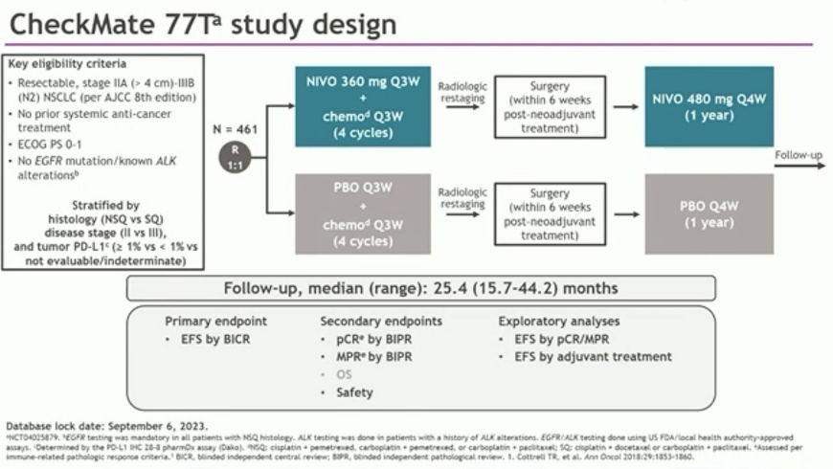
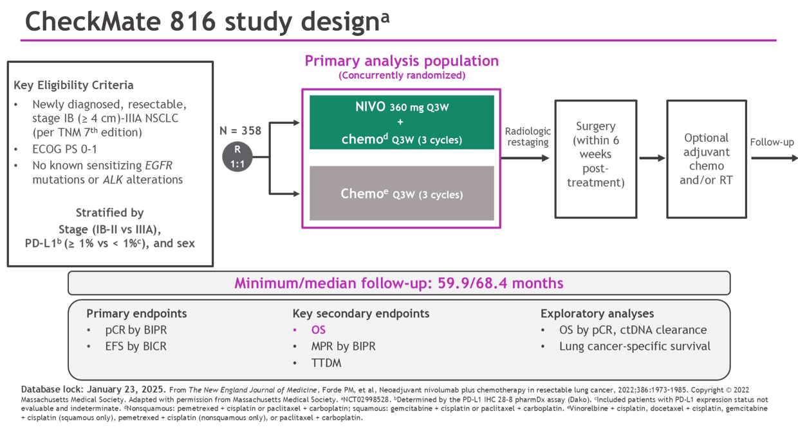

Slide 26
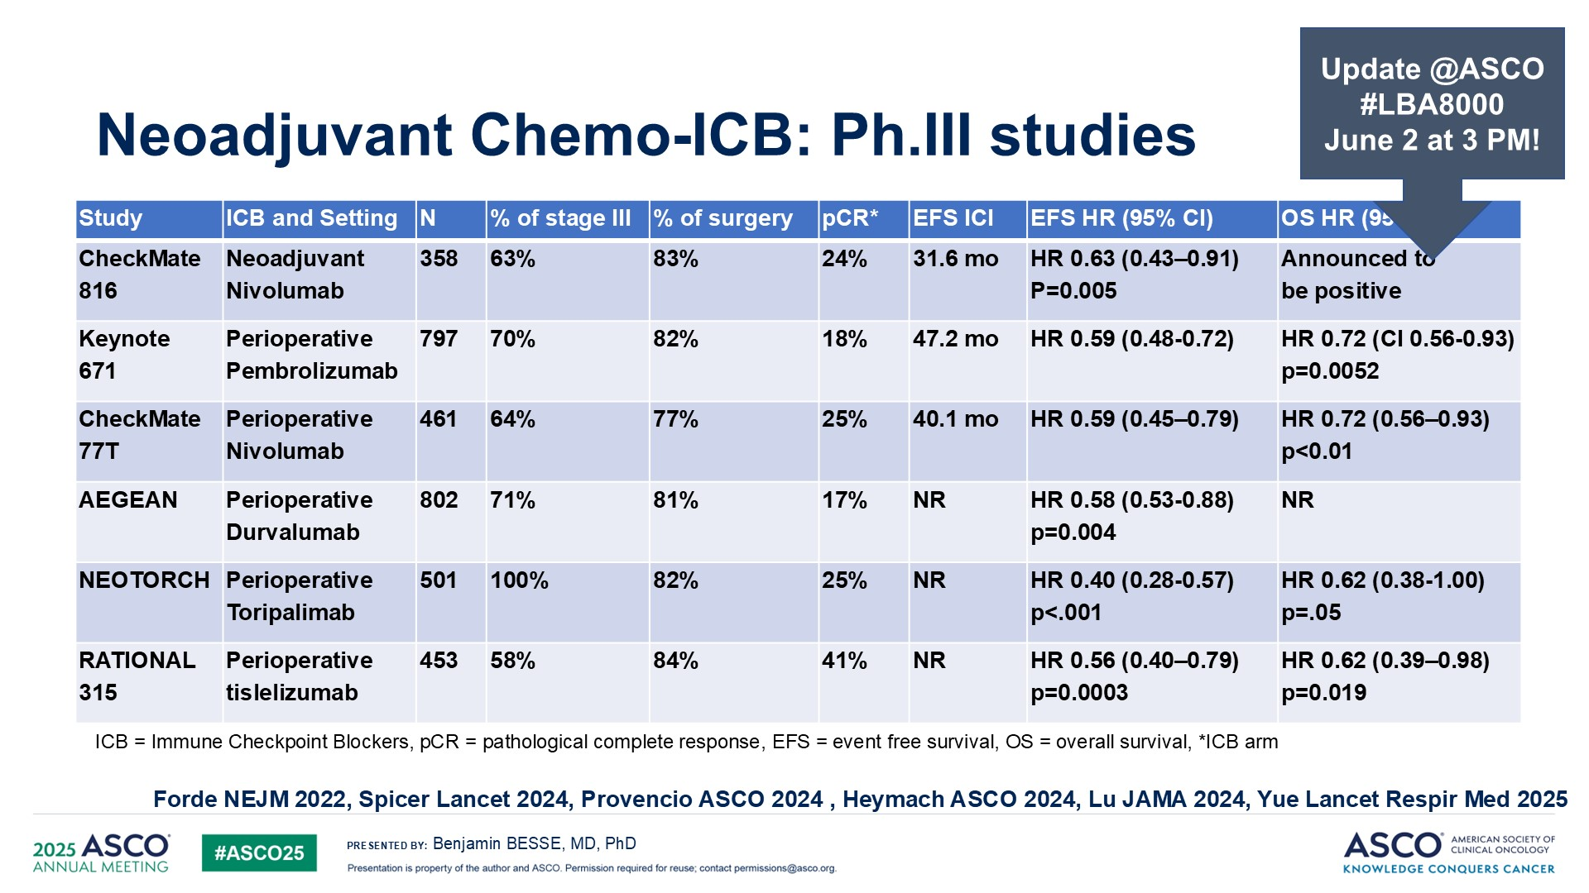

Slide 27
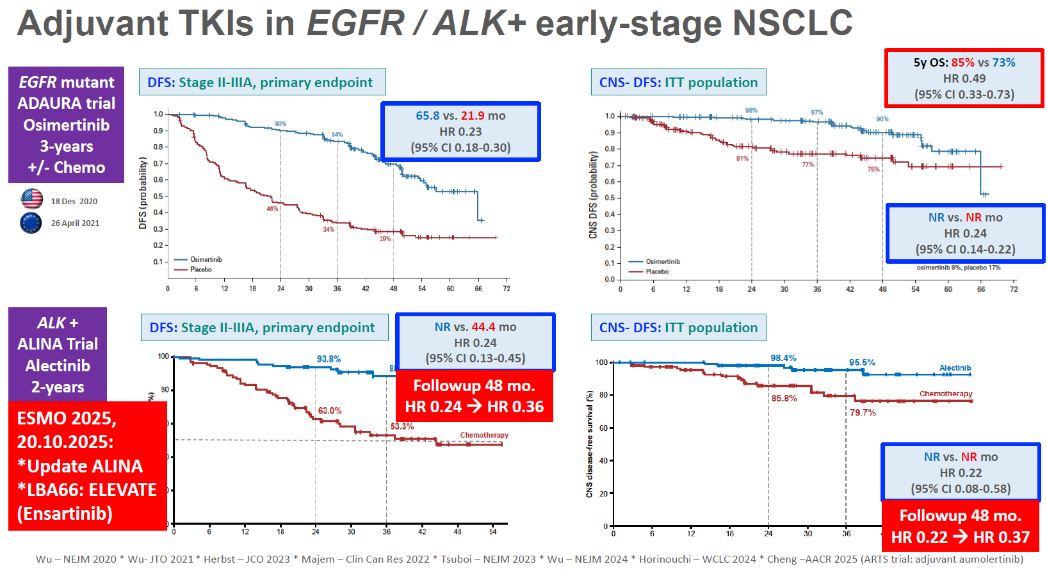

Slide 28
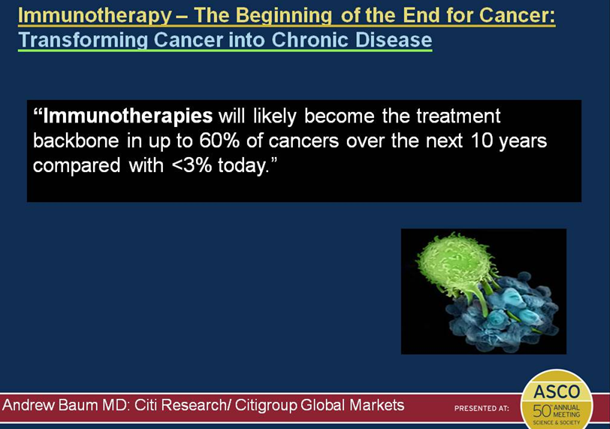

Slide 29
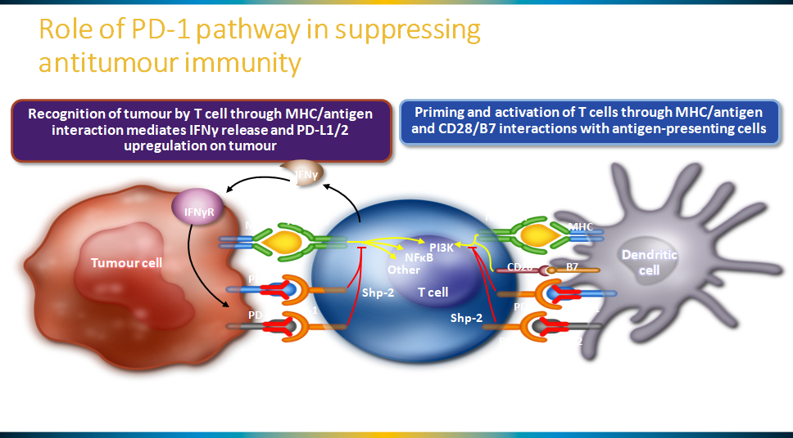

Slide 30
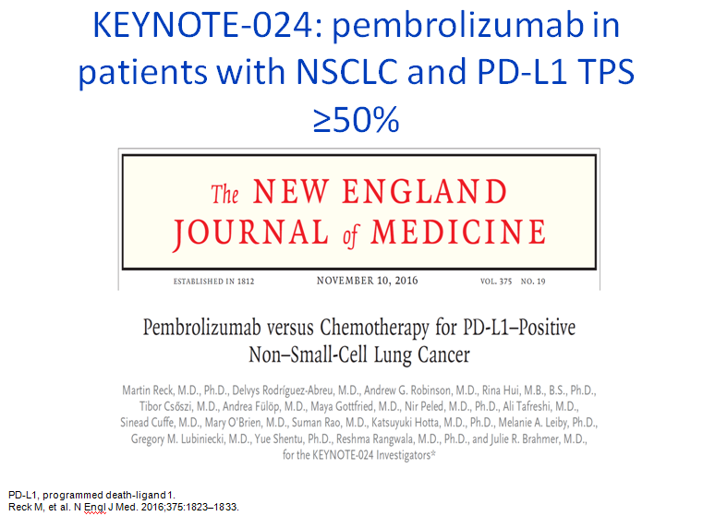

Slide 31
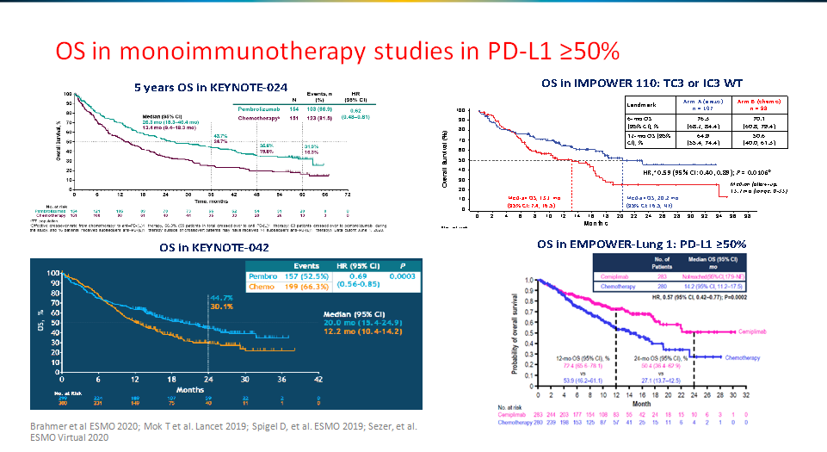

Slide 32
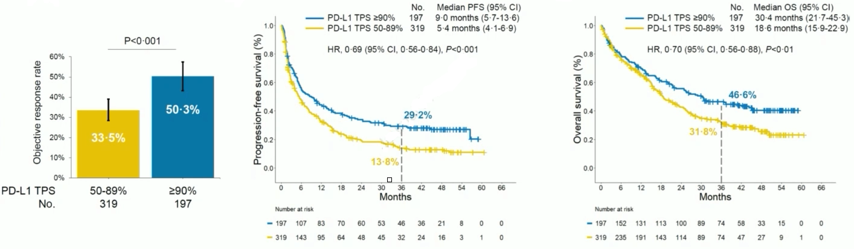
Pembrolizumab in a retrospective multicenter cohort of PD-L1 high NSCLC
Ricciuti B, JTO Clinical and Research Reports 2024

Slide 33
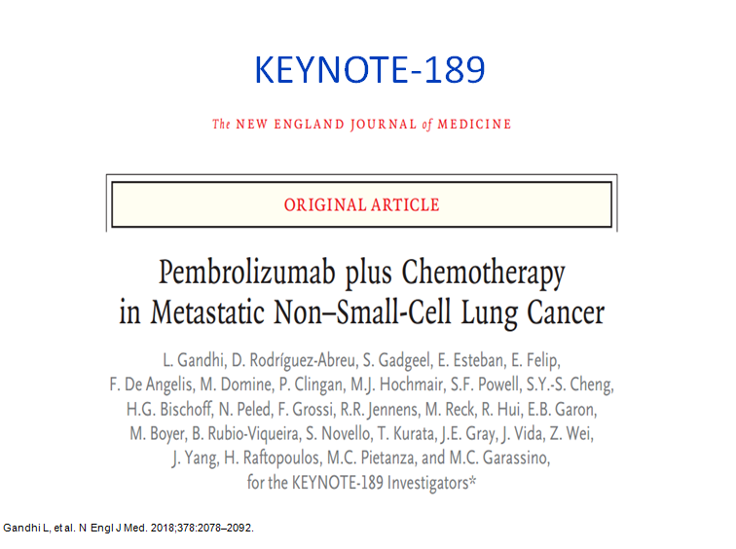

Slide 34
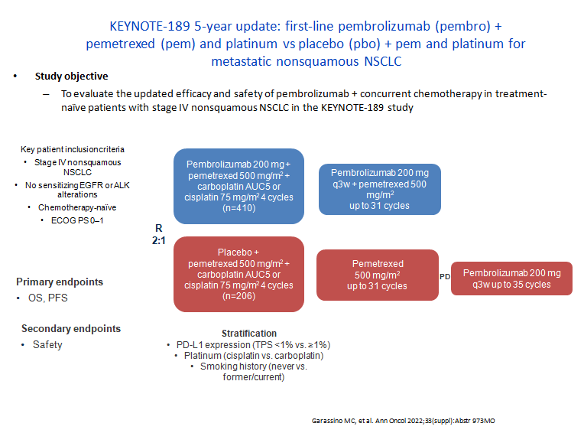

Slide 35
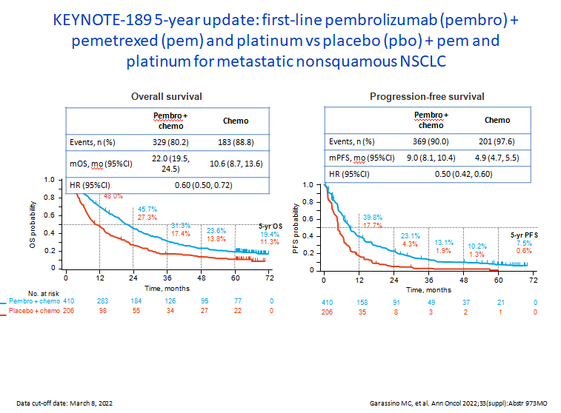

Slide 36
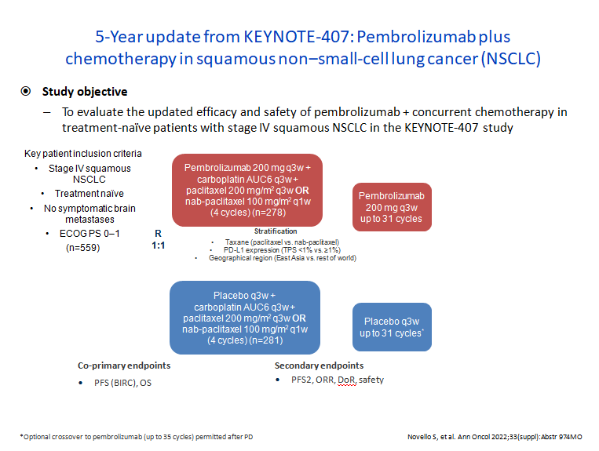

Slide 37
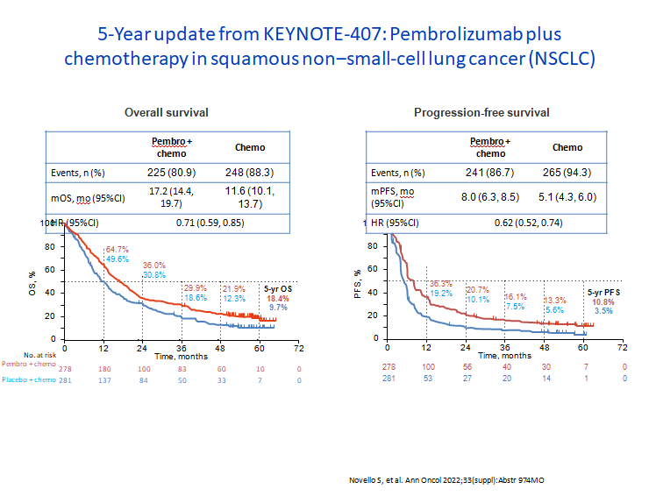

Slide 38
Quality of life in stage IV NSCLC
All randomised trials comparing TKIs or immunotherapy vs chemotherapy have shown a significant improvement in QoL and in symptoms burden.
Any combination treatment has demonstrated a significant increase in toxicity, with a higher incidence of grade III or more adverse events versus a potential, still undefined survival benefit.

Slide 39
Conclusions
New treatment strategies have clearly improved overall survival in NSCLC.
It is still uncertain in which percentage this survival improvement can be translated in a definite probability of cure.
QoL and symptoms control are both improved in all TKIs and immunotherapy trials, but with a specific, different toxicity profile.

