Slide 1
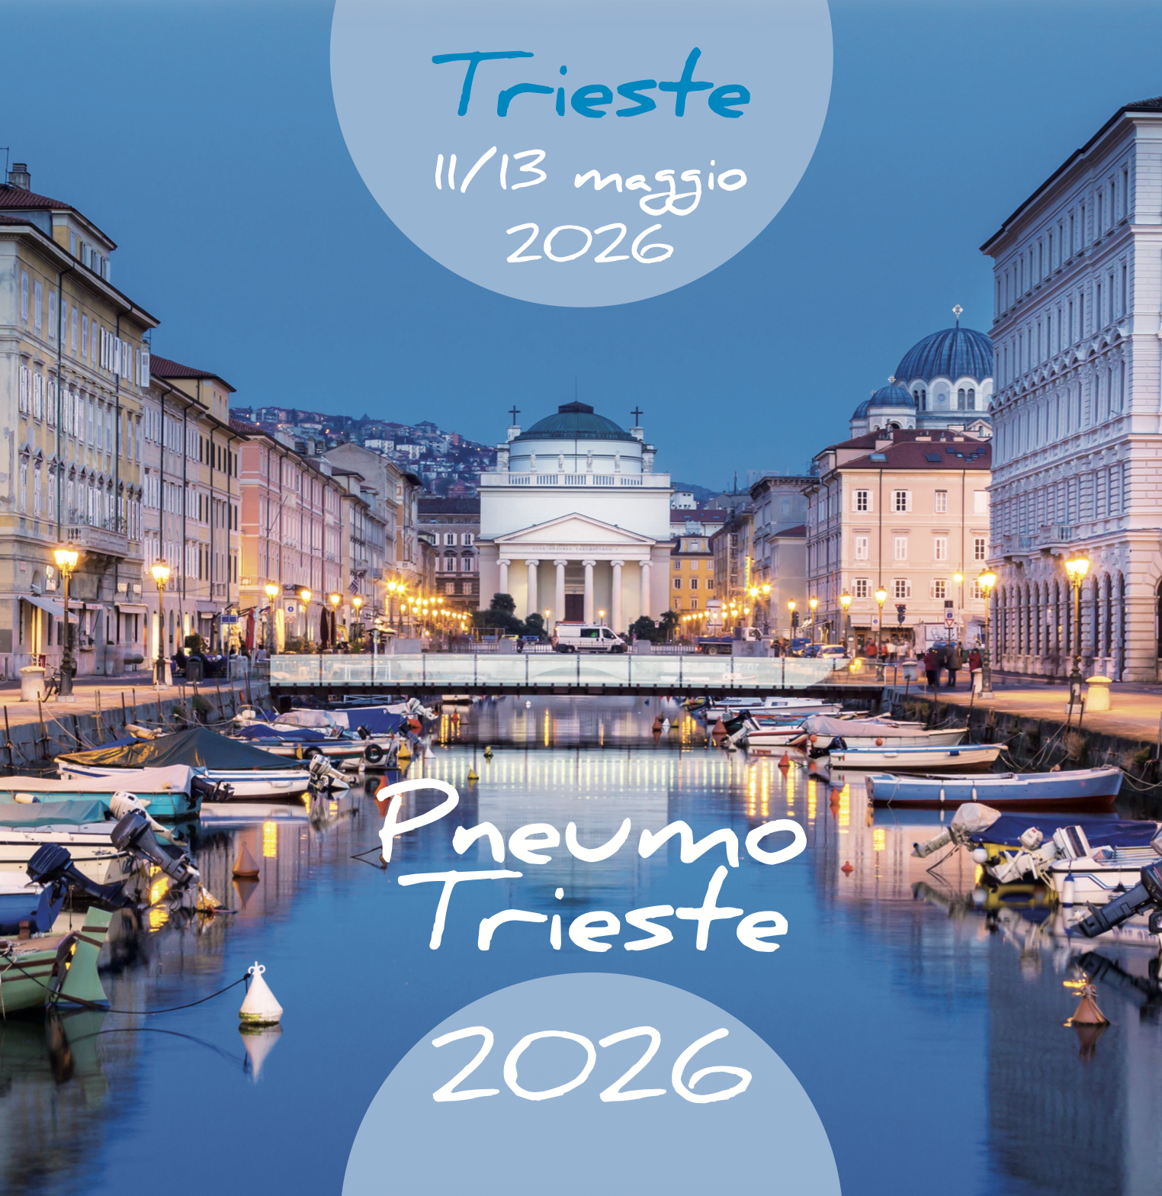


La ricerca di nuove strategie terapeutiche per la cura del tumore del polmone
senza mutazioni bersaglio
Giuseppe Bronte
Dipartimento di Medicina Traslazionale e per la Romagna
Università degli Studi di Ferrara
---
Dipartimento di Onco-Ematologia
Azienda Ospedaliero-Universitaria di Ferrara
giuseppe.bronte@unife.it

Slide 2
Disclosures
Travel grants: Astrazeneca, Roche
Speaker grants: Astrazeneca, Pfizer
Advisory Board: Novartis

Slide 3
AGENDA
Mechanisms of Resistance to Immunotherapy
Types of Novel Drug Molecules
Types of Novel Therapeutic Strategies

Slide 4
Non-oncogene-addicted NSCLC
Estimated number of global deaths attributed to most common cancers in 2020
Prevalence of oncogenic somatic driver mutations in Lung cancer in never-smokers
ESMO. Thoracic Tumours: Essentials for Clinicians. Switzerland, 2026.

Slide 5
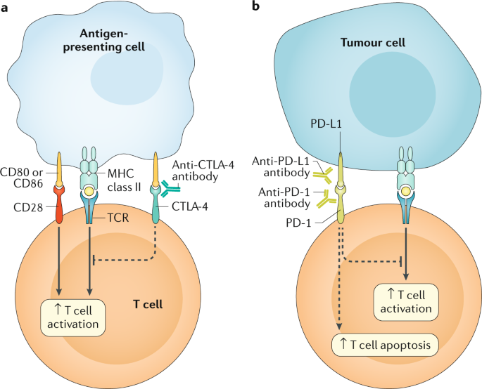
Non-oncogene-addicted NSCLC
Ramos-Casals M, et al. Nat Rev Dis Primers. 2020;6(1):38.
ESMO. Thoracic Tumours: Essentials for Clinicians. Switzerland, 2026.

Slide 6
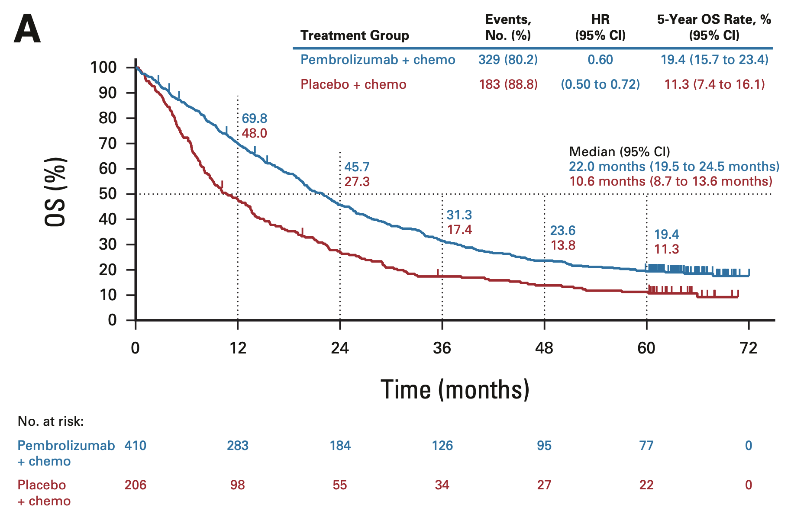
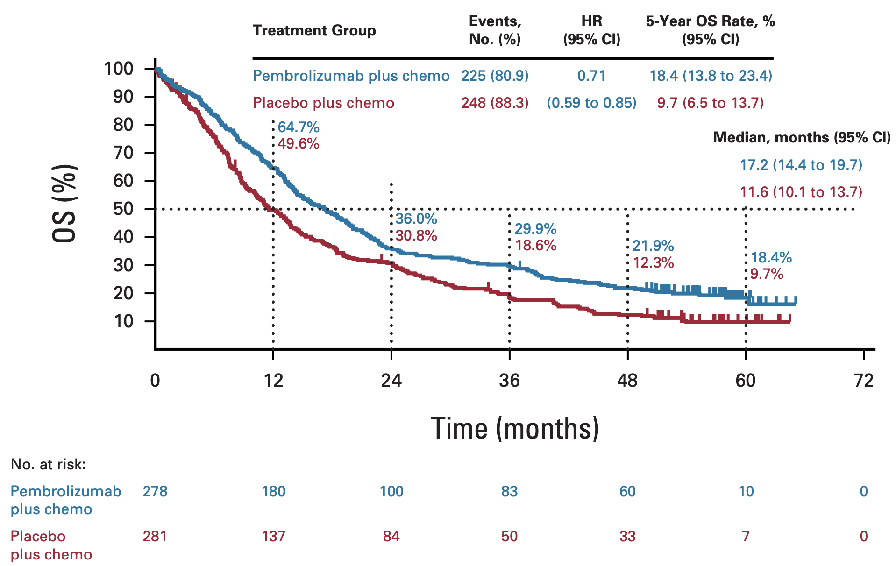
Non-oncogene-addicted NSCLC
Non-squamous
Squamous
Garassino MC, et al. J. Clin. Oncol. 2023; 41, 1992–1998.
Novello S, et al. J. Clin. Oncol. 2023; 41, 1999–2006.

Slide 7
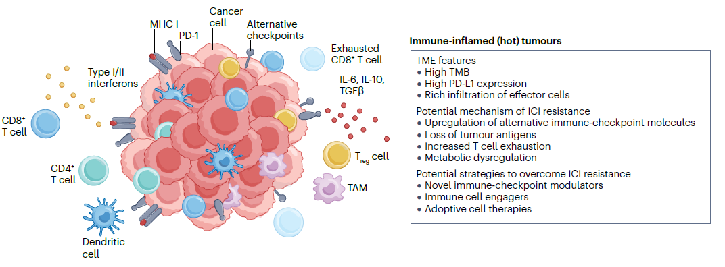
Non-oncogene-addicted NSCLC
Three immunotypes of cancer and their potential resistance mechanisms to ICIs
Zhao S, et al. Nat Rev Clin Oncol. 2025;22(8):592-616.

Slide 8
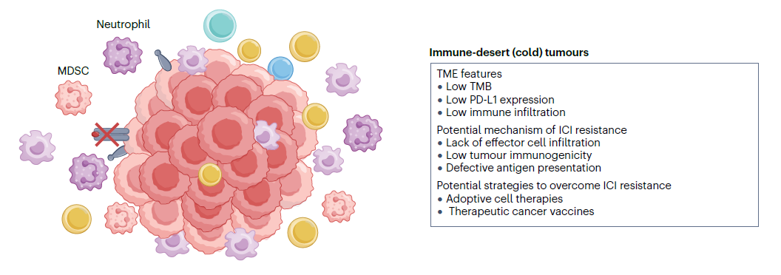
Non-oncogene-addicted NSCLC
Three immunotypes of cancer and their potential resistance mechanisms to ICIs
Zhao S, et al. Nat Rev Clin Oncol. 2025;22(8):592-616.

Slide 9
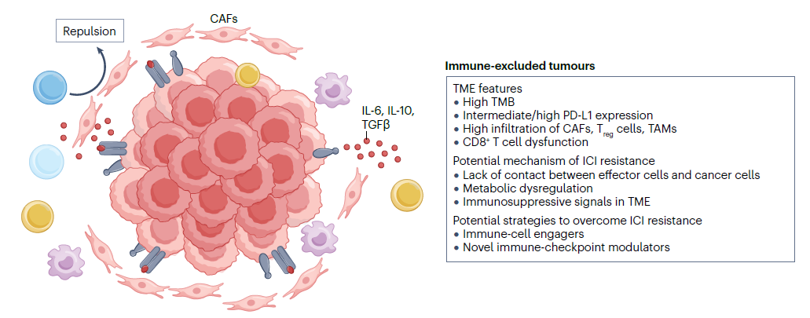
Non-oncogene-addicted NSCLC
Three immunotypes of cancer and their potential resistance mechanisms to ICIs
Zhao S, et al. Nat Rev Clin Oncol. 2025;22(8):592-616.

Slide 10
Non-oncogene-addicted NSCLC
ESMO. Thoracic Tumours: Essentials for Clinicians. Switzerland, 2026.

Slide 11
Non-oncogene-addicted NSCLC
ESMO. Thoracic Tumours: Essentials for Clinicians. Switzerland, 2026.

Slide 12
Non-oncogene-addicted NSCLC
Tumor-intrinsic resistance
Effects of STK11 and KEAP1 co-alterations on tumor immunogenicity
ESMO. Thoracic Tumours: Essentials for Clinicians. Switzerland, 2026.

Slide 13
Non-oncogene-addicted NSCLC
Factors in the tumor microenvironment
Immune cells promoting immunosuppressive TME
Hypoxia leads to upregulation of VEGF and abnormal tumor vasculature
Effects of tumour-associated endothelial cells
ESMO. Thoracic Tumours: Essentials for Clinicians. Switzerland, 2026.

Slide 14
Non-oncogene-addicted NSCLC
Tumour-extrinsic factors
Interaction between gut microbiota and immunotherapy response
Host-extrinsic factors influencing immunotherapy resistance
ESMO. Thoracic Tumours: Essentials for Clinicians. Switzerland, 2026.

Slide 15
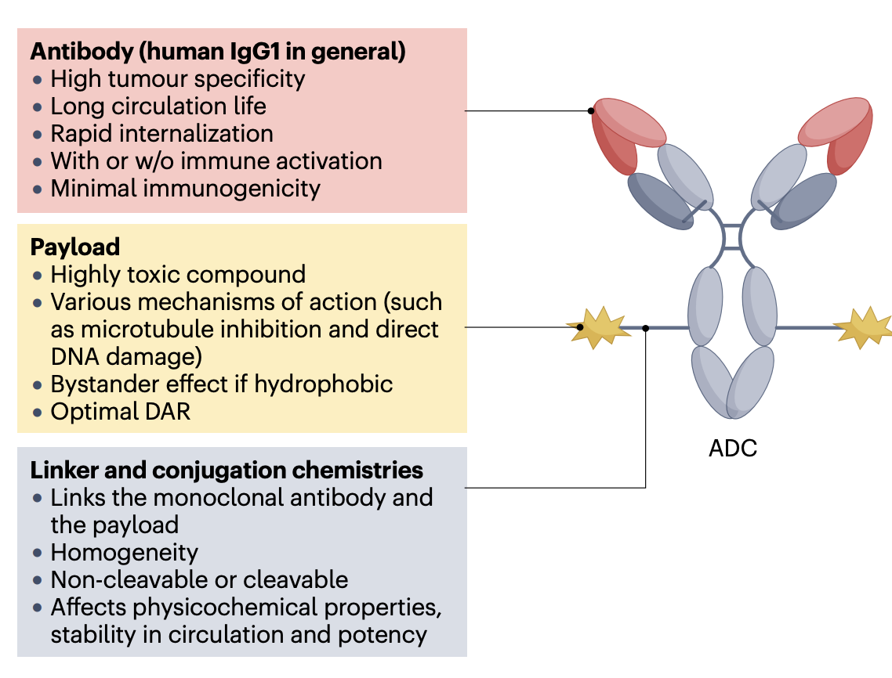
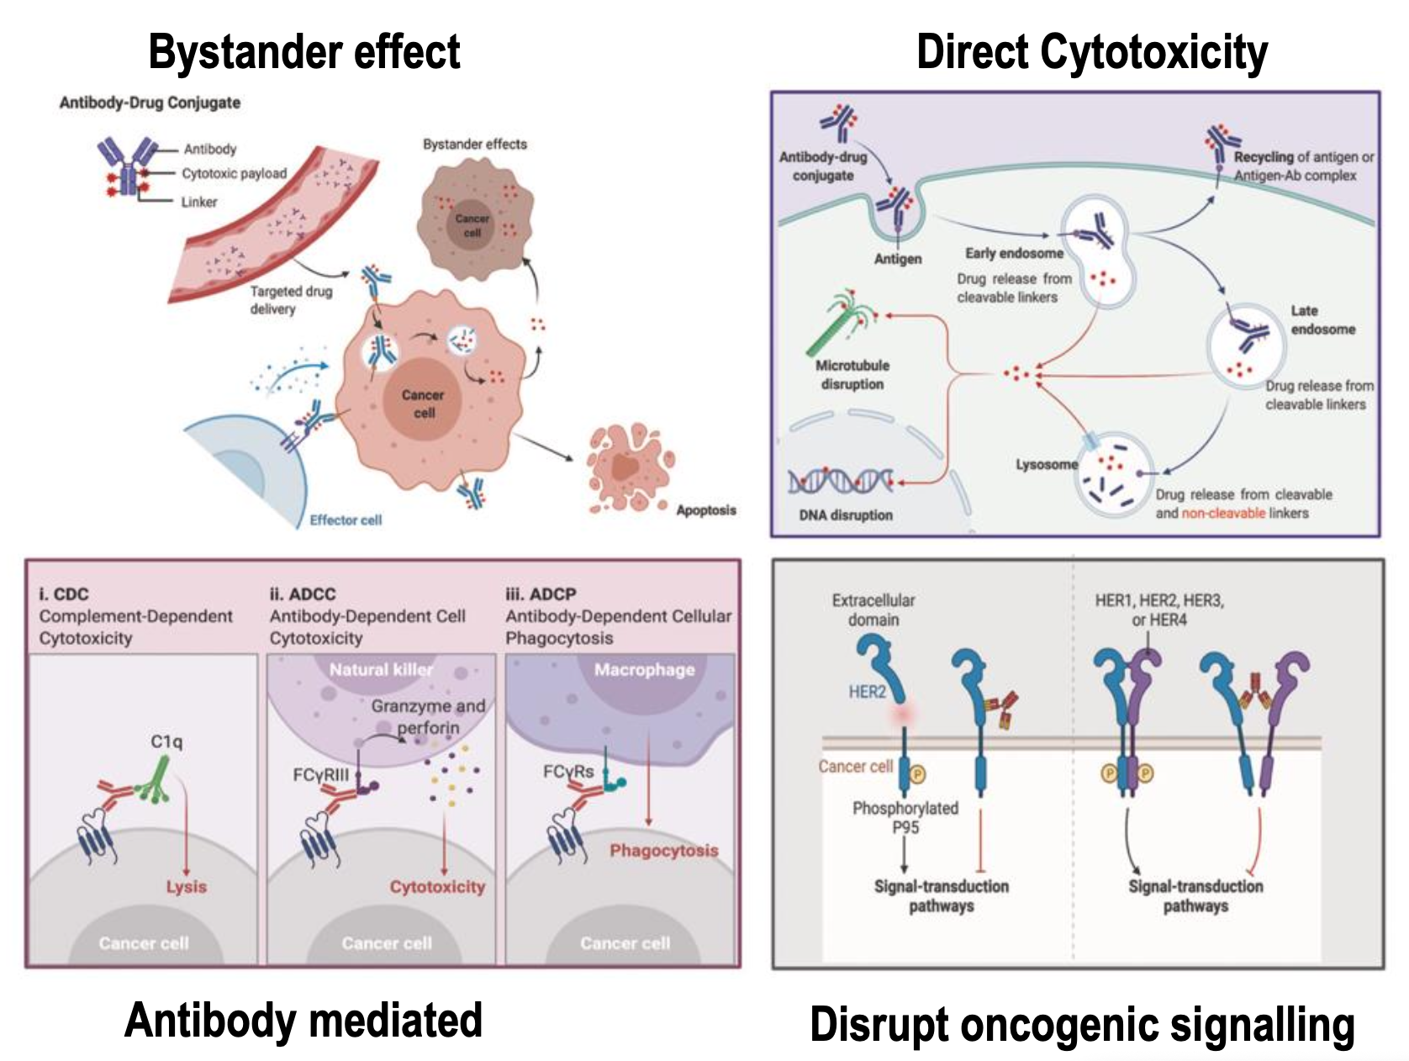
Non-oncogene-addicted NSCLC
Antibody-drug conjugates
Tsuchikama K, et al. Nat Rev Clin Oncol. 2024;21(3):203-223.
Tan D. ELCC 2026

Slide 16
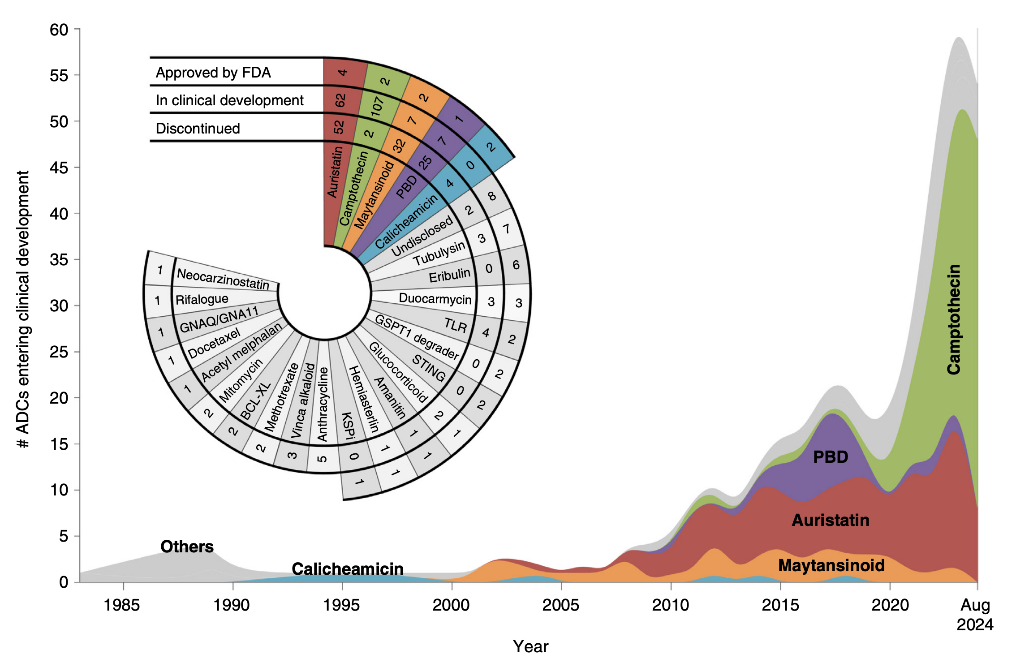
Non-oncogene-addicted NSCLC
Antibody-drug conjugates
Colombo R, et al. Cancer Discov. 2024;14(11):2089-2108.

Slide 17
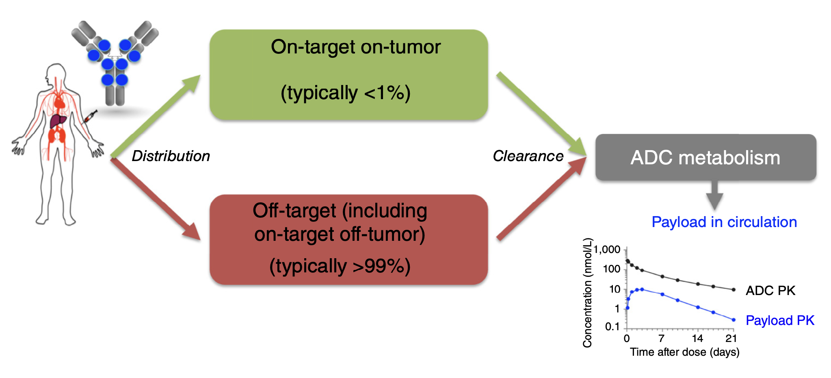
Non-oncogene-addicted NSCLC
Antibody-drug conjugates
Colombo R, et al. Cancer Discov. 2024;14(11):2089-2108.

Slide 18
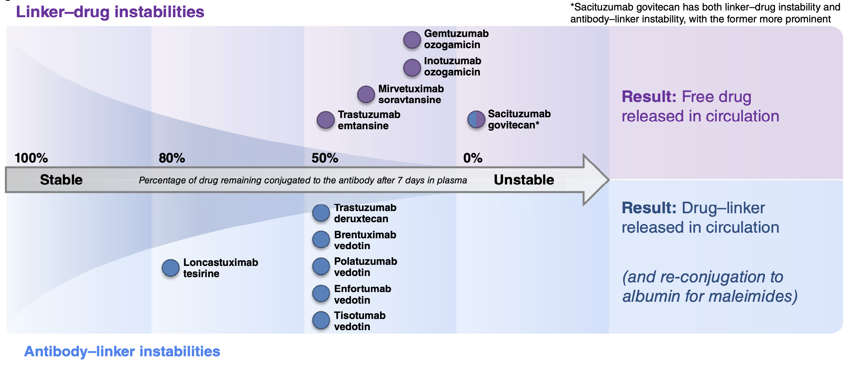
Non-oncogene-addicted NSCLC
Antibody-drug conjugates
Colombo R, et al. Cancer Discov. 2024;14(11):2089-2108.

Slide 19
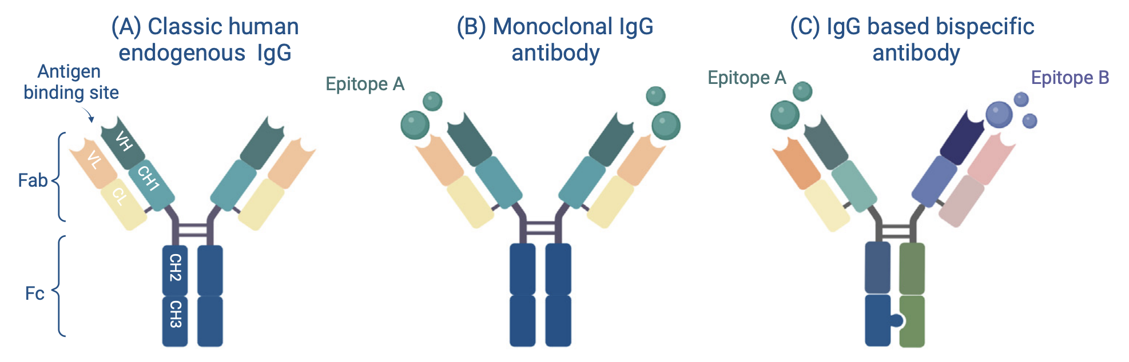
Non-oncogene-addicted NSCLC
Bispecific Antibodies
Herrera M, et al. Trends Cancer. 2024;10(10):893-919.

Slide 20
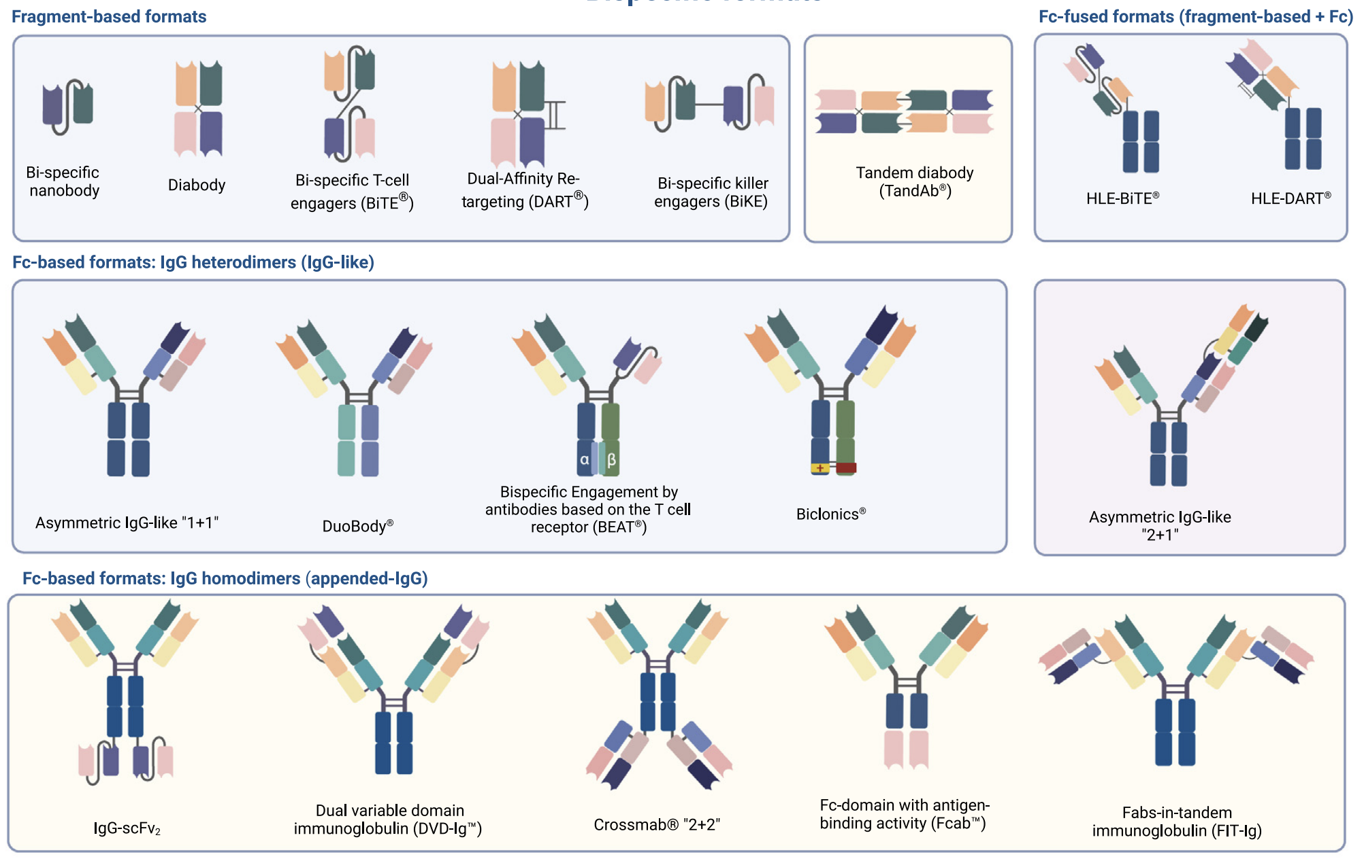
Non-oncogene-addicted NSCLC
Bispecific Antibodies
Herrera M, et al. Trends Cancer. 2024;10(10):893-919.

Slide 21
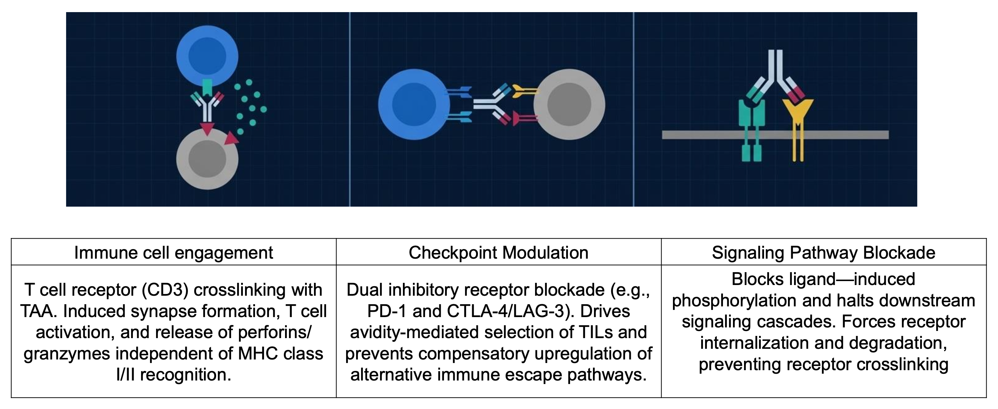
Non-oncogene-addicted NSCLC
Bispecific Antibodies
Tanizaki J. ELCC 2026

Slide 22
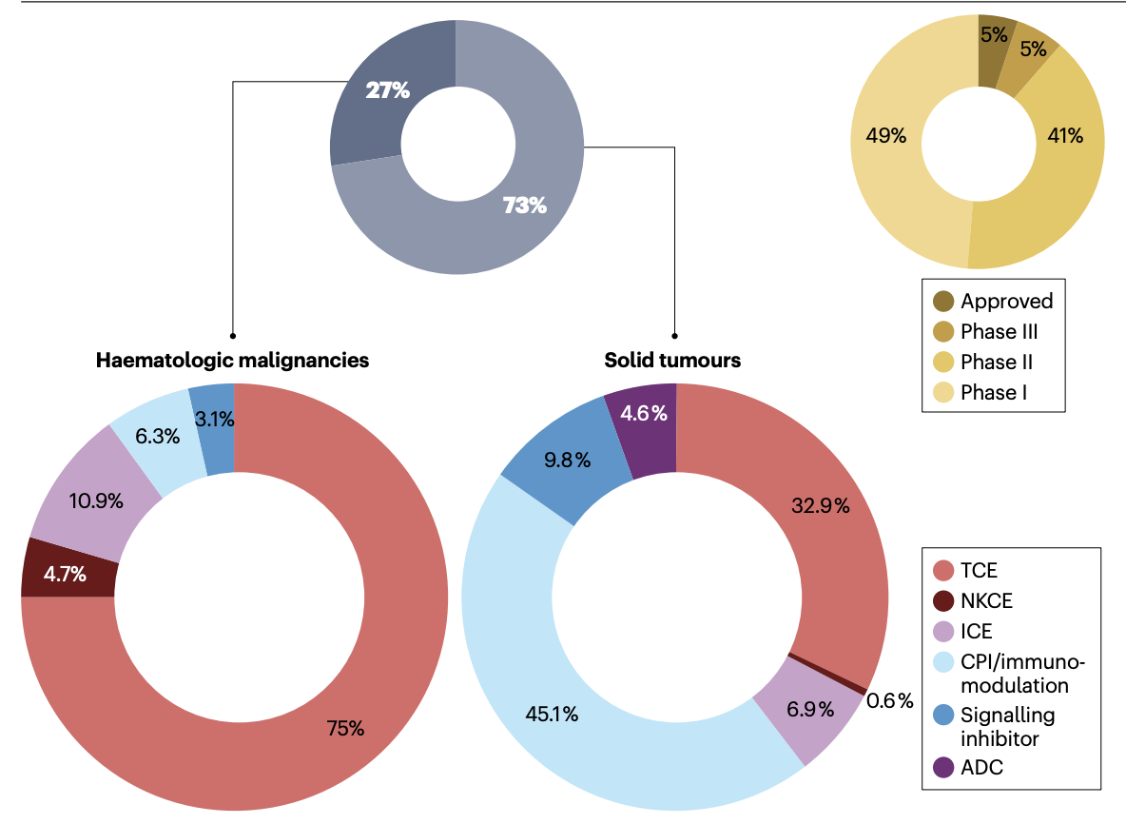
Non-oncogene-addicted NSCLC
Bispecific Antibodies
Klein C, et al. Nat Rev Drug Discov. 2024;23(4):301-319.

Slide 23
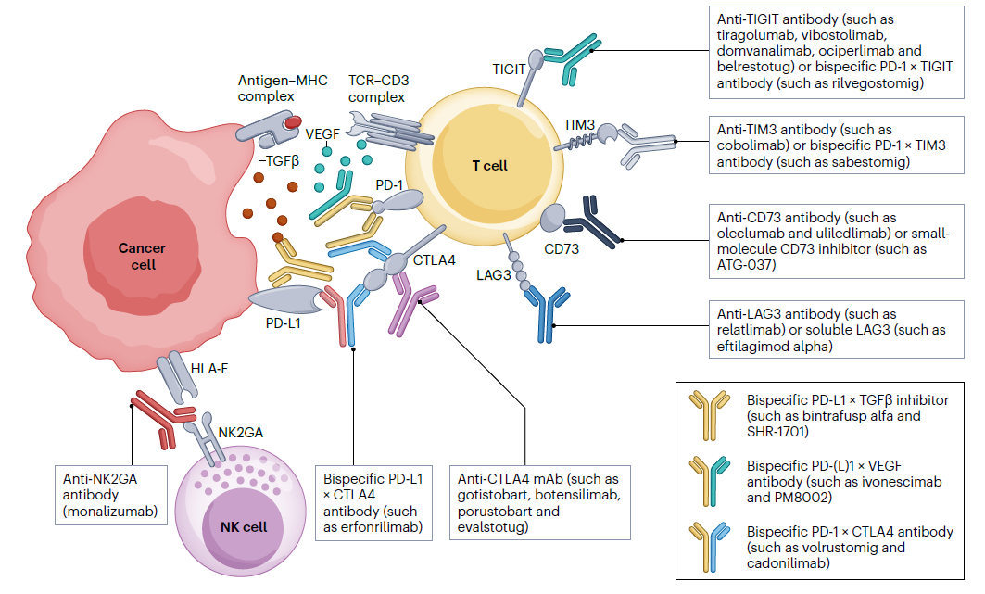
Non-oncogene-addicted NSCLC
Novel ICIs under clinical development for lung cancer
Bispecific agents targeting PD-(L)1 and immunosuppressive cytokines
Zhao S, et al. Nat Rev Clin Oncol. 2025;22(8):592-616.

Slide 24
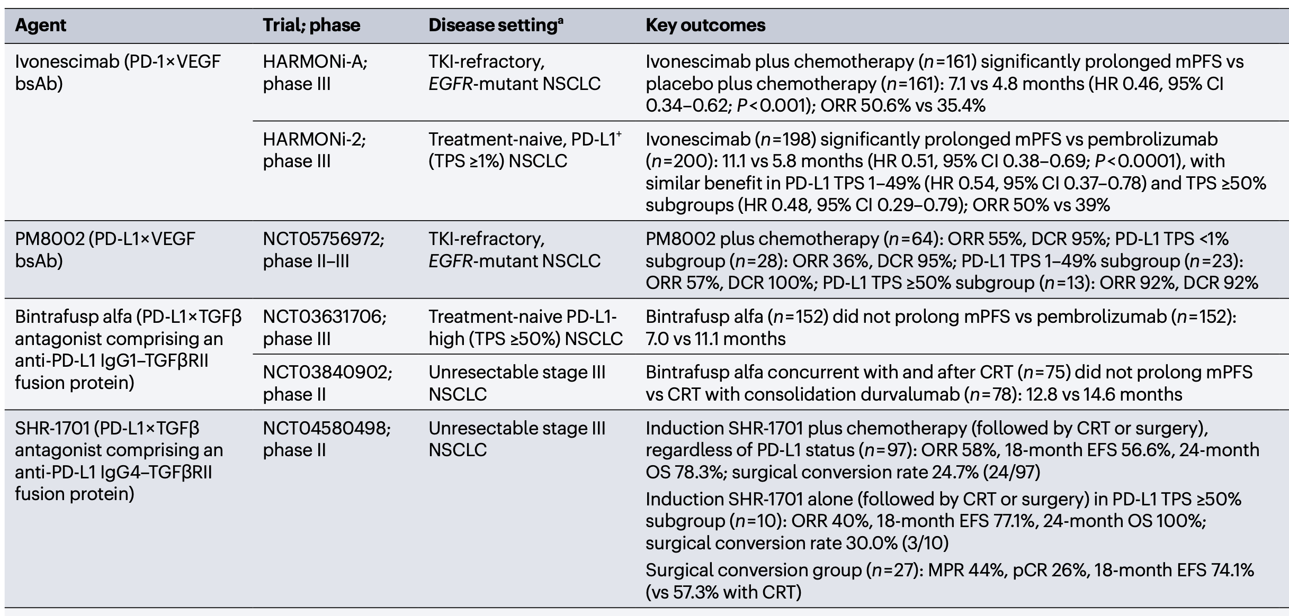
Non-oncogene-addicted NSCLC
Bispecific agents targeting PD-(L)1 and immunosuppressive cytokines
Zhao S, et al. Nat Rev Clin Oncol. 2025;22(8):592-616.

Slide 25
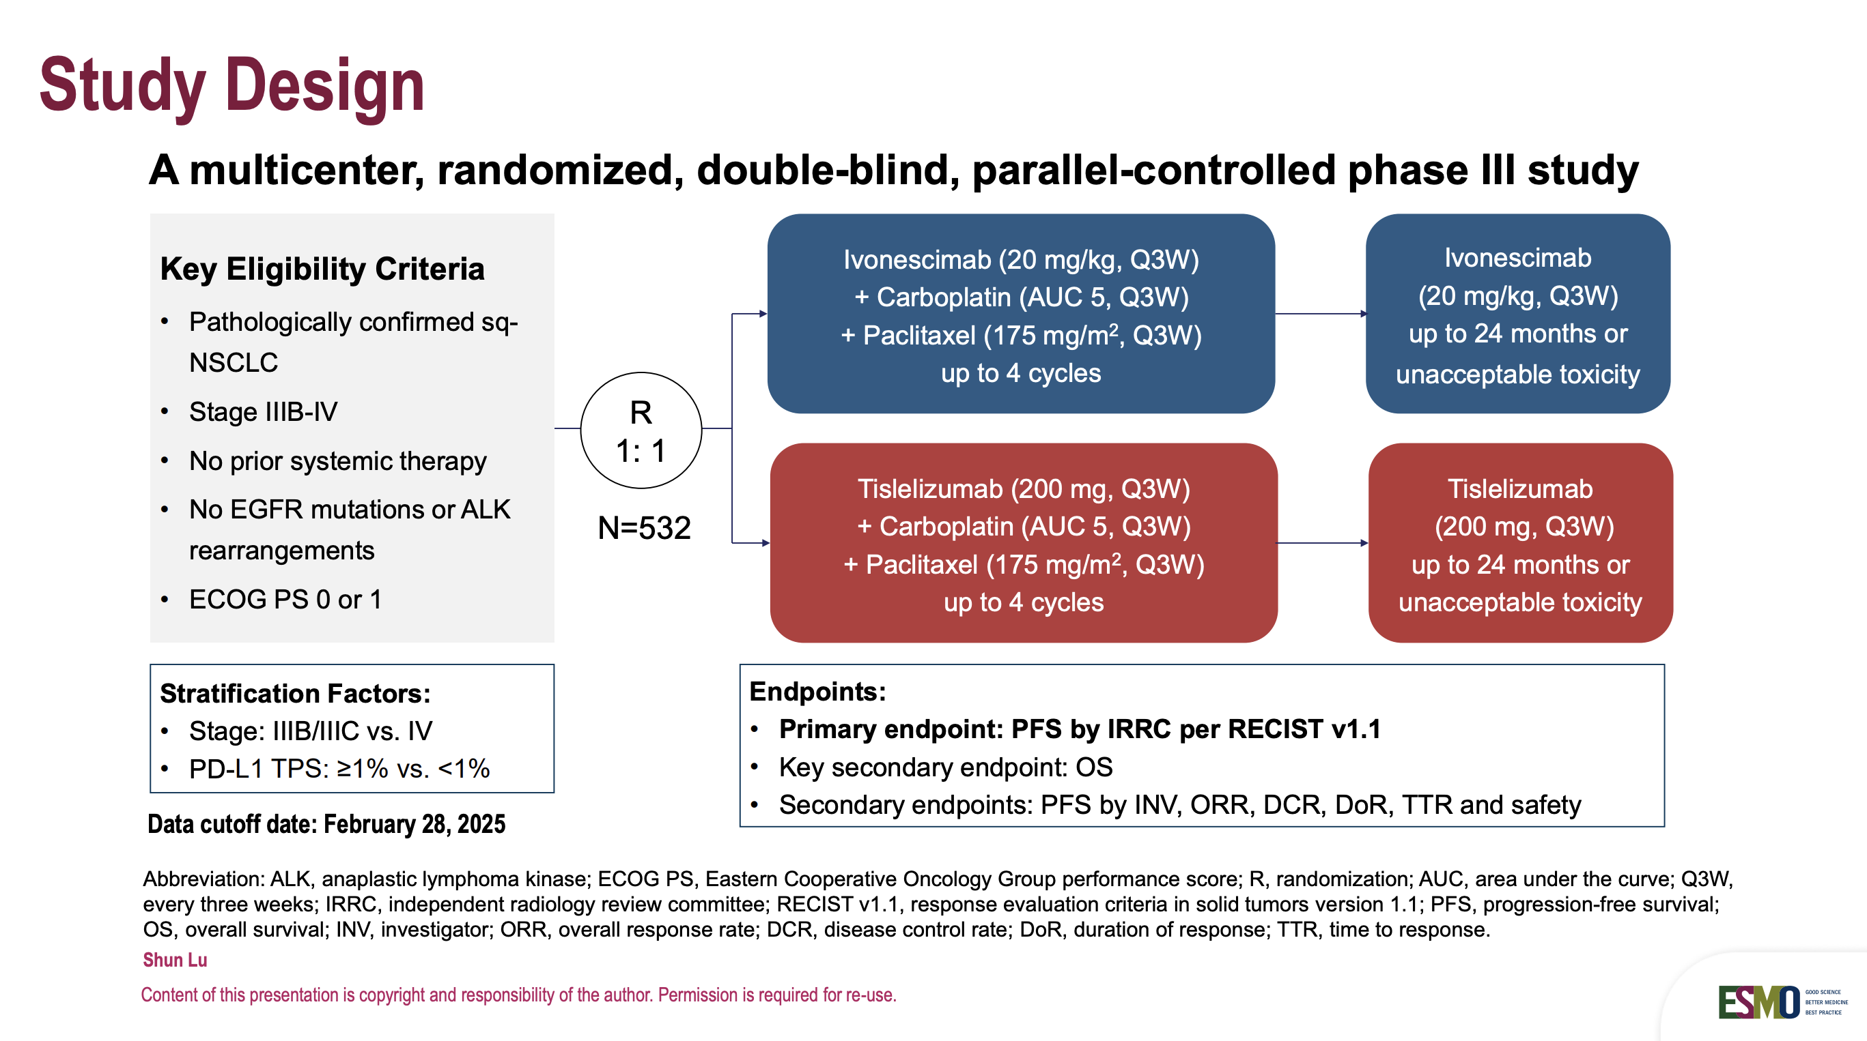
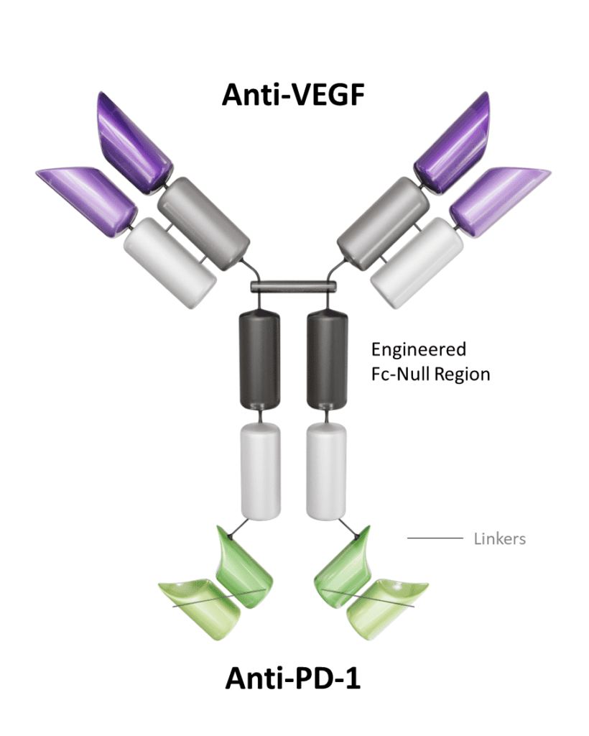
Non-oncogene-addicted NSCLC
HARMONi-6 trial
Lu S, ESMO Asia Congress 2025

Slide 26
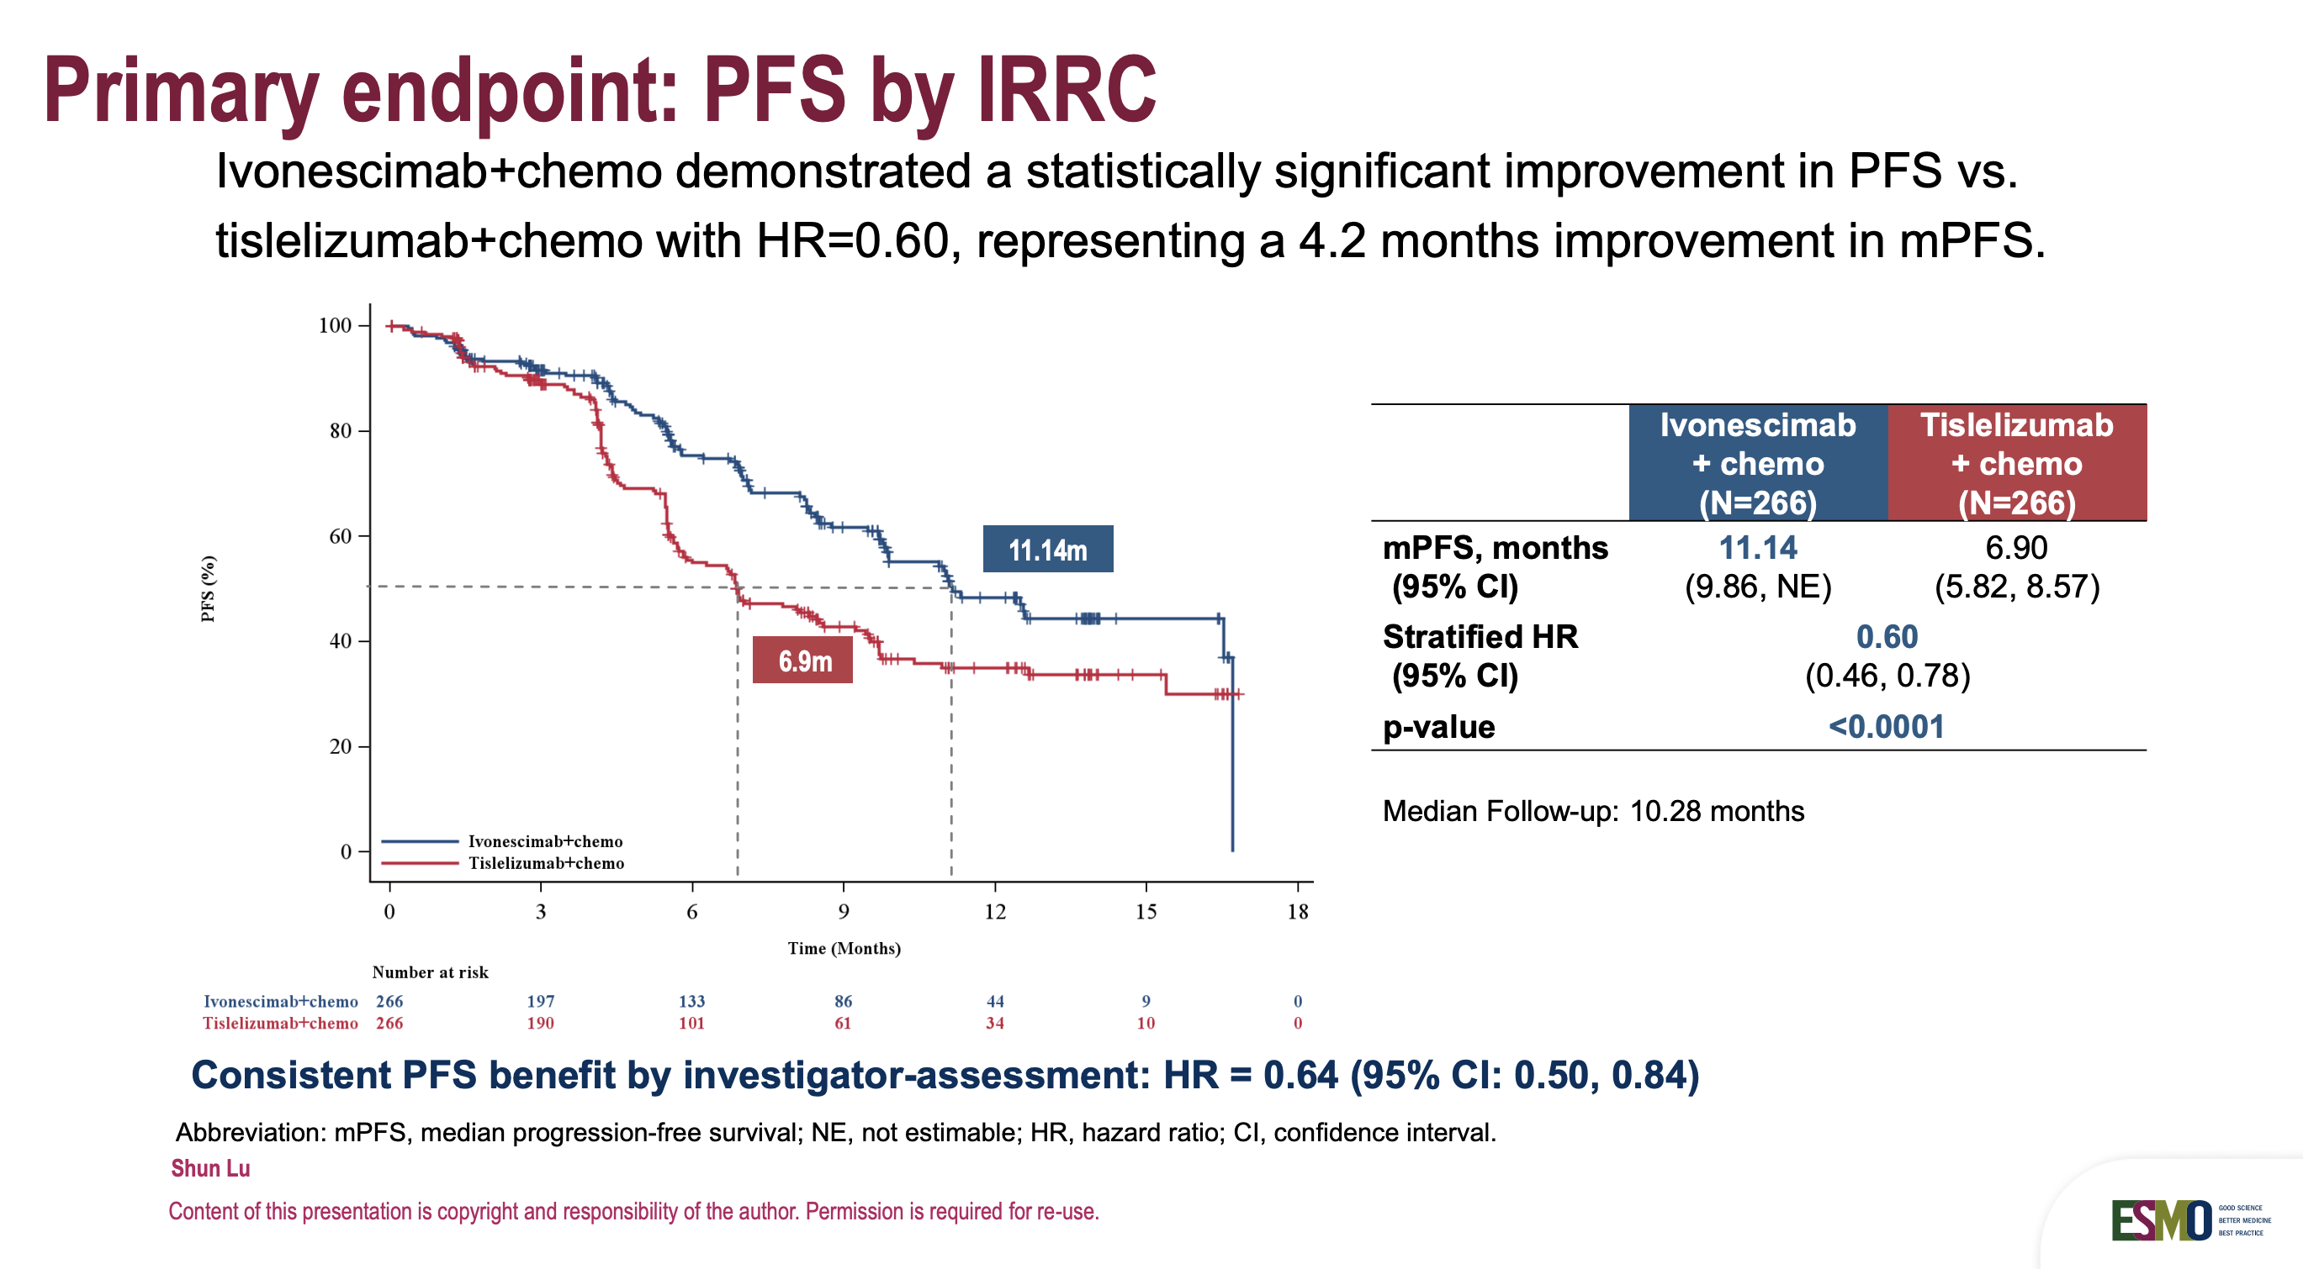
Non-oncogene-addicted NSCLC
HARMONi-6 trial
Lu S, ESMO Asia Congress 2025

Slide 27
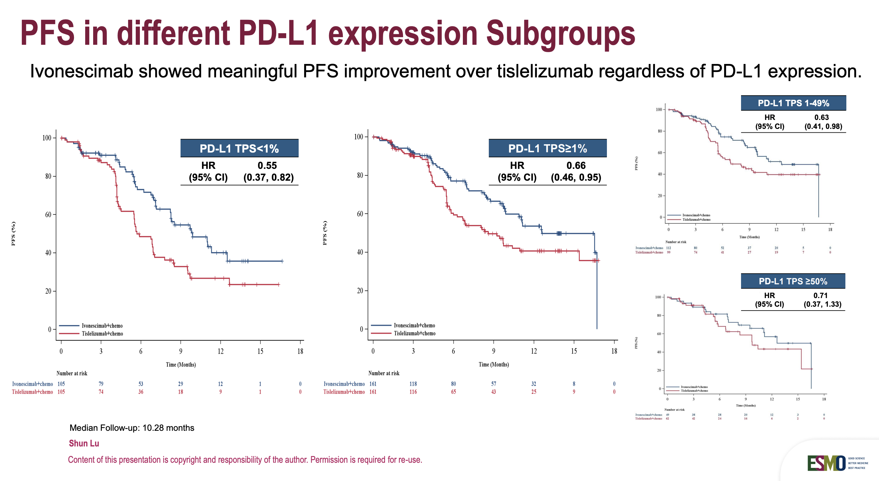
Non-oncogene-addicted NSCLC
HARMONi-6 trial
Lu S, ESMO Asia Congress 2025

Slide 28
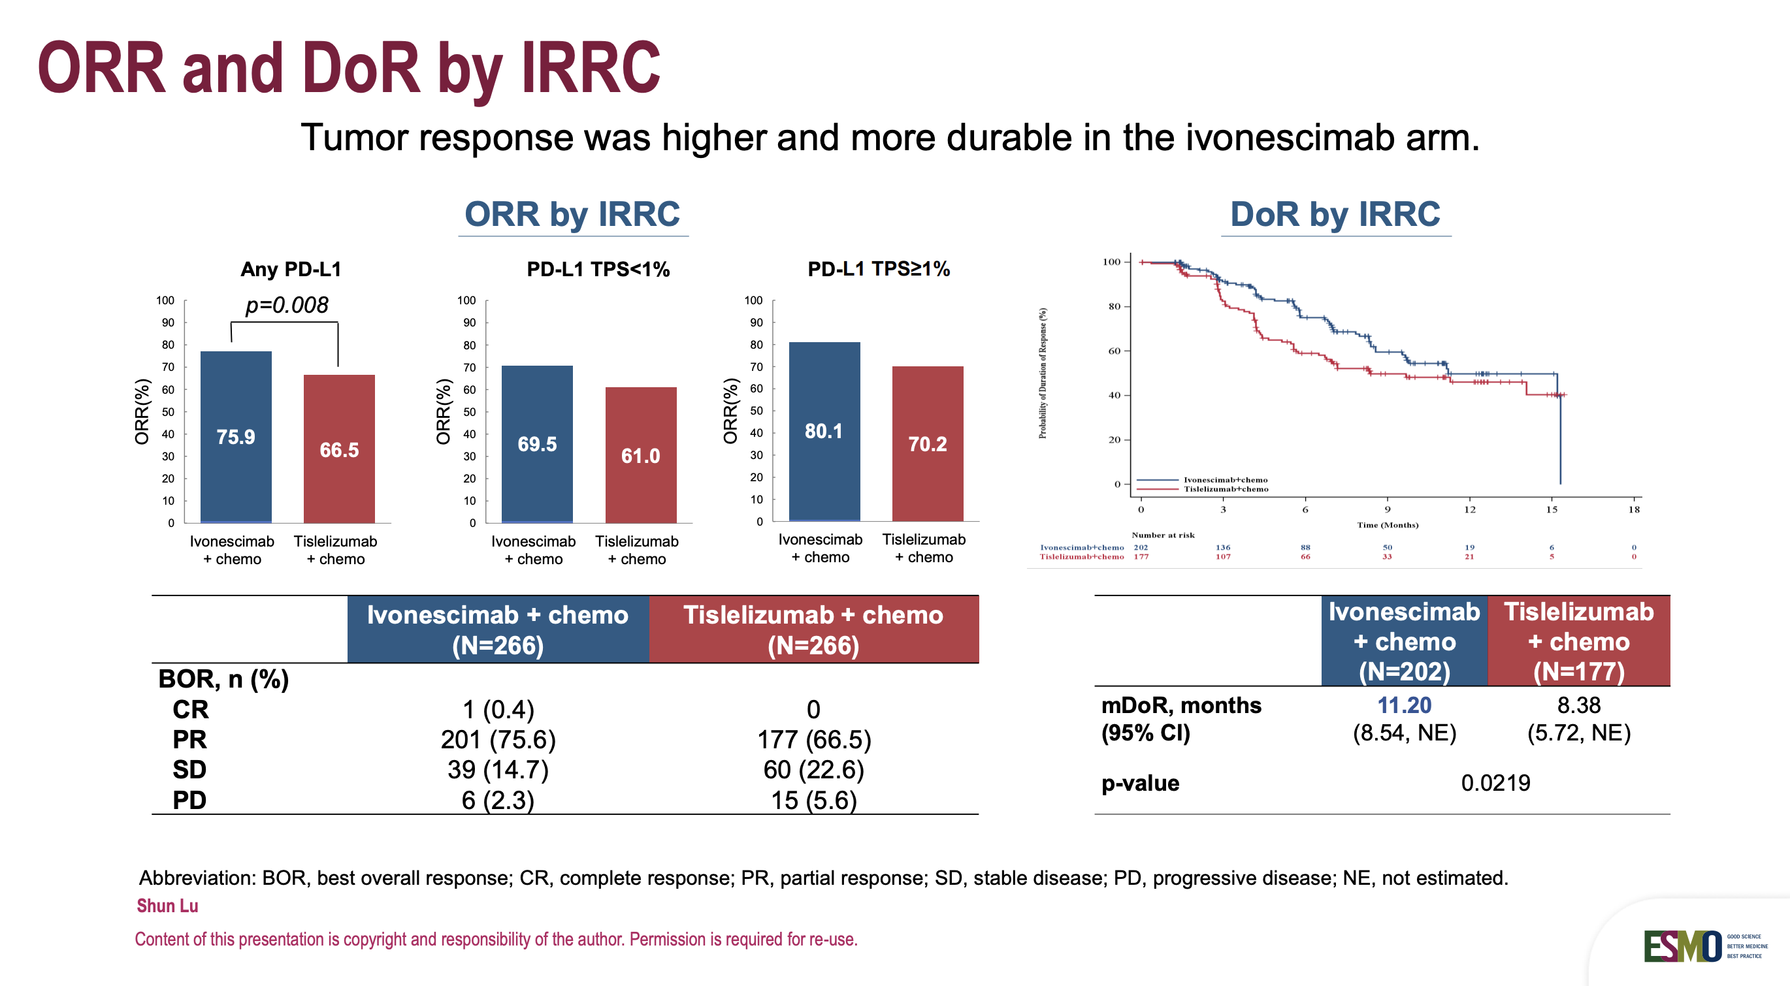
Non-oncogene-addicted NSCLC
HARMONi-6 trial
Lu S, ESMO Asia Congress 2025

Slide 29
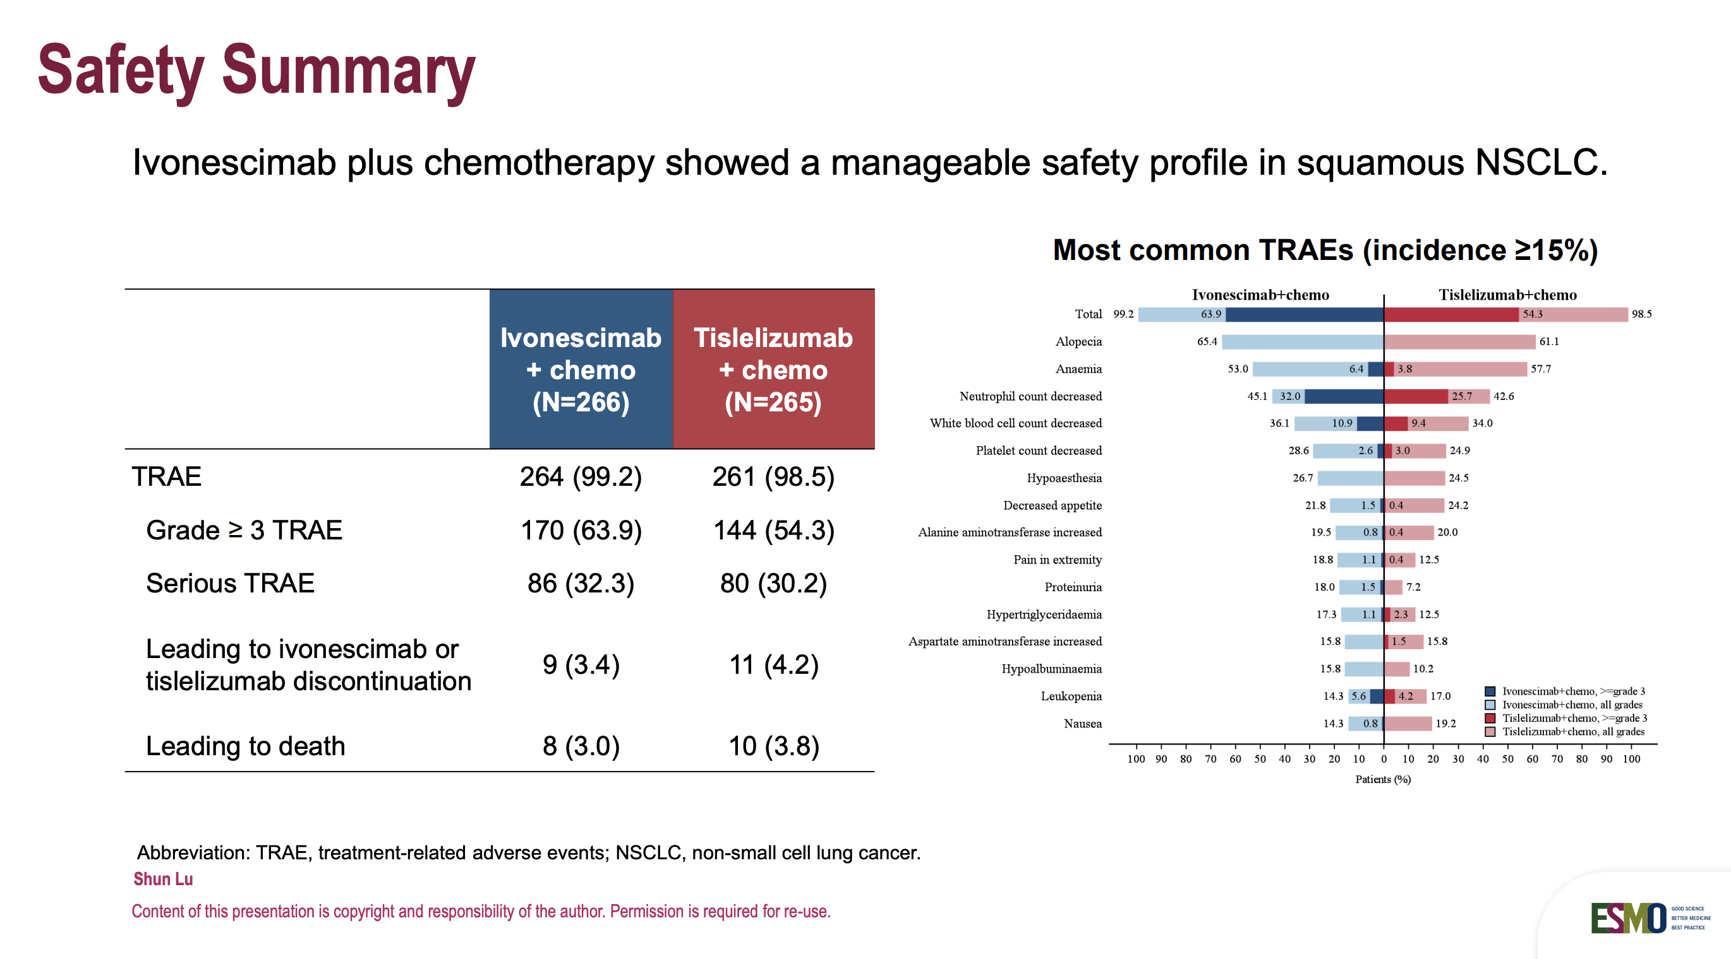
Non-oncogene-addicted NSCLC
HARMONi-6 trial
Lu S, ESMO Asia Congress 2025

Slide 30
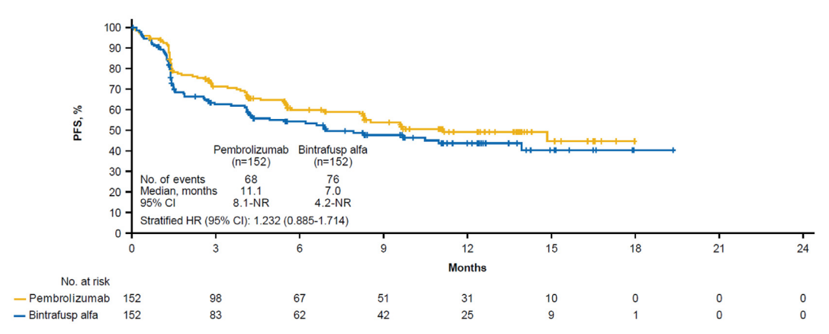
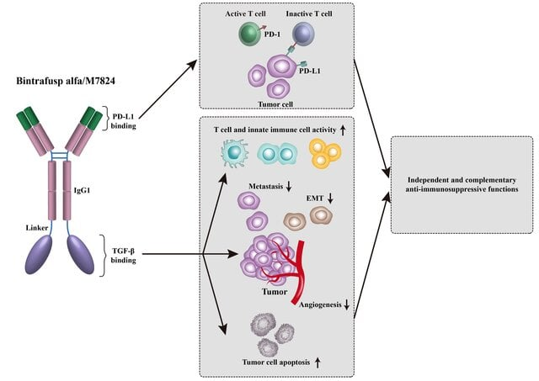
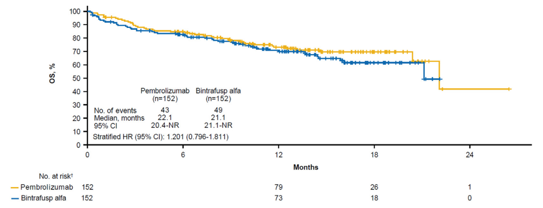
Non-oncogene-addicted NSCLC
Adaptive phase 3 trial (NCT03631706)
Li L, et al. Front Oncol. 2022;12:905520.
Cho BC, et al. J Thorac Oncol. 2023;18(12):1731-1742.

Slide 31
Non-oncogene-addicted NSCLC
Novel ICIs under clinical development for lung cancer
Co-targeting of multiple immune checkpoints
Zhao S, et al. Nat Rev Clin Oncol. 2025;22(8):592-616.

Slide 32
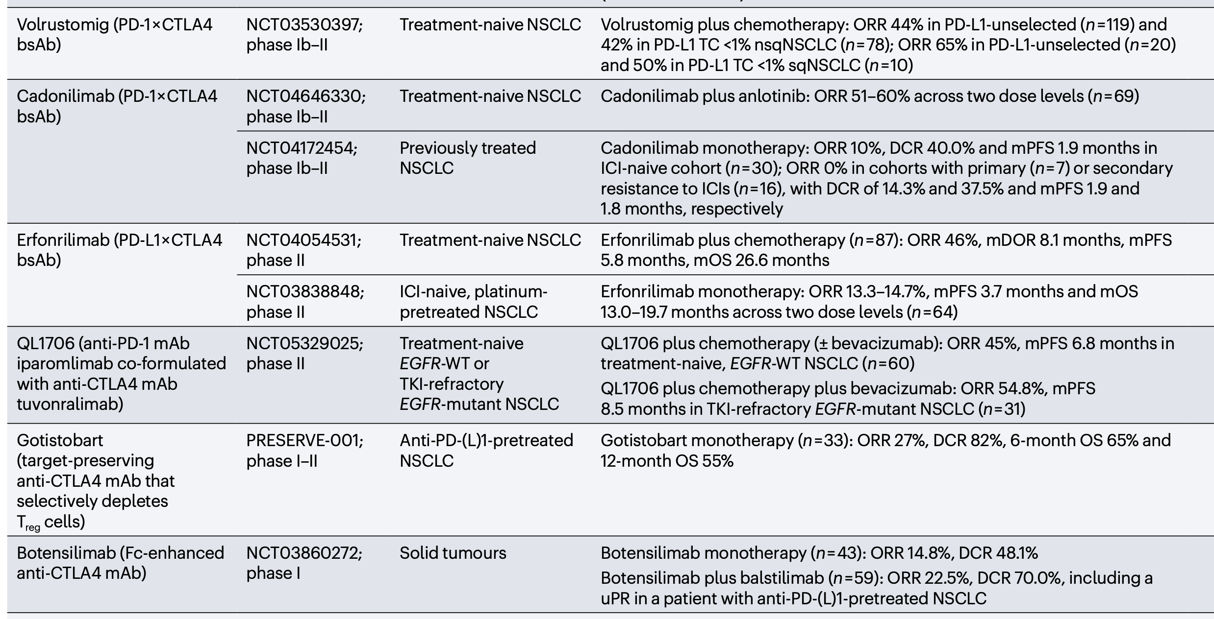
Non-oncogene-addicted NSCLC
Novel anti-CTLA-4 +/- anti-PD-1/-L1
Zhao S, et al. Nat Rev Clin Oncol. 2025;22(8):592-616.

Slide 33
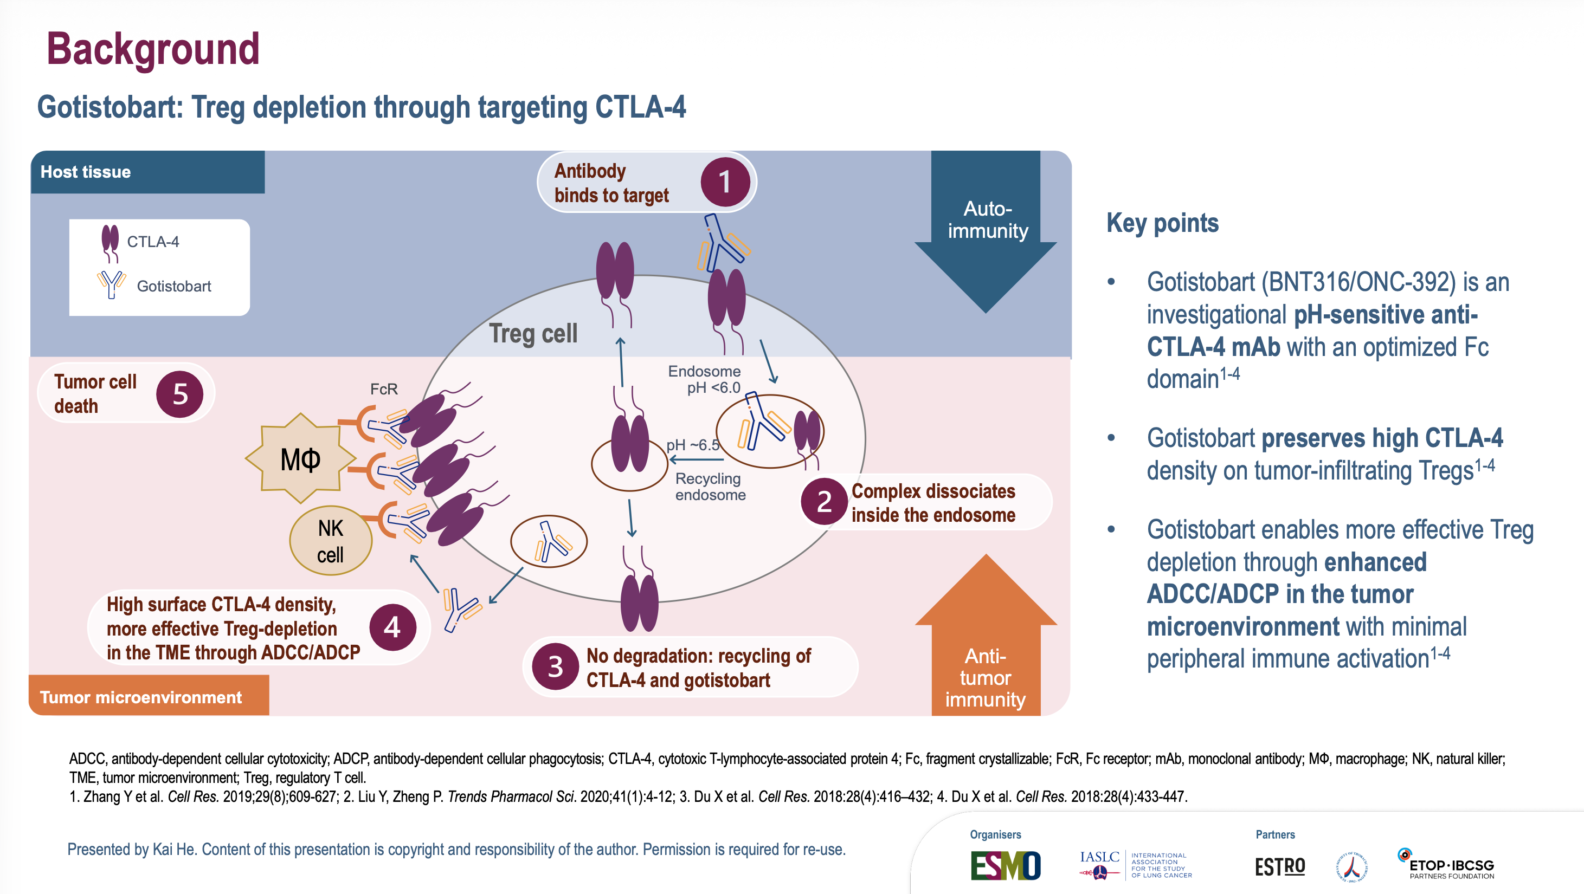
Non-oncogene-addicted NSCLC
PRESERVE-003 trial
He K, ELCC 2026

Slide 34
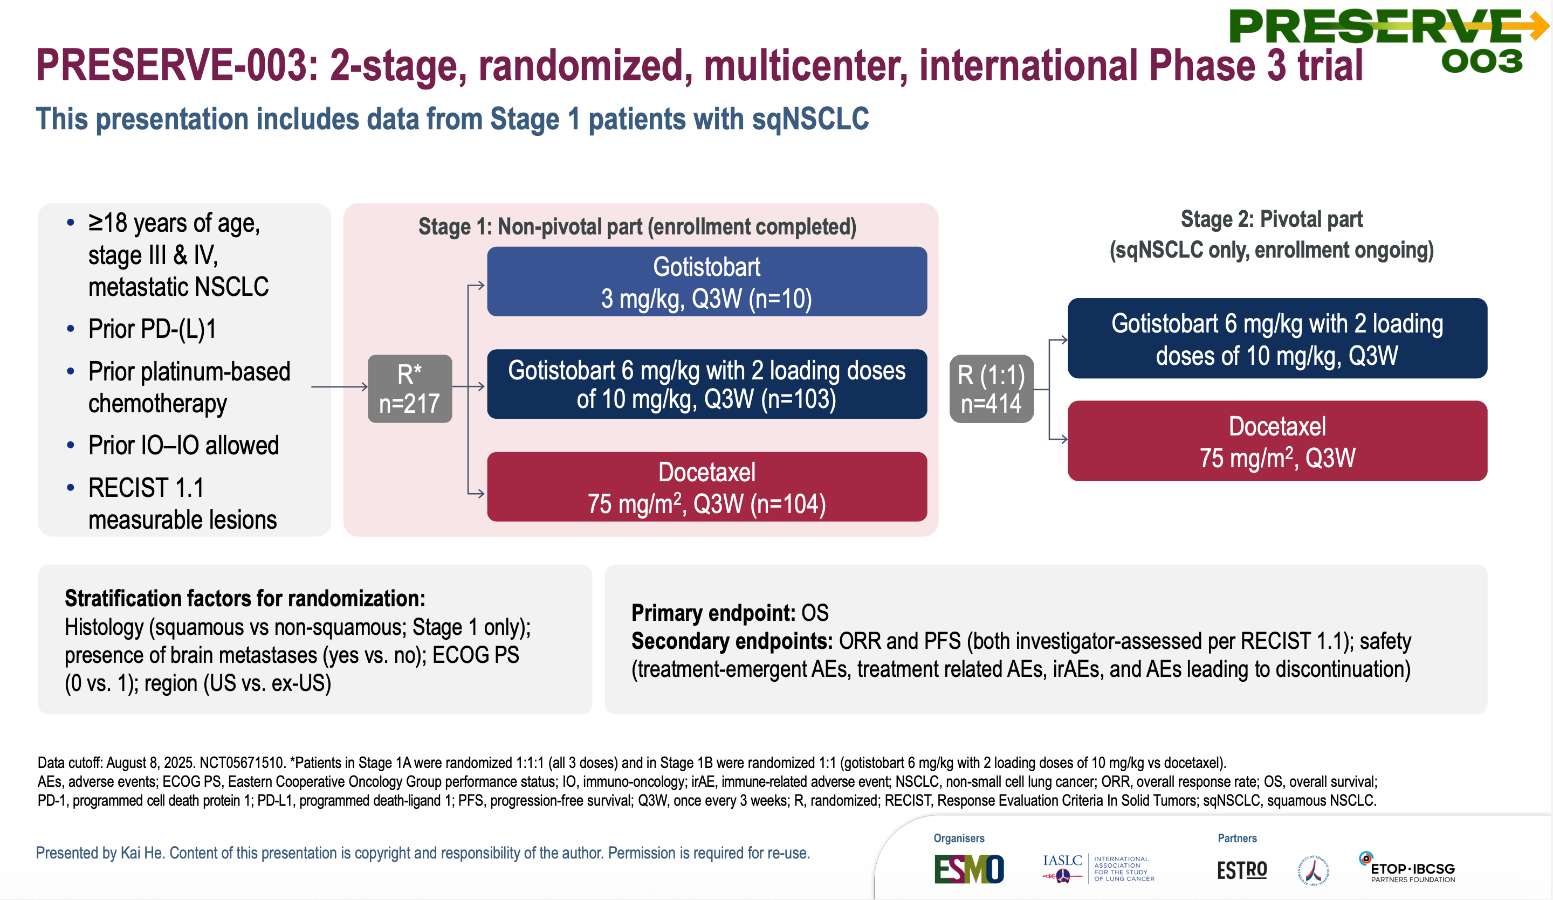
Non-oncogene-addicted NSCLC
PRESERVE-003 trial
He K, ELCC 2026

Slide 35
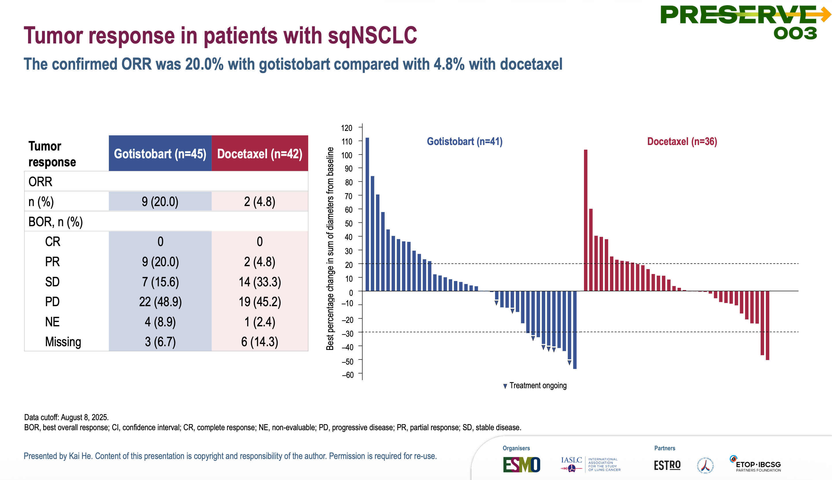
Non-oncogene-addicted NSCLC
PRESERVE-003 trial
He K, ELCC 2026

Slide 36
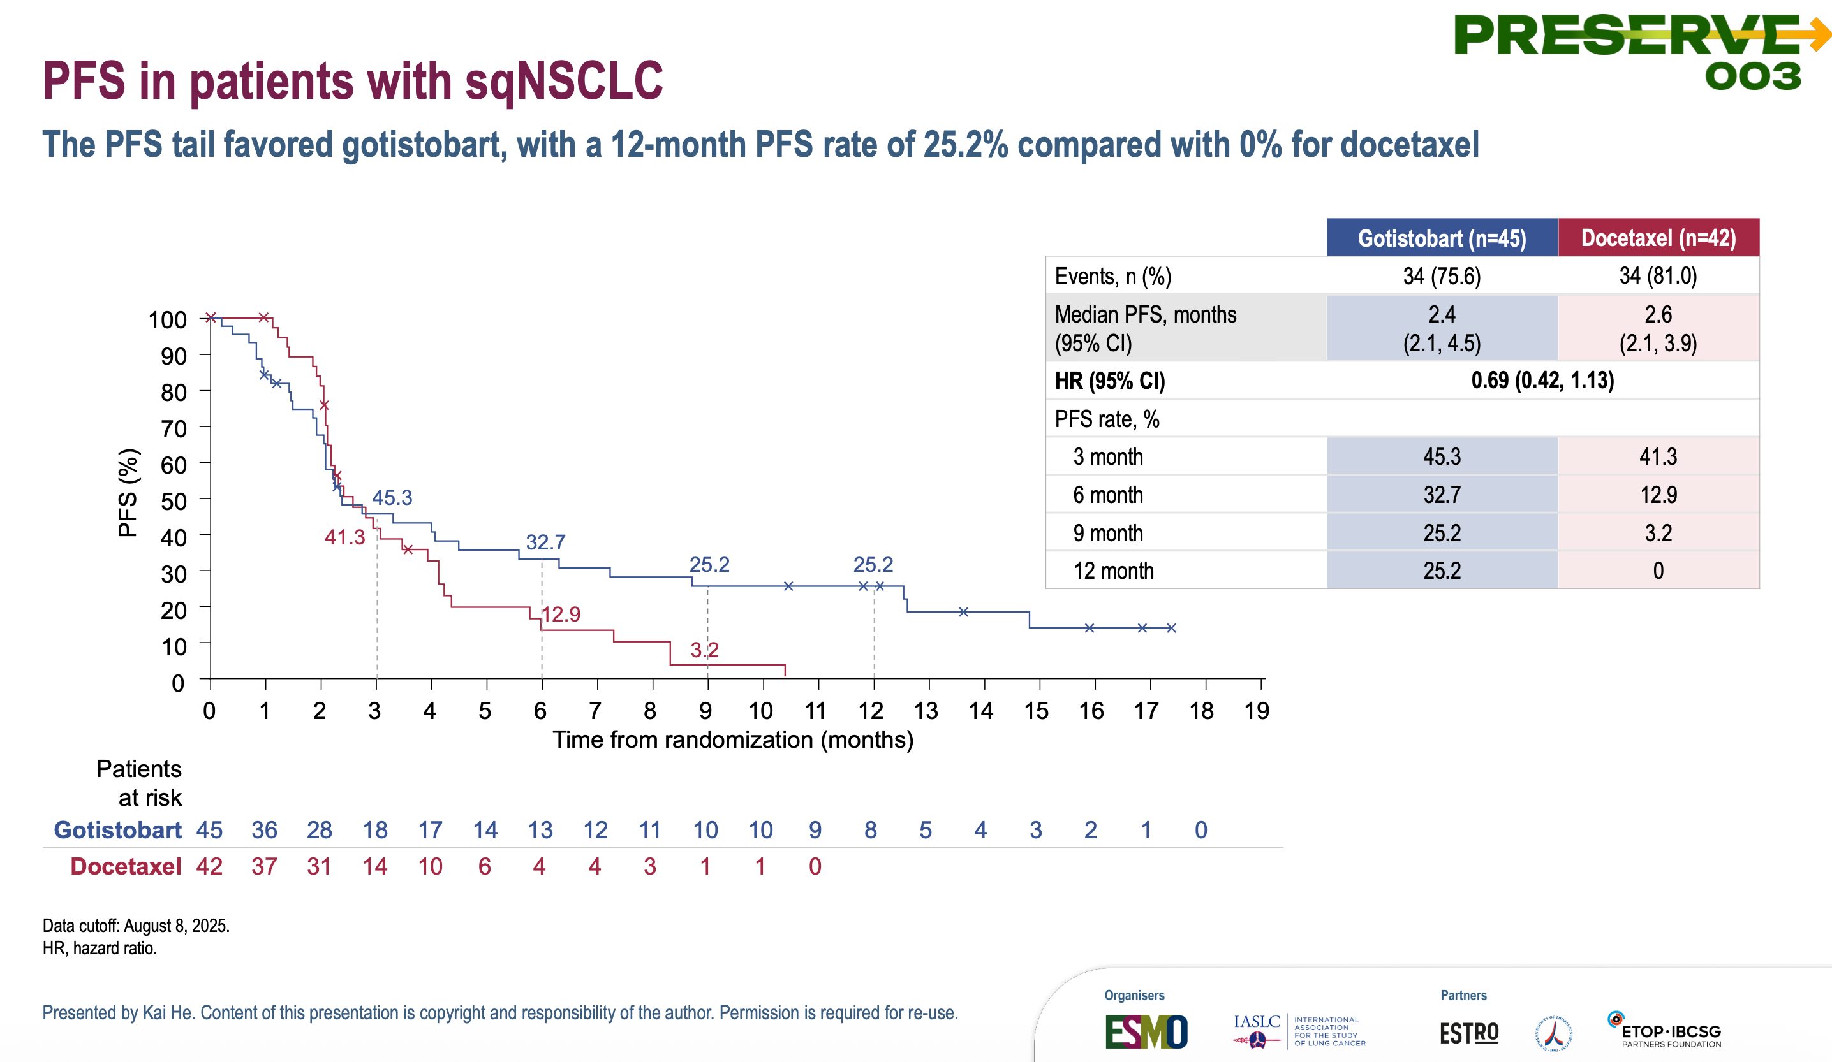
Non-oncogene-addicted NSCLC
PRESERVE-003 trial
He K, ELCC 2026

Slide 37
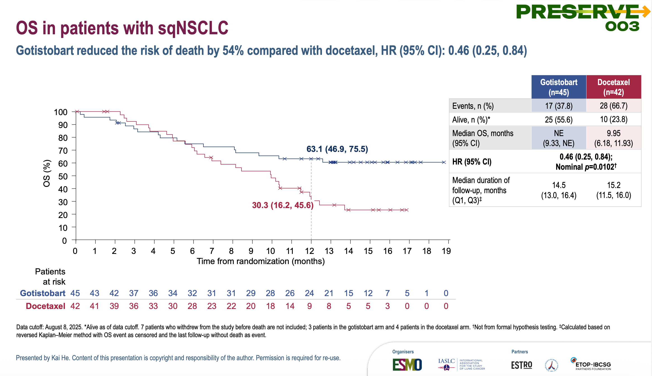
Non-oncogene-addicted NSCLC
PRESERVE-003 trial
He K, ELCC 2026

Slide 38
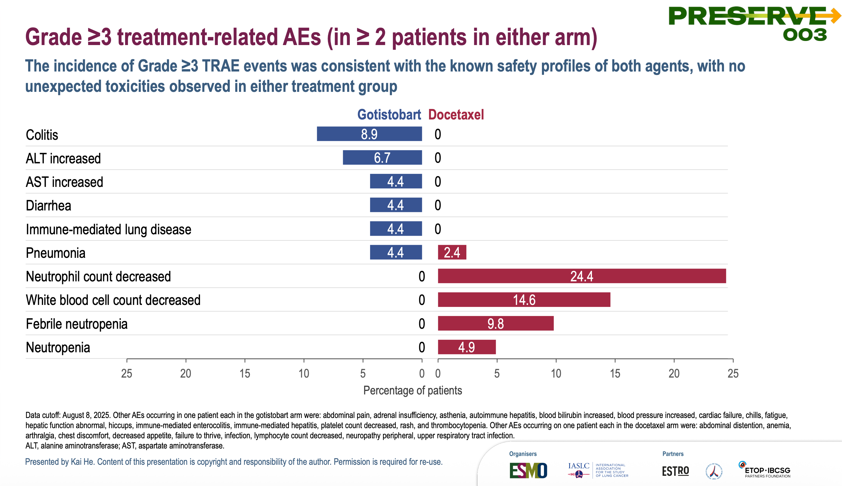
Non-oncogene-addicted NSCLC
PRESERVE-003 trial
He K, ELCC 2026

Slide 39
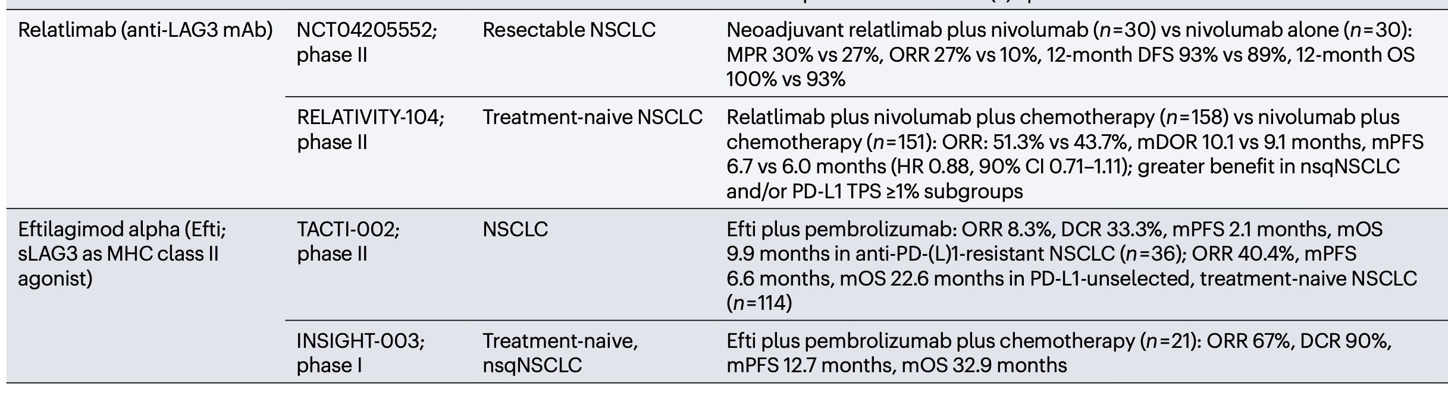
Non-oncogene-addicted NSCLC
Novel anti-LAG3
Zhao S, et al. Nat Rev Clin Oncol. 2025;22(8):592-616.

Slide 40
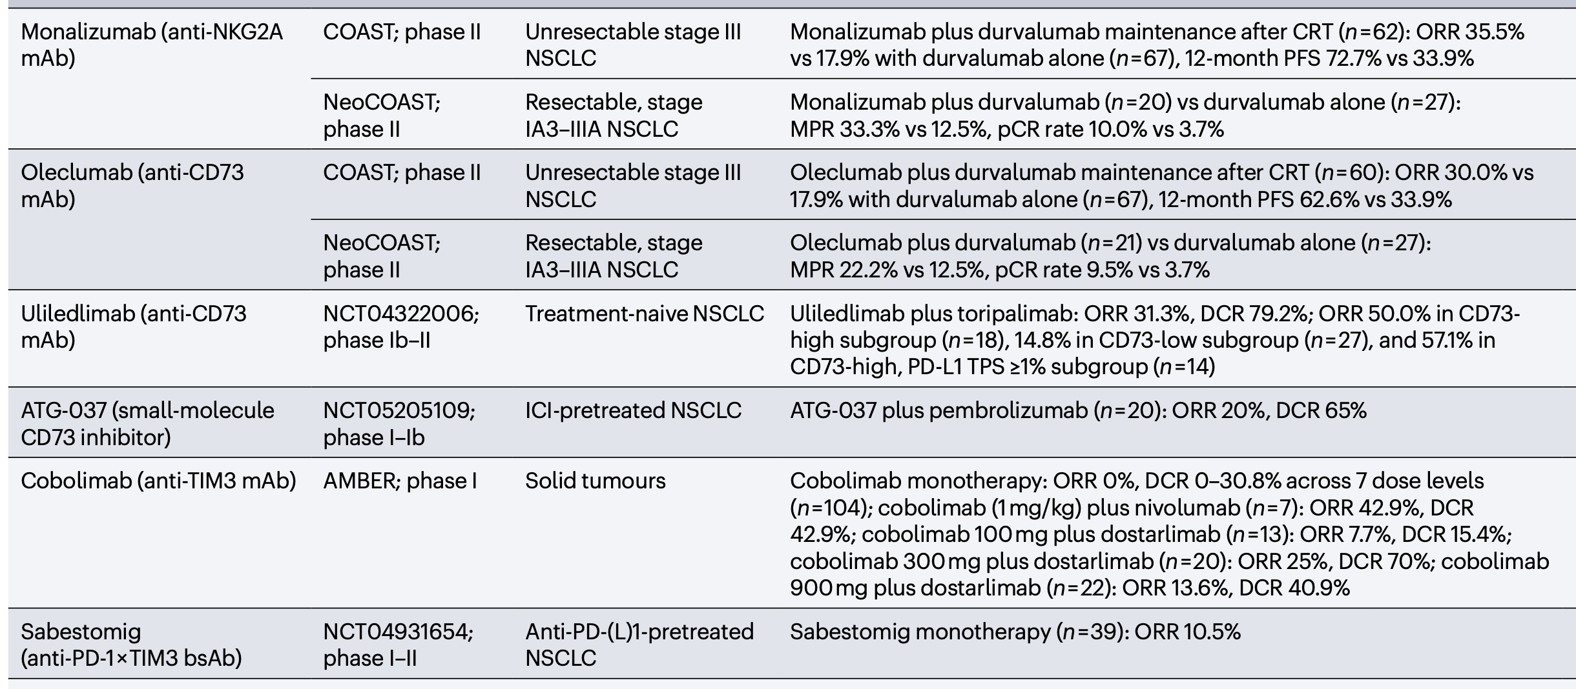
Non-oncogene-addicted NSCLC
Novel anti-NKG2A, anti-CD73, anti-TIM3
Zhao S, et al. Nat Rev Clin Oncol. 2025;22(8):592-616.

Slide 41
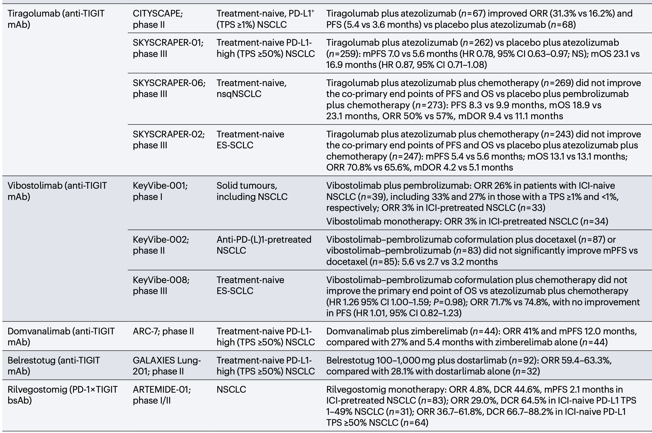
Non-oncogene-addicted NSCLC
Novel anti-TIGIT
Zhao S, et al. Nat Rev Clin Oncol. 2025;22(8):592-616.

Slide 42
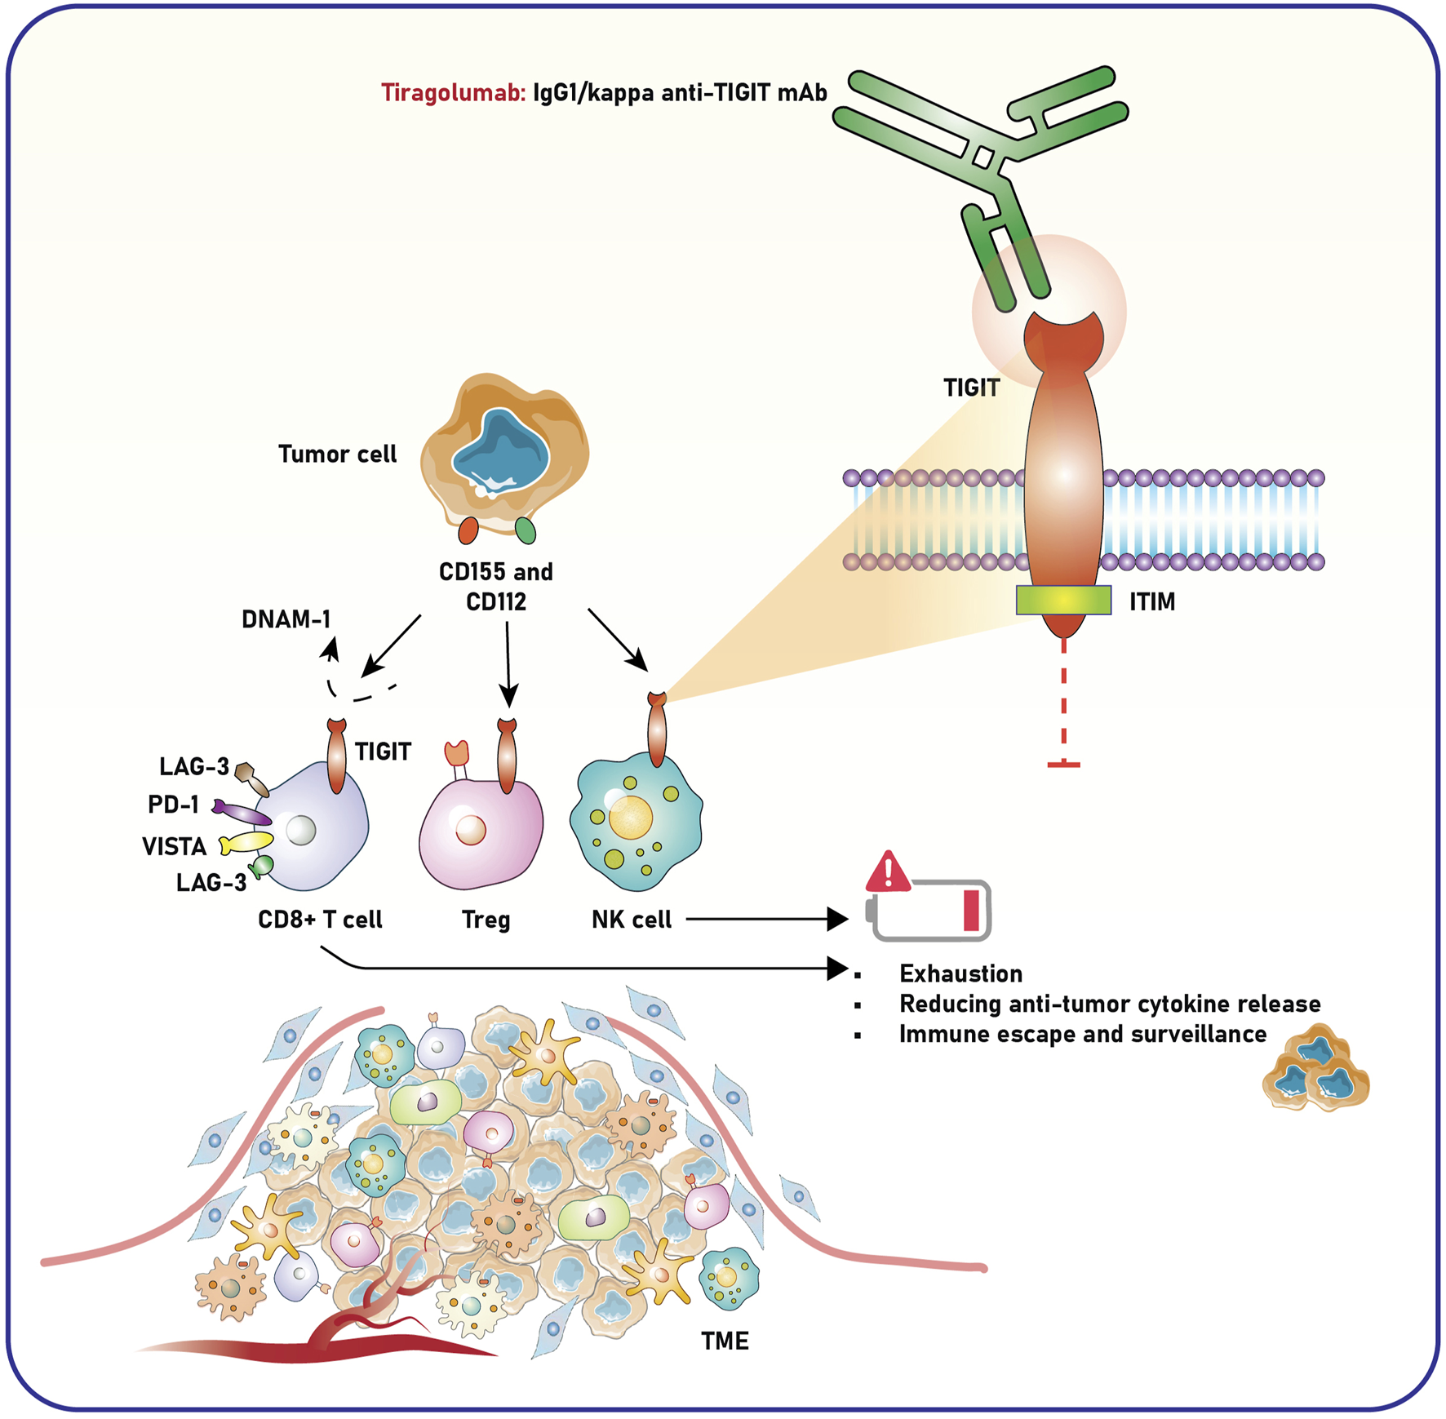
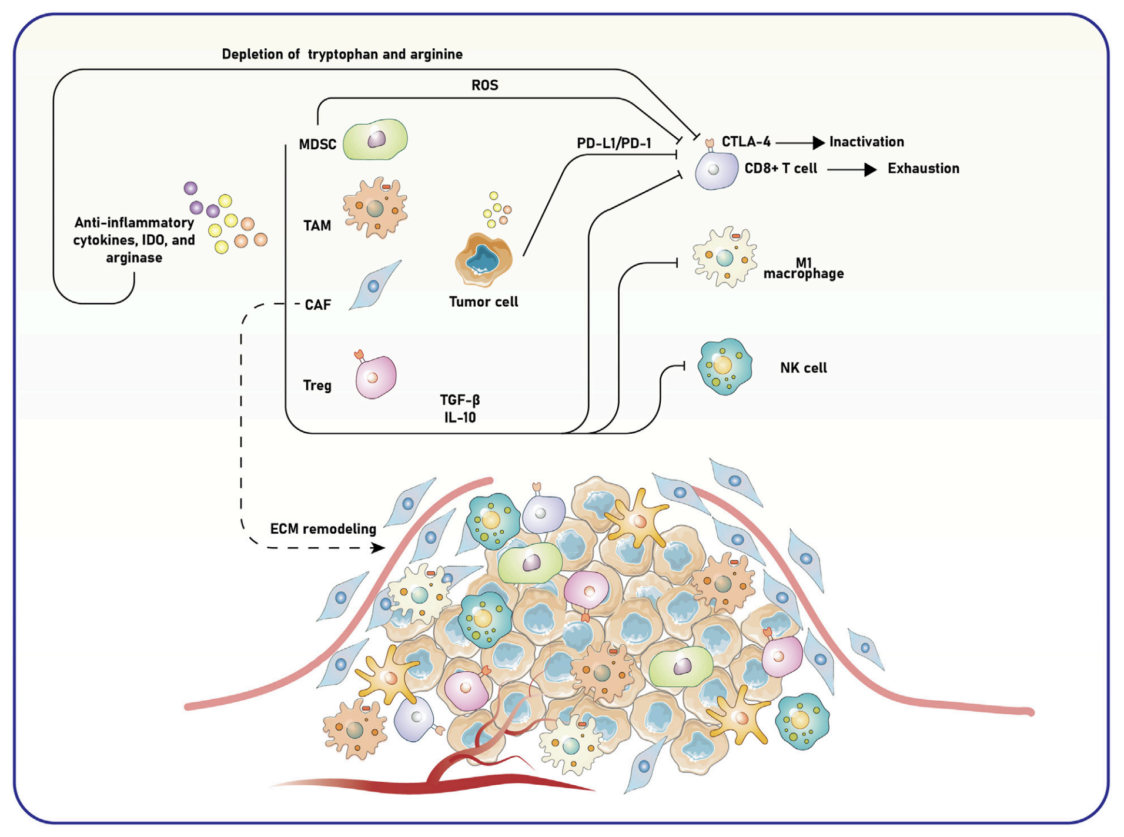
Non-oncogene-addicted NSCLC
Tiragolumab (anti-TIGIT)
Ghasemi K. Front Pharmacol. 2025;16:1568664.

Slide 43
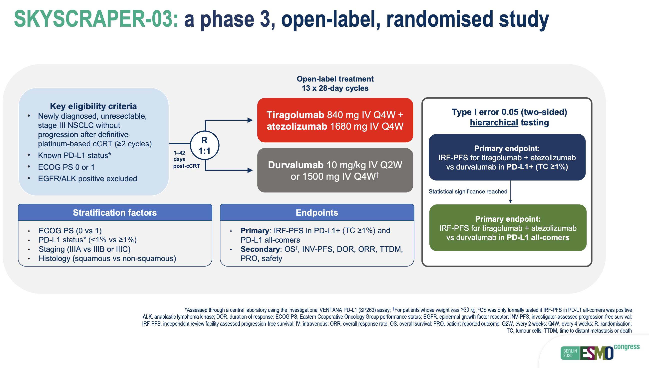
Non-oncogene-addicted NSCLC
SKYSCRAPER-03 Trial
Dziadziuszko R. ESMO Congress 2025

Slide 44
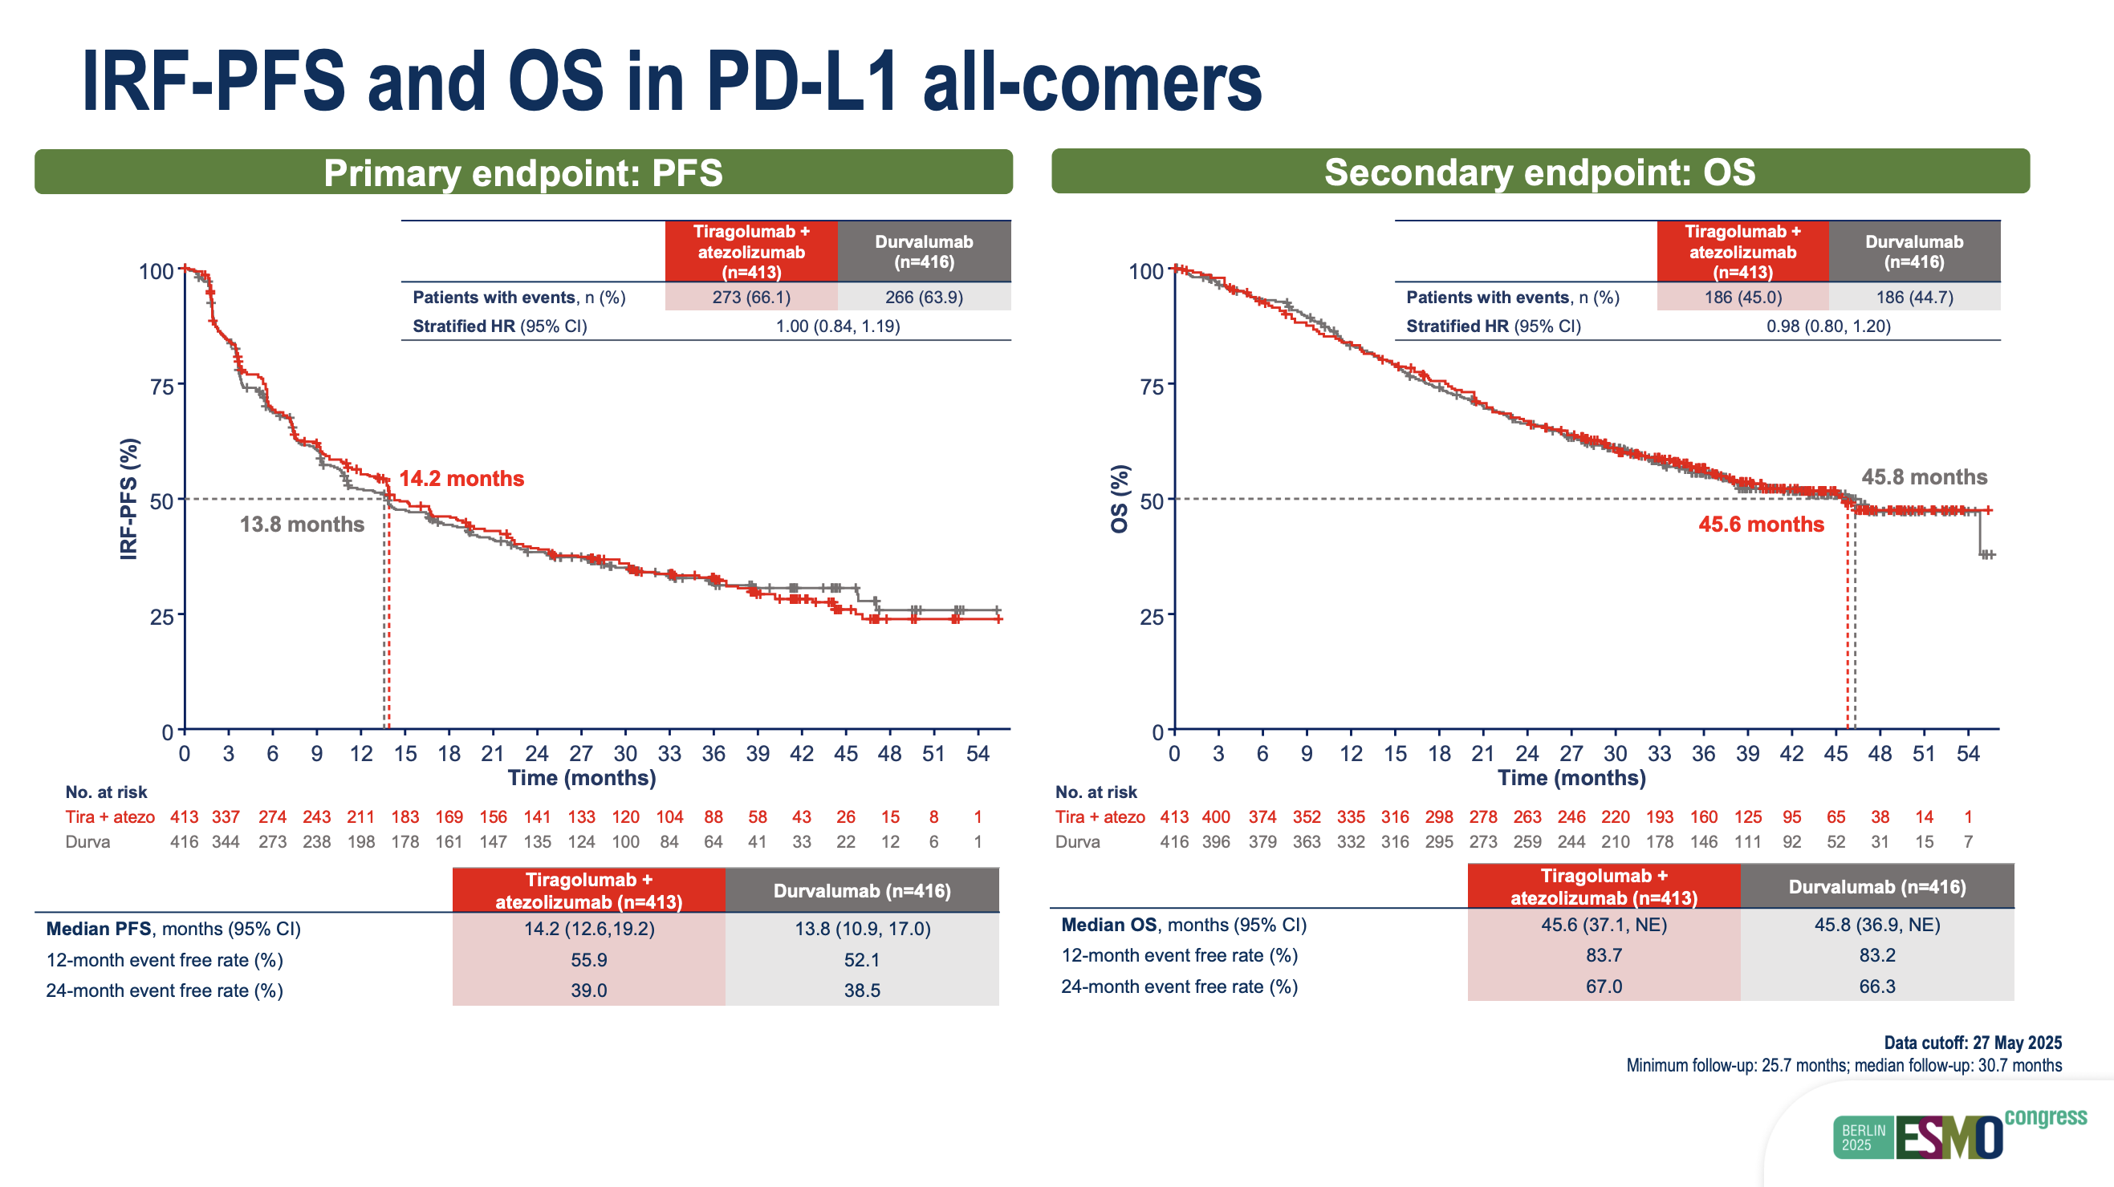
Non-oncogene-addicted NSCLC
SKYSCRAPER-03 Trial
Dziadziuszko R. ESMO Congress 2025

Slide 45
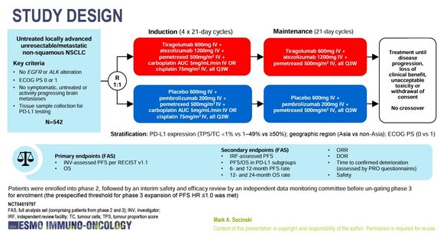
Non-oncogene-addicted NSCLC
SKYSCRAPER-06 Trial
Socinski MA, et al. ESMO IO 2024

Slide 46
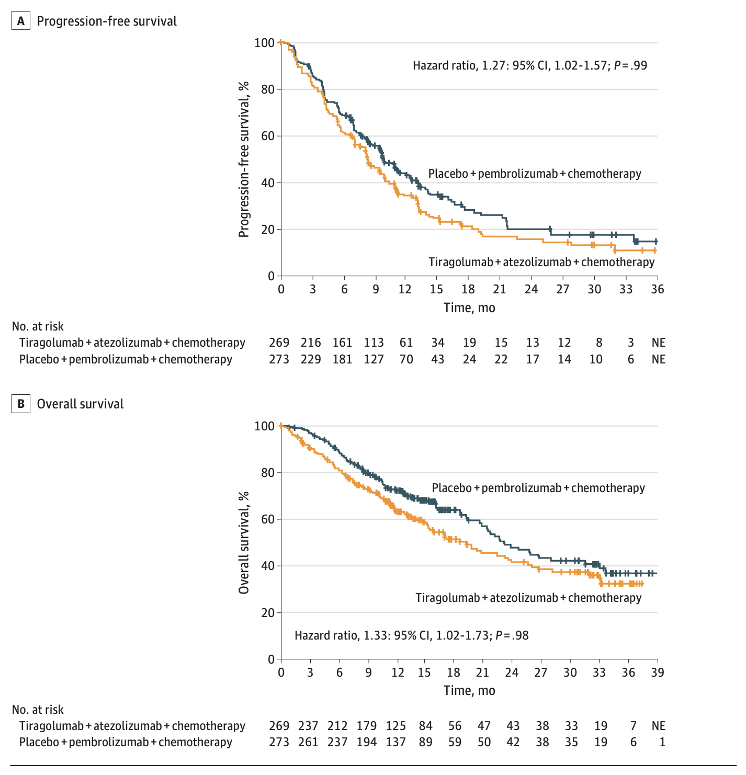
Non-oncogene-addicted NSCLC
SKYSCRAPER-06 Trial
Socinski MA, et al. JAMA Oncol. 2026:e260818.

Slide 47
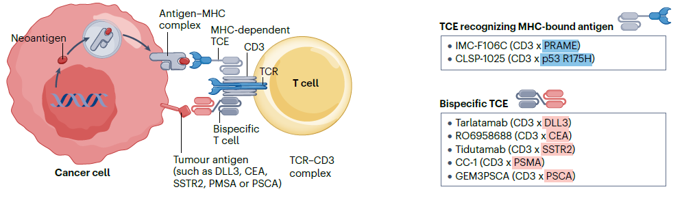
Non-oncogene-addicted NSCLC
Novel immune cell engagers
Bispecific T cell engagers targeting antigens expressed in NSCLC
Zhao S, et al. Nat Rev Clin Oncol. 2025;22(8):592-616.

Slide 48
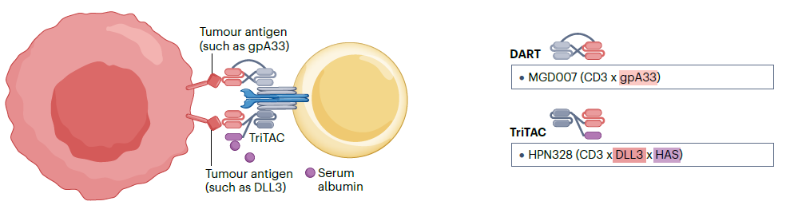
Non-oncogene-addicted NSCLC
Novel immune cell engagers
TCEs using new T cell-engaging techniques or modalities to tune T cell activation levels
Zhao S, et al. Nat Rev Clin Oncol. 2025;22(8):592-616.

Slide 49
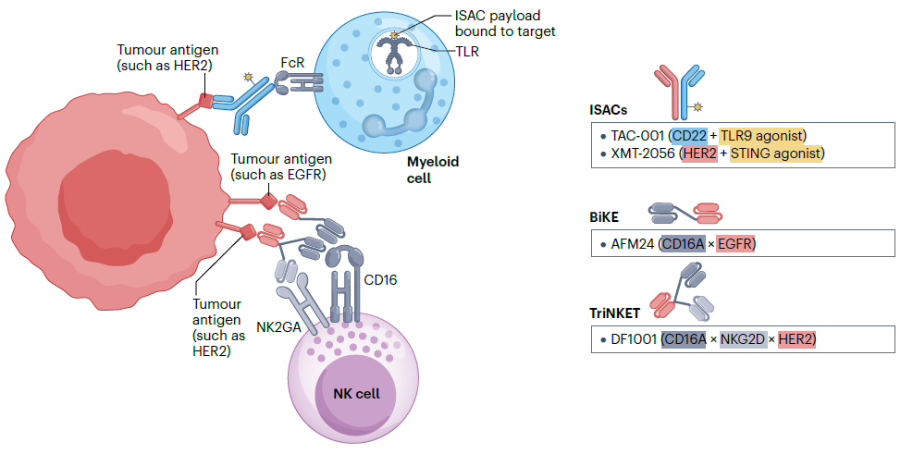
Non-oncogene-addicted NSCLC
Novel immune cell engagers
Immune cell engagers and immunostimulatory antibody conjugates
Zhao S, et al. Nat Rev Clin Oncol. 2025;22(8):592-616.

Slide 50
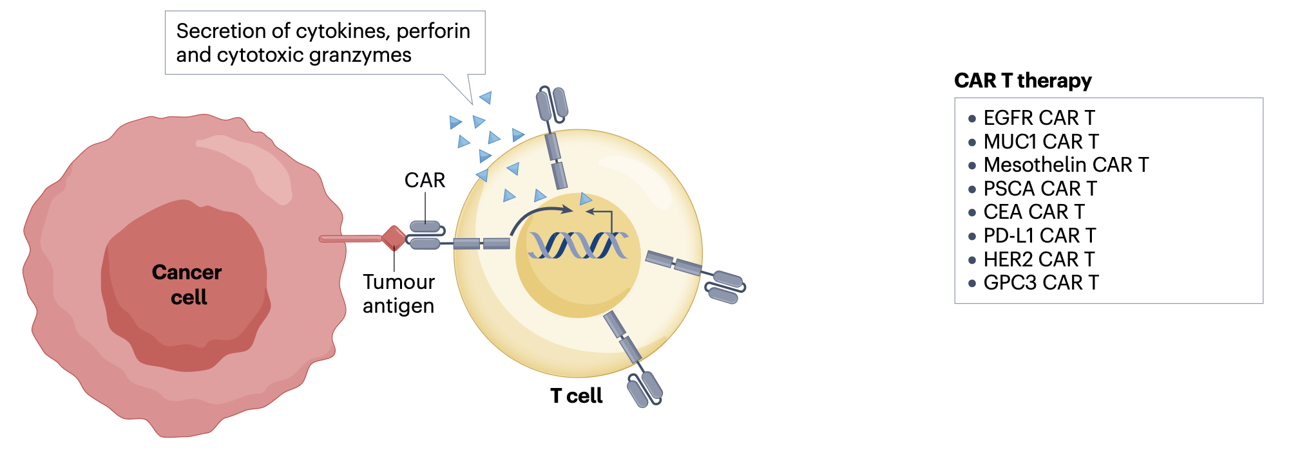
Non-oncogene-addicted NSCLC
Adoptive cell therapies
Zhao S, et al. Nat Rev Clin Oncol. 2025;22(8):592-616.

Slide 51
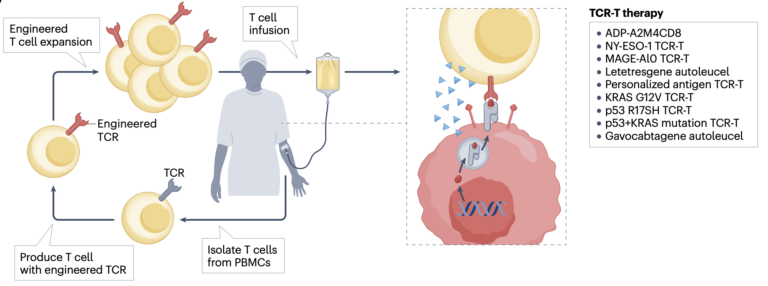
Non-oncogene-addicted NSCLC
Adoptive cell therapies
Zhao S, et al. Nat Rev Clin Oncol. 2025;22(8):592-616.

Slide 52
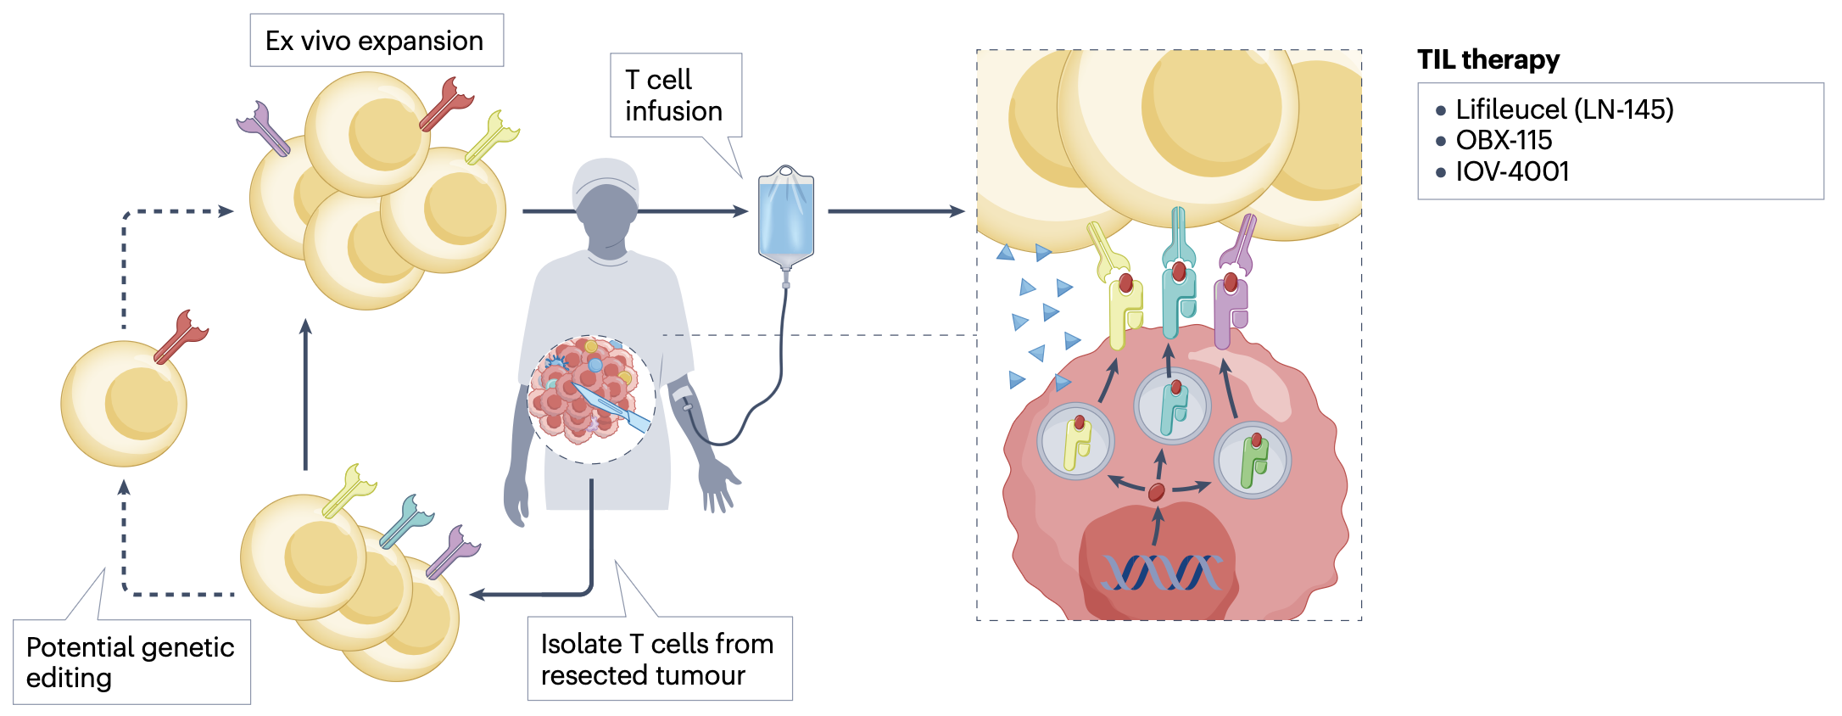
Non-oncogene-addicted NSCLC
Adoptive cell therapies
Zhao S, et al. Nat Rev Clin Oncol. 2025;22(8):592-616.

Slide 53
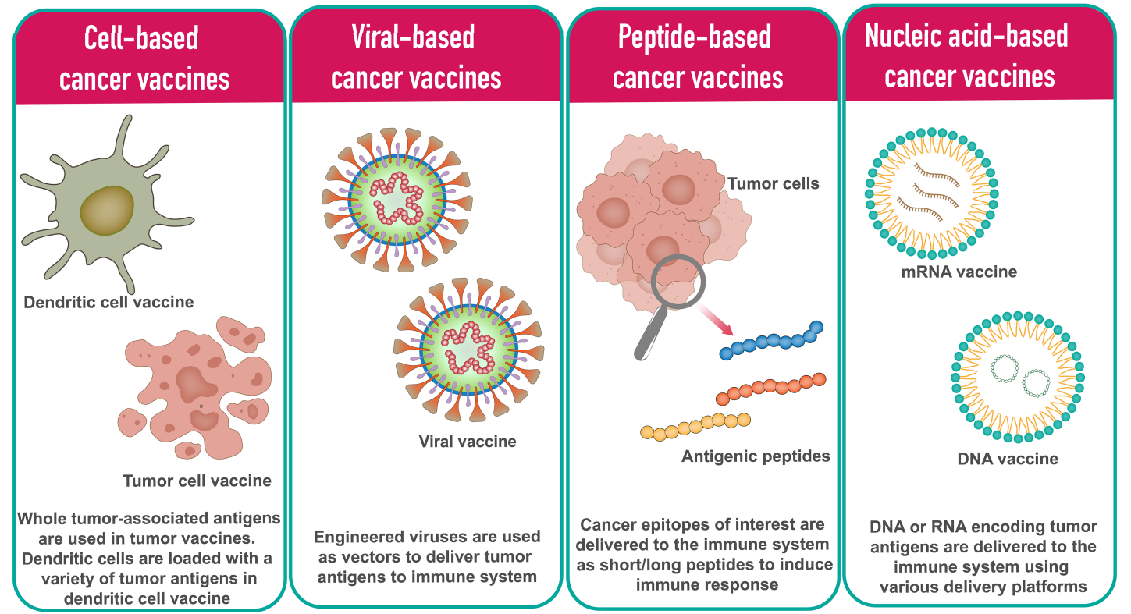
Non-oncogene-addicted NSCLC
Cancer vaccines
Vishweshwaraiah YL, Dokholyan NV. Front Immunol. 2022;13:1029069.

Slide 54

Non-oncogene-addicted NSCLC
Cancer vaccines
Besse B. ESMO 2021

Slide 55

Non-oncogene-addicted NSCLC
Cancer vaccines
Besse B. ESMO 2021

Slide 56

Non-oncogene-addicted NSCLC
Cancer vaccines
Besse B. ESMO 2021

Slide 57

Non-oncogene-addicted NSCLC
Cancer vaccines
Besse B. ESMO 2021

Slide 58

Non-oncogene-addicted NSCLC
Cancer vaccines
Besse B. ESMO 2021

Slide 59

Non-oncogene-addicted NSCLC
Cancer vaccines
Besse B. ESMO 2021

Slide 60

Non-oncogene-addicted NSCLC
Cancer vaccines
Besse B. ESMO 2021

Slide 61


Non-oncogene-addicted NSCLC
Sars-CoV2 mRNA vaccine + ICI
Grippin AJ, et al. Nature. 2025;647(8089):488-497.

Slide 62


Non-oncogene-addicted NSCLC
Sars-CoV2 mRNA vaccine + ICI
Grippin AJ, et al. Nature. 2025;647(8089):488-497.

Slide 63
TAKE HOME MESSAGES
Resistance to immunotherapy is multifactorial, involving tumor-intrinsic mechanisms, the tumor microenvironment, and tumor-extrinsic factors.
Anti-PD-(L)1 + anti-VEGF bispecific antibodies showed consistent outcome improvement.
Antibody-drug conjugates and bispecific antibodies directed to immune checkpoint targets (CTLA-4, LAG-3, TIGIT, TIM-3, NKG2A, and CD73) are among the most promising emerging approaches.
Immune cell engagers, adoptive cell therapies, and cancer vaccines may further expand treatment options, but clinical development is still early.
The future of treatment will likely be biomarker-driven and combination-based, matching therapies to tumor biology, immune phenotype, and resistance mechanisms.

Slide 64






