Slide 1
Tuberculosis and Pregnancy
Meinhard Kneussl, MD, FCCP, FESC, FERS, ATSF
Professor of Respiratory Medicine
Chairman emeritus
Department of Medicine and Pulmonary Diseases
Wilhelminenspital Vienna
Medical University Vienna
Sigmund Freud University Vienna
PneumoTrieste
May 11-13th 2026

Slide 2
Respiratory Failure in Pregnancy
23-year-old patient from India, 14th week gestation
Emergency ward because of increasing dyspnea
  Respiratory failure
  ABG: pO2 62 mmHg / pCO2 30 mmHg pH 7.45 / SO2 93.5%
Intensive care: two days
  Status febrilis: Amoxycillin and Clarithromycin
  Legionella and Pneumococci: negative
  Blood culture: aerobic & anaerobic: negative

Slide 3
Radiology
Chest X-ray: reticulo-nodular pattern: lower lung lobes
no pleural effusion
HR-CT: micro-nodular lesions increasing from cranial to caudal, especially in the middle and lower lung regions, very dense micro-nodular lesions perivascular and paraseptal
Miliar-TB: hematogen dissemination
MRI-brain: corresponding lesions of Miliar-TB,
however, no contrast used: post-partum follow up
suggested

Slide 4
Diagnostic procedures
Molecular biology: no detection of gram + & gram -DNA / no fungal DNA
Cytology Sputum: PN II, no acid-fast bacilli
Cytology Urine: PN II, no acid-fast bacilli
QF Test and MMT negative

Slide 5
Bronchoscopy
Macroscopic: Minor inflammatory mucus membrane changes
BAL: lymphocytes with normal CD4/CD8 Ratio
Histology: epithelioid-granulomatous inflammation
Cytology: brush: ZN negative
Molecular Biology:
  BAL: PCR M. tuberculosis complex: DNA positive
  Sputum: PCR M. tuberculosis complex DNA negative
  Tropical institute: DNA-PCR Pneumocystis jirovecii negative
Lymphocytic population of blood: all populations decreased

Slide 6
Specific anti-tuberculous Therapy
INH, ETH, RMP
Increase of hepatic laboratory parameters:
GOT, GPT, γ-GT INH, RMP stopped
after stabilisation: RMP
PZA started for 2 months
Therapy (54kg body weight):
PZA 500 mg 3-0-0 (2 months),
ETH 500 mg 0-2-0,
RMP 450 mg 1-0-0

Slide 7
Resistance
Microbiology BAL |  | Microbiology Urine
Streptomycin | sensitive | Streptomycin | sensitive
Isoniacid | sensitive | Isoniacid | sensitive
Rifampicin | sensitive | Rifampicin | sensitive
Ethambutol | sensitive | Ethambutol | sensitive
Pyrazinamid | sensitive | Pyrazinamid | sensitive

Slide 8
Follow up
Skin lesions suspicious of skin TB: negative
dermatitis due to pregnancy
Caesarean Section: 34th week gestation
Histology: Placenta-hypoplasia,
no granulomatous inflammation
Chest X-ray one week after labour:
significant improvement of granulomatous changes

Slide 9
British Thoracic Society
Tuberculosis Clinical diagnosis and management of tuberculosis, and measures for its prevention and control.
Issued: March 2011, NICE clinical guideline 117
... nor does it give guidance on highly specialised and individualised activities such as treatment of multidrug-resistant (MDR) TB. It does not include special guidance for patients who are pregnant, planning pregnancy...

Slide 10
British Thoracic Society
Chemotherapy and management of tuberculosis in the United Kingdom: recommendations 1998
Joint Tuberculosis Committee of the British Thoracic Society Thorax 1998;53:536–548
PREGNANCY Should pregnancy occur in patients taking rifampicin, it is not an indication for termination. Standard treatment should be given to pregnant women. None of the first line drugs has been shown to be teratogenic in humans, but ethionamide and prothionamide may be teratogenic and are best avoided. Streptomycin and other aminoglyco- sides should be avoided in pregnancy as they may be ototoxic to the fetus. Patients can breast feed normally while taking antituberculosis drugs [C].

Slide 11
American Thoracic Society
Treatment of Tuberculosis American Thoracic Society, CDC, and Infectious Diseases Society of America Recommendations and Reports June 20, 2003 / Vol. 52 / No. RR-11

Slide 12
Special treatment situations, including... tuberculosis in children, extrapulmonary tuberculosis, culture-negative tuberculosis, pregnancy and breastfeeding, ...are discussed in detail.
Because of the risk of tuberculosis to the fetus, treatment of tuberculosis in pregnant women should be initiated whenever the probability of maternal disease is moderate to high.
The initial treatment regimen should consist of INH, RIF, and EMB. Although all of these drugs cross the placenta, they do not appear to have teratogenic effects.
  INH is considered safe in pregnancy, but the risk of hepatitis may be increased in the peripartum period, RIF and EMB are considered safe
  There are insufficient data to recommend the use of rifabutin
  There is not sufficient information to recommend the use of rifapentine
Streptomycin is the only antituberculosis drug documented to have harmful effects on the human fetus (congenital deafness) and should not be used.

Slide 13
Although detailed teratogenicity data are not available, PZA can probably be used safely during pregnancy and is recommended by the World Health Organization (WHO) and the International Union against Tuberculosis and Lung Disease (IUATLD). If PZA is not included in the initial treatment regimen, the minimum duration of therapy is 9 months.
Examples of circumstances in which PZA may be withheld include severe liver disease, gout, and, perhaps, pregnancy.
Pyridoxine supplementation (25 mg/day) is recommended for all women taking INH who are either pregnant or breastfeeding. The amount of pyridoxine in multivitamins is variable but generally less than the needed amount.
  Peripheral neurotoxicity: This adverse effect is dose related and is uncommon (less than 0.2%) at conventional doses. The risk is increased in persons with other conditions that may be associated with neuropathy such as nutritional deficiency, diabetes, HIV infection, renal failure, and alcoholism, as well as for pregnant and breastfeeding women. Pyridoxine supplementation (25 mg/day) is recommended for patients with these conditions to help prevent this neuropathy.

Slide 14
Second-Line Drugs
Cycloserine crosses the placenta. There are limited data on safety in pregnancy; thus, it should be used in pregnant women only when there are no suitable alternatives
Ethionamide crosses the placenta and is teratogenic in laboratory animals. It should not be used in pregnancy.
SM is contraindicated in pregnancy because of the risk of fetal hearing loss
Both amikacin and kanamycin are contraindicated in pregnant women because of risk of fetal nephrotoxicity and congenital hearing loss
Capreomycin should be avoided in pregnancy because of risk of fetal nephrotoxicity and congenital hearing loss
PAS has been used safely in pregnancy. The drug should be used only if there are no alternatives for a pregnant woman who has multidrug-resistant tuberculosis (no studies)
Fluoroquinolons, this class of drugs should be avoided in pregnancy because of teratogenic effects

Slide 15
WHO Global tuberculosis report 2013
Special caution is required when bedaquiline is used in people aged 65 and over, and in adults living with HIV. Its use among pregnant women and children is not advised.

Slide 16
Deutsches Zentralkomitee zur Bekämpfung der Tuberkulose (DZK) und Deutsche Gesellschaft für Pneumologie und Beatmungsmedizin (DGP).
Recommendations for therapy, chemo-prevention & chemoprophylaxis in adults and children
SchabergT, BauerT, CastellSetal:
Pneumologie 2012; 66: 133–171

Slide 17
Eine antituberkulöse Therapie mit INH, RMP, PZA und EMB stellt im Falle einer unter Behandlung eintretenden oder bereits bestehenden Schwangerschaft keine Indikation zur Interruptio dar.
Streptomycin und andere Aminoglykoside/Peptidantibiotika sind potenziell toxisch für den Fötus und sollten daher in der Schwangerschaft nicht eingesetzt werden. Die Gabe dieser Substanzen in Unkenntnis einer Schwangerschaft stellen jedoch ebenfalls keine Indikation zu einer Interruptio oder für eine invasive Diagnostik dar.
Behandlung soll, ohne Anhaltspunkt für Medikamentenresistenz, mit INH (+Pyridoxin), RMP, und PZA erfolgen. Auch EMB kann eingesetzt werden.
Wird auf PZA verzichtet, ist die verlängerte Therapiedauer von 9 Monaten (2 Monate INH, RMP und EMB, 7 Monate INH und RMP) zu berücksichtigen.
Fluorochinolone sind kontraindiziert

Slide 18
Selbstverständlich ist eine medikamentenresistente Tuberkulose auch in der Schwangerschaft eine behandlungsbedürftige Erkrankung.
die präventive Therapie mit INH (+ Pyridoxin) ist im Prinzip möglich. Vertretbar ist in dieser Situation aber sicher auch der Beginn der Chemoprävention erst im 2. Trimenon. Auch die Anwendung von RMP wird als weitgehend sicher beurteilt

Slide 19
Handbuch Tuberkulose Lungenliga Schweiz 2011
Latente tuberkulöse Infektion: Isoniazid 300 mg während 9 Monaten, .... gleichzeitige Gabe von Vitamin B6 wird bei Schwangerschaft, Alkoholismus, Unterernährung, HIV-Infektion .... empfohlen
Tuberkulose während Schwangerschaft und Stillzeit: mit dem Standardschema (2 HRZE / 4 HR), plus Vitamin B6
In Fällen einer Medikamentenresistenz bzw. Unverträglichkeit können auch Medikamente der zweiten Linie eingesetzt werden.
Alle Antituberkulotika sind bei stillenden Müttern erlaubt, Konzentration der Medikamente ist aber ungenügend, das neugeborene Kind und Kinder bis 5 Jahre einer an Tuberkulose erkrankten Mutter müssen daher eine Prophylaxe erhalten
Einer Neuropathie kann durch tägliche Verabreichung von Vitamin B6 (40 mg pro Tag) vorgebeugt werden.

Slide 20
Summary
Latent tuberculous infection
INH 300mg 9 months
Vitamine B6 recommended
TB in pregnancy and postpartum
Standard therapy: first line
Resistance: second line
Newborn and Children under 5 years:
prophylactic / preventive therapy
Neuropathy: Vitamine B6 40mg per day

Slide 21


Slide 22
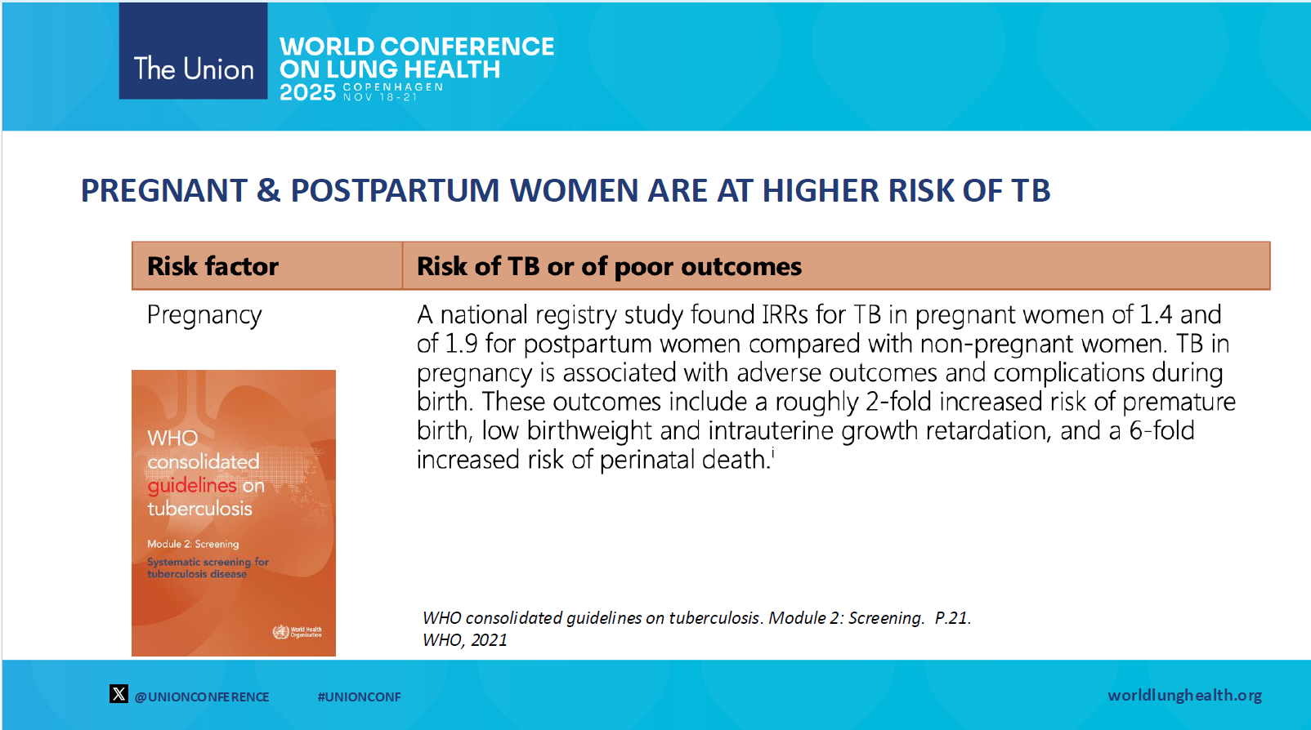

Slide 23
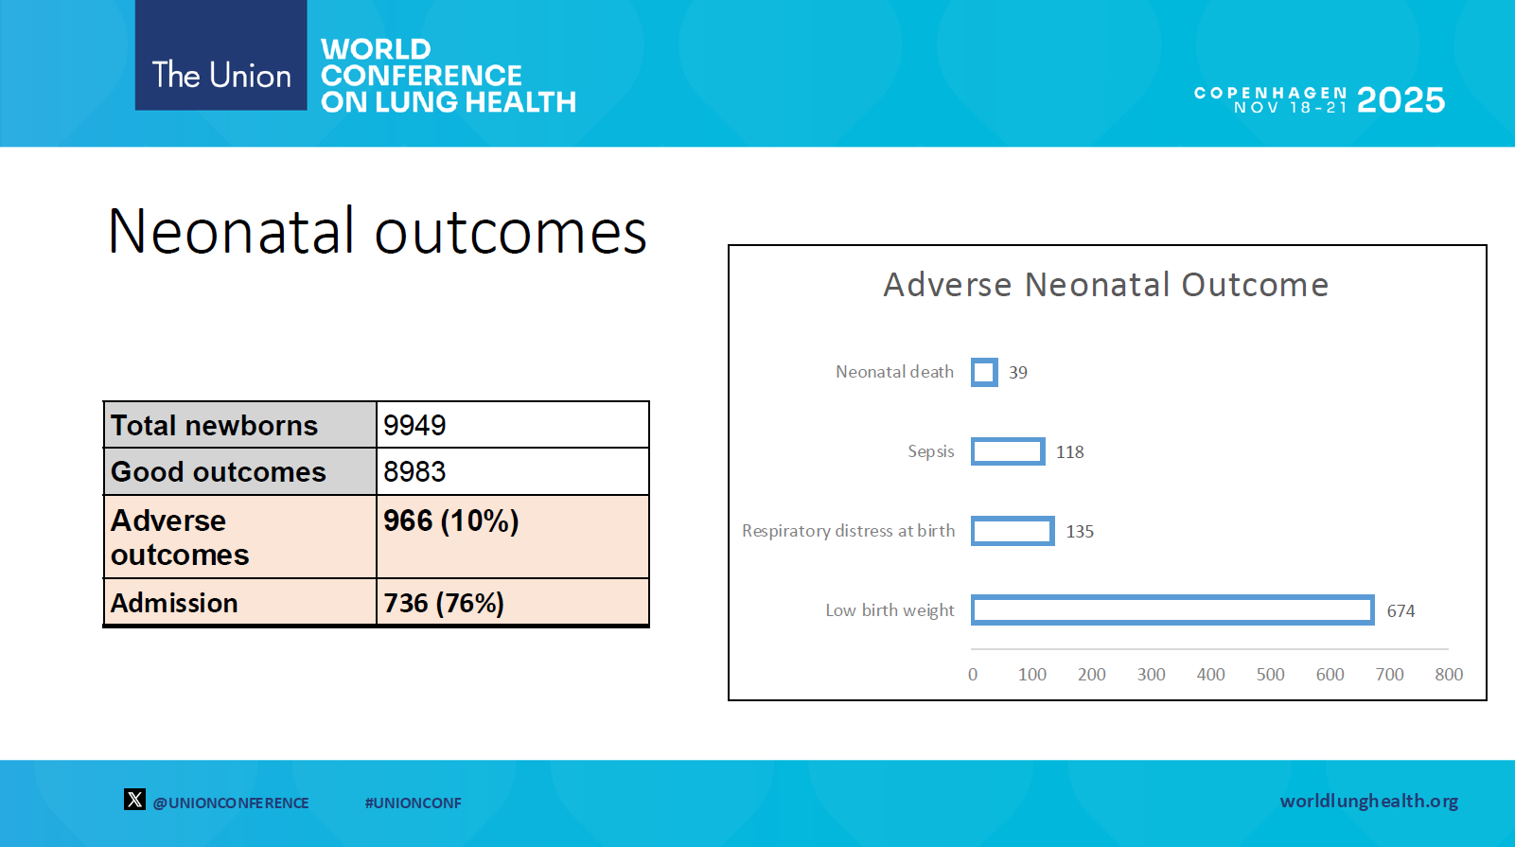

Slide 24
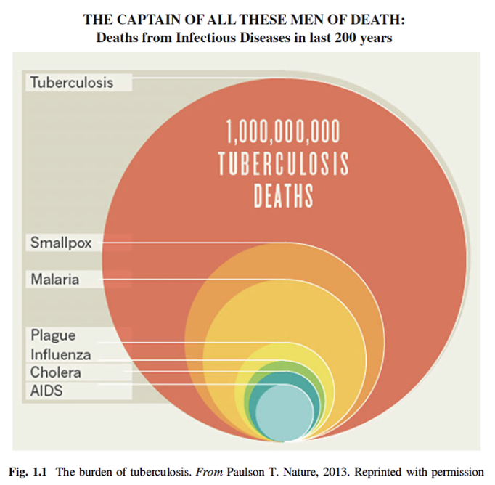



TB in children – worldwide
Every 3 minutes one child dies due to TB
Vvvvvvv
www.istockphoto.com
1 Global Tuberculosis Report 2022. & 2024, WHO. Global Tuberculosis Report 2022 (who.int); Global Tuberculosis Report 2024 (who.int)
2 Dodd PJ et al. Burden of childhood tuberculosis in 22 high-burden countries. Lancet Glob Health. 2014 Aug;2(8):e453-9. doi: 10.1016/S2214-109X(14)70245-1.

Slide 25
Take home messages
Pregnant women have a higher risk to get TB than non-pregnant women
Rise of latent TB to TB increases in the 2nd and 3rd trimenon
Peak of disease postpartum: 1st week, 2nd to 6th week or in symptomatic patients
In high risk countries TB-Screening could result in decrease of mortality of mother and newborn

Slide 26
Thank you for your attention!

