Slide 1

Riabilitazione
Respiratoria per l’Asma grave:
un’opportunità poco conosciuta
Gabriella Guarnieri
Fisiopatologia Respiratoria
Dip.to di Scienze Cardio-Toraco-Vascolari e Sanità Pubblica
Azienda Ospedale Università di Padova

Slide 2

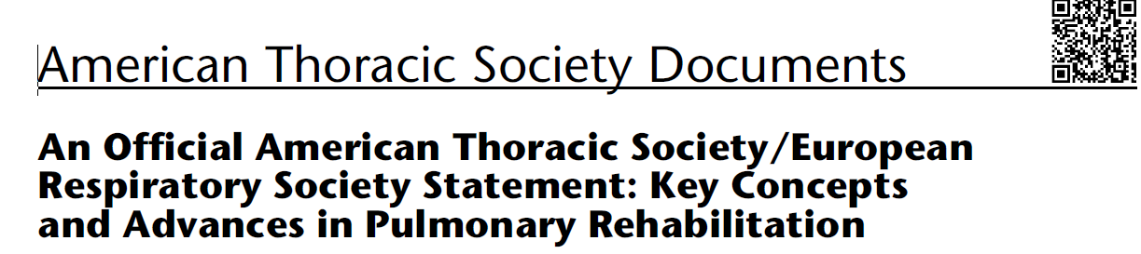
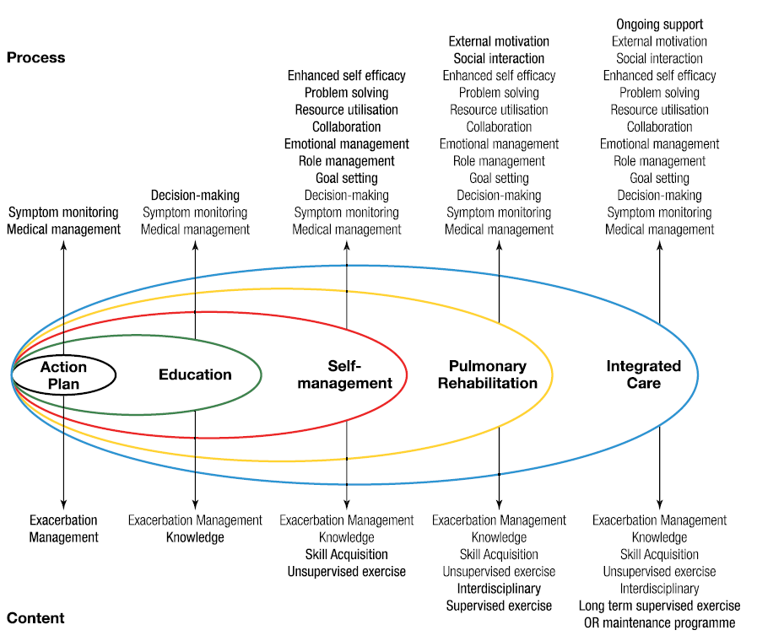
2013
PR: comprehensive intervention based on detailed patient assessment, followed by individually tailored therapies including exercise training, education and behaviour change to improve physical and psychological condition and to promote long-term adherence to health-enhancing behaviours
Notes:
Intervento globale basato su una valutazione del paziente seguita da terapie personalizzate che includono, ma non si limitano a, allenamento fisico, educazione e modifiche comportamentali, concepite per migliorare la condizione fisica e psicologica delle persone con malattie respiratorie croniche e per promuovere l’aderenza a lungo termine a comportamenti che favoriscono la salute².”
Storicamente studiata e applicata a pazienti con BPCO³

Slide 3
Severe Asthma
Estimated 339 million people with asthma, prevalence 5% severe asthmatics
Despite therapeutic advances, including inhaled corticosteroids, long-acting bronchodilators and targeted biologic agents, a proportion of patients continue to experience severe or uncontrolled asthma according to ATS/ERS definitions
Multimorbidity is common in severe asthma; rhinosinusitis, obesity, gastroesophageal reflux, anxiety, depression and dysfunctional behaviours amplify clinical complexity, worsen control and increase healthcare utilisation
Biologic therapies targeting specific inflammatory pathways have improved outcomes in selected phenotypes, but residual symptom burden and functional impairment persist in many patients
A comprehensive, multimodal care strategy is therefore
required to optimise clinical trajectories for these patients
Sadatsafavi et al, Can Resp J 2010. 2. O’Neil et al, Thorax 2015. Busse WW et al, Eur Respi Rev 2022. Chung KF et al, Eur Resp J 2014. Chen W et al Thorax 2019

Slide 4
Agenda
Pulmonary Rehabilatation in SA:
Effective?
Safe ?
Strategic approaches and modalities?
TT candidates?

Slide 5

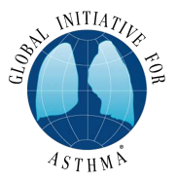

Current guidelines recommend personalised care plans negotiated between patients, caregivers and the multidisciplinary clinical team, within a continuous cycle of assessment, adjustment and review
Diagnosi
Controllo dei sintomi e fattori di rischio
(inclusa la funzionalità respiratoria)
Tecnica inalatoria e aderenza terapeutica
Preferenze del paziente
VALUTAZIONE
RIVALUTAZIONE DELLA RISPOSTA
Sintomi
Riacutizzazioni
Effetti collaterali
Soddisfazione del paziente
AGGIUSTAMENTO TRATTAMENTO
Terapia antiasmatica
Strategie non farmacologiche
Trattamento dei fattori di rischio modificabili

Slide 6
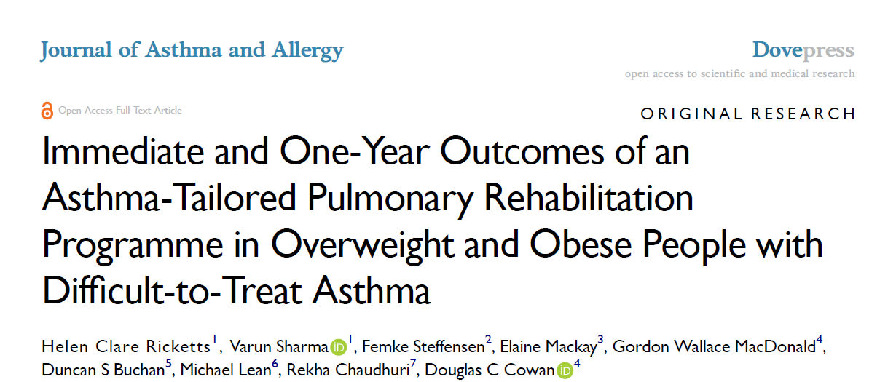
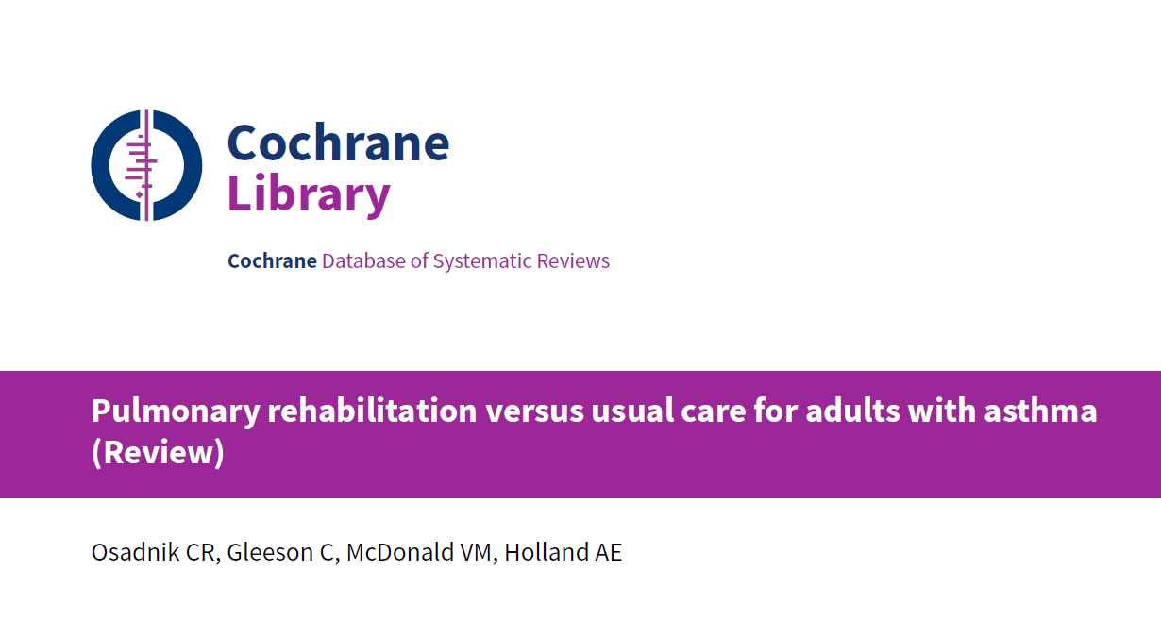
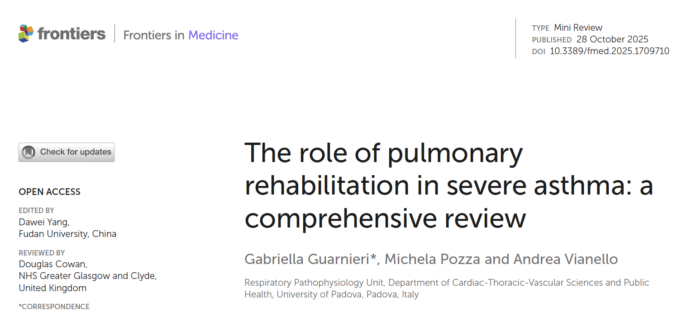
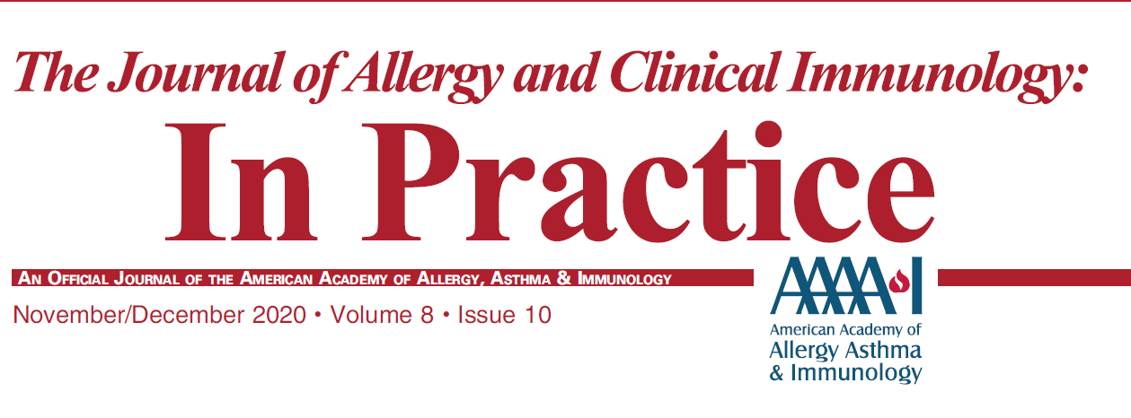
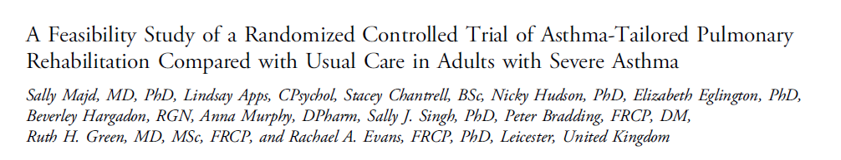
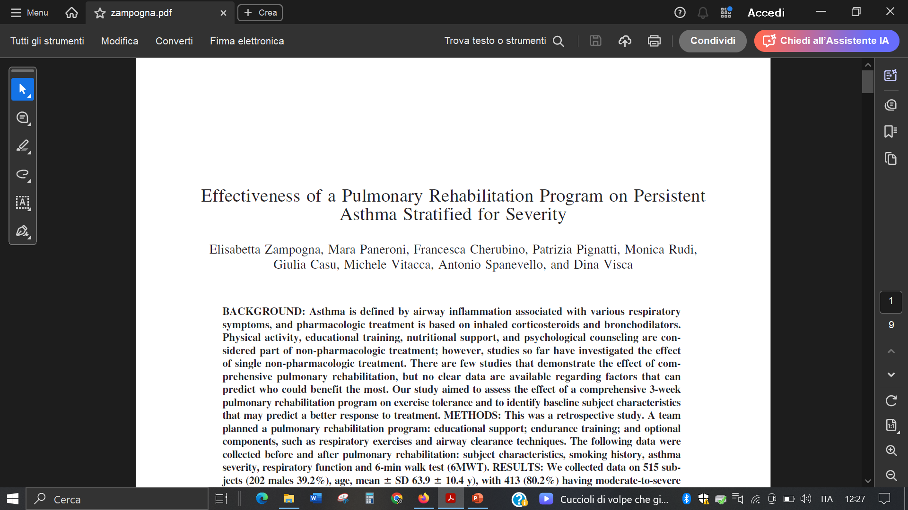
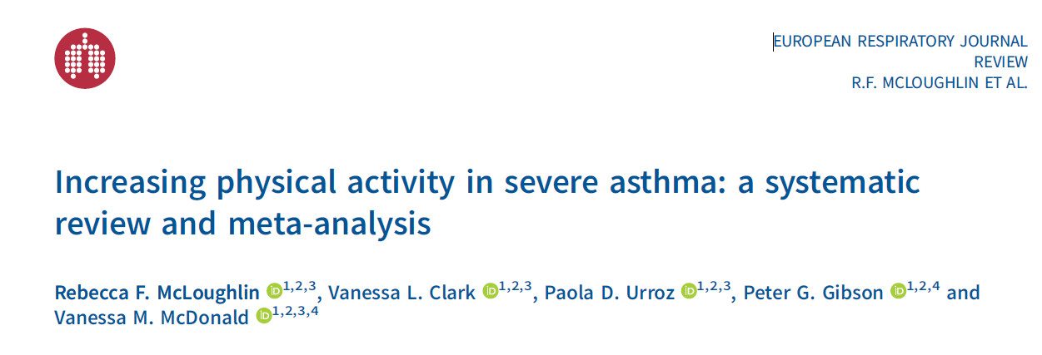
2024
2022
RESPIRATORY CARE DECEMBER 2019 VOL 64 NO 12
2022

Slide 7
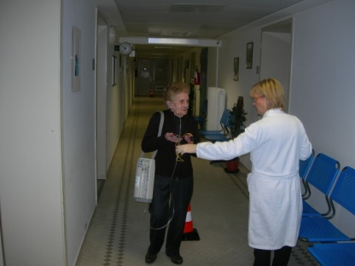
2022
significant improvement in functional capacity, with a pooled mean increase of 79.8 meters in the six-minute walk test (6MWT)
modest and uncertain improvements in maximal exercise capacity (VO₂max, VO₂peak), due to heterogeneity and limited long-term data

Slide 8
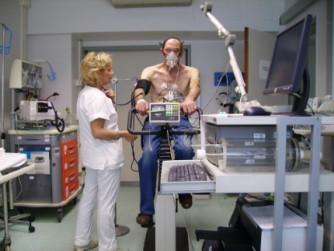
12-week tailored rehabilitation programme yielded improvements in physical performance, health-related quality of life and asthma control in patients with severe disease

Slide 9
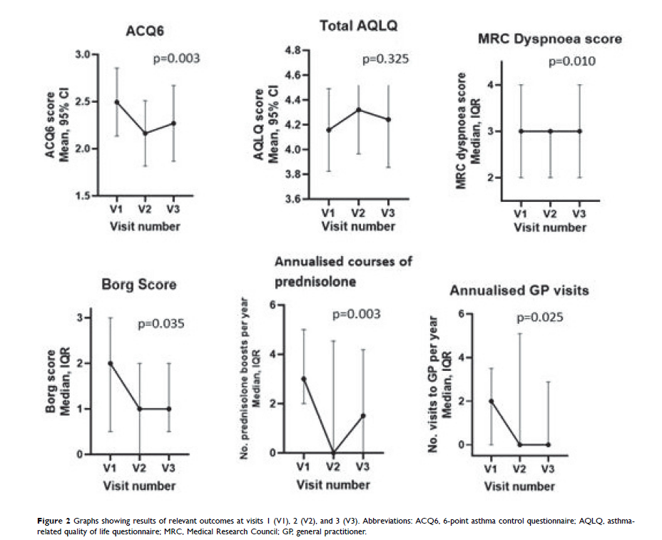
Prospective observational study
-V1 baseline (92), V2 after 8weeks (56) V3 at 1 year (45)
2024
27/56 (48%) improvement of ACQ6 at V2 e 16 (33%) at V3
ACQ6 higher at baseline were more likely to achieve ACQ6 improvement

Slide 10
Agenda
Pulmonary Rehabilatation in SA:
Effective?
Safe ?
Strategic approaches and modalities?
TT candidates?

Slide 11


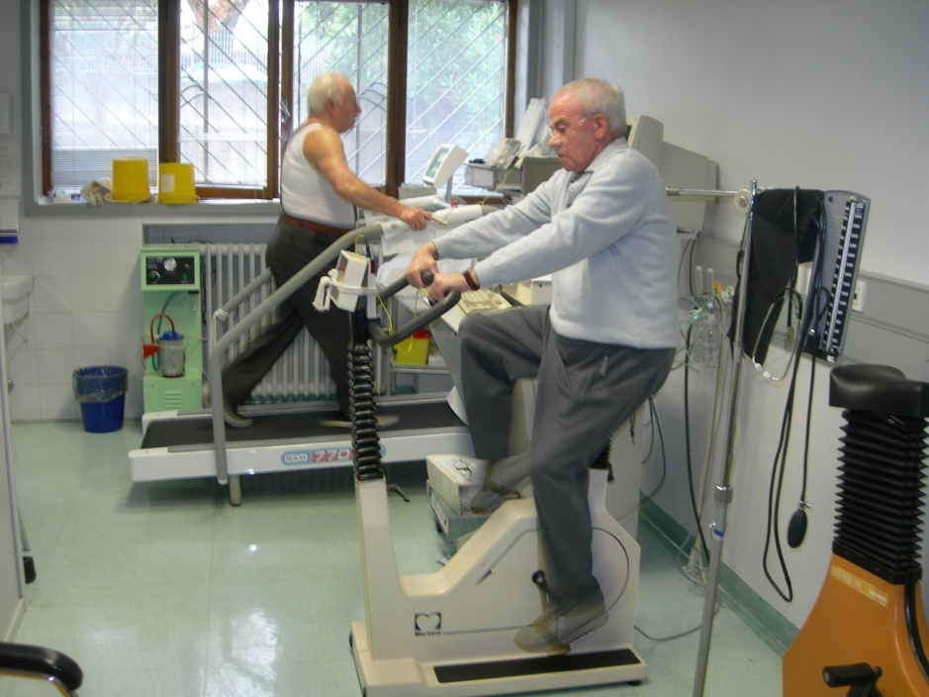
Strategic approaches and modalities in PR in severe asthma (2)
Aerobic exercise
Poor evidence is reported on a role played by exercise on inflammation in severe asthma.
Moderate-intense activity reduces airway hyperresponsiveness and attenuating the frequency and severity of exacerbations through improved airway clearance, autonomic balance and systemic metabolic health
Guarnieri G, et al FrontMed 2025. Cochrane Database 2013. McLoughlin RF et al, ERJ 2022. Xing S et al, Ann Med 2023.
Kuder MM et al J Allergy Clin Immunol Pract 2021. Hansen ESH et al, ERJ 2020. Garcia-Aymerich J, et al. AJRCCM 2009

Slide 12
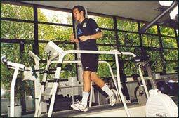
Strategic approaches and modalities in PR in severe asthma
Aerobic training is safe in adults with asthma and is associated with improved symptom control, HRQoL, maximal exercise capacity (VO₂max and HRmax) and functional capacity, reduces fall risk and exertional dyspnoea
Guarnieri G, et al FrontMed 2025. Cochrane Database 2013. McLoughlin RF et al, ERJ 2022. Xing S et al, Ann Med 2023.
Kuder MM et al J Allergy Clin Immunol Pract 2021. Hansen ESH et al, ERJ 2020.
Notes:
Adjunctive supports such as bronchodilator therapy optimisation, oxygen supplementation, anabolic support, heliox or non-invasive ventilation may enhance exercise tolerance for selected patients but require individualised risk–benefit assessment

Slide 13
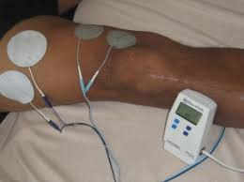
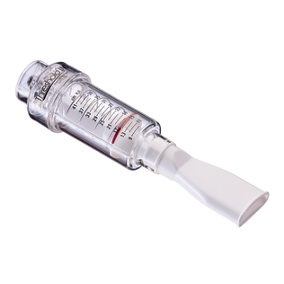
Strategic approaches and modalities in PR in severe asthma
NMES (Neuromuscular electrical stimulation )
-Adjunctive option to strengthen peripheral muscle without active exertion and is particularly useful in highly debilitated patient
-Safety profile in asthmatic subjects
Inspiratory muscle training (IMT)
increases maximal inspiratory pressures (PImax), endurance and reduces dyspnoea when training intensity reaches or exceeds approximately 30% of PImax.
Guarnieri G, et al FrontMed 2025.Scortichini M et al, Eur J Health Econ 2024. Develi E et al, Altern Ther Health Med 2024.
FrSogard AS et al, Am J Physiol-Regul Integr Comp Physiol 2021.Develi E et al, Altern Ther Health Med 2024.
Lista-Paz A et al, Ann Phys Rehabil Med 2023. . FrSogard AS et al, Am J Physiol-Regul Integr Comp Physiol 2021.Develi E et al,
Altern Ther Health Med 2024. Lista-Paz A et al, Ann Phys Rehabil Med 2023
Notes:
Opzione aggiuntiva per rafforzare i muscoli periferici senza sforzo attivo ed è particolarmente utile nei pazienti altamente debilitati

Slide 14

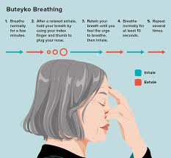
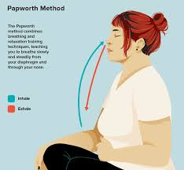
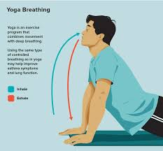
Strategic approaches and modalities in PR in severe asthma
Breathing retraining and adjunctive interventions
improving symptom perception, HRQoL and psychological outcomes although effects on lung function and exacerbation frequency are limited
Guarnieri G, et al FrontMed 2025 . GPourdowlat G et al, Adv Respir Med 2019. Bruton A et al, Lancet Respir Med 2018.
Santino TA et al, Cochrane Database Syst Rev 2020
Notes:
target dysfunctional breathing patterns, buteyko, Papworth and yoga tecniques

Slide 15
Agenda
Pulmonary Rehabilatation in SA:
Effective?
Safe ?
Strategic approaches and modalities?
TT candidates?

Slide 16
Due percorsi diversi (tracks)
GINA 2025

Slide 17
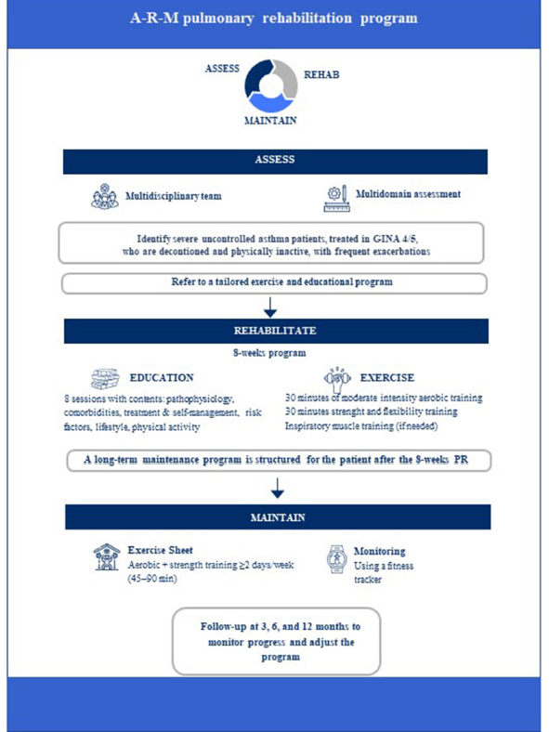
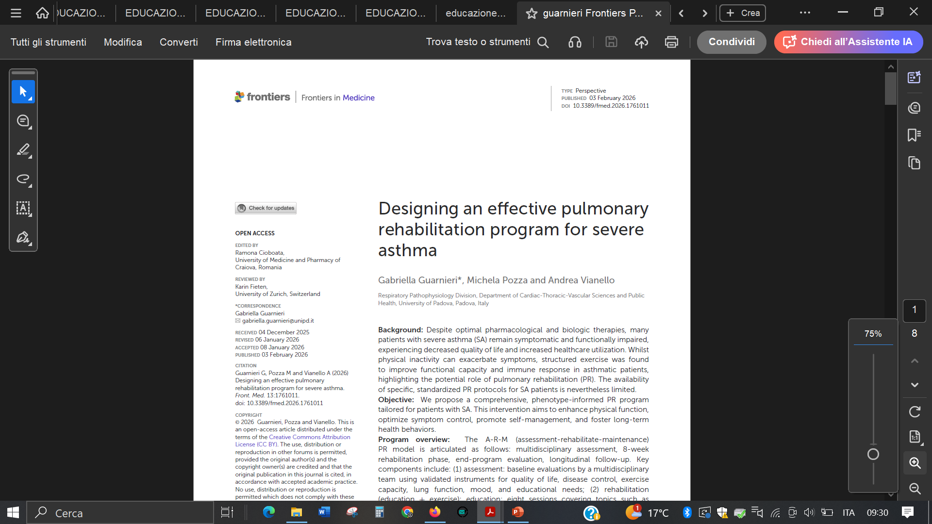
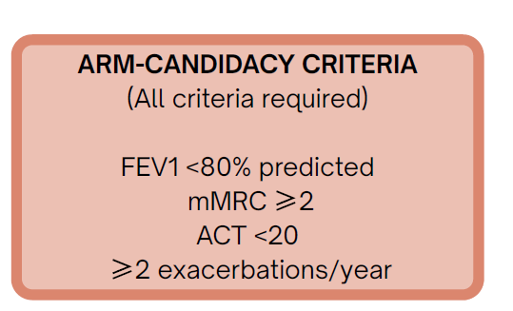

Slide 18
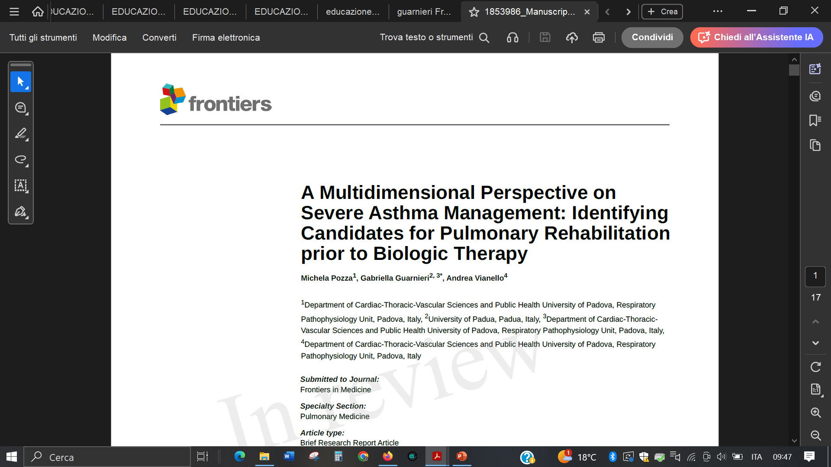
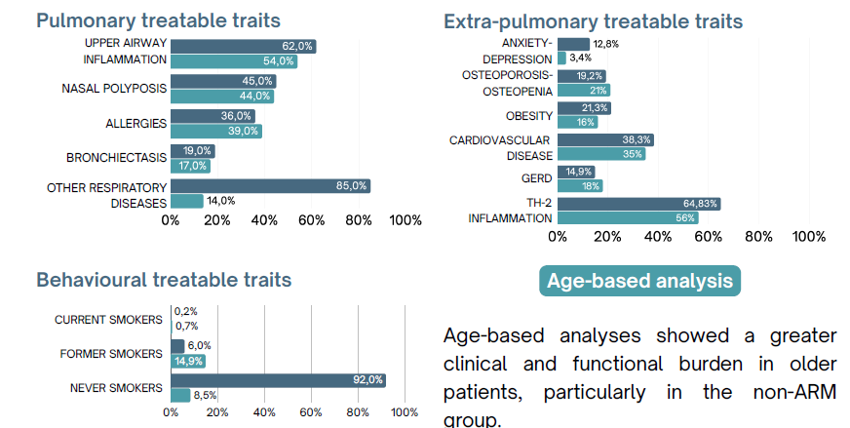
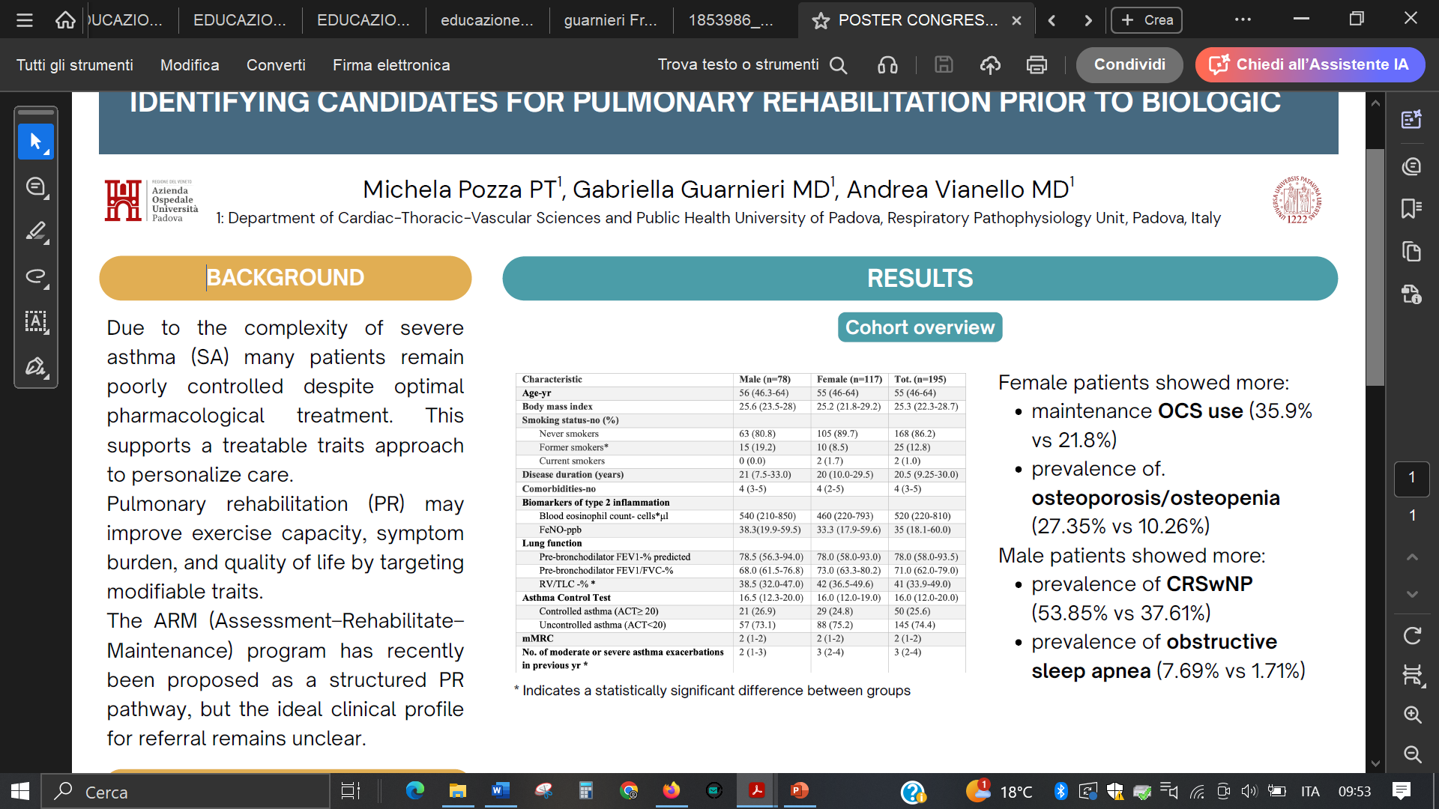
Females showed more:
-maintenance OCS use (35.9% vs 21.8%)
-prevalence of osteoporosis/osteopenia (27.5% vs 10.26%)
submitted

Slide 19
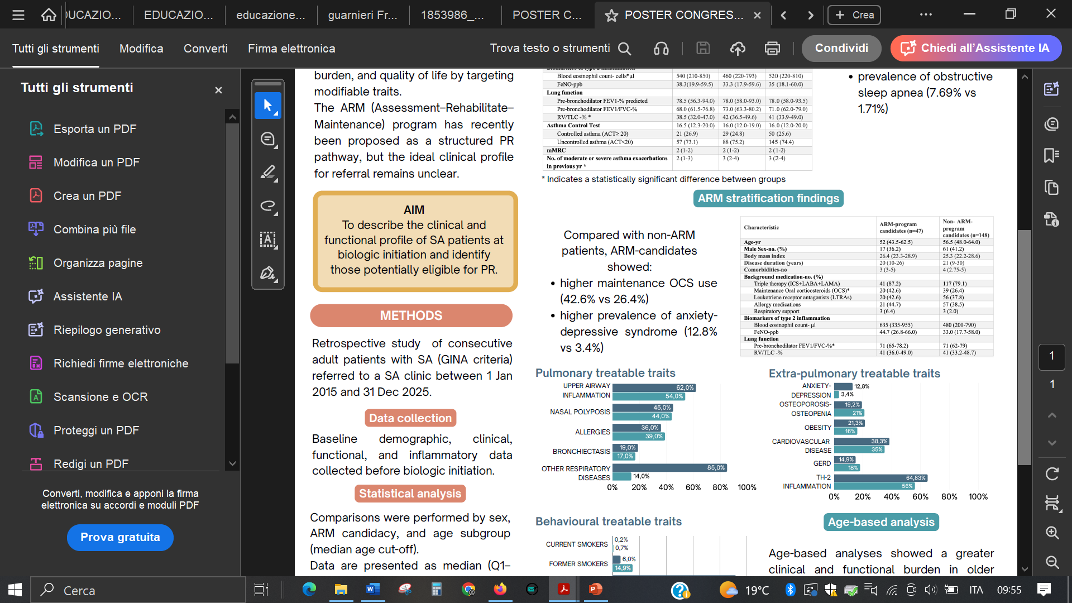
24% severe asthmatics met ARM Criteria
submitted

Slide 20
Conclusions
PR emerges as a targeted, multidisciplinary intervention with a high potential to address deconditioning, dyspnea, and extrapulmonary treatable traits in SA.
Evidence indicates that PR, particularly when combined with education and behavioural support, is safe and effective
PR may address key treatable traits, and may be particularly relevant in patients who are not optimal candidates for biologics or whose disease burden is not fully explained by T2 inflammation

