Slide 1

Le “aree grigie” che ostacolano l’applicazione delle linee-guida
Dr. Claudio Micheletto
UOC di Pneumologia
Azienda Ospedaliera
Universitaria Integrata
Verona

Slide 2
Dichiarazione conflitto di interessi
Negli ultimi due anni ho avuto i seguenti rapporti economici e/o supporti Finanziari con soggetti portatori di interessi commerciali in campo sanitario
Tipo di Rapporto Economico (Indicare il tipo di Rapporto)
Attività di Relatore: Astrazeneca, Sanofi, Novartis, GSK, Chiesi, Menarini, Guidotti, Firma, Berlin Chemie, Roche, Zambon, Boehringher, Insmed, Orion
Contributo Attività di Ricerca
Attività di Consulenza: Menarini, GSK, Astrazeneca, Sanofi
Possesso di azioni o quote partecipative
Componente di Organi Direttivi
Rapporto di lavoro subordinato

Slide 3
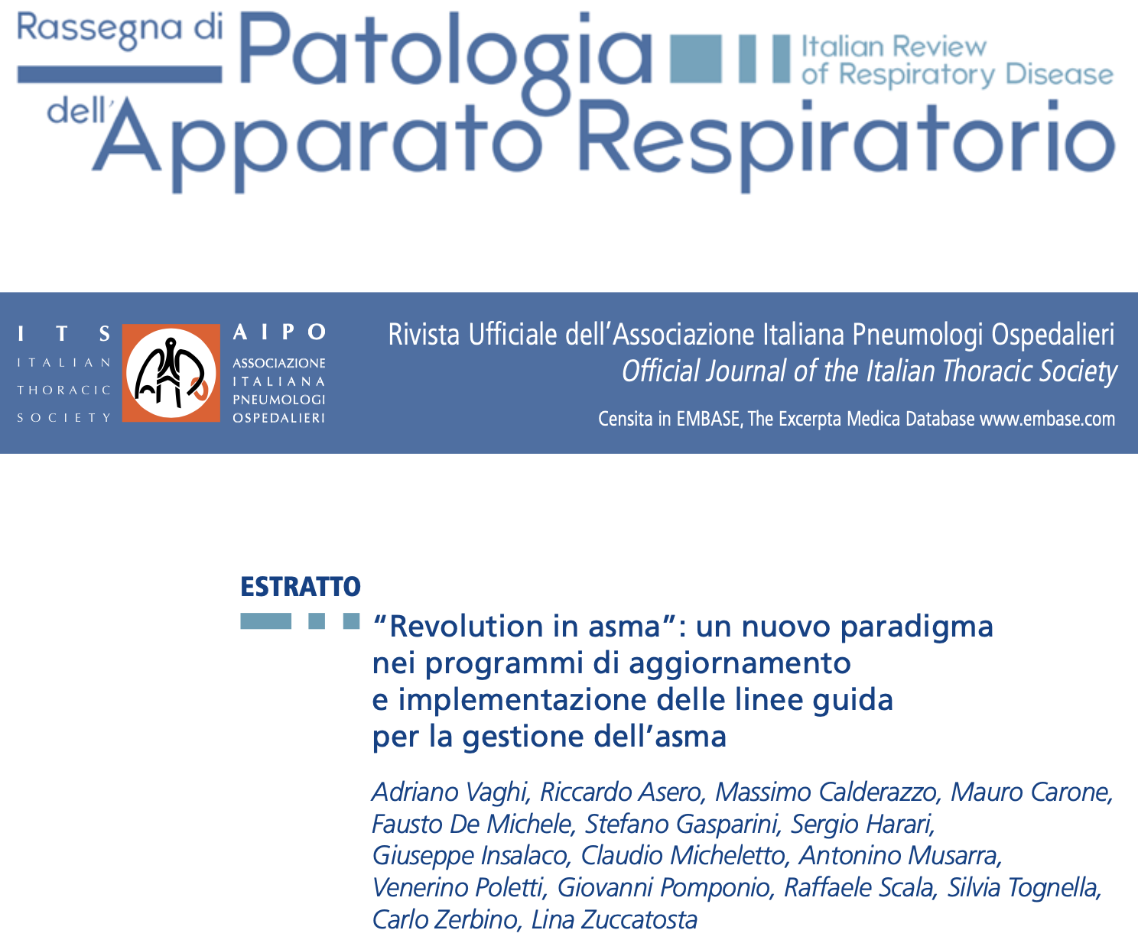
Rassegna di Patologia dell’Apparato Respiratorio 2022;37:101-116 doi: 10.36166/2531-4920-632

Slide 4
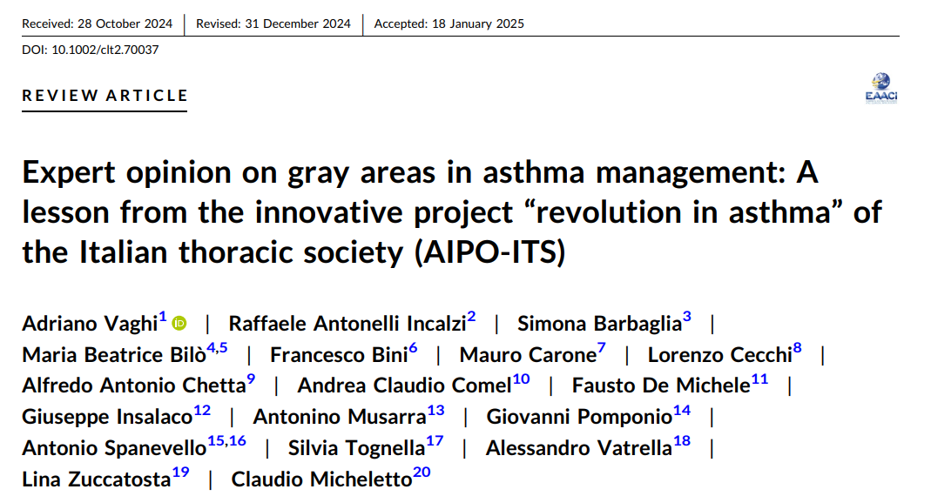
Clin Transl Allergy. 2025;e70037. https://doi.org/10.1002/clt2.70037

Slide 5

Linee guida
Al fine di colmare il gap esistente tra le conoscenze attuali e la pratica clinica real-life (effectiveness), negli ultimi 20 anni sono state pubblicate numerose linee guida (LG) con l’obiettivo di tradurre i progressi conoscitivi in raccomandazioni di buona pratica clinica.
Tuttavia, come dimostrano diversi studi osservazionali, l’impatto di queste LG è stato abbastanza modesto e le cosiddette best practices hanno avuto una diffusione limitata.
Rassegna di Patologia dell’Apparato Respiratorio 2022;37:101-116

Slide 6
Linee guida
La scarsa conoscenza delle LG stesse, la mancanza di consapevolezza dell’utilità di adottare evidenze sistematizzate e di superare l’inerzia dovuta all’abitudine, l’eccessiva frequenza con cui le LG vengono aggiornate, la scarsa corrispondenza tra esperienza clinica e raccomandazioni, la difficile applicabilità al contesto e al paziente “tipico” che viene valutato e trattato nella pratica real-life e lo scarso accordo tra le raccomandazioni delle LG e le convinzioni dei medici sono stati identificati come i principali ostacoli all’applicazione delle LG.
Rassegna di Patologia dell’Apparato Respiratorio 2022;37:101-116 doi: 10.36166/2531-4920-632

Slide 7

Linee guida: barriere esterne
Le cosiddette “barriere esterne” sono anch’esse numerose e sono dovute alla scarsità di risorse disponibili come il tempo necessario per:
visite approfondite,
esami strumentali
interventi educazionali
sia nella medicina generale sia in ambito specialistico.

Slide 8

Pur essendo presenti numerose Linee guida
per il trattamento dell’asma
le loro raccomandazioni non sono sempre
adottate nella pratica clinica quotidiana
Discrepanze tra linee guida
Discrepanze tra linee guida e normative
Vaghi A et al. Clin Transl Allergy. 2025 Feb;15(2):e70037

Slide 9



Progetto Revolution in Asthma
Fasi del Progetto
Obiettivo: migliorare la conoscenza delle principali Linee Guida in Asma
e indagare la loro effettiva applicazione nella pratica clinica, per identificare le principali barriere
ad una efficace implementazione
FASE 1
400 tra MMG, specialisti allergologi
e pneumologi sono stati coinvolti
nell’analisi e confronto delle
principali Linee Guida (LG) in Asma.
Per mezzo di una survey e stato
poi valutato il livello di accordo
delle LG alla pratica clinica italiana,
individuando le aree grigie
di disaccordo e le barriere
ad una concreta applicazione
FASE 2
18 esperti in asma
appartenenti al comitato scientifico
del progetto, partendo dalle aree
grigie emerse nella prima fase,
hanno fornito risposte basate
sulle evidenze scientifiche
prendendo inoltre in considerazione
il contesto di cura italiano
FASE 3
Pubblicazione di un documento
operativo di sintesi co-creato da esperti,
MMG e specialisti, basato sul contesto
Real Life italiano: "Expert opinion on gray areas in asthma management:
a lesson from the innovative project
Revolution in Asthma of the Italian
Thoracic Society (AIPO-ITS)"
+
Vaghi A et al. Clin Transl Allergy. 2025 Feb;15(2):e70037

Slide 10
Metodologia
Il flusso del progetto prevedeva la preparazione del materiale a cura del CS e del coordinatore, seguita da un totale di 15 incontri online (webinar FAD-ECM) estesi a tutti i 400 partecipanti.
I primi sette incontri sono stati dedicati alla presentazione comparata delle LG. Dopo questo primo round di incontri, sono state somministrate ai partecipanti 300 domande, le cui risposte sono state elaborate in forma sintetica dal CS e sono state oggetto di discussione critica nel corso dei 7 webinar successivi. L’incontro finale è stato dedicato alla sintesi conclusiva.
Rassegna di Patologia dell’Apparato Respiratorio 2022;37:101-116 doi: 10.36166/2531-4920-632

Slide 11
Survey objective
Level of agreement/disagreement with GL recommendations— This was measured using a 9-point Likert scale, where a score of 1 indicated “complete disagreement” and a score of 9 indicated “complete agreement.” This scale allowed the SC to quantify the physicians' alignment with specific guideline recommendations.
Participants' opinions on clinical issues – Physicians were asked to provide their insights into specific clinical scenarios raised by the GL recommendations. These responses were intended to reflect the participants' operational decisions in real-world practice, serving as a form of ethnographic data on how physicians mentally structure the GLs in relation to their own clinical experiences.
Clin Transl Allergy. 2025;e70037. https://doi.org/10.1002/clt2.70037

Slide 12
Survey objective
3) Actual clinical practices—Physicians were queried about their real-world clinical behaviors, specifically how they managed cases related to asthma in the context of their practice settings. This allowed for a comparison between GL recommendations and actual practice.
The SC analyzed the responses across these three dimensions to identify the areas of strong agreement with GL recommendations (Likert scores of 8–9), areas of strong disagreement (Likert scores of 1–4) and gray areas where there was partial or uncertain agreement (Likert scores of 5–7) or where discrepancies were noted between agreement with GL recommendations, participant opinions, and actual clinical practice.
Clin Transl Allergy. 2025;e70037. https://doi.org/10.1002/clt2.70037

Slide 13
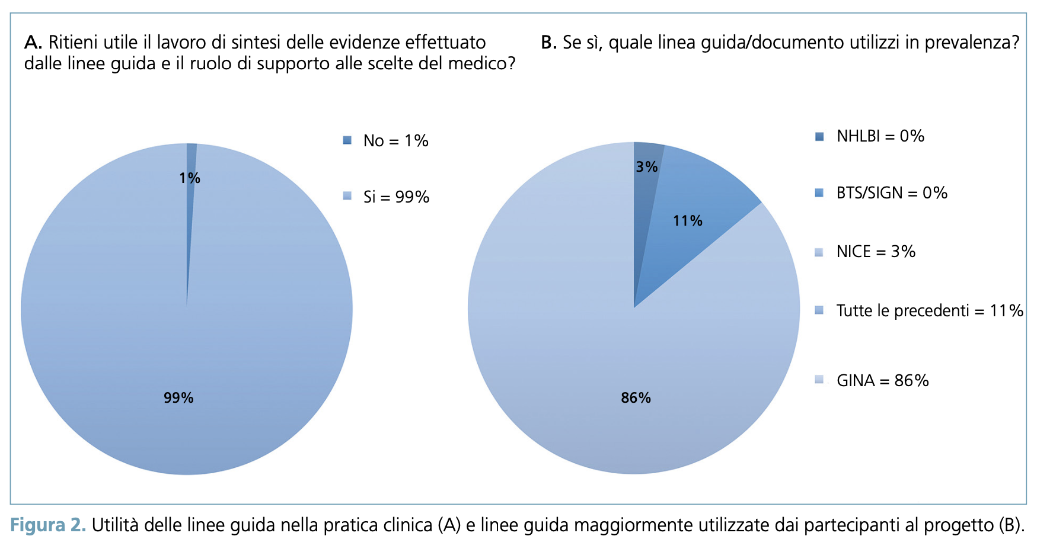
Rassegna di Patologia dell’Apparato Respiratorio 2022;37:101-116 doi: 10.36166/2531-4920-632

Slide 14
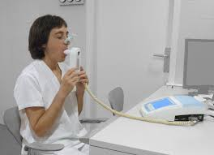
Diagnosis

Slide 15


Diagnosis
According to the scientific committee and in line with current guidelines, asthma diagnosis should combine a clinical evaluation to determine the pre-test probability of asthma, together with objective measurements to demonstrate asthma main pathophysiological feature, which is:
variable airflow obstruction
or
- evidence of eosinophilic inflammation
Clin Transl Allergy. 2025;e70037. https://doi.org/10.1002/clt2.70037

Slide 16
Table 1. Clinical pre-test probability of asthma
Symptoms*
Daily variability
Recurrent episodic symptoms
Medical History
family and personal history of allergic diseases (e.g. rhinitis, atopic dermatitis, rhinosinusitis**, peripheral blood eosinophilia)
Physical Examination
wheezing on auscultation of the chest
Clinical probability refers to the pre-test probability of asthma , prior to objective diagnostic tests ( respiratory function or biomarkers )
* wheezing, cough, chest tightness, dyspnea. Isolated symptoms are common to other respiratory diseases and poorly predictive of asthma. Combination of symptoms and fluctuation over time are more predictive of asthma.
** especially chronic rhinosinusitis with nasal polyps (CRSwNP)
Clin Transl Allergy. 2025;e70037. https://doi.org/10.1002/clt2.70037

Slide 17
Supplementary Table 1. Diagnostic tests and performance
Test | Valore di cut-off | sensibilità | specificità | ref
Spirometria : definizione di ostruzione | FEV1/FVC < 0.75 Z score : -1 | 29 % - 60% 0.55 | 27.9% - 67% 0.84 | ERS; NICE Pre test
Test di broncodilatazione (BDR) | FEV1 > 12% e 200 ml | 17% - 65% | 61% -81% | NICE
Variabilità del FEV1 | Variazione tra visite del FEV1 > 12 % e 200 ml | 16,8% Nei pz in trattamento sintomatici 21% | 93,9% Nei pz in trattamento sintomatici 92.7% | GINA
Variabilità del PEF | >15% > 20% | 5-71 | 69-99 | NICE
FENO | > 30-50 ppb | 75-80 | 75-86
MCH | PC20 : 8mg/ml | 65-97 | 57-86 | NICE, ers
Mannitolo | PD15< 635 mg | 19-91 | 75-100 | Ingl luppi

Slide 18

Symptoms
The most prominent features to determine a high probability of asthma are the concomitance of symptoms (e.g. wheezing, cough, chest tightness and dyspnea), the variability/recurrence in intensity and time of appearance, and the response to triggers such as exercise, hyperventilation, allergens
or viral infections
[Wang 2021, Tomita 2013].
Clin Transl Allergy. 2025;e70037. https://doi.org/10.1002/clt2.70037

Slide 19
Diagnostic algorithm for the primary and secondary setting
In the primary setting the S.C. recommend performing a spirometry as the first level assessment to detect the presence of airflow obstruction. The bronchodilator reversibility test might be performed if available, but this test is time consuming and rarely perform by GPs in the primary setting. Instead, the Scientific Committee suggest performing longitudinal assessment of respiratory function to measure the variability of FEV1 (or PEF as second option).
Clin Transl Allergy. 2025;e70037. https://doi.org/10.1002/clt2.70037

Slide 20
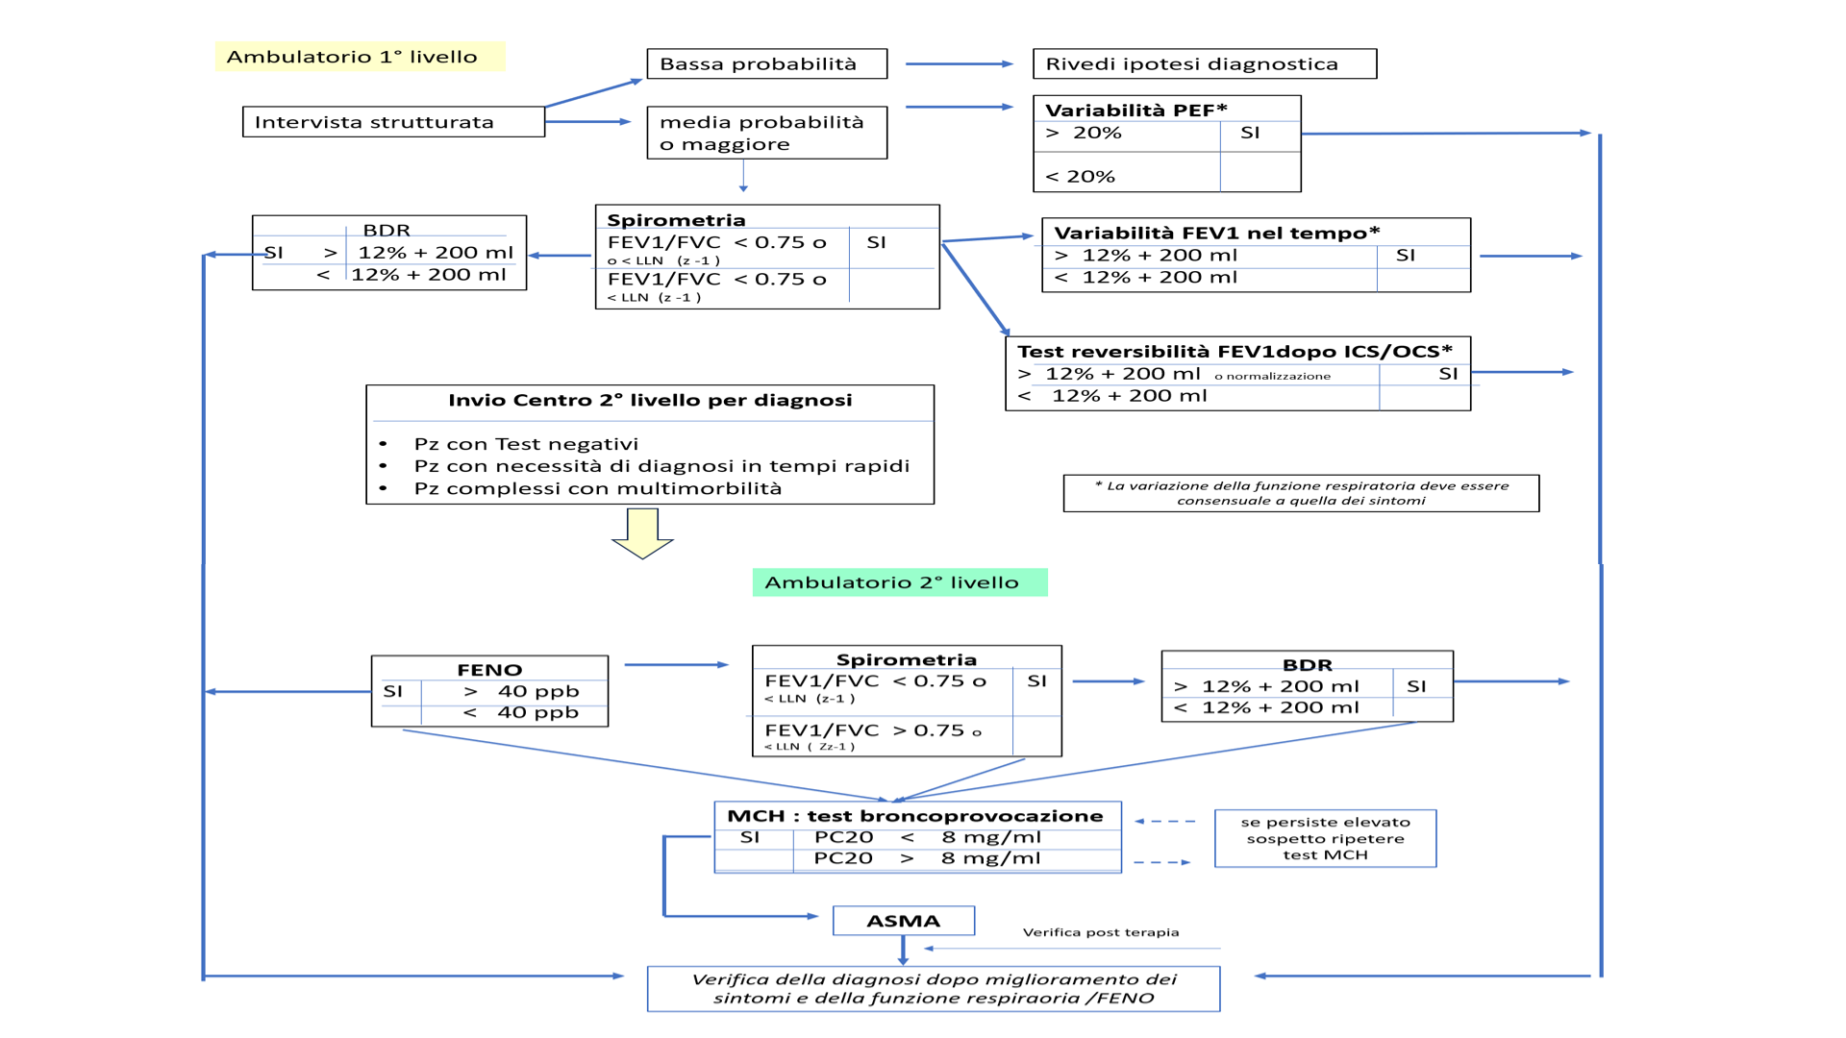
Figure 1 – Diagnostic algorithm in the first and second level setting

Slide 21
Figure 3 – Proposal for structured visit to monitor asthma (Impairment A)
Anamnesi strutturata: domande finalizzate a rispondere a mini questionari o score sintomi
Ambulatori: I e II livello
Programmata nuova visita
rivalutazione Terapia
Asma non controllata
Royal College of Physician (RCP) Three Questions (TAB 1 B )
Score sintomi per valutazione controllo NAEPP-EPR ( TAB 2 C)
GINA ( TAB 1 A )**
ACT /ACQ
ACT < 20
Fortemente consigliato negli ambulatori di I livello sempre Ambulatori II livello
Spirometria*
PEF
una riduzione del 10/20% è predittivo per perdita di controllo e riacutizzazione
(++)
una riduzione > 20% è predittivo per perdita di controllo e riacutizzazione
(+)
Ambulatori II livello
misura FENO
aumento FENO è predittivo per perdita di controllo
(+/-)
Valutazione BHR – stimoli indiretti
Solo in casi particolari difficoltosa titolazione ICS e/o frequenti riacutizzazioni in pz con ridotti marcatori T2
Fortemente consigliato FENO/Spirometria Ambulatori II livello
Valutazione eosinofili e cellule espettorato indotto

Slide 22
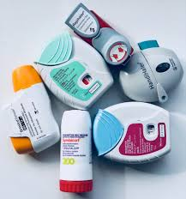
Treatment

Slide 23
Participants in the “Revolution project” expressed maximum agreement with the recommendations summarized in Table 1, common to all guidelines
T A B L E 1
The goal of therapy is to achieve and maintain overall asthma control, thus minimizing current and future risks, using the least amount of medication to reduce the risk of adverse events.
Inhaled corticosteroids (ICS), alone or in combination, are the most effective background therapy (controller drugs) to achieve the overall therapeutic goal and good asthma control.
(c) In patients who do not achieve asthma control with low doses of ICS, it is preferable to add a long-acting β2-agonist (LABA) rather than doubling the dose of the ICS.
Only the NICE guidelines recommend the combination with anti-LT as the first option in case of uncontrolled asthma with ICS rather than LABA. However, the participants disagreed with this option.

Slide 24
What the guidelines say
The 2019 recommendation of the British Thoracic Society (BTS) and the 2017 National Institute for Health and Care Excellence (NICE) guidelines to prescribe SABAs as needed in all patients with asthma yielded uncertain responses.
Concurrently, the Global Initiative for Asthma (GINA) recommendation to treat mild patients using ICS + F as needed and reserving SABA as needed, always taken with ICS as needed, as a second option.
There are therefore serious differences between the guidelines that the group examined.
Clin Transl Allergy. 2025;e70037. https://doi.org/10.1002/clt2.70037

Slide 25
a1) In a patient with mild asthma, should the physician use, as only as needed therapy, a combination of ICS + F or SABA?
Once an objective diagnosis of asthma is confirmed (i.e., the certainty of the disease), the SC suggests prescribing ICS/ formoterol as needed or with a background ICS therapy instead of a SABA for as-needed therapy in cases of asthma assessed as mild.
The general suggestion is that the prescription of an as-needed SABA should not be made without prescribing an ICS taken regularly.
Clin Transl Allergy. 2025;e70037. https://doi.org/10.1002/clt2.70037

Slide 26
2) in a patient with mild-moderate to severe asthma, should the physician use SABA as a reliever? What are the other possible indications for the use of SABA as needed in asthma?
The SC acknowledged the divergent opinions of physicians on the use of SABAs in patients with asthma, with polarization between those who commonly use SABAs in clinical practice and those who never use them, as they believe SABAs are primarily responsible for asthma deaths, near-fatal asthma episodes, and severe flare-ups.
Clin Transl Allergy. 2025;e70037. https://doi.org/10.1002/clt2.70037

Slide 27
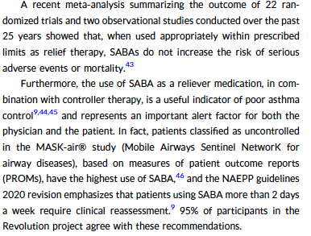
Clin Transl Allergy. 2025;e70037. https://doi.org/10.1002/clt2.70037

Slide 28
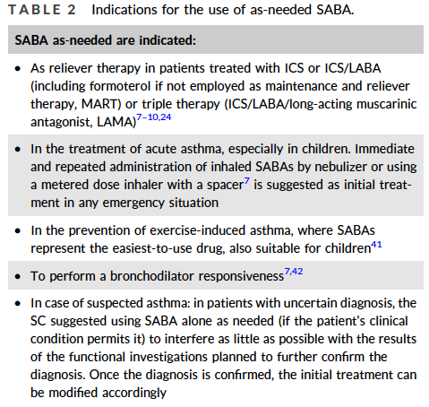
Clin Transl Allergy. 2025;e70037. https://doi.org/10.1002/clt2.70037

Slide 29
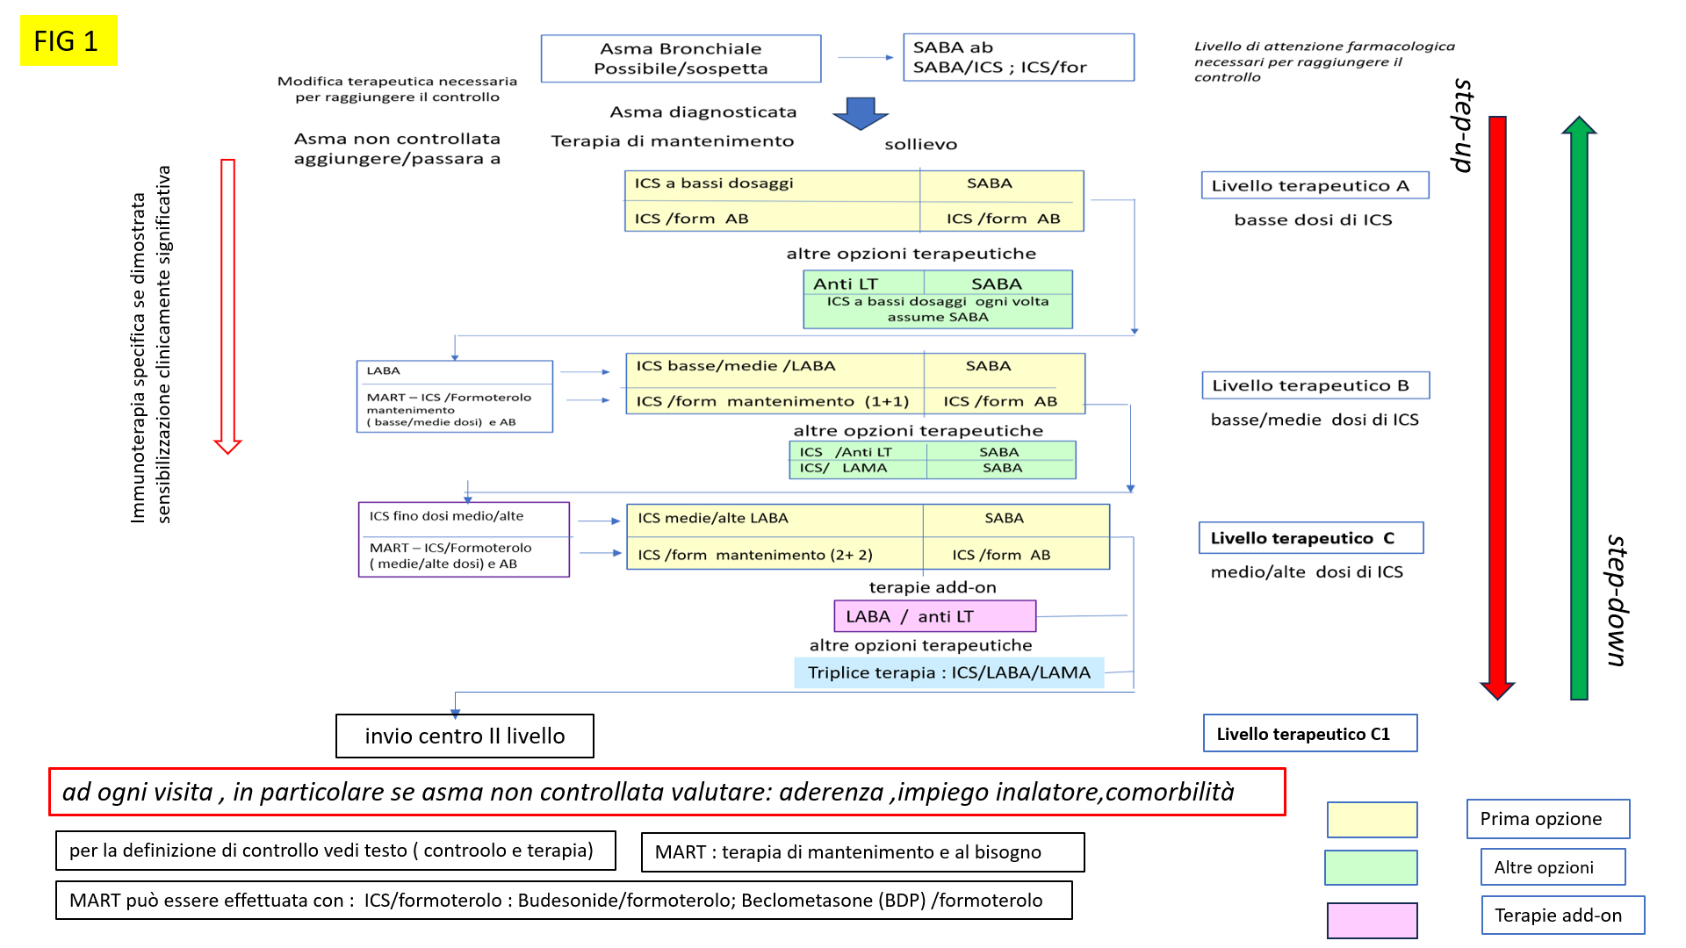
Figure 4 – Treatment algorithm for patients with asthma

Slide 30
Treatment
Three levels of pharmacological treatment are recommended to maintain good asthma control:
low doses of ICS (A);
low/medium doses of ICS (B);
medium/high doses of ICS (C).
Clin Transl Allergy. 2025;e70037. https://doi.org/10.1002/clt2.70037

Slide 31
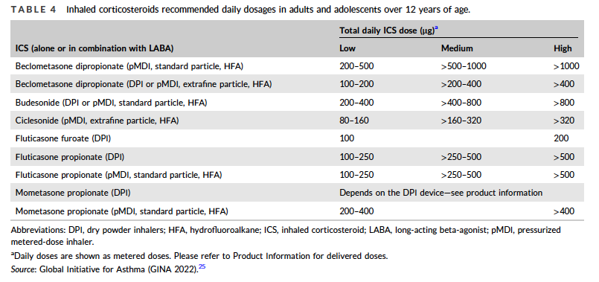
Clin Transl Allergy. 2025;e70037. https://doi.org/10.1002/clt2.70037

Slide 32
Treatment
While assessing incremental response to ICSs, it is necessary to consider the complexity of asthma and the existence of different phenotypes, in order to tailor the therapy to patients’ needs.
Clin Transl Allergy. 2025;e70037. https://doi.org/10.1002/clt2.70037

Slide 33
Treatment
It is therefore important to identify as early as possible patient's Treatable Traits, such as:
the type of inflammation,
the presence of fixed or variable bronchial obstruction,
allergic sensitization
intolerance to NSAIDs [Agusti 2023].
Clin Transl Allergy. 2025;e70037. https://doi.org/10.1002/clt2.70037

Slide 34
Therapeutic level A: low doses of ICS
This therapeutic level coincides with step 2 of the GINA (track 1 and 2), NAEPP, EPR3 and Spanish guidelines [GINA 2022, NAEPP, EPR-3, SPANISH LG].
ICSs are the reference maintenance treatment for persistent asthma [NICE, GINA 2022, NAEPP, EPR-3, SPANISH LG]. Regular use of ICSs, even at low doses, is associated with a decreased risk of exacerbations, hospitalizations, visits to the emergency department or death from asthma [Suissa 2000, Suissa 2002, Ye 2017]
Clin Transl Allergy. 2025;e70037. https://doi.org/10.1002/clt2.70037

Slide 35
Therapeutic level A: low doses of ICS
Similarly to what is reported in the Spanish guidelines [SPANISH LG], the S.C. suggest as first-choice either daily ICS and SABA as needed or ICS/formoterol as needed, and as second choice antileukotrienes and SABA as needed [Miligkos 2015], reserved for patients with severe contraindications to ICS.
Clin Transl Allergy. 2025;e70037. https://doi.org/10.1002/clt2.70037

Slide 36
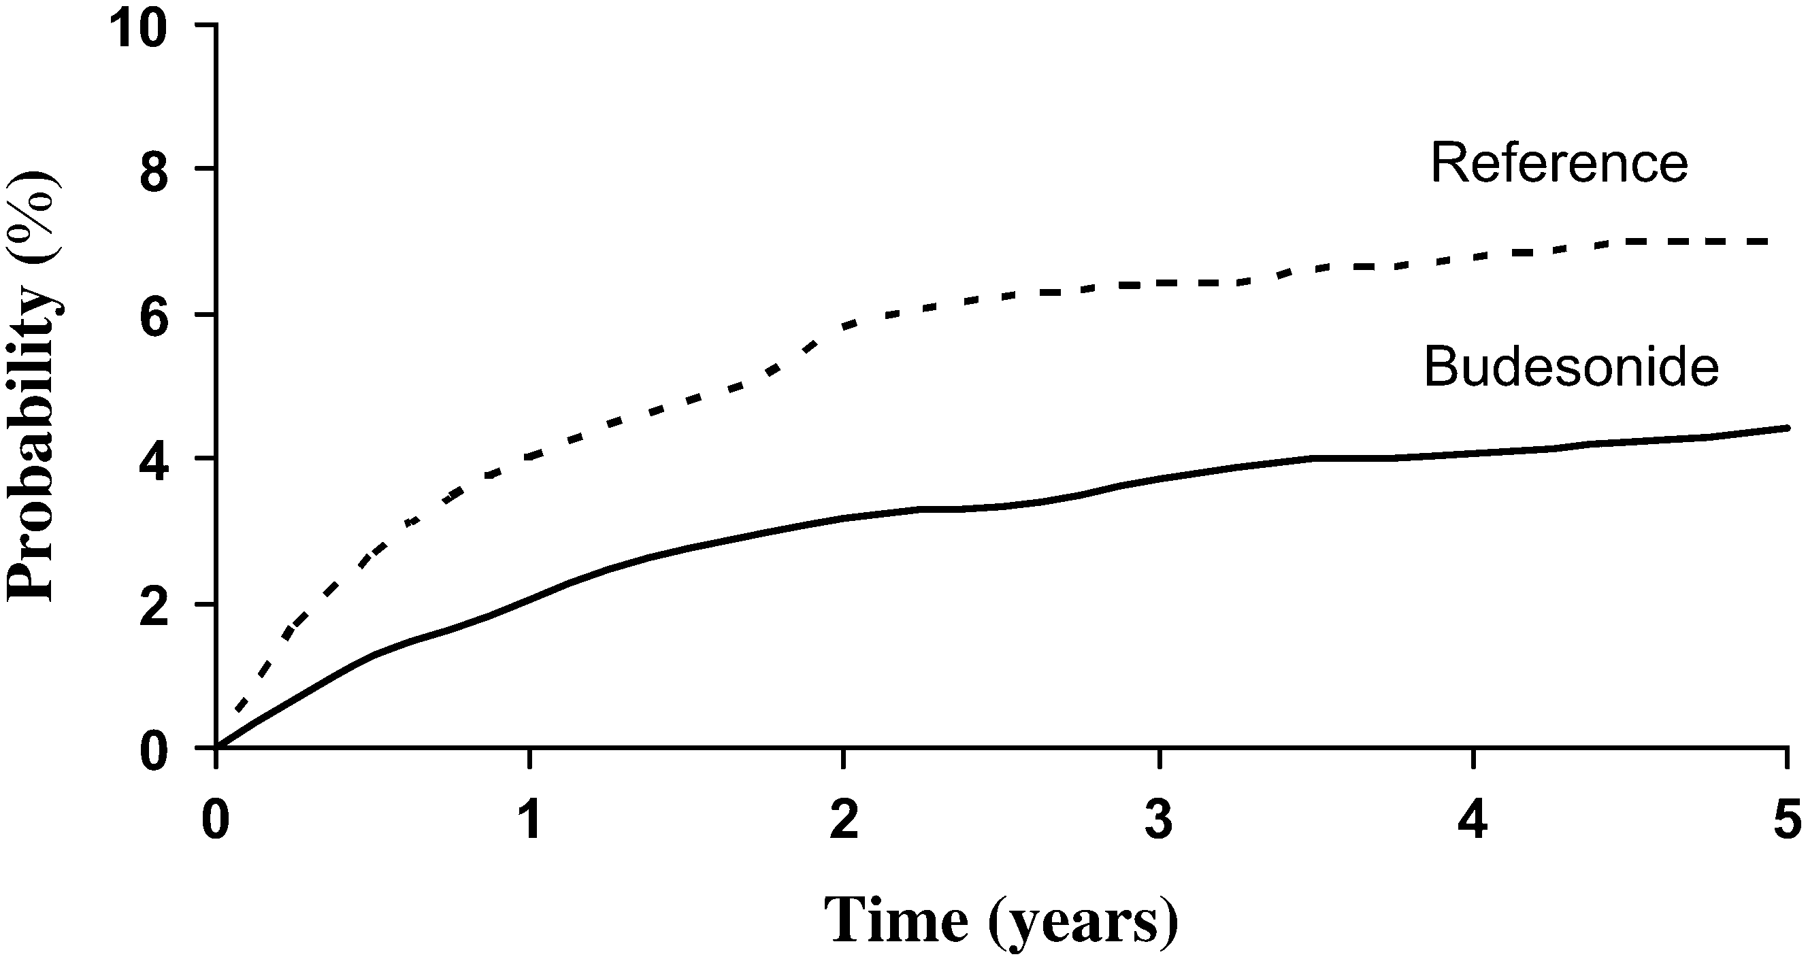
The Inhaled Steroid Treatment As Regular Therapy in Early Asthma (START) study 5-year follow-up: Effectiveness of early intervention with budesonide in mild persistent asthma
Time to the first severe asthma-related event (SARE)
Busse WW, et al. J All Clin Immunol 2008

Slide 37
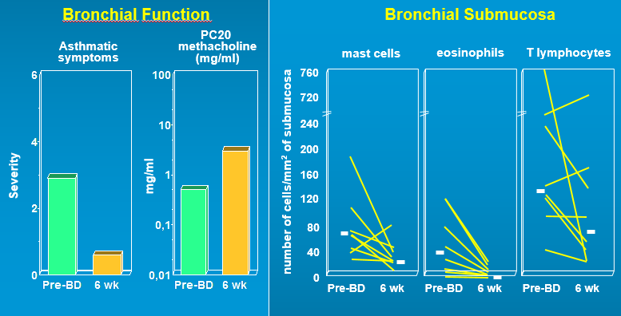
Effects of Inhaled Beclomethasone Dipropionate in Clinical Asthma
Djukanovic et al, Am Rev Respir

Slide 38
Therapeutic level A: low doses of ICS
The SYGMA studies compared the efficacy of three regimens in patients with mild persistent asthma:
budesonide/formoterol as-needed in a single inhaler,
budesonide with SABA as needed,
SABA as needed [O’Byrne 2018, Bateman 2018].
ICS/formoterol as-needed reduced the risk of severe exacerbations by 60-64% compared with SABA as-needed (SYGMA 1-2) [O’Byrne 2018, Bateman 2018];
Clin Transl Allergy. 2025;e70037. https://doi.org/10.1002/clt2.70037

Slide 39
Therapeutic level A: low doses of ICS
ICS/formoterol as needed was not inferior to continuous treatment with ICS in preventing severe exacerbations but resulted in less symptom control (SYGMA 1-2) [O’Byrne 2018, Bateman 2018]and less improvement in respiratory function [Bateman 2018].
Of note, the total ICS dosage taken by patients in the ICS/formoterol as-needed arm was lower than that in the regular budesonide arm.
Clin Transl Allergy. 2025;e70037. https://doi.org/10.1002/clt2.70037

Slide 40
- 60 %
Bud/For 57 μg
Bud 340 μg
O’Byrne, et. N Engl J Med 2018;378:1865-76

Slide 41
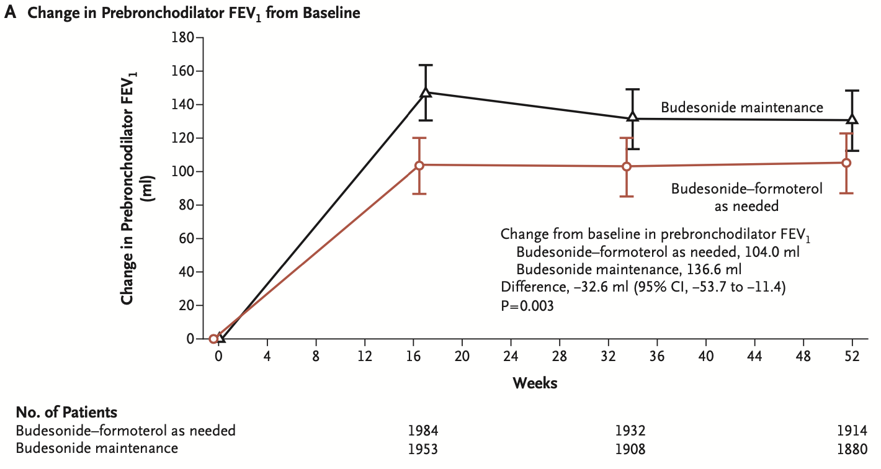
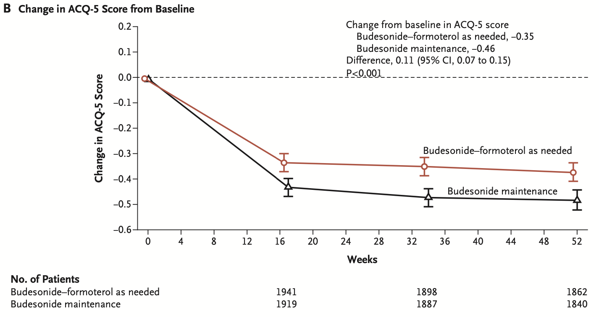
Bateman, et al. N Engl J Med 2018;378:1877-87.

Slide 42
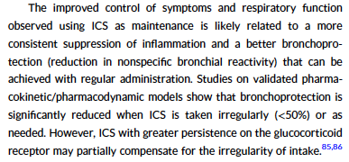
Clin Transl Allergy. 2025;e70037. https://doi.org/10.1002/clt2.70037

Slide 43
Therapeutic level A: low doses of ICS
In conclusion according to the S.C. the physician should assess for each individual patient the advantages and disadvantages of continuous ICS therapy versus ICS/formoterol as needed, keeping in mind both the pragmatic advantages of as-needed administration and the greater degree of symptom control achieved with maintenance ICS, while at the same time tailoring the therapeutic approach to patient's preferences, expectations, inclinations, and phenotypic characteristics.
Clin Transl Allergy. 2025;e70037. https://doi.org/10.1002/clt2.70037

Slide 44
Therapeutic level B: low/medium doses of ICS (step 3 GINA)
In patients who do not achieve good control with daily low doses of ICS, alternative treatments include combination with a LABA or an antileukotriene, or doubling the dose of ICS [GINA 2022, NAEPP, EPR-3, SPANISH LG].
The most effective option to improve asthma control seems to be the combination of low doses ICS with a LABA (vilanterol, salmeterol, formoterol, indacaterol), administered either with one (preferred option) or separate inhalers [Kankaanranta 2004].
Clin Transl Allergy. 2025;e70037. https://doi.org/10.1002/clt2.70037

Slide 45
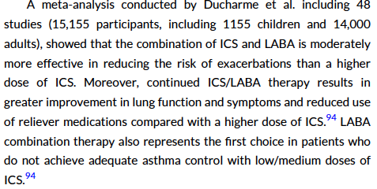
Clin Transl Allergy. 2025;e70037. https://doi.org/10.1002/clt2.70037

Slide 46
Therapeutic level B: low/medium doses of ICS
Both SABA and ICS/formoterol can be used as reliver drugs in combination with ICS/LABA.
In patients using ICS/formoterol as needed, the next therapeutic step would preferably be ICS/formoterol at a fixed dose and as needed (MART) [Atienza 2013].
However, transitioning from ICS/formoterol as-needed to MART therapy can be complex and the criteria for this transition are still under discussion [GINA 2023, Mohan 2023].
Clin Transl Allergy. 2025;e70037. https://doi.org/10.1002/clt2.70037

Slide 47
Therapeutic level B: low/medium doses of ICS
Participants to the Revolution project [Vaghi 2022] were uncertain over the exact frequency of symptoms and number of inhalations per day or per week that can be used as baseline to start the transition from as-needed to continued therapy, also considering the wide range of use and number of inhalation per day recommended for each drug [Mohan 2023].
Clin Transl Allergy. 2025;e70037. https://doi.org/10.1002/clt2.70037

Slide 48
Therapeutic level B: low/medium doses of ICS
Advantages and disadvantages of each therapeutic choice should be taken into consideration and discussed with the patient to meet their expectations and characteristics.
Single daily administration of ICS/LABA are the preferred option for 84% of participants according to Revolution, as they are easier to manage and give the patient a feeling of immediate improvement of symptoms.
Clin Transl Allergy. 2025;e70037. https://doi.org/10.1002/clt2.70037

Slide 49
Therapeutic level B: low/medium doses of ICS
Similarly, the real-life Salford study showed that daily single administration of fluticasone furoate plus vilanterol allows, compared with other inhaled therapies, to rapidly achieve good adherence and better asthma control in a heterogeneous population of asthmatic patients [Woodcock 2017].
Clin Transl Allergy. 2025;e70037. https://doi.org/10.1002/clt2.70037

Slide 50
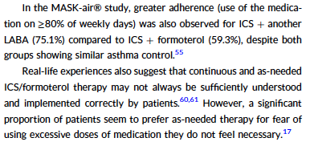
Clin Transl Allergy. 2025;e70037. https://doi.org/10.1002/clt2.70037

Slide 51
All patients
Confronto con
ICS in monoterapia
Confronto con
Altri ICS/LABA
71 % dei Pazienti
ACT < 20
Salford Study. The Lancet 2017

Slide 52
Studio Salford
Risultati – Endpoint Secondario
p = 0.0001
Il numero medio di confezioni di farmaco al bisogno utilizzate è stato
significativamente inferiore nel gruppo trattato con Fluticasone Furoato\Vilanterolo
rispetto al gruppo che ha proseguito la Terapia Usuale
Woodcock A et al. Lancet 2017; 1-9

Slide 53
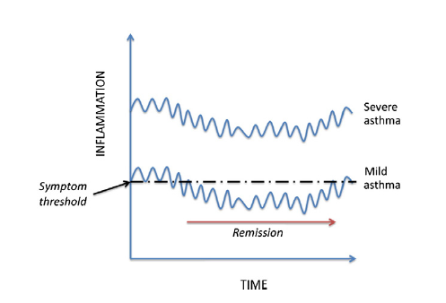
BENEFICI DEL TRATTAMENTO REGOLARE
La patologia asmatica è caratterizzata da infiammazione cronica e da iperresponsività delle vie aeree
Infiammazione cronica
e iperresponsività delle vie aeree
persistono anche quando
i sintomi sono assenti
o in soggetti asintomatici
per anni (1;2)
Il trattamento regolare con corticosteroidi inalatori si traduce in (3) :
ridotta infiammazione
prolungata efficacia broncoprotettiva
Fig 2 di 1. Relazione teorica tra la gravità dell'infiammazione e la probabilità di sviluppare una remissione nel tempo.
1 - Upham J et al. Pharmacology & Therapeutics 2011; 130: 38-45 2- Van Den Toorn et al Am J Respir Crit Care Med 2011;164: 2107-2113
3 - Chapman KR et al. Respir Med 2022;201:106948

Slide 54
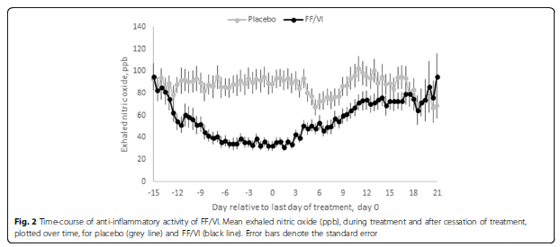
FLUTICASONE FUROATO/VILANTEROLO
Efficacia Antinfiammatoria
Il trattamento con Fluticasone Furoato\Vilanterolo ha documentato un effetto antinfiammatorio prolungato coerente con l’elevata affinità per il recettore dei glucocorticoidi di Fluticasone Furoato
Giorno 0, fine trattamento
In uno studio sull’andamento temporale dell’attività antinfiammatoria di FF\VI in pazienti asmatici,
la soppressione del FeNO è perdurata per circa 18 giorni dopo la sospensione del trattamento con Fluticasone Furoato\Vilanterolo 92\22 mcg
FeNO, PBB
Studio randomizzato, in doppio cieco, crossover, controllato con placebo, condotto su 27 pazienti adulti con asma non precedentemente trattati con steroidi con l’obiettivo di caratterizzare la durata dell’attività antinfiammatoria di FF/VI 92/22 mcg. I pazienti sono stati trattati per 14 giorni con FF/VI o con Placebo. Endpoint primario: variazione rispetto al baseline nel FeNO (Frazione esalata di ossido nitrico, biomarker dello stato infiammatorio) nei 21 giorni dopo il termine del trattamento
Bardsley G et al. Respir Res 2018; 13;19(1):133.

Slide 55
Therapeutic Level C: medium/high doses of ICS (step 4-5)
In patients with uncontrolled asthma treated with low/medium doses of ICS/LABA, the ICS dosage should be increased after re-evaluating and correcting possible risk factors such as adherence to therapy, inhaler use, and comorbidities [GINA 2022, NAEPP, EPR-3, SPANISH LG, Ni Chroinin 2009]. Patients under MART can double the dosage to two inhalations twice daily and as needed. In special situations, daily inhalations can also be increased to 3-4 times a day or even 8 inhalations per day in patients who tolerate high doses of LABA [Toogood 1982].
Clin Transl Allergy. 2025;e70037. https://doi.org/10.1002/clt2.70037

Slide 56
Therapeutic Level C: medium/high doses of ICS.
Literature data show that the medium-dose MART strategy led to a reduction in severe exacerbations compared with fixed-dose treatment and SABA, although the dose of budesonide used with the MART strategy was higher than with the fixed-dose strategy (943.5 μg vs 684.3 μg) [Patel 2013].
Clin Transl Allergy. 2025;e70037. https://doi.org/10.1002/clt2.70037

Slide 57
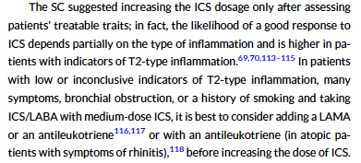
Clin Transl Allergy. 2025;e70037. https://doi.org/10.1002/clt2.70037

Slide 58
Therapeutic Level C: medium/high doses of ICS.
In patients with uncontrolled asthma treated with medium/high doses of ICS, the Scientific Committee recommend adding a LAMA (Thiotopium Br) on top of the current therapy to reduce exacerbations, improve symptoms and respiratory function [Kerstjens 2012, Befekadu 2014]. Triple therapy with a single inhaler ''Single inhaler triple therapy (SITT)'' may lead to improved treatment adherence and seem to improve symptoms and respiratory function and reduced exacerbations in patients with uncontrolled asthma treated with medium/high doses ICS and LABA [Agusti 2022, Wechsler 2023].
Clin Transl Allergy. 2025;e70037. https://doi.org/10.1002/clt2.70037

Slide 59
conclusioni
Diagnosi precoce sulla base di corretta anamnesi/intervista
Differenti setting di diagnostica
Trattamento steroideo regolare con possibilità di aumentare/incrementare il dosaggio
Preferenza per un trattamento regolare, a dosi fisse
Obiettivo controllo dei sintomi e riduzione rischio futuro

Slide 60
Grazie per l’attenzione

