Slide 1

Infiammazione eosinofilica e disfunzione epiteliale: due facce della stessa patologia?
Francesco Menzella
UOC Pneumologia
Presidio ospedaliero di Montebelluna e Castelfranco Veneto (TV) AULSS 2 Marca Trevigiana

Slide 2
Dichiarazione conflitto di interessi
Negli ultimi due anni ho avuto i seguenti rapporti economici e/o supporti finanziari con soggetti portatori di interessi commerciali in campo sanitario:
Tipo di Rapporto Economico Azienda
Attività di Relatore GSK, Astra-Zeneca, Chiesi, Sanofi
Contributo Attività di Ricerca GSK, Astra-Zeneca
Attività di Consulenza GSK, Astra-Zeneca, Chiesi, Sanofi
Possesso di azioni o quote partecipative NA
Componente di Organi Direttivi NA
Rapporto di lavoro subordinato AULSS2 Marca Trevigiana

Slide 3
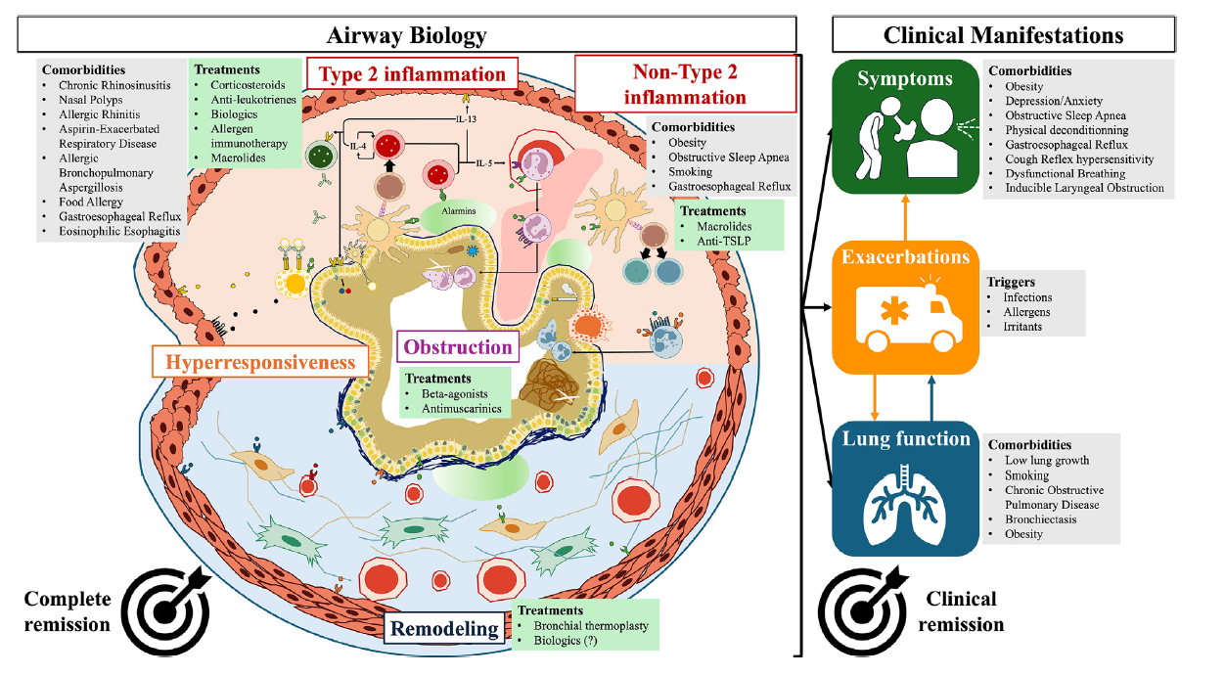
Asthma biologics target key points in the inflammatory pathways and comorbidities
Mailhot-Larouche S, et al. Ann Allergy Asthma Immunol. 2024:S1081-1206(24)01559-X.

Slide 4
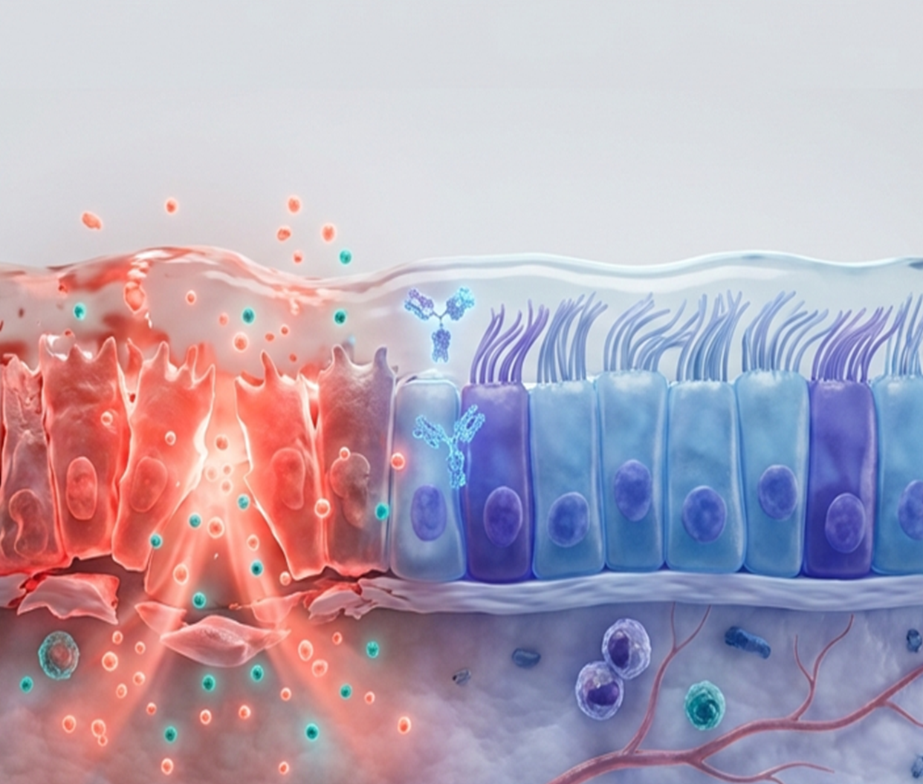
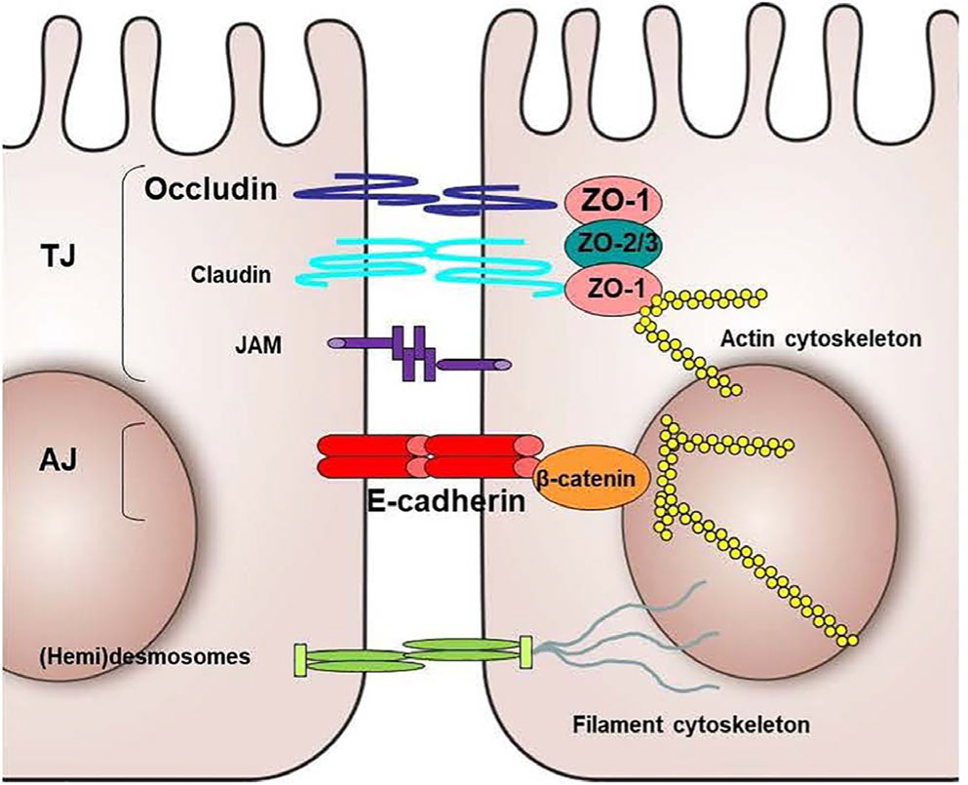
Epithelial-driven inflammation in severe asthma
Cell adhesion molecule (CAM)
Heijink IH, et al. Allergy. 2020;75(8):1902-1917.
Notes:
Cadherins (named for "calcium-dependent adhesion") are a type of cell adhesion molecule (CAM) that is important in the formation of adherens junctions to allow cells to adhere to each other. Cadherins are a class of type-1 transmembrane proteins, and they are dependent on calcium (Ca2+) ions to function, hence their name. Cell-cell adhesion is mediated by extracellular cadherin domains, whereas the intracellular cytoplasmic tail associates with numerous adaptors and signaling proteins, collectively referred to as the cadherin adhesome.

Slide 5






TSLP is a key driver of epithelial-driven inflammation in severe asthma and CRSwNP, driving persistent and recurrent symptoms
Viruses
Insults
Bacteria
Smoke/
pollutants
Fungi
Protease
inhibitor
Pathogens
Allergens
Mucus
Protease
PRR
TSLP
Tight
junction
Epithelium¹⁻¹⁶
Goblet cell
TSLP
Mesenchymal cell
In response to inhaled insults, TSLP is released by the epithelium to
initiate and amplify multiple pathways
of T2 inflammation
and beyond^{1,2}
Once activated by TSLP, inflammatory and effector cells may act back on the epithelium, causing
further damage and epithelial disruption
T2 inflammation and beyond
Cytokines and
effector cells
Th2 cell
ILC2
IL-5
Eosinophil
IL-4
IgE
IL-13
FeNO
Mast cell
Severe asthma
CRSwNP
Airway remodeling and reduced lung function
Airway hyperresponsiveness
Asthma exacerbations
Polyp formation
Impaired/loss of smell
Persistent nasal congestion
Clinical manifestations
1. Ha J-G et al. Int J Mol Sci. 2023;24(18):14229; 2. Kato A et al. J Allergy Clin Immunol. 2022;149(5):1491-1503; 3. Laidlaw TM et al. J Allergy Clin Immunol Pract. 2021;9(3):1133-1141; 4. Stevens WW et al. J Allergy Clin Immunol Pract. 2016;4(4):565-572; 5. Ordovas-Montanes J et al. Nature. 2018;560(7720):649-654; 6. Takabayashi T et al. J Allergy Clin Immunol. 2020;145(3):740-750; 7. Kohanski MA et al. J Allergy Clin Immunol. 2021;148(5):1161-1164; 8. Siddiqui S et al. J Allergy Clin Immunol. 2023;152(4):841-857; 9. Chiarella E et al. Int J Mol Sci. 2020;21(18):6878; 10. Qin D et al. Front Immunol. 2022;13:941608; 11. De Corso E et al. Curr Allergy Asthma Rep 2024:25(1):7; 12. Calvén J et al. Int J Mol Sci. 2020;21(23):8907; 13. Bachert C et al. J Allergy Clin Immunol. 2020;145(3):725-39; 14. Menzies-Gow A et al. Respir Res. 2020;21(1):266; 15. Dekeyser A et al. Int J Mol Sci. 2024;25(8):4460; 16. Porsbjerg CM et al. Eur Respir J. 2020;56(5):2000260.
Notes:
References
Ha J-G, Cho H-J. Unraveling the role of epithelial cells in the development of chronic rhinosinusitis. Int J Mol Sci. 2023;24(18):14229. doi:10.3390/ijms241814229
Kato A, Schleimer RP, Bleier BS. Mechanisms and pathogenesis of chronic rhinosinusitis. J Allergy Clin Immunol. 2022;149(5):1491-1503.
doi: 10.1016/jjaci 2022.02.016
Laidlaw TM, Mullol J, Woessner KM, et al. Chronic rhinosinusitis with nasal polyps and asthma. Allergy Clin Immunol Pract. 2021;9(3):1133-1141. doi:10.1016/j.jaci.2022.02.016
Stevens WW, Schleimer RP, Kern RC. Chronic rhinosinusitis with nasal polyps. J Allergy Clin Immunol Pract. 2016;4(4):565-572. doi:10.1016/j jaip 2016.04.012
Ordovas-Montanes J, Dwyer DF, Nyquist SK, et al. Allergic inflammatory memory in human respiratory epithelial progenitor cells. Nature. 2018;560(7720):649-654. doi:10.1038/s41566-018-0449-8
Takabayashi T, Schleimer RP. Formation of nasal polyps: The roles of innate type 2 inflammation and deposition of fibrin. J Allergy Clin Immunol. 2020;145(3):740-750. doi:10.1016/j jaci 2020.01.027
Kohanski MA, Cohen NA, Barrett NA. Epithelial dysregulation in chronic rhinosinusitis with nasal polyposis (CRSwNP) and aspirin-exacerbated respiratory disease (AERD). J Allergy Clin Immunol. 2021;148(5):1161-1164. doi:10.1016/j.jaci 2021.07.034
Siddiqui S, Bachert C, Bjermer L, et al. Eosinophils and tissue remodeling: Relevance to airway disease. J Allergy Clin Immunol. 2023;152(4) 841-857. doi: 10.1016/j jaci 2023 06.005
Chiarella E, Lombardo N, Lobello N, et al. Nasal polyposis: Insights in epithelial-mesenchymal transition and differentiation of polyp mesenchymal stem cells. Int J Mol Sci. 2020;21(18):6878. doi:10.3390/ijms21186878
Qin D, Liu P, Zhou H, et al. TIM-4 in macrophages contributes to nasal polyp formation through the TGF-β1-mediated epithelial to mesenchymal transition in nasal epithelial cells. Front Immunol. 2022;13:941608. doi: 10.3389/fimmu.2022.941608
De Corso E, Hellings PW, Fokkens WJ, et al. Thymic Stromal Lymphopoietin (TSLP): Evidence in respiratory epithelial-driven diseases including chronic rhinosinusitis with nasal polyps. Curr Allergy Asthma Rep. 2024;25(1):7. doi:10.1007/s11882-024-01186-2
Calven J, Ax E, Rådinger M. The airway epithelium-a central player in asthma pathogenesis. Int J Mol Sci. 2020;21(23):8907. doi:10.3390/ijms21238907
Bachert C, Zhang N, Cavaliere C, et al. Biologics for chronic rhinosinusitis with nasal polyps. J Allergy Clin Immunol. 2020;145(3):725-739. doi:10.1016/j.jaci.2020.01.020
Menzies-Gow A, Colice G, Griffiths JM, et al. NAVIGATOR: a phase 3 multicentre, randomized, double-blind, placebo-controlled, parallel-group trial to evaluate the efficacy and safety of tezepelumab in adults and adolescents with severe, uncontrolled asthma. Respir Res. 2020;21(1):266. doi:10.1186/s12931-020-01526-6
Dekeyser A, Huart C, Hummel T, et al. Olfactory loss in rhinosinusitis mechanisms of loss and recovery. Int J Mol Sci. 2024;25(8):4460. doi:10.3390/ijms25084460
Porsbjerg CM, Sverrild A, Lloyd CM, et al. Anti-alarmins in asthma: Targeting the airway epithelium with next-generation biologics. Eur Respir J. 2020;56(5):2000260. doi: 10.1183/13993003.00260-2020

Slide 6
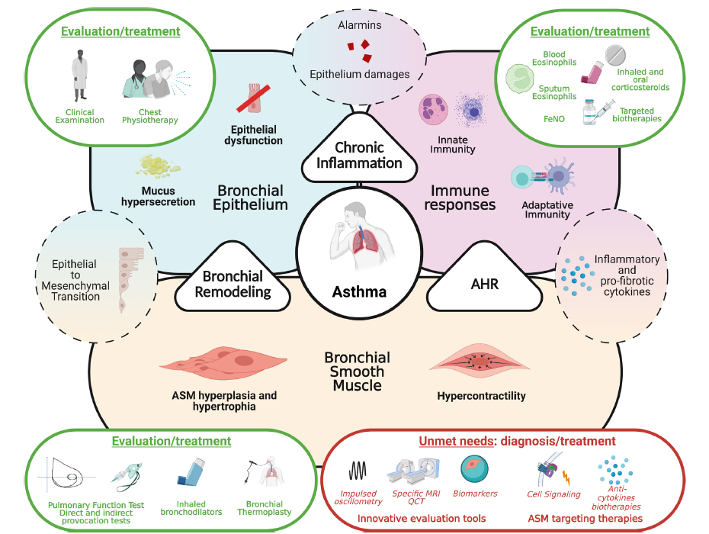
Bronchial smooth muscle cells in asthma from pathophysiological consideration to evaluation and treatments
Hassoun D, et al. BMJ Open Respir Res. 2022;9(1):e001351.
Notes:
Asthma development relies on three main pathophysiological processes, bronchial remodelling, chronic inflammation and airway hyper-responsiveness,
consequences of alteration of bronchial epithelium and ASM and development of inadequate immune responses. Whereas anti-inflammatory therapeutic strategies got significantly improved in the last years, little progress has been made considering ASM. Innovative precise evaluation tools of ASM function along with specific targeting strategies need to be developed. AHR, airway hyper-responsiveness; ASM, airway smooth muscle; FeNO, exhaled fraction of azote monoxide.

Slide 7
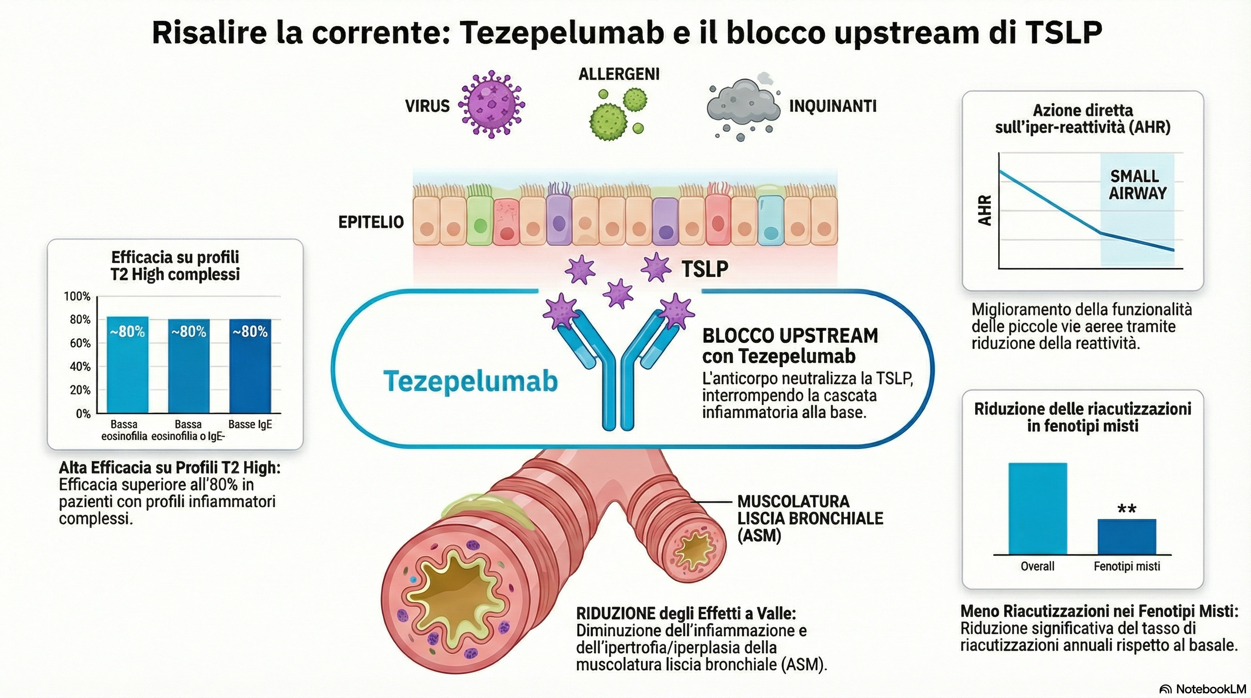
Risalire la corrente: il blocco upstream di TSLP
Elaborazione personale

Slide 8
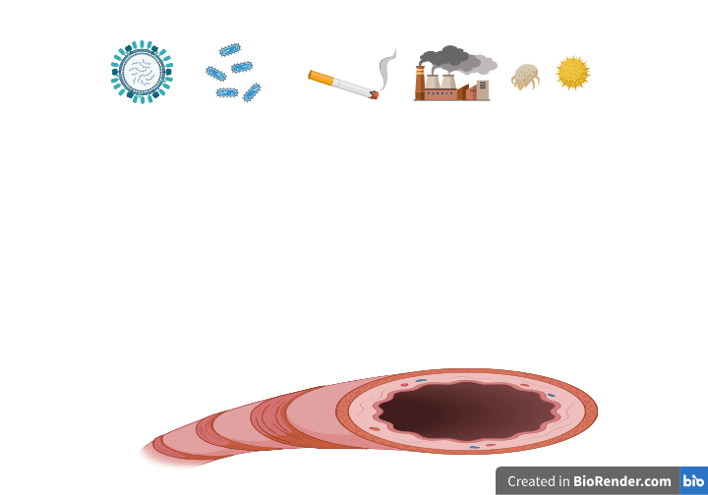
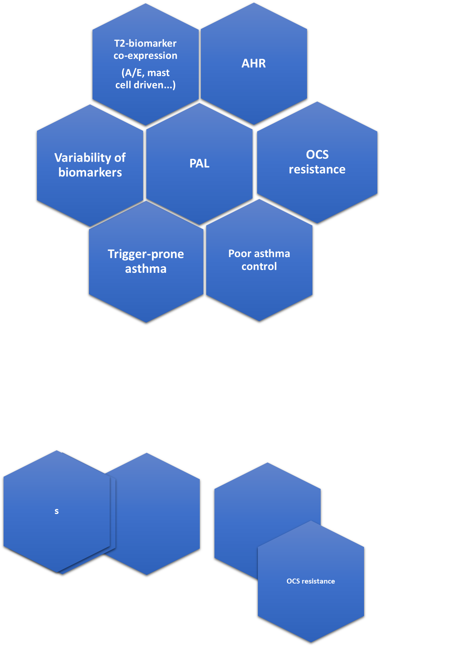

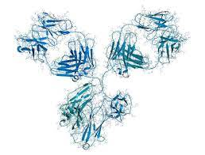
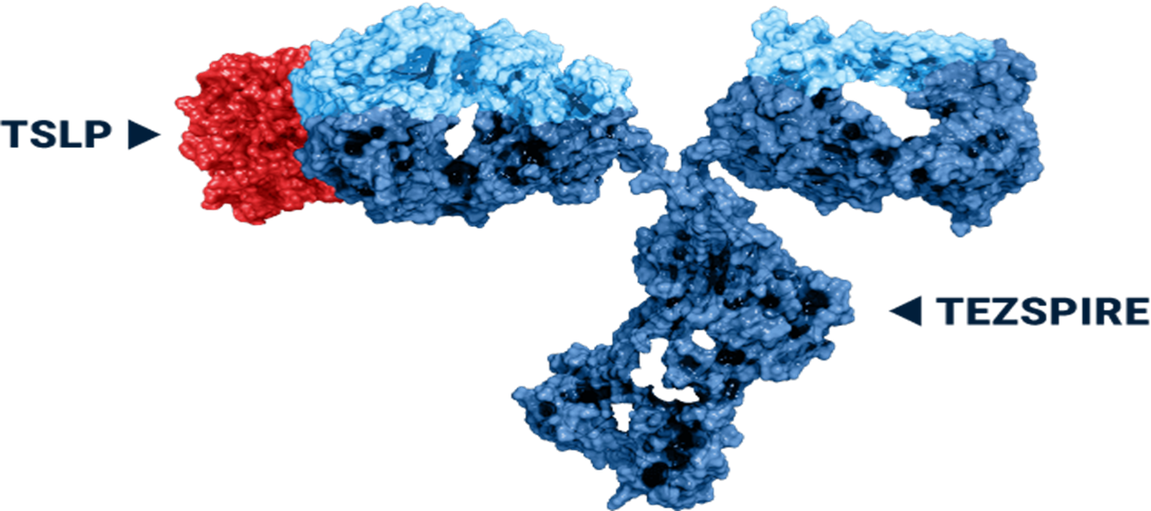

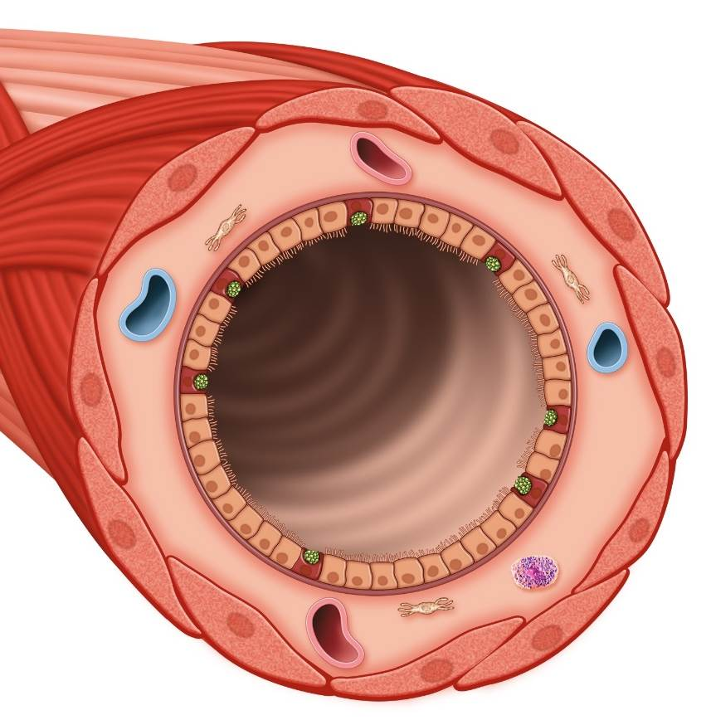
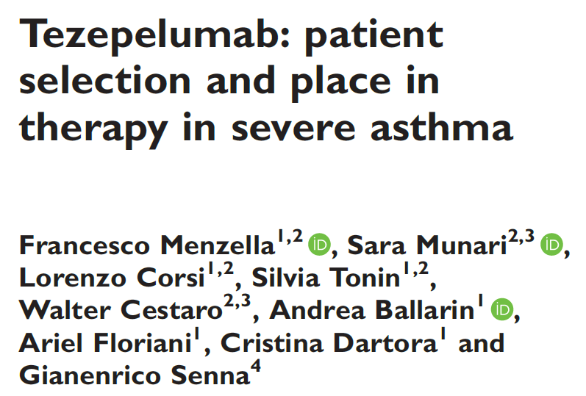
Triggers
Characteristics of patients with epithelial dysfunction
Airway epithelium
TSLP, IL-25, IL-33
Blocks
Tezepelumab
TSLPR
Multiple activated signalling pathways
Lower airways
J Int Med Res. 2024;52(4):1–17.
Notes:
Figure 1. Mechanism of action of Tezepelumab and clinical phenotype characteristics of patients with epithelial dysfunction.

Slide 9
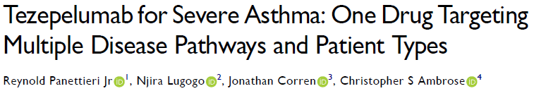
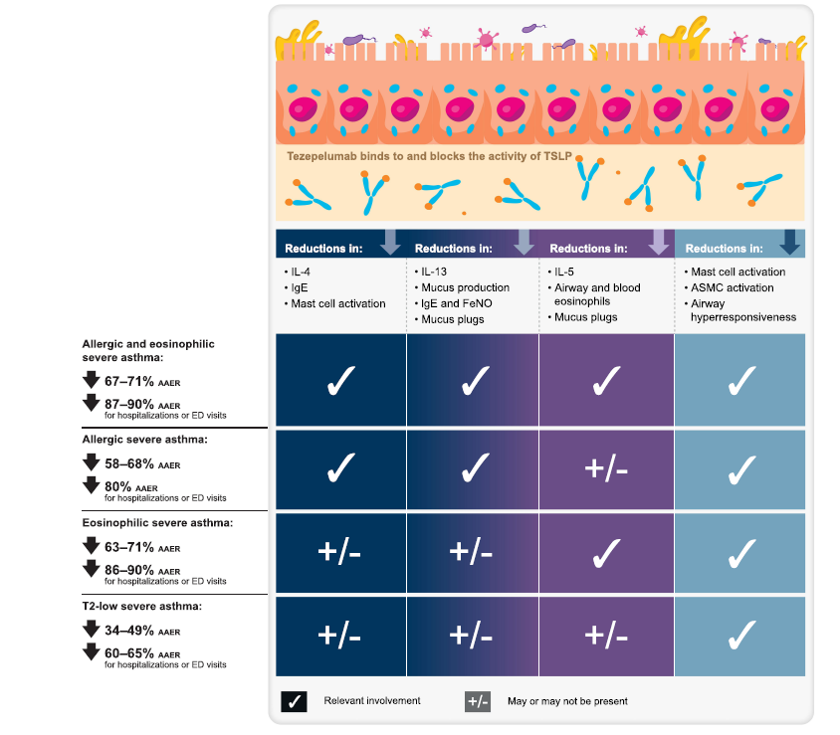
J Asthma Allergy. 2024:17:219-236.

Slide 10
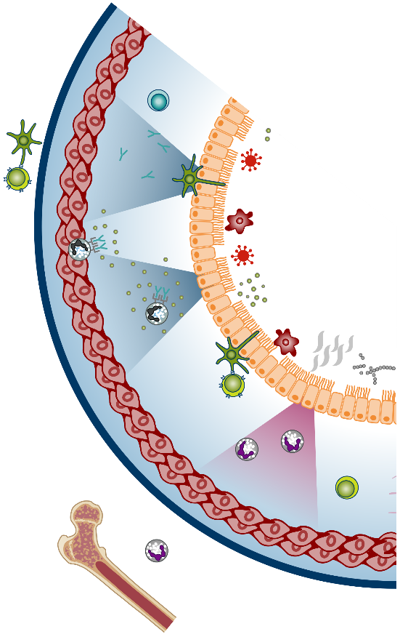
Airway hyperresponsiveness in asthma and role of TSLP
AHR depends upon many possible factors:
Airway inflammation
Airway structural changes
Genetic predisposition
Airway smooth muscle bronchoconstriction
Interactions of mast cells and airway smooth muscle
Asthma is usually characterized by chronic airway inflammation and airway hyperresponsiveness (AHR)
AHR is a heightened broncho-constrictive response to stimuli that would produce little to no response in non-asthmatics
AHR is associated with: lung function, asthma severity, wheeze, treatment required for symptom control
Understanding the factors contributing to AHR provides an opportunity for improved asthma control and reduced disease progression
Role of TSLP in AHR
contribute to AHR⁴
Environmental exposures trigger epithelial release of TSLP, which acts on numerous immune cell types associated with AHR
The resulting airway inflammation, ASM proliferation, and mast cell-ASM interactions contribute to AHR
Through mast cell activation, TSLP may potentiate ASM hypercontractility and hypertrophy
Comberiati P et al. Immunol Allergy Clin North Am. 2018;38:545–571; 3.Chapman DG, Irvin CG. Clin Exp Allergy. 2015;45:706–719; 4. Brutsche MH et al. Thorax. 2006;61:671–677; 5. Koefoed HJ et al. Pediatr Allergy Immunol. 2021;32(6):1238-1254; 6.Yan K et al. Thorax.1983;38:760–765; 7.Cockcroft DW et al. Clin Allergy.1977;7:235–243; 8.Leuppi JD et al. Am J Respir Crit Care Med. 2001;163:406–412; 9. Sears MR et al. N Engl J Med. 2003;349:1414–1422. 10. Robinson DS. J Allergy Clin Immunol. 2014;114: 58-65; 11 Ziegler SF et al. Adv Pharmacol. 2013;66:129-155; 12. Gauvreau GM et al. Expert Opin Ther Targets. 2020;24:777–792; 13. Gunst SJ, Pannettieri RA Jr. J Appl Physiol. 2012;113:837–839; 14. Kaur D et al. Chest. 2012;142:76-85.
TSLP acts on and can be released by mast cells and airway smooth muscle cells. Mast cell and airway smooth muscle “cross-talk” may drive airway hyperresponsiveness
Notes:
AHR has been correlated to:
The degree of diurnal PEF variability¹
The degree of exercise-induced bronchospasm (EIB)²
Asthma severity in children & adults³
Eosinophilia (circulating & sputum) and FeNO⁴
References:
Brand PL, Postma DS, Kerstjens HA, et al. Relationship of airway hyperresponsiveness to respiratory symptoms and diurnal peak flow variation in patients with obstructive lung disease. The Dutch CNSLD Study Group. Am Rev Respir Dis. 1991;143(5 Pt 1):916-921.
Anderton RC, Cuff MT, Frith PA, et al. Bronchial responsiveness to inhaled histamine and exercise. J Allergy Clin Immunol. 1979;63(5):315-320.
Yan K, Salome C, Woolcock AJ. Rapid method for measurement of bronchial responsiveness. Thorax. 1983;38(10):760-765.
Chapman DG and Irvin CG. Mechanisms of Airway Hyperresponsiveness in Asthma: The Past, Present and Yet to Come. Clin Exp Allergy. 2015;45(4): 706–719.
GINA 2023, pg 22, Box, “what is asthma?”, Bullet 2, lines 4-6
Reference updated to 2023 GINA report

Slide 11
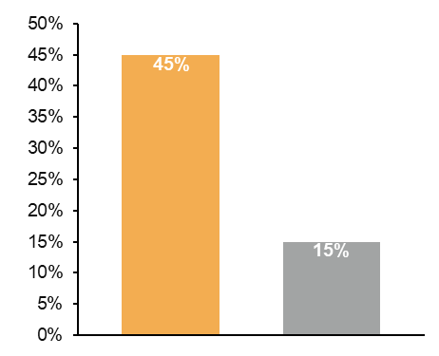
Tezepelumab reduces AHR in patients with asthma
Select AHR results
Phase 1 allergen challenge study^{1,4}
Mild allergic asthma, N=31
Phase 2 UPSTREAM²
Uncontrolled, symptomatic asthma, N=40
Phase 2 CASCADE³
Moderate-to-severe asthma, N=116
P=0.04
Incidence of negative mannitol test at Week 12 (PD₁₅ >635 mg)
Difference: 138.8^{b} (14.2, 263.3); nominal P=0.03
16
P=0.04
197.4^{b}
(107.9, 286.9)
8
401.5
(247.1)
58.6^{b}
(−30.1, 147.3)
700
4
600
241.6
(243.3)
263.2
(225.1)
295.5
(231.8)
Methacholine PC₂₀ (mg/mL)ª
500
2
Tezepelumab 700 mg
Q4W (n=20)
400
1
Percentage of patients (%)
Placebo (n=20)
Interpolated/extrapolated PD₁₅ of mannitol (mg)
300
0.5
200
Tezepelumab 700 mg Q4W (n=16)
100
0.25
Placebo (n=15)
0
Baseline
−15
EOT
83
Baseline
−15
EOT
83
−100
Tezepelumab 210 mg Q4W
Placebo
Day:
Baseline
(n=28)
EOT
(n=29)
Baseline
(n=31)
EOT
(n=26)
Methacholine challenge test
Mannitol challenge tests
1. Gauvreau GM et al. N Engl J Med. 2014;370(22):2102-2110; 2. Sverrild A et al. Eur Respir J. 2021;59(1):2101296; 3. Diver S et al. Lancet Respir Med. 2021;9(11):129-1312; 5. In-house data, AstraZeneca. DoF Z4-45005.
Notes:
There was a small improvement in the methacholine provocative concentration resulting in 20% decrease in FEV1 (PC20) prior to allergen challenge after tezepelumab treatment.
Sverrild 2021, pg 12, para 3, lines 1-4,
Table 2
Gauvreau 2014, pg 5, col 2, para 1 &
Supp appendix, pg 17, table S5
Diver 2021, pg 11, Fig 4B
Gauvreau 2014, pg 8, col 2, para 2, lines 1-8; Sverrild 2021, pg 12, para 3, lines 1-4; Diver 2021, pg 11, Fig 4B, page 12, col 2, para 4, line 3
Gauvreau 2014, Supp appendix, pg 17, table S5
In-house data. DoF Z4-45005, page 3, Table 14.2.4.13

Slide 12
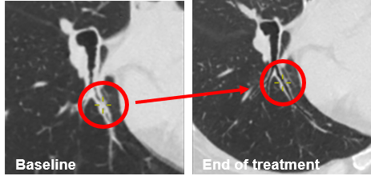

Tezepelumab reduced mucus plugging in patients with uncontrolled asthma
      14/21 (66.7%) of tezepelumab patients and 6/14 (42.9%) of placebo patients changed status from plug at baseline to no plug at EOT^{1,a}
Exploratory endpoint: Effect on Mucus Plugging
Mucus plug before and after tezepelumab
Overall population^{1,b}
Patients with BEC ≥300 cells/µL and FeNO ≥25 ppb^{1,b}
12
Tezepelumab
Placebo
Tezepelumab
1
12
12
1
12
Placebo
10
Mean (SD) change
−1.7 (2.6)
(n=37)
10
Mean (SD) change
0.0 (1.4)
(n=45)
1
10
10
8
8
1
8
Mean change
-6.80
(n=5)
Mean change
0.00
(n=7)
2
8
Mucus Plug Score
2
6
1
6
1
Mucus Plug Score
4
1
6
6
1
4
2
2
4
1
4
2
1
2
2
3
4
2
2
4
2
4
3
2
1
1
7
7
7
2
2
1
0
16
29
0
31
30
Baseline
0
3
0
5
4
Baseline
EOT
Baseline
EOT
Baseline
EOT
Baseline
EOT
1. Nordenmark LH, et al. Article and supplementary appendix. NEJM Evid. 2023;2(10); 2. In House Data, AstraZeneca. DoF Z4-55018.
Notes:
Notes:
Tezepelumab reduced mucus plugging scores compared with placebo at EOT, which correlated with improvements in lung function¹
A suggested mechanism is through the suppression of multiple T2 inflammatory pathways, including IL-5 and IL-13¹
Greater improvements were observed among patients with T2-high inflammation with tezepelumab patients¹
Change in Mucus Plug Score Among Patients with T2-High Inflammation:
Tezepelumab¹
Mucus plug scores for baseline/EOT:
Tezepelumab: 7.2/0.40
Placebo: 1.0/1.0
Dupilumab
Patients included in VESTIGE, a Phase IV trial which investigated the efficacy of dupilumab on changes in mucus plug score, had BEC ≥300 and FeNO ≥25 ppb.^{3,4}
Changes in global mucus score were significantly greater in patients treated with dupilumab vs. placebo by Week 24. LSM (SE) change from baseline at Week 24: placebo 1.44 (0.66), dupilumab -3.48 (0.46). LSM difference -4.92 (0.80).^{2,3}
Background on Mucus Plugs:
Type 2 cytokines, such as IL-5 and IL-13, could orchestrate multiple pathologies to cause mucus plug formation⁴
The epithelium, stimulated by IL-13, secretes high concentrations of mucin, particularly cysteine-rich MUC5AC mucin, into the airway lumen.
IL-13 also increases transport of thiocyanate into the airway lumen through the ion exchanger pendrin.
High levels of IL-5 promote survival of eosinophils.
On activation, eosinophils release eosinophil peroxidase and hydrogen peroxide that react with thiocyanate to promote crosslinking of mucins and mucus gel stiffening through cysteine oxidation and disulfide bond formation
Notes References:
Nordenmark LH, Hellqvist Å, Emson C, et al. Tezepelumab and mucus plugs in patients with moderate-to-severe asthma. NEJM Evid. 2023;2(10):EVIDoa2300135. doi:10.1056/EVIDoa2300135
Castro M, Papi A, Porsbjerg C, et al. Evaluating the effect of dupilumab on type 2 airway inflammation and mucus plugging in patients with uncontrolled moderate-to-severe asthma: the VESTIGE trail [poster and supplement]. Presented at: the American Academy of Allergy Asthma & Immunology (AAAAI) Annual Scientific Meeting; February 23-26, 2024. Washington, DC, USA. Poster L24.
Sanofi. The effect of dupilumab on lung inflammation and related changes in airway volumes detectable by functional respiratory imaging in patients with moderate-severe asthma (VESTIGE). ClinicalTrials.gov website. https://clinicaltrials.gov/study/NCT04400318
Dunican EM, Watchorn DC, Fahy JV. Autopsy and Imaging Studies of Mucus in Asthma. Lessons Learned about Disease Mechanisms and the Role of Mucus in Airflow Obstruction. Ann Am Thorac Soc. 2018;15(Suppl 3):S184-S191. https://doi.org/10.1513/AnnalsATS.201807-485AW

Slide 13

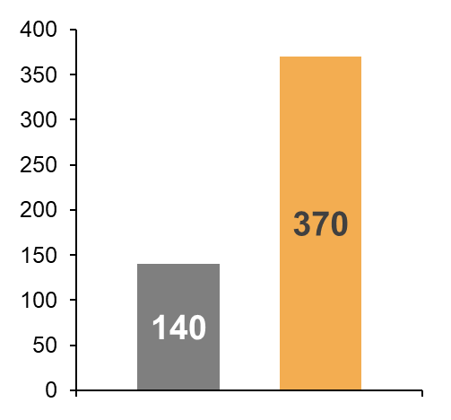
Tezepelumab resulted in early, sustained, and clinically meaningful improvement in lung function from baseline versus placebo over 52 Weeks
Overall population
BEC ≥300 cells/µL
LS mean
change from baseline
to Week 52
300
Placebo (n=531)
Tezepelumab 210 mg Q4W (n=528)
230 mL
200
230 mL
improvement in pre-BD FEV₁
vs placebo
Change from baseline to
Week 52 in pre-BD FEV₁, (mL)^{b}
Change from baseline to
Week 52 in pre-BD FEV₁, (mL)^{c}
130 mL
improvement in
pre-BD FEV₁
p<0.001 vs placebo
100
90 mL
0
n=189
0
2
4
8
12
16
24
36
52
Placebo
Tezepelumab 210 mg Q4W
Time (weeks)
n=189
1. Menzies-Gow A et al. Article and supplementary appendix. N Engl J Med. 2021; 384(19):1800-1809; 2. Tepper RS et al. J Allergy Clin Immunol. 2012;129:(3)(suppl):S65-S87.

Slide 14
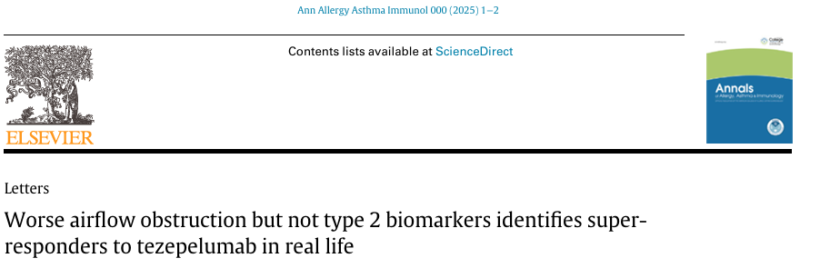
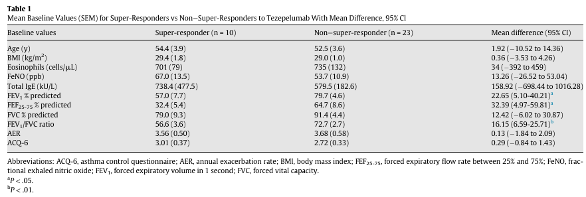
Super Responders: Pazienti che a 6 mesi manifestano remissione di malattia: no OCS, zero riacutizzazioni, ACT 25, spirometria normale.
Tezepelumab ha anche effetti sul muscolo liscio delle vie aeree, che gioca un ruolo cruciale nell’ostruzione bronchiale.
Pazienti con ostruzione marcata (es. FEV₁<60%) hanno più margine di miglioramento, quindi possono mostrare cambiamenti più evidenti e clinicamente rilevanti.
Greig R, et al. Ann Allergy Asthma Immunol. 2025;134(6):732-734.
Notes:
Paziente con ostruzione persistente e tendenza al remodelling. 33 patients taking tezepelumab in this study more than or equal to 6 months of treatment who had assessable follow-up of pulmonary function data.

Slide 15
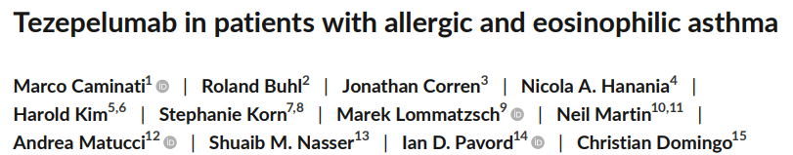
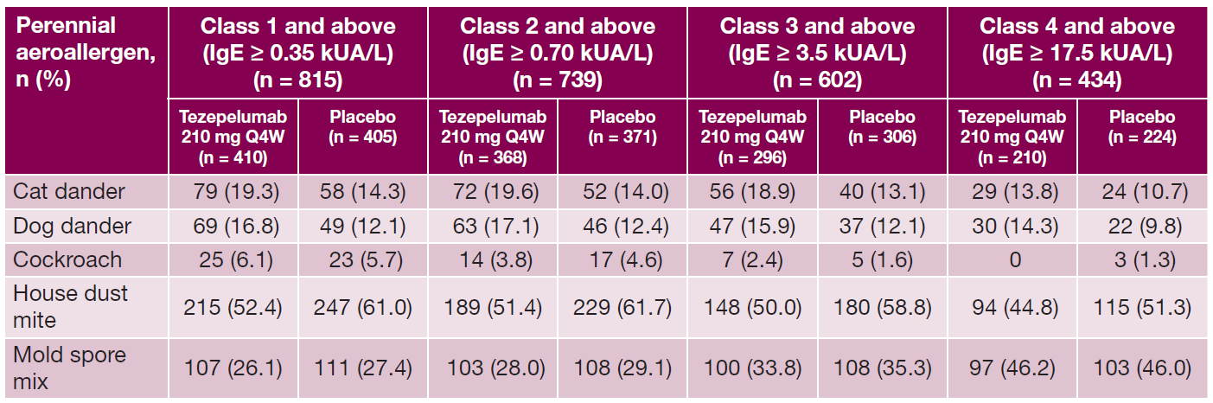
Tezepelumab is effective in patients with severe, uncontrolled asthma regardless of the antigen-specific threshold for perennial allergen sensitivity, supporting the efficacy of tezepelumab in a broad range of patients.
AAER over 52 weeks by sensitivity threshold to any perennial allergen
Of the perennial aeroallergens assessed, the most common sensitization was to house dust mites, which occurred in approximately 50% of patients across specific IgE threshold subgroups.
Allergy. 2024;79(5):1134-1145.
Notes:
In a pooled analysis of the phase 2b PATHWAY (NCT02054130) and phase 3 NAVIGATOR (NCT03347279) studies, compared with placebo, tezepelumab reduced the annualized asthma exacerbation rate over 52 weeks by 62% (95% confidence interval [CI]: 53, 70) in patients with perennial aeroallergen sensitization (allergic asthma); by 71% (95% CI: 62, 78) in patients with a baseline blood eosinophil count ≥300 cells/μL; and by 71% (95% CI: 59, 79) in patients with allergic asthma and a baseline blood eosinophil count ≥300 cells/μL.

Slide 16
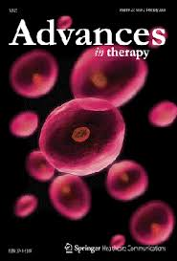
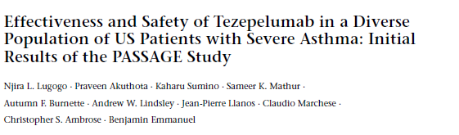
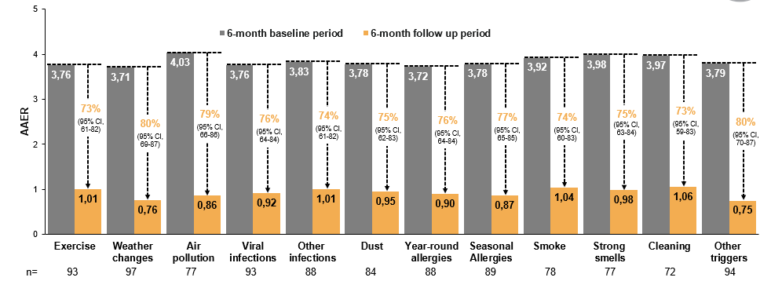
In the PASSAGE interim analysis, treatment with tezepelumab resulted in reductions in AAER
across patient-reported asthma triggers
Adv Ther. 2025;42(7):3334–3353.
Notes:
Lo studio PASSAGE è uno studio di fase 4, in aperto, in corso negli Stati Uniti, che valuta l'efficacia e la sicurezza di tezepelumab nel "mondo reale" per pazienti (dai 12 anni in su) con asma grave non controllata. I risultati preliminari indicano una riduzione significativa delle esacerbazioni asmatiche e miglioramenti nella funzione polmonare e nella qualità della vita.

Slide 17
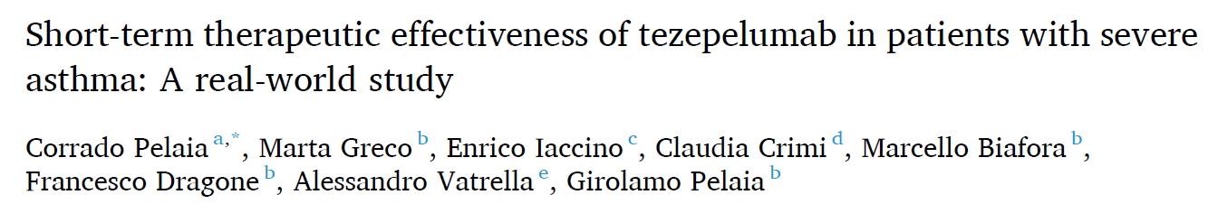
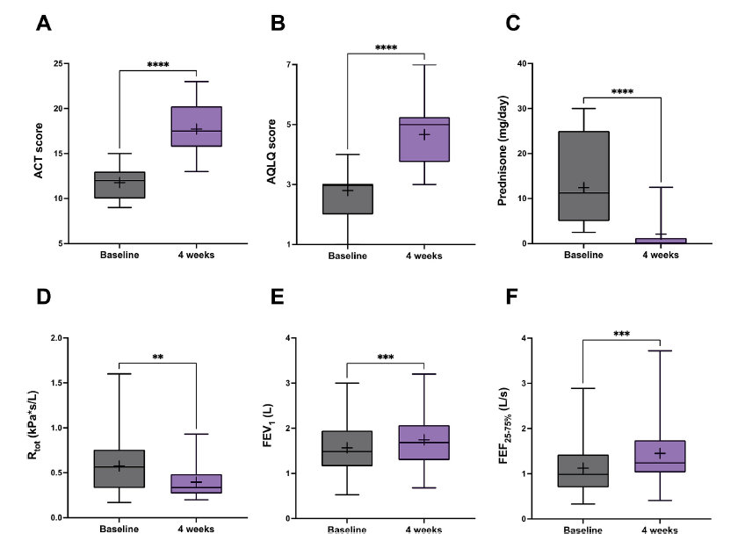
Tezepelumab induced significant improvements in ACT score, AQLQ score, OCS intake, and lung function. Tezepelumab also significantly decreased the levels of FeNO and blood basophil count. Moreover, tezepelumab significantly lowered the serum concentrations of IL-2 and VEGF
Int Immunopharmacol. 2025:162:115185.
Notes:
30 consecutive outpatients with either T2-high or T2-low severe asthma, who were under add-on biologic treatment with tezepelumab. After 4 weeks of treatment, tezepelumab induced significant improvements in symptom control (ACT score), asthma-related quality of life (AQLQ score), oral corticosteroid intake, and lung function (FEV1, FEF25–75, Rtot). Tezepelumab also significantly decreased the levels of fractional exhaled nitric oxide (FeNO) and blood basophil count. Moreover, tezeIndeed, it has been recently shown that TSLP is able to induce the release of VEGF from human macrophages activated by both T2-high (IL-4, IL-13) and T2-low (lipopolysaccharide) immunological stimuli tezepelumab significantly lowered the serum concentrations of interleukin-2 (IL-2) and vascular endothelial growth factor (VEGF). Vascular endothelial growth factor (VEGF) is a signaling protein that plays a significant role in asthma pathogenesis, contributing to airway remodeling and inflammation by promoting angiogenesis (new blood vessel formation) and increasing vascular permeability in the airways. L'IL-2 (Interleuchina-2), appartenente alla famiglia delle citochine IL-2, svolge un ruolo chiave nella patogenesi dell'asma, in particolare nella infiammazione di Tipo 2, attivando le cellule Th2 e contribuendo a meccanismi di infiammazione e rimodellamento delle vie aeree che caratterizzano l'asma grave e allergico

Slide 18
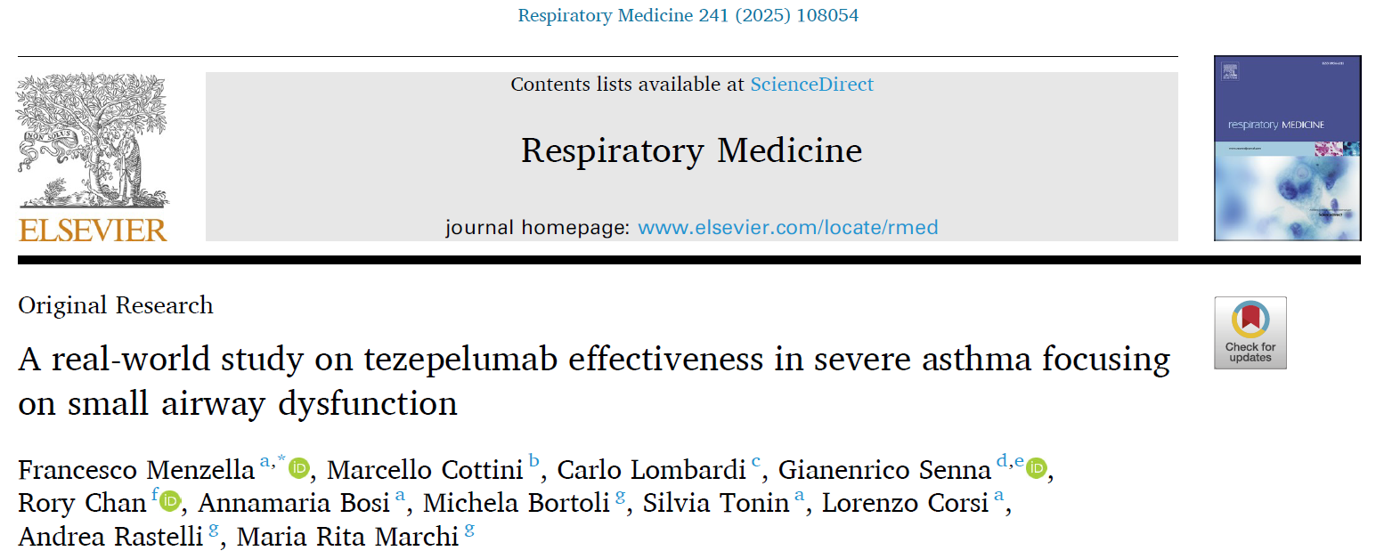
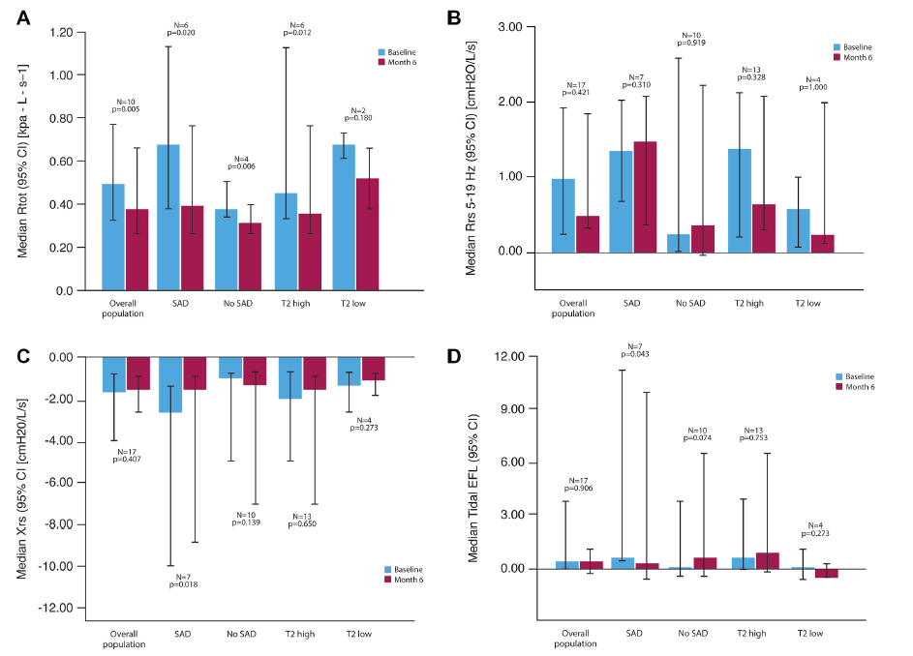
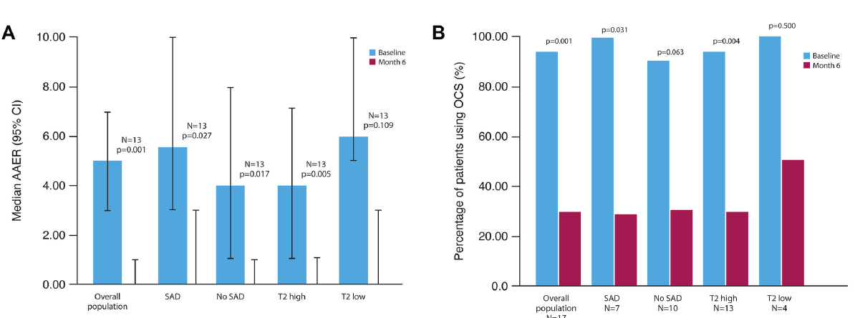
A 6 mesi miglioramento della reattanza maggiormente espresso nel sottogruppo SAD, caratterizzato da maggiore dipendenza da OCS e una dose mediana di ICS più alta
“This study demonstrates the clinical value of tezepelumab in improving asthma outcomes in real life and underscores the importance of identifying and addressing SAD in SA patients. By showing that tezepelumab significantly improved respiratory and small airway measures in SAD patients, this study supports the concept of SAD as a treatable trait in SA.”
Notes:
real-world, prospective, single-arm study involving 17 consecutive patients

Slide 19

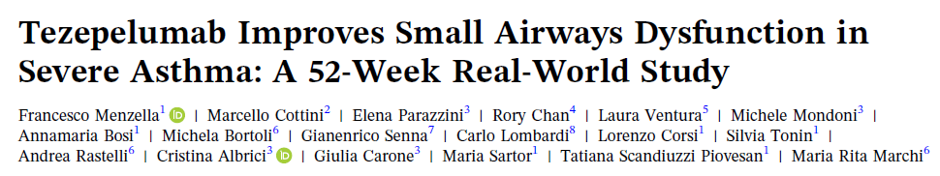
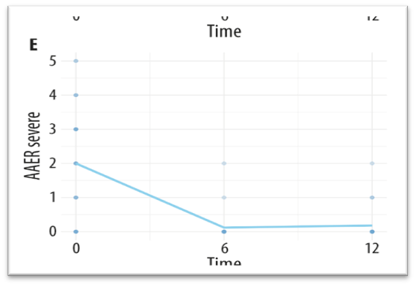
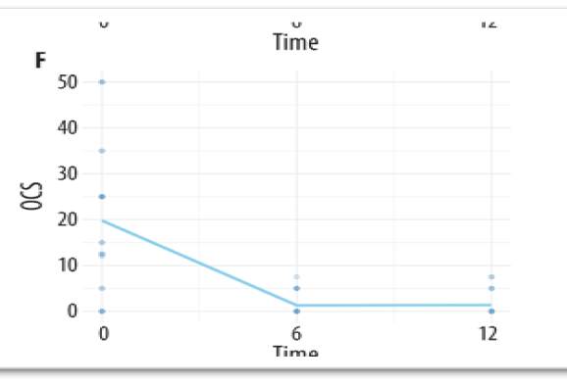
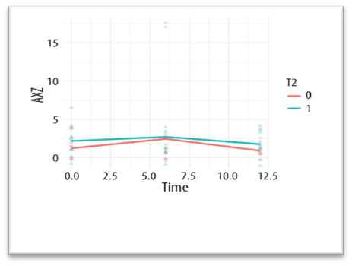
Clin Transl Allergy. 2026;16(1):e70147.
A key finding was the dissociation between spirometric and oscillometric outcomes. While conventional spirometry did not change significantly, oscillometry captured a significant improvement in small airway function (normalization of Xrs5)
In parallel, FeNO levels decreased significantly, driven by a strong response in the T2‐high cohort
Tezepelumab effectively targets distal airway pathology, an effect not visible with traditional lung function tests
Notes:
27 consecutive adult subjects with SA. These findings from more in‐depth clinical phenotyping with oscillometry support the integration of this tool into routine SA management, enabling more informed therapeutic decision‐making and ultimately improving patient outcomes

Slide 20
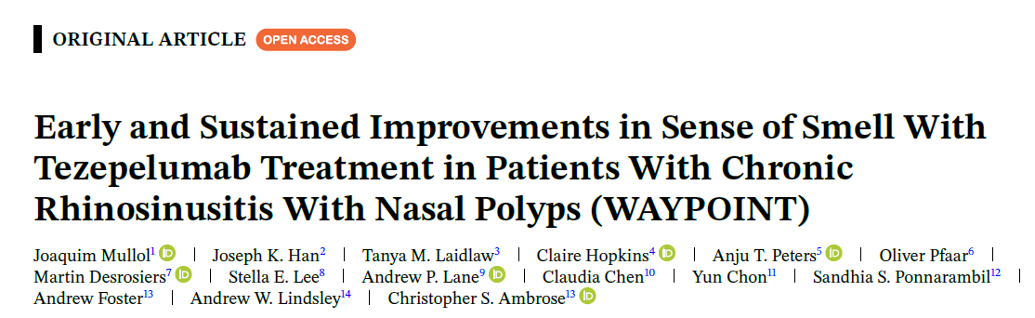
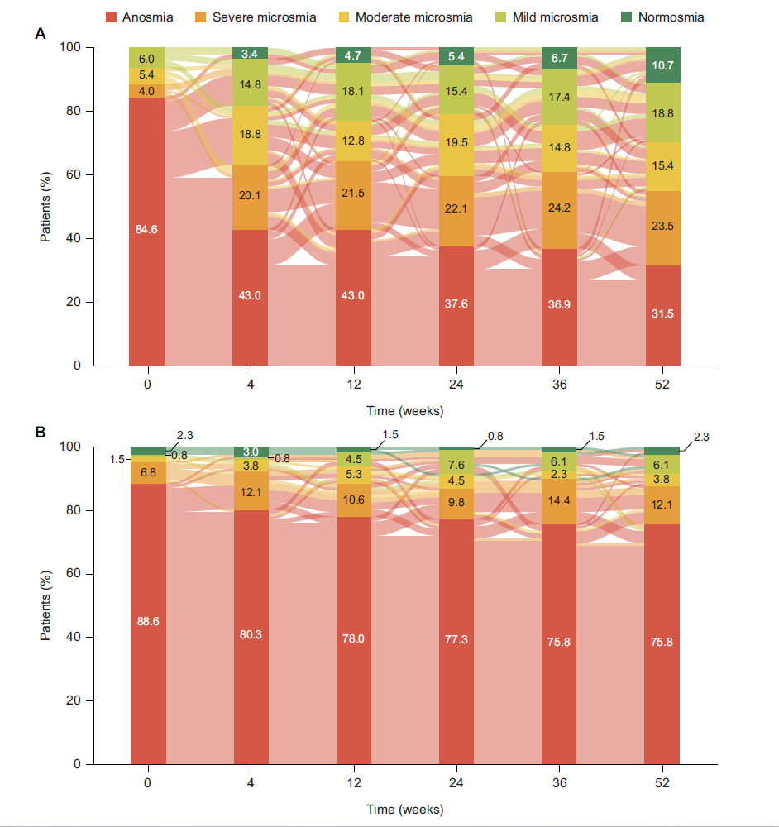
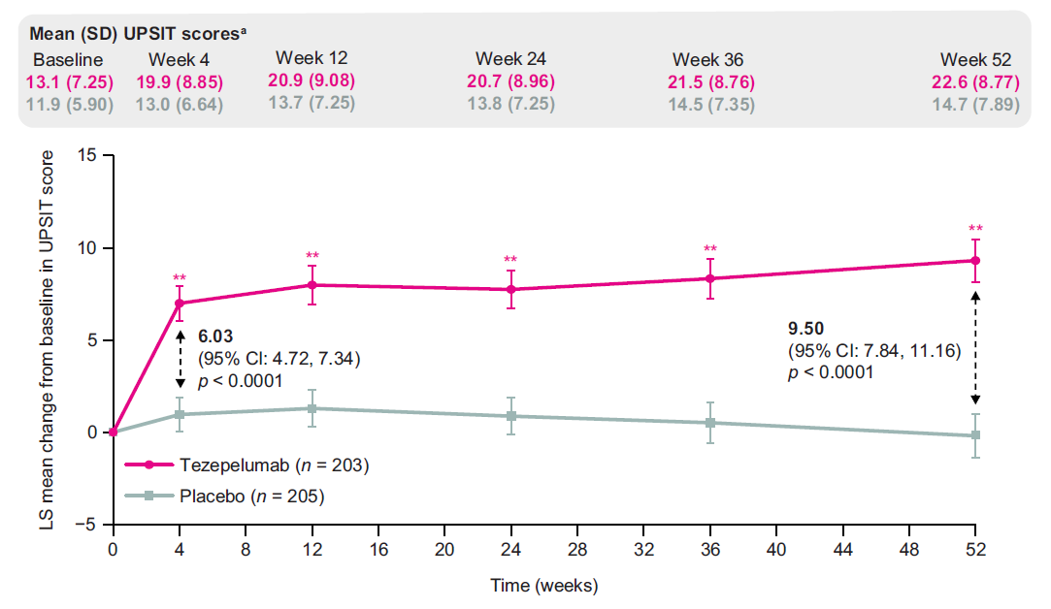
Int Forum Allergy Rhinol. 2026 Jan 6.
Notes:
Rapidità d'azione: Già alla settimana 4, il gruppo trattato con Tezepelumab mostra un incremento significativo di +6.03 punti rispetto al basale (p < 0.0001).
Efficacia a lungo termine: Il miglioramento continua a crescere costantemente fino alla settimana 52, raggiungendo un incremento medio di +9.50 punti.
Confronto con Placebo: Il gruppo placebo (linea grigia) non mostra miglioramenti rilevanti, mantenendosi vicino allo zero per tutta la durata dello studio.
Punteggi medi: Nella tabella in alto a sinistra, si nota che il punteggio UPSIT dei pazienti passa da una media di 13.1 (anosmia/microsmia grave) a 22.6 alla fine del trattamento.
2. Cambiamento delle Categorie Olfattive (Grafici a destra)
I grafici di tipo "Sankey" mostrano come i pazienti si spostano tra le diverse categorie di deficit olfattivo nel tempo.
Grafico A: Gruppo Tezepelumab
Baseline: L'84.6% dei pazienti inizia in una condizione di Anosmia (assenza totale di olfatto, colore rosso scuro).
Settimana 52: La percentuale di pazienti con Anosmia scende drasticamente al 31.5%.
Recupero: Si osserva un aumento significativo dei pazienti che raggiungono la Normosmia (olfatto normale, verde scuro, 10.7%) e la Microsmia lieve (verde chiaro, 18.8%).
Grafico B: Gruppo Placebo
Baseline: L'88.6% è in condizione di Anosmia.
Settimana 52: La situazione rimane pressoché invariata, con il 75.8% dei pazienti ancora in stato di Anosmia e miglioramenti trascurabili nelle altre categorie.
Sintesi dei Risultati
I dati suggeriscono che Tezepelumab offre:
Un miglioramento precoce (già dal primo mese).
Un beneficio sostenuto e progressivo fino a un anno.
Una reale ricategorizzazione clinica, portando una quota significativa di pazienti dalla perdita totale dell'olfatto verso livelli di funzionalità normale o quasi normale.
Nota: Questo studio è particolarmente rilevante perché la perdita dell'olfatto è uno dei sintomi più invalidanti per i pazienti con poliposi nasale e spesso uno dei più difficili da trattare.

Slide 21





Tezepelumab demonstrated statistically significant and clinically meaningful improvement in both co-primary endpoints of nasal polyp size (NPS) and nasal congestion score (NCS), which was consistently observed across pre-specified subgroups^{1,2}
Tezepelumab improved all key secondary outcomes in the overall population at Week 52^{1,2}
Within the first week, tezepelumab treatment resulted in rapid and sustained improvements in congestion and sense of smell³
Tezepelumab nearly eliminated the need for NP surgery.and significantly reduced SCS use for NP, with reductions of 98% and 89%, respectively, at Week 52 compared to placebo^{1,2,a}
Tezepelumab consistently demonstrated improvements in quality of life and nasal symptoms compared to placebo, demonstrating a 45-point reduction from baseline in SNOT-22 at Week 52⁴
In the Phase III WAYPOINT study, tezepelumab treatment resulted in rapid and sustained improvements
No clinically meaningful differences in safety results were observed between the tezepelumab and placebo groups in the WAYPOINT study^{1,2}
Lipworth BJ, et al. N Engl J Med. 2025;392(12):1178-1188.
Notes:
Reference:
Lipworth BJ, Han JK, Desrosiers M, et al. Tezepelumab in adults with severe chronic rhinosinusitis with nasal polyps [article and supplementary appendix]. N Engl J Med. 2025;392:1178-1188. doi:10.1056/NEJMoa2414482
Hopkins C, Han JK, Lipworth BJ, et al. Efficacy and safety of tezepelumab in adults with severe, uncontrolled chronic rhinosinusitis with nasal polyps: results from the Phase 3 WAYPOINT study​ [presentation]. Presented at: European Rhinologic Society (ERhS); June 22-25, 2025; Budapest, Hungary.
Pfaar O, Han JK, Desrosiers M, et al. Onset of action of tezepelumab in adults with severe, uncontrolled chronic rhinosinusitis with nasal polyps in the phase 3 WAYPOINT study [poster]. Presented at: European Rhinologic Society (ERhS); June 22-25, 2025; Budapest, Hungary.
Mullol J, Han JK, Desrosiers M, et al. Efficacy of tezepelumab on loss of smell in adults with severe, uncontrolled chronic rhinosinusitis with nasal polyps in the phase 3 WAYPOINT study [poster]. Presented at: European Rhinologic Society (ERhS); June 22-25, 2025; Budapest, Hungary.

Slide 22






Eosinophilic driven asthma patient features
Elevated blood eosinophils (bEOS)
Chronic rhinosinusitis with nasal polyps (CRSwNP)
Frequent and severe exacerbations
Adult-onset asthma
Good steroid responder
Low FEV₁, often with persistent airflow obstruction (PAO)
de Groot J et al. ERJ Open Res. 2015;1:00024-2015.
Notes:
SPEAKER: Nei principali dataset osservazionali, il fenotipo eosinofilico grave si associa a marcata riduzione del FEV1, spesso con ostruzione persistente, elevate concentrazioni di eosinofili ematici, frequenti e gravi esacerbazioni, buona responsività agli steroidi, insorgenza tardiva della malattia e frequente associazione con rinosinusite cronica con poliposi nasale. Tali caratteristiche, specie se presenti in combinazione, incrementano la probabilità di coinvolgimento del pathway Th2-high a spinta eosinofilica, indirizzando la scelta terapeutica verso farmaci mirati al controllo di questa tipologia infiammatoria
Direct lift from ML-3034-ALL-0062 slide 10 except I deleted the hyperlink to another slide in the bottom right corner of this slide

Slide 23
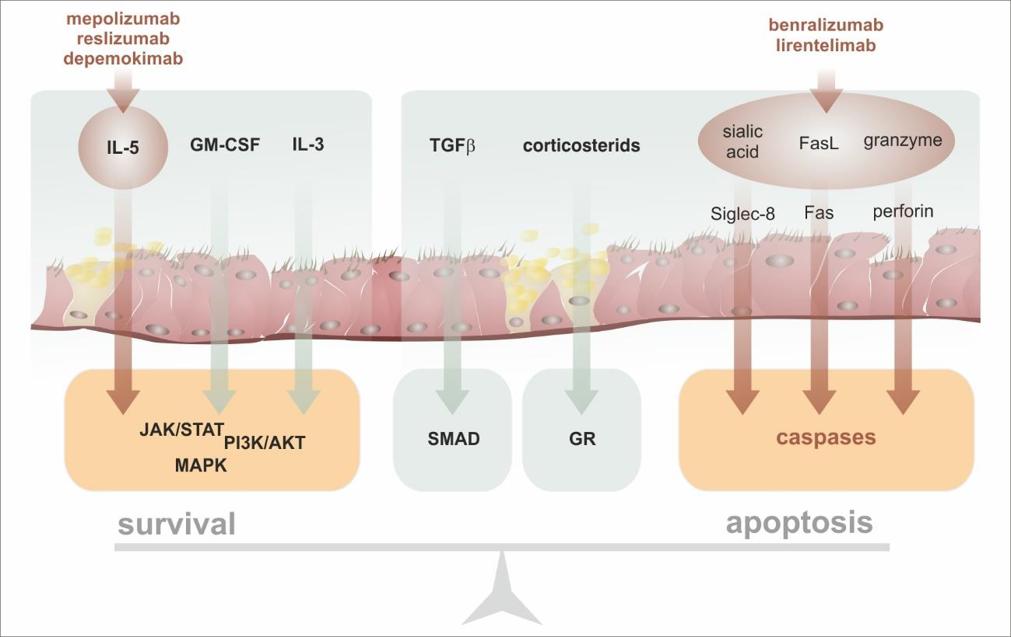
Mode of action of antieosinophil biologicals
Novosad J, et al. Int J Mol Sci. 2023;24(6):5716.
Notes:
survival is always a result of the balance between prosurvival proapoptotic signals. In general, mepolizumab, reslizumab, and depemokimab are biologicals an anti-IL-5 mode of action that lead to a reduction in the lifespan of eosinophils. contrast, benralizumab can induce the apoptosis of targeted eosinophils by utilizing ADCC through ligation of the Fas receptor and the activation of caspases in response to an intracellular influx of granzyme. Lirentelimab can signal through the inhibitory Siglec-8 receptor. Depemokimab (GSK-3511294) is a long-acting anti-IL-5 monoclonal antibody. Depemokimab can be used for research of asthma. GSK’294 is an anti-IL-5 monoclonal antibody currently in development for the treatment of severe eosinophilic asthma. It i Lirentelimab induces cell apoptosis of IL-5-activated eosinophils and inhibits IgE-mediated mast cell activation. Lirentelimab can be used for the research of eosinophilic gastritis and duodenitis.s a distinct, new biologic entity and has been engineered for high affinity and long-acting suppression of IL-5 function. Lirentelimab (AK002) is a humanized IgG1 monoclonal antibody that targets sialic acid-binding Ig-like lectin 8 (SIGLEC8).

Slide 24
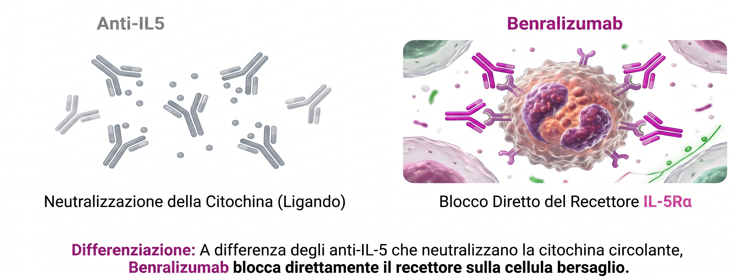
Precisione biologica: target recettoriale Vs. target citochinico

Slide 25
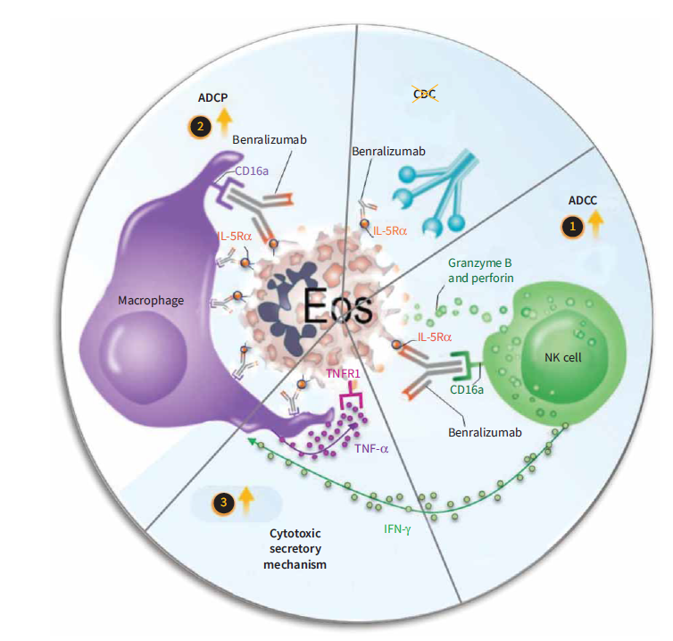
There is more beyond eosinophils killing…
1) ADCC: mediante una citotossicità cellulo-mediata anticorpo-dipendente potenziata, riduce l’infiammazione eosinofilica determinando apoptosi degli eosinofili
2) ADCP: fagocitosi cellulare anticorpo dipendente nel quale benralizumab promuove la fagocitosi da parte dei macrofagi che promuovono l’eliminazione degli eosinofili.
3) TNF/TNFR1-mediated eosinophil apoptosis, attivazione cellule NK e conseguente produzione di fattori quali IFN-γ che inducono una citotossicità da parte dei macrofagi con conseguente eliminazione di tutte le cellule apoptotiche all’interno del sistema.
Il macrofago attivato e l’IFNγ prodotto da NK promuovono il rilascio di TNFα, stimolo proapoptotico per EOS.
Dagher R, et al. Eur Respir J. 2022;59:2004306.
Notes:
In aggiunta al meccanismo di ADCC c’è un altro meccanismo che è quello di ADCP fagocitosi cellulare anticorpo dipendente in cui benralizumab non fa altro che promuovere la fagocitosi da parte appunto dei macrofagi promuovendo l’eliminazione degli eosinofili. C’è poi un terzo meccanismo nel quale, una volta che le cellule natural killer vengono attivate, vengono prodotti fattori come IFN gamma che anch’essi inducono una citotossicità da parte dei macrofagi con conseguente eliminazione di tutte quelle cellule apoptotiche che quindi si trovano all’interno del Sistema. L'efferocitosi è il processo biologico mediante il quale i fagociti, come i macrofagi, riconoscono, inglobano ed eliminano le cellule apoptotiche (morenti), impedendo che il loro contenuto tossico danneggi i tessuti circostanti. Questo meccanismo "sepolcrale" previene l'infiammazione e la necrosi secondaria, essendo cruciale per la riparazione tissutale e l'omeostasi. [1, 2, 3, 4, 5]
Proposed mechanisms for benralizumab-induced eosinophil (Eos) depletion through antibody-dependent cell-mediated cytotoxicity (ADCC), antibody-dependent cellular phagocytosis (ADCP) and tumour necrosis factor-α (TNF-α)-dependent macrophage cytotoxicity. 1) In the ADCC process, benralizumab induce eosinophil apoptosis by activated natural killer (NK) cells. 2) Also, benralizumab promoted ADCP by macrophages to deplete eosinophils either by phagocytosis or efferocytosis. 3) Activated NK cells release stimulatory factors such as interferon-γ (IFN-γ) to induce macrophage cytotoxicity through TNF-α that can trigger TNF receptor 1 (TNFR1)-dependent eosinophil apoptosis; these apoptotic cells are removed by macrophage efferocytosis. Lastly, complement-dependent cytotoxicity (CDC) seems not to be involved in benralizumab-mediated eosinophil depletion. IL-5Rα: interleukin-5 receptor α.

Slide 26
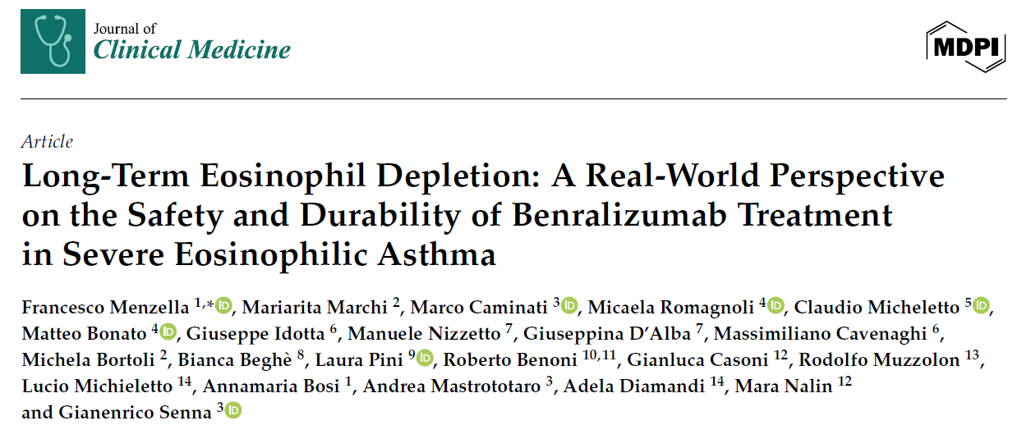
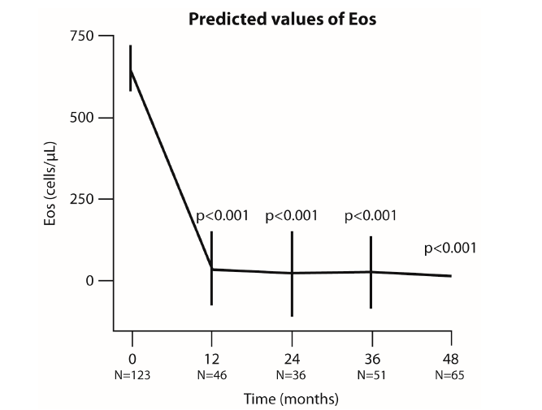
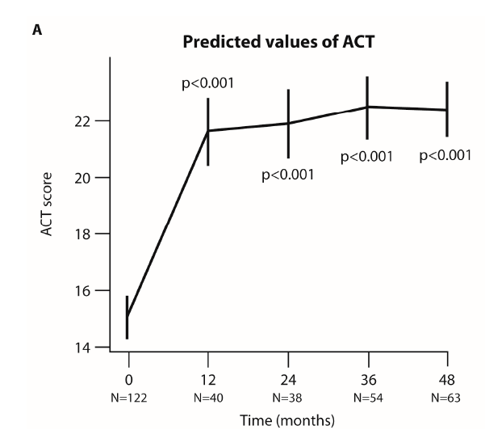
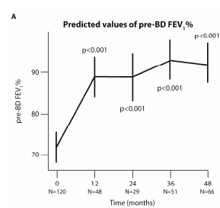
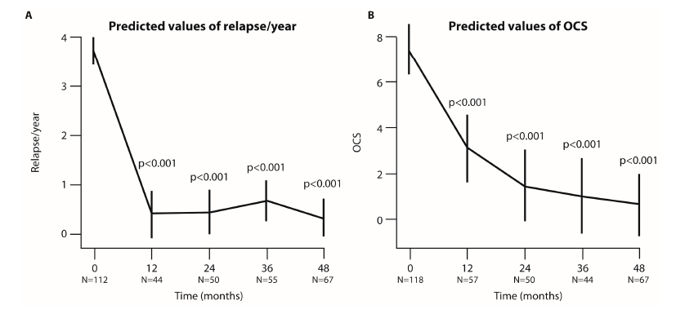
J Clin Med. 2024;14(1):191.

Slide 27
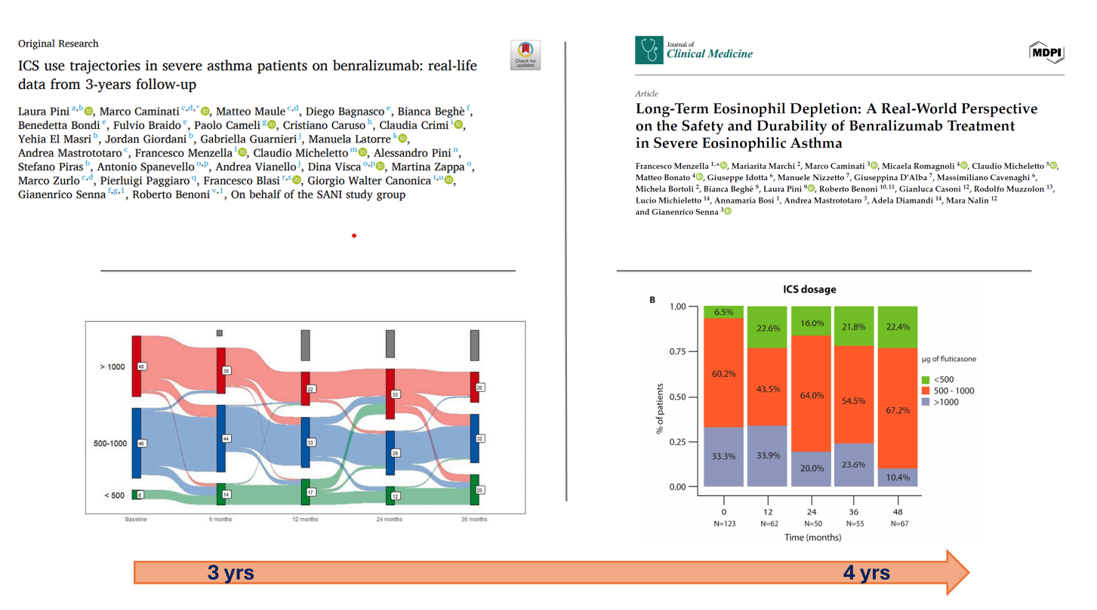
Respir Med. 2025:245:108198; J Clin Med. 2024;14(1):191.

Slide 28
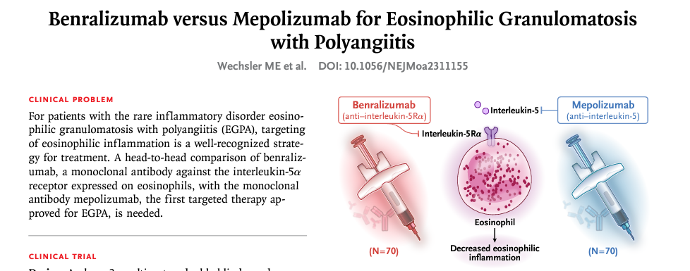

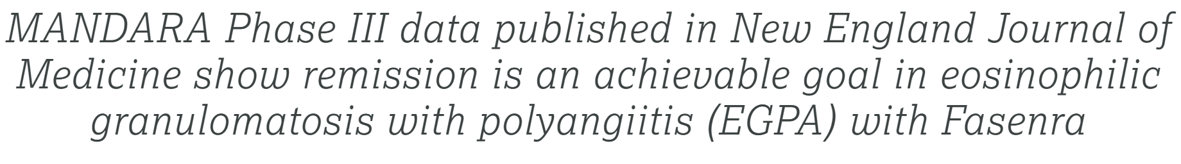

Slide 29

MIRRA remission results: co-primary and secondary
Co-Primary Endpoints | Mepolizumab N=68 | Placebo N=68 | Odds ratio† (95% CI)
Accrued Weeks of Remission over 52-week Treatment Period |  |  | 5.91 (2.68, 13.03); P<0.001
0 weeks, n (%) | 32 (47) | 55 (81)
>0–<12 weeks, n (%) | 8 (12) | 8 (12)
12–<24 weeks, n (%) | 9 (13) | 3 (4)
24–<36 weeks, n (%) | 10 (15) | 0
≥36 weeks, n (%) | 9 (13) | 2 (3)
Remission* at Weeks 36 and 48, n (%) | 22 (32) | 2 (3) | 16.74 (3.61, 77.56); P<0.001
Other Endpoint
Remission within first 24 weeks and sustained until Week 52 | 13 (19) | 1 (1) | 19.65 (2.30, 167.93); P=0.007
*Remission is defined as BVAS=0 and prednisolone/prednisone dose ≤4 mg/day
Wechsler ME, et al. N Engl J Med. 2017;376(20):1921–1932.
Notes:
A total of 136 participants underwent randomization, with 68 participants assigned to receive mepolizumab and 68 to receive placebo. Mepolizumab treatment led to significantly more accrued weeks of remission than placebo (28% vs. 3% of the participants had ≥24 weeks of accrued remission; odds ratio, 5.91; 95% confidence interval [CI], 2.68 to 13.03; P<0.001) and a higher percentage of participants in remission at both week 36 and week 48 (32% vs. 3%; odds ratio, 16.74; 95% CI, 3.61 to 77.56; P<0.001). Remission did not occur in 47% of the participants in the mepolizumab group versus 81% of those in the placebo group. The annualized relapse rate was 1.14 in the mepolizumab group, as compared with 2.27 in the placebo group (rate ratio, 0.50; 95% CI, 0.36 to 0.70; P<0.001). A total of 44% of the participants in the mepolizumab group, as compared with 7% of those in the placebo group, had an average daily dose of prednisolone or prednisone of 4.0 mg or less per day during weeks 48 through 52 (odds ratio, 0.20; 95% CI, 0.09 to 0.41; P<0.001).

Slide 30

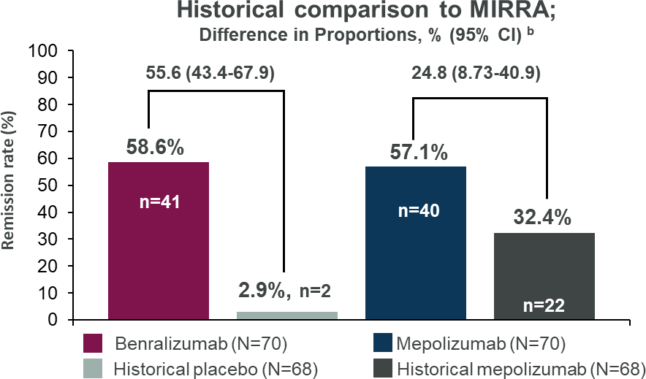
Historical comparison of remission between benralizumab and mepolizumab
In MANDARA, the remissionª rates were not significantly different between benralizumab and mepolizumab groups
  Non-inferiority demonstrated: lower 95% CI is well above NI margin of −25%
Indirect treatment comparison demonstrated a greater improvement in remission for benralizumab vs historical placebo
  Mepolizumab remission rate in MANDARA is higher than in MIRRA
1. Wechsler ME, et al. N Engl J Med. 2024;390(10):911-921. 2. Wechsler ME, et al. N Engl J Med. 2017;376:1921–1932.

Slide 31
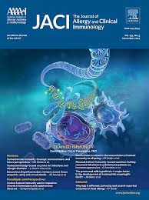
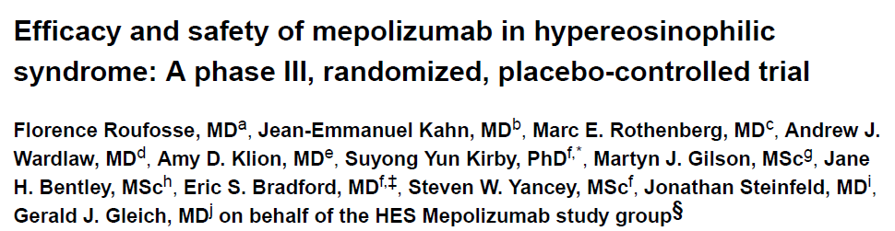

J Allergy Clin Immunol. 2020;146(6):1397-1405.
Notes:
Eligible patients had FIP1L1-PDGFRA-negative HES, experienced 2 or more flares (worsening of HES-related symptoms or blood eosinophil count requiring therapeutic escalation) in the previous 12 months. 141 patients were screened for eligibility and 108 were randomized, of whom 54 received mepolizumab and 54 received placebo

Slide 32







Ogbogu PU, et al. Nat Med. 2026 Mar 31.
Notes:
therapy. Benralizumab significantly reduced the risk of first flare versus placebo (hazard ratio 0.35, 95% CI 0.18 to 0.69, P = 0.0024). Adverse events
occurred in 64.2% and 66.7% of benralizumab-and placebo-treated patients, respectively. minerale naturale composto principalmente da carbonato di sodio decaidrato, storicamente usato dagli antichi egizi per la mummificazione. Si trova come efflorescenza in depositi lacustri alcalini. Il termine si riferisce anche al Lago Natron in Tanzania Lago altamente alcalino (pH 9-10,5) e salino, famoso per ospitare fenicotteri rosa e per l'ambiente estremo che può "mummificare" gli animali che muoiono nelle sue acque.

Slide 33




Take away
Notes:
L’epitelio delle vie aeree svolge un ruolo fondamentale nella patogenesi dell’asma. Altri effetti riguardano la modulazione della risposta immune adattiva, la promozione della infiammazione mediata da allarmine, citochine e chemochine, del rimodellamento bronchiale e le alterazioni del muscolo liscio. L’epitelio è coinvolto anche nella risposta immune nei confronti dei patogeni, che nei pazienti asmatici è deficitaria o meno efficiente- Saranno presto disponibili farmaci innovativi con azione target anche subepiteliale il cui first-in-class è tezepelumab, in grado di dare risposte agli unmet needs dei pazienti che non hanno indicazione ai biologici attualmente disponibili
Nel contesto di un corretto management dei pazienti con asma grave è necessario conoscere approfonditamente questi processi, allo scopo di gestire in modo appropriato la selezione dei pazienti e dei farmaci idonei

