Slide 1

BPCO: La remissione clinica come obiettivo di trattamento
Francesco Menzella
UOC Pneumologia
Presidio ospedaliero di Montebelluna e Castelfranco Veneto (TV) AULSS 2 Marca Trevigiana

Slide 2
Dichiarazione conflitto di interessi
Negli ultimi due anni ho avuto i seguenti rapporti economici e/o supporti finanziari con soggetti portatori di interessi commerciali in campo sanitario:
Tipo di Rapporto Economico Azienda
Attività di Relatore GSK, Astra-Zeneca, Chiesi, Sanofi
Contributo Attività di Ricerca GSK, Astra-Zeneca
Attività di Consulenza GSK, Astra-Zeneca, Chiesi, Sanofi
Possesso di azioni o quote partecipative NA
Componente di Organi Direttivi NA
Rapporto di lavoro subordinato AULSS2 Marca Trevigiana

Slide 3

La remissione è un obiettivo concretamente raggiungibile in BPCO?

Slide 4
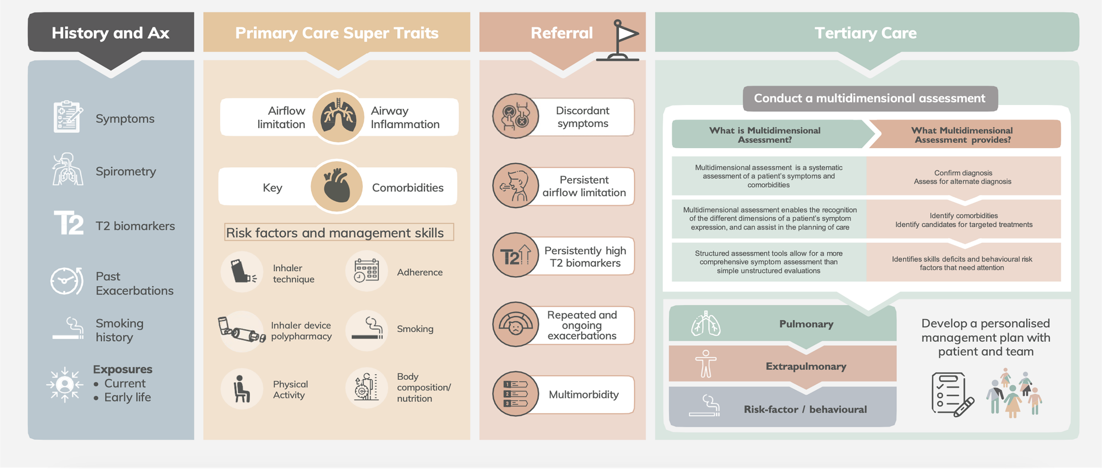
A model for the future implementation of treatable traits model of care across different health care settings, using trait prioritization strategies
Gibson PG, et al. Respirology. 2023;28(9):828-840.

Slide 5
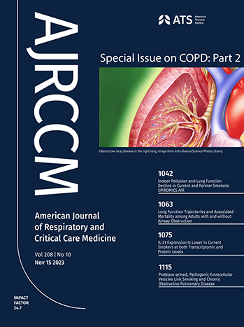
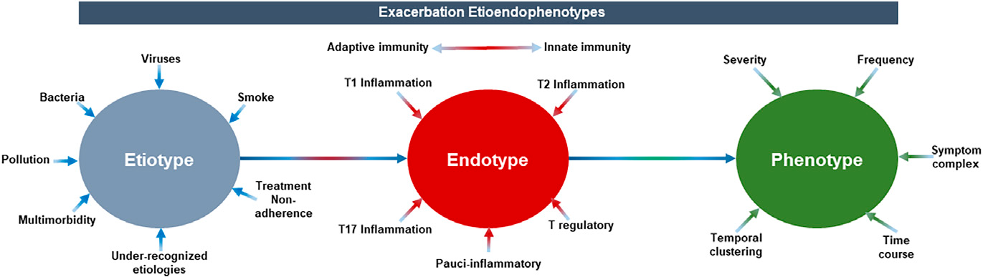
Etioendophenotypes of exacerbations
Bhatt SP, et al. Am J Respir Crit Care Med. 2023;208(10):1026-1041.
Notes:
Un fenotipo è l'insieme delle caratteristiche osservabili di un individuo, derivanti dall'interazione tra il suo genotipo (la sua composizione genetica) e l'ambiente. Un endotipo, invece, è un sottotipo di malattia definito da un preciso meccanismo biologico o fisiopatologico sottostante, come un particolare pattern infiammatorio. In sostanza, il fenotipo è la manifestazione clinica della malattia, mentre l'endotipo ne rappresenta la causa biologica e cellulare sottostante. Gli "eziotipi" della BPCO si riferiscono alle cause e ai fattori di rischio che portano allo sviluppo della Broncopneumopatia Cronica Ostruttiva (Bronchopulmonary dysplasia, BPD) rappresenta la principale sequela respiratoria cronica dei neonati fortemente pretermine

Slide 6
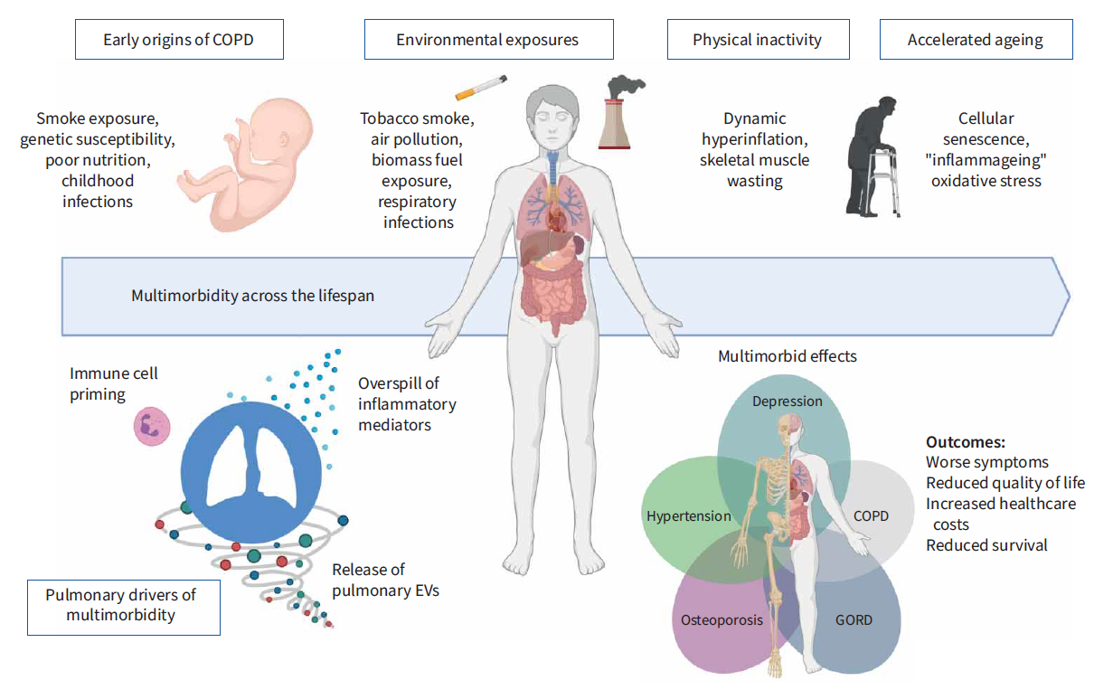
COPD: a multimorbid disease caused by several mechanisms
Worsening of lung function
Increased CV comorbidities and all cause mortality
Pulmonary inflammation with CRP/IL6/IL8/TNFα
Adapted from Burke H, et al. Eur Respir Rev. 2021;30:210041
Notes:
L’iperinflazione, che rappresenta una delle caratteristiche principali nella fisiopatologia delle BPCO, è dovuta a due meccanismi: diminuzione del ritorno elastico del polmone (iperinflazione statica) ed interruzione dell’espirazione prima del raggiungimento del volume di FRC, a causa della riduzione del flusso espiratorio (iperinflazione dinamica). In condizioni di iperinflazione dinamica, a fine espirazione negli alveoli rimane una pressione positiva residua, chiamata pressione positiva di fine espirazione intrinseca (PEEPi). L’iperinflazione provoca diverse conseguenze: 1) meccanica respiratoria: a volumi polmonari prossimi alla capacità polmonare totale, la compliance polmonare è fisiologicamente ridotta, ed il lavoro elastico necessario per generare lo stesso volume inspiratorio è, quindi, aumentato; 2) muscoli respiratori: le proprietà contrattili del diaframma si deteriorano quanto più il volume polmonare aumentato tende ad appiattire la cupola diaframmatica, l’inspirazione viene effettuata principalmente dai muscoli inspiratori e l’espirazione diviene attiva; 3) circolo: le resistenze vascolari polmonari aumentano a causa della compressione esercitata dall’iperinflazione sui vasi alveolari e della vasocostrizione ipossica; il postcarico ventricolare destro aumenta ed il cuore destro va incontro ad ipertrofia e dilatazione; il postcarico ventricolare sinistro può aumentare a causa dell’aumento della presssione intrapleurica, che si traduce in un aumento della pressione transmurale che deve essere vinta dalla contrazione ventricolare.

Slide 7
COPD is associated with many comorbid diseases that increase mortality
The COPD “Comorbidome”
Cardiovascular diseases
are among the
most prevalent
of comorbidities
and have one of the strongest associations with
increased risk for death
OSA
CVA
Hyperlipidemia
Pulmonary HTN/RHF
PAD
CHF
Pulmonary Fibrosis
Diabetes
CAD
Lung Cancer
Anxietyª
A. Fibrillation
Hypertension
Death
BPH
Breast Cancerª
Esophageal Cancer
Prevalence
Diabetes w/Neuropathy
Pancreatic Cancer
Liver Cirrhosis
50%
Erectile Dysfunction
Gastric Duodenal Ulcer
Substance Abuse
CRF
Depression
10%
Risk
1/HR=0.5
DJD
GERD
Divo M, et al. Am J Respir Crit Care Med. 2012;186:155-161.
Notes:
Coronary artery disease (CAD), also called coronary heart disease (CHD), ischemic heart disease (IHD), Peripheral artery disease (PAD)

Slide 8
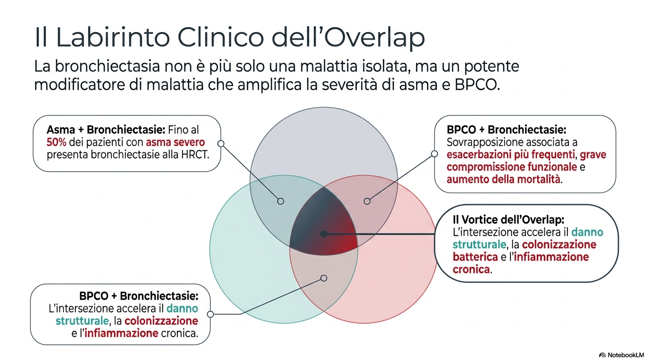
Il labirinto clinico dell’ overlap
Le bronchiectasie non sono più solo una malattia isolata ma un continuum di patologia
1. Zhang SQ, et al. Medicine (Baltimore). 2021;100(4):e23858; 2.
Du Q, et al. PLoS One. 2016;11(3):e0150532.

Slide 9


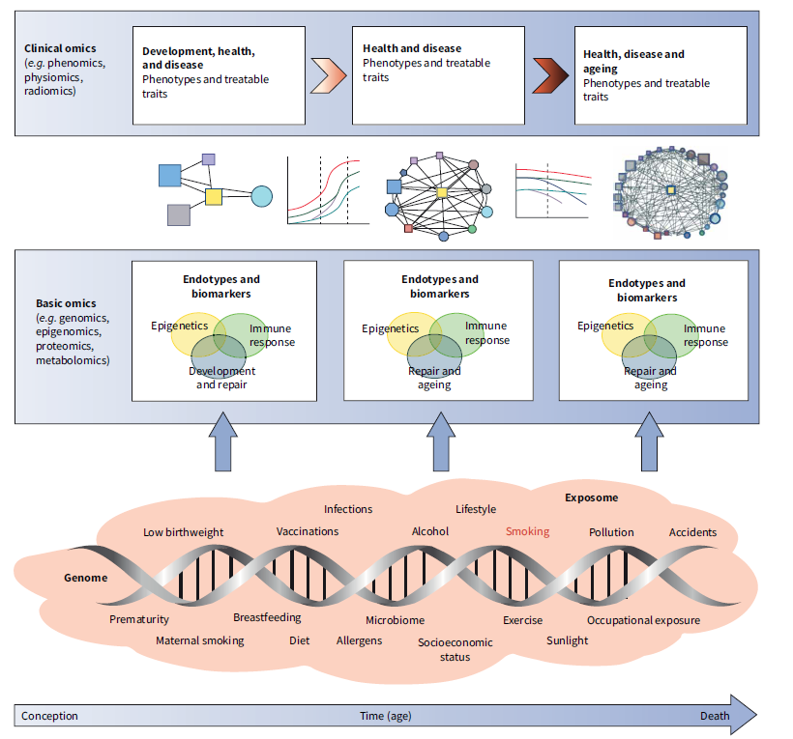
GETomics: gene (G) – environment (E) interactions that an individual encounter through life (T)
Eur Respir Rev. 2024;33(171):230143.
Notes:
The term GETomics has been recently proposed to illustrate that human health and disease are actually the final outcome of many dynamic, interacting and cumulative gene (G) - environment (E) interactions that occur through the lifetime (T) of the individual. Un fenotipo è l'insieme delle caratteristiche osservabili di un individuo, derivanti dall'interazione tra il suo genotipo (la sua composizione genetica) e l'ambiente. Un endotipo, invece, è un sottotipo di malattia definito da un preciso meccanismo biologico o fisiopatologico sottostante, come un particolare pattern infiammatorio. In sostanza, il fenotipo è la manifestazione clinica della malattia, mentre l'endotipo ne rappresenta la causa biologica e cellulare sottostante.

Slide 10

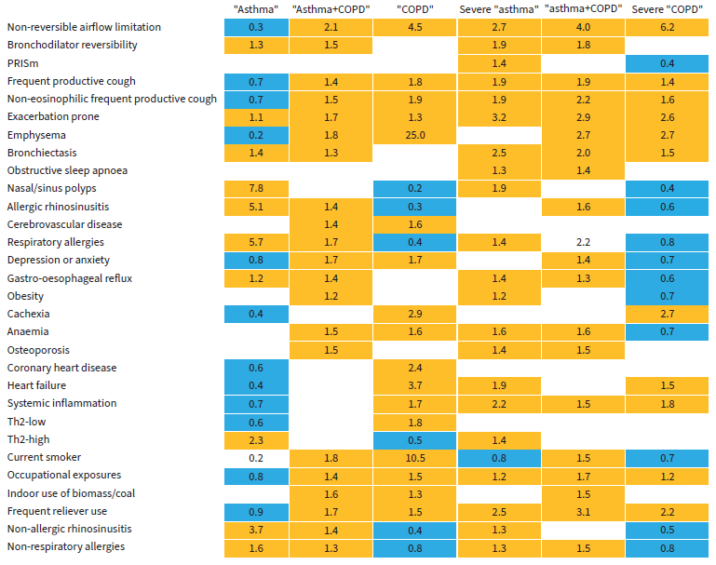
Eur Respir Rev. 2024;33(171):230143.
Notes:
The NOVELTY study cohort (NOVEL Observational Longitudinal Study), a large (n=11 226), global, real-world study that uniquely collects data both in primary care clinics and specialised centres from 19 countries, for patients with “asthma” (n=5932), “COPD” (n=3898) or both “asthma+COPD” (n=1396) [11]. The aim of the study was to analyse the different treatable traits in relation to the specific clinical labels and the severity. Diagnosis and severity assignments were both provided by physicians. The 30 treatable traits were classified into three domains (pulmonary, extrapulmonary or risk factor/behavioural).

Slide 11
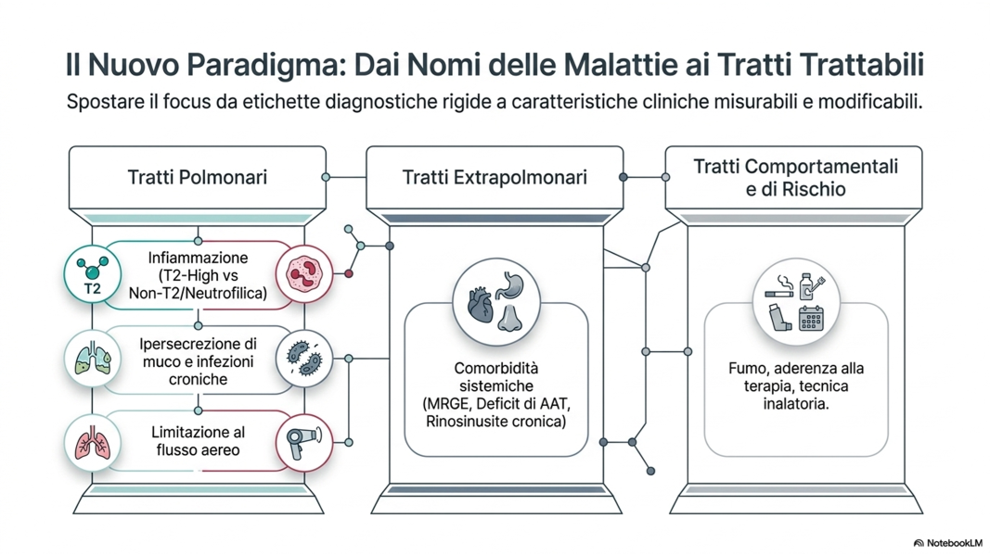
Il nuovo paradigma: dai nomi delle malattie ai tratti trattabili

Slide 12
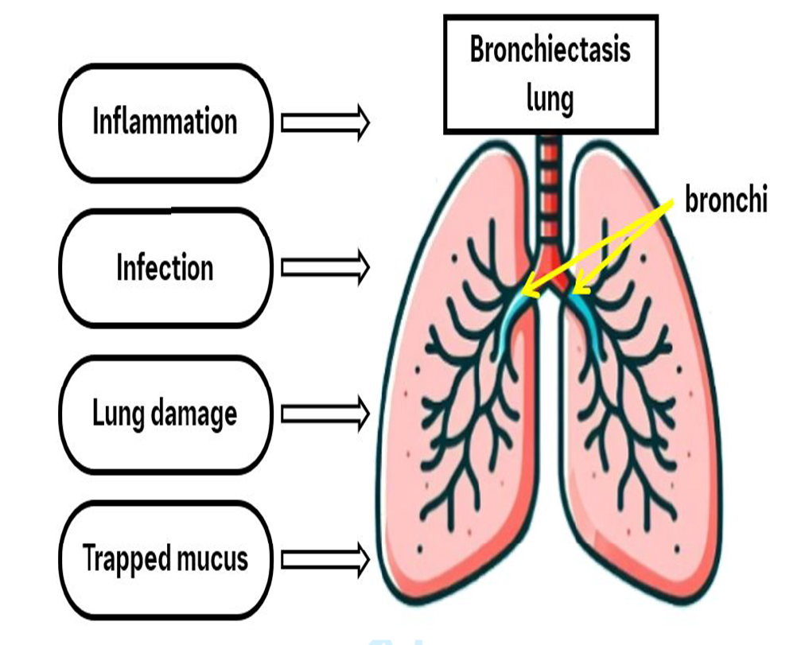
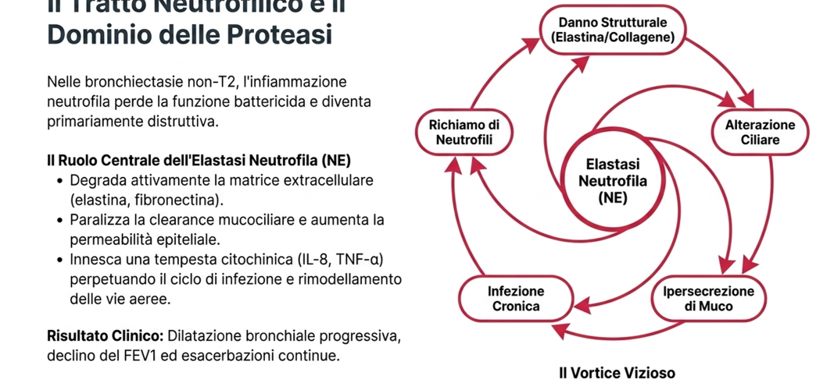
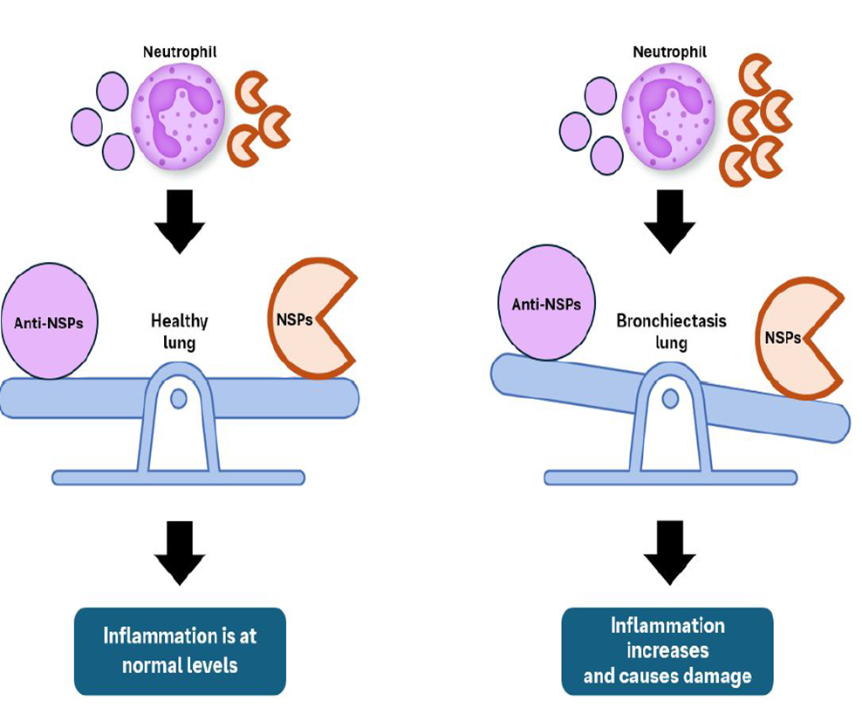
Il tratto neutrofilico e il dominio delle proteasi
Elastasi, catepsina G e proteinasi 3 → DDP1
Elaborazione personale
Notes:
Le proteasi neutrofile (come elastasi, catepsina G e proteinasi 3) sono enzimi litici rilasciati dai neutrofili durante l'infiammazione per eliminare agenti patogeni e detriti cellulari. Fondamentali per la difesa innata, se attivate in modo incontrollato, queste proteasi possono causare danni ai tessuti, degrado della matrice extracellulare e patologie croniche. La dipeptidil peptidasi-1 (DPP1), nota anche come catepsina C (CatC), è una proteasi lisosomiale di tipo cisteina fondamentale per l'attivazione delle serin proteasi dei neutrofili (NSP). Queste ultime, tra cui l'elastasi neutrofila, la proteinasi 3 e la catepsina G, sono enzimi chiave nell'infiammazione e nel danno tissutale, in particolare nelle malattie polmonari croniche

Slide 13
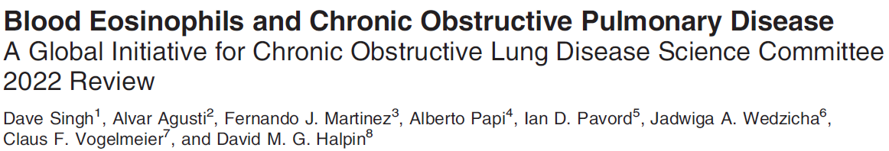
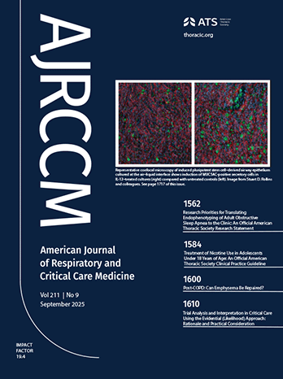
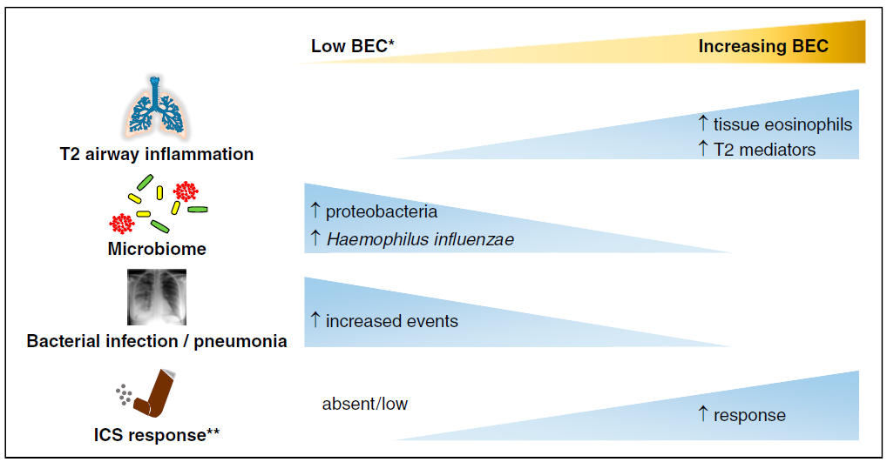
The relationships between blood eosinophil counts (BEC) and type-2 (T2) inflammation, microbiome, bacterial infection/pneumonia episodes, and ICS response
Am J Respir Crit Care Med. 2022;206(1):17-24.
Notes:
including the connections between BEC, T2 inflammation, and lung microbiome, which identify COPD subgroups with increased ICS response (higher BEC) or increased risk of bacterial infection (lower BEC);

Slide 14
Exacerbations can irreversibly reduce lung function and accelerate disease progression
Following an exacerbation, lung function may not
recover to pre-exacerbation levels
…leading to accelerated lung function decline, particularly in mild-to-moderate COPD
A post-hoc analysis of the WISDOM study
FEV₁ decline in patients with at least 1 severe exacerbation
0.02
3.0
COPD severity (defined by lung function)
Excess lung function decline per COPD exacerbation/year
Exacerbation
0.00
2.5
FEV₁ loss of approx. 32 mL
Mild
−0.02
−87 mL
2.0
Mean ± SE change from
Week 8 in FEV₁ (L)
−0.04
FEV₁ (L)
Moderate
1.5
−20 mL
−0.06
1.0
Severe
−20 mL
−0.08
Very severe
−9 mL
−0.10
0.5
−8
−7
−6
−5
−4
−3
−2
−1
1
2
3
4
5
6
7
8
1
Visit
2
Weeks from moderate/severe exacerbation
No exacerbation
Exacerbation
1. Watz H, et al. Respir Res. 2018;19:251; 2. Dransfield MT, et al. Am J Respir Crit Care Med. 2017;195:324–330.
Notes:
A post-hoc analysis of the WISDOM study in 360 patients with moderate-to-very-severe COPD to characterize lung function before, during, and after a moderate/severe and severe exacerbation. The WISDOM (Withdrawal of Inhaled Steroids During Optimised bronchodilator Management) study (NCT00975195) aims to evaluate the need for ICS use via stepwise withdrawal of ICS in COPD patients (GOLD 3-4 with a history of at least one exacerbation during the 12-month period prior to screening) receiving dual bronchodilation.

Slide 15
Damage from exacerbations goes beyond the lungs
In patients with COPD without a requirement for history of CVD:
The risk of CV complications, such as MI and stroke, was increased following a moderate exacerbation
During a Hospitalized Exacerbation,
the Risk of a CV Event Increased 20-fold
40% increased risk of stroke
MI
Risk of
MI doubles
within 5 days
2x increased
risk of MI^{b}
Stroke
Risk of a CV Event
During Exacerbation:
Severe Exacerbation
HR, 21.84; p<0.001
Moderate Exacerbation
HR, 2.63; p<0.001
Incidence Rate Ratios
Risk of
stroke
increased 40%
within 10 days
Days Following a Moderate COPD Exacerbation
.
1. Donaldson GC, et al. Chest. 2010;137:1091-1097. 2. Dransfield M et al. Poster presented at: Chest 2020 Annual Meeting; October 18-21, 2020; Chest. 2020;158(4, suppl):A1722-A1726.

Slide 16
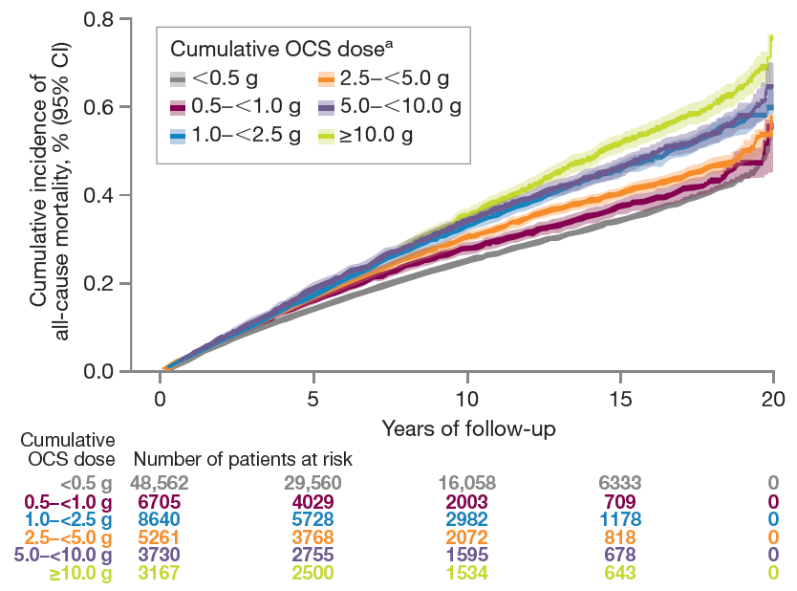
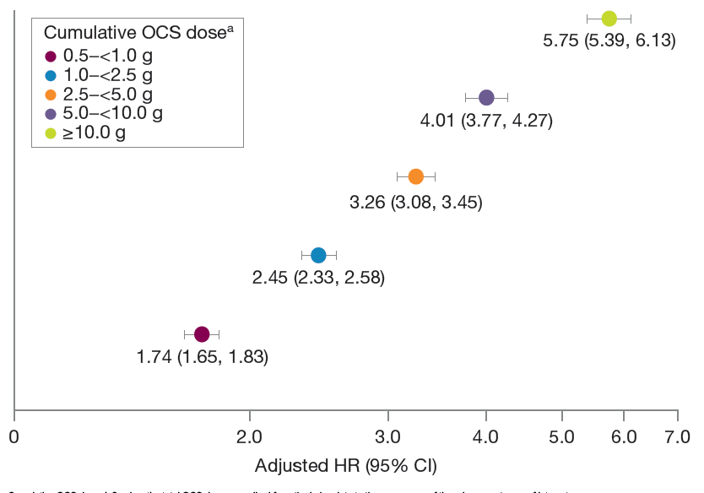
OCS use is associated with a higher risk of all-cause mortality in COPD patients
Cumulative OCS dose defined as the total OCS dose prescribed from the index date to the occurrence of the adverse outcome of interest
Within the OCS cohort, there was a positive dose–response relationship between time-varying cumulative OCS dose and risk for all-cause mortality in all dose categories relative to the <0.5 g reference dose
Cumulative incidence of all-cause mortality increased during the follow-up period across all OCS dose categories, with higher doses associated with increased all-cause mortality rates
UK Clinical Practice Research Datalink (1987−2019)
OCS use was associated with a higher risk of all-cause mortality in people living with COPD, with risk increasing as cumulative dose increased. Increased risk of all-cause mortality was seen with cumulative OCS doses as low as 0.5 to <1.0 g
Tse G, et al. Eur Respir J. 2022;Abs PA3607.
Notes:
This historical, observational cohort study used the UK Clinical Practice Research Datalink (1987−2019) linked to mortality data to compare patients who ever (OCS group) or never (non-OCS group) used OCS.
Patients with a COPD diagnosis on/after 1 April 2003 were identified. Direct matching was performed between the OCS group (index date: first COPD-related OCS prescription) and non-OCS group (index date: nearest primary care visit to a matched OCS patient). Cox regressions examined associations between. OCS use or time-varying cumulative OCS exposure and ACM, adjusted for confounders that included baseline exacerbation number.
Results: Of 323,722 patients with COPD identified, 106,775 received COPD-related OCS (median follow-up, 7.8 years); 53,299 pairs were able to be matched (mean ± SD age, 64.6±12.5 years; 59.8% male). Compared with the non-OCS group, the OCS group had higher ACM risk (adjusted hazard ratio [HR] [95% CI]: 1.03 [1.00, 1.06]). Relative to cumulative OCS exposure <0.5g, cumulative exposure>0.5g was associated with higher ACM risk
After adjusting for key confounders associated with mortality including exacerbation history, OCS use was associated with a higher risk of all-cause mortality in people living with COPD, with risk increasing as cumulative dose increased − Importantly, increased risk of all-cause mortality was seen with cumulative OCS doses as low as 0.5 to <1.0 g Our analysis of a large and individually matched cohort builds upon evidence describing OCS-related adverse
outcomes in people living with COPD. These findings highlight the importance of improving awareness of OCS-related mortality; understanding additional mortality risk associated with OCS is urgent and paramount to reducing the burden of COPD. Mortality outcomes associated with oral corticosteroid use in patients with COPD Gary Tse, David Price, Mona Bafadhel, Alberto Papi, Victoria Carter, Con Ariti, Jiandong Zhou, Derek Skinner, Xiao Xu, Hana Müllerová, Benjamin Emmanuel [abstract]. Presented at: European Respiratory Society International Congress; September 4-6, 2022; Barcelona, Spain. Eur Respir J. 2022. Abs PA3607. Accessed September 7, 2022.

Slide 17
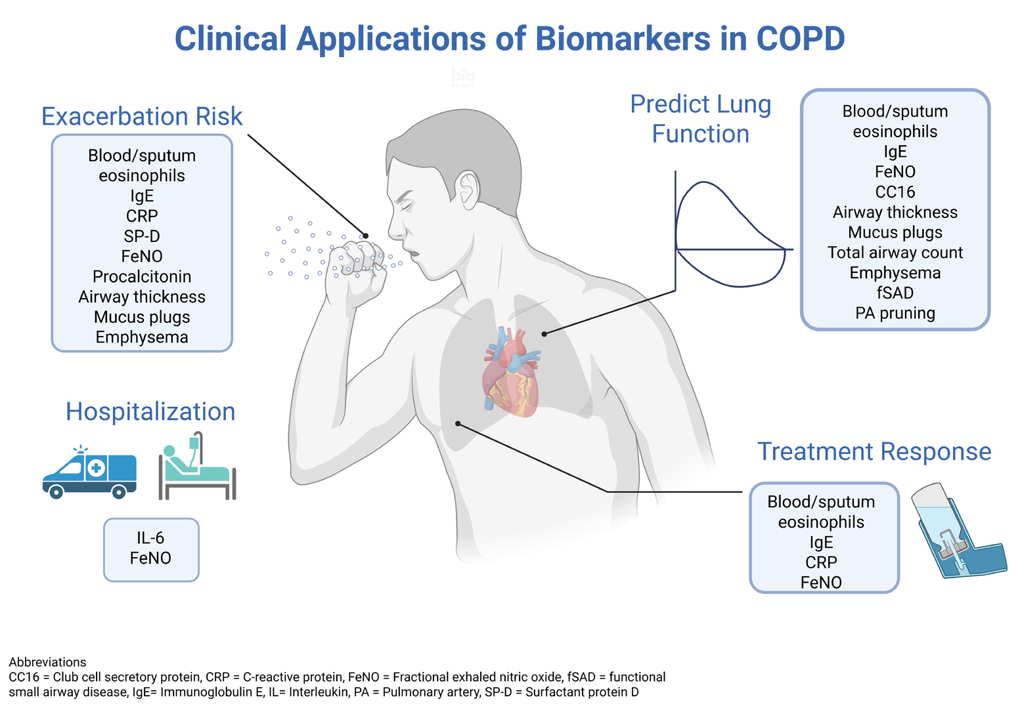
Clinical applications of biomarkers in COPD
Phillips KM, et al. Diagnostics (Basel). 2025;15(10):1245.

Slide 18
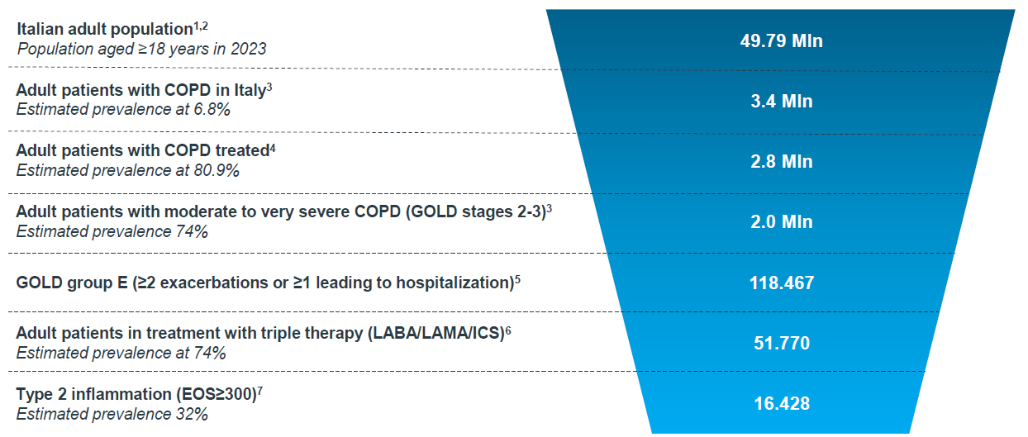
Dimensione e stratificazione epidemiologica
Sources: 1. Popolazione residente al 1° gennaio 2023, Istat; 2. Aspects of Daily Life dataset 2019; 3. Burden di malattia ed epidemiologia della BroncoPneumopatia Cronica Ostruttiva (BPCO) moderata o grave nella popolazione adulta italiana, Statinfo 2023; 4. Data collection from administrative database (SDO) from 2016-2019- only inpatient; 5. RWE from administrative database (ASL Umbria); 6. Alcazar-Navarrete et al., 2022, Vestbo et al., 2019, ECLIPSE Study.
Notes:
Sources: 1. Popolazione residente al 1° gennaio 2023, Istat; 2. IQVIA reprocessed istat data from the "Aspects of Daily Life" dataset 2019; 3. Burden di malattia ed epidemiologia della BroncoPneumopatia Cronica Ostruttiva (BPCO) moderata o grave nella popolazione adulta italiana, Statinfo 2023; 4. Sanofi Data on File; 5. Data collection from administrative database (SDO) from 2016-2019- only inpatient; 6. RWE from administrative database (ASL Umbria); 7. Alcazar-Navarrete et al., 2022, Vestbo et al., 2019, ECLIPSE Study

Slide 19
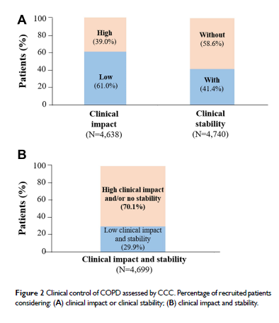
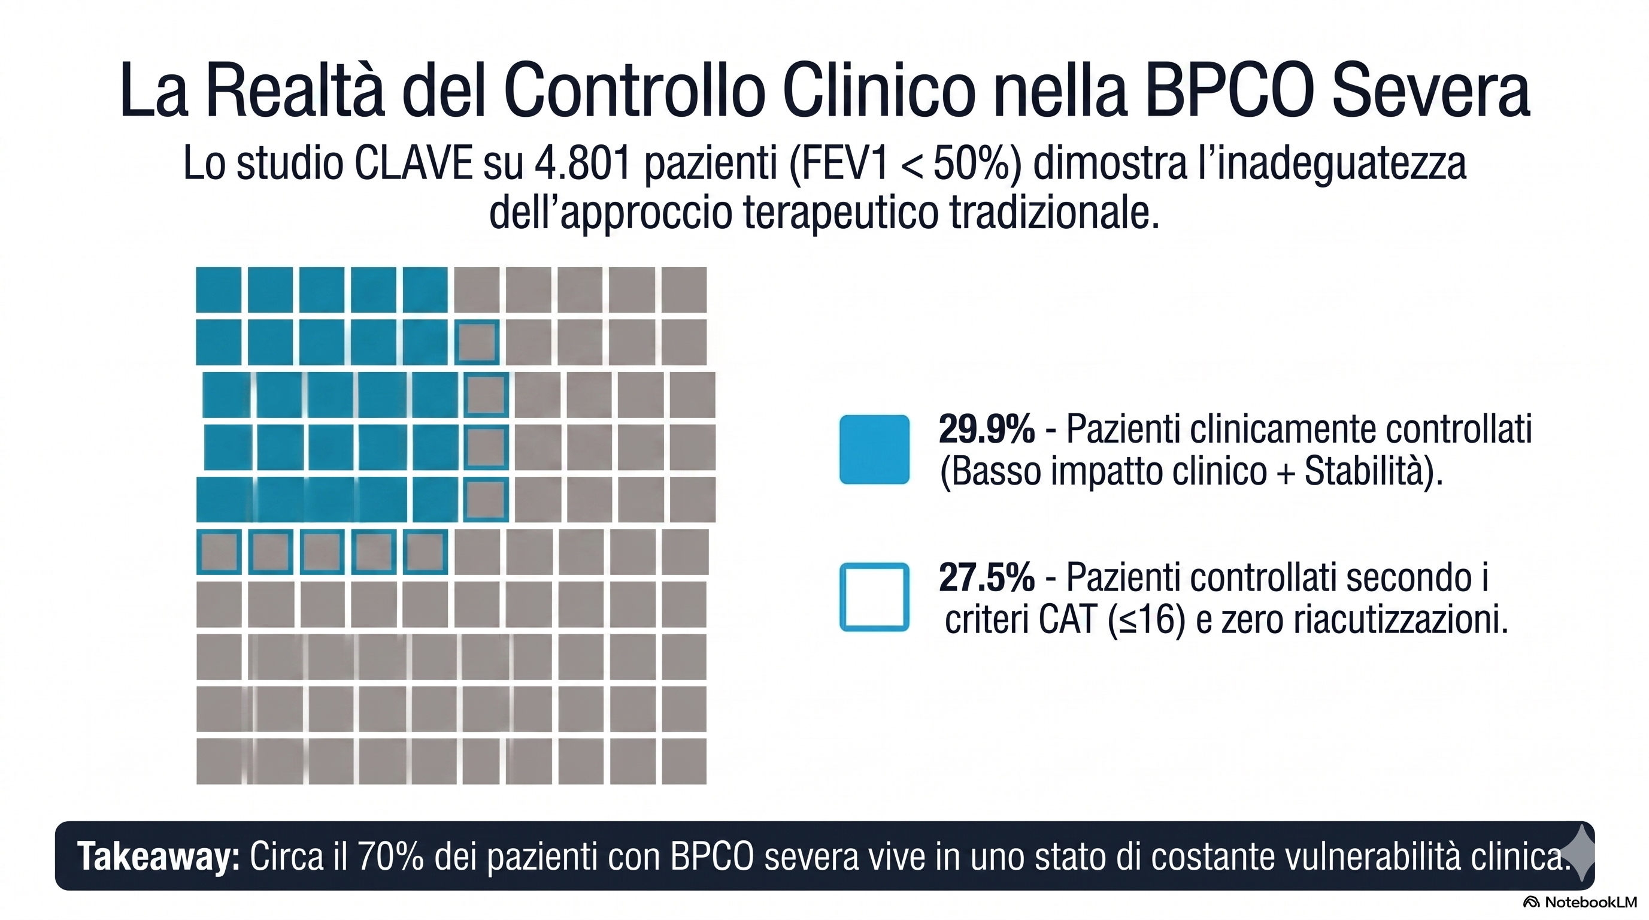
La realtà del controllo clinico nella BPCO grave
Lo studio CLAVE su 4.801 pazienti (FEV1 < 50%) dimostra l’inadeguatezza dell’approccio terapeutico tradizionale
Circa il 70% dei pazienti della coorte vive in uno stato di costante vulnerabilità clinica
Modificato da: Soler-Cataluña JJ, et al. Int J Chron Obstruct Pulmon Dis. 2021;16:137-146.
Notes:
The study design was observational, multicenter, cross-sectional study involving 4801 patients with severe COPD in Spain. Clinical control was defined according to clinical impact (dyspnea grade, use of rescue treatment in last week, sputum color, and daily physical activity) and stability (exacerbations in last 3 months and patient’s perception about health status). Clinical control of COPD was alternatively evaluated with the COPD assessment test (CAT) and the presence of exacerbations in the last 3 months. Results: According to CCC, 61.0% of patients had low clinical impact, and 41.4% showed clinical stability. Overall, 29.9% of patients had both low clinical impact and stability (controlled), whereas 70.1% showed high clinical impact and/or no clinical stability (non-controlled). COPD control was also assessed by using only the definition of CAT≤16 and no exacerbations in the last 3 months. Results obtained with this definition were similar to those obtained by CCC, and the concordance between both definitions was high (Kappa index = 0.698). Conclusion: By using the CCC, approximately only one third of patients with severe COPD were considered as controlled. Physical activity, adherence to inhalers, age, post-bronchodilator FEV1, age-adjusted Charlson comorbidity index, and healthcare level were independent factors associated with COPD control.

Slide 20
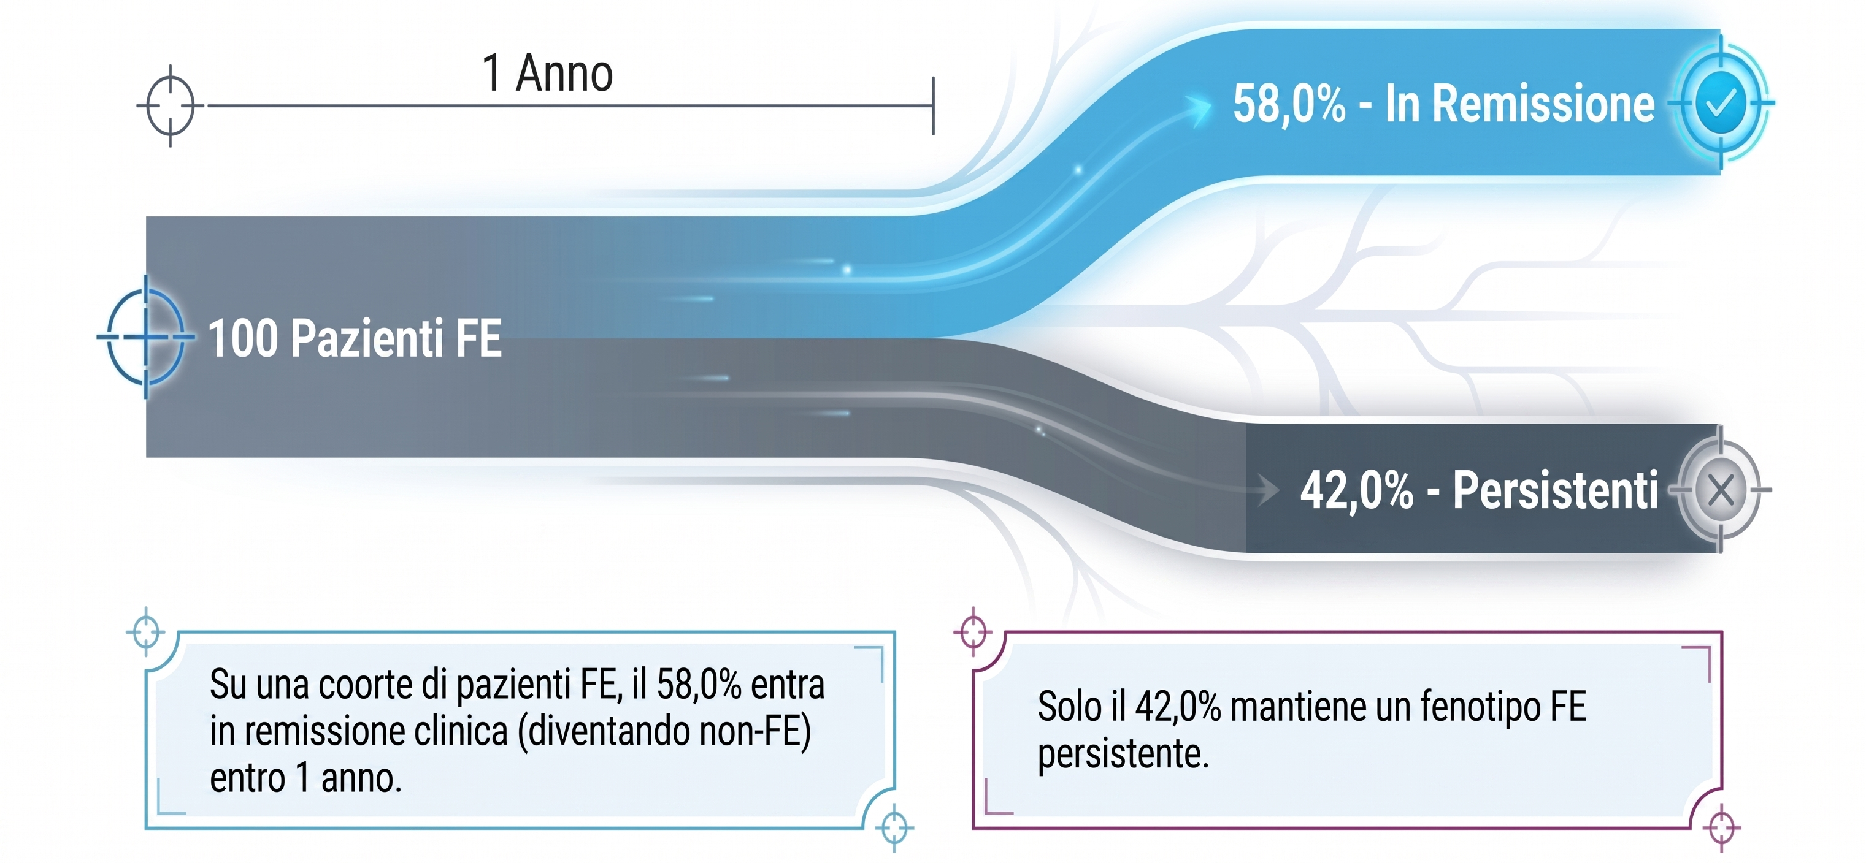
Il fenotipo “Frequent Exacerbator” (FE) non è una condizione statica
Airway eosinophilia—especially SE% ≥ 3%—independently associates with FE remission
Modificato da: Huang L, et al. Lung. 2026;204(1):2.
Notes:
A single-center prospective cohort (n = 289), patients were classified as FE (≥ 2 moderate or ≥ 1 severe exacerbation in the prior year; n = 88) or non-FE (n = 201) and followed 12 months. FE patients were labeled FE-persistent or FE-remitted at 1 year. Clinical data, spirometry, CT, fractional exhaled nitric oxide (FeNO), blood counts, and induced-sputum cytology were collected. Logistic regression identified correlates of remission; ROC/AUC with bootstrap validation and calibration assessed models.
Results FE prevalence was 30.4%; 58.0% of FE patients remitted. Compared with non-FE, FE had higher SE% and more eosinophilic/mixed sputum phenotypes. Within FE, remitters had better lung function and greater airway eosinophilia. Each 1% SE% increase independently predicted remission (OR 1.21, 95% CI 1.03–1.47); SE% ≥ 3% tripled the odds (OR 3.76, 95% CI 1.29–11.91). Prior severe exacerbations and CT-defined chronic bronchitis predicted persistence (ORs 0.21–0.27). Models showed good discrimination (AUC 0.785–0.799; bootstrap-corrected 0.750–0.773) and calibration (Brier 0.179). Conclusion FE status is dynamic; over half remit within a year. Airway eosinophilia—especially SE% ≥ 3%—independently associates with FE remission, while prior severe exacerbations and CT-chronic bronchitis indicate persistence. Incorporating sputum cytology with history and imaging may enable earlier re-stratification and treatable-trait–guided COPD care.

Slide 21
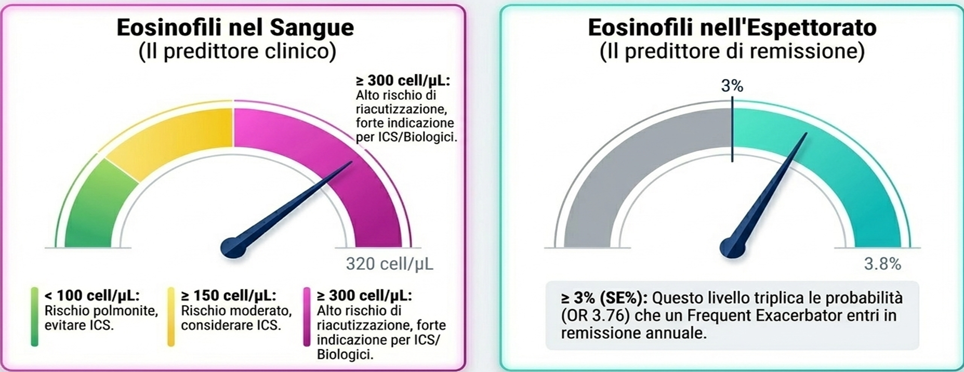
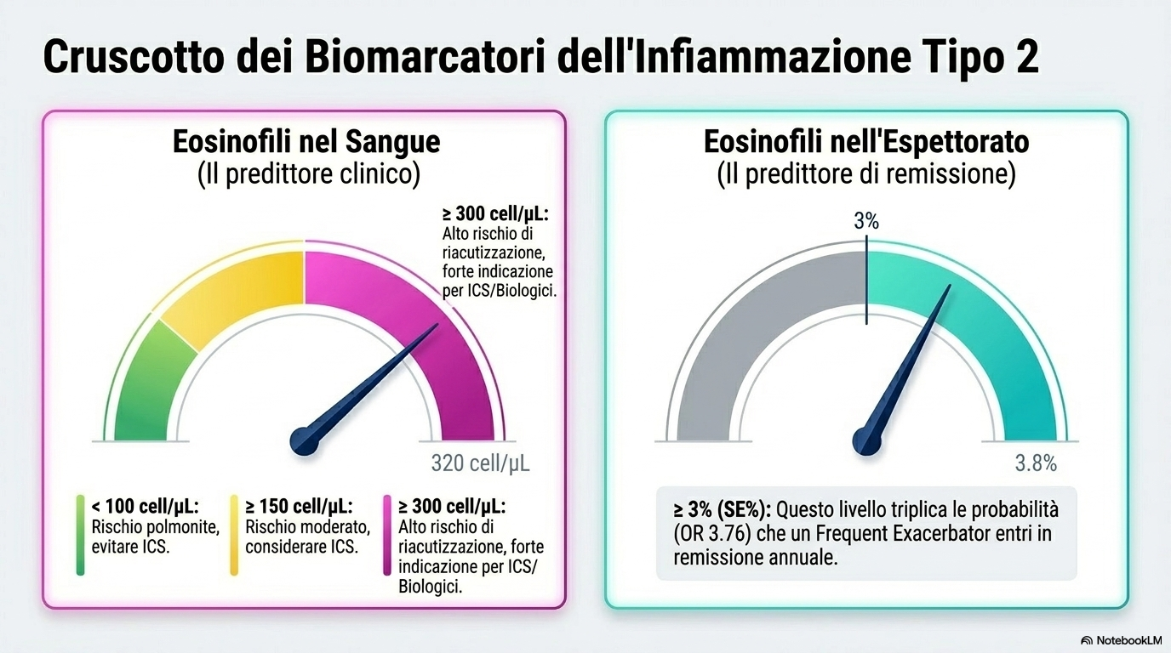
Cruscotto dei biomarkers Type 2
Modificato da: Huang L, et al. Lung. 2026;204(1):2.

Slide 22
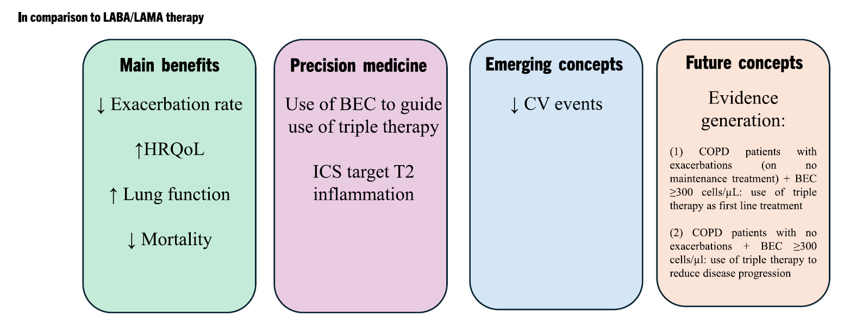
Triple therapy (ICS/LABA/LAMA) in the treatment of stable COPD
Singh D, et al. Drugs. 2025;85(7):911-930.

Slide 23
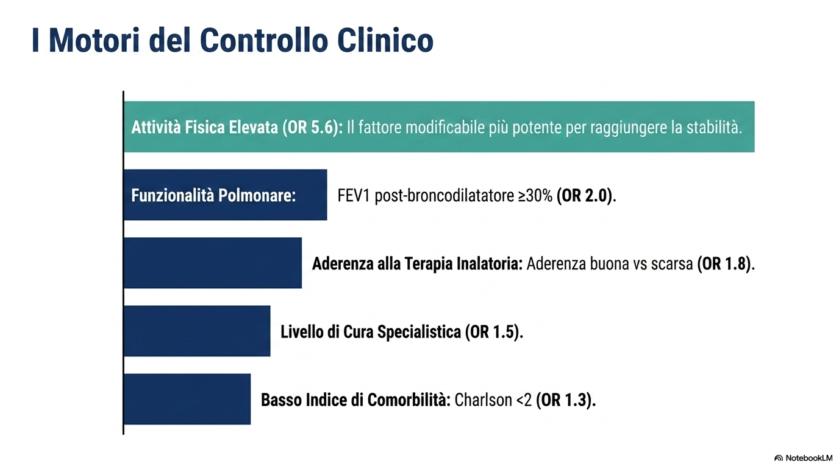
I motori del controllo clinico
Modificato da: Garcia-Aymerich J, et al. Thorax. 2003;58(2):100-5.

Slide 24
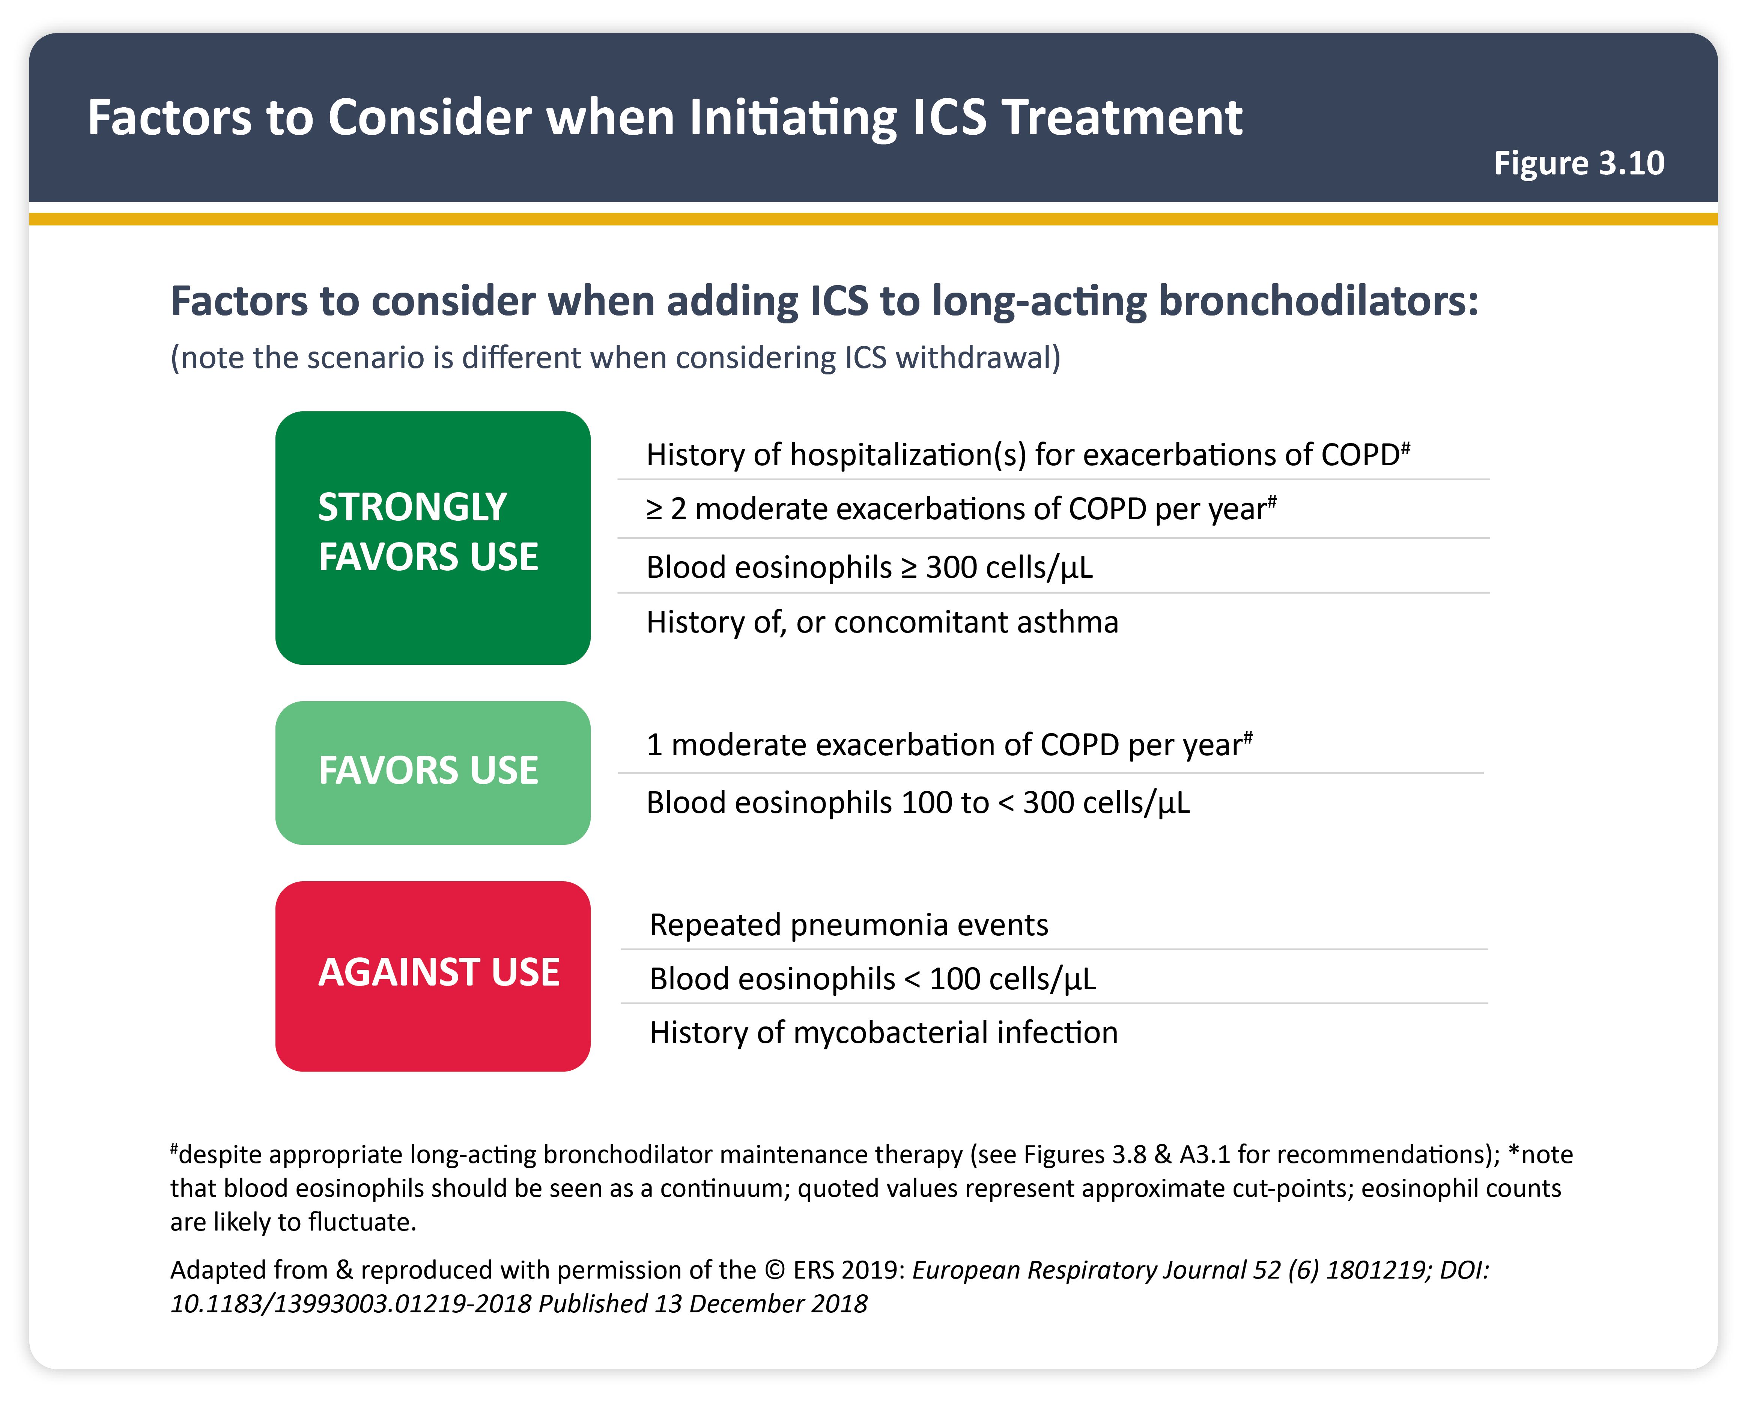

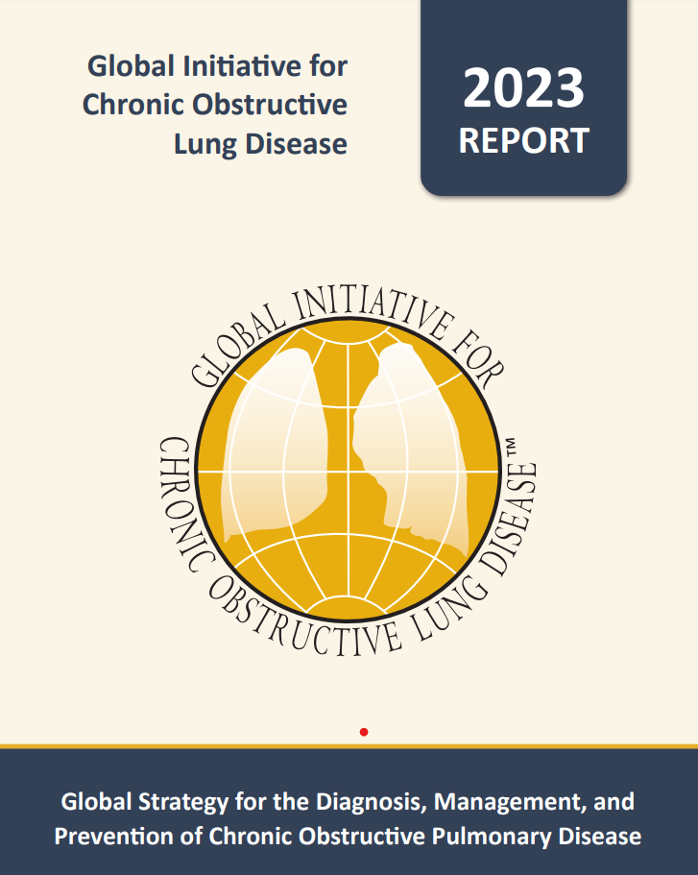

Slide 25
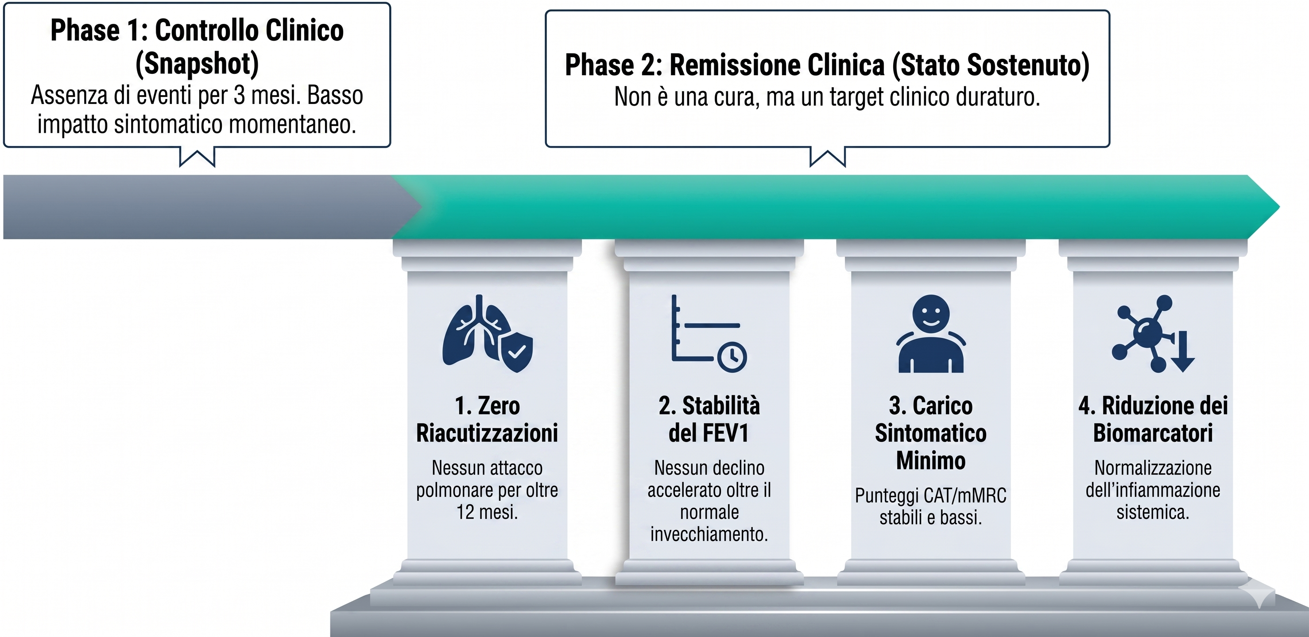
Oltre il controllo: obiettivo remissione clinica

Slide 26
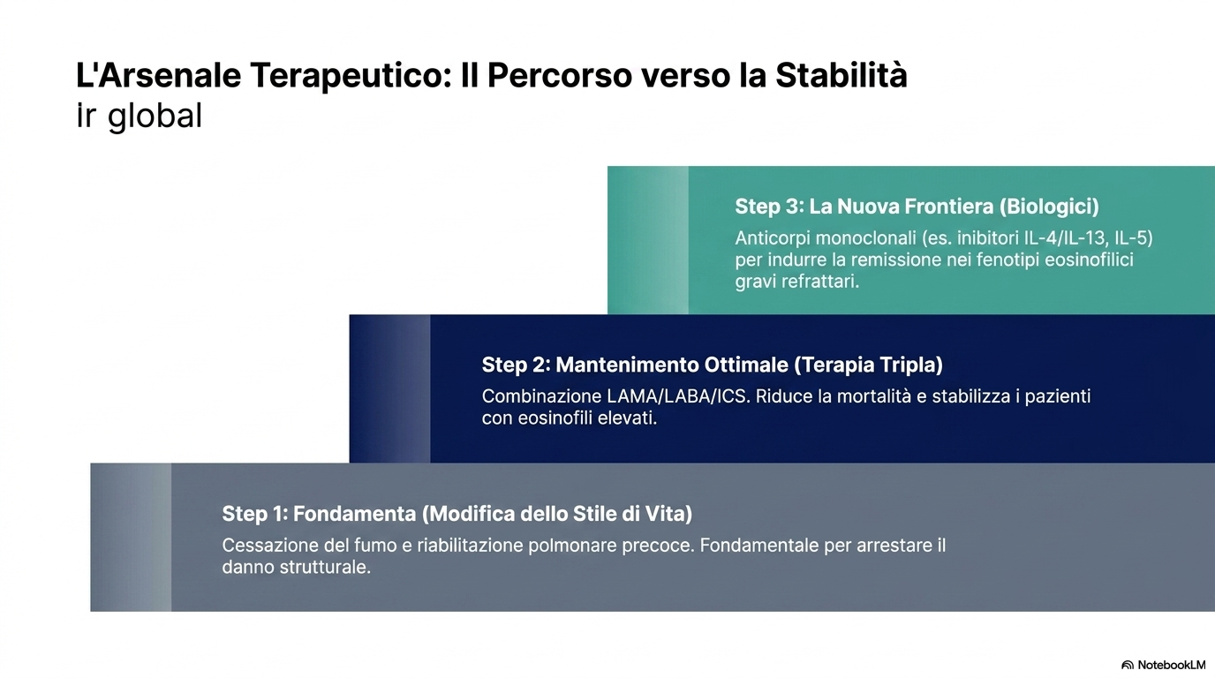
L’arsenale terapeutico: il percorso verso la stabilità

Slide 27
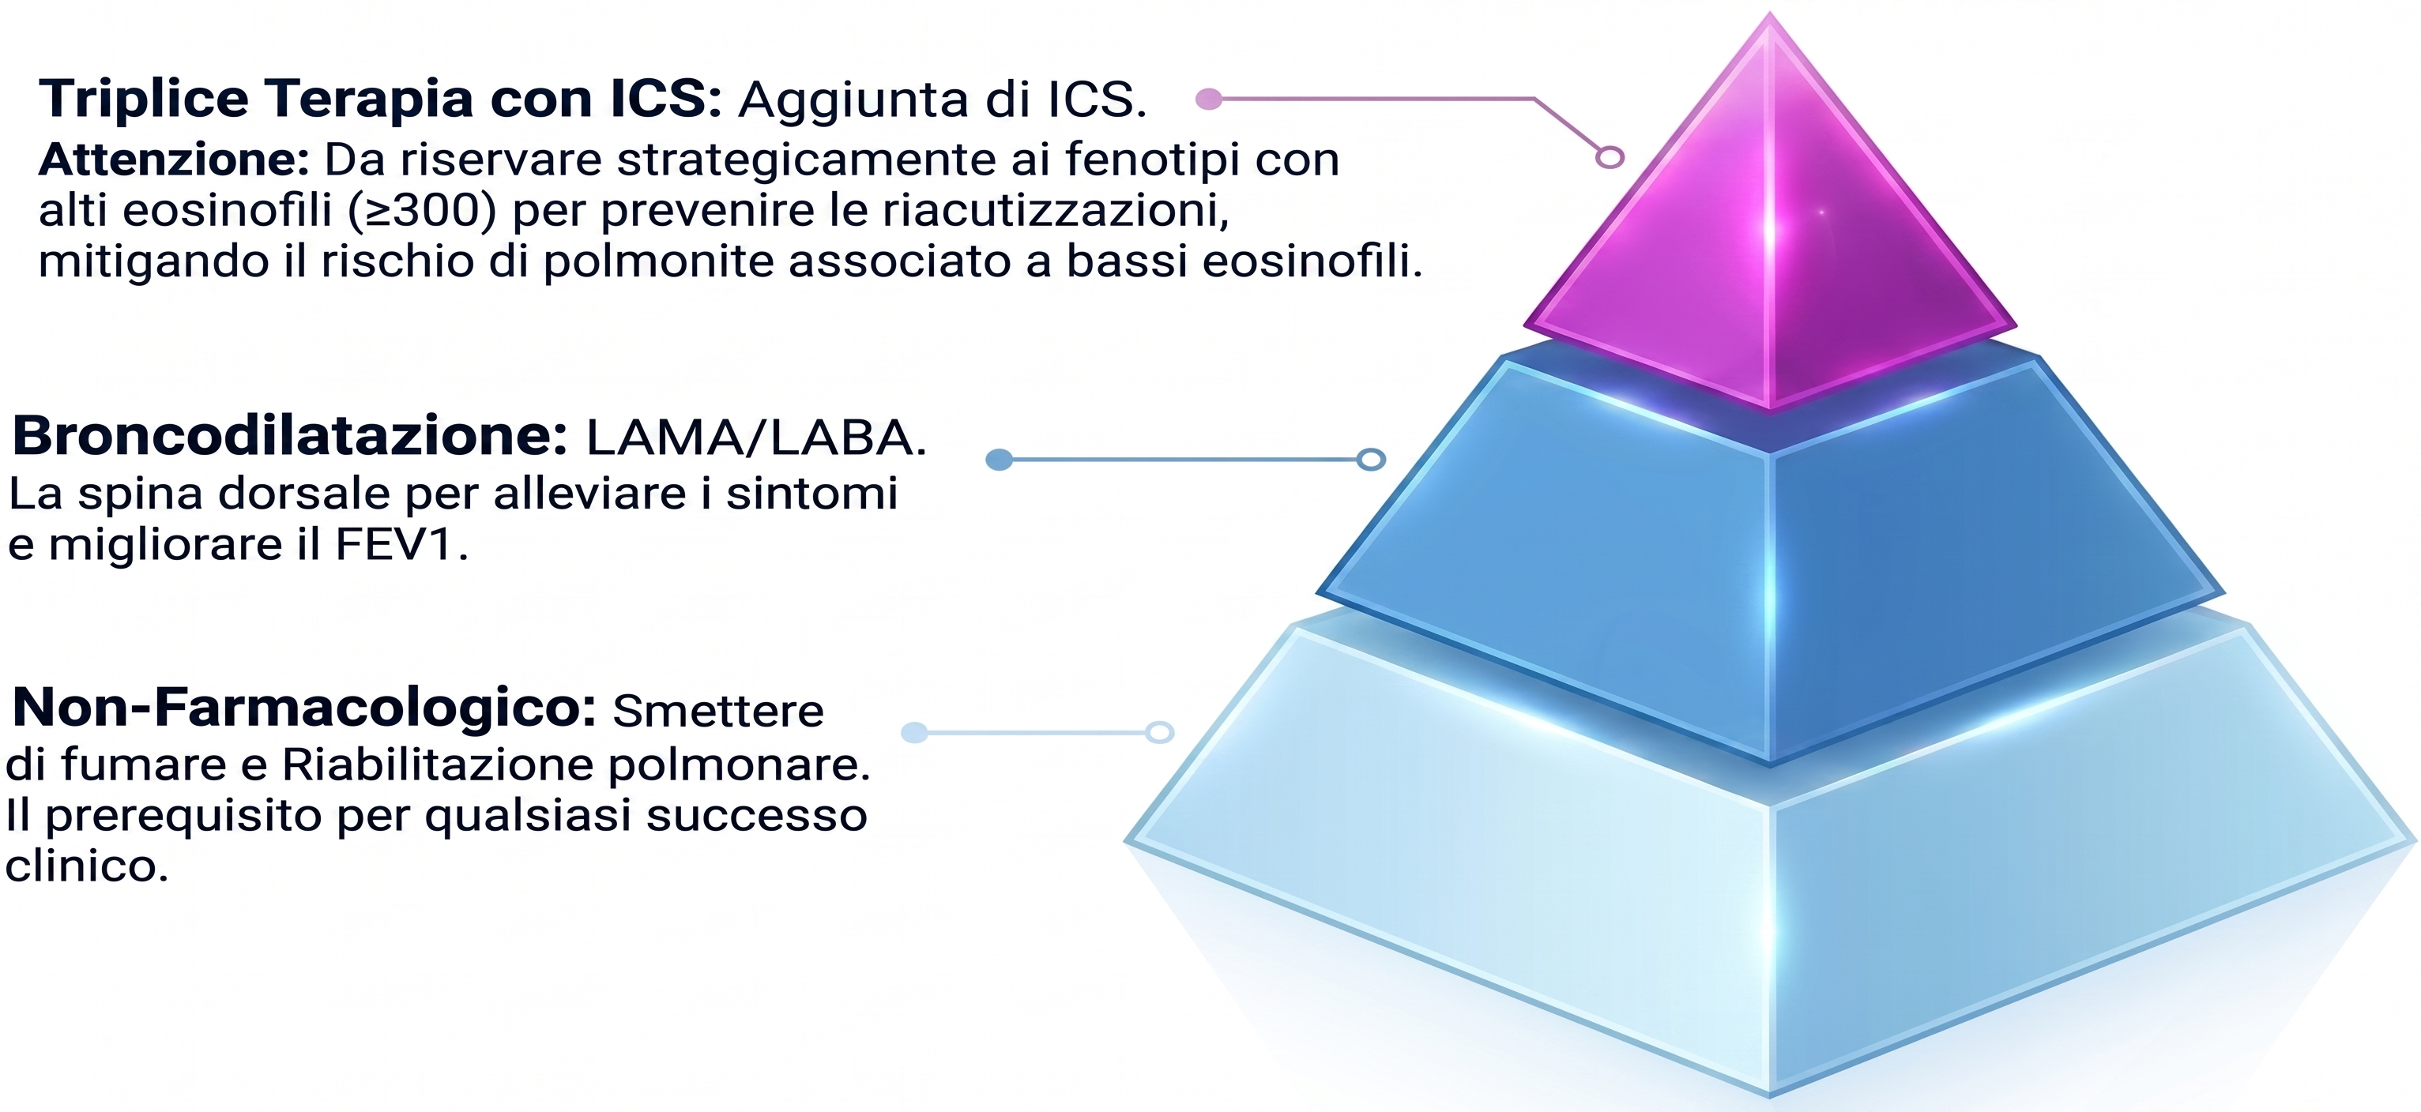
Le fondamenta del controllo: stratificare la terapia
GOLD 2026

Slide 28
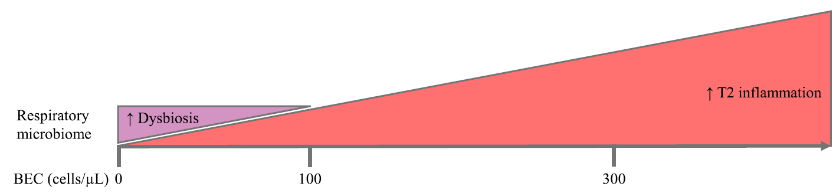
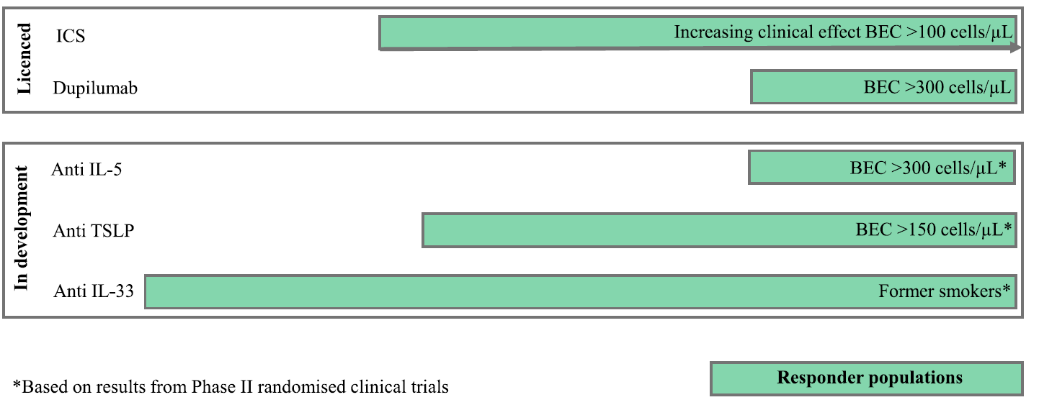
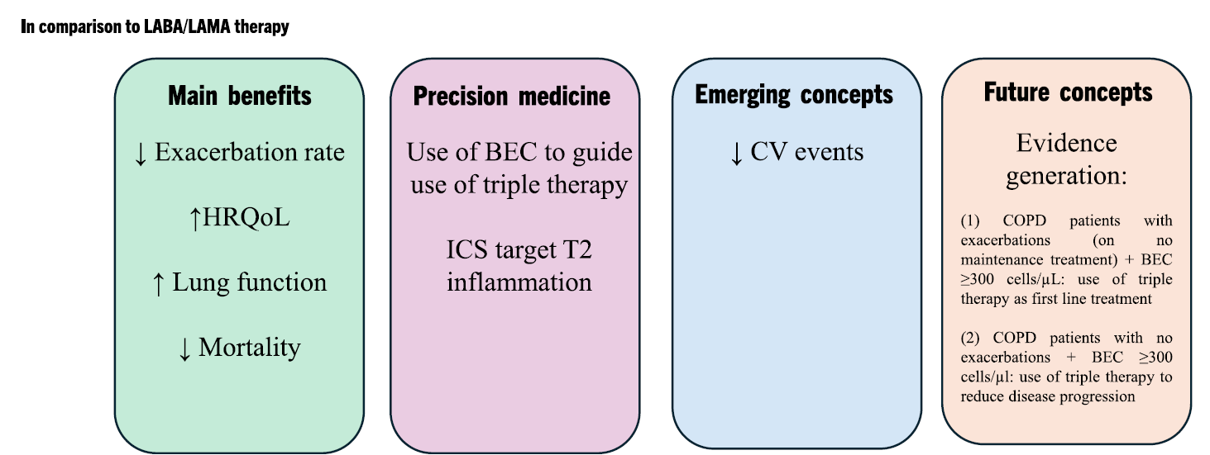
Pharmacological treatment for stable COPD
Singh D, et al. Drugs. 2025;85(7):911-930.

Slide 29
Dupilumab phase 3 Studies: annual rate of AECOPD (Primary Outcome)
NOTUS¹
BOREAS²
Rate Ratio (95% CI)
0.70 (0.58 to 0.86)
P<0.001
34% reduction in moderate or severe exacerbations over 52 weeks (P<0.001)
30% reduction in moderate or severe exacerbations over 52 weeks (P=0.0005)³
1. Bhatt SP, et al. N Eng J Med. 2024;390(24):2274-2283. 2. Bhatt SP, et al. N Engl J Med. 2023;389(3):205-214.

Slide 30
Dupilumab phase 3 studies: annualized rate of moderate or severe exacerbations in patients with baseline FeNO ≥20 ppb
NOTUS¹
BOREAS²
Rate Ratio (95% CI)
0.47 (0.33 to 0.68)
Rate Ratio (95% CI)
0.6 (0.5 to 0.9)
P=0.005
52% reduction in moderate or severe exacerbations in patients with baseline FeNO ≥20 ppb over 52 weeks
36% reduction in moderate or severe exacerbations over
52 weeks (P=0.0005)
1. Bhatt SP, et al. N Eng J Med. 2024;390(24):2274-2283. 2. Bhatt SP, et al. N Engl J Med. 2023;389:205–214.

Slide 31
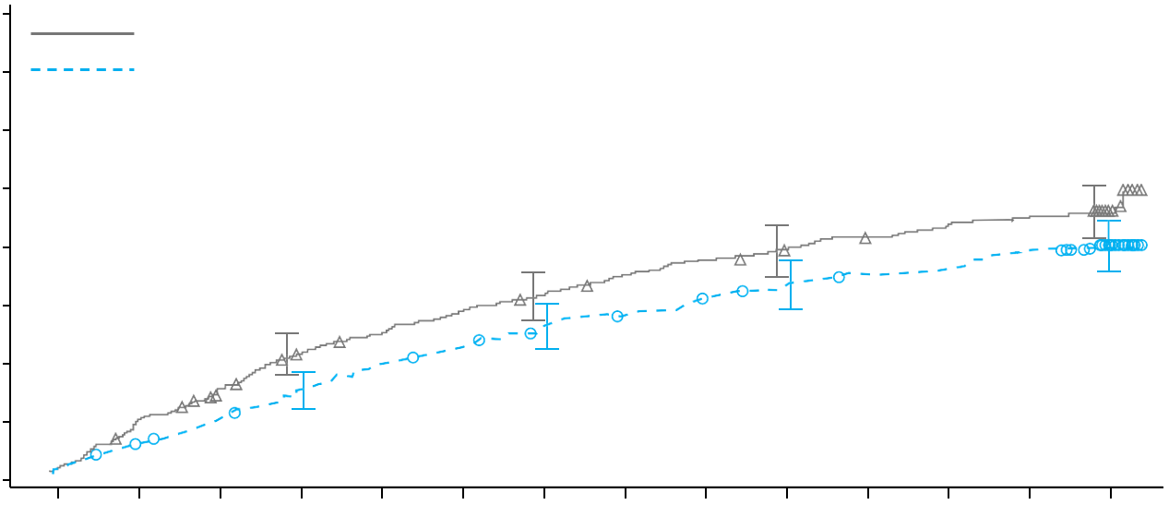
Dupilumab phase 3 studies: Time-to-first moderate or severe AECOPD over 52 weeks
NOTUS¹
BOREAS²
60
Placebo
Cumulative proportion of patients with moderate or severe COPD exacerbation
80
Placebo Dupilumab
Dupilumab
70
50
60
40
50
30
Probability of event (%)
40
20
30
20
10
10
0
0
Baseline
4
8
12
16
20
24
28
32
36
40
44
48
52
0
4
8
12
16
20
24
28
32
36
40
44
48
52
Week
Week
Number at risk
Number at risk
Placebo
465
442
414
378
355
339
319
301
282
262
248
232
211
149
Placebo | 471 | 435 | 405 | 370 | 350 | 333 | 320 | 302 | 290 | 281 | 269 | 262 | 253 | 197
Dupilumab | 468 | 446 | 425 | 403 | 378 | 363 | 348 | 333 | 324 | 309 | 299 | 294 | 280 | 216
Dupilumab
470
448
433
416
391
377
352
325
304
284
270
258
236
176
1. Bhatt SP, et al. N Eng J Med. 2024;390(24):2274-2283. 2. Bhatt SP, et al. N Engl J Med. 2023;389:205–214.

Slide 32
Dupilumab phase 3 studies: change in pre-BD FEV₁ at week 12
NOTUS¹
BOREAS²
LSMD (95% CI)
0.083 (0.042 to 0.125)
P<0.001
+82 mL improvement in lung function at Week 12 (P<0.001)
+83 mL improvement in lung function at Week 12 (P<0.001)
1. Bhatt SP, et al. N Eng J Med. 2024;390(24):2274-2283. 2. Bhatt SP, et al. N Engl J Med. 2023;389:205–214.

Slide 33
Dupilumab phase 3 studies: change in Pre-BD FEV₁ over 52 weeks
NOTUS¹
BOREAS²
Placebo
Placebo Dupilumab
Placebo: 0.07L change from baseline
Dupilumab: 0.153L change from baseline
Dupilumab
Placebo: 0.054L change from baseline
Dupilumab: 0.115L change from baseline
LS Mean Change from Baseline
in pre-BD FEV₁ (L)
0.32
0.32
0.28
Placebo: 0.057L change from baseline
Dupilumab: 0.139L change from baseline
0.28
Placebo: 0.077L change from baseline
Dupilumab: 0.160L change from baseline
0.24
0.24
0.20
0.20
0.16
0.16
LS mean change from baseline
in pre-BD FEV₁ (L)
0.12
0.12
0.8
0.08
0.4
0.04
0
0
–0.04
–0.04
–0.08
–0.08
BL
2
4
8
12
24
36
44
52
BL
2
4
8
12
24
36
44
52
Week
Week
No. of patients with data
No. of patients with data
Placebo
359
351
343
342
342
334
326
324
Placebo | 471 | 455 | 459 | 439 | 439 | 435 | 415 | 404 | 420
Dupilumab | 467 | 457 | 454 | 446 | 449 | 443 | 415 | 410 | 426
344
Dupilumab
361
352
347
348
341
335
327
332
353
1. Bhatt SP, et al. N Eng J Med. 2024;390(24):2274-2283. 2. Bhatt SP, et al. N Engl J Med. 2023;389:205–214.

Slide 34
Dupilumab phase 3 studies: change in SGRQ over 52 Weeks
NOTUS¹
BOREAS²
Placebo
Placebo Dupilumab
Dupilumab
0
Placebo: –6.4 change from baseline
Dupilumab: –9.8 change from baseline
LSM difference: –3.4 (–5.8 to –0.9)
LS Mean Change (95% CI) in SGRQ
0
Placebo: –6.4 change from baseline
Dupilumab: –9.7 change from baseline
LSM difference: –3.4 (–5.5 to –1.3) P=0.002
–2
–2
–4
–4
–6
–6
LS Mean Change from Baseline
in SGRQ Total Score
–8
–8
–10
–10
–12
–12
–14
–14
Baseline
4
12
24
36
52
Baseline
4
12
24
36
52
Week
Week
No. of patients with data
No. of patients with data
Placebo
347
325
318
313
318
310
Placebo | 461 | 439 | 430 | 407 | 414 |  | 400
Dupilumab | 461 | 444 | 436 | 434 | 407 |  | 415
Dupilumab
352
326
327
331
322
317
1. Bhatt SP, et al. N Eng J Med. 2024;390(24):2274-2283. 2. Bhatt SP, et al. N Engl J Med. 2023;389:205–214.
Notes:
LSM difference (Least Squares Mean difference) represents the adjusted difference between two group means in statistical models (like ANOVA or ANCOVA), accounting for covariates and unbalanced data

Slide 35
MATINEE recruited a wide spectrum of patients with COPD and treated them for up to 104 weeks
A randomised, double-blind, placebo-controlled Phase III trial to investigate the efficacy and safety of mepolizumab in a wide spectrum of patients with COPD with type 2 inflammation characterised by BEC who continued to exacerbate despite
ICS-based triple inhaled therapy¹
Patient population^{1,2}
Age ≥40 years
COPD diagnosis for ≥1 year, but no history or concurrent diagnosis of asthma
Screening BEC ≥300 cells/µL and a documented historical BEC ≥150 cells/µL in the 12 months prior or 14–21 days before randomisation
≥2 moderate or ≥1 severe COPD exacerbation(s)* in past 12 months
SoC background therapy: ICS + LAMA + LABA ≥3 months prior to Visit 1
Patients with and without symptoms
of chronic bronchitis
GOLD Stage 2–4
mMRC dyspnoea scale grade 0–4
Former and current smokers
52 to 104-week variable duration§
Triple inhaled therapy +
placebo
Screening
V0†
Screening
V1/run-in‡
R
1:1
3–21 days
14–21 days
Triple inhaled therapy¶ +
mepolizumab 100 mg SC Q4W
  Secondary efficacy endpoints (in order of hierarchy):¹
  Time-to-first moderate/severe exacerbation** up to Week 104
  Proportion of CAT score responders at Week 52, SGRQ total score responders at Week 52 and E-RS:COPD total score responders at Week 49–52
  Annualised rate of exacerbations requiring ED visit and/or hospitalisation up to Week 104
  Primary endpoint:¹
  Annualised rate of moderate/severe exacerbations**
  up to Week 104
  Exploratory efficacy endpoints (excerpt):^{1,2}
  Annualised rate of severe exacerbations
  Change from baseline in prebronchodilator FEV₁ at Week 52
1. Sciurba FC, et al. N Engl J Med. 2025;392:1710–20; 2. Sciurba FC, et al. N Engl J Med. 2025;392:1710–20. Supplementary appendix.

Slide 36
MATINEE Outcomes overview
1
MATINEE is a Phase III trial investigating the efficacy and safety of mepolizumab in patients with COPD with type 2 inflammation characterised by BEC:
It enrolled a wide spectrum of patients who continued to exacerbate despite ICS-based triple
inhaled therapy
It is the first trial to assess efficacy and safety outcomes of a biologic in COPD for up to 104 weeks
2
Mepolizumab was effective in improving exacerbation-related outcomes:
Mepolizumab significantly reduced annualised rate of moderate/severe exacerbations by 21% compared with placebo, sustained for up to 104 weeks
Mepolizumab significantly delayed the time to first moderate/severe exacerbation by 98 days compared with placebo
The annualised rate of exacerbations leading to ED visits and/or hospitalisation was reduced by 35% with mepolizumab compared with placebo (nominal significance)
3
The efficacy of mepolizumab in reducing moderate/severe exacerbations appeared to be generally consistent across key subgroups
4
Mepolizumab was well tolerated in patients with COPD, with similar rates of AEs between mepolizumab
and placebo

Slide 37

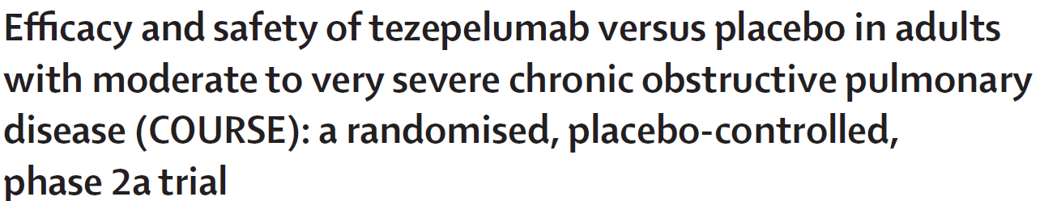
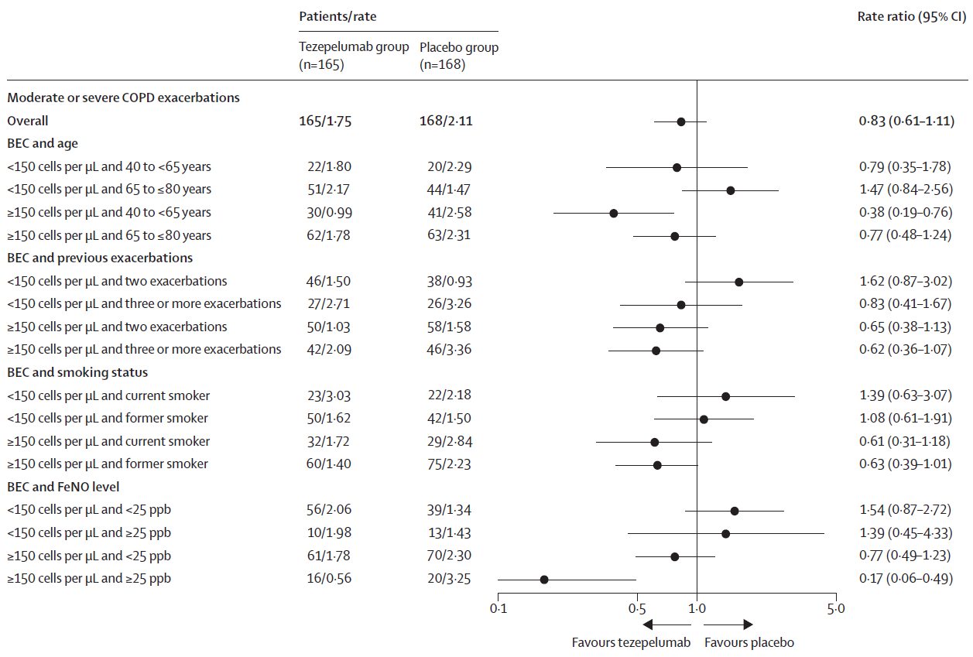
Tezepelumab did not significantly reduce the annualised rate of moderate or severe COPD exacerbations compared with placebo.
Prespecified and post-hoc analyses identified a potential population of patients with a blood eosinophil count of 150 cells per μL or higher who might benefit from tezepelumab treatment.
Singh D et al. Lancet Respir Med. 2025;13:47–58.

Slide 38




The Phase III EMBARK and JOURNEY studies will investigate the efficacy and safety of tezepelumab in patients with COPD
Objective
Patient population
Primary endpoint
Evaluate the efficacy and safety of tezepelumab in adult patients with COPD
Adult patients (aged 40–80 years) with moderate to very severe COPD on triple or dual inhaled therapy,ª a history of ≥2 moderate or ≥1 severe exacerbations in prior 12 months, and BEC of ≥150 cells/μL
Annualized rate of moderate or severe COPD exacerbations
up to 76 weeks
Tezepelumab Dose 1 SC Q4W
Safety Follow-up
Screening
(Estimated N=990
per trial)
Randomization 1:1:1
Tezepelumab Dose 2 SC Q4W
Placebo SC Q4W
52 weeks minimum; up to 76 weeks maximum
12 weeks
Select secondary endpoints
Change from baseline in pre- and post-BD FEV₁ at Week 52
Change from baseline and clinically meaningful improvement^{b} in the SGRQ and CAT total score over 52 weeks
Annualized rate of severe COPD exacerbations up to 76 weeks
Time to first moderate to severe, and severe COPD exacerbation up to 76 weeks
Annualized rate of moderate or severe COPD exacerbations among patients with BEC ≥300 cells/µL
1. Study NCT06883305. ClinicalTrials.gov website. https://clinicaltrials.gov/study/NCT06883305; 2. Study NCT06878261. ClinicalTrials.gov website. https://clinicaltrials.gov/study/NCT06878261.

Slide 39






Tozorakimab is a high-affinity human anti-IL33 antibody with a unique MOA inhibiting downstream activity of both IL-33RED and IL-33OX
Tozorakimab has a novel mechanism of action
Epithelial dysfunction
IL-33RED
Tozorakimab uniquely inhibits both IL-33RED–ST2 and IL-33OX–RAGE/EGFR activity, offering the potential to address pathophysiological features of COPD to reduce inflammation and reverse airway epithelial dysfunction
Tozorakimab
IL-33OX
ST2 pathway
RAGE/EGFR pathway
IL-1RAP
ST2
Inflammation
England E, et al. Sci Rep 2023;13:982
Notes:
An innovative antibody generation campaign was undertaken to generate a therapeutic antibody which can target IL-33. Tozorakimab was identified and is the first anti-IL-33 antibody that inhibits the activity of both IL-33RED and IL-33OX¹The left panel is a schematic of the mode of action of tozorakimab. IL-33RED is rapidly released following epithelial damage. Tozorakimab binds to IL-33RED and neutralizes it’s inflammatory activities at the ST2 receptor. The IL-33RED–tozorakimab complex prevents the conformational change of IL-33RED to IL-33OX, IL-33OX–RAGE/EGFR signalling and the associated epithelial dysfunction¹
Abbreviations
EGFR, epidermal growth factor receptor; IL, interleukin; IL-33RED, reduced IL-33; IL-33OX, oxidized IL-33; RAGE, receptor for advanced glycation end products; ST2, serum-stimulated 2
References
England E, et al. Sci Rep 2023;13:982
IL-33ox activates an alternative, ST2-independent pathway through a signalling complex of receptor for advanced glycation end products (RAGE) and epidermal growth factor receptor (EGFR) expressed on the airway epithelium. Activation of the IL-33ox–RAGE/EGFR pathway in healthy airway epithelial cells impaired epithelial wound closure and led to mucus hypersecretion, mimicking the phenotype of COPD-derived cells

Slide 40
Outcomes of biological agents in COPD
Biologic Agent | Target | Population / Biomarker | Effect on Exacerbation Rate | Effect on Lung Function (FEV₁) | Effect on Quality of Life / Symptoms | Trial/Notes
Mepolizumab | IL-5 | Eosinophilic COPD (≥150 eos/µL) | ~20% reduction (significant in eos ≥300/µL) | Modest improvement | Some improvement (SGRQ, CAT) | METREX, METREO, MATINEE
Benralizumab | IL-5Rα | Eosinophilic COPD | Mixed results; modest in high eos subgroup | Mild improvement | No significant overall improvement | GALATHEA, TERRANOVA, ABRA, RESOLUTE
Dupilumab | IL-4Rα (blocks IL-4/13) | COPD with type 2 inflammation (eosin ≥300/µL or high FeNO) | ~30% reduction in exacerbations | Significant FEV₁ gain (~160 mL) | Notable QoL improvement | BOREAS, NOTUS
Itepekimab | IL-33 | Moderate-to-severe COPD | ~19% reduction (not statistically significant overall) | Minimal | Slight improvement in SGRQ | AERIFY-1, AERIFY-2
Tozorakimab | IL-33 (neutralizing antibody) | Broad COPD population | Early trials; possible reduction | TBD | TBD | FRONTIER-4, OBERON, TITANIA, PROSPERO
Astegolimab | ST2 (IL-33 receptor) | Non-eosinophilic COPD | No significant benefit | No consistent FEV₁ change | No clear symptom change | RIVER, ALIENTO, ARNASA
Tezepelumab | TSLP | Broad COPD (including non-eosinophilic) | No significant reduction in recent Phase 2 trial | No benefit | No benefit | COURSE, JOURNEY, EMBARK

Slide 41
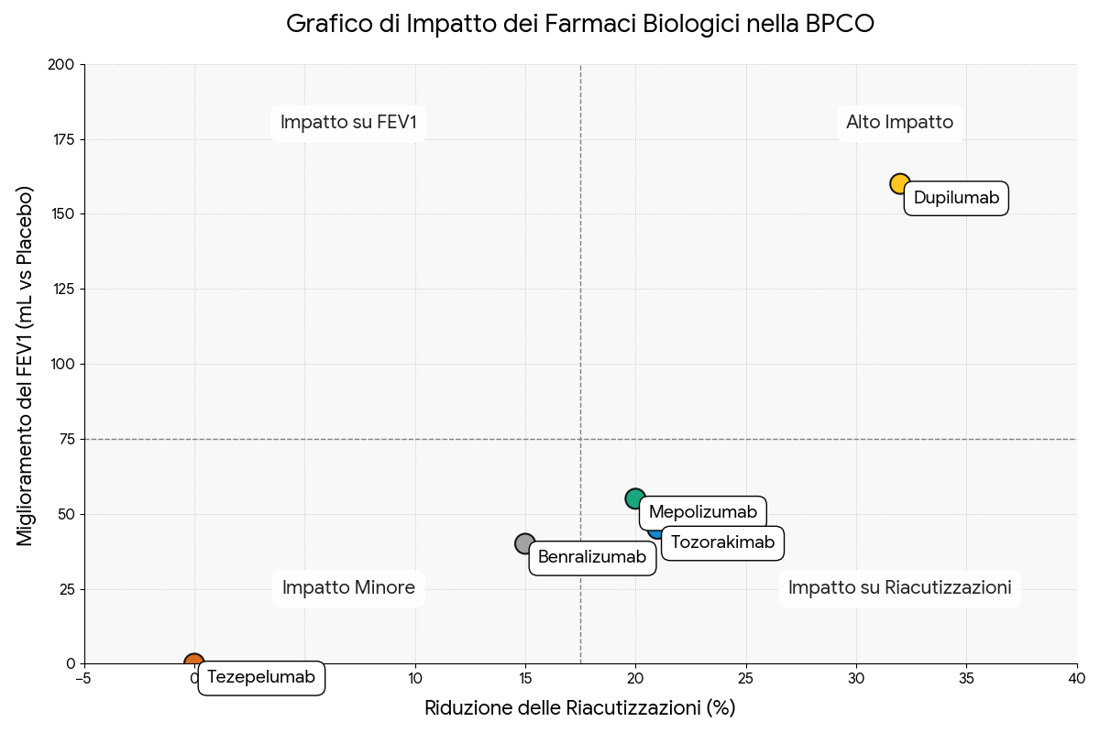
Efficacia dei farmaci biologici per la BPCO
Astegolimab
Itepekimab
Notes:
Interpretazione del GraficoCome mostra il grafico, i farmaci si posizionano in modo diverso in base alla loro efficacia:Quadrante in alto a destra (Alto Impatto): Dupilumab si colloca chiaramente in questa area, dimostrando un'elevata efficacia sia nel ridurre le riacutizzazioni sia nel migliorare significativamente la funzione polmonare.Altri quadranti: Gli altri farmaci mostrano un impatto più moderato o mirato. Mepolizumab e Tozorakimab mostrano un buon effetto sulla riduzione delle riacutizzazioni ma con un miglioramento più modesto del FEV₁. Benralizumab (nella sua indicazione per la terapia di mantenimento) ha un impatto più lieve su entrambi i fronti, mentre Tezepelumab si posiziona all'origine, riflettendo i risultati non significativi dello studio di fase 2.

Slide 42
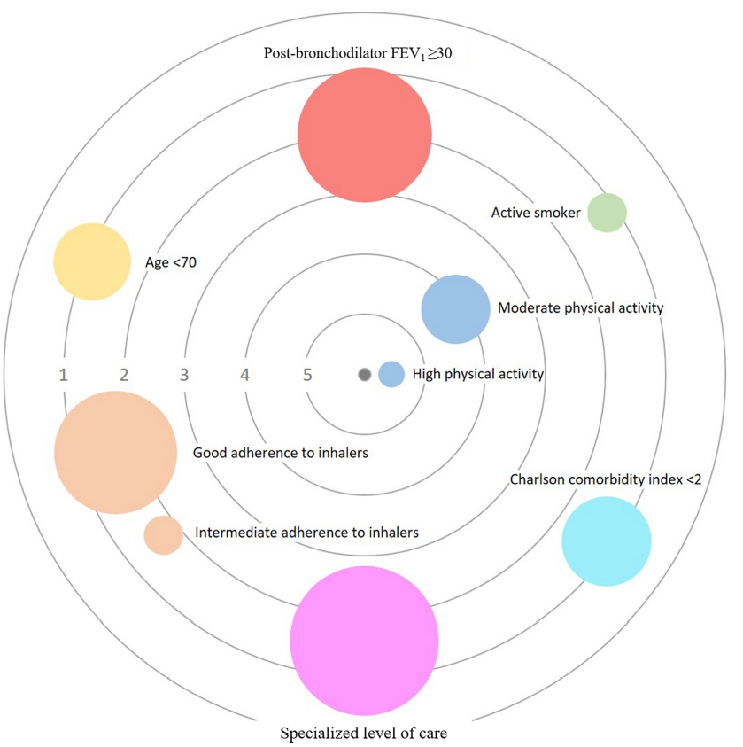
Strength of the association between independent factors and COPD control
Soler-Cataluña JJ, et al. Int J Chron Obstruct Pulmon Dis. 2021;16:137-146.
Notes:
Radial Cluster Diagram (diagramma radiale a cluster), spesso chiamato colloquialmente anche grafico a bersaglio (Target Plot)Questa slide presenta graficamente i risultati di uno studio (Soler-Cataluña JJ, et al., 2021) sulla forza dell'associazione tra diversi fattori indipendenti e il controllo della BPCO (Broncopneumopatia Cronica Ostruttiva).
Ecco come interpretare correttamente il grafico a "bersaglio":
1. Come leggere la struttura del grafico
Posizione (Distanza dal centro): Più un cerchio è vicino al centro (valore 5), maggiore è la forza dell'associazione statistica con il buon controllo della malattia. I cerchi posizionati sugli anelli più esterni (1 o 2) hanno un'associazione più debole.
Dimensione dei cerchi: Tipicamente, in questo tipo di rappresentazioni, la dimensione riflette il peso o la prevalenza del fattore nel campione studiato o la precisione del dato (intervallo di confidenza).
2. Analisi dei fattori chiave
I fattori sono disposti in base al loro impatto sul controllo della BPCO:
I fattori più influenti (più vicini al centro):
Attività fisica: Sia l'attività fisica alta (quasi al livello 5) che quella moderata (livello 4) sono i fattori più vicini al centro. Questo suggerisce che muoversi costantemente sia uno dei predittori più forti per una malattia ben controllata.
Fattori con impatto intermedio (livello 3):
Aderenza agli inalatori: Il grafico distingue tra aderenza "buona" e "intermedia". È interessante notare che l'aderenza è posizionata verso il centro, sottolineando che prendere correttamente i farmaci è fondamentale.
Fattori periferici (livelli 1-2):
Funzione polmonare (FEV1​≥30): Sebbene importante, si trova in una fascia più esterna rispetto all'attività fisica.
Età < 70 e Comorbidità (Charlson index < 2): Hanno un'associazione rilevabile ma meno "centrale" rispetto ai comportamenti attivi del paziente.
Fumo (Active smoker): Si trova sull'anello esterno, a indicare la sua influenza negativa o la difficoltà di controllo nei pazienti fumatori.
Livello di cura specialistico: Anche l'essere seguiti da specialisti appare come un fattore correlato, posizionato tra il livello 2 e 3.
3. Messaggio principale (Take-home message)
La slide vuole comunicare che il controllo della BPCO non dipende solo dalla gravità clinica "statica" (come i valori della spirometria), ma è fortemente influenzato dallo stile di vita e dal comportamento del paziente.
In sintesi: L'attività fisica elevata e una buona aderenza alla terapia inalatoria sono i pilastri che pesano di più nel determinare se un paziente avrà una malattia ben controllata.
clinical control criteria (CCC) The study design was observational, multicenter, cross-sectional study involving 4801 patients with severe COPD in Spain. Clinical control was defined according to clinical impact (dyspnea grade, use of rescue treatment in last week, sputum color, and daily physical activity) and stability (exacerbations in last 3 months and patient’s perception about health status). Clinical control of COPD was alternatively evaluated with the COPD assessment test (CAT) and the presence of exacerbations in the last 3 months. Results: According to CCC, 61.0% of patients had low clinical impact, and 41.4% showed clinical stability. Overall, 29.9% of patients had both low clinical impact and stability (controlled), whereas 70.1% showed high clinical impact and/or no clinical stability (non-controlled). COPD control was also assessed by using only the definition of CAT≤16 and no exacerbations in the last 3 months. Results obtained with this definition were similar to those obtained by CCC, and the concordance between both definitions was high (Kappa index = 0.698). Conclusion: By using the CCC, approximately only one third of patients with severe COPD were considered as controlled. Physical activity, adherence to inhalers, age, postbronchodilator FEV1, age-adjusted Charlson comorbidity index, and healthcare level were independent factors associated with COPD control.

Slide 43
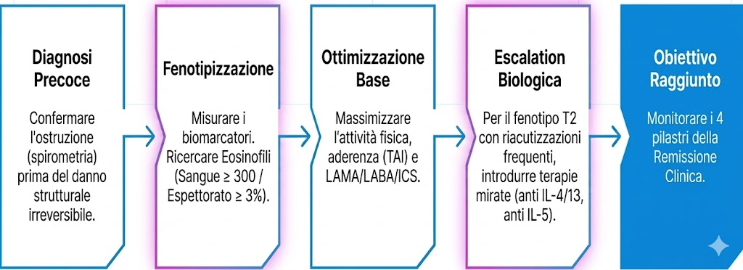
Take Away
Il percorso verso la remissione clinica della BPCO
Notes:
Assenza di riacutizzazioni: Nessun episodio che richieda l'uso di steroidi sistemici o ospedalizzazione.
Controllo dei sintomi: Punteggio ottimale nei test validati (come l'ACT per l'asma o il CAT per la BPCO).
Stabilità della funzione polmonare: Nessun declino significativo del $FEV_1$ (Volume Espiratorio Forzato nel primo secondo).
4. Assenza di corticosteroidi orali (OCS): Il controllo deve essere mantenuto senza ricorrere ciclicamente al cortisone per bocca, minimizzando gli effetti collaterali a lungo termine.

