Slide 1


Effetti a lungo termine della terapia della BPCO
Antonio Spanevello MD, FERS
GOLD National Leader - Italy
Università degli Studi dell’Insubria, Varese - Como
Dipartimento di Medicina e Chirurgia
Malattie dell’Apparato Respiratorio
Istituti Clinici Scientifici Maugeri, IRCCS, Tradate
Dipartimento di Medicina e Riabilitazione Cardiorespiratoria
UO Pneumologia Riabilitativa
Notes:
In quest’ottima rassegna di Dave Sing viene messo in risalto come non solo la condizione cronica ma anche la riacutizzazione di BPCO aumenta il rischio di eventi cardiovascolari.

Slide 2
Il sottoscritto ANTONIO SPANEVELLO
ai sensi dell’art. 76, comma 4 dell’Accordo Stato- Regioni del 2 febbraio 2017 e del paragrafo 4.5. del Manuale nazionale di accreditamento per l'erogazione di eventi ECM,
dichiara
che negli ultimi due anni ha avuto rapporti diretti di finanziamento con i seguenti soggetti portatori di interessi commerciali in campo sanitario:
Chiesi
Astrazeneca
Menarini
GSK
MSD
Sanofi
Lusofarmaco

Slide 3

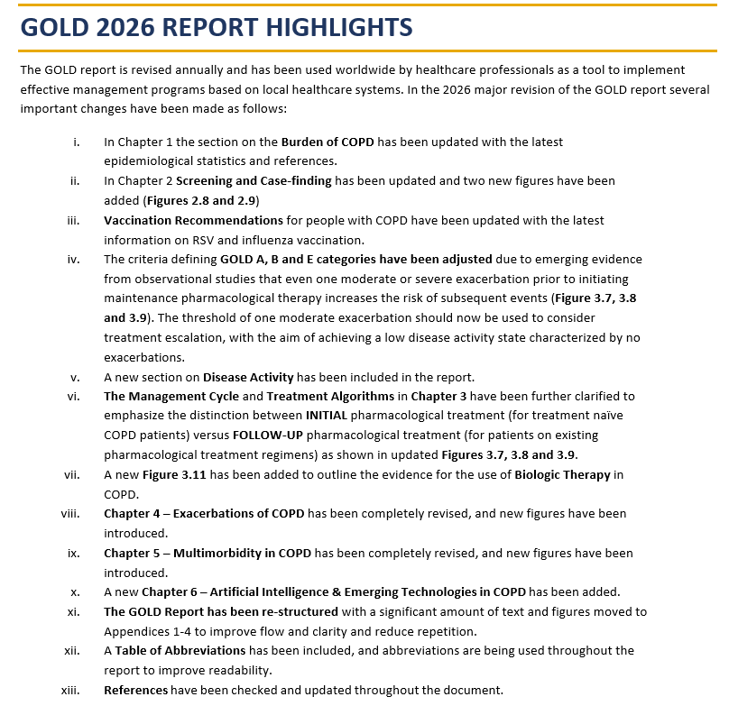

Slide 4


AGENDA
Screening and case finding
Disease activity
Pharmacological Treatment
Non-Pharmacological Treatment

Slide 5
AGENDA
Screening and case finding
Disease activity
Pharmacological Treatment
Non-Pharmacological Treatment

Slide 6
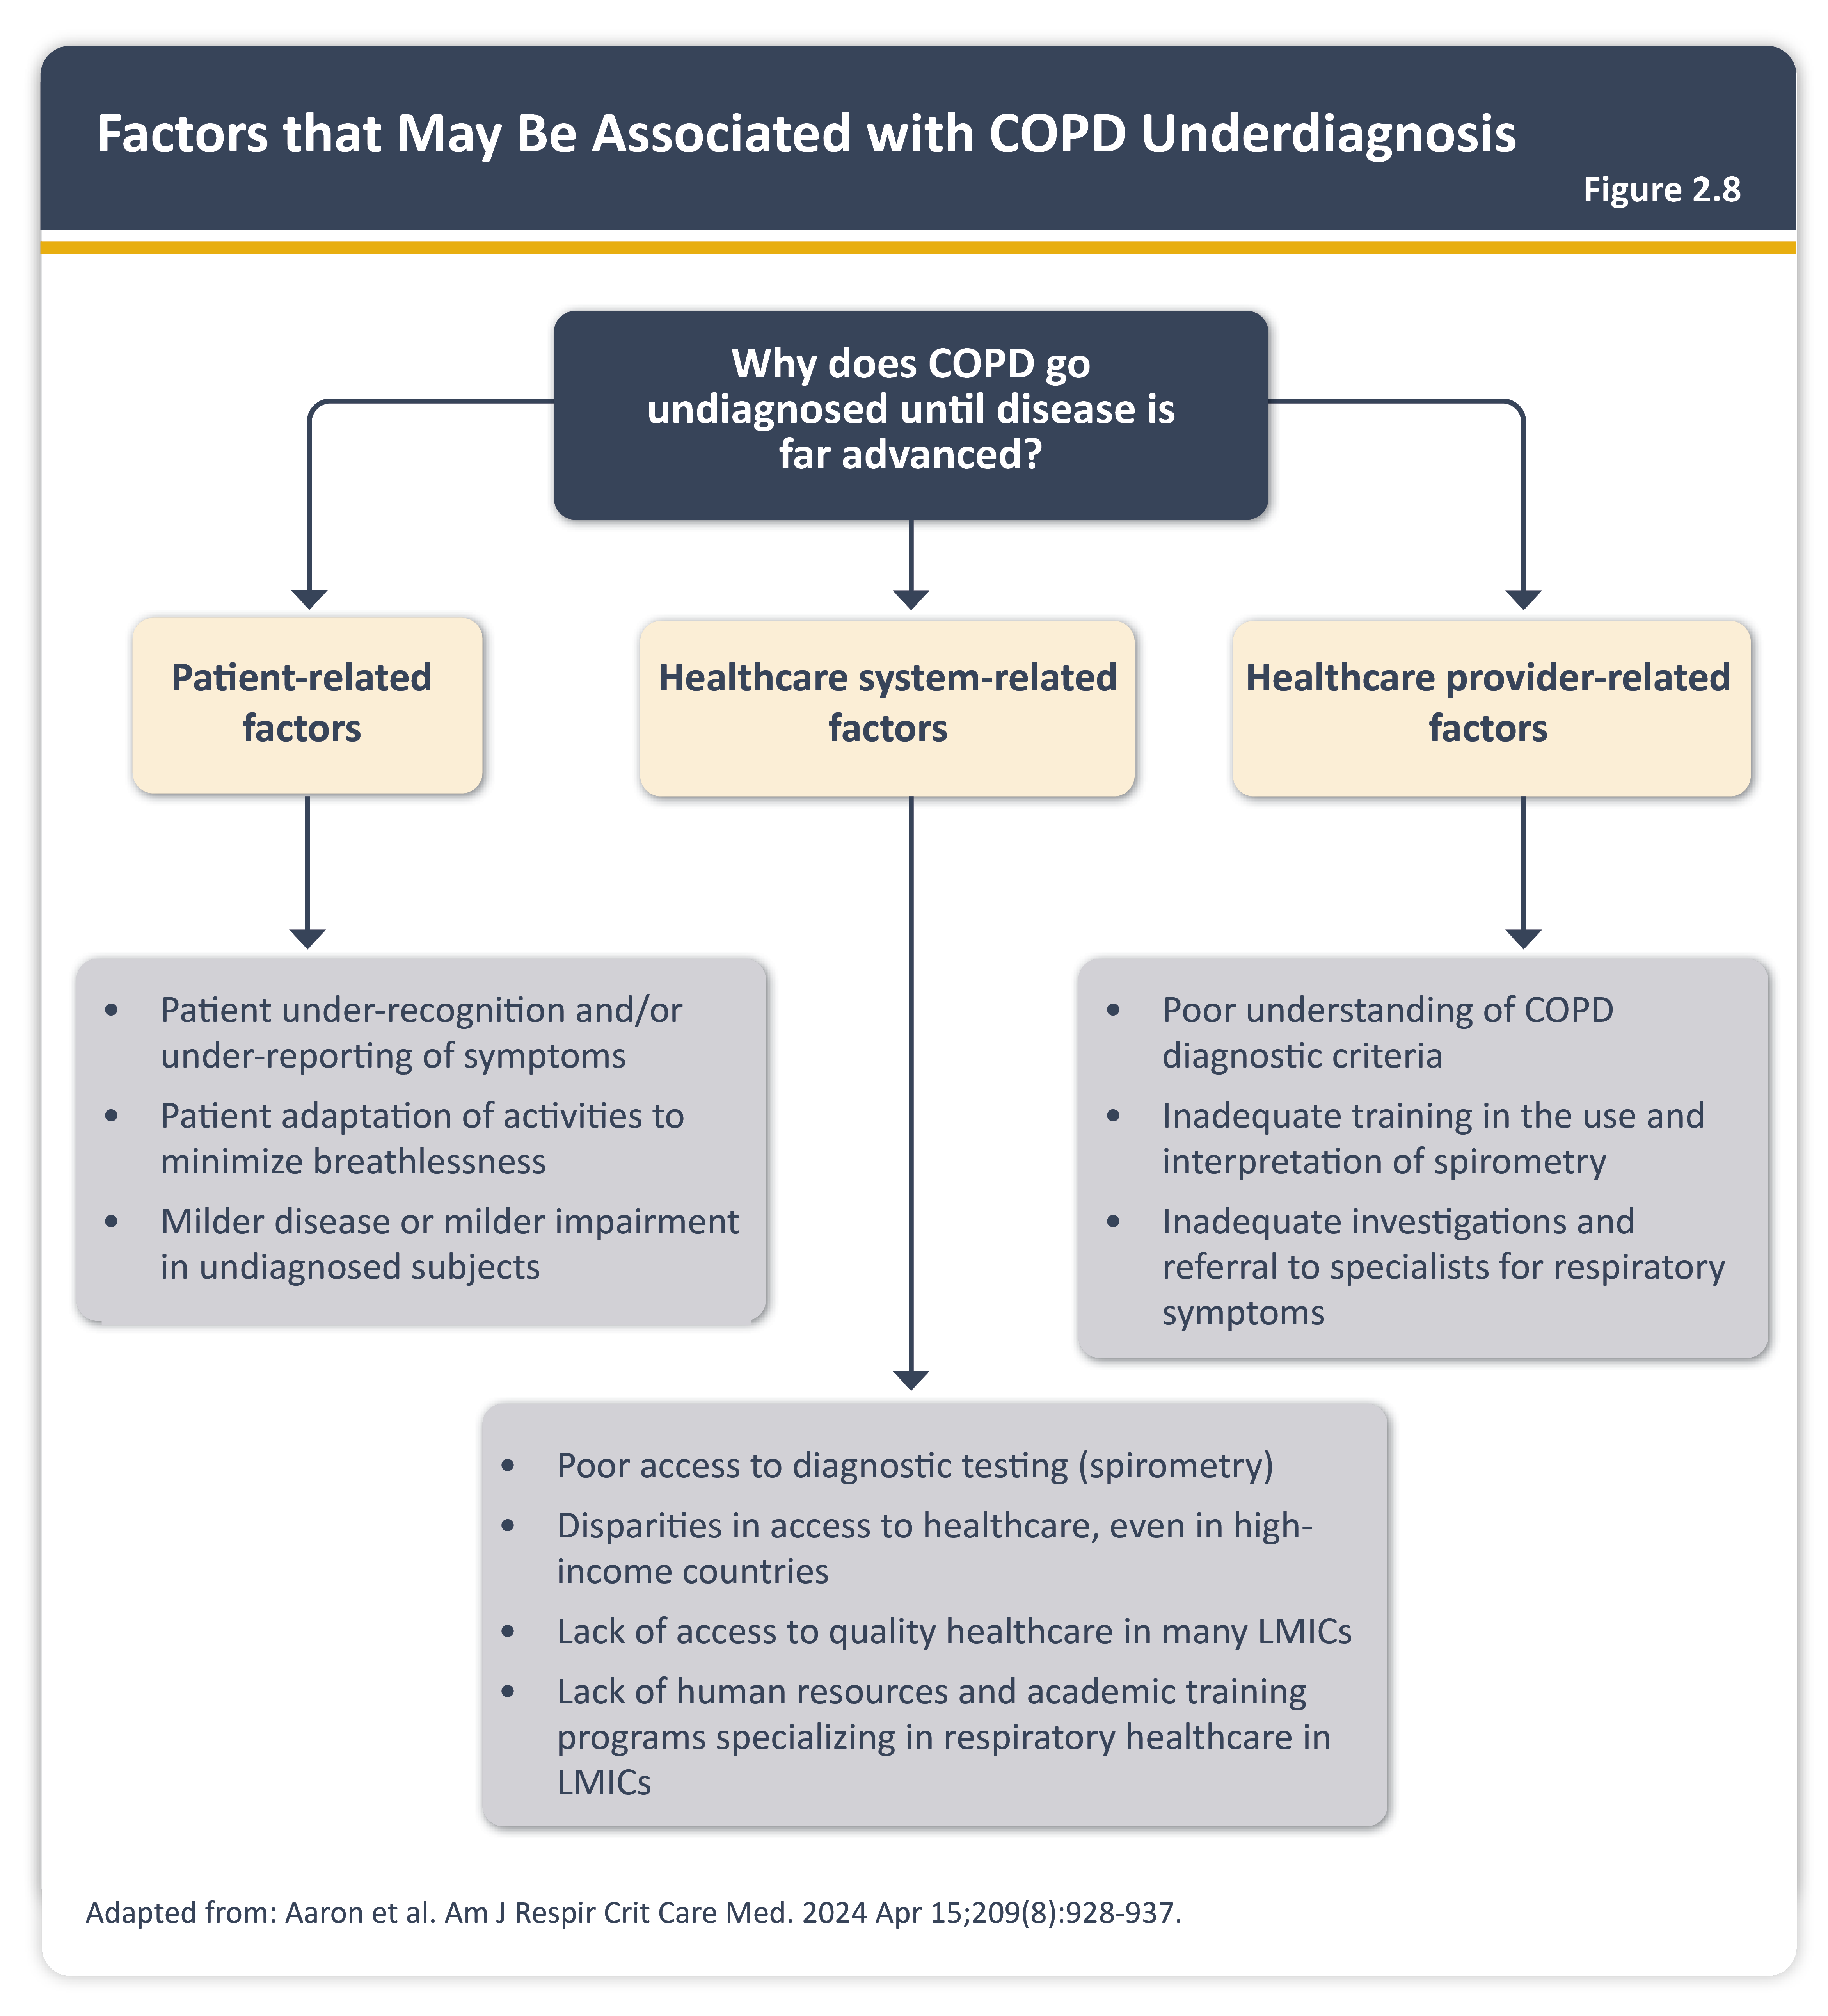
Studies from across the world suggest that up to 70% of adults with COPD remain undiagnosed.
Reasons for under-diagnosis of COPD are complex and are summarized in Figure 2.8.

Slide 7
Finding undiagnosed COPD: screening vs case-finding
  Earlier diagnosis of COPD can be potentially achieved by either: I) screening or II) case-finding.
  Screening is performed in the general population and involves testing mostly asymptomatic individuals with spirometry. This approach is expensive and is not recommended by the US Preventive Services Task Force and GOLD.
  Case-finding targets only those who have unexplained respiratory symptoms, or specific risk factors for COPD, for subsequent testing with spirometry. In turn, case-finding approaches can be divided into
  1) active case-finding or 2) opportunistic case- finding:

Slide 8
Finding undiagnosed COPD: screening vs case-finding
  Active case-finding involves proactively searching for individuals at higher risk of the condition, often based on presence of symptoms. Respiratory symptoms and risks for COPD (e.g. unexplained dyspnea, or > 20 pack-years of smoking, or history of recurrent chest infections, or history of early life events) are elicited from the individual via questionnaire
  The diagnosis is then confirmed with an objective measure such as pre-/post bronchodilator spirometry.
  Several COPD case-finding questionnaires, including the CDQ and the CAPTURE questionnaire, have been validated in different populations. Hand-held devices, such as the PEF and micro-spirometers (COPD-6 and the Piko-6) have also been widely tested to try to improve identification of people with undiagnosed COPD. Increasingly, it appears that combining questionnaires with simple physiological measurements provided by hand-held devices enhances case-finding performance.

Slide 9
Finding undiagnosed COPD: screening vs case-finding
  Opportunistic case-finding involves identification of individuals when they present themselves for healthcare services for reasons other than the condition being screened for. An example would be performing diagnostic spirometry in individuals who present for lung cancer screening.

Slide 10
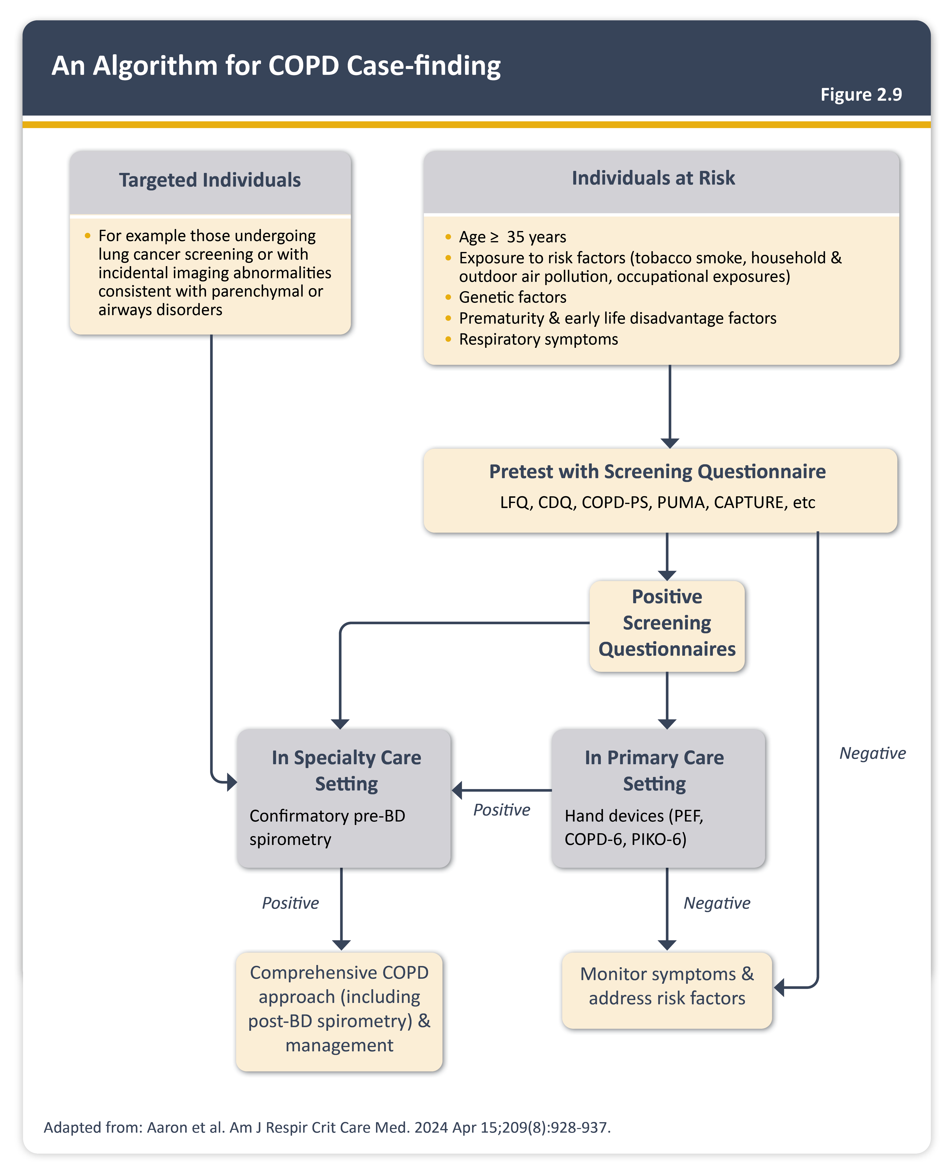

Slide 11
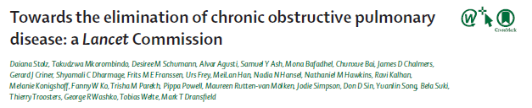
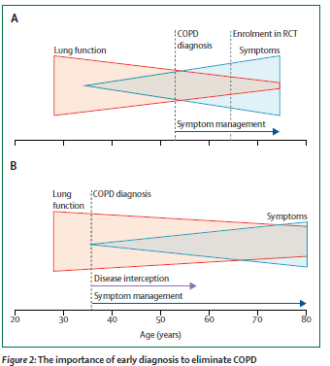
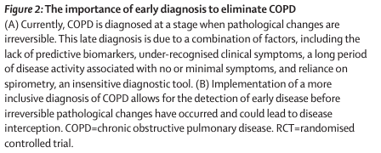
Notes:
Ispirata a Fabbri
Despite the heterogeneity of COPD, diagnostic approaches have not changed in decades and rely almost exclusively on post-bronchodilator spirometry,
which is insensitive for early pathological changes
Furthermore, despite the years-long emphasis on the crucial role of spirometry in the diagnosis of COPD, this simple technology is still not universally available, much less routinely used worldwide
In a survey that we did through the European Respiratory Society, we found that chest CT was as available as or more available than spirometry in many countries (figure 3, table 1).

Slide 12
AGENDA
Screening and case finding
Disease activity
Pharmacological Treatment
Non-Pharmacological Treatment

Slide 13
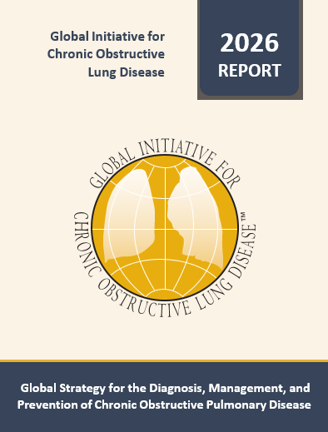


Slide 14
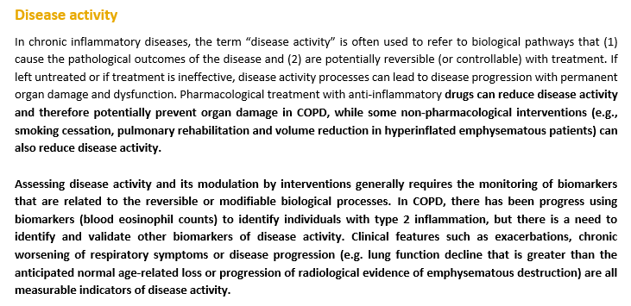

Slide 15


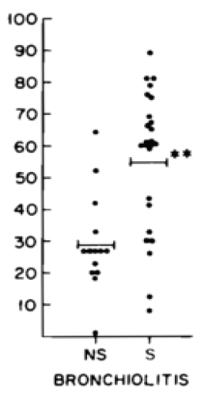
Smokers had increased bronchiolitis, goblet cells and cellular infiltrate in small airways
Notes:
Smooth muscle hypertrophy

Slide 16
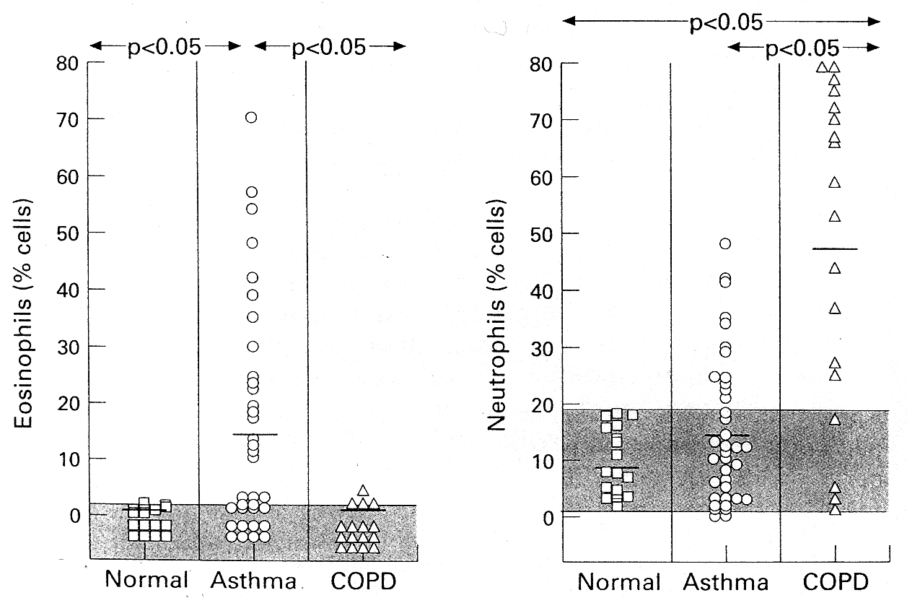
Ronchi MC et al. Thorax 1996; 51: 1000-1004
Neutrophils predominated in the sputum of subjects with COPD
Notes:
Here you see a comparison between sputum cells in asthmatic patients, mainly eosinophilis, and in COPD patients characterized by neutrophils. As you can see the percentages of sputum neutrophils in COPD are spread from 30 to 80% this means that among COPD subjects different inflammatory patterns exist

Slide 17
Saetta M., et al.
Smokers who develop symptoms of chronic bronchitis and chronic airflow limitation have an increased number of CD81 T-lymphocytes in the peripheral airways.

Slide 18

Notes:
L’occlusione delle piccole vie è correlata al grado di severità della COPD

Slide 19
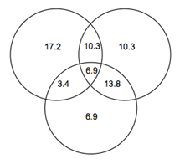
Bronchial Reversibility
Bronchial Hyperreactivity
Sputum Eosinophilia
31.0%

Slide 20
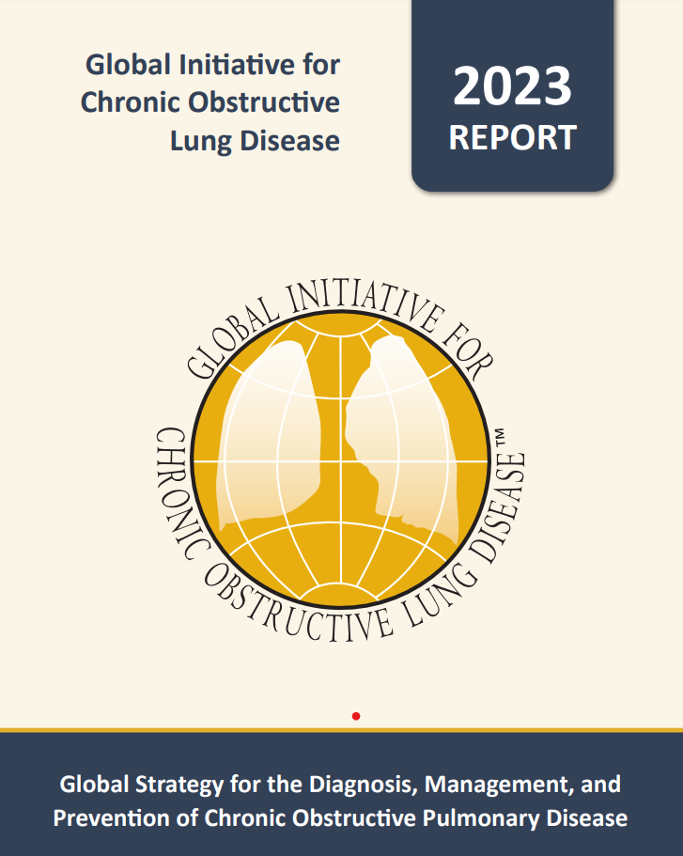
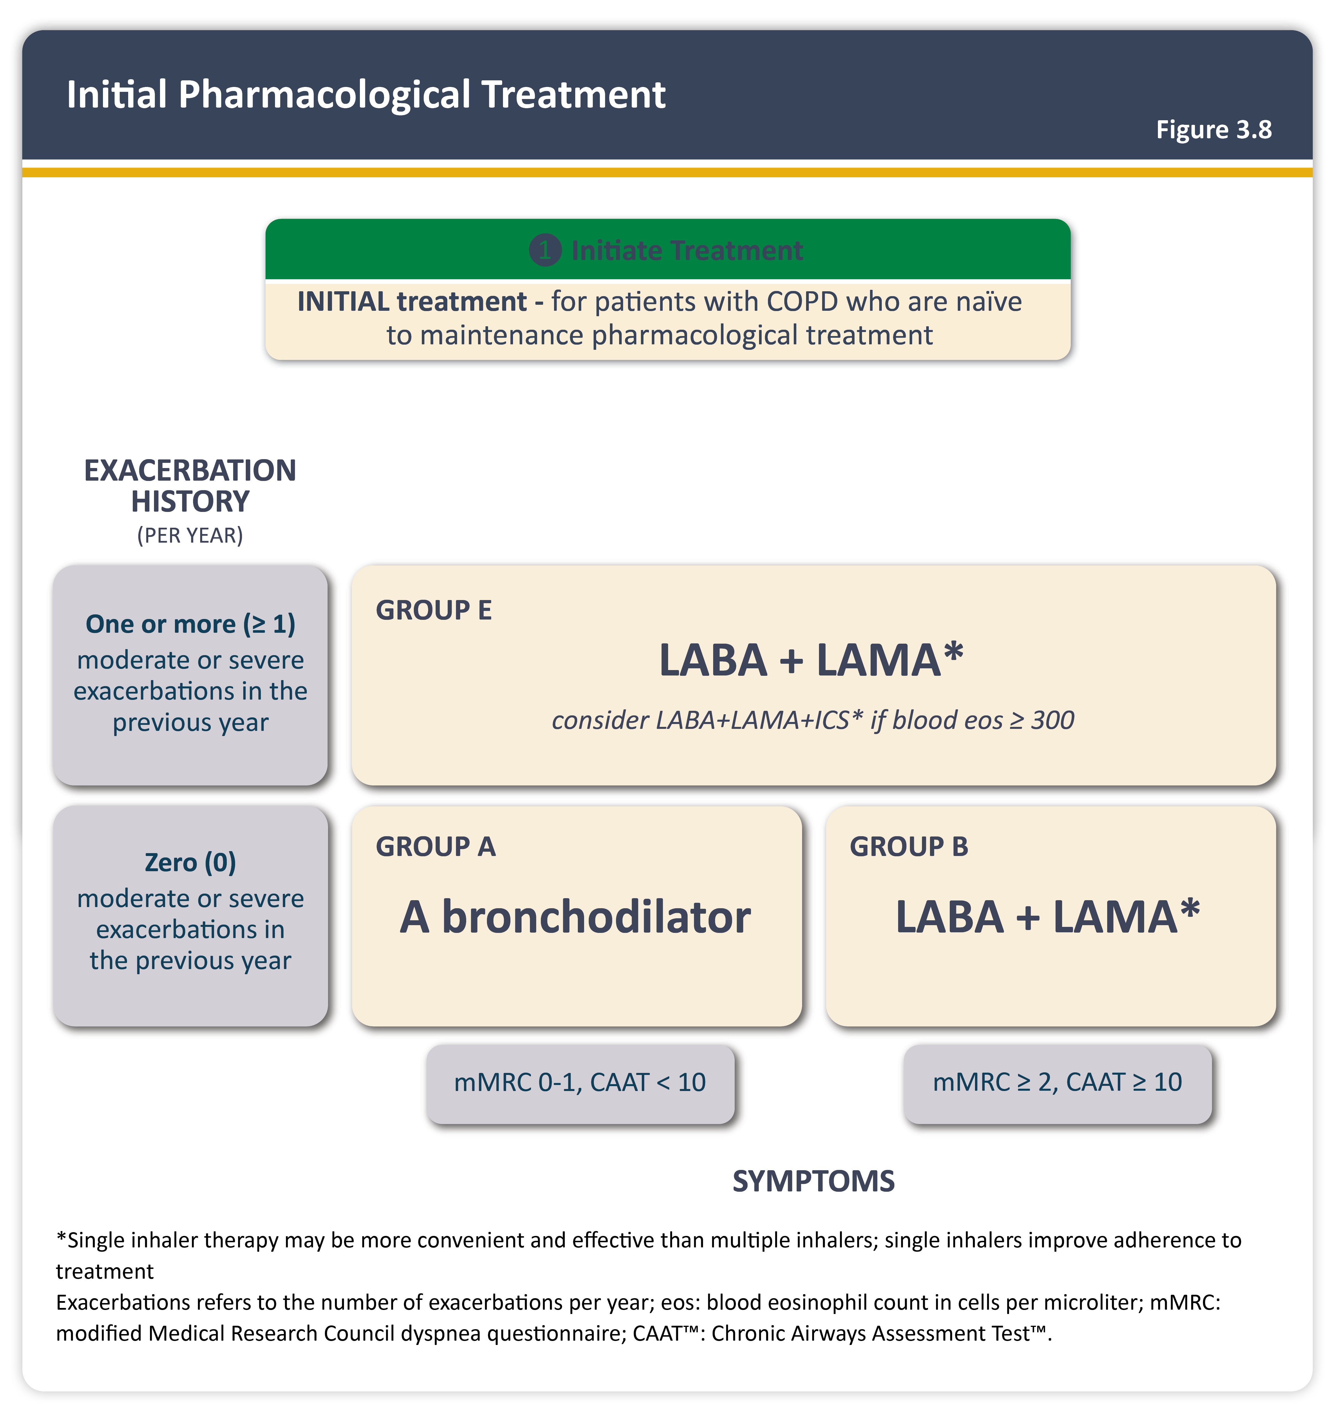
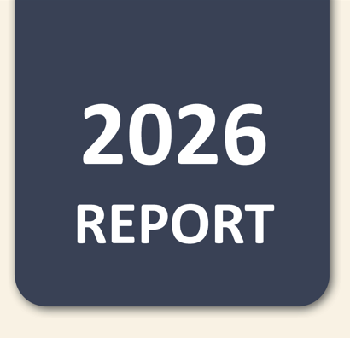

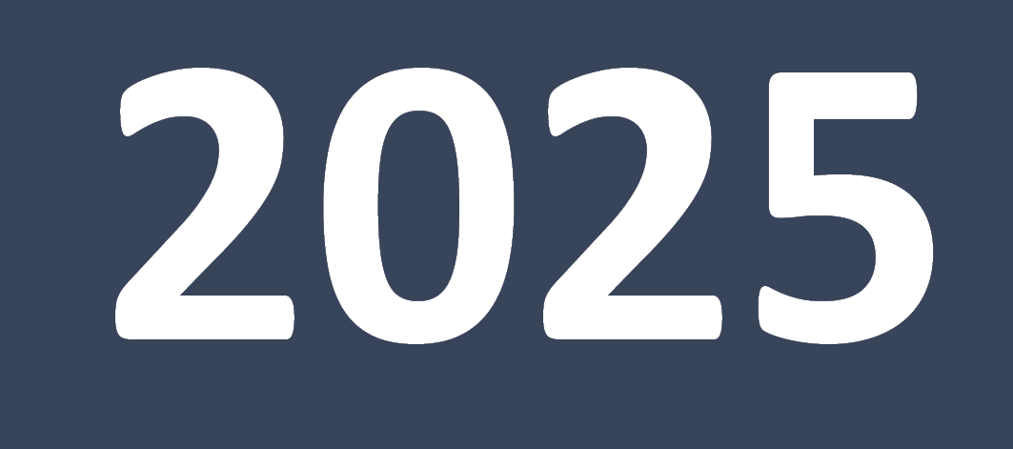

Initial pharmacological treatment
Teaching
Slide Set
Teaching
Slide Set
MPTOM
EXACERBATIONS HISTORY
BEC≥ 300
* SINGLE DEVICE
SYMPTOMS

Slide 21
Am J Respir Crit Care Med. 2018 May 1;197(9):1216-1219
Blood Eosinophilia Neither Reflects Tissue Eosinophils nor Worsens Clinical Outcomes in Chronic Obstructive Pulmonary Disease.
Turato G¹, Semenzato U¹, Bazzan E¹, Biondini D¹, Tinè M¹, Torrecilla N², Forner M², Marin JM², Cosio MG^{1,3}, Saetta M

Slide 23

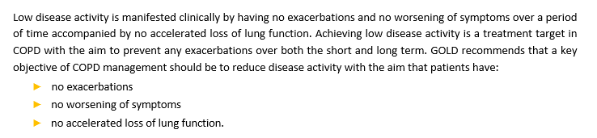

Slide 24
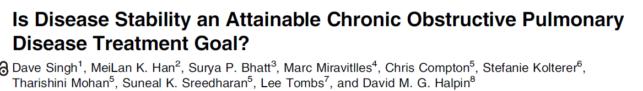
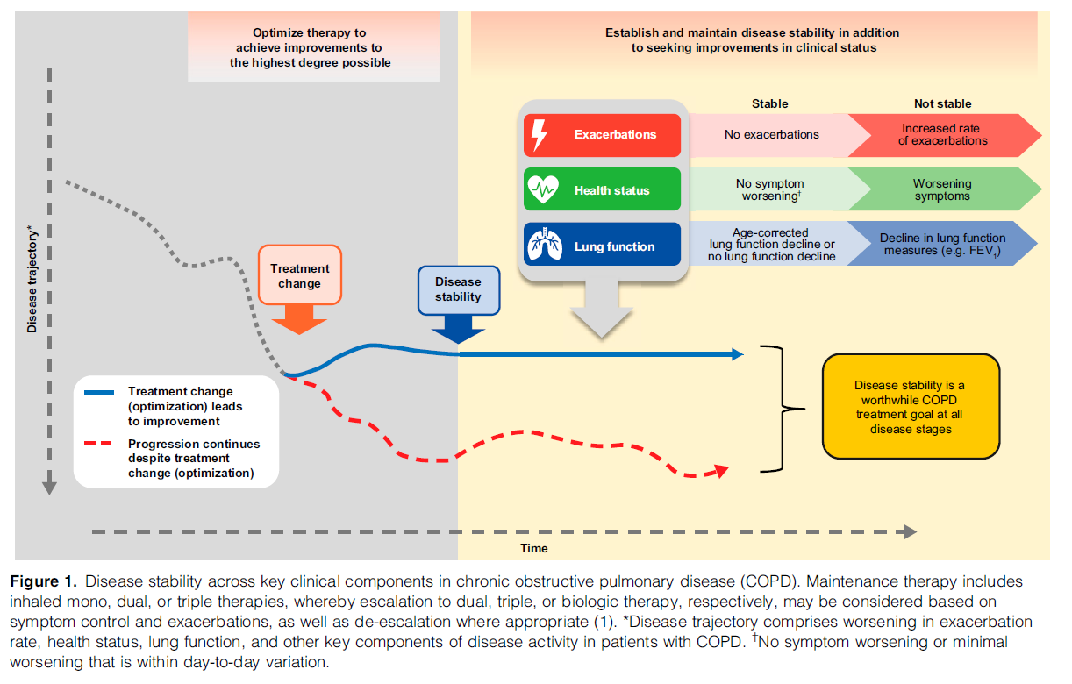

Slide 25
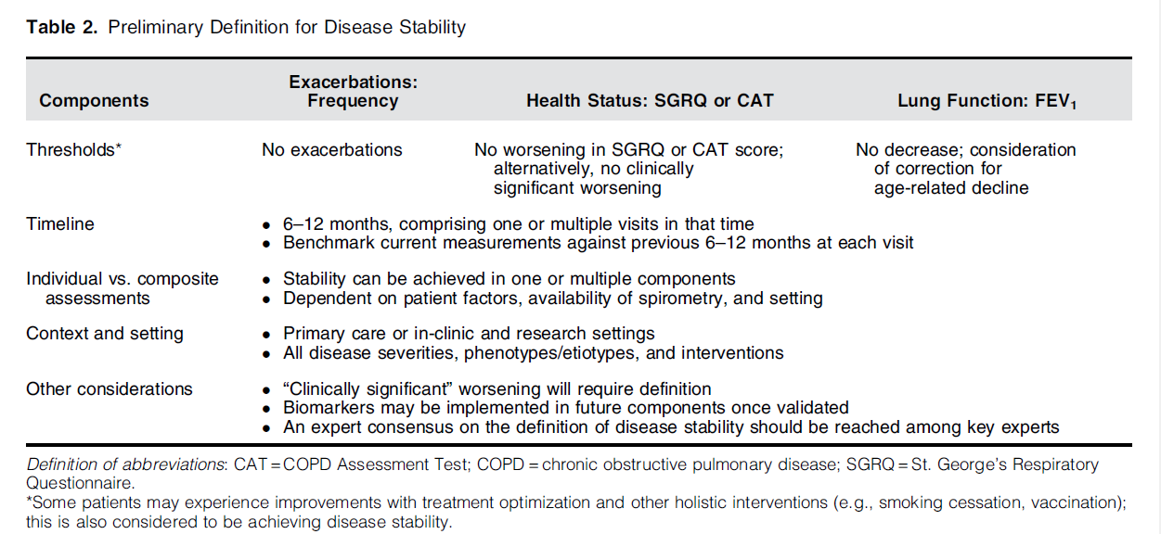

Slide 26
Conclusions: Given the continued burden of COPD worldwide, more attainable treatment goals should be sought to encourage better management and provide better outcomes for patients living with COPD. These goals should also be future-ready to adapt to the ever-evolving landscape of available therapies. This review has summarized some of the key considerations for development of a preliminary deﬁnition of disease stability as an achievable treatment goal for all patients with COPD, regardless of severity, phenotypes/etiotypes, and treatments. A holistic approach to COPD management can further support disease stability, including smoking cessation, reduction of exposure to risk factors, vaccination, pulmonary rehabilitation, and improved adherence(1, 133–136). In addition, harmonious goals and clear communication between patients and physicians are crucial in ensuring good clinical outcomes, good adherence, and improved overall well-being (137–139). Once empirically validated, these disease stability criteria may provide a clinical treatment goal and function as clinical trial endpoints. Future clinical trials and real-world studies should seek to validate and use disease stability as a treatment target to advance the standard of care for patients with COPD.

Slide 27
AGENDA
Screening and case finding ?
Disease activity ?
Pharmacological Treatment
Non-Pharmacological Treatment

Slide 28

COPD exacerbations lead to:
Decline in lung function¹
Increased symptoms
(breathlessness)²
Worsening health status³
Increased risk
of hospitalization⁴
1. Donaldson et al. Thorax 2002;57:847-52.
2 Donaldson et al. Eur Respir J 2003;22:931-6.
3. Seemungal et al. Am J Resp Crit Care Med 1998;157:1418-22.
4. Groenewegen et al. Chest 2003;124:459-67.
5. Soler-Cataluna et al. Thorax 2005;60:925-31.
Increased risk of mortality^{4,5}

Slide 29
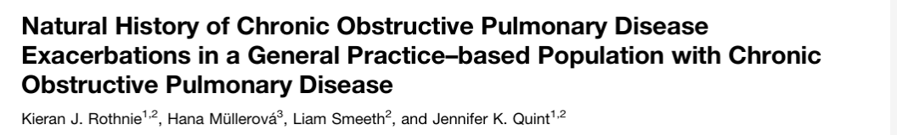
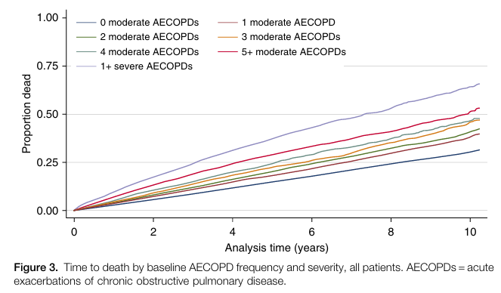
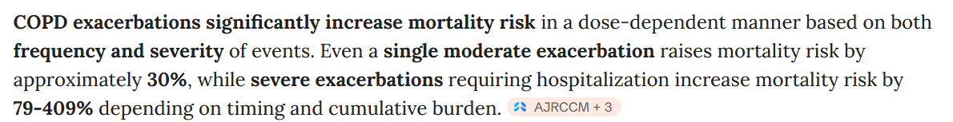

Slide 30
Initial pharmacological treatment
Teaching
Slide Set
Teaching
Slide Set
EXACERBATIONS HISTORY
SYMPTOMS

Slide 31
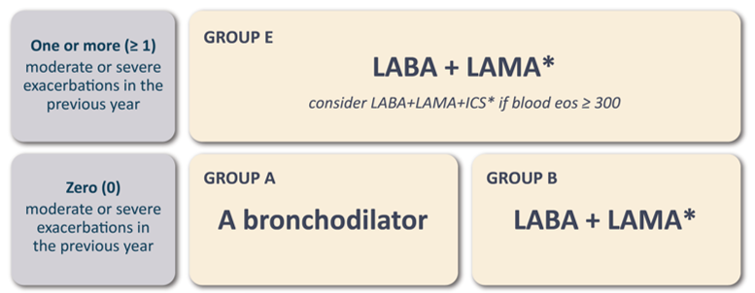
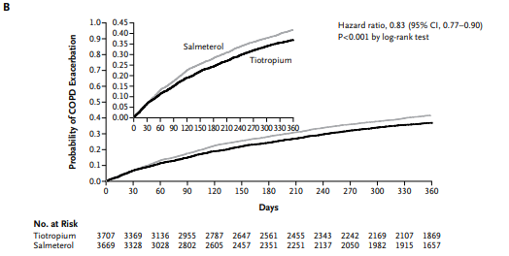
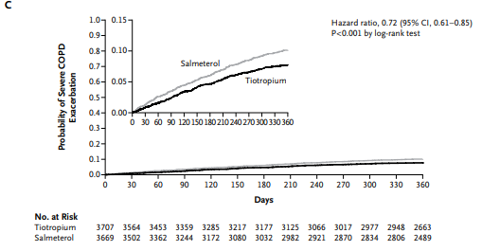
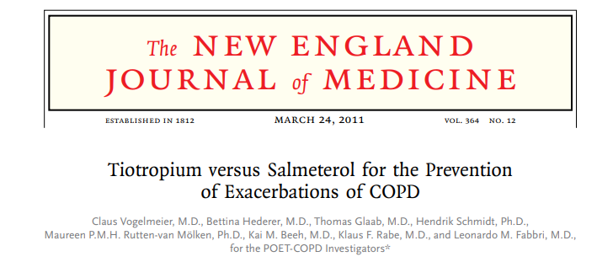
Notes:
Treatment guidelines recommend the use of inhaled long-acting bronchodilators to alleviate symptoms and reduce the risk of exacerbations in patients with moderate-tovery-severe chronic obstructive pulmonary disease (COPD) but do not specify whether a long-acting anticholinergic drug or a β2-agonist is the preferred agent. We investigated whether the anticholinergic drug tiotropium is superior to the β2-agonist salmeterol in preventing exacerbations of COPD. METHODS In a 1-year, randomized, double-blind, double-dummy, parallel-group trial, we compared the effect of treatment with 18 μg of tiotropium once daily with that of 50 μg of salmeterol twice daily on the incidence of moderate or severe exacerbations in patients with moderate-to-very-severe COPD and a history of exacerbations in the preceding year. RESULTS A total of 7376 patients were randomly assigned to and treated with tiotropium (3707 patients) or salmeterol (3669 patients). Tiotropium, as compared with salmeterol, increased the time to the first exacerbation (187 days vs. 145 days), with a 17% reduction in risk (hazard ratio, 0.83; 95% confidence interval [CI], 0.77 to 0.90; P

Slide 32
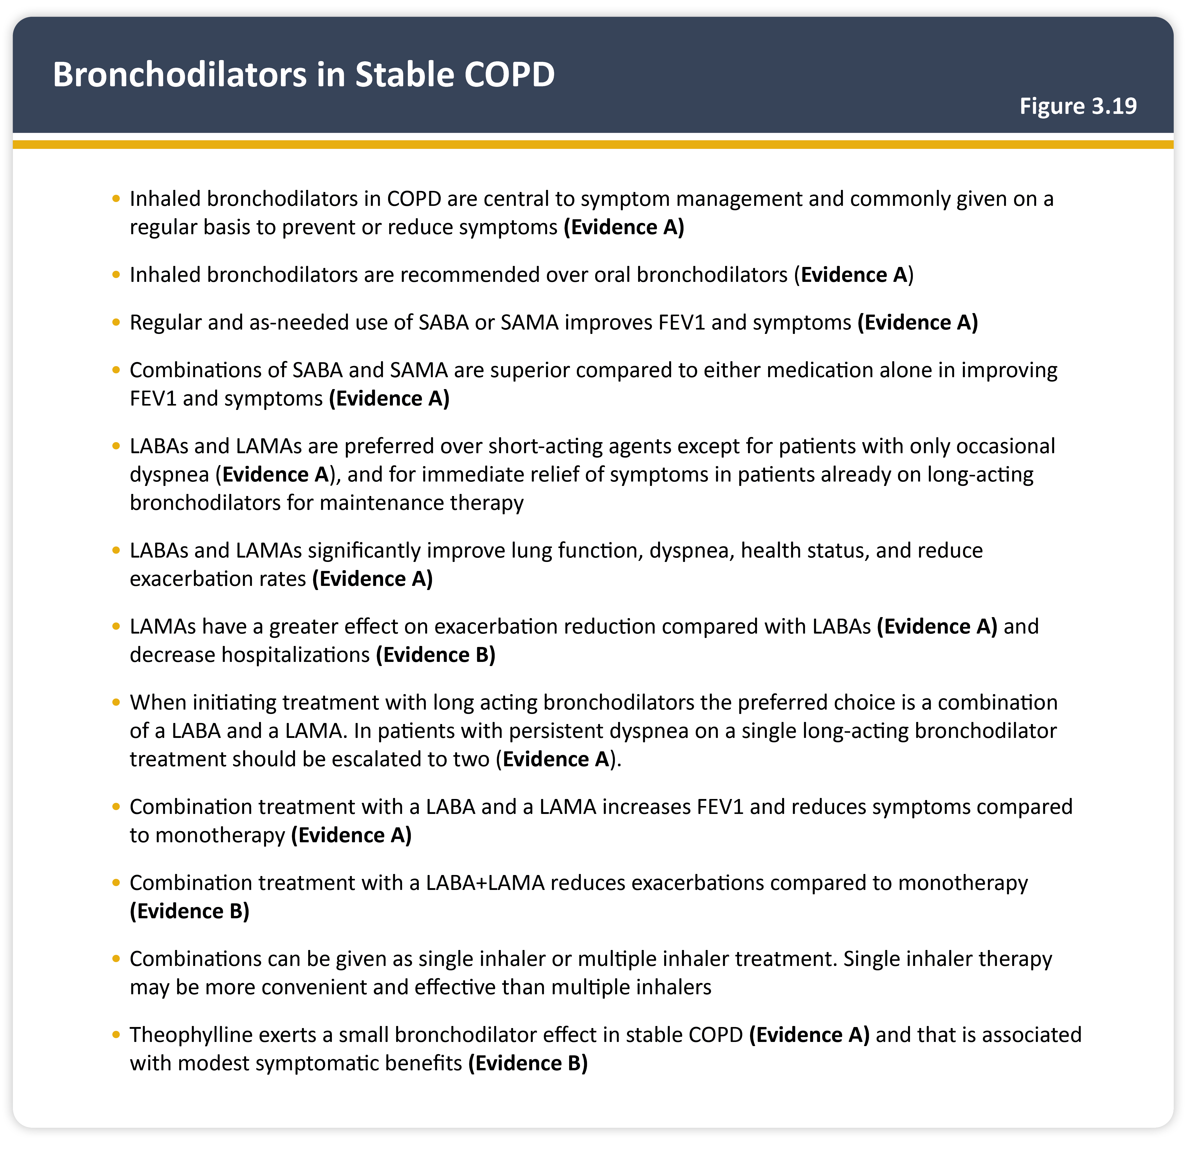
Notes:
Passando al gruppo E qui la raccomandazione è supportata da numerosi studi, sulla destra si vede riportato lo spark study cha ha valutato pazienti che ricevavano la combinazione indacaterolo glicopirronio in singola inalazione. Vediamo che overall c’è una significativa riduzione delle riacutizzazioni moderate e severe. La riduzione delle riacutizzazioni si associava anche ad un miglioramento sul piano clinico a tutti e 5 timepoint. Sempre per il gruppo E abbiamo una cochrane che ha incluso 99 RCT afferenti al gruppo E. dalla metanalisi possiamo vedere che i pazienti afferenti al gruppo E in terapia con LABA + LAMA avevano una riduzione delle riacutizzazioni riseptto ai pz in LABA, in LAMA o ICS/LABA

Slide 33
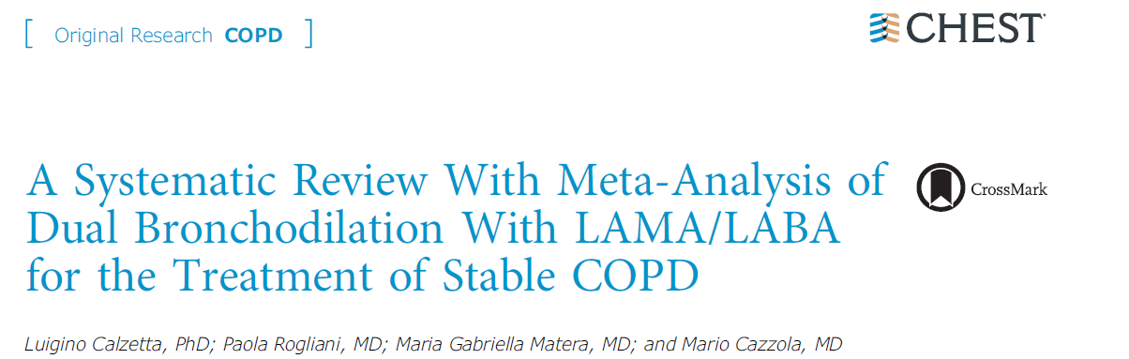
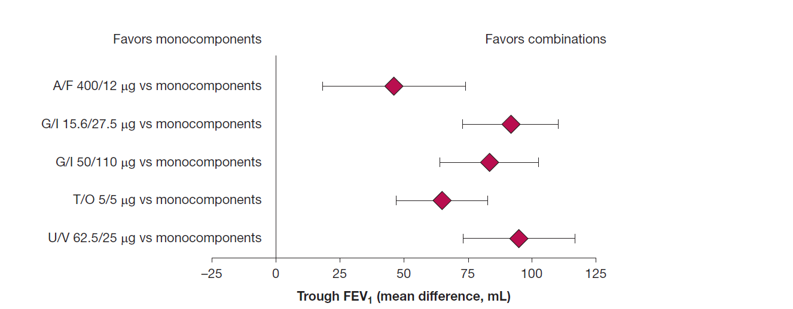

Slide 34
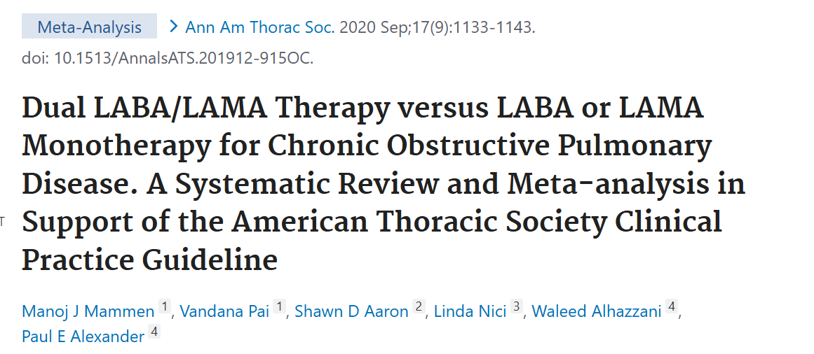
A systematic review and meta-analysis of 24 studies (45,441 patients) comparing LABA/LAMA dual therapy to monotherapy found significant reductions in hospital admissions (11% reduction) and acute exacerbations (20% reduction), but mortality was not significantly different between dual therapy and monotherapy.
.

Slide 35
Initial pharmacological treatment
Teaching
Slide Set
Teaching
Slide Set
MPTOM
EXACERBATIONS HISTORY
BEC≥ 300
* SINGLE DEVICE
SYMPTOMS

Slide 36
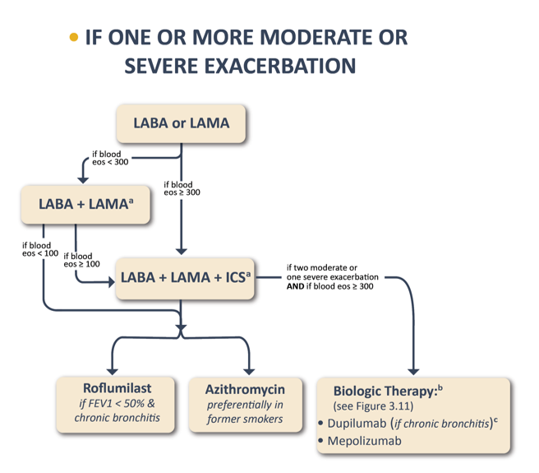
1
BDP/GLY/FF: TRIBUTE (2018)
FF/UMMEC/VI: IMPACT (2018)
BUD/GLY/FF: ETHOS (2020)
2
3
Reduction in annual exacerbation rate

Slide 38
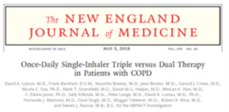
The primary outcome was the annual rate of moderate or severe COPD exacerbations during treatment.
The rate of moderate or severe exacerbations in the triple-therapy group was 0.91 per year, as compared with 1.07 per year in the fluticasone furoate-vilanterol group; p<0.001) and 1.21 per year in the umeclidinium-vilanterol; p<0.001).

Slide 39
The primary end point was the annual rate of moderate or severe COPD exacerbations.
The annual rates of moderate or severe exacerbations were 1.08 in the 320-µg-budesonide triple-therapy group, 1.07 in the 160-µg-budesonide triple-therapy group, 1.42 in the glycopyrrolate-formoterol group, and 1.24 in the budesonide-formoterol group.
The rate was sig­nificantly lower with 320-µg-budesonide triple therapy than with glycopyrrolate-formoterol (p<0.001) or budesonide-formoterol; p=0.003). Similarly, the rate was signifìcantly lower with 160-µg-budesonide triple therapy than with glycopyrrolate-formoterol; p<0.001) or budesonide-formoterol; p=0.002).
Triple therapy with twice-daily budesonide (at either the 160-µg or 320-µg dose), glycopyrrolate, and formoterol resulted in a lower rate of moderate or severe COPD exacerbations than glcopyrrolate-formoterol or budesonide- formoterol.
39

Slide 40
In this secondary analysis from the IMPACT trial, once –daily single inhaler FF/UMEC/VI triple therapy reduced the risk of all cause mortality (AMC) versus UMEC/VI in patients with symptomatic COPD (p=0.042).

Slide 41
Triple therapy with BGF 320 reduced the risk of death compared with GFF (p=0.0035)
Triple therapy containing a lower dose of inhaled corticosteroid (BGF 160) was not shown to significantly reduce the risk of death compared with dual therapy comparators

Slide 42
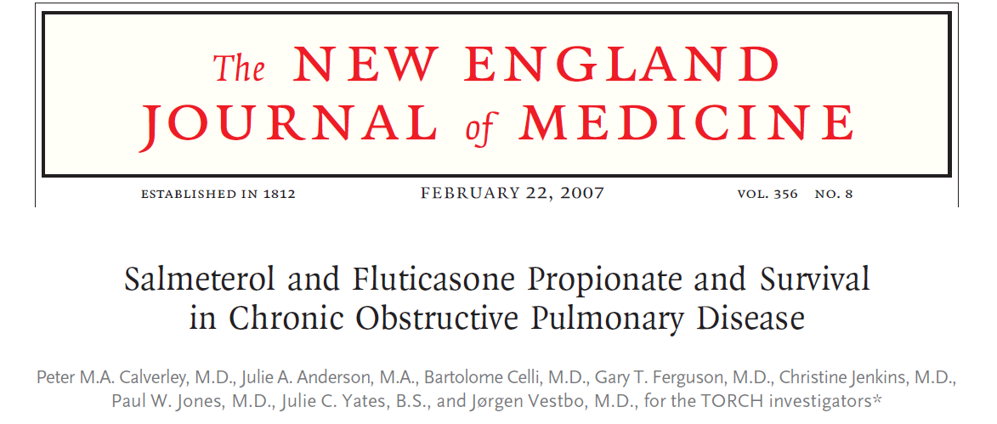
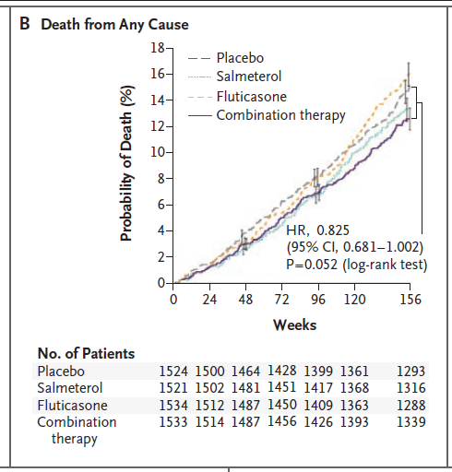

Slide 43


Slide 44
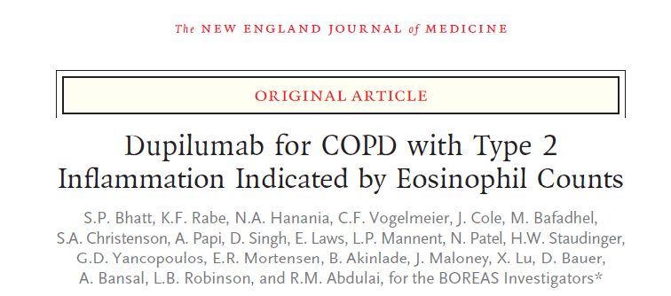

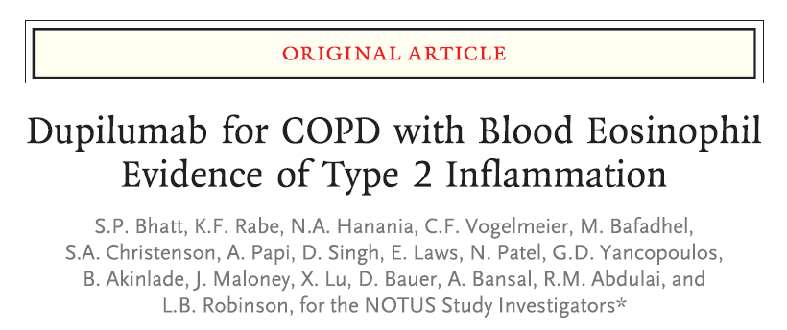
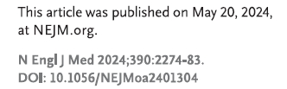

Slide 45
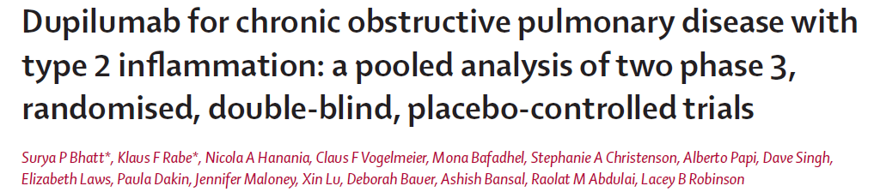
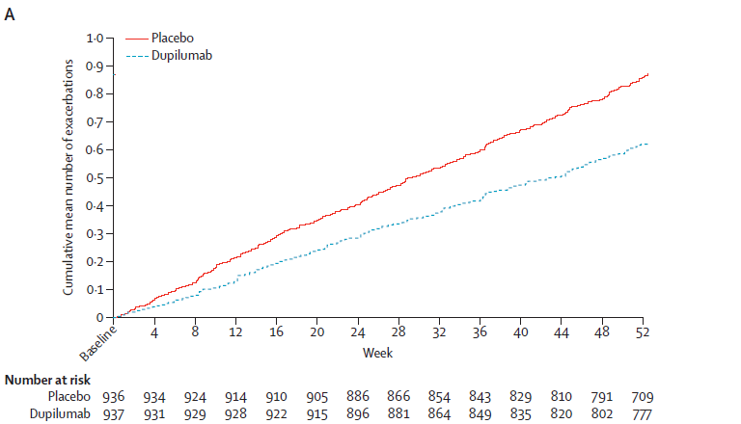
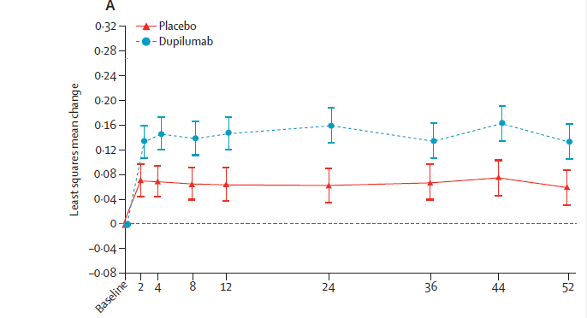

Slide 46
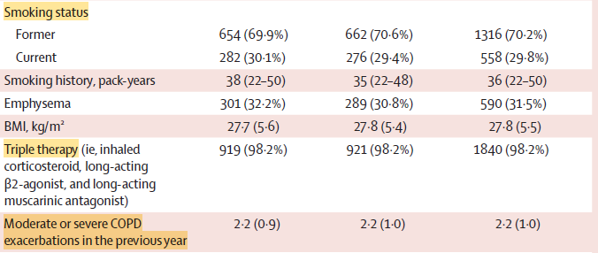
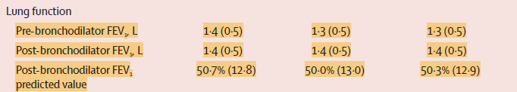


Slide 47
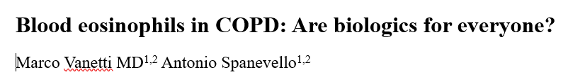
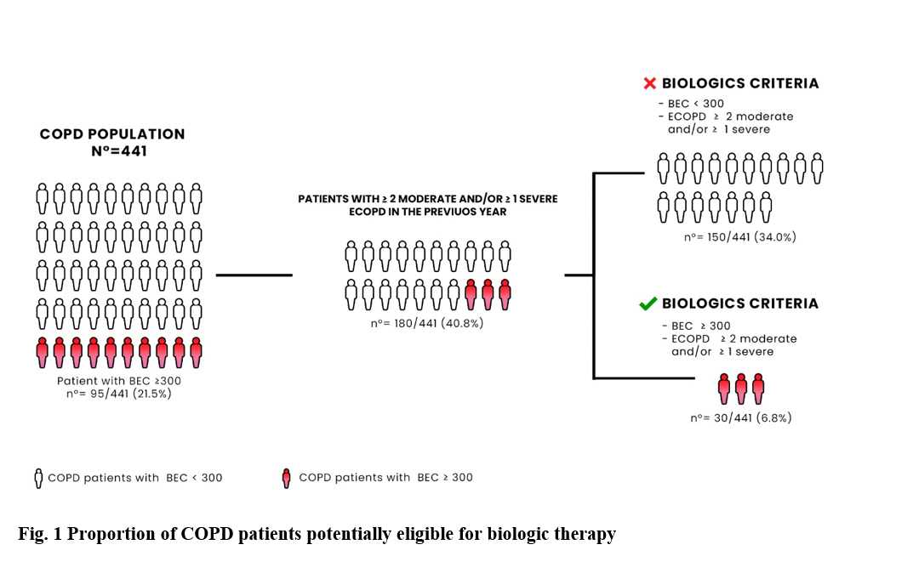

submitted

Slide 48
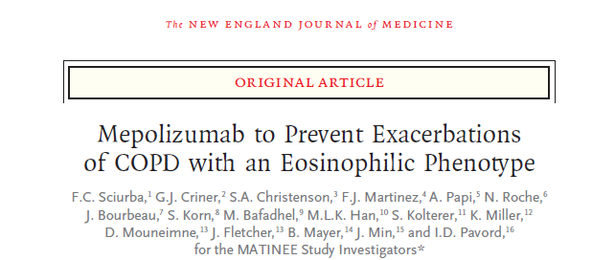
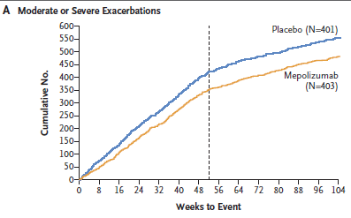

Slide 49
AGENDA
Screening and case finding
Disease activity
Pharmacological Treatment
Non-Pharmacological Treatment

Slide 50
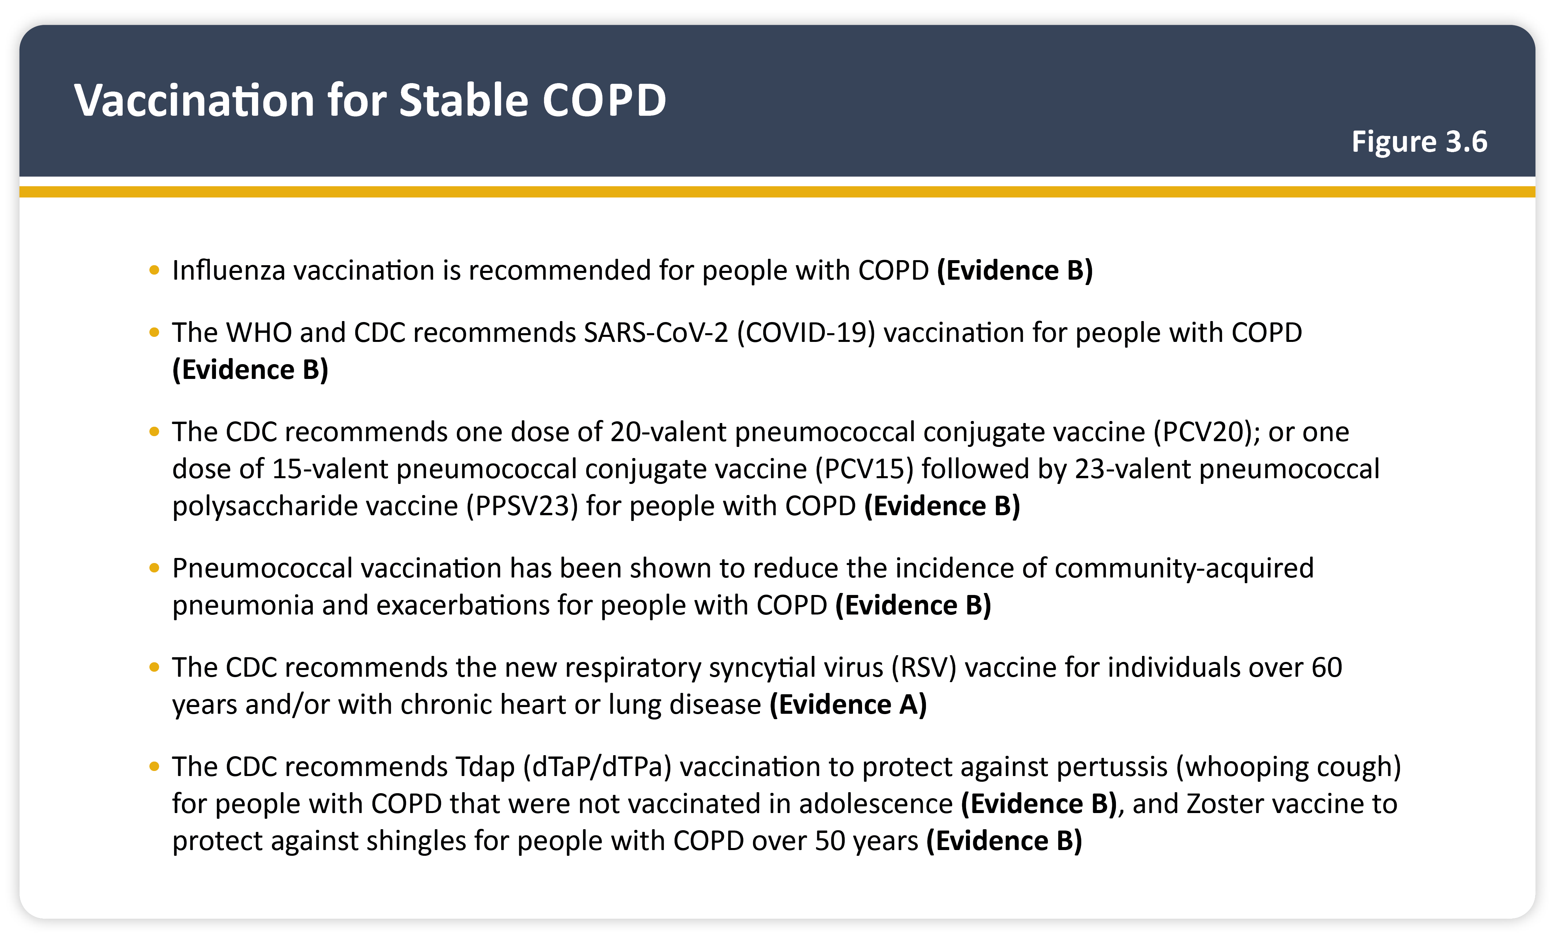

Slide 51
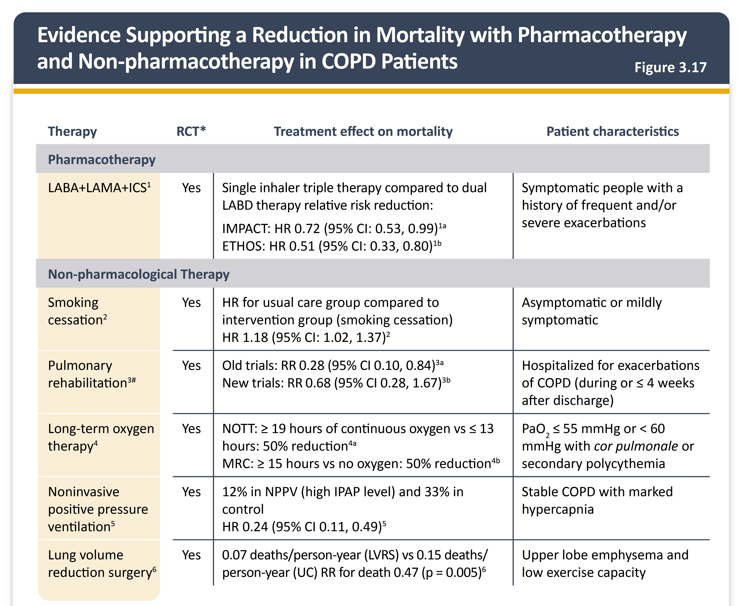
Notes:
Lista di eveidenze in grado di modificare la storia della malattia e ridurre la mortalità. La maggior parte non farmacologici in gruppi di pazienti con traits specifici in cui è roiportato il vantaggop in termini di sopravvivenmza

Slide 52
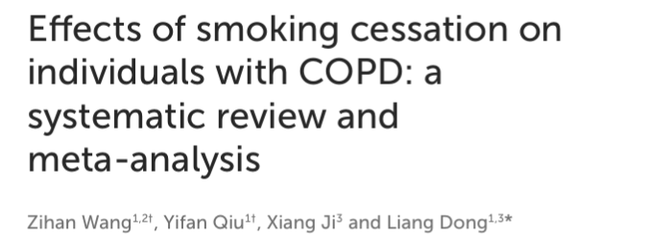

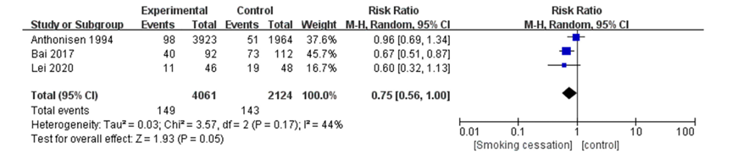
Multiple studies demonstrate that quitting smoking lowers all-cause mortality, with benefits observed even when patients quit after COPD diagnosis.

Slide 53
Notes:
Lista di eveidenze in grado di modificare la storia della malattia e ridurre la mortalità. La maggior parte non farmacologici in gruppi di pazienti con traits specifici in cui è roiportato il vantaggop in termini di sopravvivenmza

Slide 54




Slide 55


