Slide 1


Slide 2
BPCO riacutizzata è un carico sanitario ancora troppo pesante: cosa fare tra realtà e ambizione
Dejan Radovanovic
Dipartimento di Scienze Biomediche e Cliniche
Università degli Studi di Milano
dejan.radovanovic@unimi.it

Slide 3
DISCLOSURE FORM:
In accordance with the National-Regional Regulation of 2 February 2017, art. 76, page 34
The undersigned, RADOVANOVIC DEJAN, as Speaker in this activity
DECLARES
that have received honoraria for lectures or consulting from:
Astra Zeneca, Berlin Chemie, Glaxo Smith Kline, Insmed, Menarini, Sanofi, Zambon

Slide 4
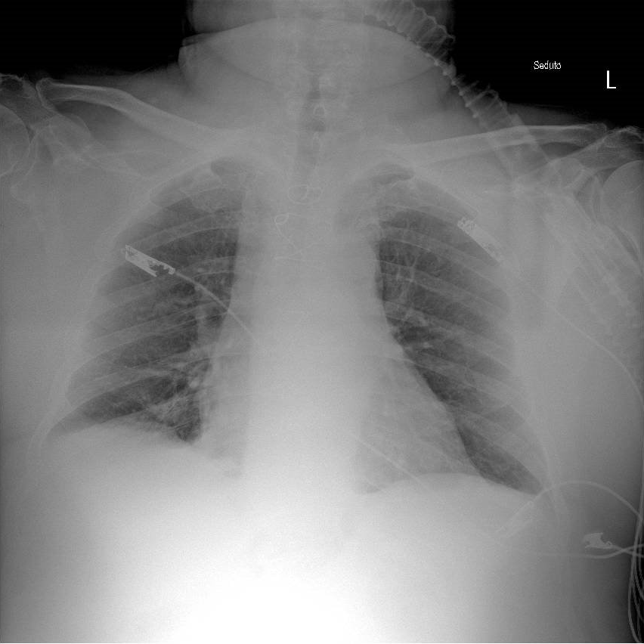
COPD
FEV1 38%pred
TLC 140%pred
HFpEF
Arterial hypertension
Ao-Co by pass
In ED
pH 7.18
PaCO2 80 mmHg
PaO2 42 mmHg
CRP 80 (n.v. 0-10)

Slide 5
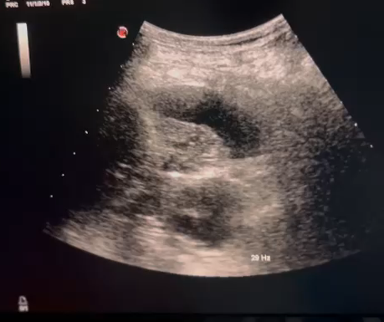

Slide 7
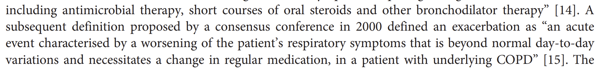

Slide 8
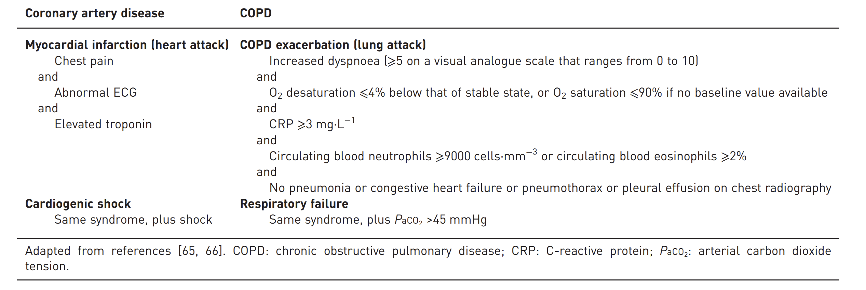
Agusti A et al. Lancet Respir Med 2018

Slide 9
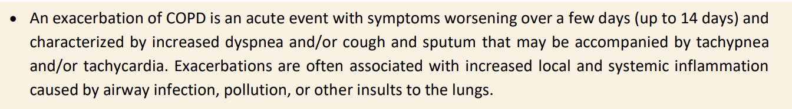
GOLD Report 2026

Slide 10
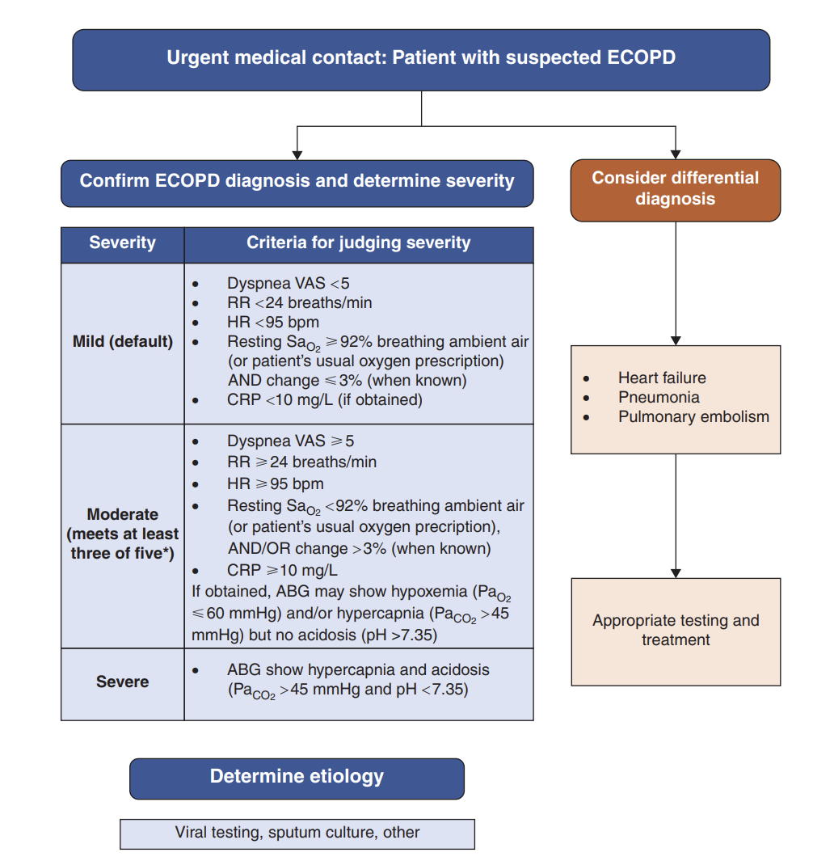
Celli B et al. Am J Respir Crit Care Med 2021

Slide 11
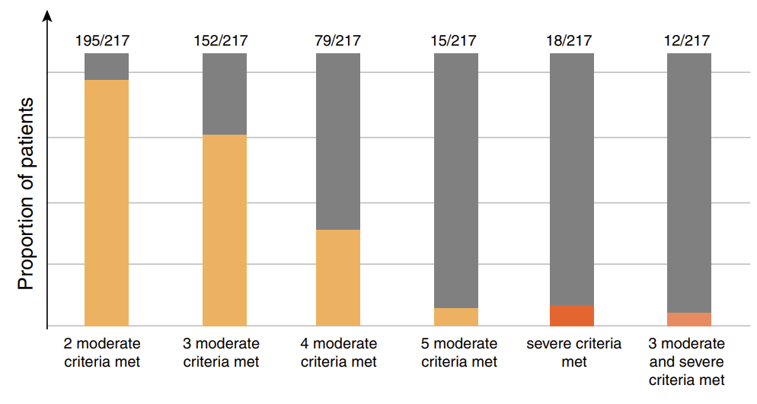
Bafadhel M et al. Am J Respir Crit Care Med 2022

Slide 12
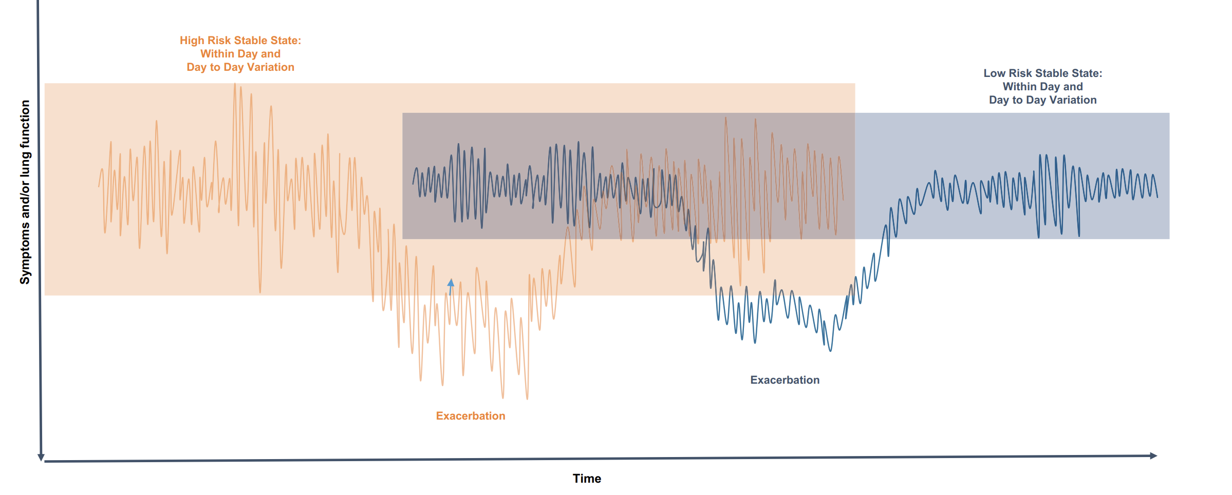
Bhatt SP et al. Am J Respir Crit Care Med 2023

Slide 13
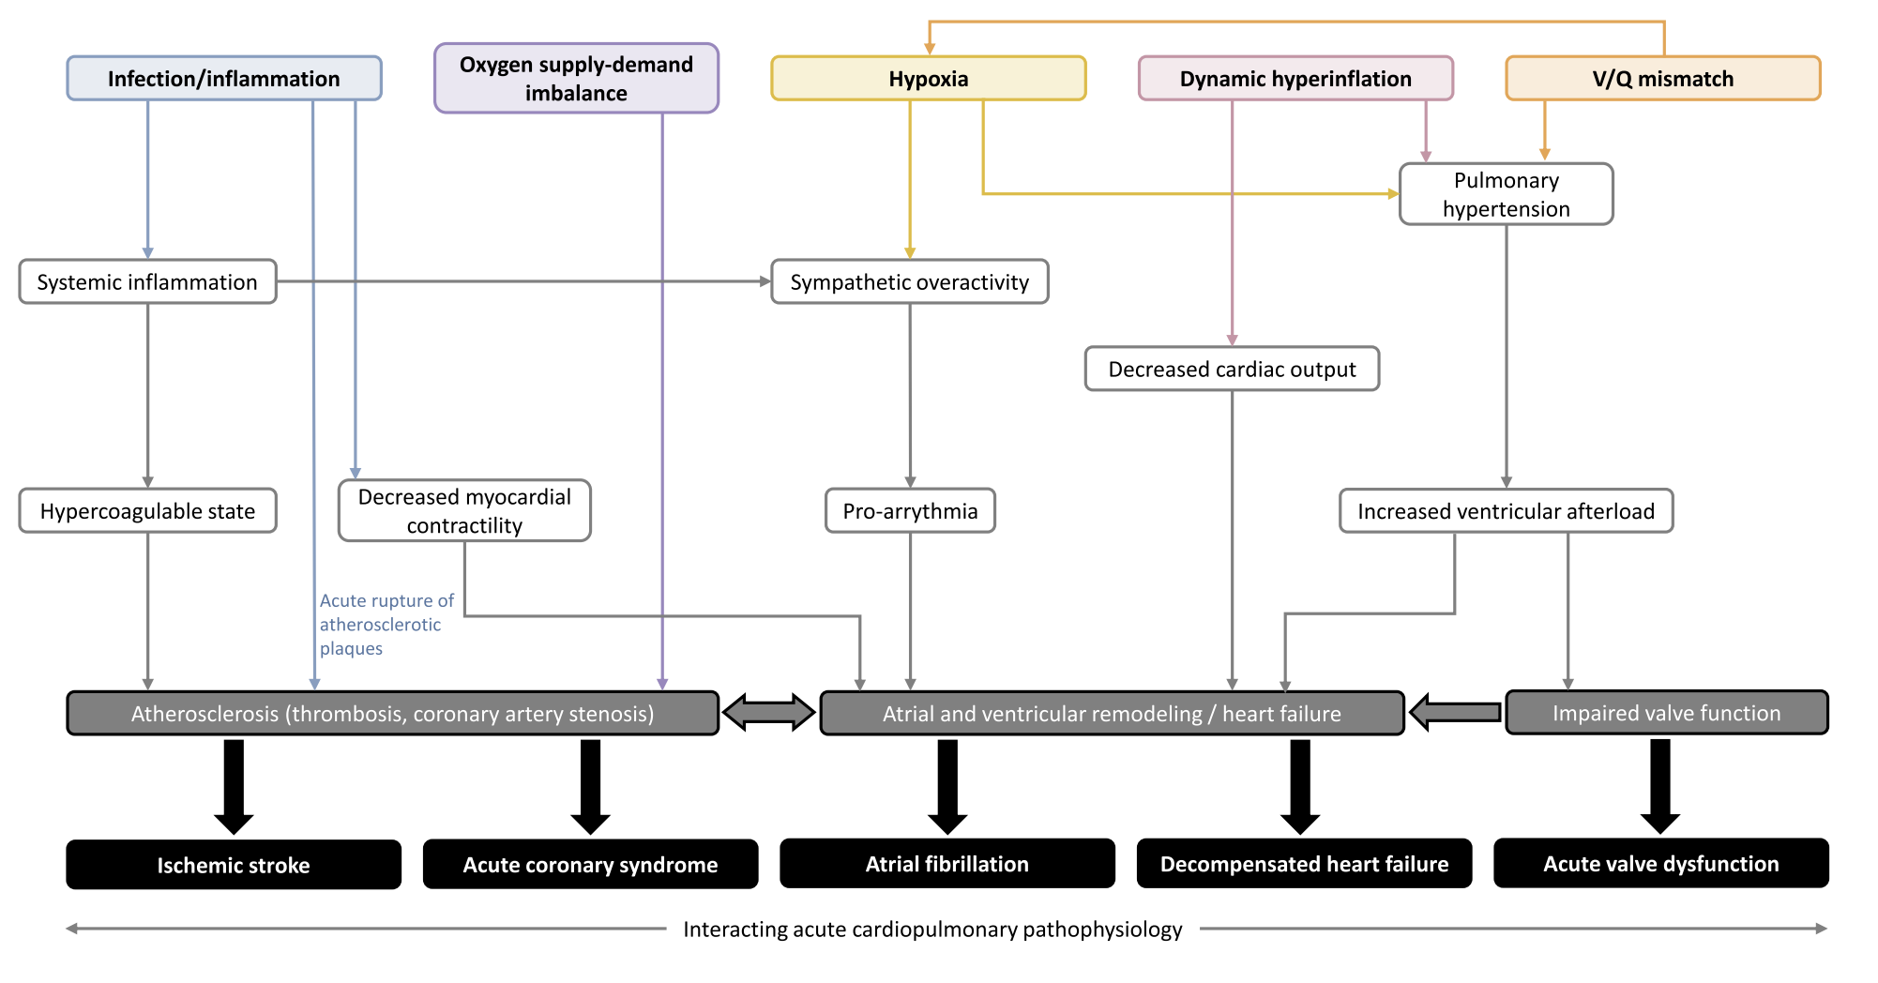
Garcia-Aymerich J et al. Thorax 2011

Slide 14
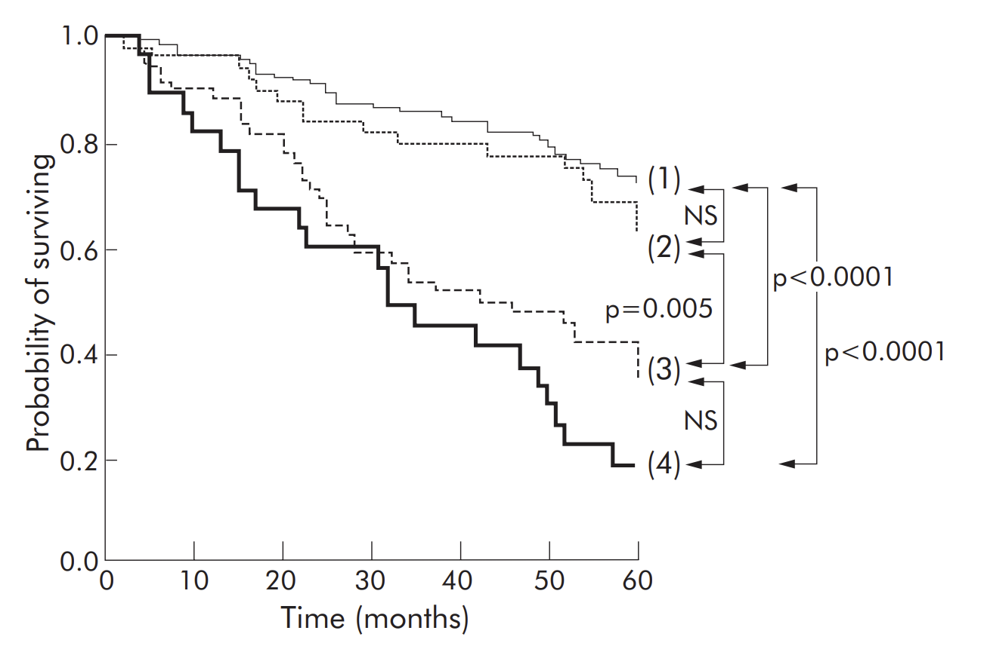
1 : no AECOPD
2 : AECOPD requiring ED but no admission
3 : AECOPD with hospitalization
4 : AECOPD requiring readmission
Soler-Cataluna JJ et al. Thorax 2005

Slide 15
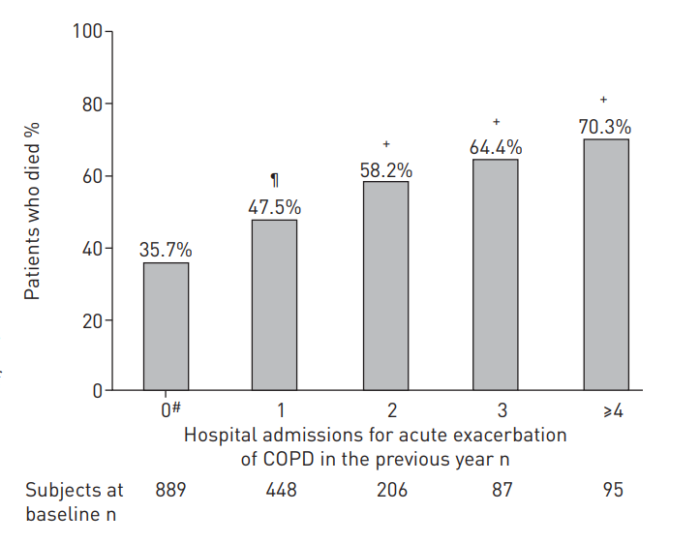
COPD exacerbations and risk of death:
high regardless of number of events
Median follow up 18 months
Piquet J et al. Eur Respir J 2013

Slide 16


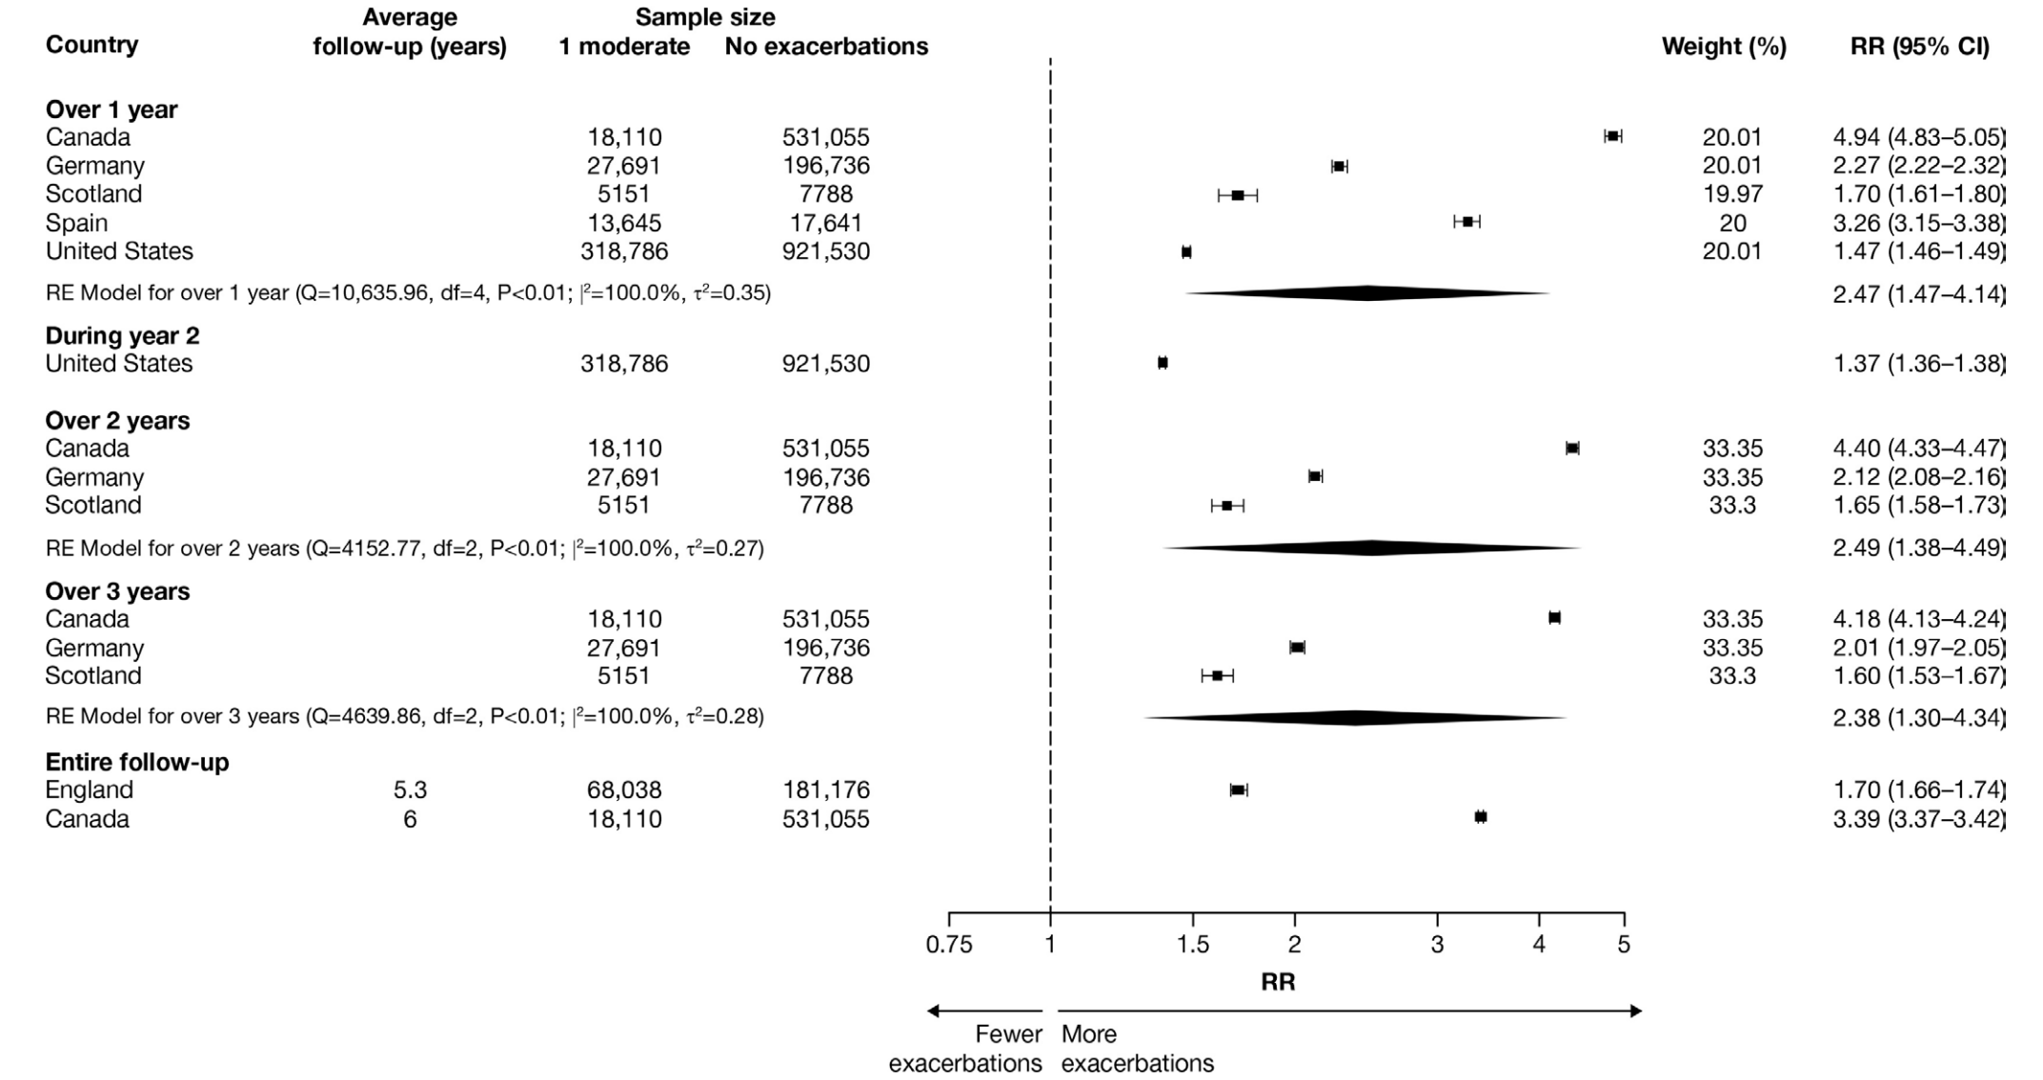
One moderate AECOPD leads to a
higher risk of moderate/severe events
Rhodes K et al. BMJ Open

Slide 17
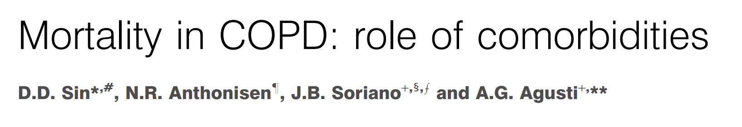
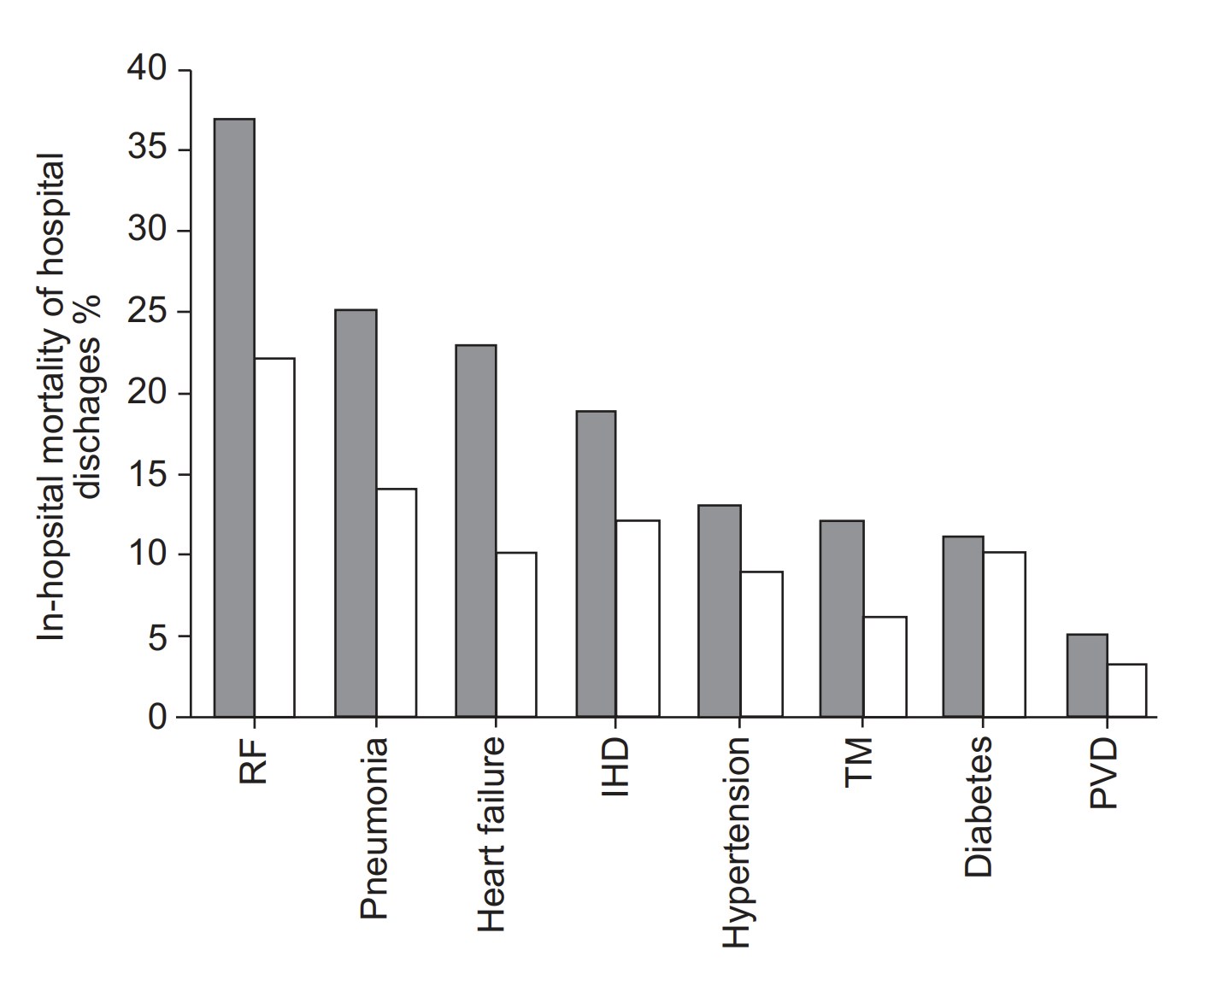
Sin D et al. Eur Respir J 2006

Slide 18
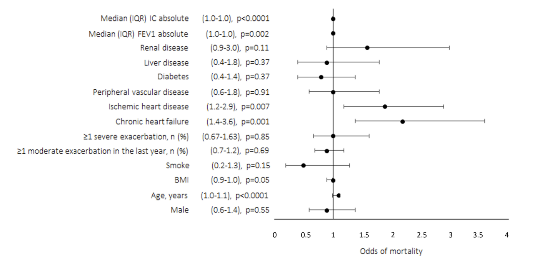
Santus P et al. Int J COPD 2024

Slide 19
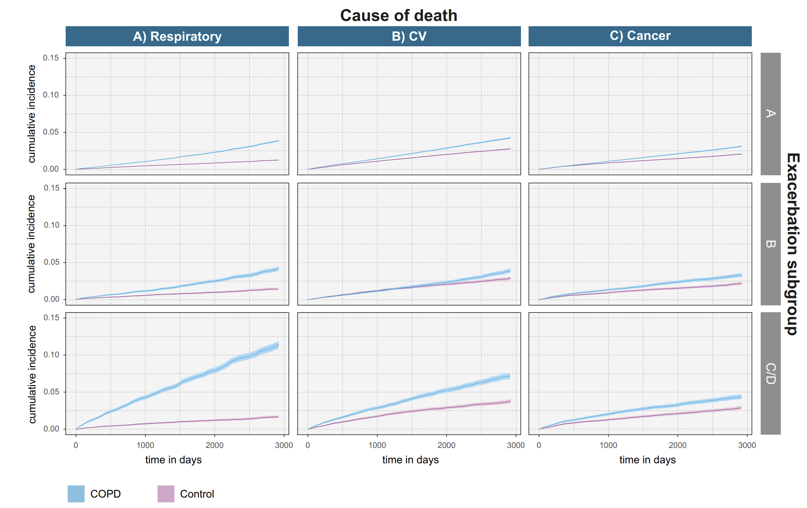
Vogelmeier C et al Int J COPD 2025

Slide 20
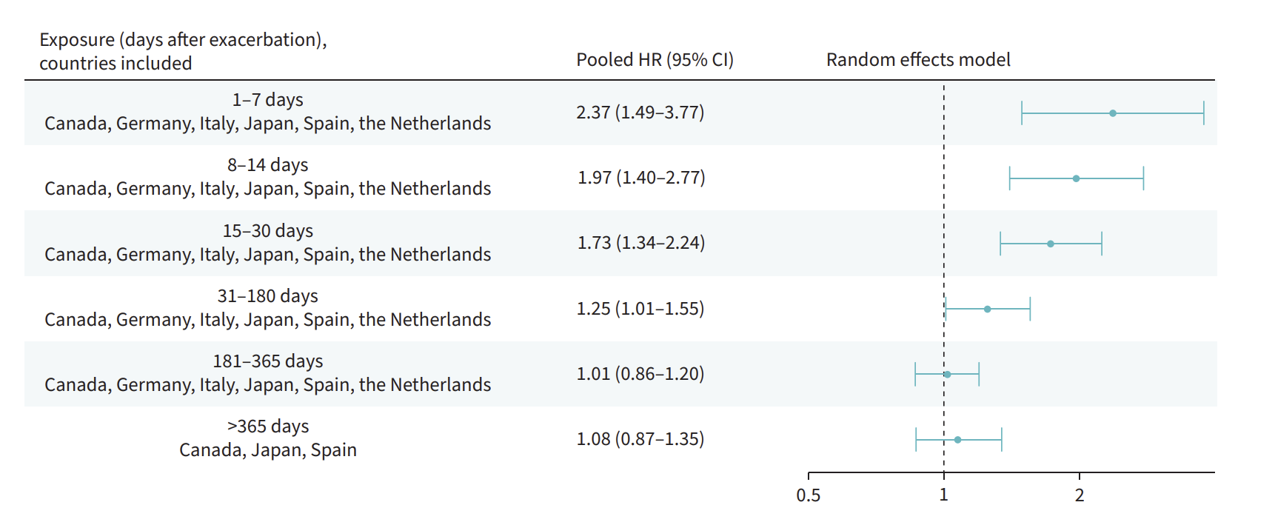
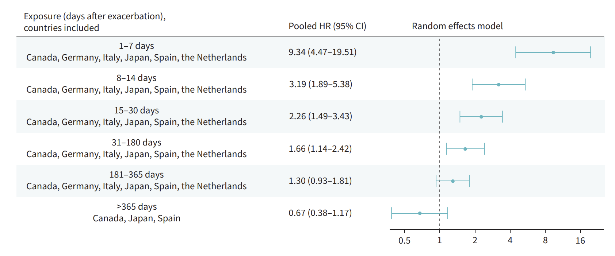
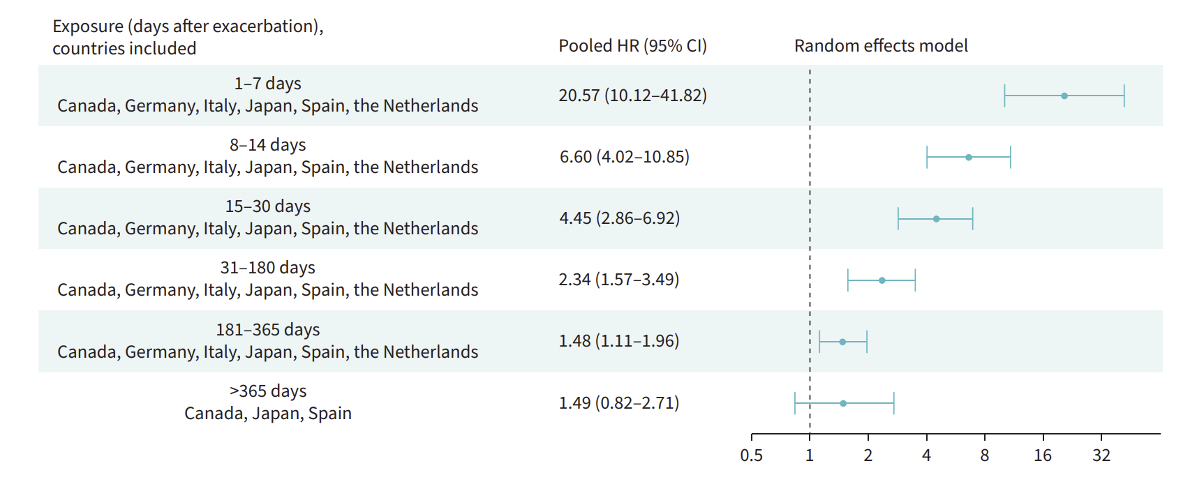
Following a moderate COPD exacerbation
Following the FIRST COPD exacerbation
Following a severe COPD exacerbation
Nordon C et al. ERJ Open Res 2025

Slide 21
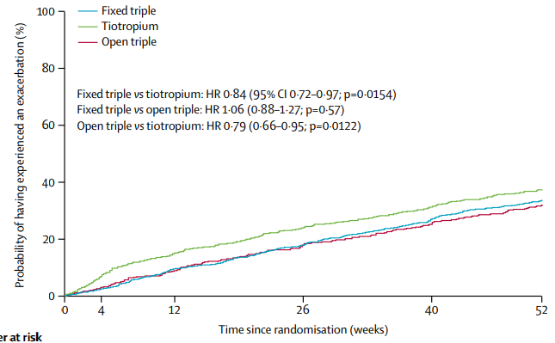
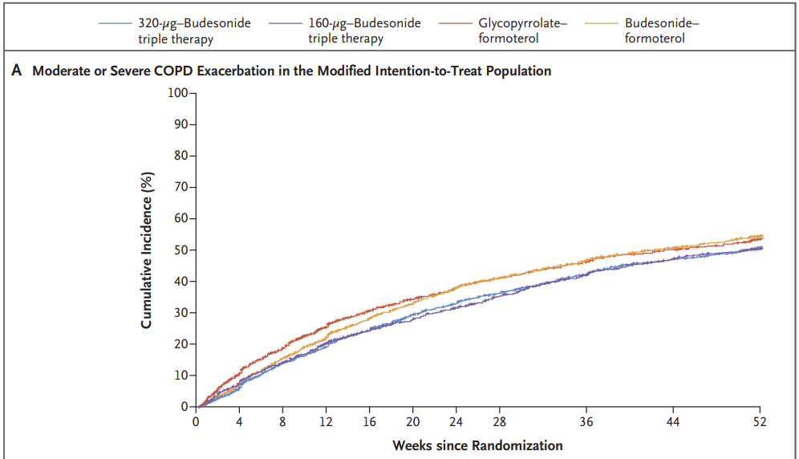
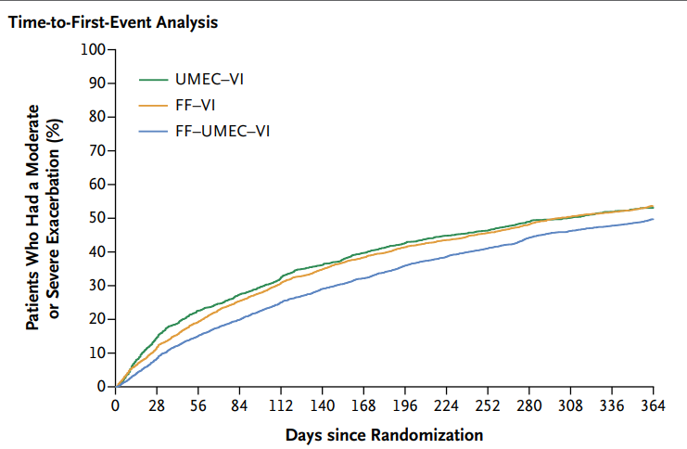
50%
38%
50%
Lipson DA et al. N Engl J Med 2018
Rabe K et al. NEJM 2020
Vestbo J K et al. Lancet 2017

Slide 22
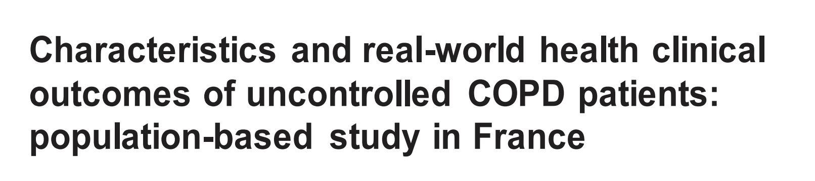
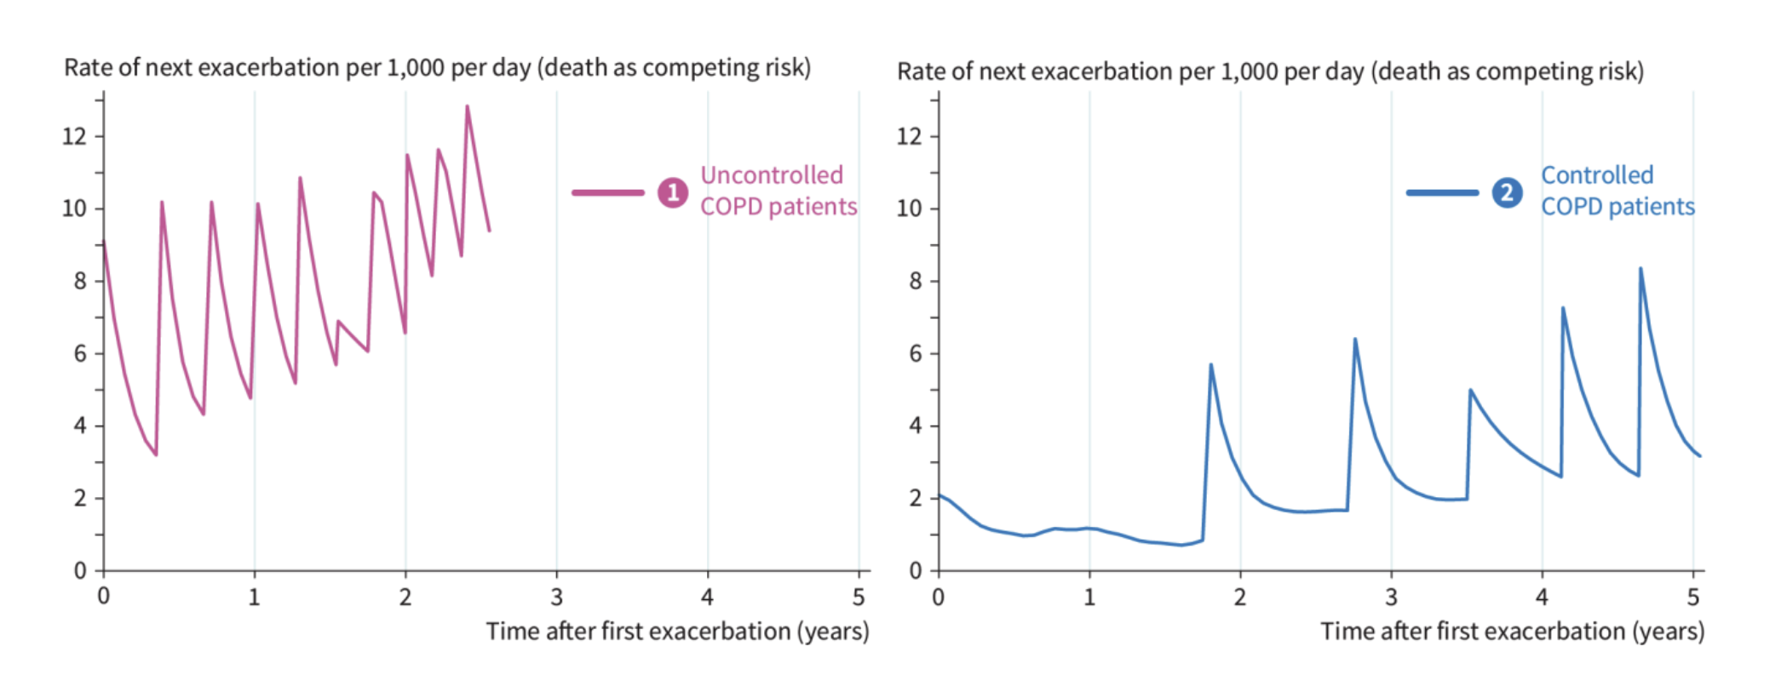
Roche N et al. ERJ Open 2025
186,963 COPD patients on triple therapy, 21.2% (n=39,647) uncontrolled

Slide 23
COPD exacerbation history in the year before enrollment
N = 1865
Data on file – ICORE Registry

Slide 24
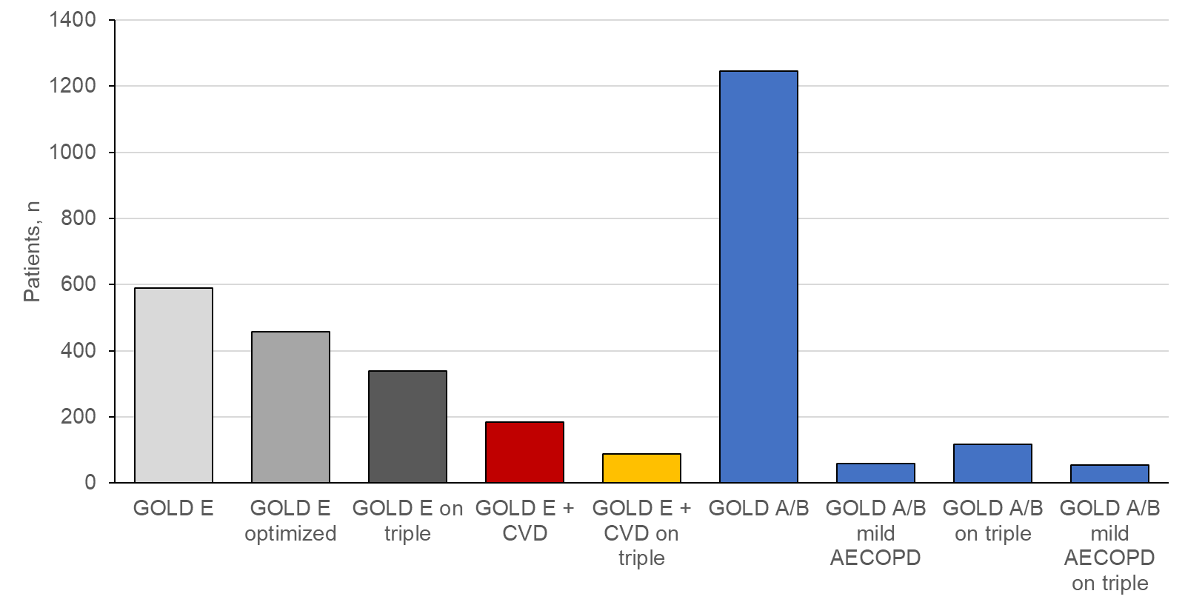
 | GOLD E N = 589
GOLD 1, n (%) | 33 (5.6)
GOLD 2, n (%) | 159 (27)
GOLD 3, n (%) | 142 (24.1)
GOLD 4, n (%) | 47 (8)
mMRC ≥ 2, n (%) | 466 (79.1)
CAT ≥ 10, n (%) | 468 (79.4)
GOLD E = 32.1% of registry
77.8%
Triple + LABA/LAMA
9.4
On triple
57.5
Triple
26.4%
On LABA/LAMA
31.4%
+ CVD
22.1%
+ CVD on LABA/LAMA
47.6%
+ CVD on triple
4.8
Mild AECOPD
90%
Mild AECOPD +
triple
Data on file – ICORE Registry

Slide 25
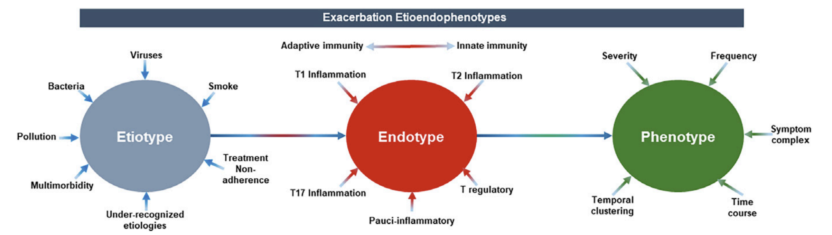
Bhatt SP et al. Am J Respir Crit Care Med 2023

Slide 26
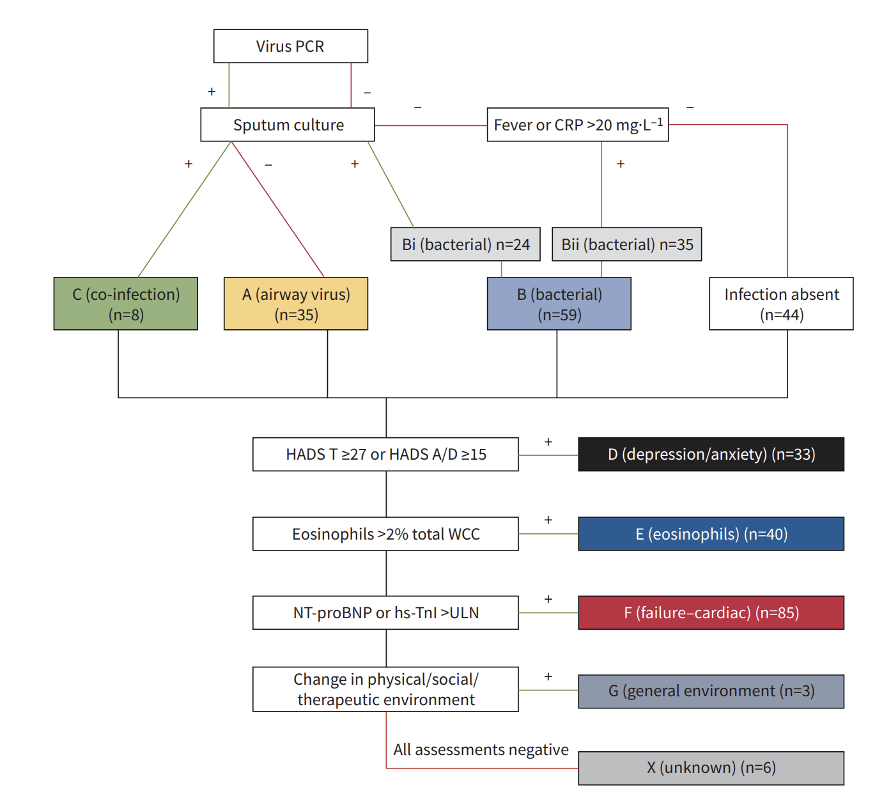
MacDonald MI et al. ERJ Open Res 2021

Slide 27
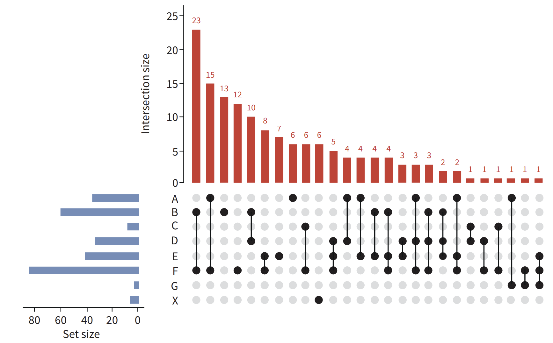
Bacterial + HF, 15.7%
Viral + HF, 10.3%
Bacterial, 8.9%
HF, 8.2%
Viral
Bacterial
Co-infection
Depression/anxiety
Eosinophils
Cardiac failure
Social environment
Unknwon
MacDonald MI et al. ERJ Open Res 2021

Slide 28
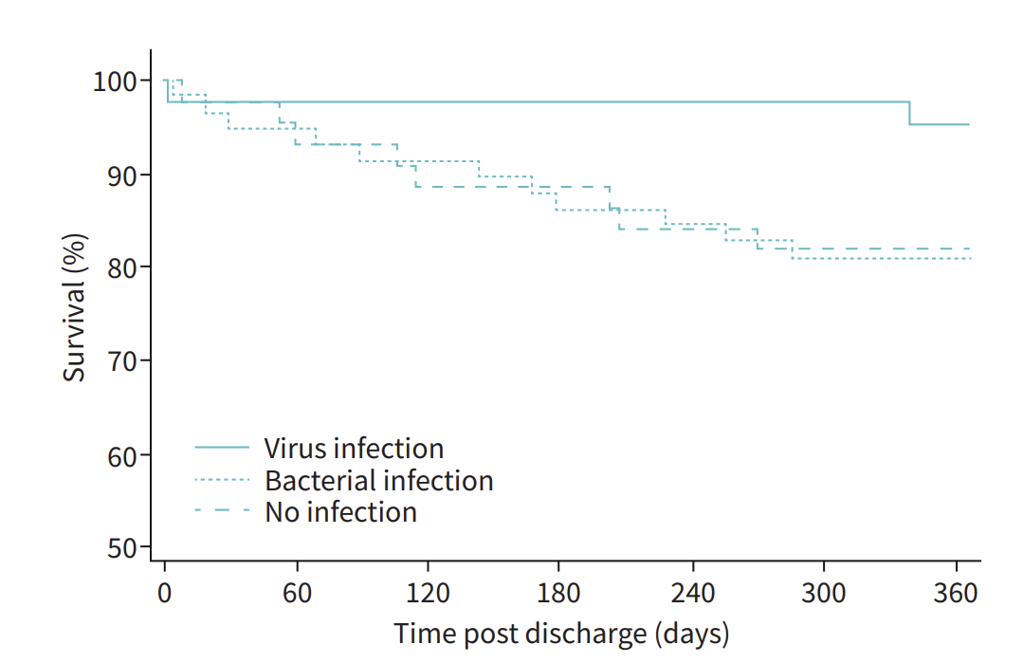
MacDonald MI et al. ERJ Open Res 2021

Slide 29
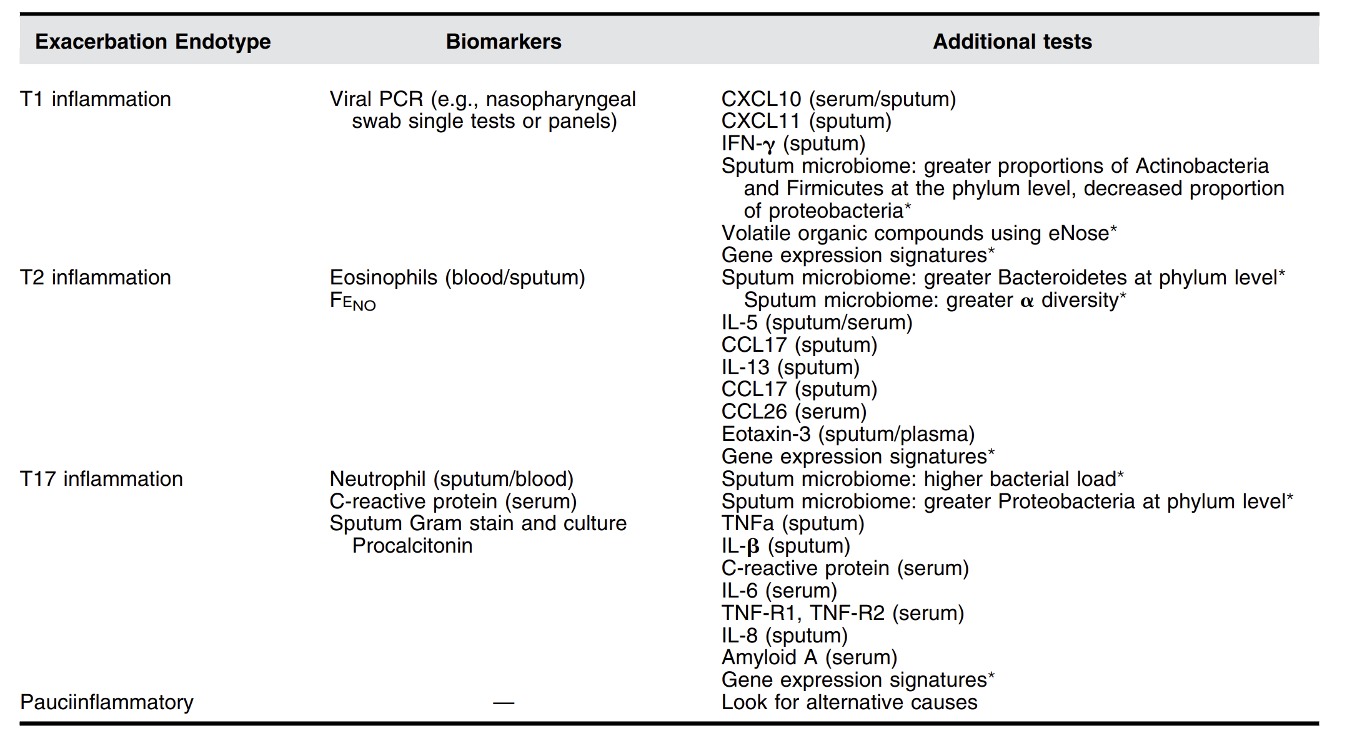
Bhatt SP et al. Am J Respir Crit Care Med 2023

Slide 30
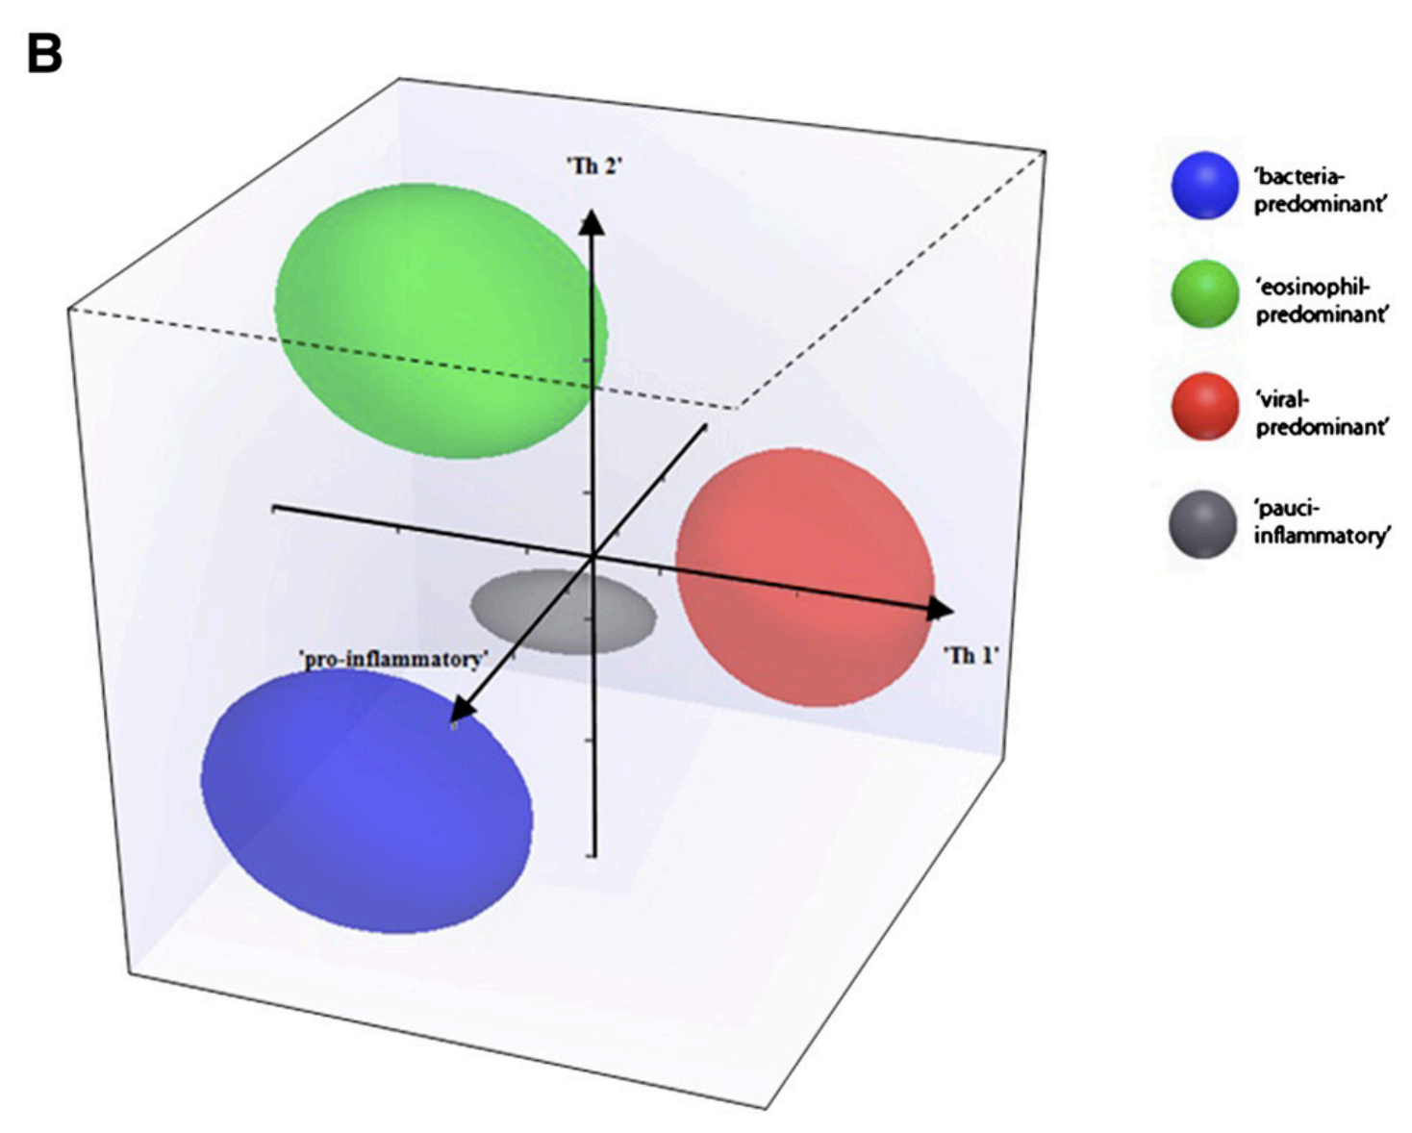
Bafadhel M et al. Am J Respir Crit Care Med 2011

Slide 31
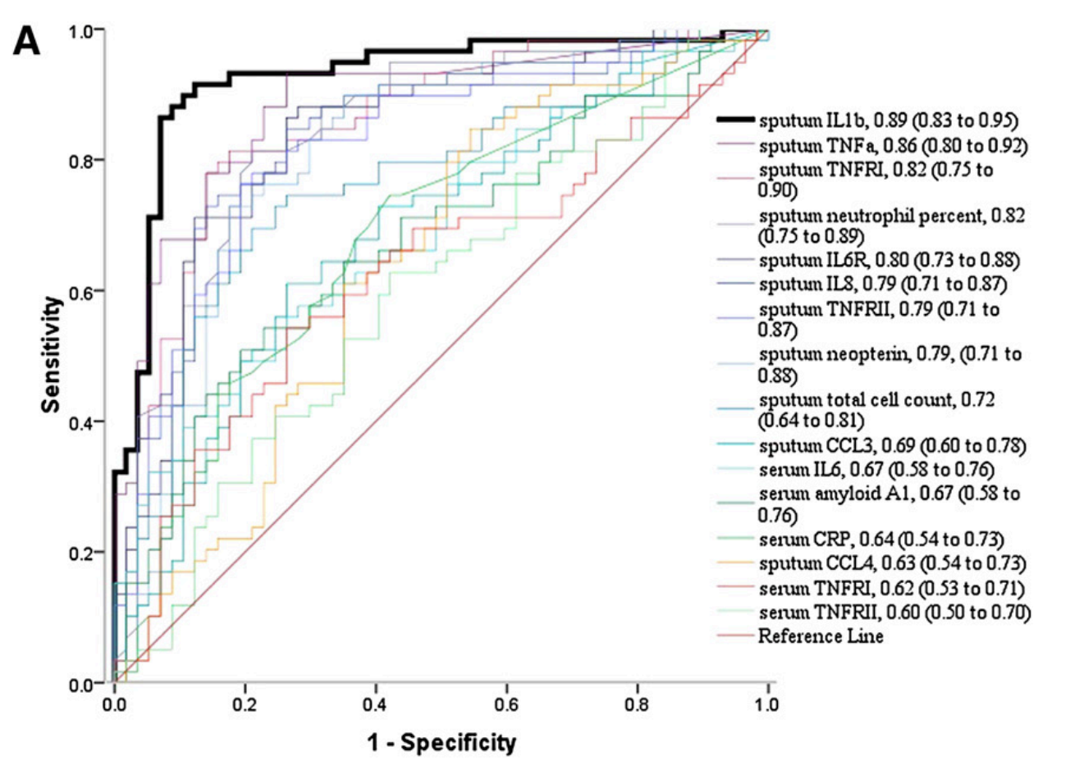
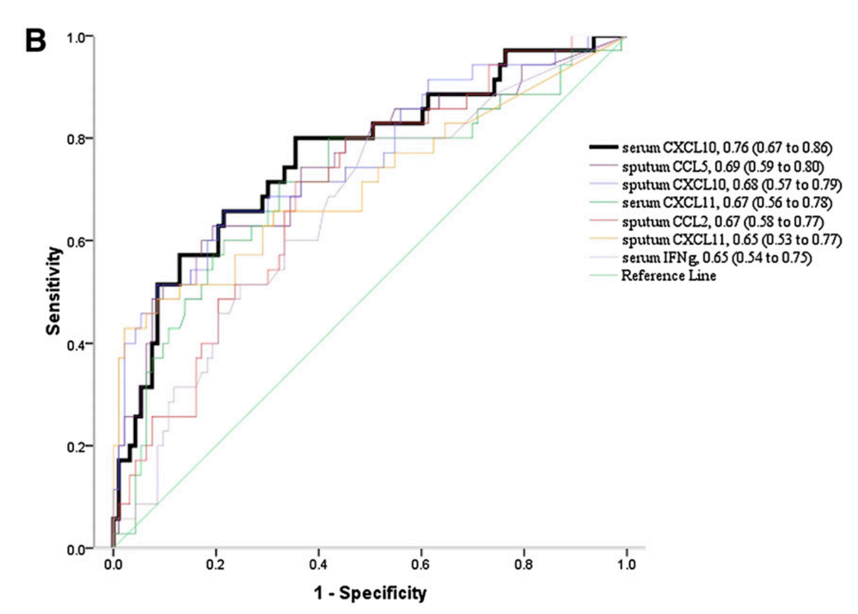
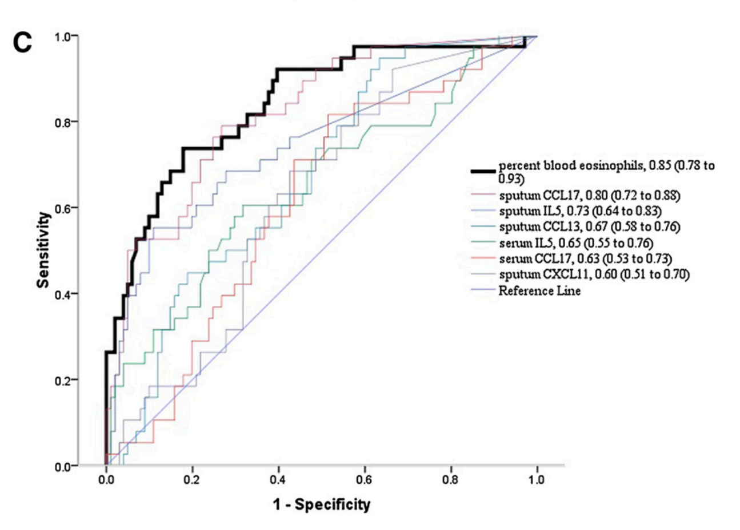
Sputum IL-1β
Serum CXCL10
Blood Eosinophils
Bafadhel M et al. Am J Respir Crit Care Med 2011

Slide 32
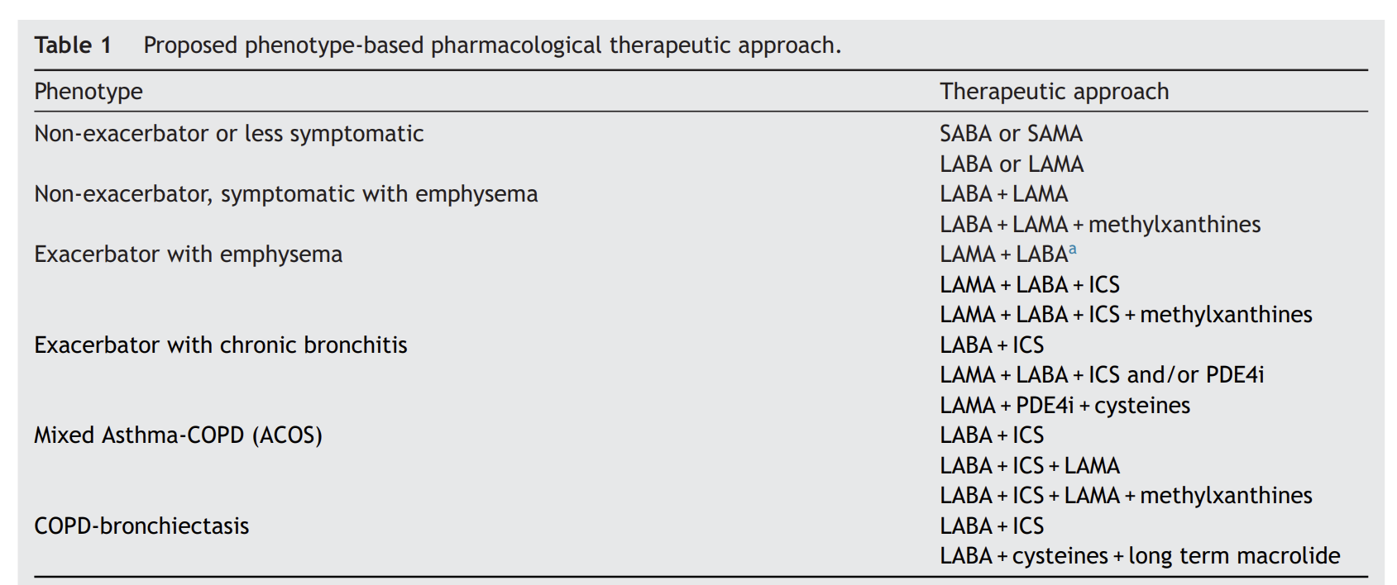
Fragono E et al. Rev Port Pneumol 2016

Slide 33
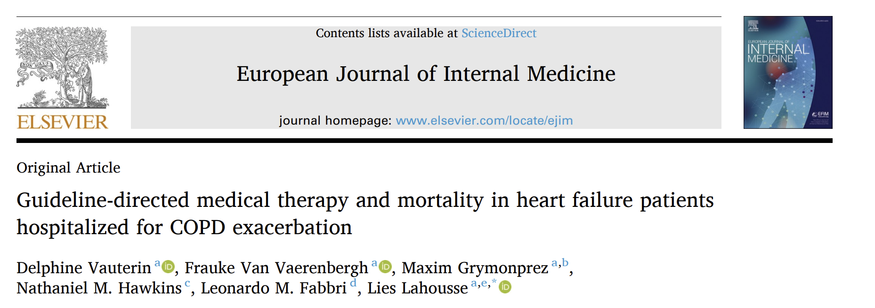
Testo: calibri light 14/16/18 pt, colore nero
N = 14,582 HF patients hospitalized with AECOPD
N = 2,058 died during hospitalization
Vauterin D, et al. Eur J Int Med 2026

Slide 34
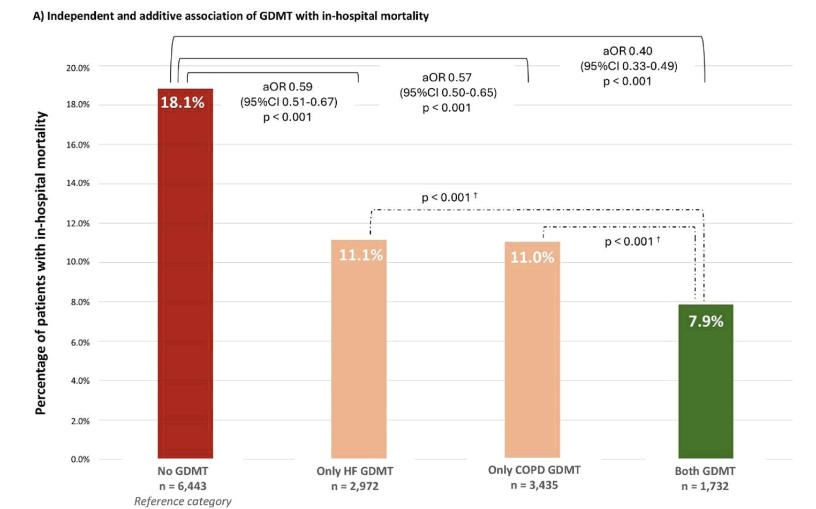
Vauterin D, et al. Eur J Int Med 2026

Slide 35
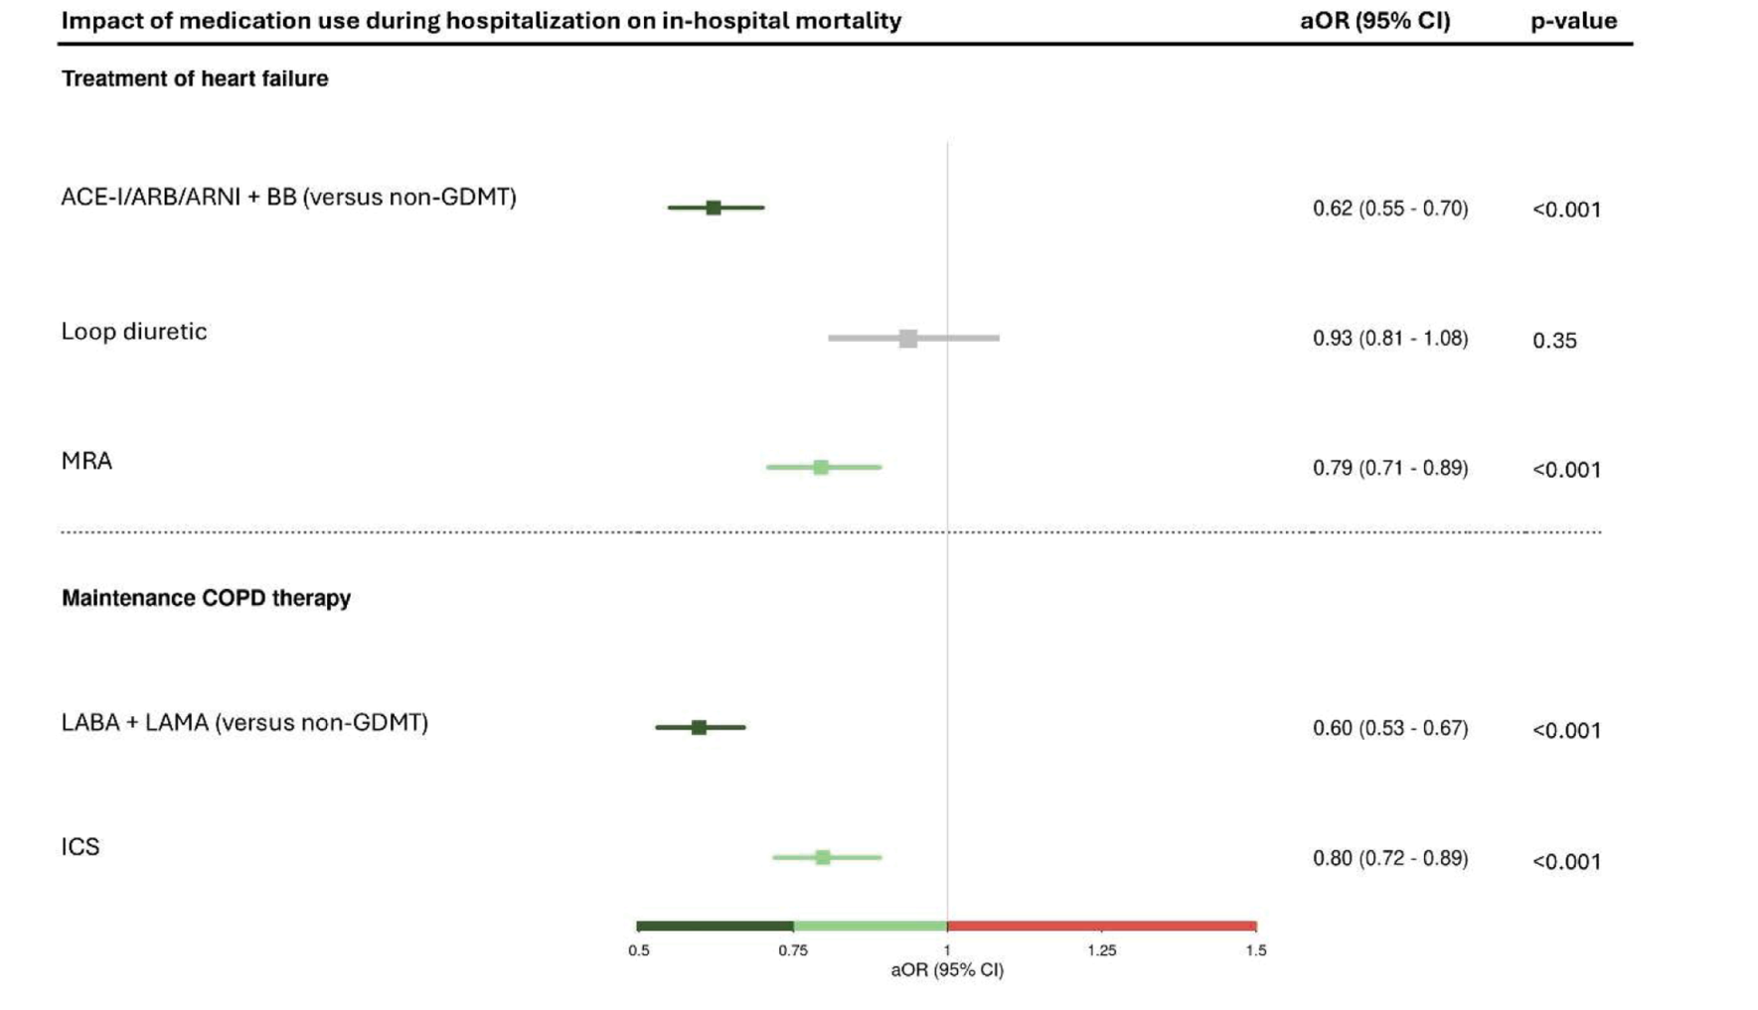
Vauterin D, et al. Eur J Int Med 2026

Slide 36
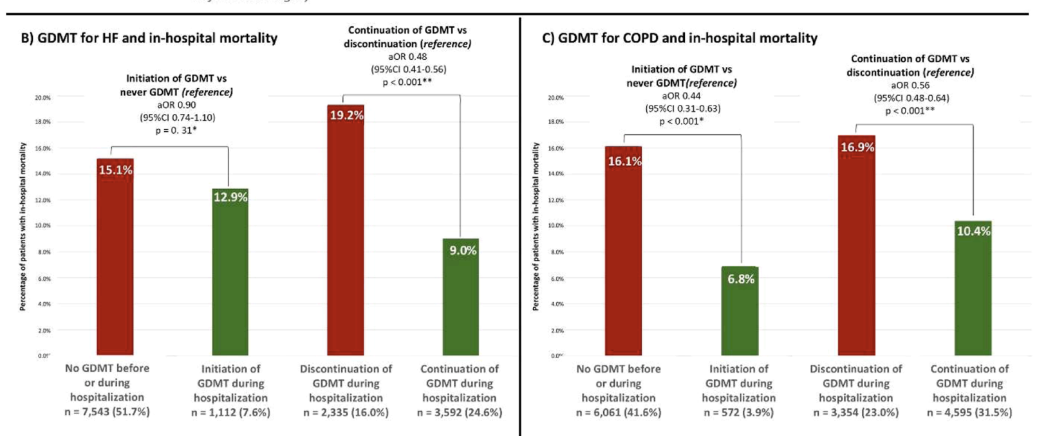
Vauterin D, et al. Eur J Int Med 2026

Slide 37
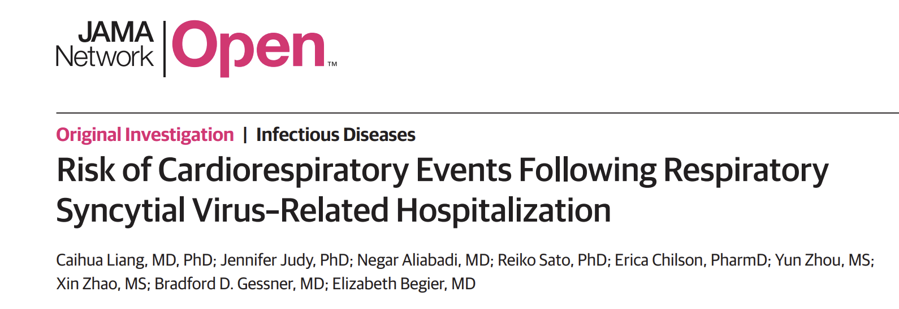
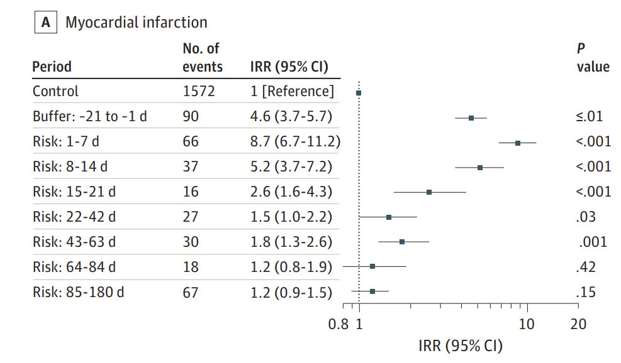
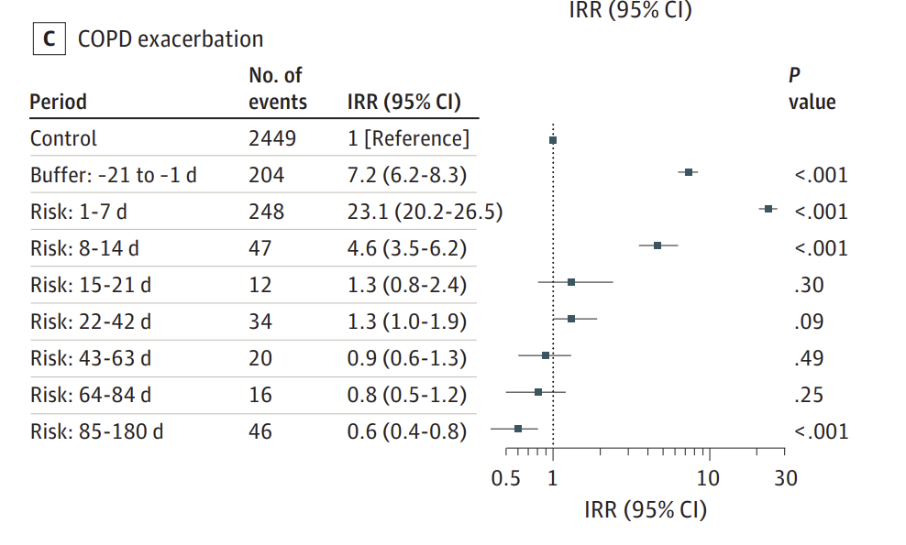
Lian C et al. JAMA Net Open 2026

Slide 38
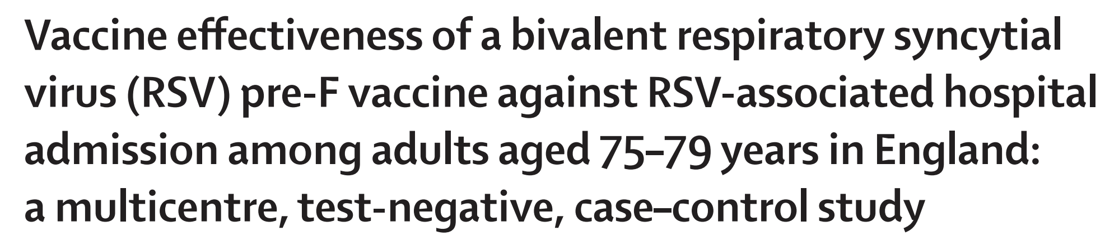
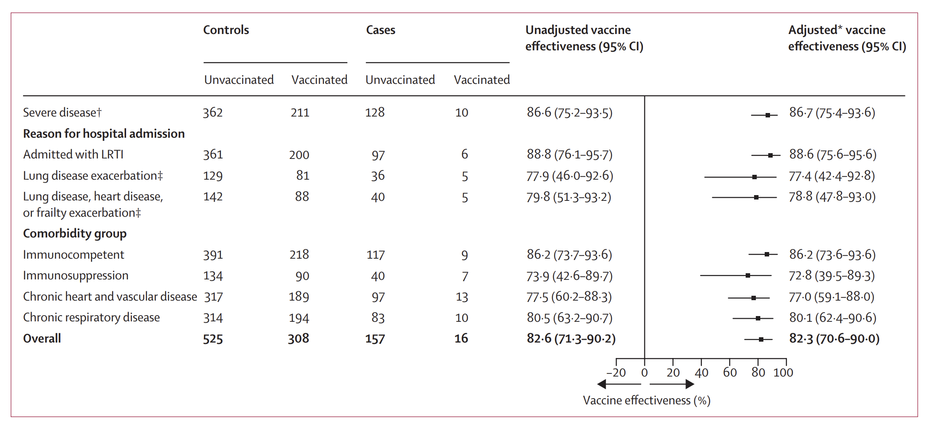
Symes R et al. Lancet Infect Dis 2026

Slide 39
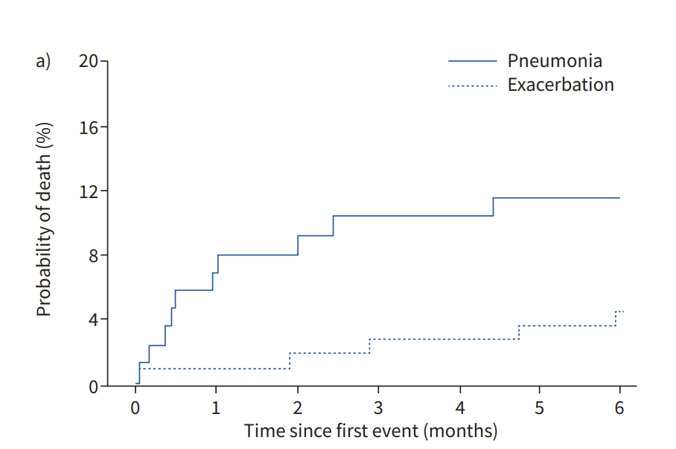
Mortality risk after admission for pneumonia is
significantly higher compared with severe AECOPD
Vestbo J et al. Eur Respir J 2021

Slide 40
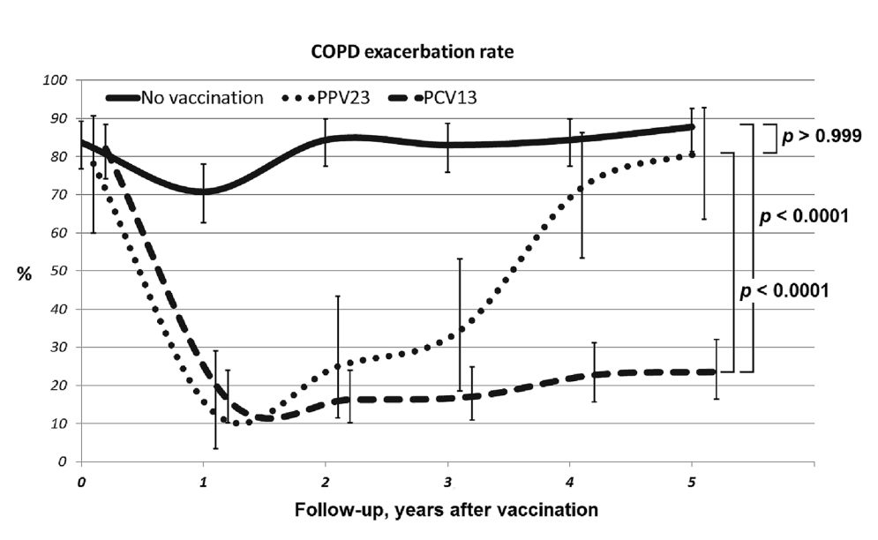
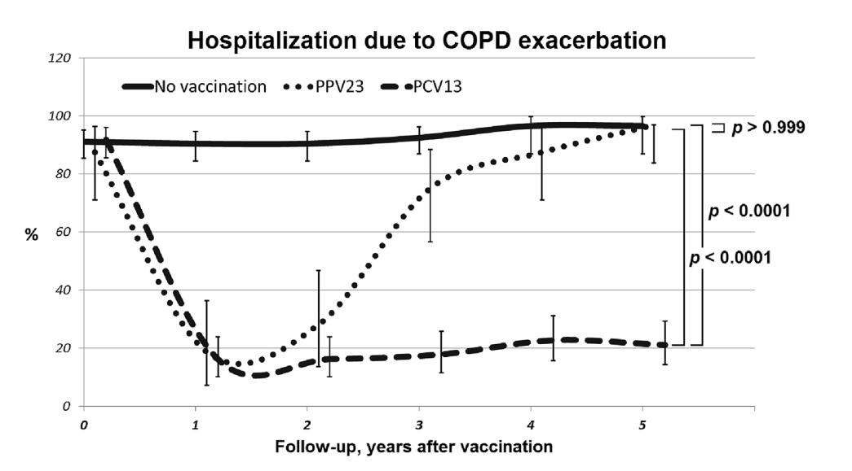
Ignatova G et al. Sci Rep 2021

Slide 41
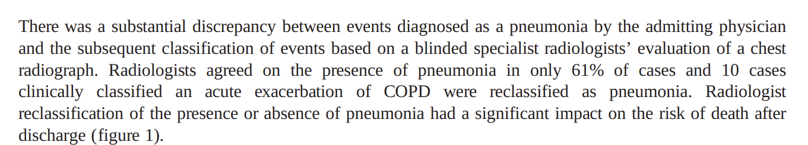
Mortality risk after admission for pneumonia is
significantly higher compared with severe AECOPD
Vestbo J et al. Eur Respir J 2021

Slide 42
Vaccination status of COPD patients in ICORE
Italian COPD Registry
Data on file – ICORE Registry

Slide 43
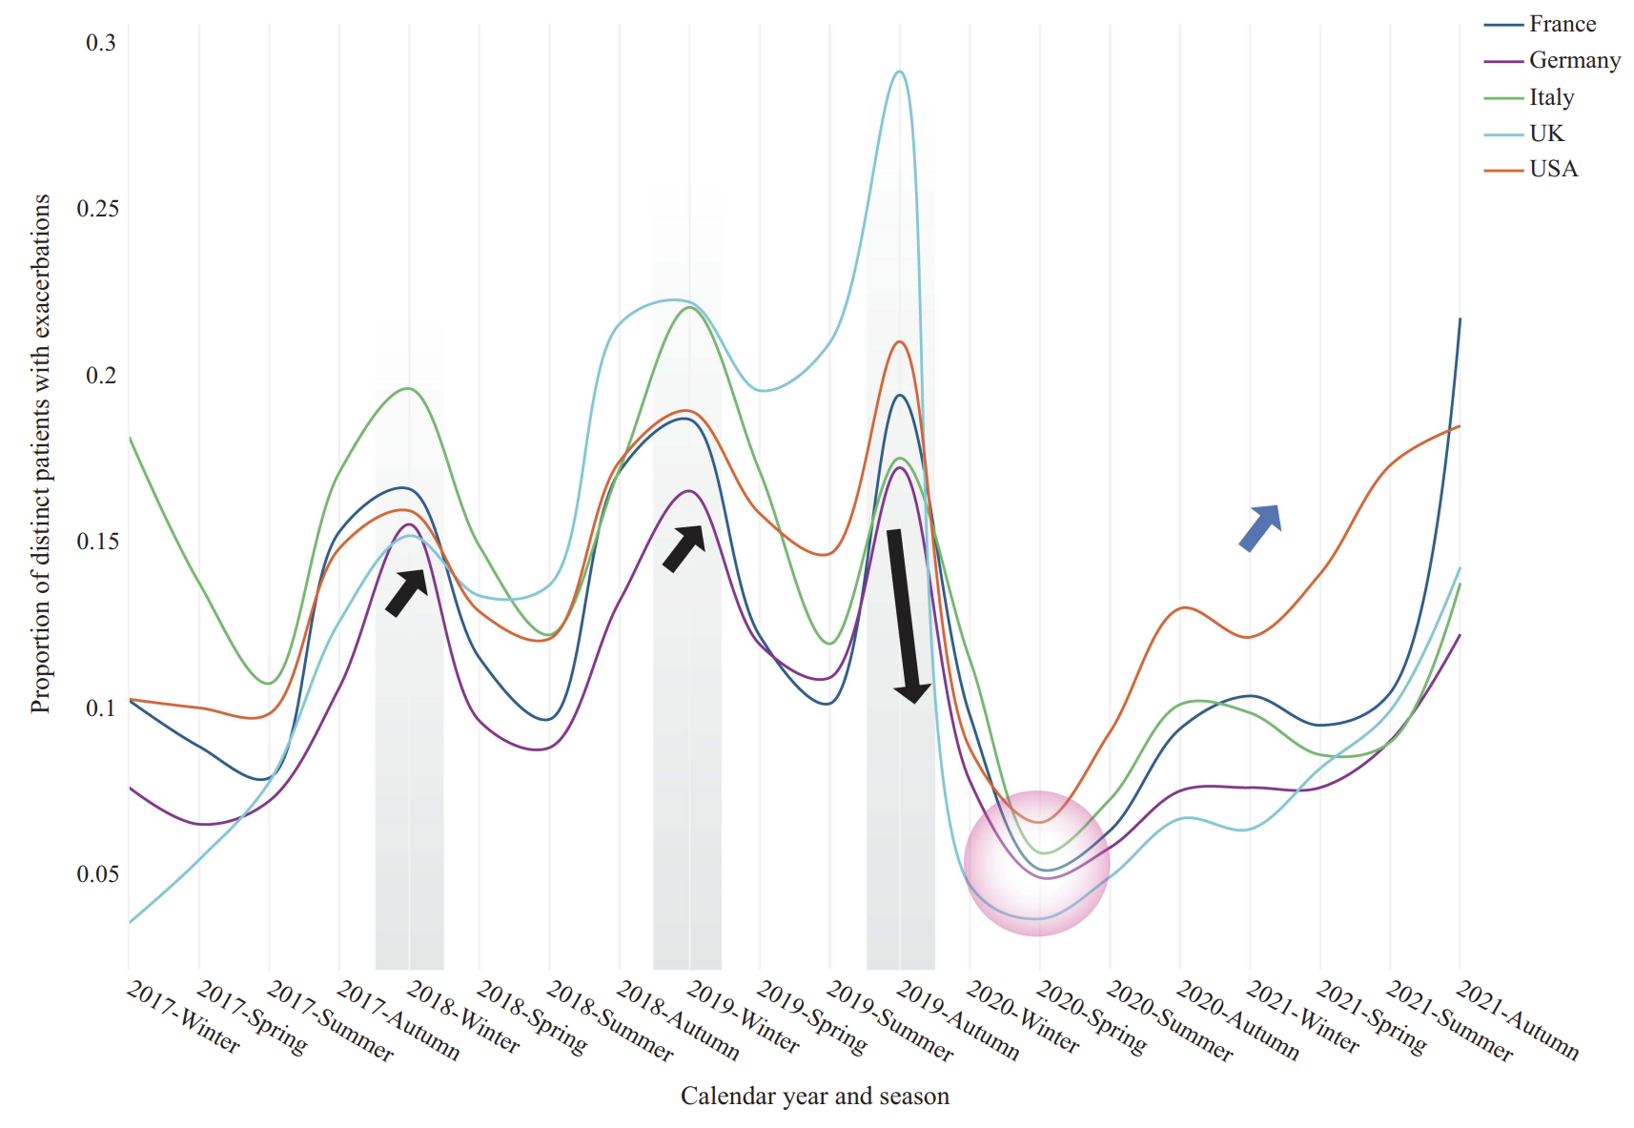
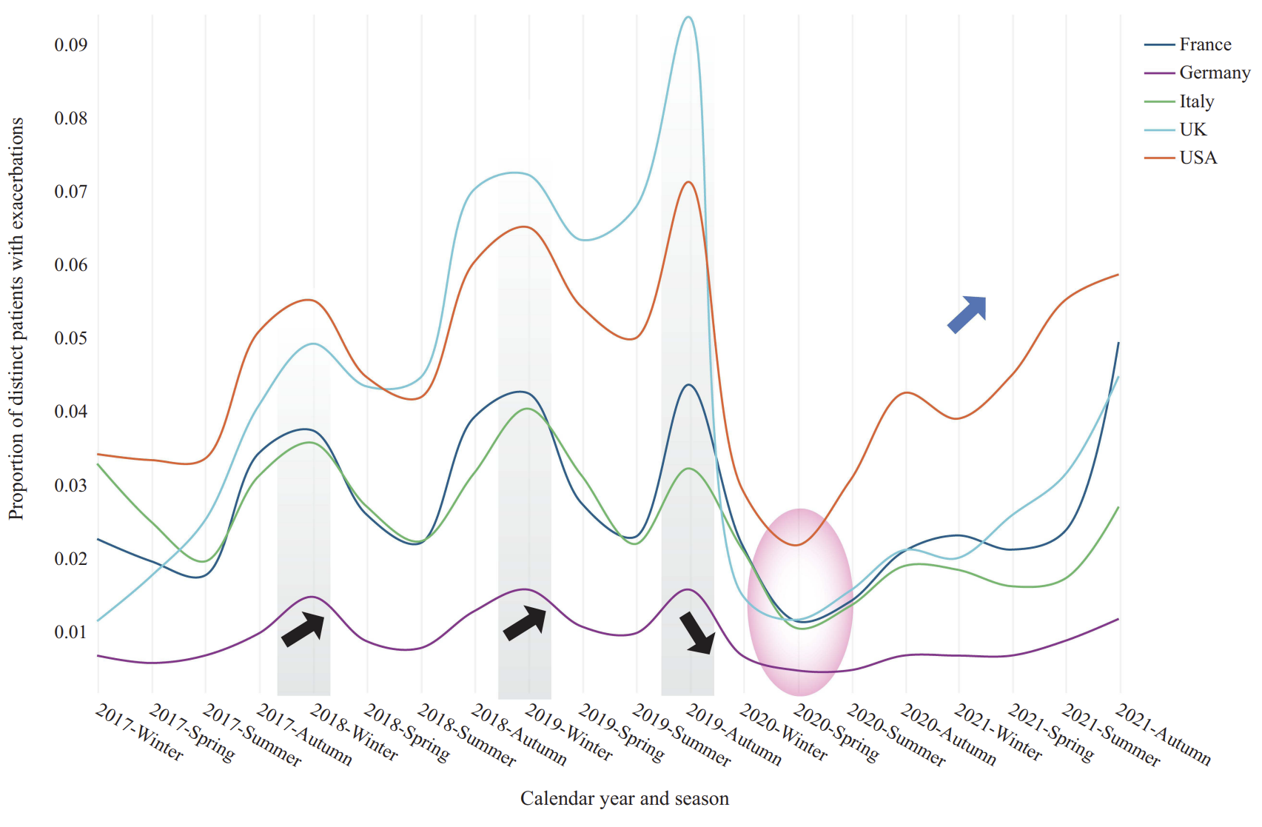
Martinez FJ et al. Int J COPD 2024

Slide 44
Take home message
Prevention strategies for COPD exacerbations should be our first goal
(early) Optimization of available pharmacological therapy is mandatory
Active search for etiology (etiotype) in AECOPD can guide appropriateness of therapy
WE MUST be sensitised to IN-HOSPITAL optimization of COPD and CVD therapy

Slide 45



Soldati G et al. Multidiscip Respir Med 2026
Courtesy of Prof. Tobin MJ, Hines Veterans Affairs Hospital, Loyola University of Chicago
Stritch School of Medicine

