Slide 1



Esiste la BPCO eosinofila?
Dott. Umberto Semenzato
UOC Pneumologia

Slide 2
Conflict of interest disclosure
I have the following real or perceived conflicts of interest that relate to this presentation:
Affiliation / Financial interest | Commercial Company
Grants/research support: | -
Honoraria or consultation fees: | AstraZeneca, GlaxoSmithKline, Insmed, Sanofi.
Participation in company sponsored meetings/online events: | AstraZeneca, Chiesi Farmaceutici, GlaxoSmithKline, Insmed, Menarini, MSD, Sanofi, Sanofi Suisse, Zambon.
Stock shareholder: | -
Spouse / partner: | -
Other support / potential conflict of interest: | Travel and courses registrations support from AstraZeneca, Chiesi Farmaceutici, Insmed and Menarini

Slide 3
Agenda
A historical perspective: eosinophils in COPD
Eosinophilic COPD: is it just asthma?
From biomarker to therapeutic target
Diagnostic labels still matter?

Slide 4

1. A historical perspective: Eos in COPD
Late 1990s: baseline sputum eosinophil concentrations predicted therapeutic response to oral prednisone.
In subsequent years it has been assumed that blood eosinophilia is a faithful representation of tissue eosinophilia.
Mid 2010s: post-hoc and retrospective analyses of several large COPD clinical trials showing that increased blood eosinophil count → risk of exacerbations, response to ICS.
Pizzichini E et al. Am J Respir Crit Care Med 1998; 158: 1511–1517.
Tinè M, Biondini D, Semenzato U et al. Journal of Clinical Medicine. 2019; 8(7):962.
Pascoe S et al. Lancet Respir Med. 2015;3(6):435-442.

Slide 5
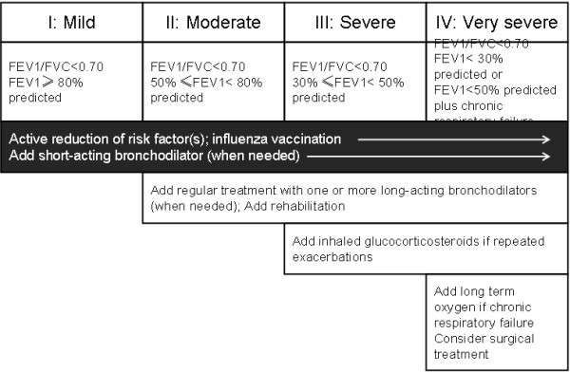
GOLD 2007

Slide 6
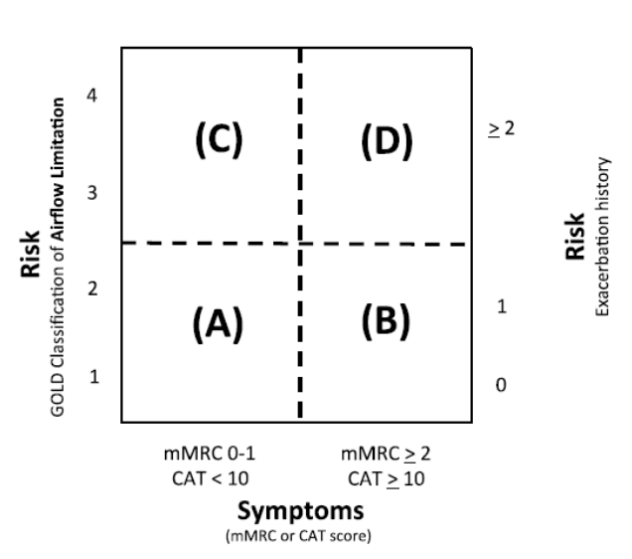
GOLD 2011

Slide 7
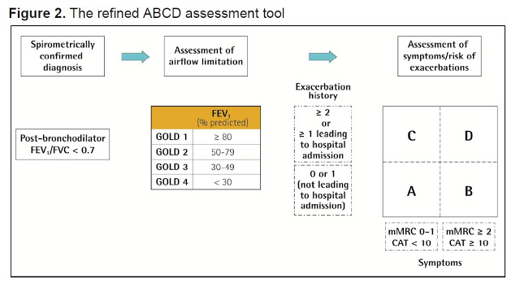
GOLD 2017

Slide 8
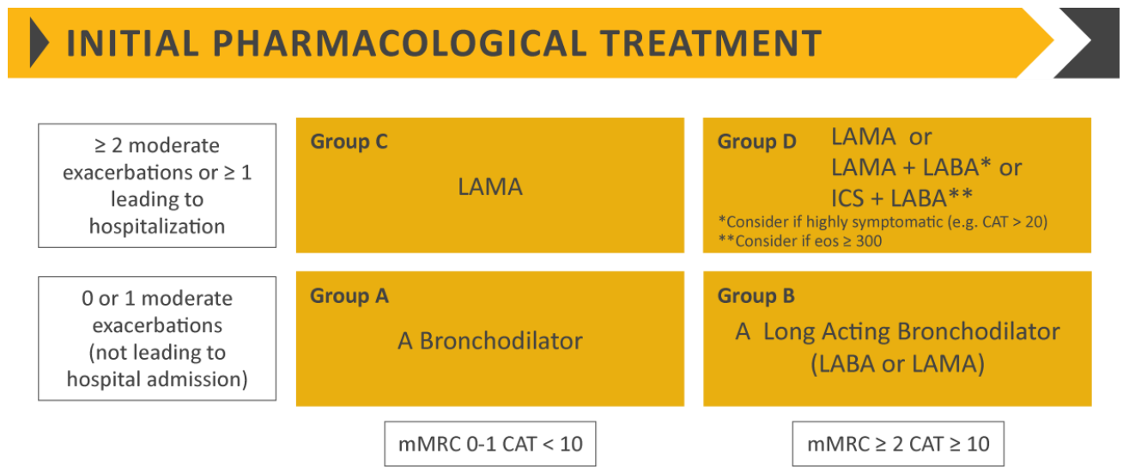
GOLD 2019

Slide 9
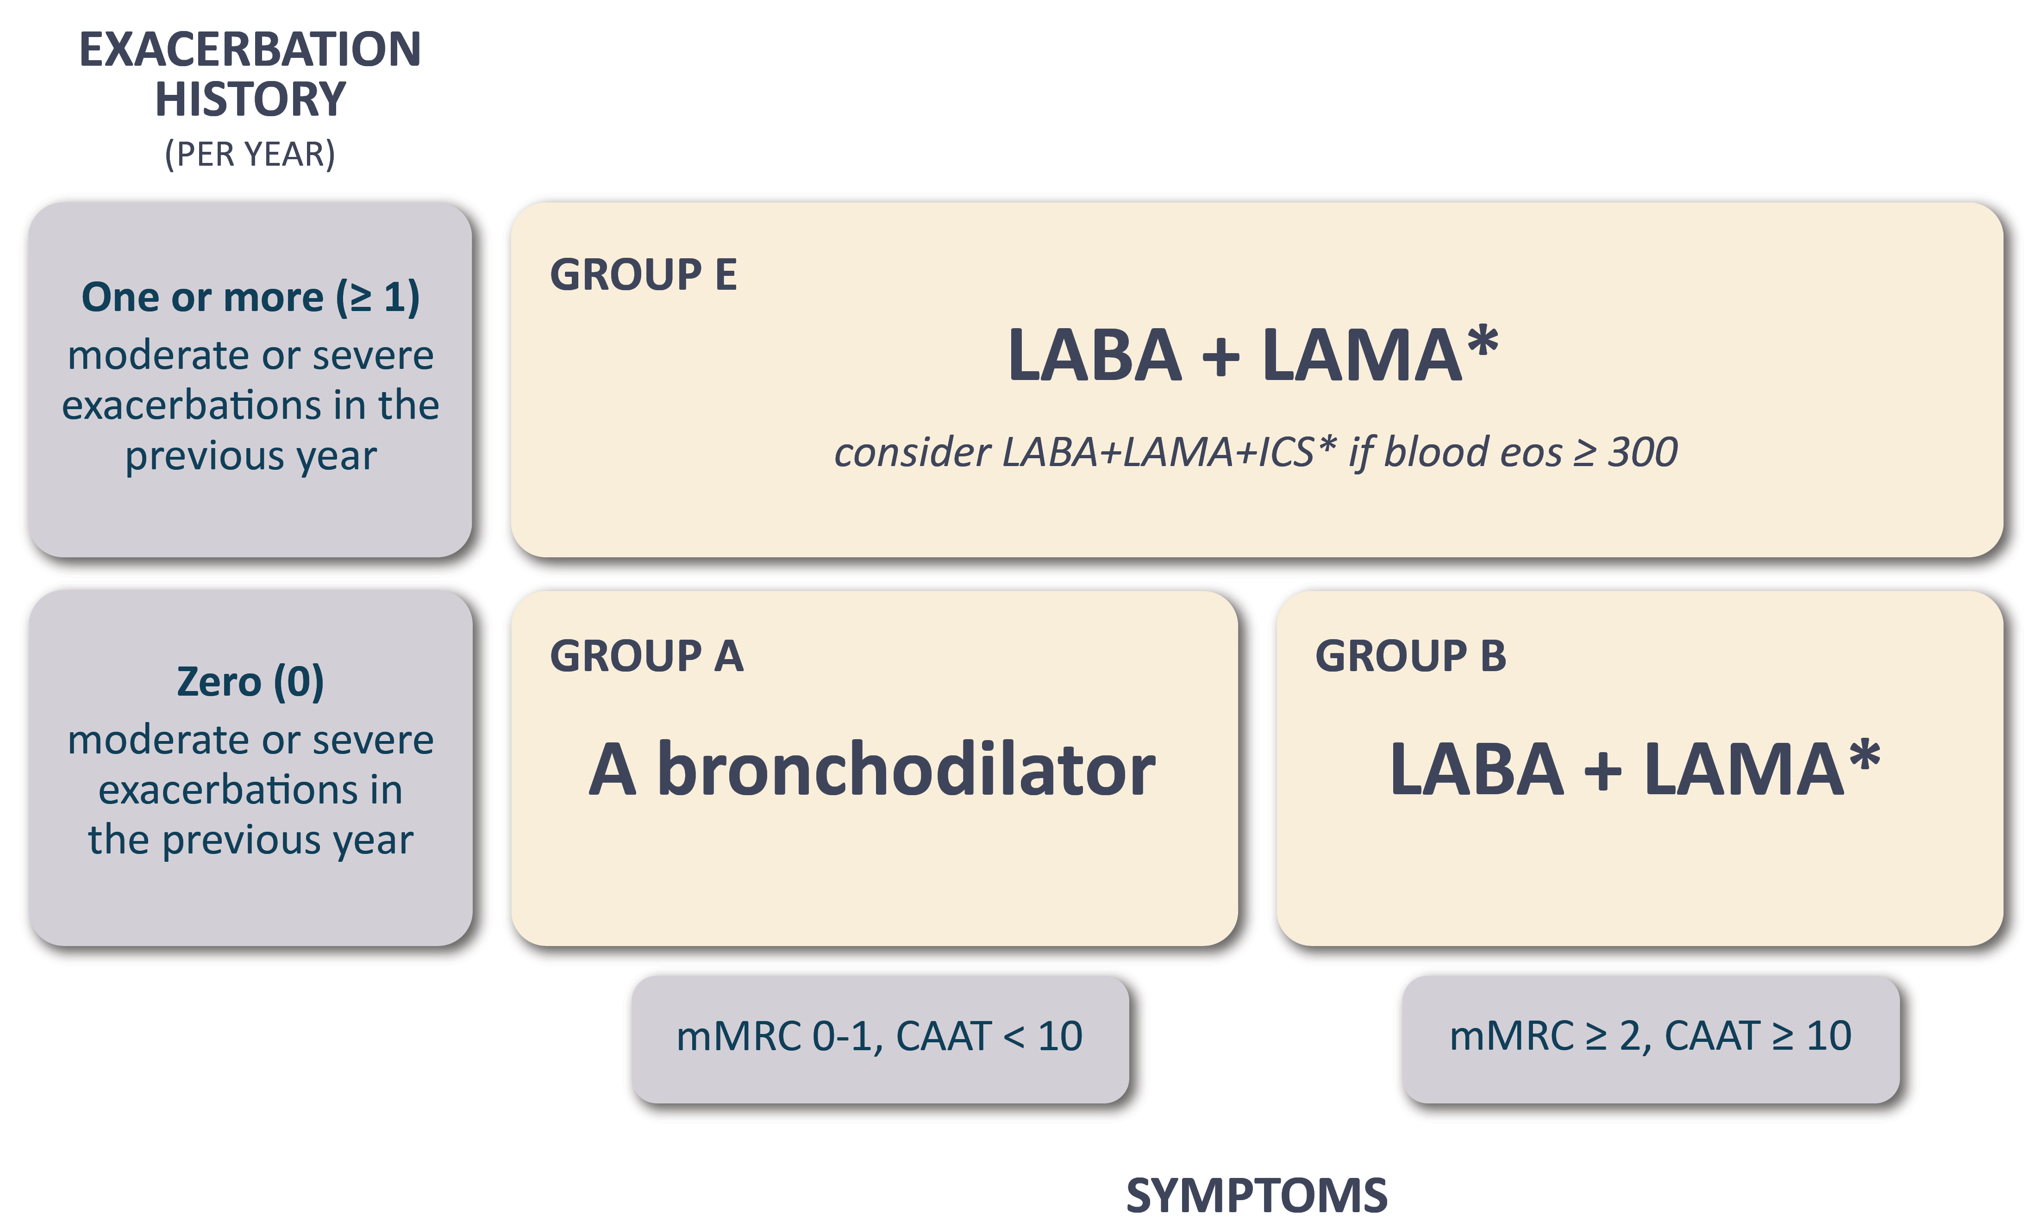
GOLD 2026
Global Initiative for Chronic Obstructive Lung Disease (GOLD) 2026

Slide 10
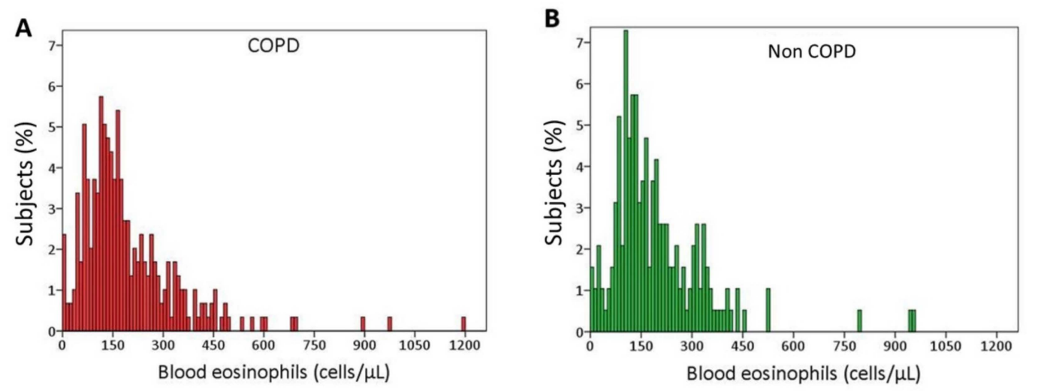
Eosinophils in COPD: controversies
Cut-off: 300 cells/uL is within the normal value of blood eos.
Turato G, Semenzato U et al. Am J Respir Crit Care Med. 2018 May 1;197(9):1216-1219.
Tinè M, Biondini D, Semenzato U et al. Journal of Clinical Medicine. 2019; 8(7):962.
Polverino F, Sin DD. Eur Respir J. 2024;63(5):2400150.

Slide 11
Eosinophils in COPD: controversies
Cut-off: 300 cells/uL is within the normal value of blood eos.
Blood eos presents a significant variability within the same patient.
Blood eosinophil counts in COPD may not accurately reflect eosinophils in the airways.
Turato G, Semenzato U et al. Am J Respir Crit Care Med. 2018 May 1;197(9):1216-1219.
Tinè M, Biondini D, Semenzato U et al. Journal of Clinical Medicine. 2019; 8(7):962.
Polverino F, Sin DD. Eur Respir J. 2024;63(5):2400150.

Slide 12
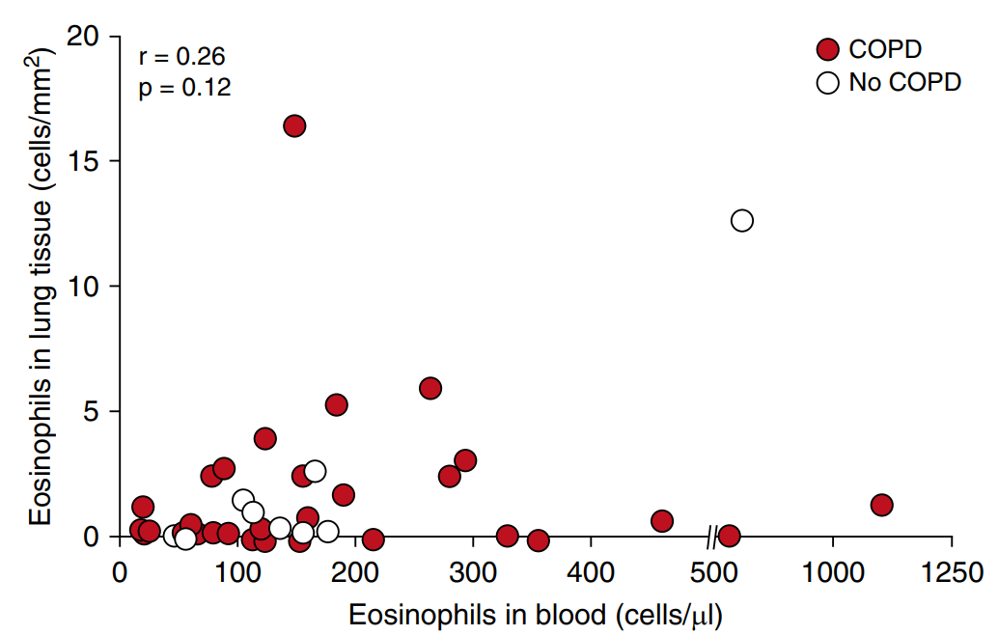
Eosinophils in COPD: controversies
Turato G, Semenzato U et al. Am J Respir Crit Care Med. 2018 May 1;197(9):1216-1219.

Slide 13
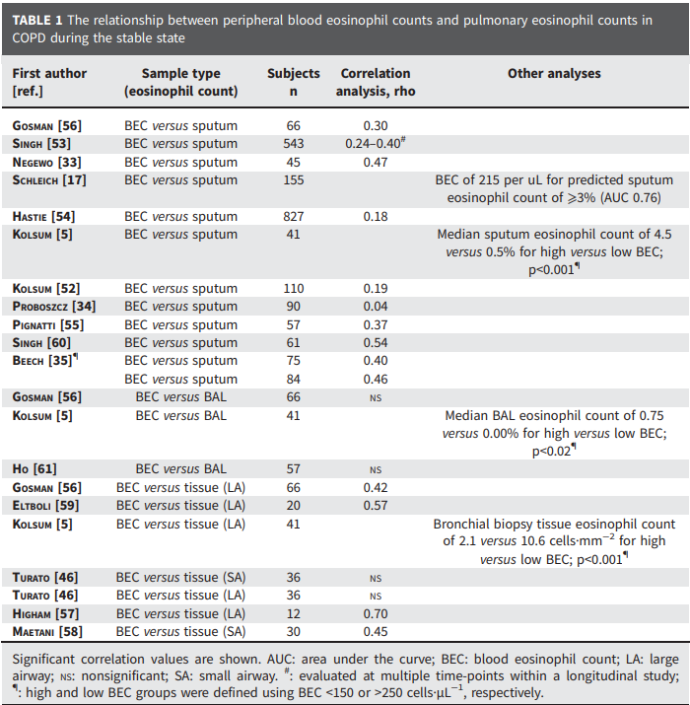
Adapted from Beech A. Eosinophils and COPD. ERS Monograph European Respiratory Society, 2024; pp. 149–167.

Slide 14
2. Eosinophilic COPD: is it just asthma?
Asthma contamination in COPD trials
Eosinophils: COPD trait or asthma footprint?
ICS benefit: true COPD effect or diagnostic bias?
Park KJ. ERJ Open Res. 2026 Feb 16;12(1):01059-2025.
Notes:
Come facciamo a dirlo senza che diventi una religione?

Slide 15
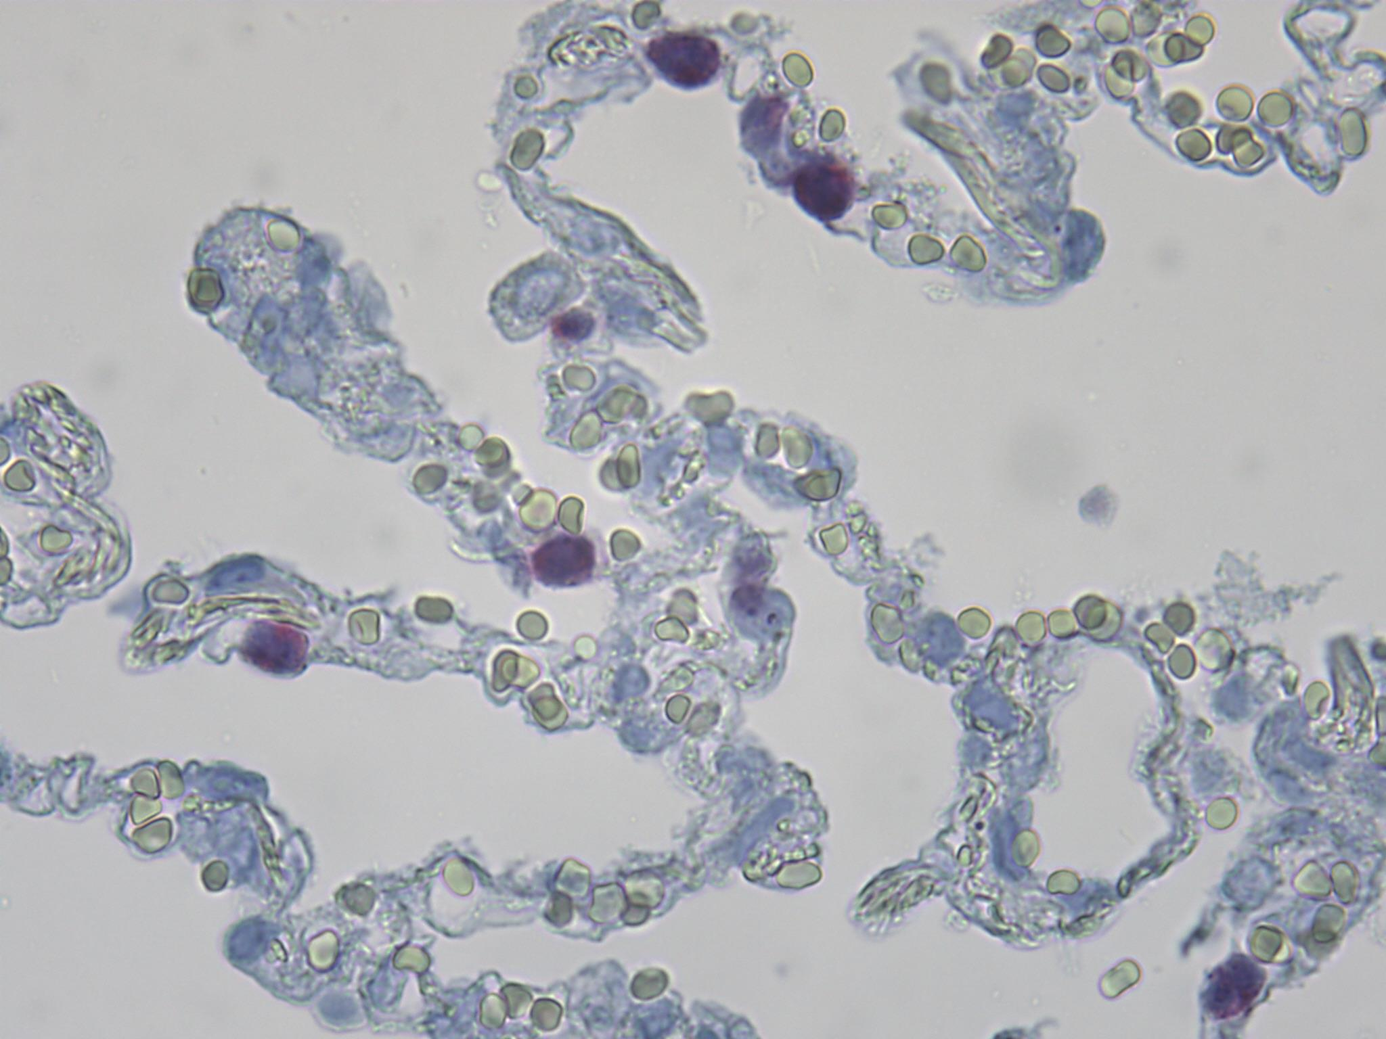
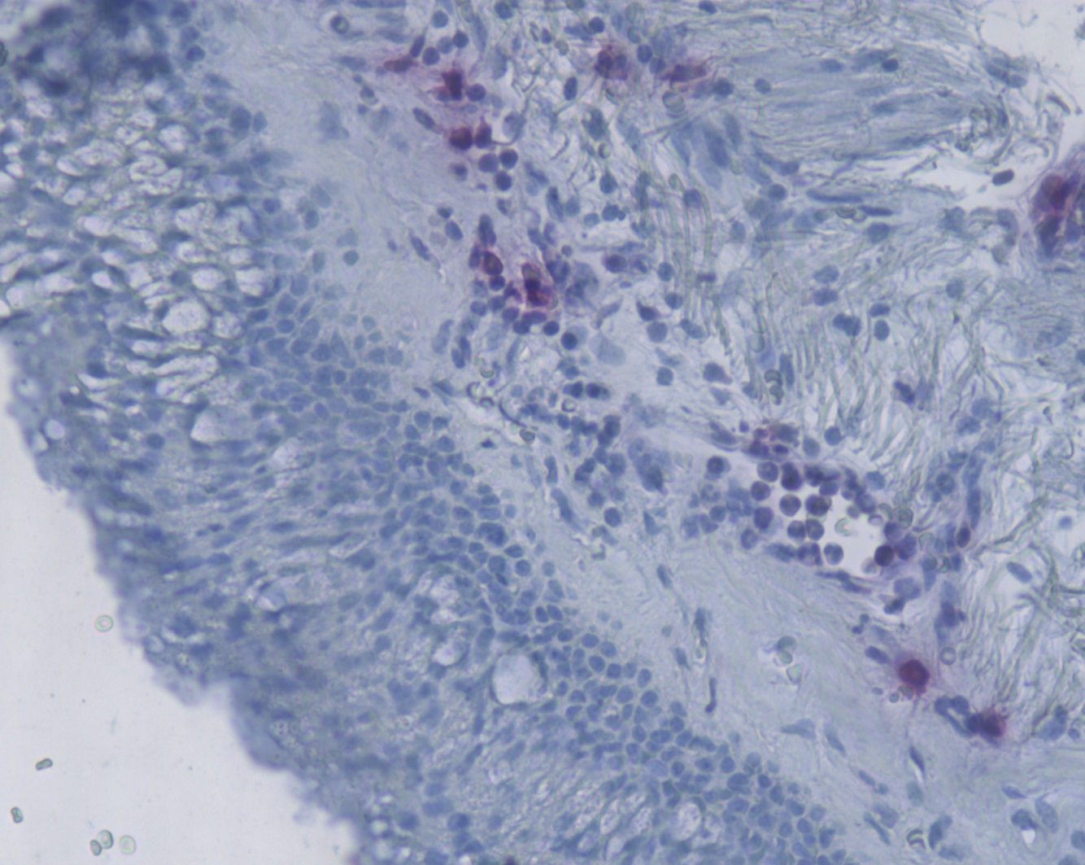
2. Eosinophilic COPD: is it just asthma?
Pathological studies comparing asthma and COPD provide additional insights
Semenzato U, Turato G, Saetta M personal images
Notes:
Come facciamo a dirlo senza che diventi una religione? Con le bio

Slide 16
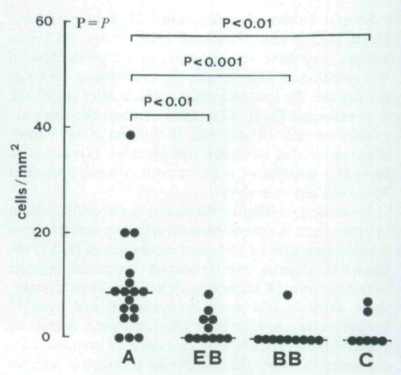
2. Eosinophilic COPD: is it just asthma?
Bronchial eosinophilia in both conditions during exacerbations, increased IL-5 in bronchial tissue only in asthma.
Saetta M et al. 1996. Clinical & Experimental Allergy, 26: 766-774
Notes:
Come facciamo a dirlo senza che diventi una religione? Con le bio

Slide 17
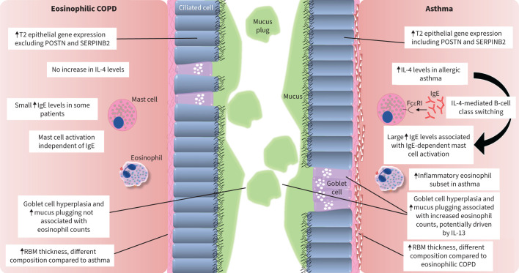
Beech A et al. Breathe (Sheff). 2024;20(3):230229.
Notes:
POSTN: periostin; SERPINB2: serine peptidase inhibitor B2

Slide 18
Why eosinophilic COPD is not asthma
Less dominant eosinophilic inflammation
Distinct epithelial T2 gene signature
Weaker IgE/IL-4 allergic axis, Non-IgE mast-cell activation
Different mucus pathophysiology
Shared treatable trait ≠ same disease biology
Beech A et al. Breathe (Sheff). 2024;20(3):230229.
Notes:
Asthma shows a broader T2 epithelial gene expression profile; eosinophilic COPD shows a more restricted and partially distinct signature.

Slide 19
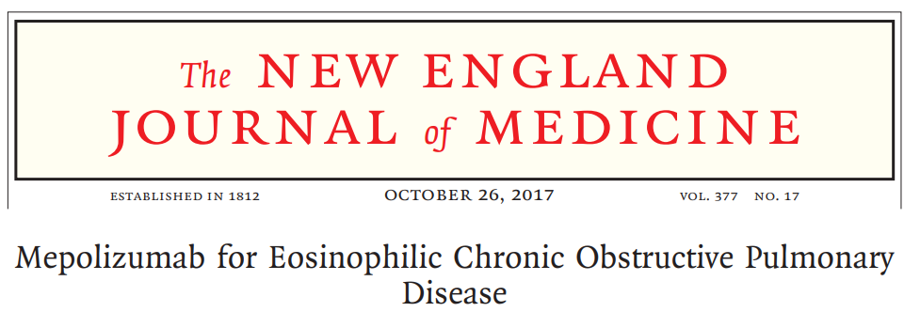
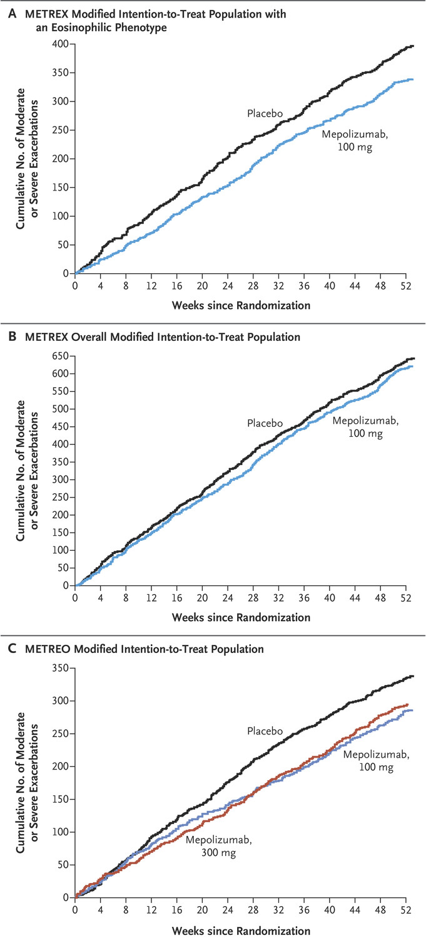
3. From biomarker to therapeutic target

Slide 20
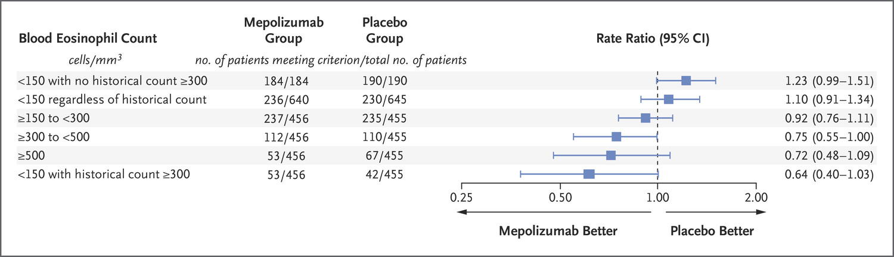
Exclusion criteria: current diagnosis of asthma, nonsmokers with a history of asthma.

Slide 21
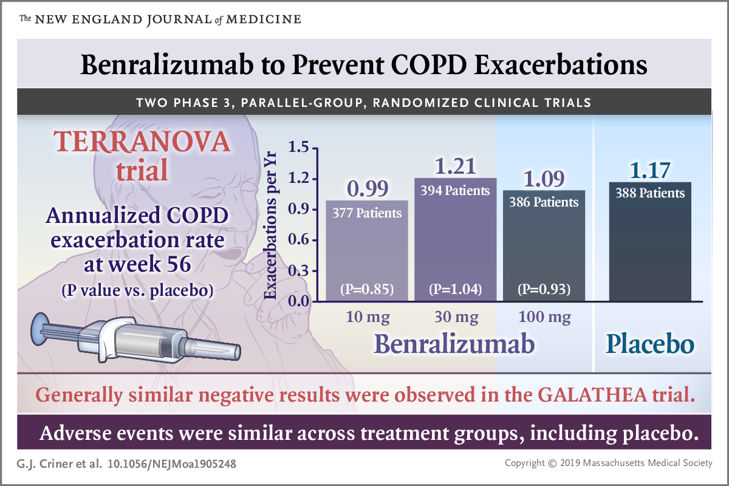
Notes:
220 cut off

Slide 22

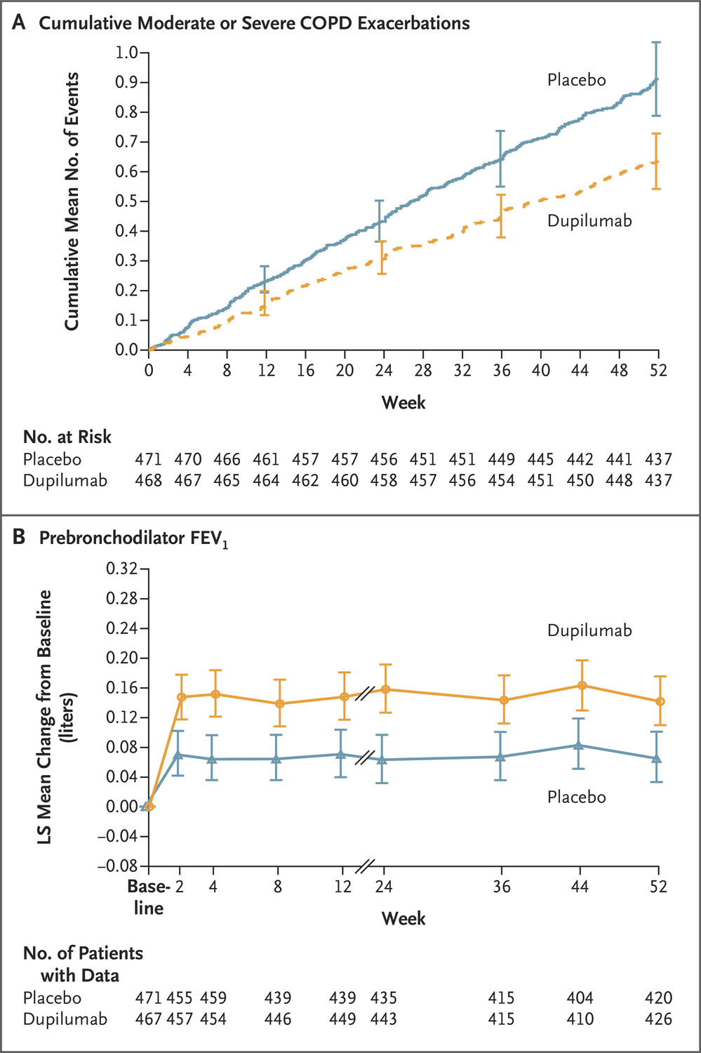

Slide 23
Patients with history of asthma or current asthma were excluded.
Mechanism of action of dupilumab in COPD:
Mucus changes, decreased airway inflammation, reduced edema, lowered airway resistance
May reduce up-regulation of NO synthase, T2 helper T-cell differentiation, and recruitment of type 2 inflammation–related effector cells (eosinophils, mast cells, basophils).
Notes:
220 cut off

Slide 24
Dupilumab Phase 3 Studies: Annualized Rate of Moderate or Severe Exacerbations in
Patients With Baseline FeNO ≥20 ppb
NOTUS¹
BOREAS²
Rate Ratio (95% CI)
0.47 (0.33 to 0.68)
Rate Ratio (95% CI)
0.6 (0.5 to 0.9)
P=0.005
52% reduction in moderate or severe exacerbations in patients with baseline FeNO ≥20 ppb over 52 weeks
36% reduction in moderate or severe exacerbations over
52 weeks (P=0.0005)
FeNO, fractional exhaled nitric oxide.
1. Bhatt S. P. et al. (2024). Dupilumab for COPD with Blood Eosinophil Evidence of Type 2 Inflammation. The New England Journal of Medicine, May 20, 2024. 2. Bhatt, S. P. et al. (2023). Dupilumab for COPD with Type 2 Inflammation Indicated by Eosinophil Counts. The New England journal of medicine, 389(3), 205–214.
24

Slide 25
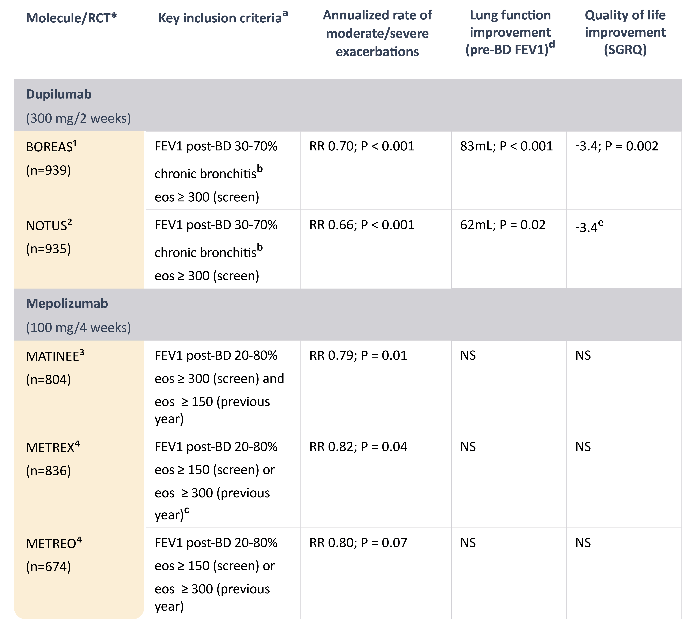

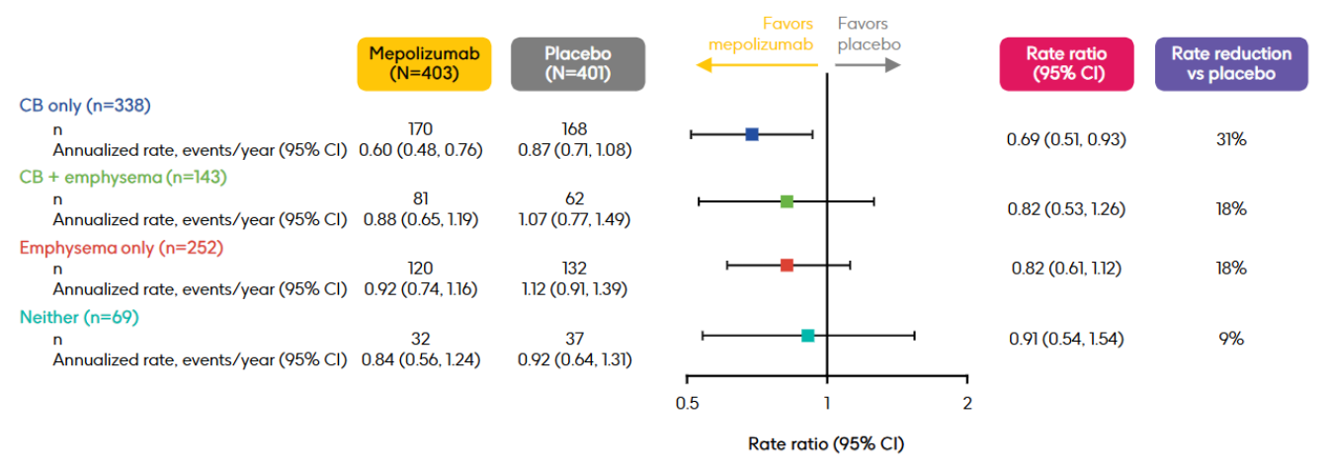
FeNO >20 ppb:
Higher AE
reduction
RR 0.64-0.48
https://doi.org/10.1164/ajrccm.2025.211.Abstracts.A5033
Global Initiative for Chronic Obstructive Lung Disease (GOLD) 2026

Slide 26
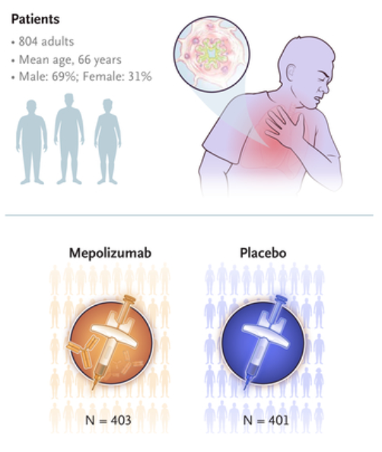
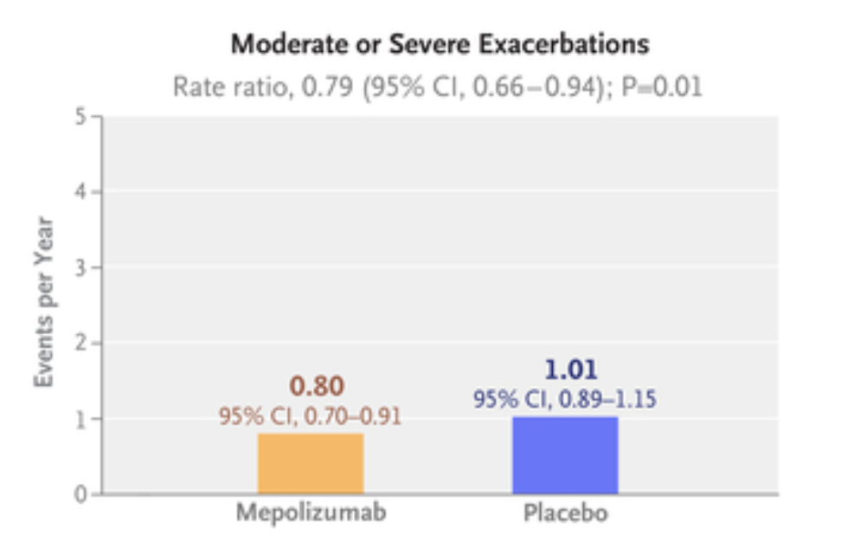
MATINEE
N Engl J Med 2025;392:1710-1720 DOI: 10.1056/NEJMoa2413181

Slide 27
4. Diagnostic labels still matter?
In clinical practice, distinction between asthma and COPD remains imperfect in some cases.
In real-life cohorts it is unlikely that asthma exclusion will be enforced with the same rigor as in randomized controlled trials
Park KJ. ERJ Open Res. 2026 Feb 16;12(1):01059-2025.
Notes:
Come facciamo a dirlo senza che diventi una religione?

Slide 28
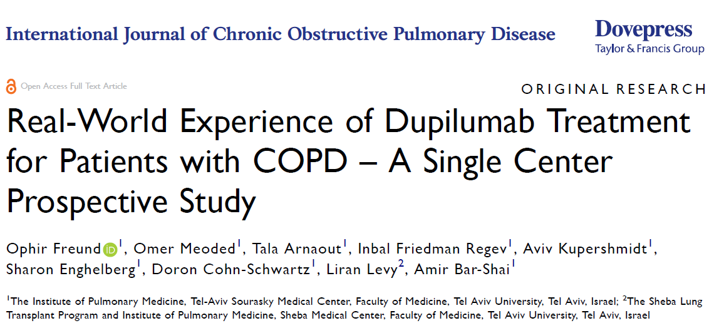
Real life?

Slide 29
Patient Selection
GOLD-defined COPD
Blood eosinophils ≥300 cells/µL
≥1 prior-year exacerbation despite triple inhaler therapy
Persistent symptoms (dyspnea, cough, sputum)
Exclusions:
  Current Asthma or asthma–COPD overlap
  Other approved indications for dupilumab (e.g. CRSwNP)
Freund O, et al. Int J Chron Obstruct Pulmon Dis. 2025;20:2753-2760.

Slide 30
Patient Selection
Some patients would not meet RCT inclusion criteria:
7 were over 80 years’ old
4 had FEV1 < 30%
7 use OTLT > 12 hours/day
2 did not meet the criteria for having chronic bronchitis.
Freund O, et al. Int J Chron Obstruct Pulmon Dis. 2025;20:2753-2760.

Slide 31
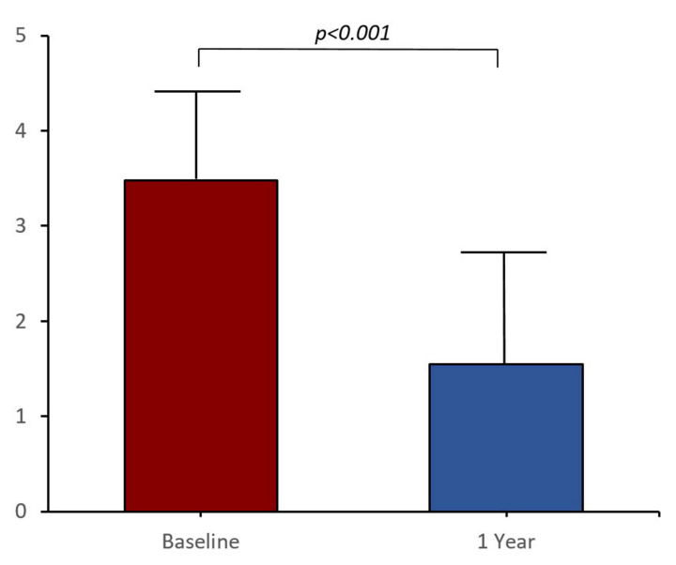
Total exacerbations rate
55% reduction (total)
Reduction also in severe (median 1→0, p=0.04)
Freund O, et al. Int J Chron Obstruct Pulmon Dis. 2025;20:2753-2760.

Slide 32
4. Diagnostic labels still matter?
Real-world evidence will likely face the “concomitant asthma problem”
For the individual patient, coexistence is not necessarily a problem
For research, however, it may become a major source of bias
The same bias may also become a source of knowledge (a clinically relevant population is usually excluded from trials)
Semenzato U, Menzella F (viewpoint) submitted.
Notes:
Come facciamo a dirlo senza che diventi una religione?

Slide 33
4. Diagnostic labels still matter?
The solution is not exclusion, but deeper phenotyping:
Anamnestic features
Symptom patterns
Functional assessment
Biomarkers
Radiological evaluation
These features rarely allow a clear-cut distinction between diseases, but may help define the dominant biological driver.
Semenzato U, Menzella F (viewpoint) submitted.
Notes:
Come facciamo a dirlo senza che diventi una religione?

Slide 34
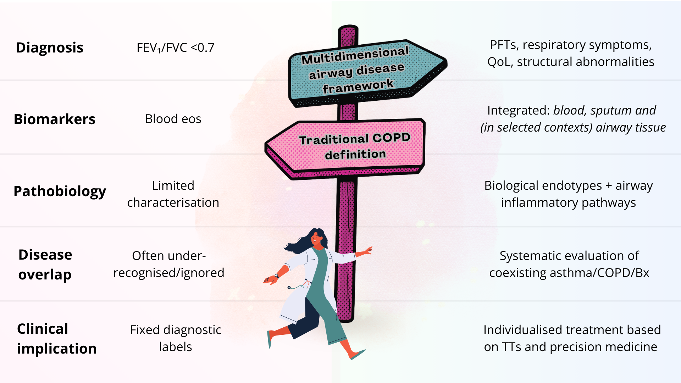
Semenzato U, Padrin Y, Previtero D et al. ERJ Open Research. Accepted 06/04/2026

Slide 35
Take home messages
Some patients with COPD show evidence of T2 inflammation
T2 inflammation does not necessarily mean concomitant asthma
Biologics are now entering the COPD therapeutic landscape
Diagnostic labels may matter less at the bedside, but labels still matter for translational research
Personal view of the speaker

Slide 36



Thank you for the attention
umberto.semenzato@aopd.veneto.it
Foto di Vickie Heydon-Matterface su Unsplash

