Slide 1
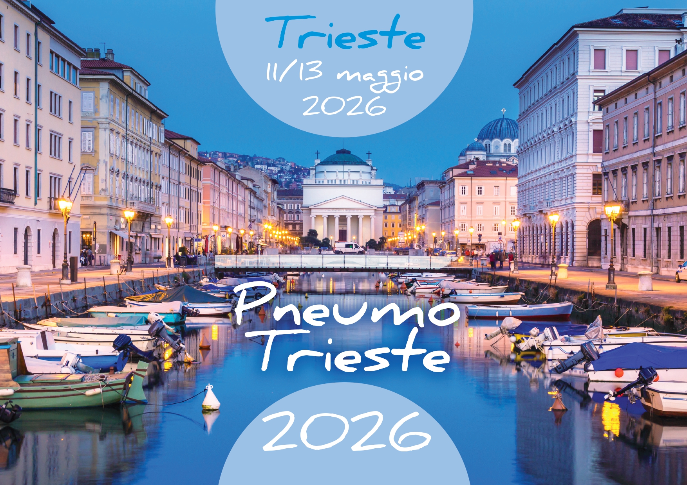

Slide 2
Myo-inositolo: un nuovo alleato nelle patologie respiratorie
Alessia Achille
U.O.C. Fisiopatologia Respiratoria
Dipartimento Cardio-Toraco-Vascolare e Sanità Pubblica
Azienda Ospedale Università di Padova

Slide 3
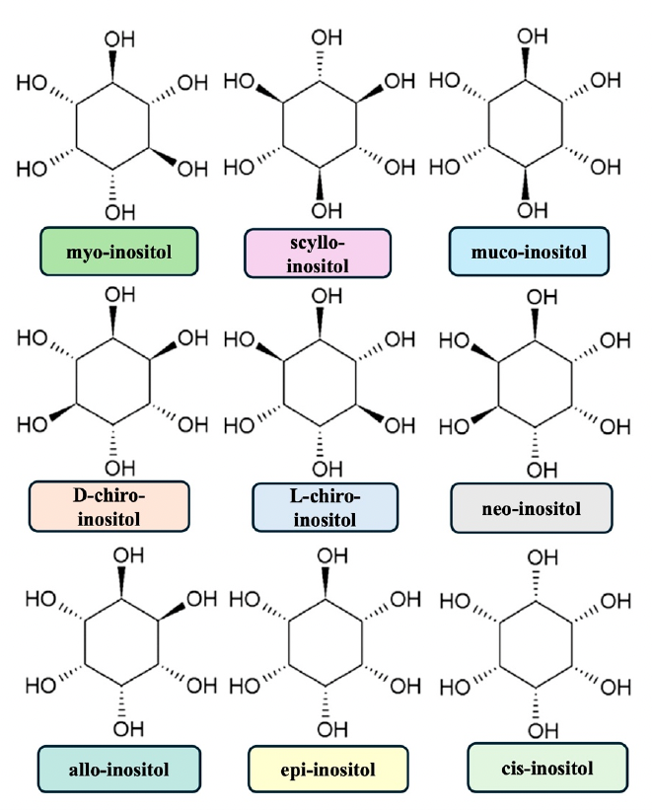
Myo-inositol
Placidi M et al, Biology (Basel). 2024 Nov 16;13(11):936.

Slide 4
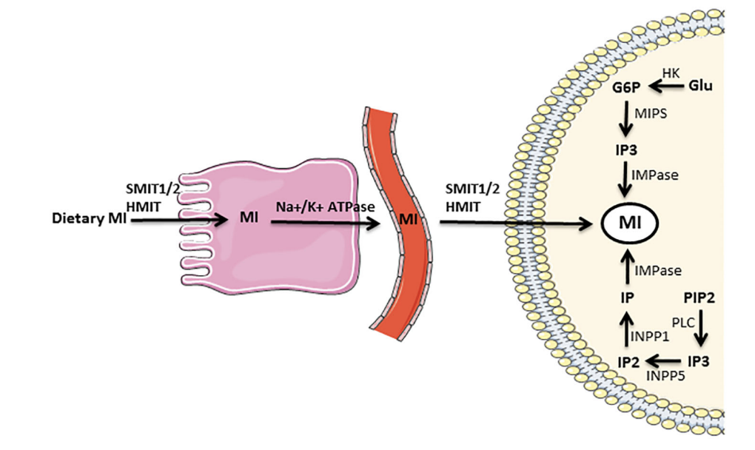
Myo-inositol
Su XB et al, Adv Biol Regul. 2023 Jan;87:100921.

Slide 5
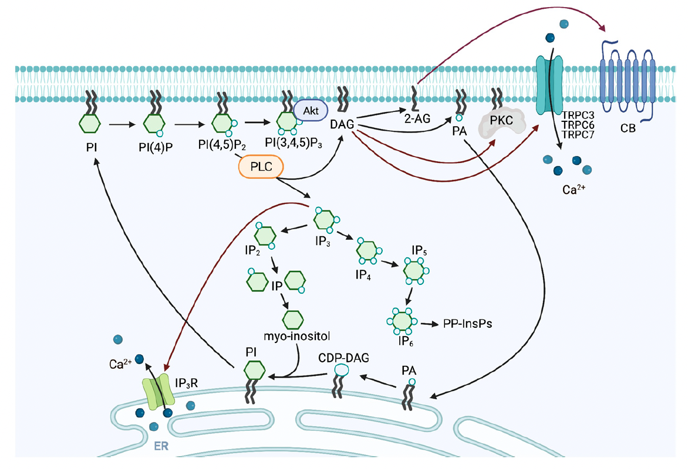
Myo-inositol: structural and functional roles
Kanemaru K et al, Biomolecules. 2023 May 31;13(6):915.

Slide 6
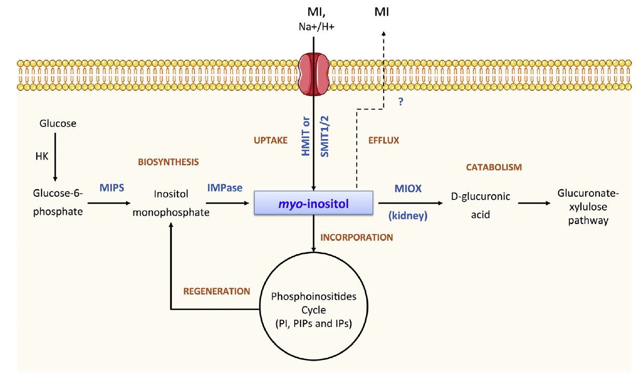
Myo-inositol: structural and functional roles
Croze ML et al, Biochimie. 2013 Oct;95(10):1811-27.

Slide 7
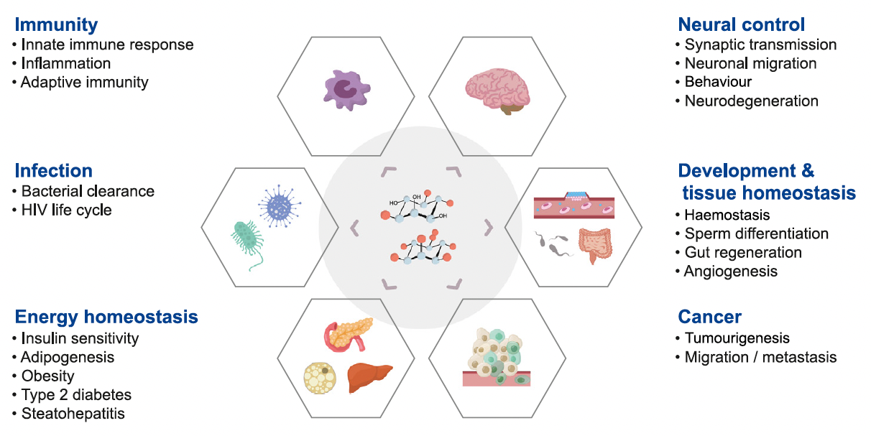
Myo-inositol: areas of research
Kim S et al, Trends Biochem Sci. 2024 Nov;49(11):969-985.

Slide 8
Why myo-inositol in respiratory diseases?
Inflammation
Mucus
Respiratory diseases
Pulmonary surfactant

Slide 9
Myo-inositol and pulmonary surfactant
Inflammation
Mucus
Respiratory diseases
Pulmonary surfactant

Slide 10
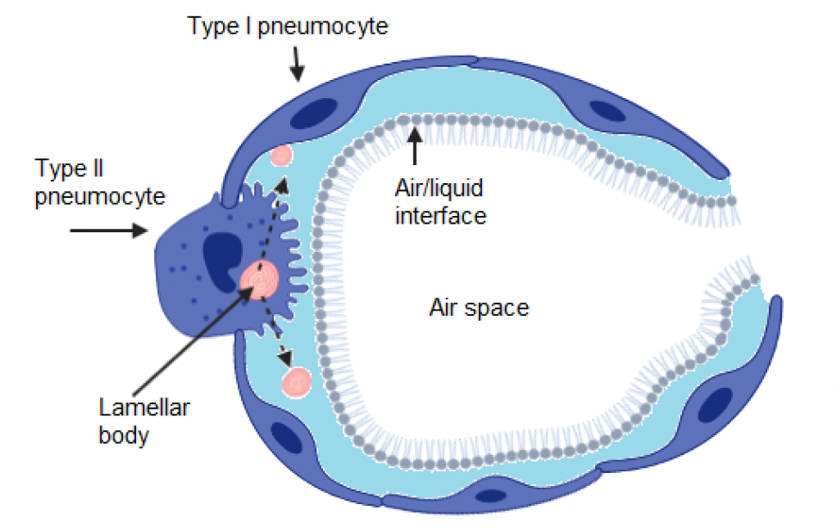
Pulmonary surfactant
Dziura M et al, Symmetry 2021, 13, 1259.

Slide 11
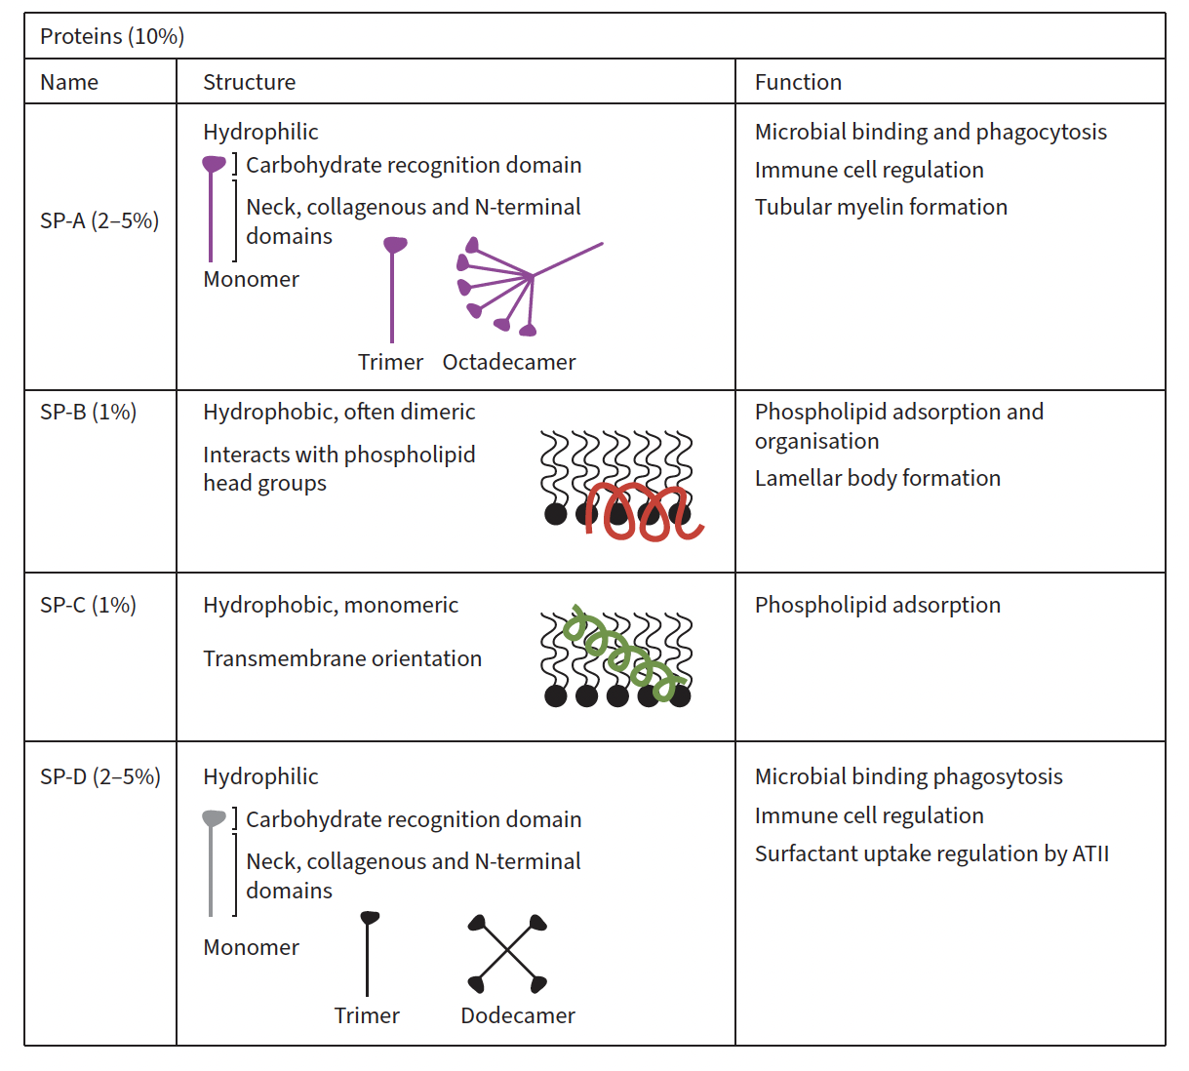
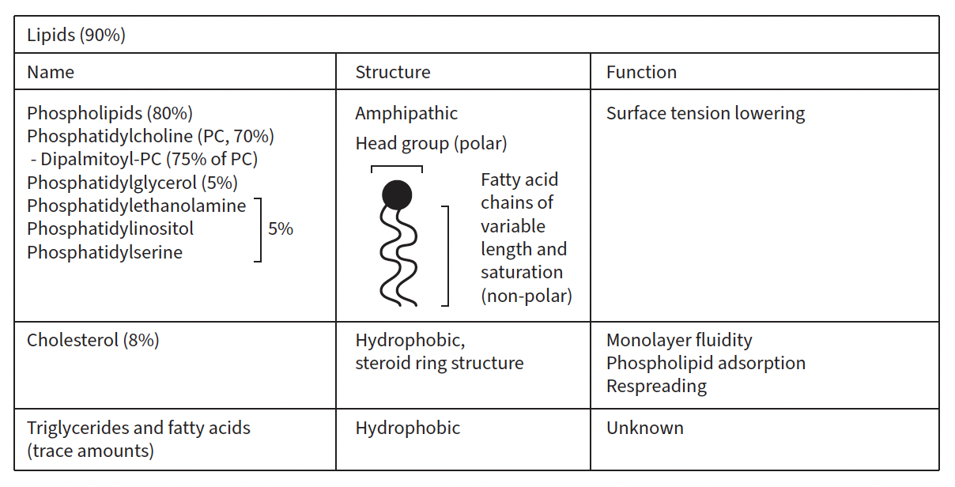
Pulmonary surfactant
Adapted from Milad N, Morissette MC. Eur Respir Rev. 2021 Dec 15;30(162):210077.

Slide 12
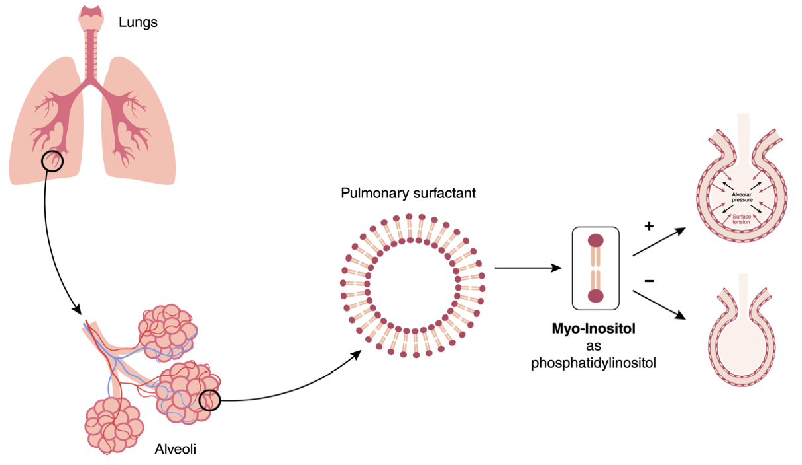
Myo-inositol and pulmonary surfactant
Quecchia C, Vianello A, Int J Mol Sci. 2025 Feb 28;26(5):2185.

Slide 13
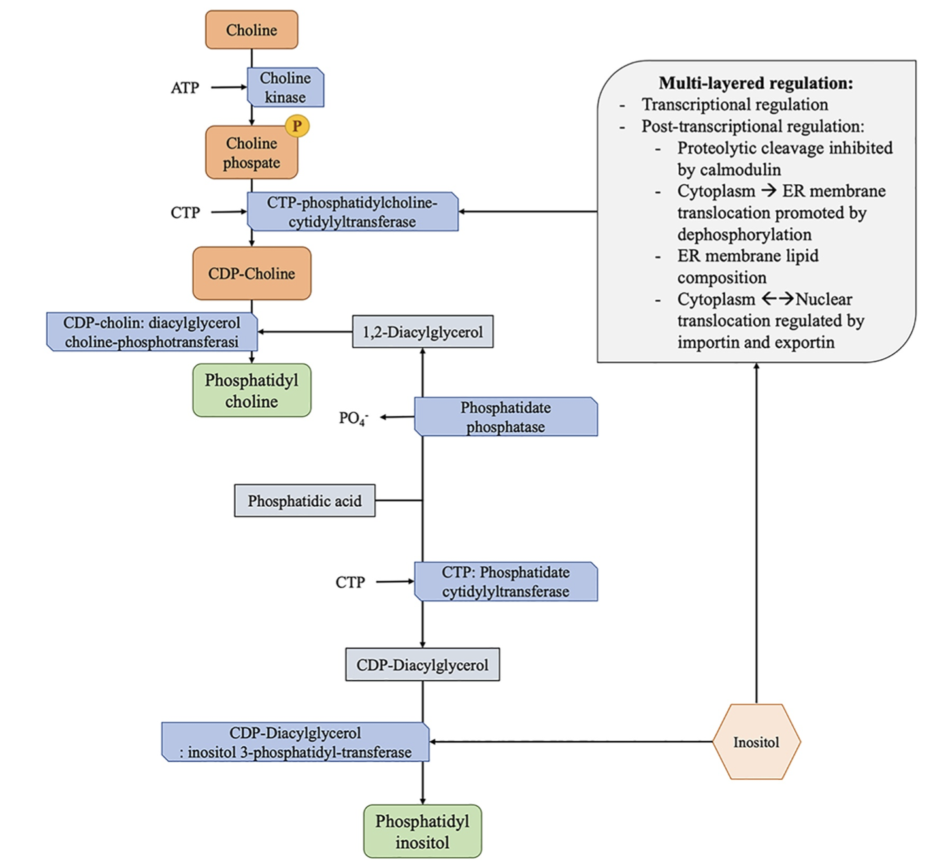
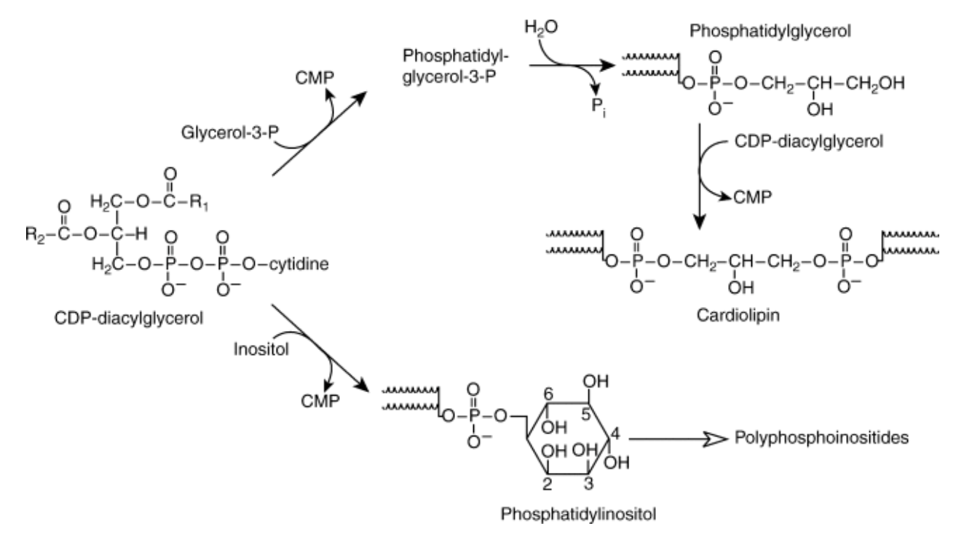
Myo-inositol and pulmonary surfactant
Claudia Kent, Encyclopedia of Biological Chemistry, Elsevier,2004,Pages 314-320.
Laganà AS et al, Med Hypotheses. 2020 Nov;144:110262.

Slide 14
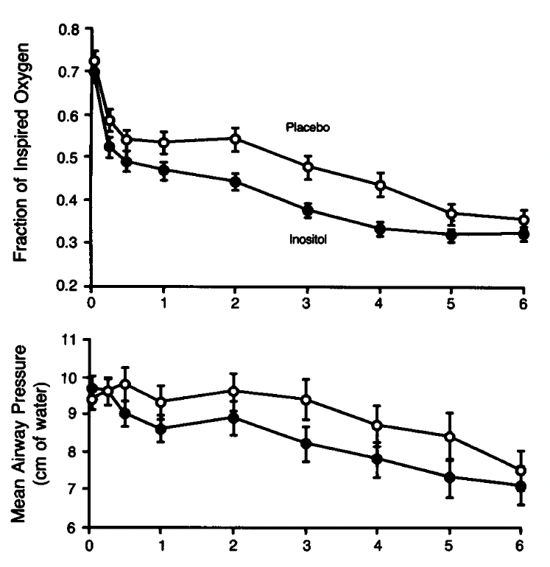
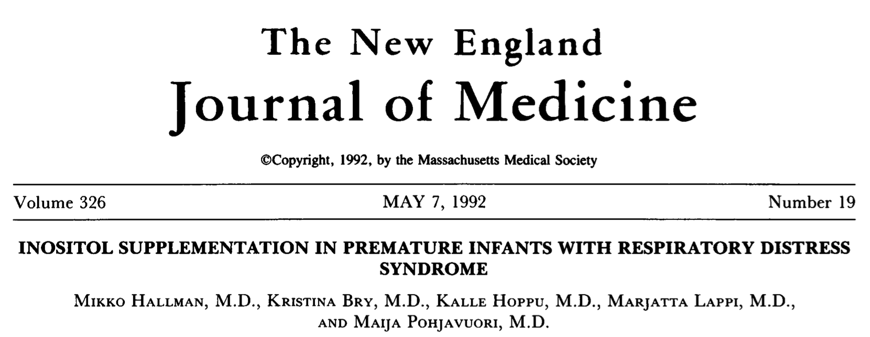
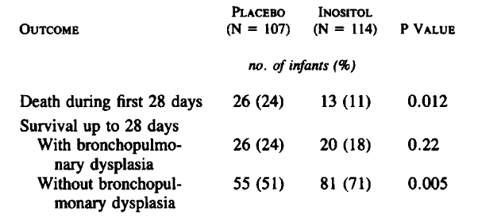
Myo-inositol and pulmonary surfactant
Hallman M et al, N Engl J Med. 1992 May 7;326(19):1233-9.

Slide 15
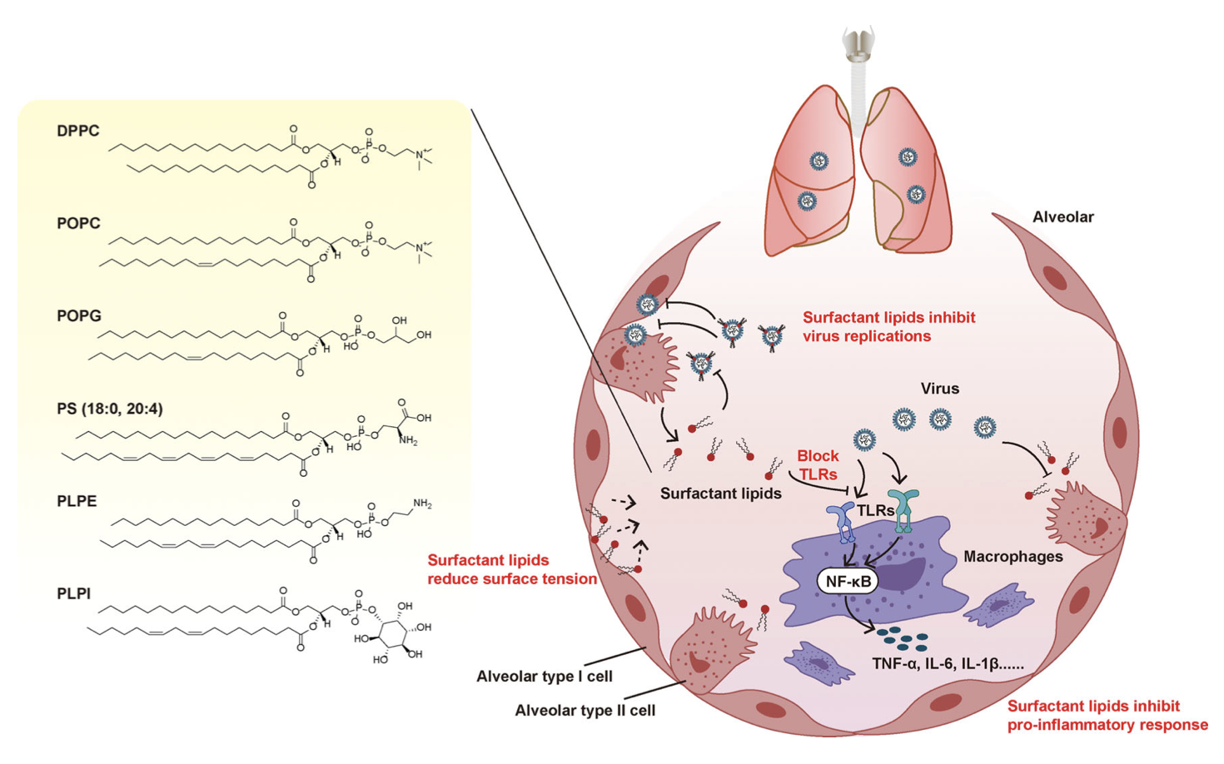
Pulmonary surfactant
Ji J et al, Front Immunol. 2021 Sep 27;12:730022.

Slide 16
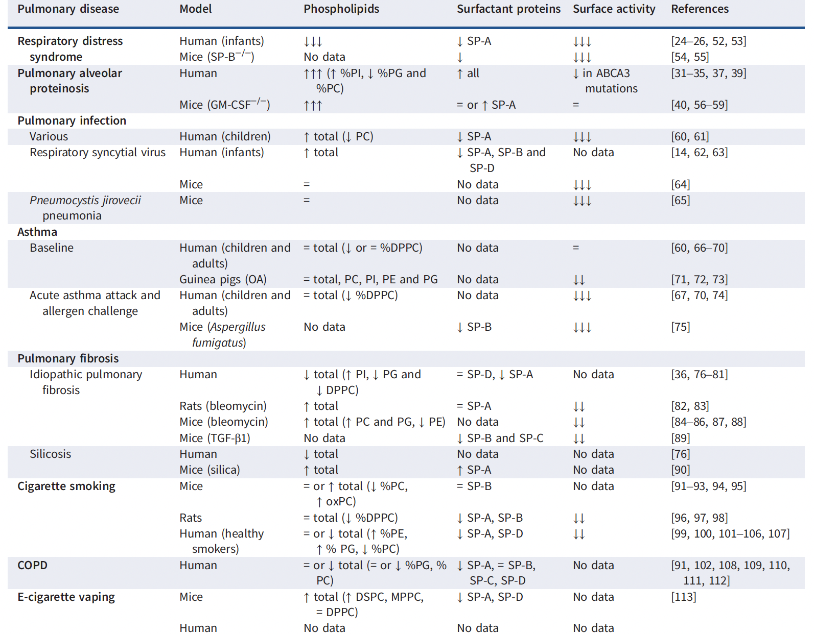
Pulmonary surfactant and respiratory diseses
Adapted from Milad N, Morissette MC. Eur Respir Rev. 2021 Dec 15;30(162):210077.

Slide 17
Myo-inositol and mucus
Inflammation
Mucus
Respiratory diseases
Pulmonary surfactant

Slide 18
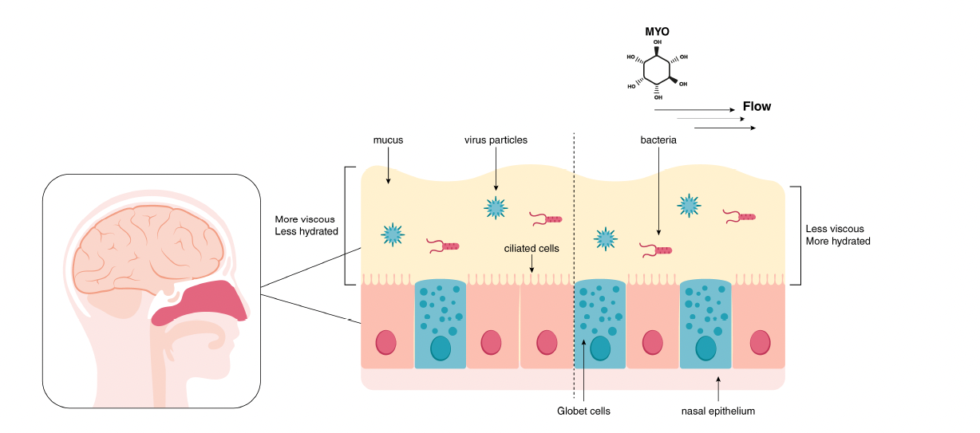
Myo-inositol and mucus
Quecchia C, Vianello A, Int J Mol Sci. 2025 Feb 28;26(5):2185.

Slide 19
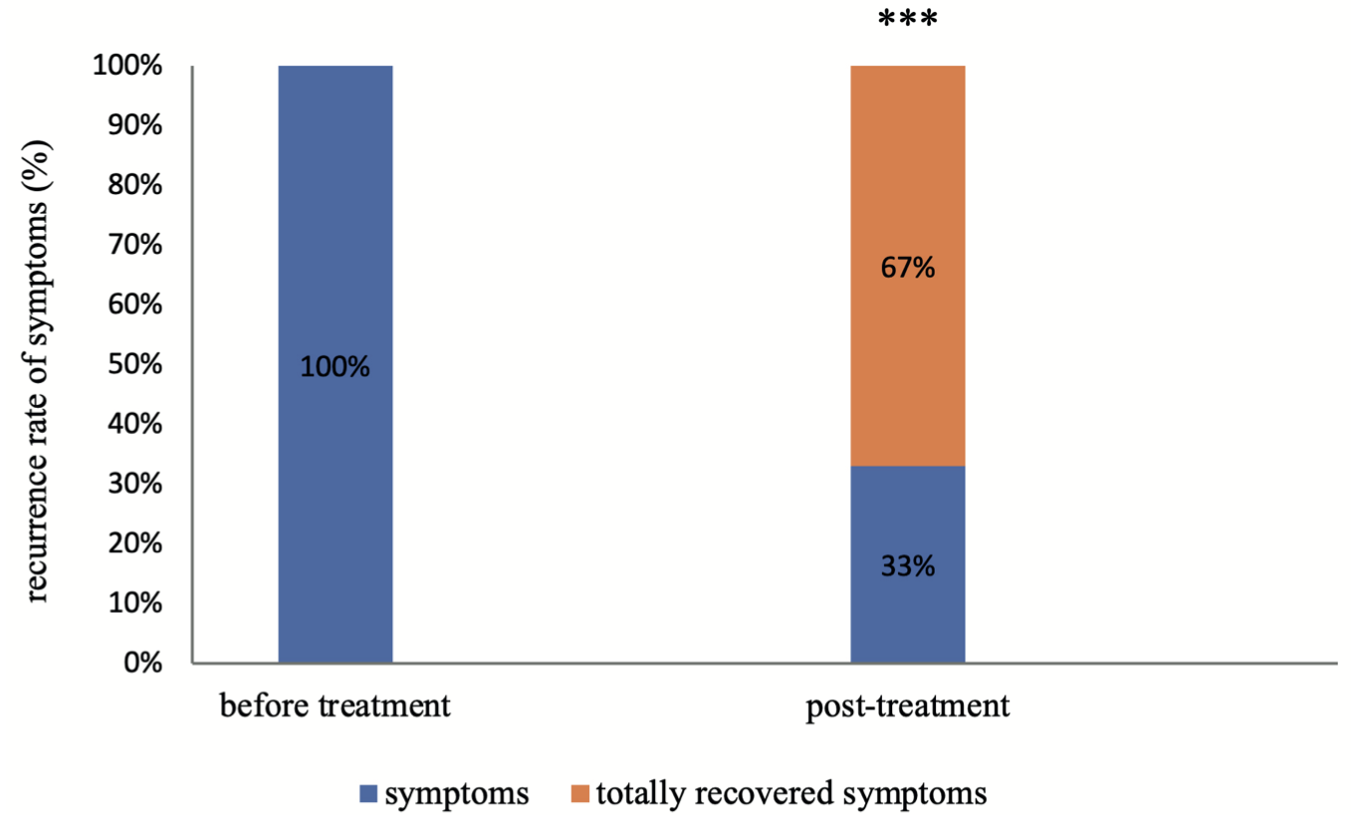
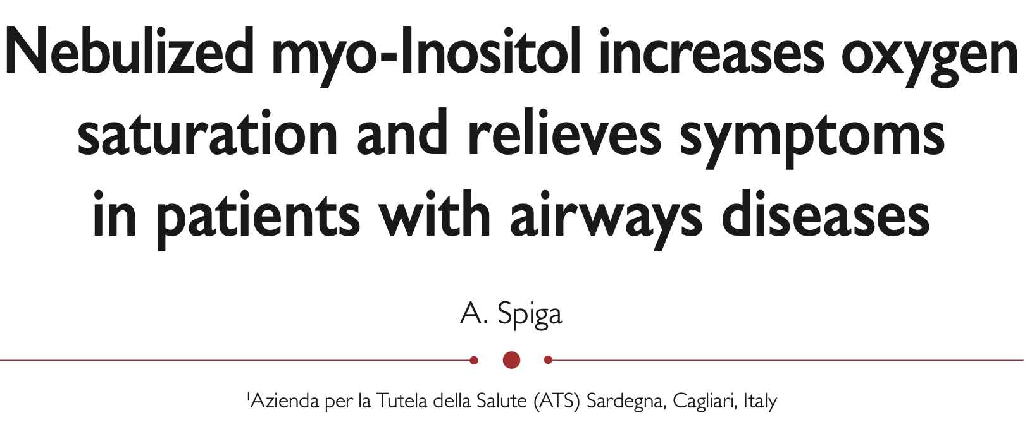
Myo-inositol and mucus
Spiga A, IJMDAT 2021; 4 : e356

Slide 20
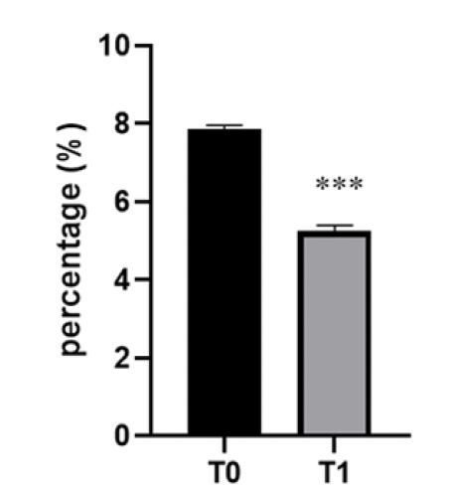
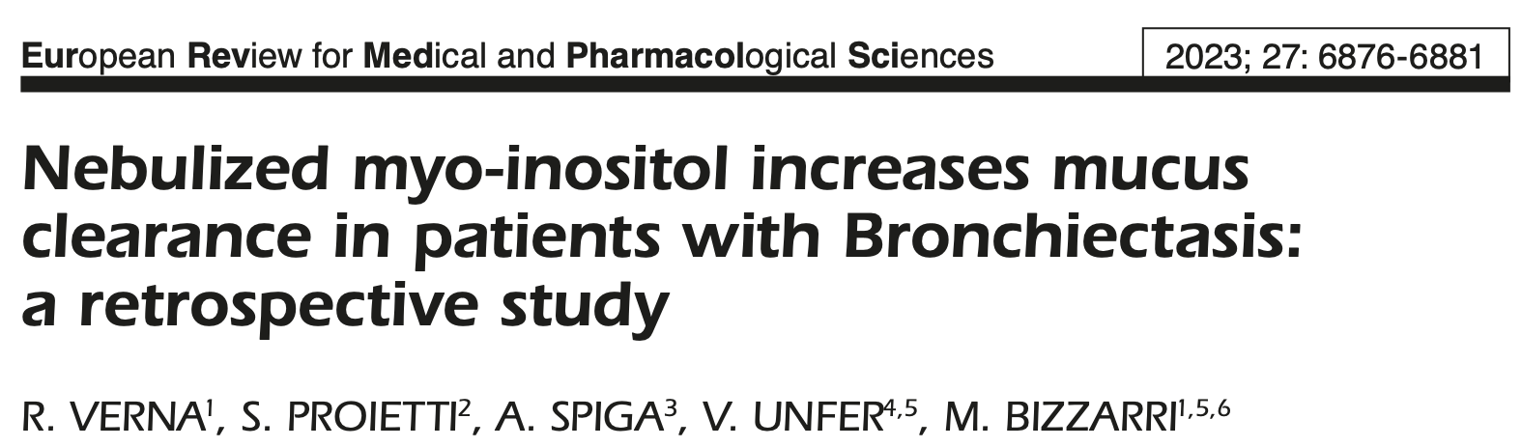
Myo-inositol and mucus
Verna R et al, Eur Rev Med Pharmacol Sci. 2023 Jul;27(14):6876-6881.

Slide 21
Myo-inositol and inflammation
Inflammation
Mucus
Respiratory diseases
Pulmonary surfactant

Slide 22
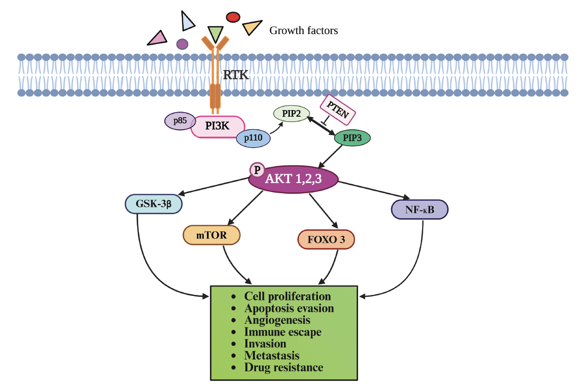
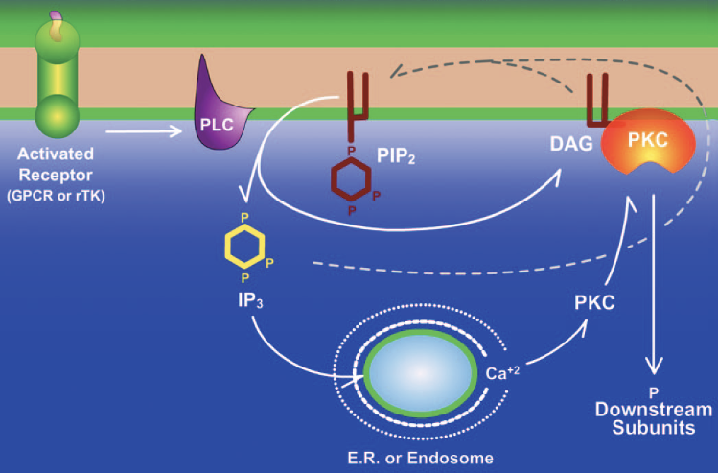
Myo-inositol in signaling pathways
Thatcher JD, Sci Signal. 2010 Apr 27;3(119):tr3.
Veerasamy V et al, Oncol Res. 2025 Jul 18;33(8):1835-1860.

Slide 23
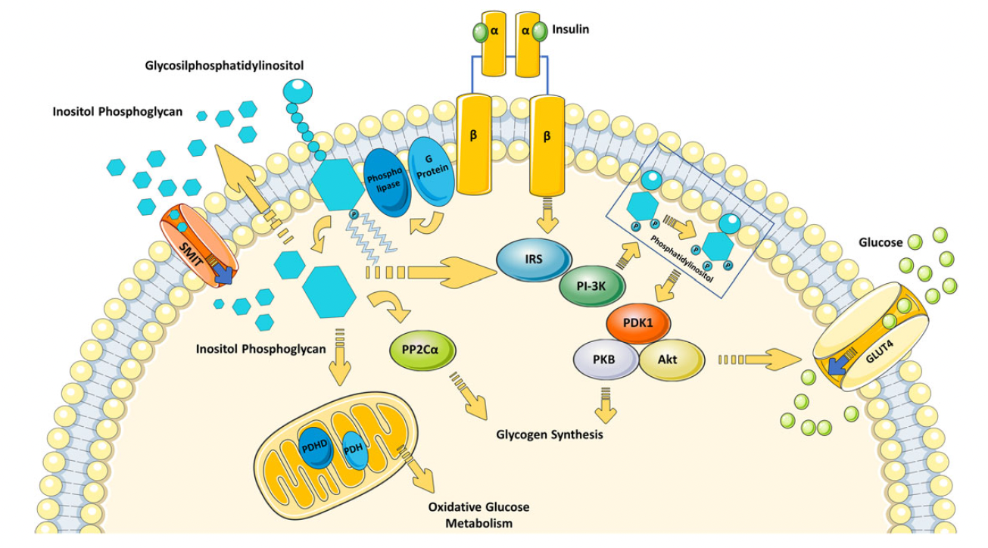
Myo-inositol in signaling pathways
Formoso G et al, Diabetes Metab Res Rev. 2019 Jul;35(5):e3154.

Slide 24
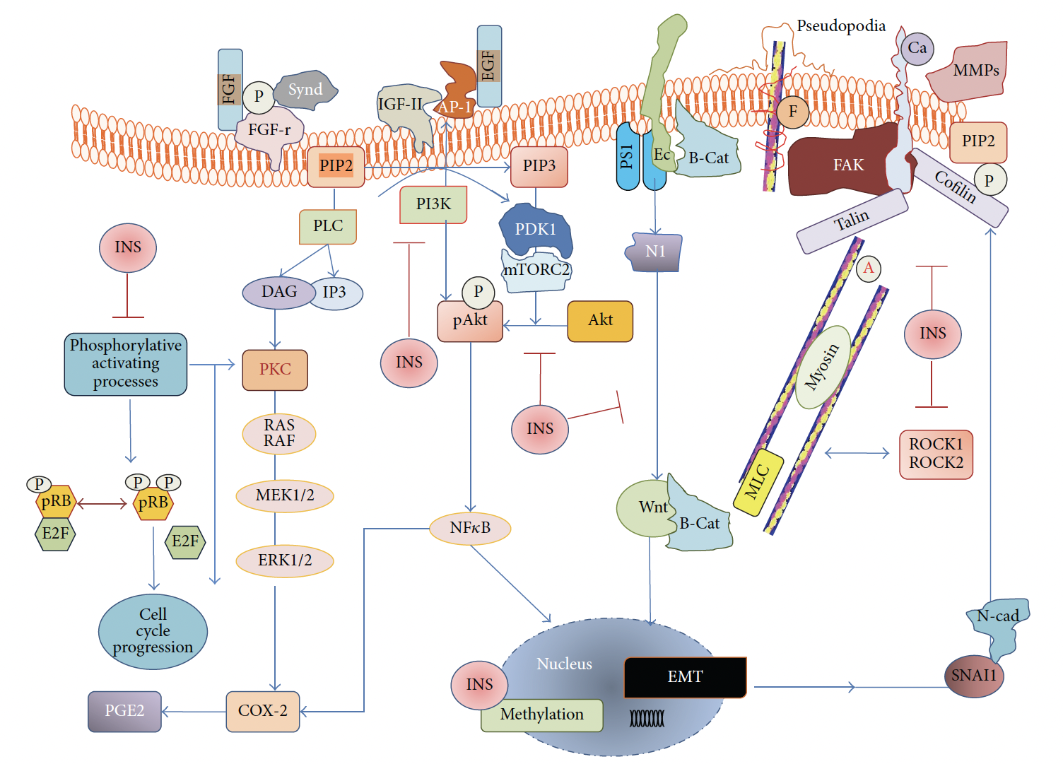
Myo-inositol in signaling pathways
Bizzarri M et al, Int J Endocrinol. 2016;2016:5616807.

Slide 25
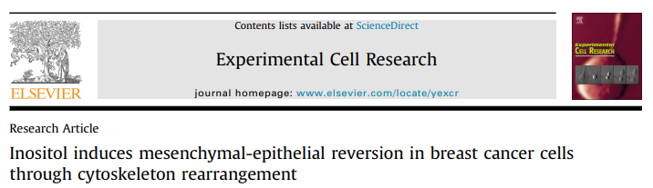
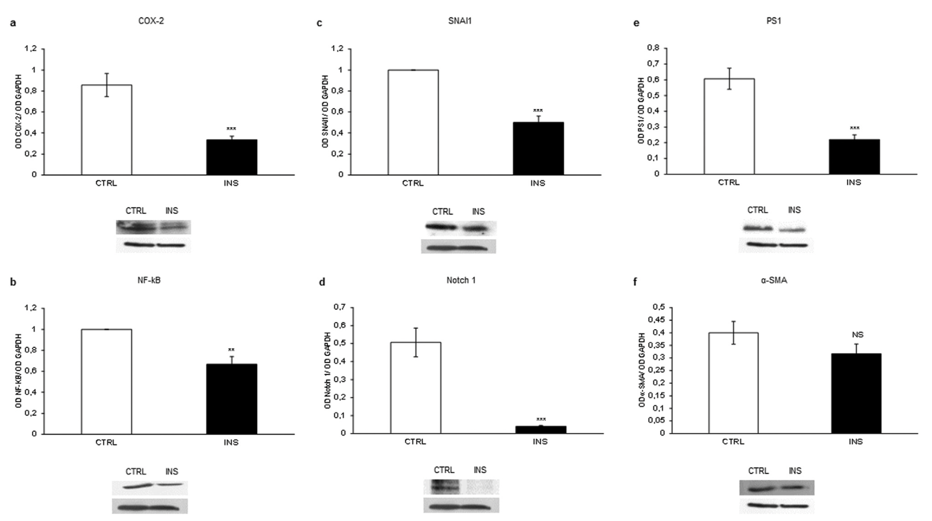
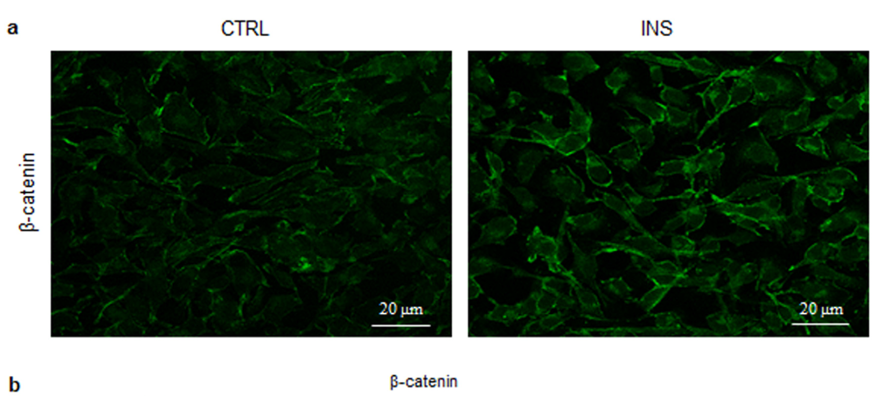
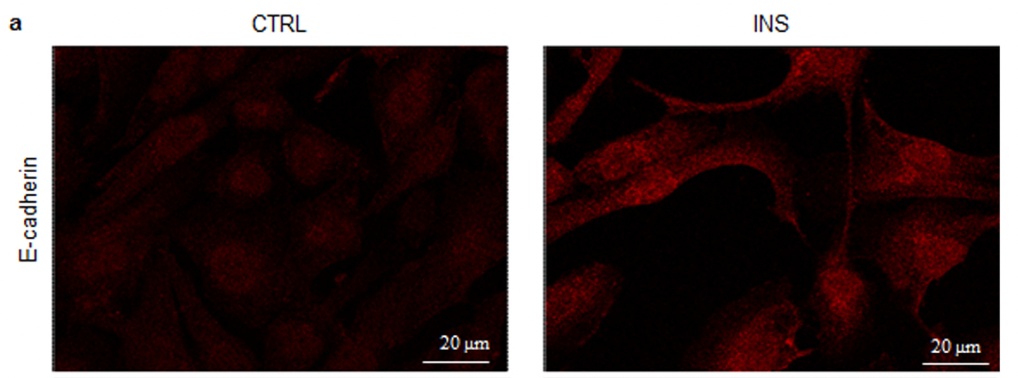
Myo-inositol in signaling pathways
Dinicola S et al, Exp Cell Res. 2016 Jul 1;345(1):37-50.

Slide 26
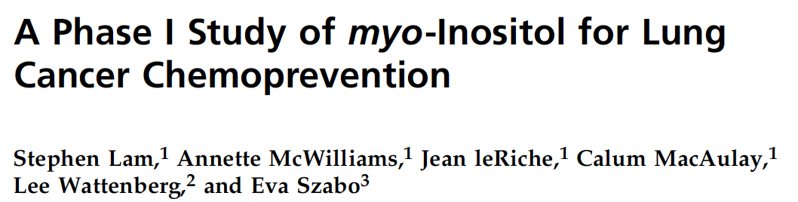
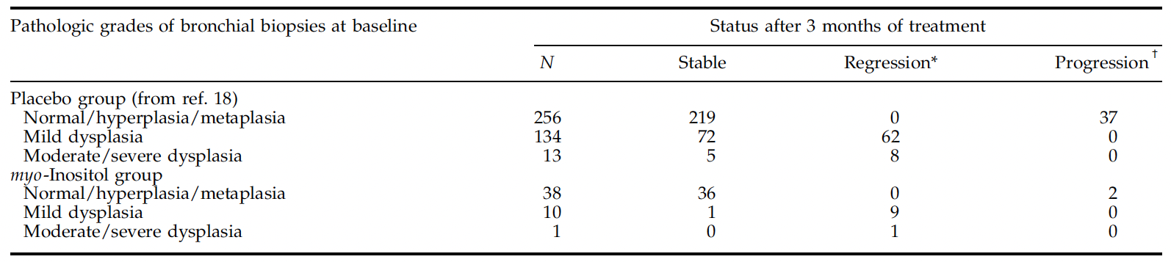
Myo-inositol in signaling pathways
Lam S et al, Cancer Epidemiol Biomarkers Prev. 2006 Aug;15(8):1526-31.

Slide 27
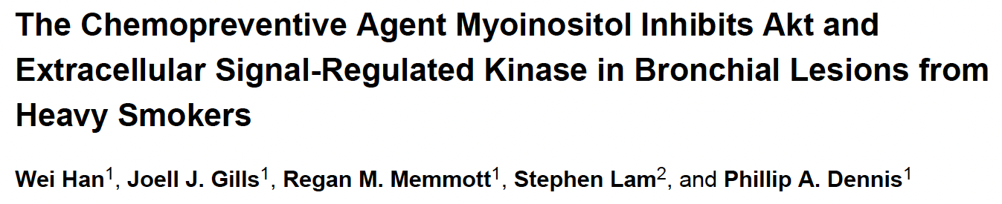
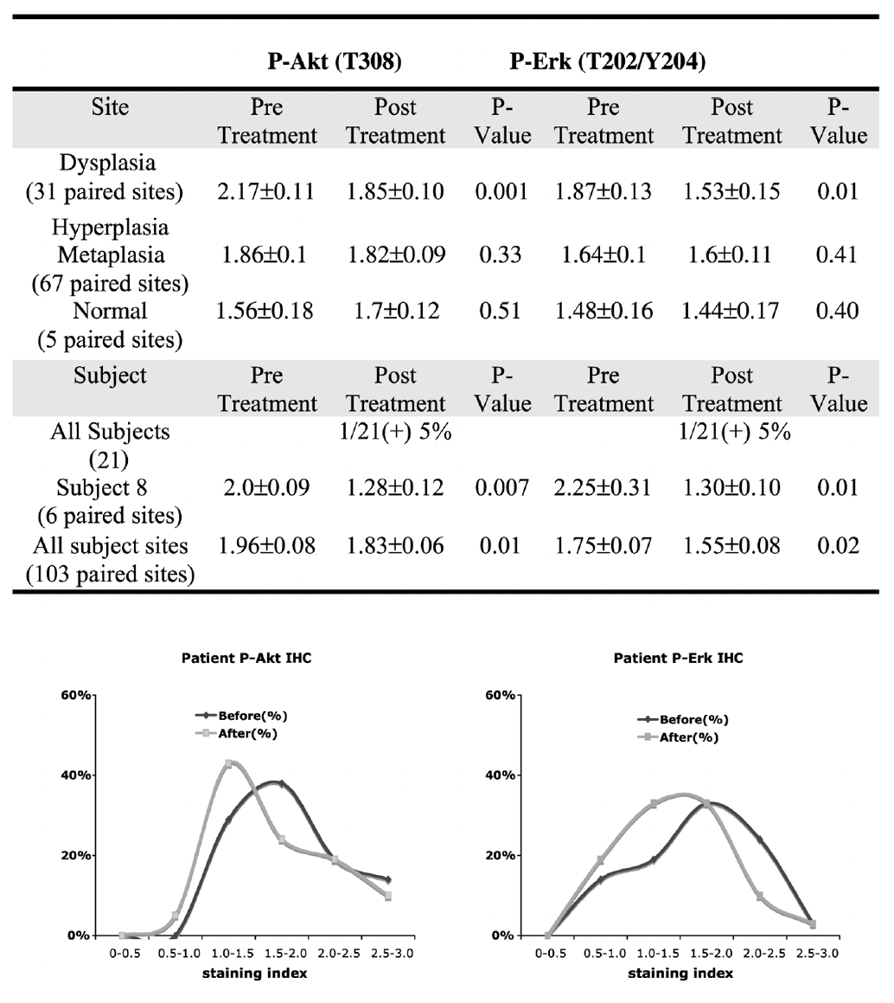
Myo-inositol in signaling pathways
Han W, Gills JJ et al, Cancer Prev Res (Phila). 2009 Apr;2(4):370-6.

Slide 28
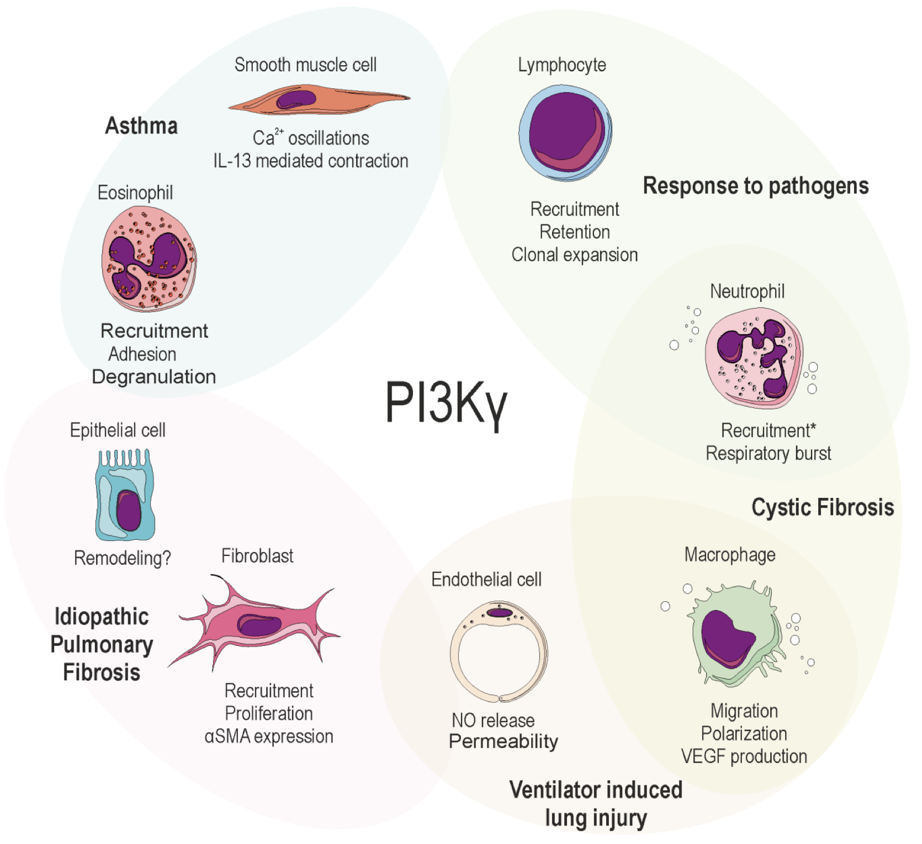
Signaling pathways in respiratory diseases
Sala V et al, Cell Stress. 2021 Mar 8;5(4):40-51.

Slide 29
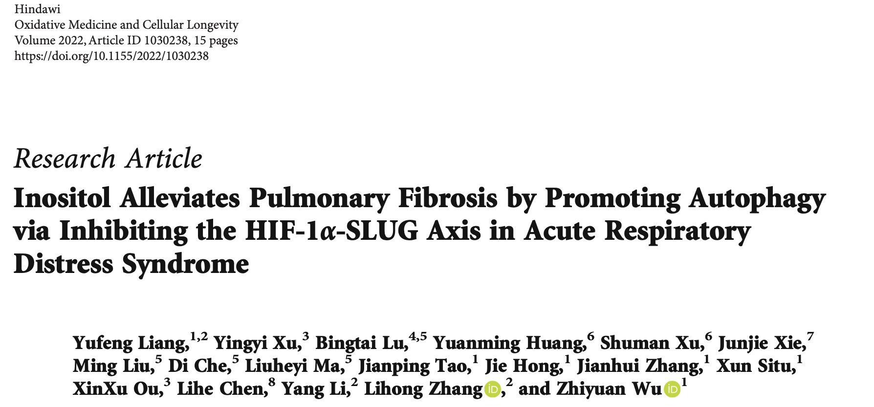
Myo-inositol in respiratory diseases
Liang Y et al, Oxid Med Cell Longev. 2022 Dec 23;2022:1030238.

Slide 30
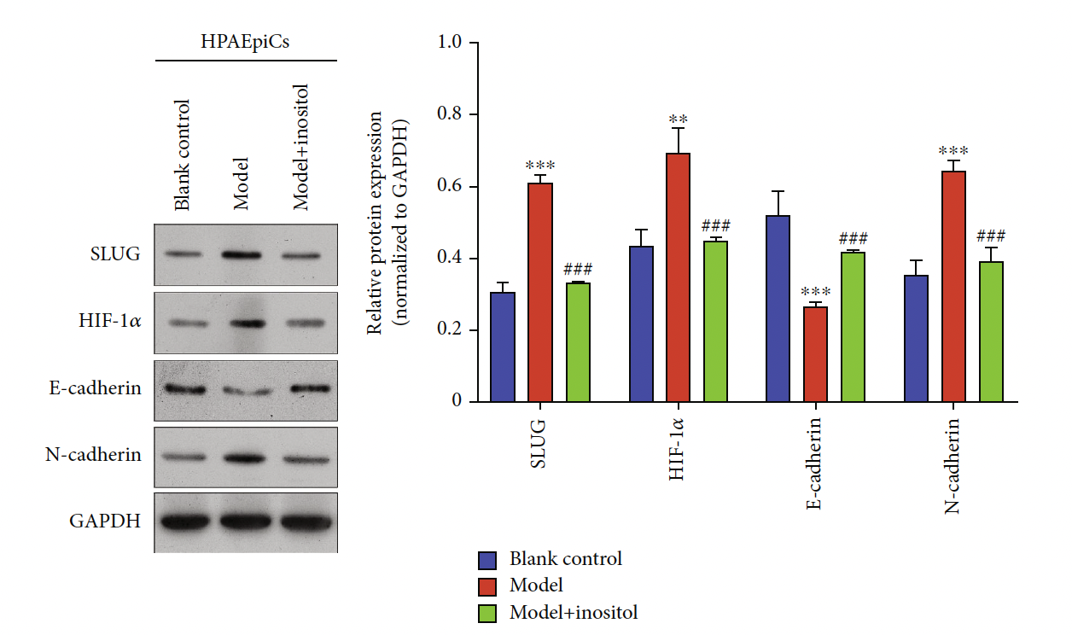
Myo-inositol in respiratory diseases
Liang Y et al, Oxid Med Cell Longev. 2022 Dec 23;2022:1030238.

Slide 31
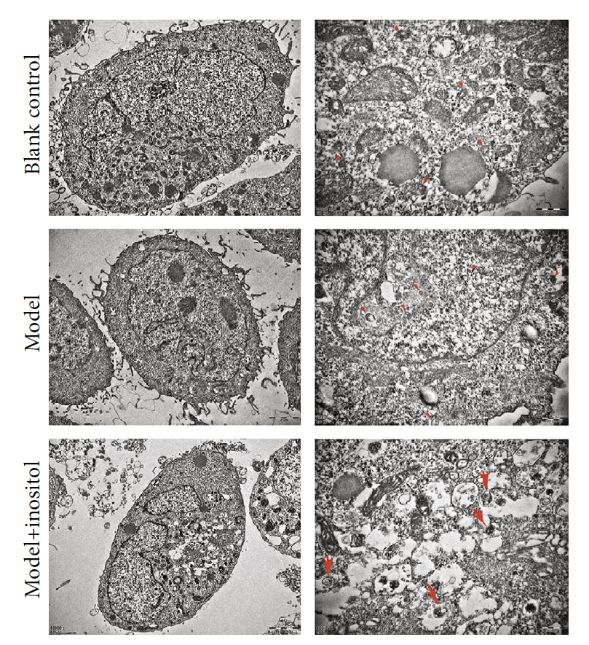
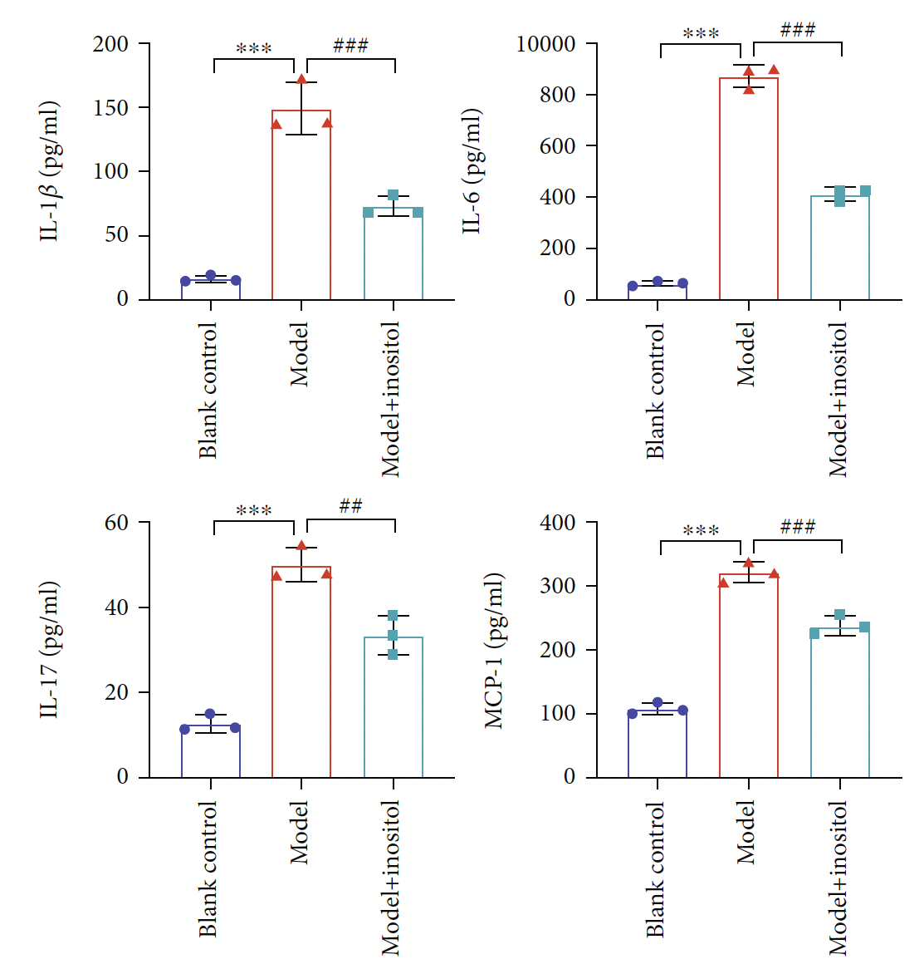
Myo-inositol in respiratory diseases
Liang Y et al, Oxid Med Cell Longev. 2022 Dec 23;2022:1030238.

Slide 32
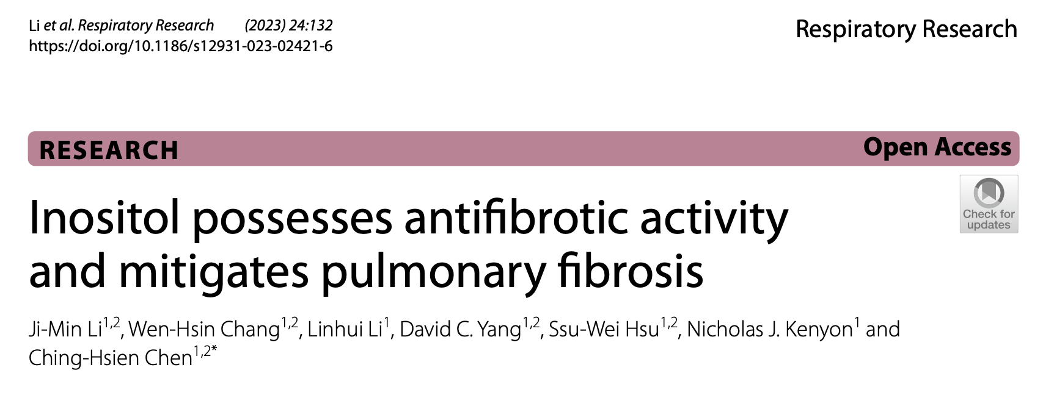
Myo-inositol in respiratory diseases
Li JM et al, Respir Res. 2023 May 16;24(1):132.

Slide 33
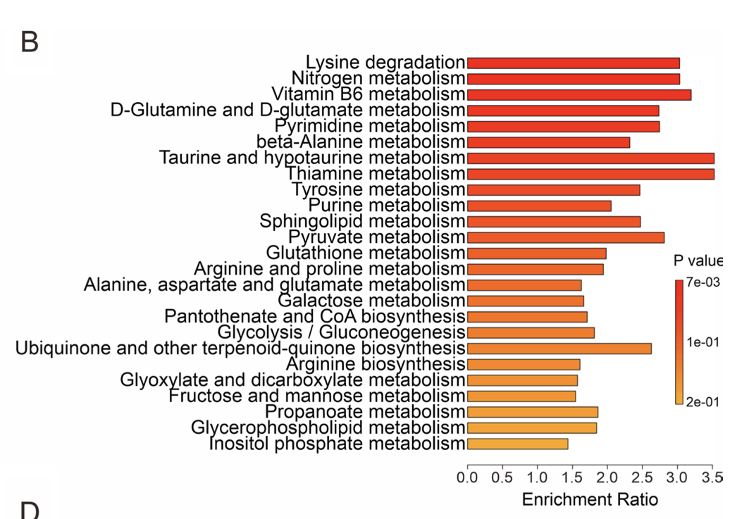
Myo-inositol in respiratory diseases
Li JM et al, Respir Res. 2023 May 16;24(1):132.

Slide 34
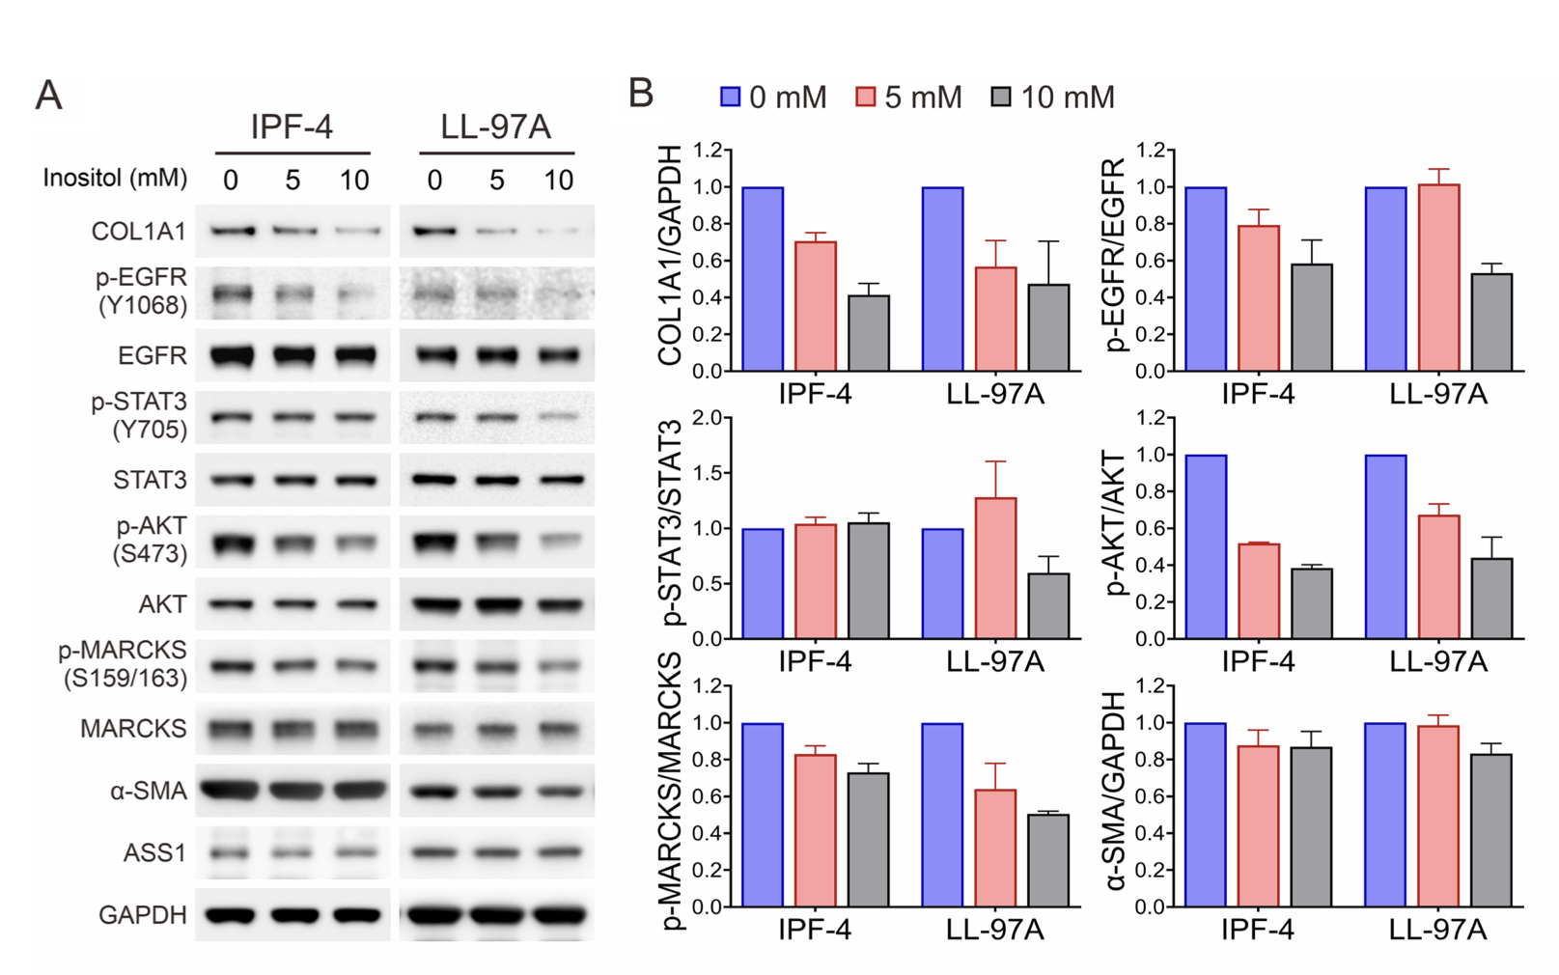
Myo-inositol in respiratory diseases
Li JM et al, Respir Res. 2023 May 16;24(1):132.

Slide 35
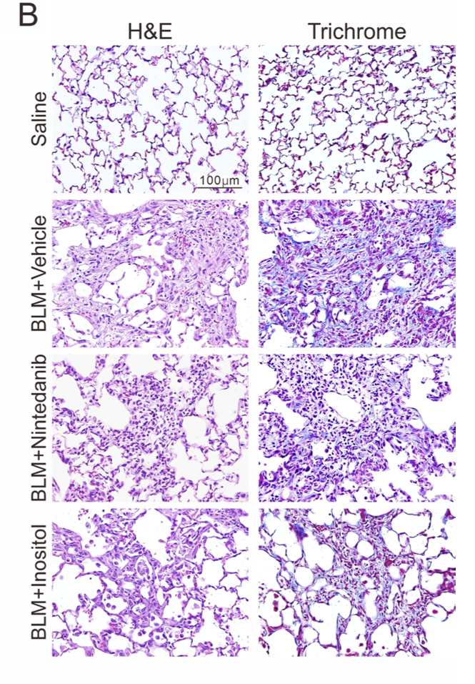
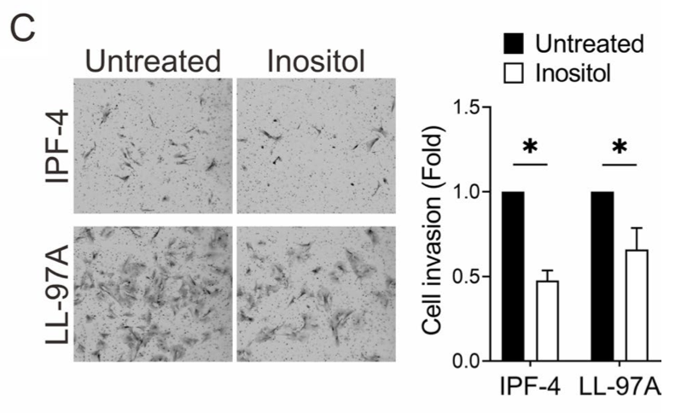
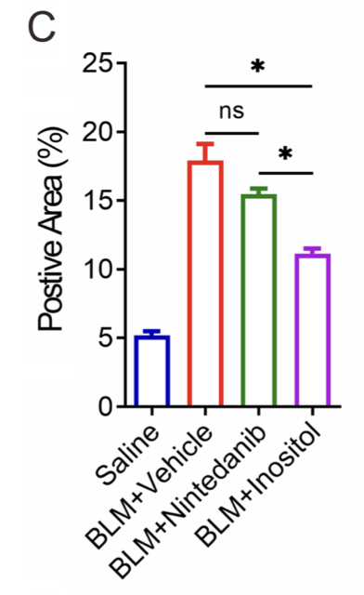
Myo-inositol in respiratory diseases
Li JM et al, Respir Res. 2023 May 16;24(1):132.

Slide 36
Take Home Messages:
Myo-inositol is a key cellular molecule with structural and signaling roles.
It is a safe compound already used in clinical practice.
Its role in pulmonary surfactant is established, although modern clinical evidence remains limited.
Its osmotic properties may enhance mucus hydration and rheology, though large-scale studies are still lacking.
Its signaling functions represent a promising field for respiratory research.

