Slide 1



Gestione attuale delle micobatteriosi non tubercolari
Andrea Calcagno
Università del Piemonte Orientale – Dipartimento di Medicina Traslazionale
AOU Ospedale Maggiore della Carità di Novara – Unità di Malattie Infettive
Pneumo Trieste 2026 – 11-13 maggio 2026

Slide 2
Disclosures
I have read and understood ICMJE policy on declaration of interest, and I declare that in the past five years
My previous institution has received research grants from Gilead Sciences, MSD and ViiV Healthcare
I received speaker and consultancy honoraria from Astra Zeneca, Gilead Sciences, Insmed, Johnson&Johnson, MSD, Pfizer, Roche and ViiV Healthcare

Slide 3
Outline
Epidemiologia
Diagnosi e ritardo diagnostico
  Diagnosi precoce
  Nuovi fattori di rischio
Terapia
  «Standard»
  Malattia refrattaria
  Nuove opzioni in studio
  Micobatteriosi extrapolmonari e disseminate

Slide 4
Outline
Epidemiologia
Diagnosi e ritardo diagnostico
  Diagnosi precoce
  Nuovi fattori di rischio
Terapia
  «Standard»
  Malattia refrattaria
  Nuove opzioni in studio
  Micobatteriosi extrapolmonari e disseminate

Slide 5
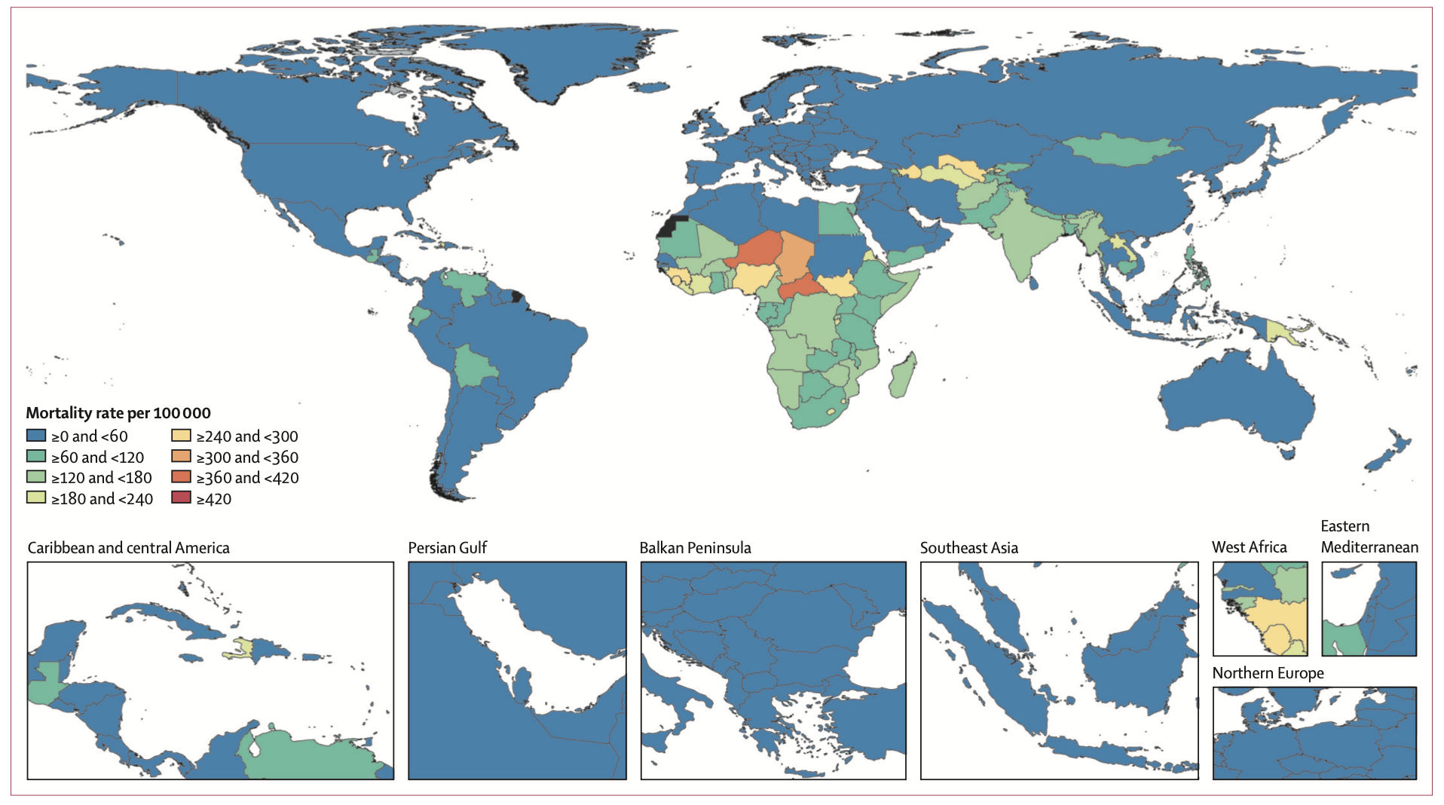
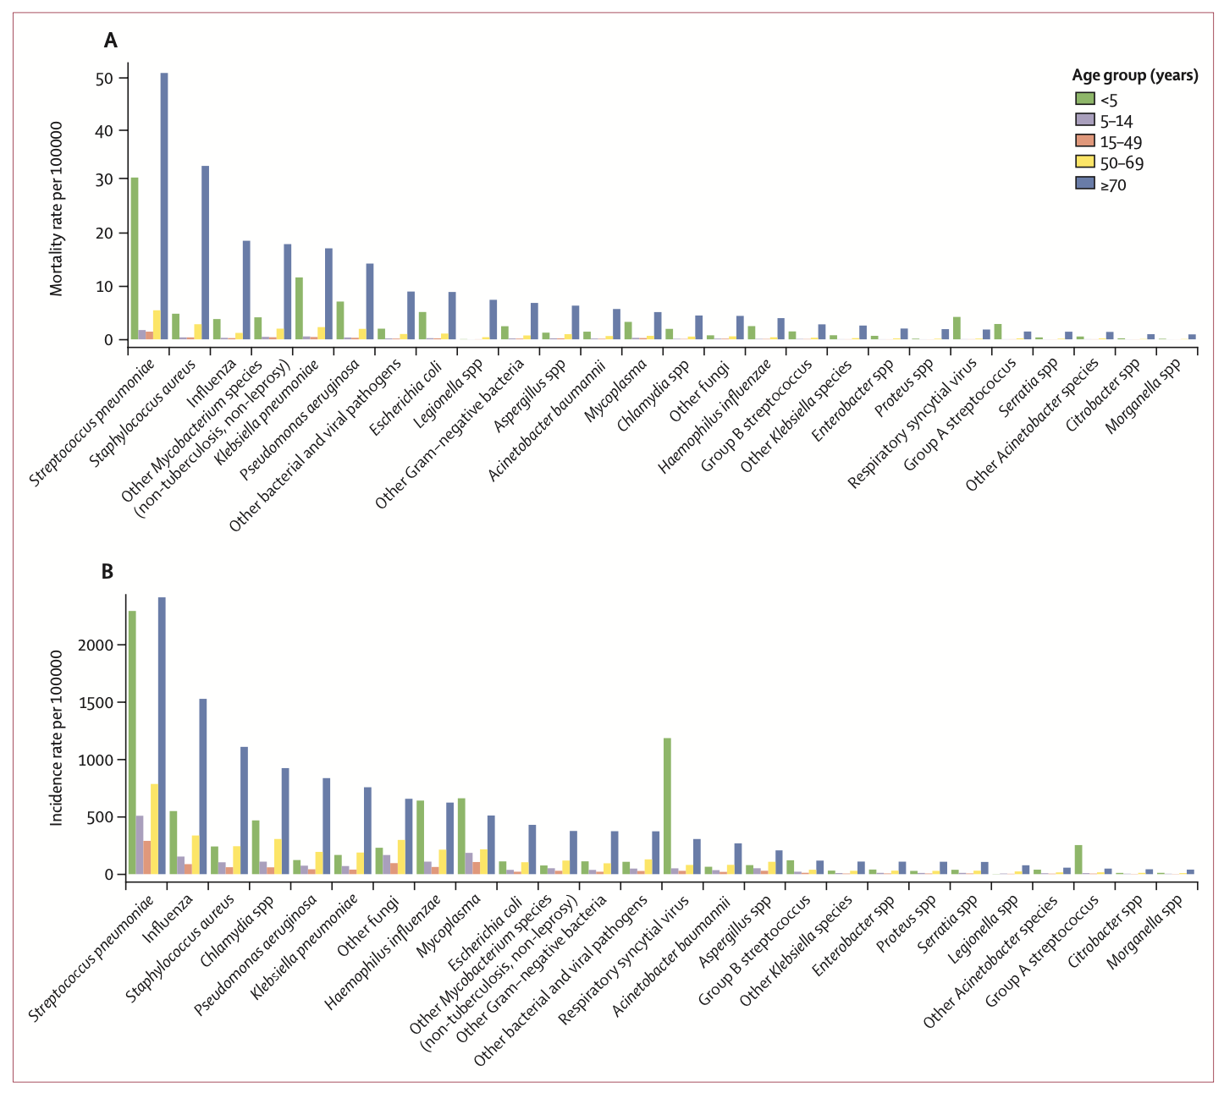
Global Burden of Disease
GBD 2023 Lower Respiratory Infections and Antimicrobial Resistance Collaborators*Lancet ID 2026

Slide 6
Outline
Epidemiologia
Diagnosi e ritardo diagnostico
  Diagnosi precoce
  Nuovi fattori di rischio
Terapia
  «Standard»
  Malattia refrattaria
  Nuove opzioni in studio
  Micobatteriosi extrapolmonari e disseminate

Slide 7
71.8 months
Delay in diagnosis and treatment
Higher radiological score
Hayashi M, et al. Helyon 2024

Slide 8
Late onset immunedeficiencies
GATA2
  Young age
  Multiple infections
anti IFN-γ antibodies
  Female, Asia
  HLAs
  Disseminated
  Observed in 9.3% Sjogren e 7.4% SLE
Wu U-I and Holland SM. Lancet Inf Dis 2015; Gupta S, et al. Artr Rheumat 2016

Slide 9
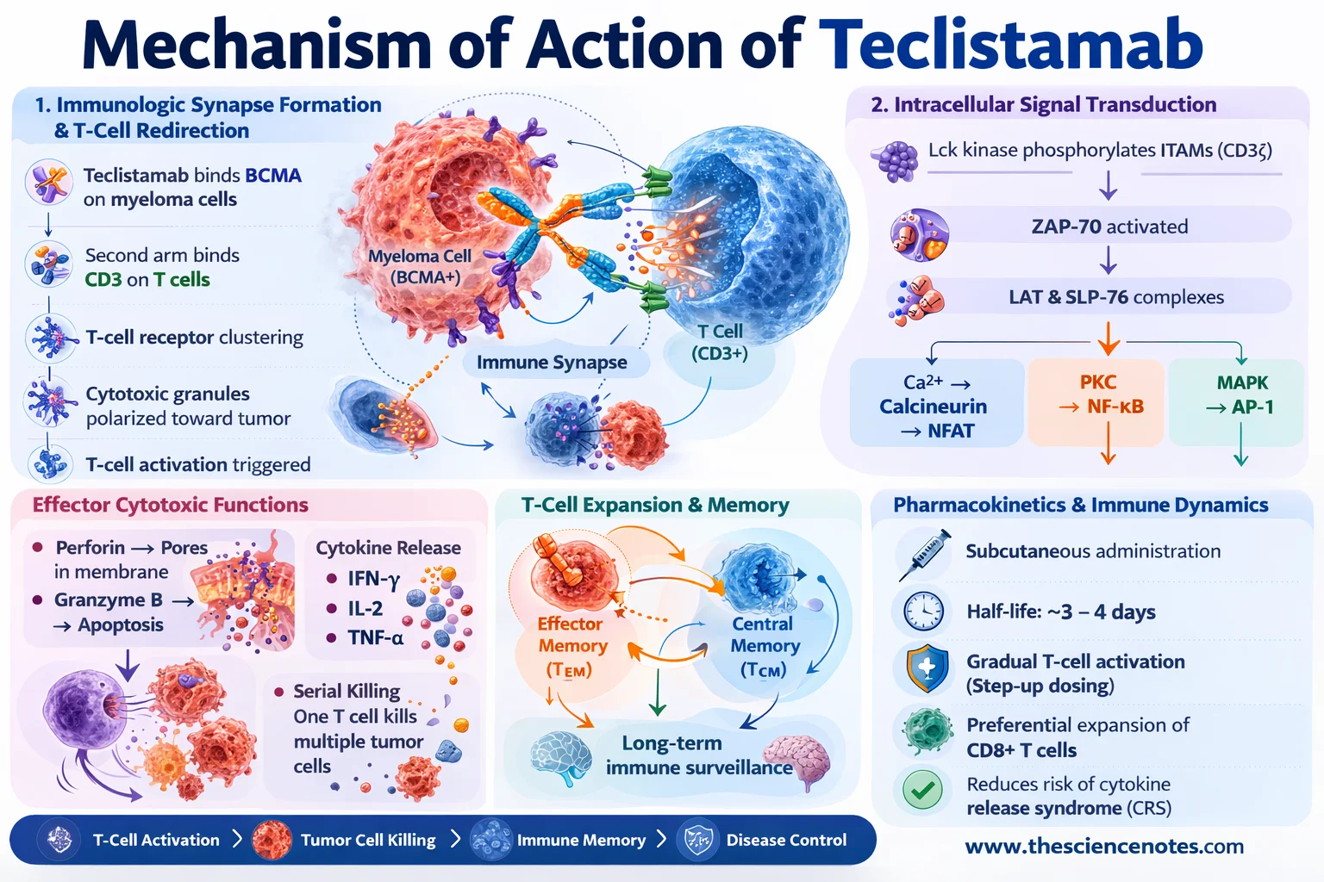
New immune modulators

Slide 10
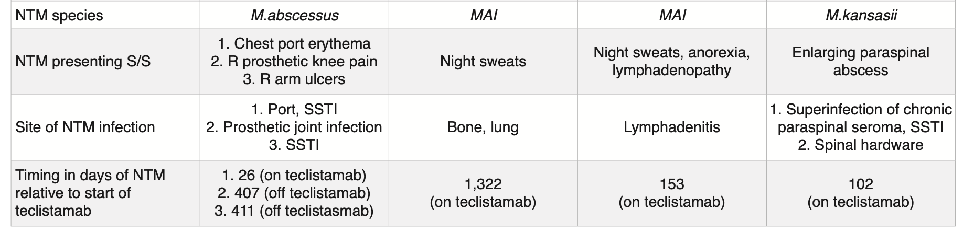
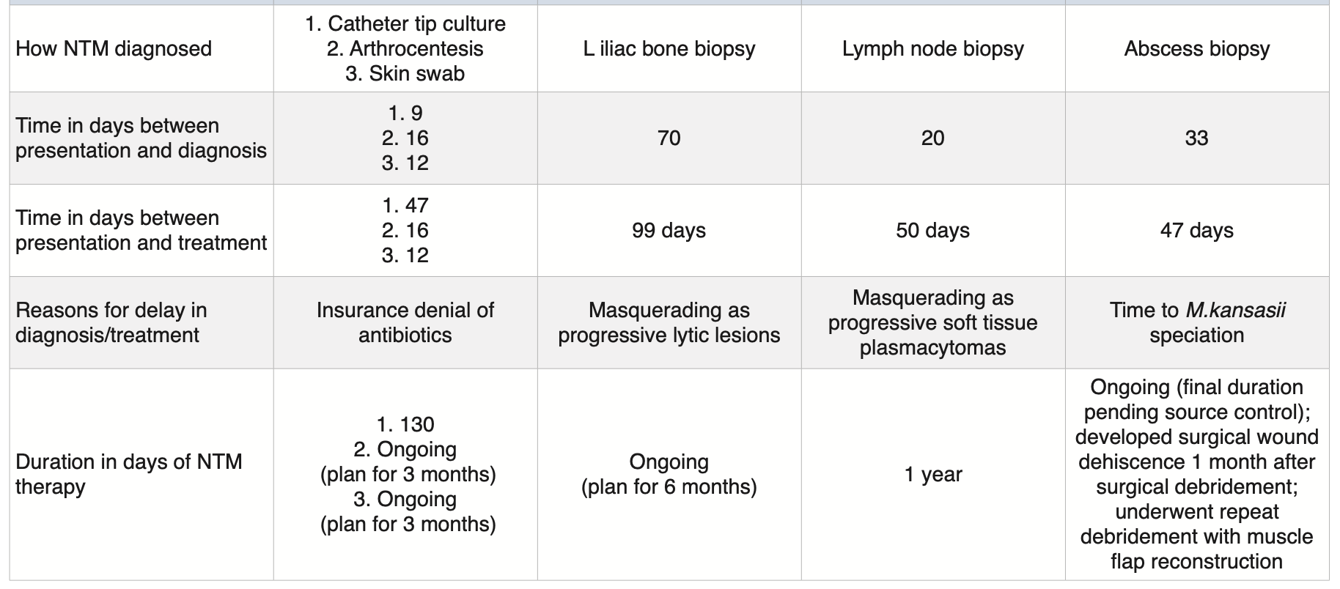
NTM infections following teclistamab in multiple myeloma
Ho M, et al. Haematologica 2025

Slide 11
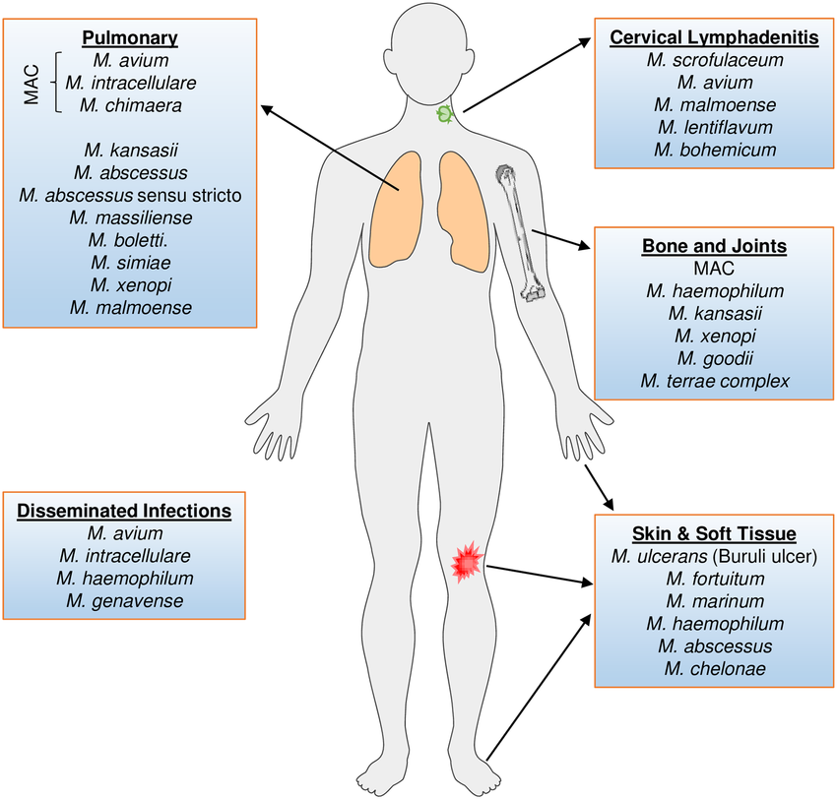
Extrapulmonary and disseminated (>1 or blood+) NTM infections
Baldwin S, et al. PloS Negl Trop Dis 2019

Slide 12
Outline
Epidemiologia
Diagnosi e ritardo diagnostico
  Diagnosi precoce
  Nuovi fattori di rischio
Terapia
  «Standard»
  Malattia refrattaria
  Nuove opzioni in studio
  Micobatteriosi extrapolmonari e disseminate

Slide 13
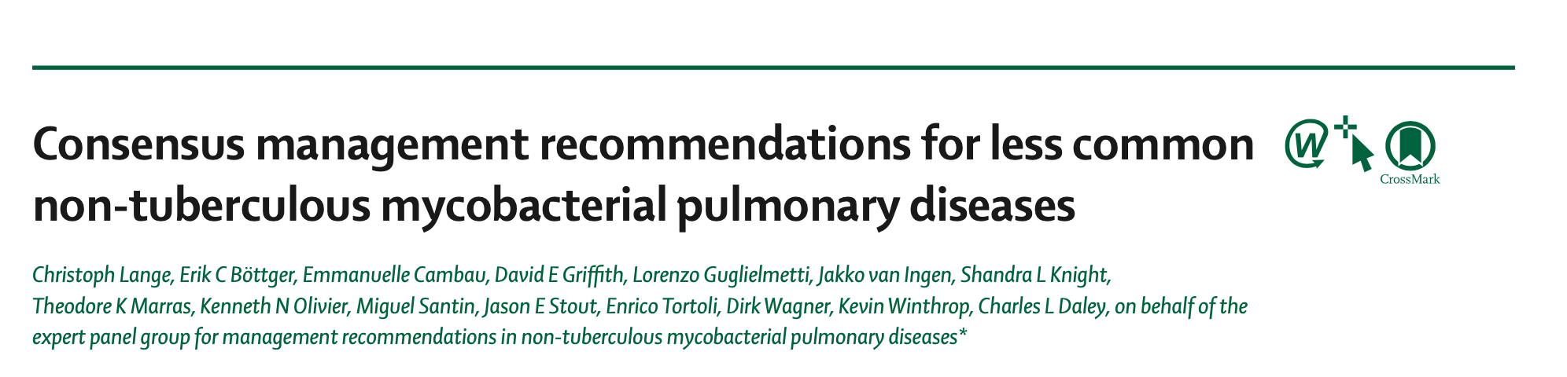
Guidelines
Daley CL, et al. CID 2020; Haworth C, et al. Thorax 2017; Lange C, et al. Lancet Inf Dis 2022

Slide 14
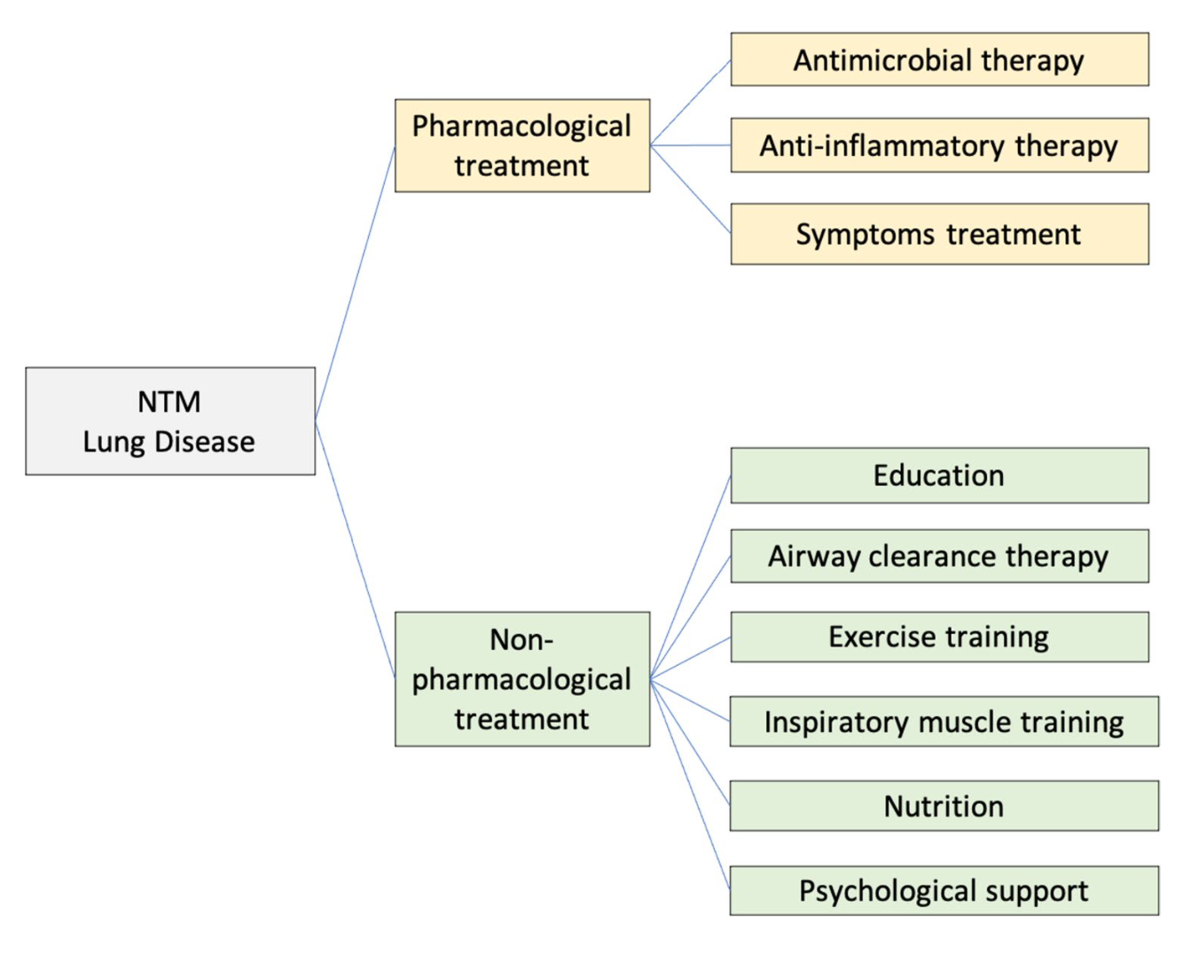
Management of NTM-PD
Calcagno A and MYGRO/SIMIT. Infection 2024; Sulaiman N, et al. ERJ Open Res 2025

Slide 15
Treatment of NTM Pulmonary Disease (Questions I–II)
I: Should patients with NTM pulmonary disease be treated with antimicrobial therapy or followed for evidence of progression (“watchful waiting”)?
Recommendation
1. In patients who meet the diagnostic criteria for NTM pulmonary disease, we suggest initiation of treatment rather than watchful waiting, especially in the context of positive acid-fast bacilli sputum smears and/or cavitary lung disease (conditional recommendation, very low certainty in estimates of effect).
Guidelines: when to treat?
Daley Cl, et al. CID 2020

Slide 16
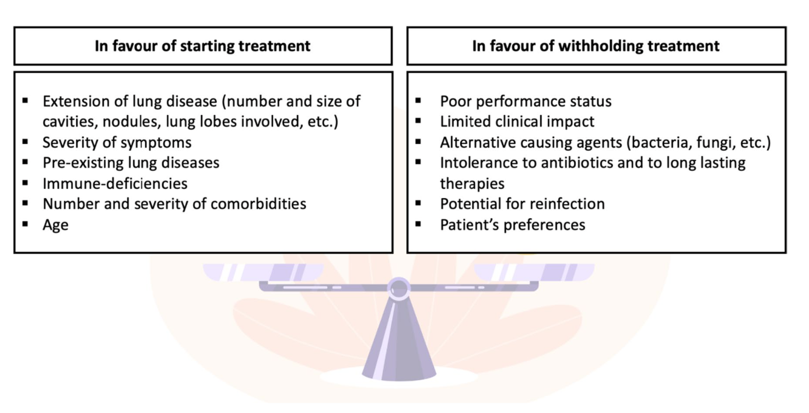
When to start?
Calcagno A and MYGRO/SIMIT. Infection 2024

Slide 17
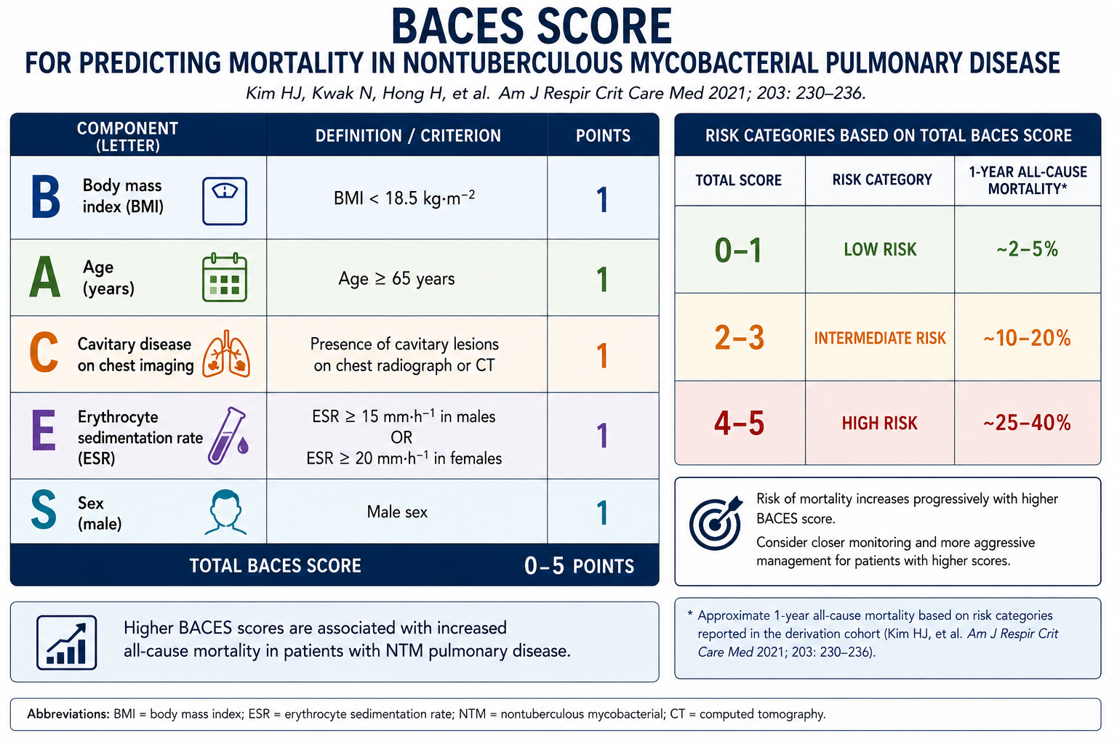
The BACES Score
Kim HJ, et al. Am J Respir Crit Care Med 2021; Aksamit TR. Am J Respir Crit Care Med 2021; Kim HJ, et al. Sci Rep 2023; Kim BG, et al. Sci Rep 2022; Lemson A, et al. ERJ Open Res 2025. Figure created with assistance from ChatGPT (OpenAI)

Slide 18
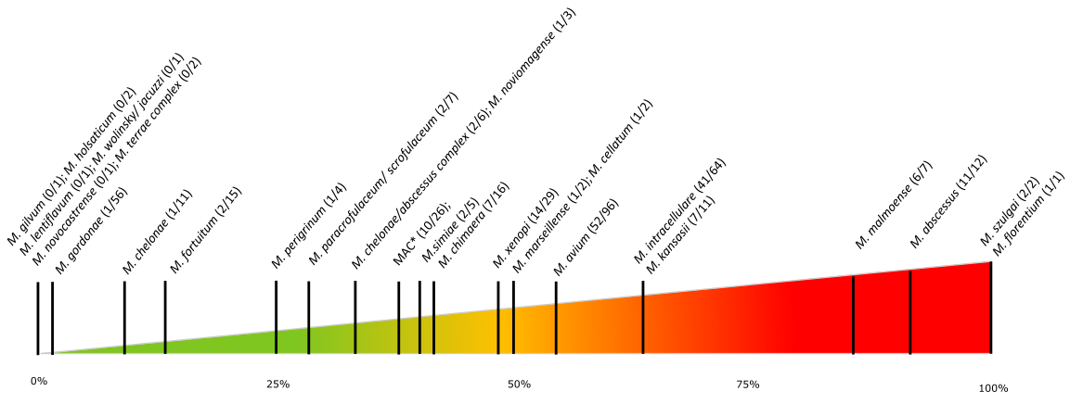
NTM identification and treatment
Female, 75 yo, lung cancer
Male, 42yo, HSCT
Y Vande Weygaerde et al. BMC Infect Dis 2019

Slide 19
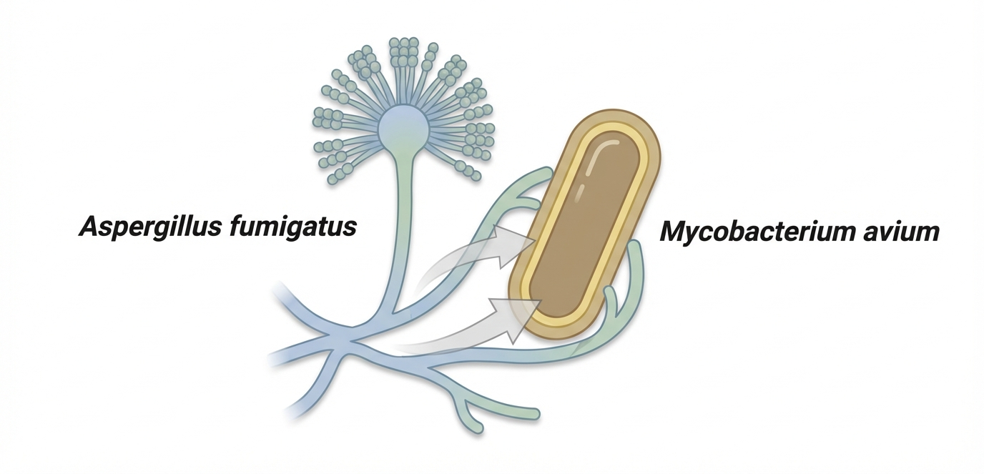
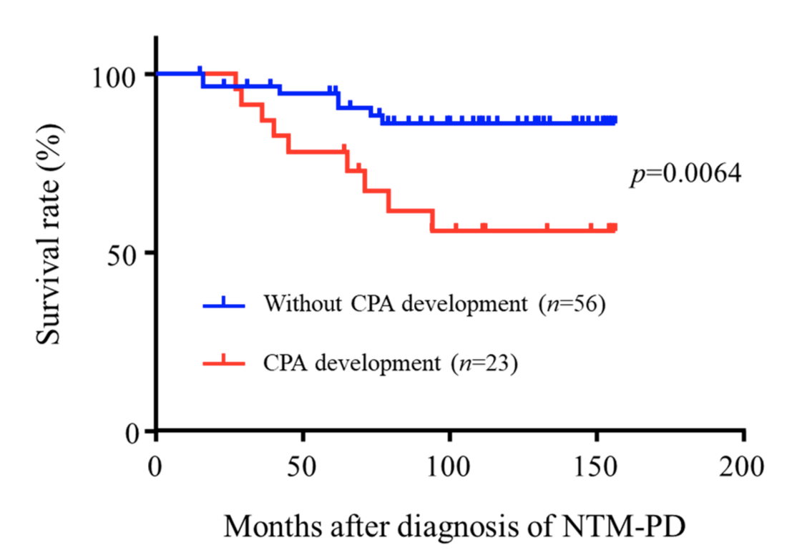
409 NTM-PD patients
Median observation time of 85 months
Aspergillus species were isolated from 79 (19.3%) and 23 (5.6%) developed CPA
  Multivariate logistic regression analysis revealed that the use of systemic steroids (p = 0.0189) and cavity (p = 0.0207) were independent risk factors for the progression to CPA.
Co-infections
Multivariate logistic regression analysis revealed that higher CRP (p = 0.0213) and AFB stain positivity (p = 0.0101) were independently associated with Aspergillus isolation
CPA development severely affects clinical outcome (p=0.0064)
Fukushima K, et al. Microorganisms 2021

Slide 21
1263 pts in Shangai, retrospective (2014-2018)
Median time to sputum culture conversion was 4 months for M. kansasii, 10 months for MAC and 24 months (no conversion) for Mabs.
The overall median time of treatment was 19.1 months (95%CI: 18.6, 19.6) in the treatment success group and 23.9 months (95%CI: 23.8, 24.1)
Risk factors for treatment failure:
  pathogenic NTM
  elevated ESR
  being middle-aged or elderly
Treatment outcomes
Cheng L, et al. Trop Med and Inf Dis 2022

Slide 22
Macrolides
Ethambutol
Rifamycins
GI
QT prolong
Liver
Ear
Optical neur
Liver
Neuropathy
Liver
Flu-like
DDIs
Adverse effects of anti-NTM treatment
Clofazimine
Amikacin
Linezolid
Moxifloxacin
…
Skin
Liver
QT prolong
Kidney
Ear
…

Slide 23
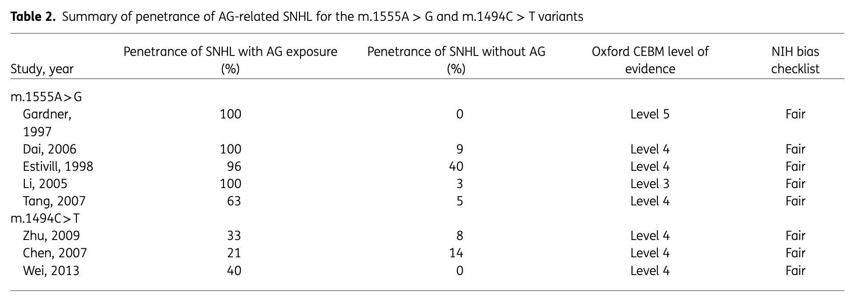
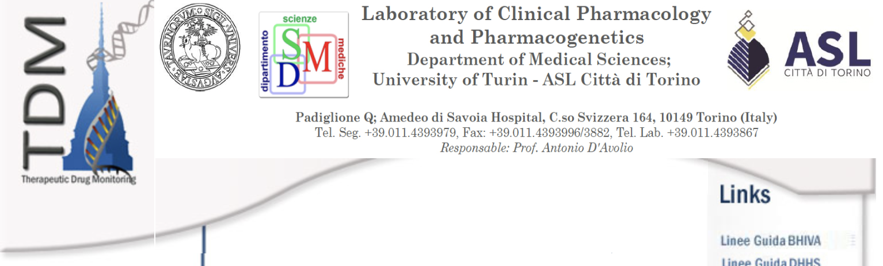
Pharmacogenetics of ototoxicity
Irreversible sensorineural hearing loss (SNHL)
Local Lab or
http://www.tdm-torino.org
Gaafar D, et al. JAC 2024

Slide 24
IN PRATICA…

Slide 25
Multidisciplinary Management
Lab test
  Bronchietasis diagnosis
ECG
Sputum/BAL culture
Audiometry
Ophtalmologist visit
  Color discrimination test
HRCT
Spirometry with DLCO
Respiratory Medicine &
Infectious Diseases
Microbiology
(Immunology)
Radiology
Respiratory Physiotherapy
(Psicology/Psychiatry)
Food and Nutrition

Slide 26
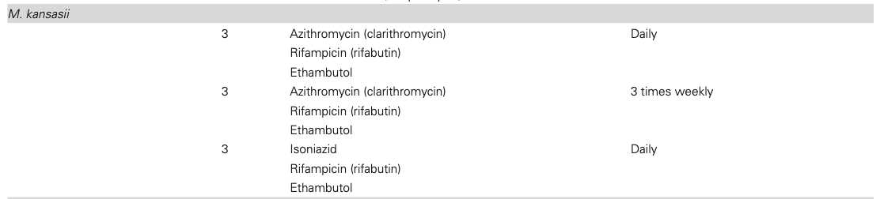
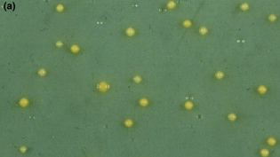
Usually a good clinical and microbiological response (approx. 90% of culture conversion)
Rifampicin-containing regimens showed low failure rates (1.1%) and low long-term relapses (<1%)
M. kansasii
Daley CL, et al. CID 2020; Griffith DE. Chest Med. 2002

Slide 27
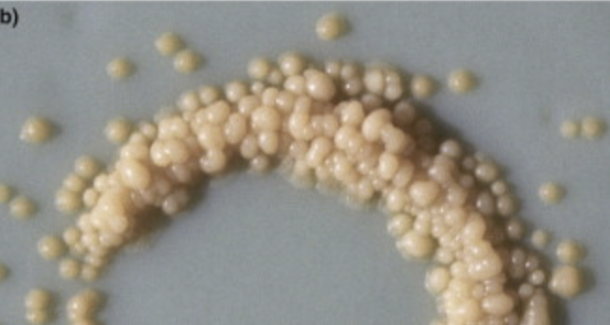
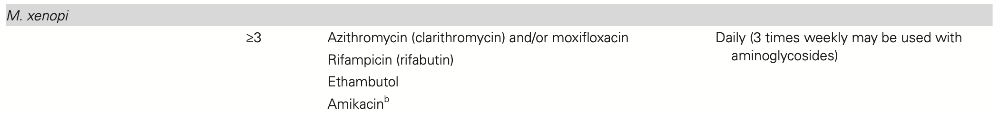
Highest mortality among NTMs
Average response with culture conversion reported at 70.8%
M. xenopi
Zaheen A, et al. Resp Med 2020

Slide 28
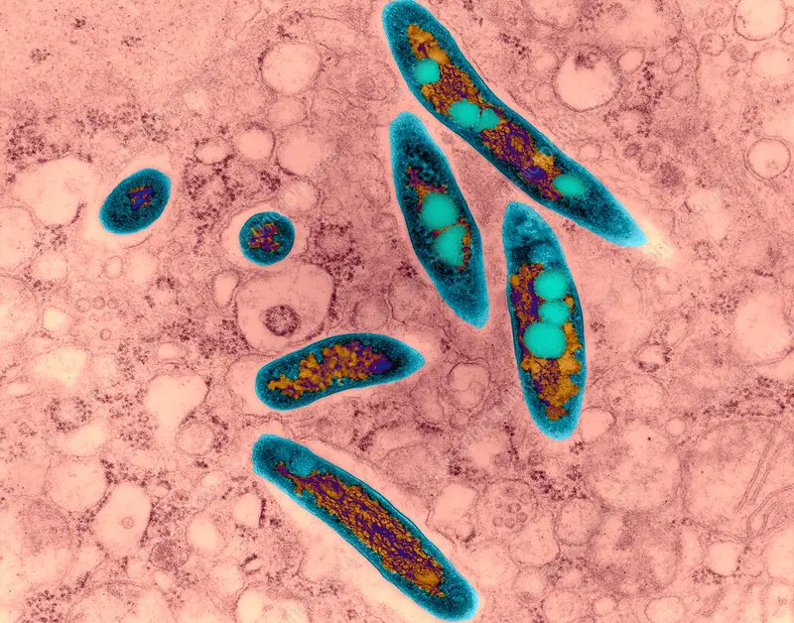
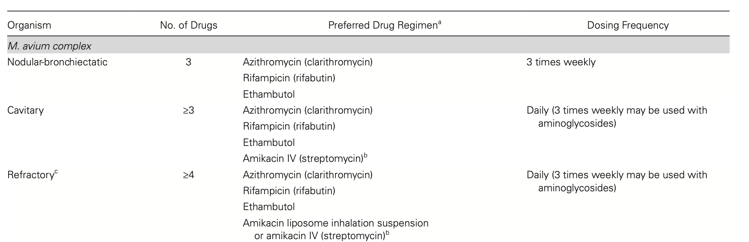
MAC
Daley CL, et al. CID 2020

Slide 29
No role for rifampicin for MAC?
RIF MICs are very high
PK/PD models suggest that RIF >50 mg/Kg may be needed
In vitro/in vivo evidence: RIF did not avoid the emergence of resistance to macrolides
RIF decreases macrolide exposure
Van Ingen J, et al. ERJ 2024

Slide 30
Alternatives to rifampicin?
Two drugs only (Azythromicin and Ethambutol)
  Retrospective data were favorable in limited disease
  A randomized trial of 2 vs. 3 is ongoing
Rifabutin
  Lower MICs, good intracellualar and tissue penetration
  DDIs, side effects, costs, non higher effivcacy in retrospective studies
Clofazimine
  Good tissue penetration
  Retrospective data favorable (culture conversion 64%)
  Non inferior vs. rifampicin in a small RCT
  Dose??
Miwa S, et al. Ann Am Thorac Soc 2014; Moon SM, et al. AAC 2019; Fukushima K, et al. Scient Reports 2021; Kim DH, et al. AAC 2021; Hajikhani B, et al. Front in Pharmacol 2021; Javad Nasiri M, et al. Front Med 2021; Bao S, et al. IJAA 2024; Zweijpfenning SMH, et al. Chest 2023

Slide 31
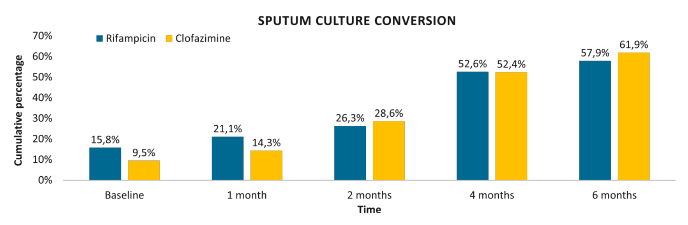
Clofazimine RCT
n=40 → REAz (19) vs. CzEAz (21)
Study discontinuation, mainly due to adverse events, was equal in both arms (26% vs 33%)
  In the clofazimine arm, diarrhoea was more prevalent (76% vs 37%; p=0.012), while arthralgia was more frequent in the rifampicin arm (37% vs 5%; p=0.011).
  No difference in the frequency of QTc prolongation was seen
Sputum culture conversion (6 months) → 79% in both groups.
Zweijpfenning SMH, et al. Chest 2023

Slide 32
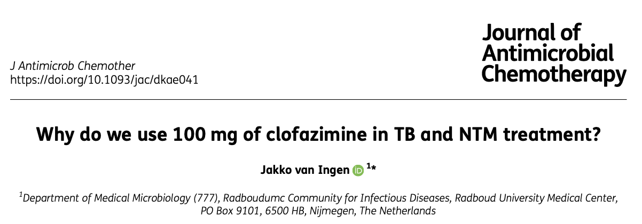
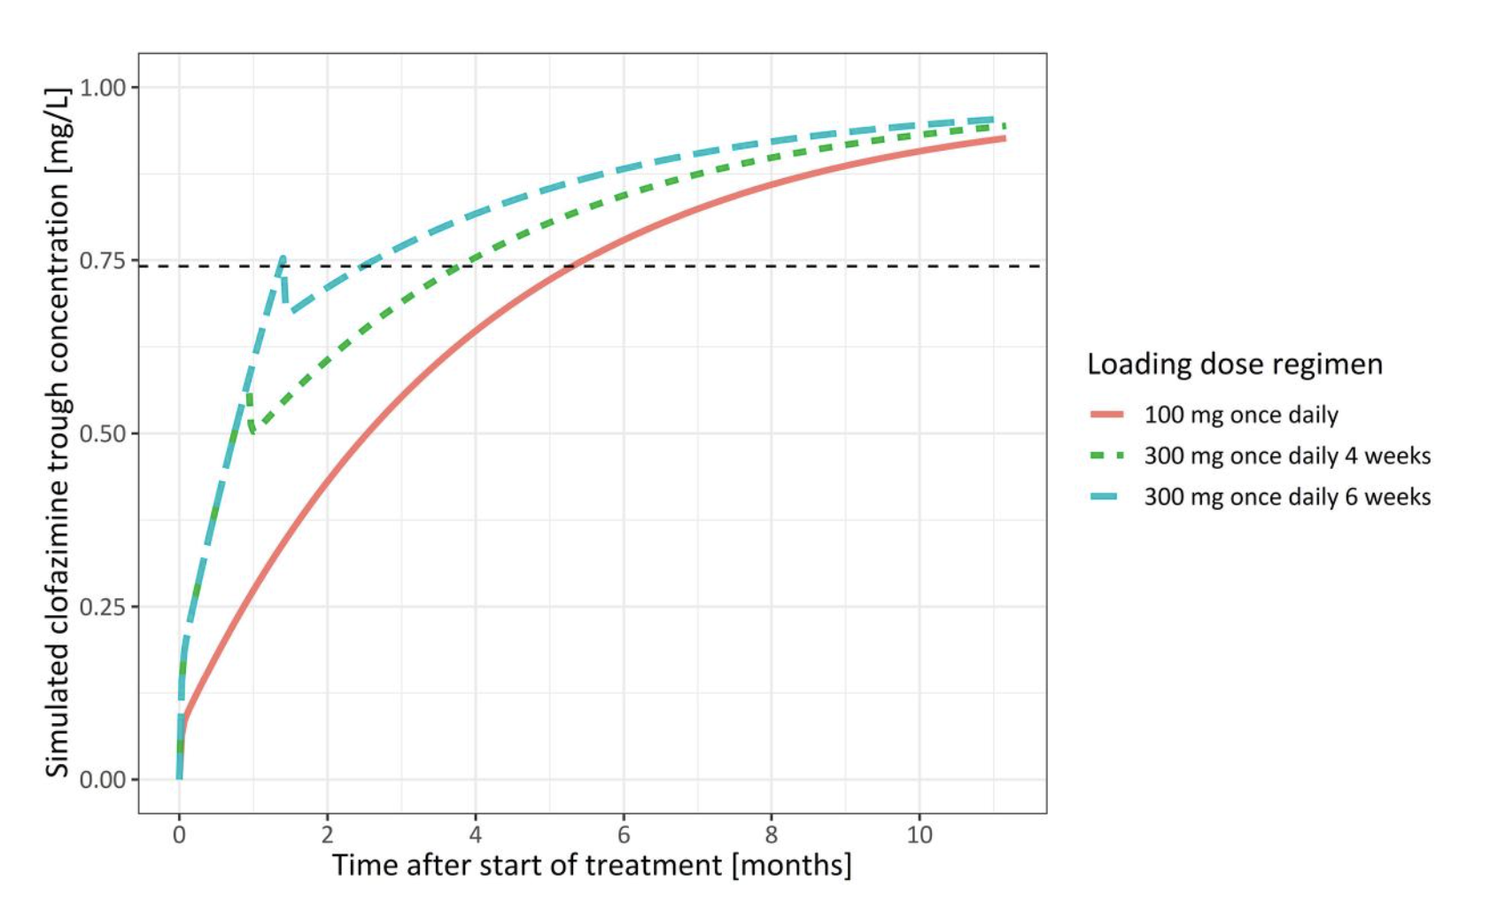
Clofazimine Dose
Van Ingen JAC 2024; Stemkens R, et al. JAC 2024

Slide 33
REFRACTORY DISEASE

Slide 34
Alternative therapeutic options for NTM
 | AIFA | Dose | Comment
Moxifloxacin | Off label | 400 mg/day | long term-tolerability uncertain (QT, muscoskeletal, GI)
Clofazimine | Off label (bought abroad) | 100 mg/day (loading dose?) | Tolerability (skin pigmentation, liver, QT)
Tedizolid | Off label | 200 mg/day | Expensive, long term-tolerability uncertain
Bedaquiline | Off label | 400 mg/day (2 weeks) and then 200 mg 3/w | Expensive, 6 months only, tolerability (QT, liver, GI)
Inhaled liposomial amikacin | C(nn) class for adults with MAC LD with limited treatment options (non CF) | 590 mg inhaled/day | Expensive, short-term tolerability

Slide 35
Refractory Disease and patients with limited treatment options
ALIS
Griffith DE, et al. Chest 2022

Slide 36
Refractory Disease and patients with limited treatment options
ALIS(2)
Marras TK, et al. ERJ Open Res 2022

Slide 37


Slide 38
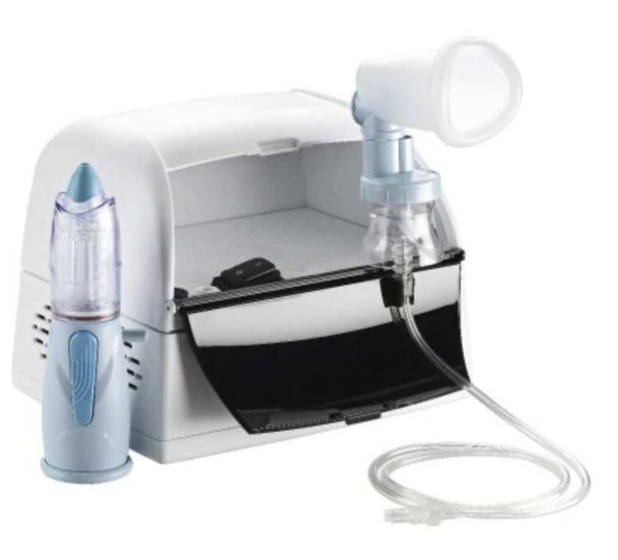
Complex regimens
26 patients (23 MAC, 3 Mabs)
Culture conversion 43.5%
Radiological improvement in 30.4%
One auditory toxicity (despite undetectable through levels)
iAmika + Clofa
52 patients
Culture conversion 33% (37% if >12 months)
Overall, 15 (29%) patients achieved favorable outcomes, including microbiological cure, cure, and clinical cure.
Refractory Disease
Inhaled amikacine sulfate
Yagi K, et al. BMC Infect Dis 2017 Kim BG, et al. J Clin Med 2020

Slide 39
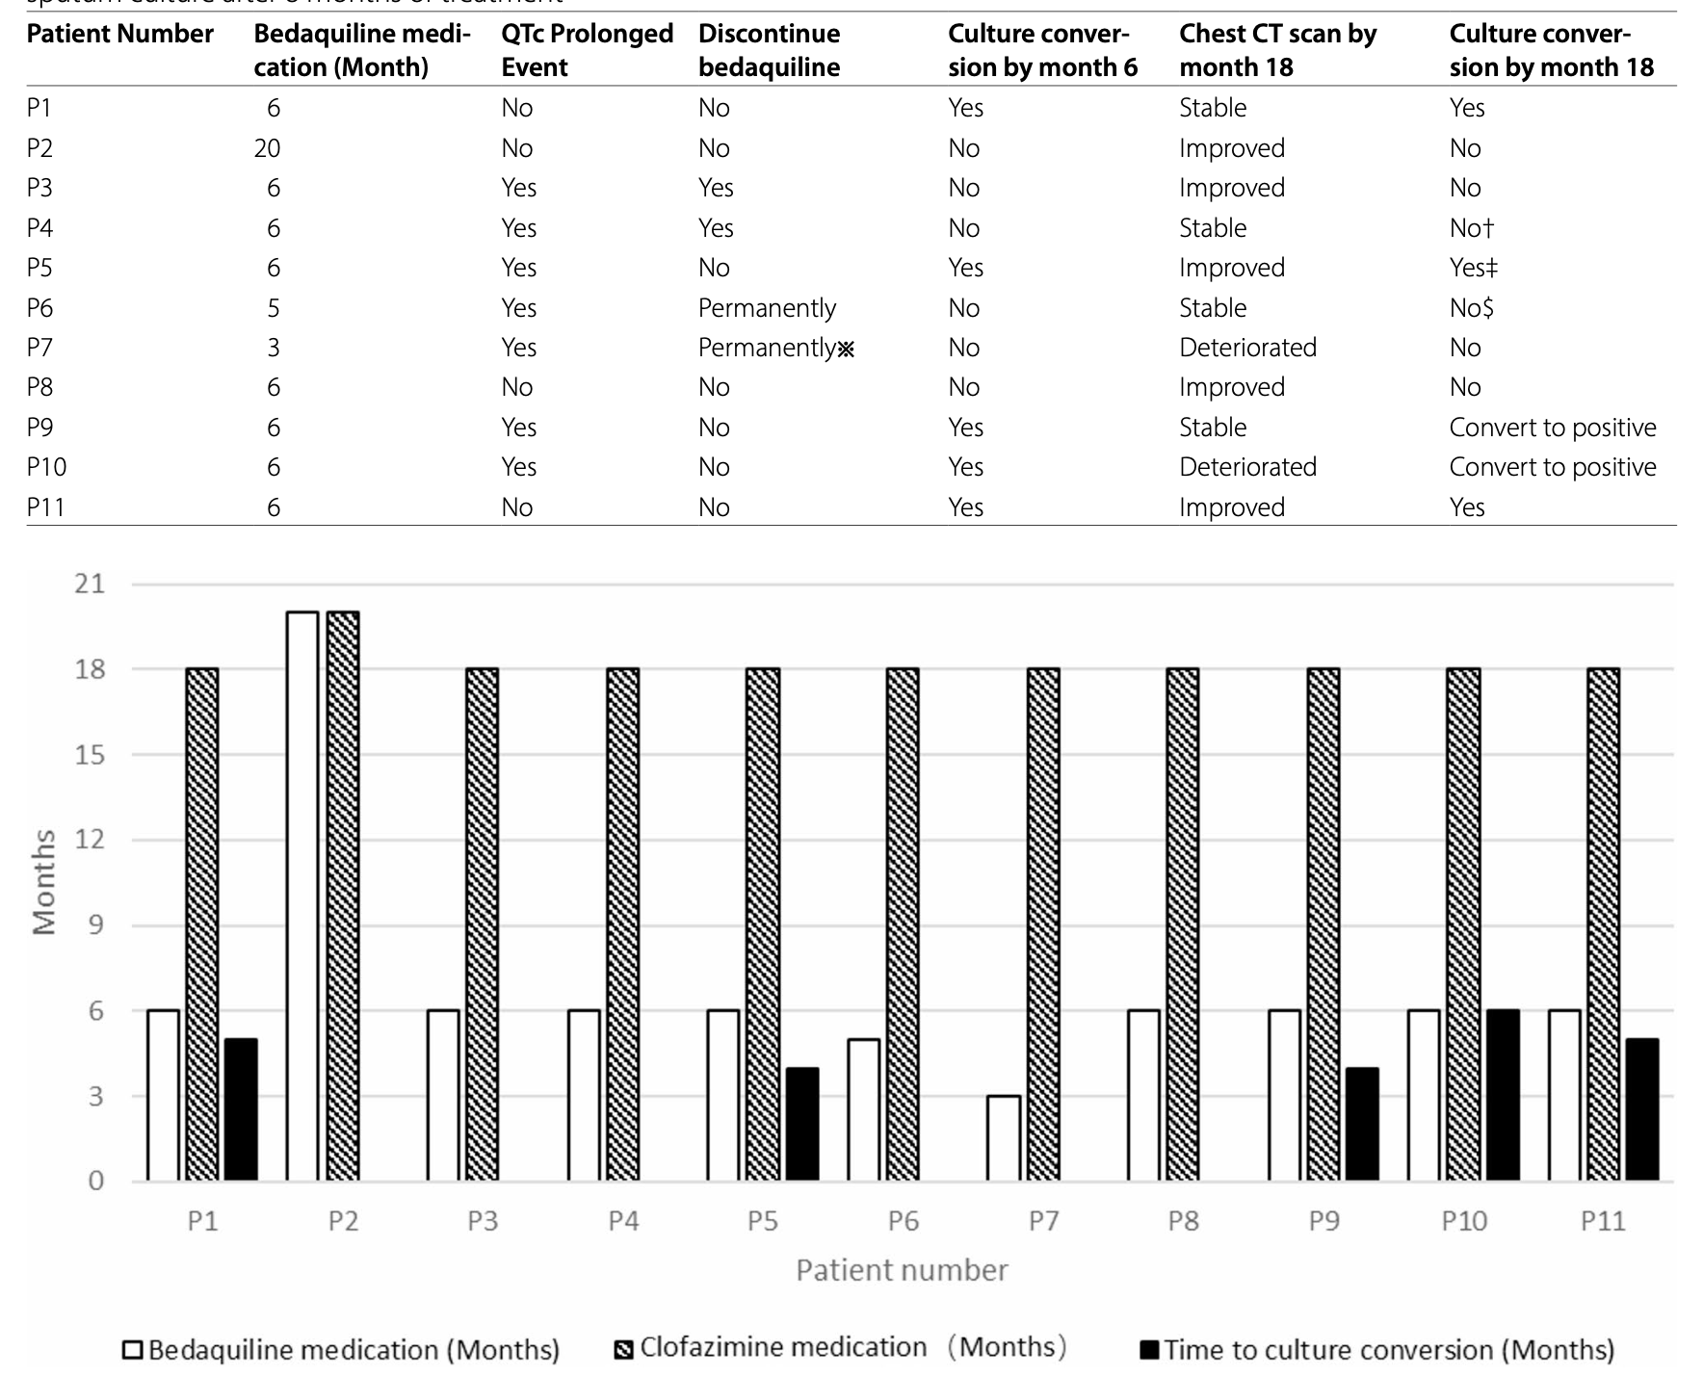
Bedaquiline + Clofazimine
45% culture conversion
Yao L, et al. BMC Infectious Diseases 2025

Slide 40
Female, 64 yo, low BMI, GERD, Anxiety
NB disease with MAC isolation (chronic cough + weight loss + direct AFP)
  Starts REA, poorly tolerated
  Stable CT scan, minor clinical improvement, no culture conversion → stops at 18 months
  1 year later productive cough and malaise
Failure, Relapse, Reinfection
Treatment of refractory disease?

Slide 41
PET after relapse?
Watchful waiting + enhancd FKT
Stable since 5 years
Stroffolini G, et al. J of Infect 2023

Slide 42
Omadacycline (Mabs e RGM)
  Sinergy with macrolides, Lz, Rb
Oritavancin (Mabs)
  Long half-life (393 hours), Synergy with clarithromycin, tigecycline, cefoxitin, moxifloxacin and meropenem
New Beta lactams/beta lactamase inhibitors (Mabs)
  Avibactam and Relebactam
Contezolid (MAC)
Sulbactam/Durlobactam (Mabs)
Eravacicline (Mabs)
Epetraborole (Mabs)
Minocycline (MAC)
Clofazimine Inhalation Suspension (MAC/Mabs)
  Long lung persistence
Phage Therapy
  Personalized, case series
New drugs
Quang NT and Jang J. Frontiers Pharmacol 2021; Krieger D, et al. ERJ 2016; Kim DH, et al. AAC 2019; Nicklas DA, et al. AAC 2022; Wang G, et al. Int J Mol Sci. 2021; Dousa KM, et al. mBio 2022; Lefebvre AL, et al. AAC 2016; Kunkel M, et al. AAC 2023; Dedrick RM, et al. Nat Med 2019; Dedrick RM, et al. CID 2023; Huang Y, et al. AAC 2025; Raaijmakers J, et al. IJAAs 2025; Terschlüsen
E, et al. Diagn Microb & Infect Dis 2025; Nguyen M-VH, et al. JAC 2025; Shrivastava A, et al. Microb Spectrum 2026; Ying R , et al. Microb Spectrum 2025

Slide 43
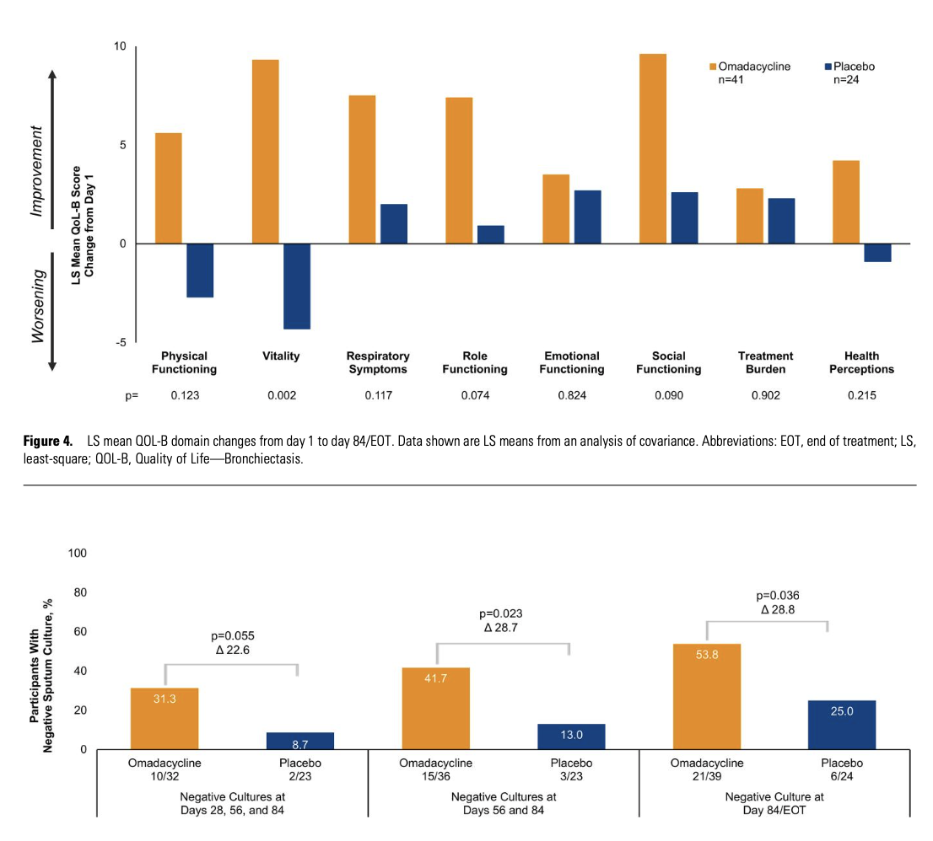
A randomized, double-blind, placebo-controlled, multicenter phase 2 study of omadacycline monotherapy
In adults with NTM-PD caused by M. abscessus.
Eligible patients meeting the diagnostic criteria for NTM-PD were randomized 1.5:1 to receive omadacycline 300 mg orally once daily or placebo for 84 days
Omadacycline
Winthrop KL, et al. CID 2026

Slide 44
PWH → cART
Other immunedepressions → consider reducing immune suppression if feasible
anti-IFNγ autoantibodies → rituximab, bortezomib
Cystic fibrosis → CFTR modulators
Host-directed therapies
Browne SK, et al. Blood 2012; Rocco JM, et al. Journal of Translational Autoimmunity 2021; Ricotta EE, et al. ERJ Open Res 2022

Slide 45

Conclusioni
Incidenza in aumento delle NTM-PD, associate a un elevato utilizzo di risorse e mortalità
Notevole ritardo diagnostico (impatto sull’outcome?)
  Coinvolgimento di MMG, pneumologi e reumatologi
  Computer-assisted diagnosis?
Gestione “olistica” e coinvolgimento del paziente
  Gestione multidisciplinare
  Terapia con efficacia incompleta e tossicità rilevante → Necessari nuovi farmaci con attività battericida
Molte domande aperte
  Ottimizzazione farmacologica (clofazimina al posto di rifampicina? Dosi? TDM? PG per amiglicosidi?)?
  Terapia della malattia refrattaria?
  Quando interrompere in caso di fallimento microbiologico?
  Terapia della malattia extrapolmonare
Randomized and controlled trials!!!

Slide 46





Acknowledgements
Cristoforo Comi
Fabiola De Marchi
Giovanni Di Perri
Stefano Bonora
Mattia Trunfio
Antonio D’Avolio
Jessica Cusato
Marco Mussa
Roberto Angilletta
Sabrina Vicinanza
The SCDO Malattie Infettive!
Stefano Patrucco
Elisa Clivati
Paolo Ravanini
Anna Camaggi
Valeria Ghisetti
Alessandra Mondo
Prof. Carlo F Perno
Prof.ssa Claudia Alteri
Rossana Scutari
Valeria Fox
Luna Colagrossi
Marisa Gariglio
Cinzia Borgogna
Marta Mellai
Sandra D’Alfonso

Slide 47
Global Trends
Naestholt Dah V, et al. Chest 2022

Slide 48
Mortality
France
Incidence 1-1.1/100K inhabitants
increased mortality rate X 2.8 (95% CI: 2.53; 3.11) and lower for patients treated with antibiotics (HR = 0.772; 95% CI [0.628; 0.949).
Increasing mortality in recent years
Harada K, et al. IJID 2025
Veziris N, et al. BMC Infect Dis 2021

Slide 49
Clofazimine efficacy in the treatment of MAC-PD
A very recent paper in patients «unsuitable» for standard regimens identified 50 participants treated with Cz
Culture conversion in 64%
Clinical response 68%
Radiological response 52%
Favorable features:
CFZ MIC <0.25 mg/L
previous TB treatment history
56.8%
(47.1-66.5)
Javad Nasiri M, et al. Front Med 2021;
Bao S, et al. IJAA 2024

Slide 50
Rifampicin has no role in treatment of MAC-PD?
NO EFFECT ON MAC GROWTH AND NO PROTECTION FROM RESISTANCE
SIGNIFINCANTLY DECREASES AZ EXPOSURE
Lower azithromycin exposure by 35% (when dosed with rifampicin)
High MICs
PK/PD targets not attained (dose >50 mg/Kg)
In a recent hollow fiber model omission of rifampicin from the treatment regimen did not have any impact on antimycobacterial activity or the emergence of macrolide resistance
Schildkraut JA, et al. AAC 2023; van ingen J, et al. AJRCCM 2012; Gaviraghi A, submitted

Slide 51
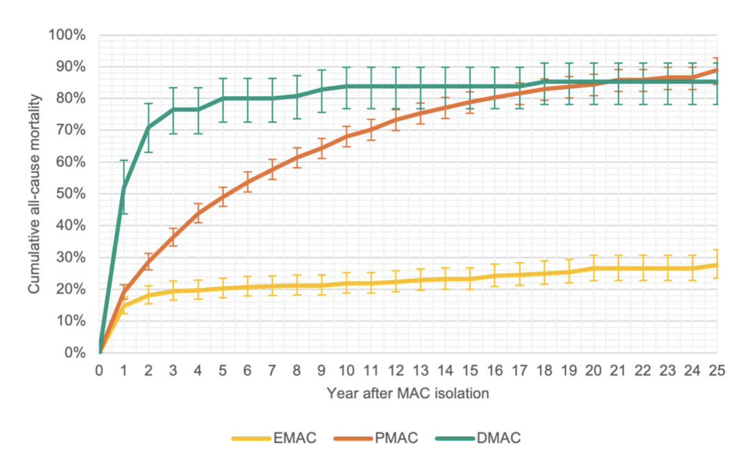
Mortality and causes of death in patients with MAC
Denmark 1991-2018 (n=2207)
Dahl VN, et al. OFID 2025

Slide 52
Skin and soft tissues
2-6 months
Muscoskeletal
6-12 months + surgery?
Disseminated
6-12 months after immune restoration
Post CCH
12 months after negative culture+ surgery
Lymphadenitis
Surgery / antibiotics / observation
How to treat ENTM?
Wi YM. Infect Chemother 2019

Slide 53
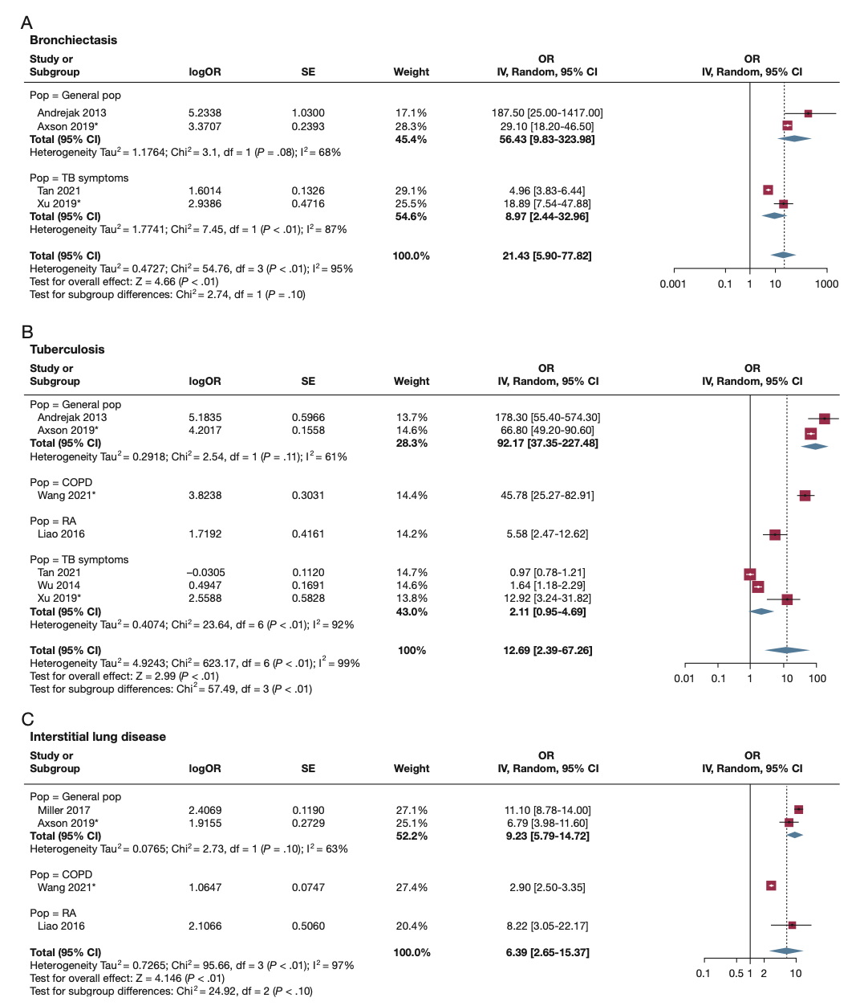
Risk Factors for NTM-PD
A Systematic Literature Review and Meta-Analysis
Loebinger MR, et al. Chest 2023

Slide 54
Two factors associated with better outcomes in the multivariate analysis:
Macrolide-containing regimens
Treatment duration of >12 months
68.1%
(64.7-71.4)
How effective are treatments for
MAC-PD?
Nasiri MJ, et al. Exp Rev Anti-inf Ther 2020; Cheng L, et al. Trop Med and Inf Dis 2022

Slide 55
Therapeutic drug monitoring in NTM therapy
Alffenaar JW, et al. Clin Pharmacok 2021

