Slide 1



Il circolo vizioso
infezione–infiammazione nelle bronchiectasie non-CF: come interromperlo
Francesco Salton
SC Pneumologia, ASUGI
francesco.salton@units.it

Slide 2
Conflitti di interesse
Negli ultimi due anni ho avuto i seguenti rapporti economici e/o supporti Finanziari con soggetti portatori di interessi commerciali in campo sanitario:
Tipo di Rapporto Economico Azienda
Attività di Relatore GlaxoSmithKline, Insmed, Chiesi Farmaceutici, OrionPharma
Contributo Attività di Ricerca Vivisol
Attività di Consulenza GlaxoSmithKline, Chiesi Farmaceutici
Possesso di azioni o quote partecipative Gossamer Bio
Componente di Organi Direttivi
Rapporto di lavoro subordinato

Slide 3
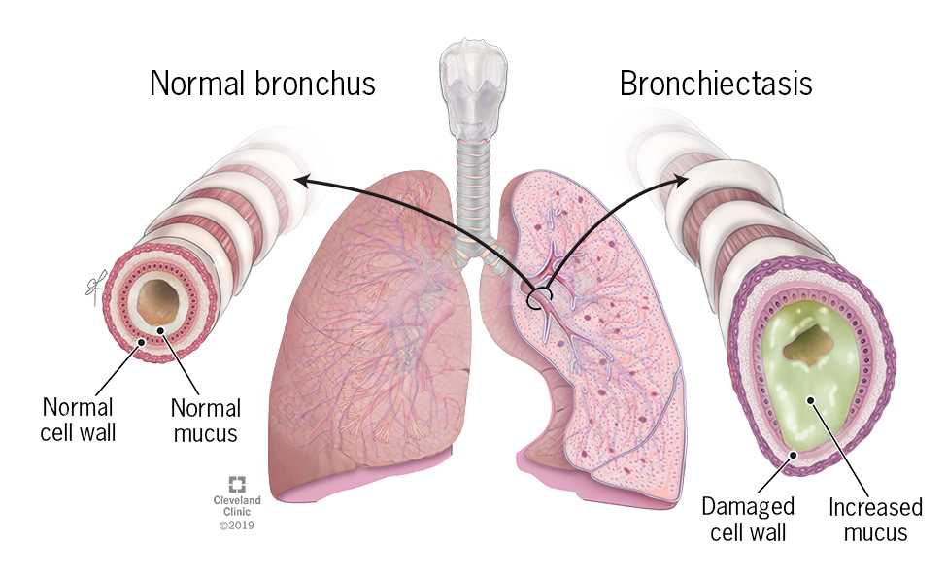
Bronchiectasie e circolo vizioso
Bronchiectasis is a chronic inflammatory lung disease characterised by clinical symptoms such as cough, sputum production and recurrent respiratory infections
Chalmers JD et al. Nat Rev Dis Primers 2018; Schäfer J et al. BMC Pulmonary Medicine 2018; Chalmers J et al. ERJ 2025
Notes:
Vorrei iniziare nel modo più prevedibile possible, e cioè dalla definizione di bronchiectasie.
Nella definizione fornita dalle LLGG sono contemplati i principali momenti di quello che abbiamo Imparato a riconoscere come il meccasnismo patogenetico più accettato per la genesi delle bronchiectasie e cioè il cd circolo vizioso, che siamo abituati a far partire da una infezione/colonizzazione batterica e che risuta poi in un aumento dell’infiammzione, disfunzione epiteliale e dilatazione delle vie aeree.

Slide 4
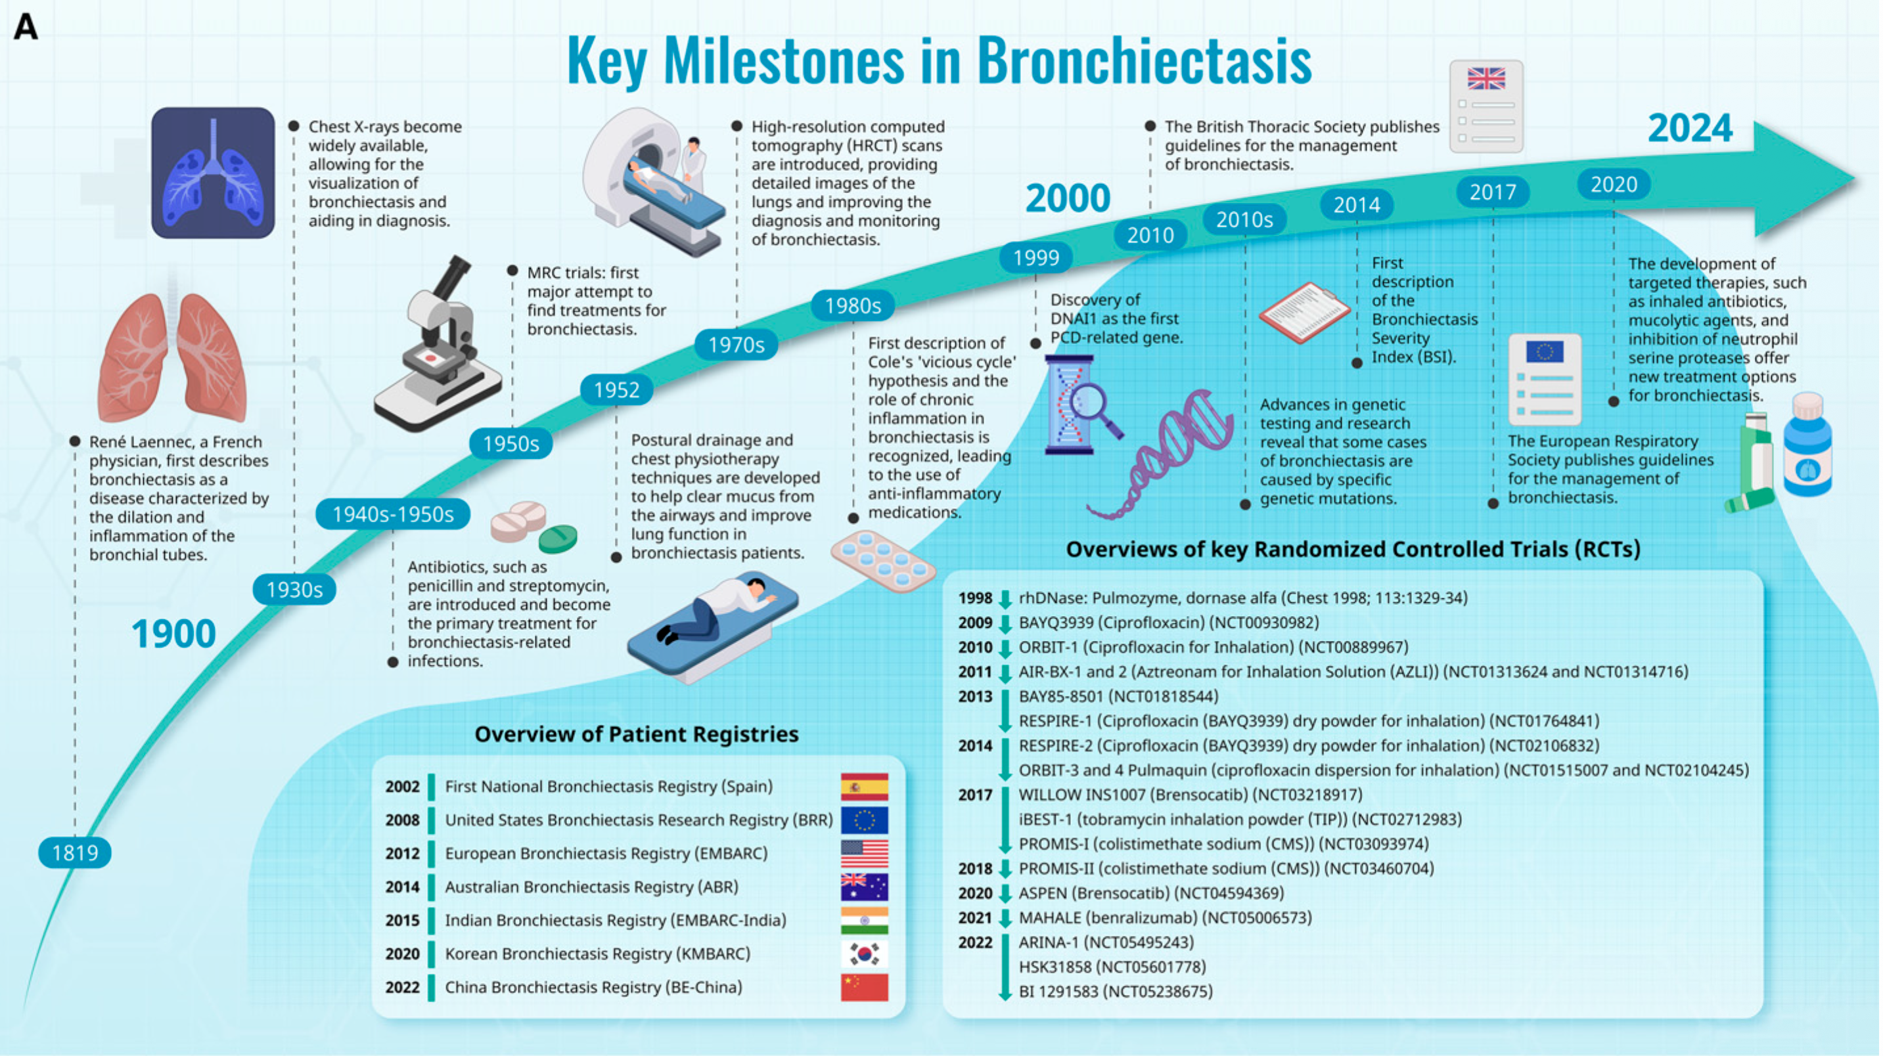
Bronchiectasie: una malattia infettiva?
Chotirmall SH, Chalmers JD. The Precision Medicine Era of Bronchiectasis. Am J Respir Crit Care Med. 2024

Slide 5

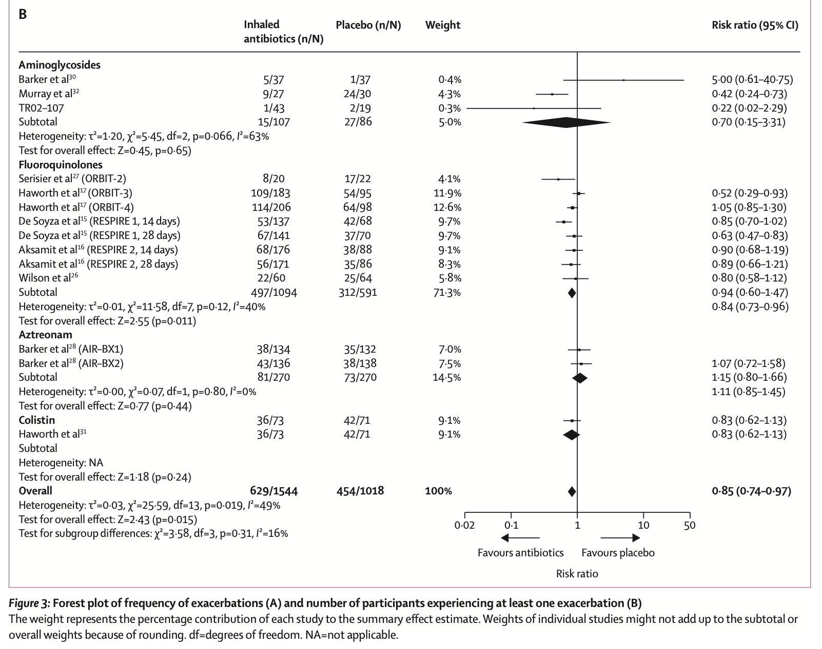
Non (solo) una malattia infettiva
Clinical trials for inhaled antibiotics shown conflicting results
Data on exacerbations →
Data on symptoms reduction and QoL are conflicting
Long term macrolides also effective in patients with P. aeruginosa infection
Cordeiro R et al . Chest. 2024;166(1):61-80
Chalmers JD et al. Lancet Respir Med. 2019;7(10):845-854.

Slide 6
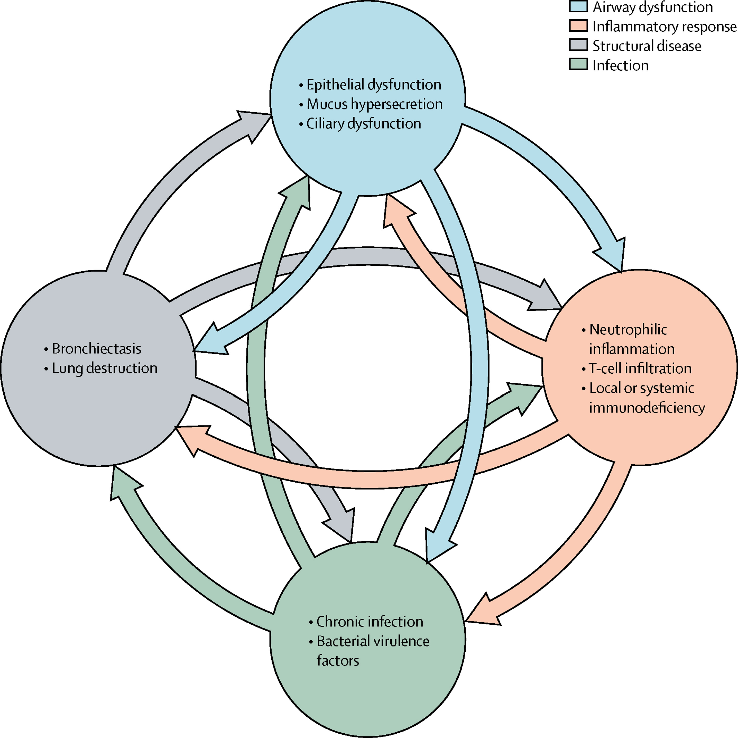
Vicious circle → vortex
?
X
The vortex concept may better explain why individual treatments (e.g. antibiotics or anti-inflammatories) in isolation have only modest effects on clinical outcomes in bronchiectasis; rather than breaking a vicious cycle, which would be expected to halt disease, antibiotics, for example, only affect one component of the vortex meaning inflammation and lung damage can be sustained by other stimuli.
Flume PA et al. Lancet 2018;392(10150):880-890.

Slide 7
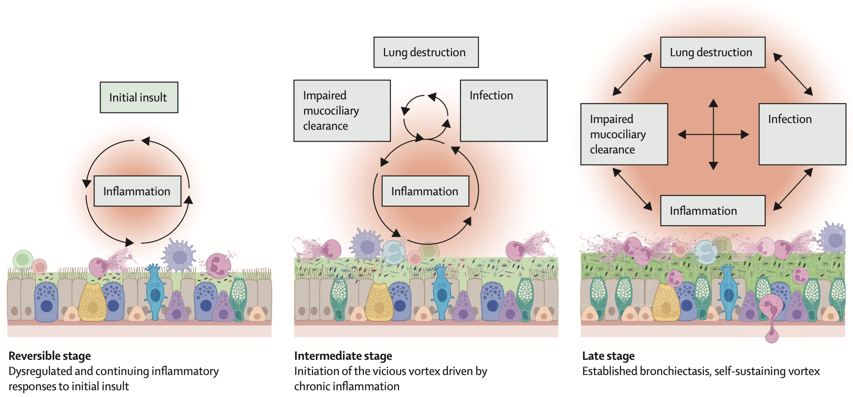
Il ruolo dell’infiammazione
Long MB et al. Lancet Respir Med. 2024;12(11):901-914.
Notes:
The most widely used treatments for recurrent chest infections are long-term antibiotics with approximately one in four patients in Europe receiving a long-term prophylactic oral or inhaled antibiotic according the EMBARC registry data, and one in three patients receiving a long-term suppressive antibiotic in the USA, according to the US Bronchiectasis
and NTM Registry. However, as effective as antibiotics can be for many patients with bronchiectasis, the focus on infection has not generated the breakthrough in bronchiectasis care that has been sought.16 We have seen a series of unsuccessful clinical trial programmes with inhaled antibiotics.2,3 The AIR-BX, ORBIT, and RESPIRE programmes were each replicate phase 3 programmes with inhaled antibiotics that showed convincing antimicrobial effects, measured by reduced bacterial load, but produced conflicting and ultimately negative results.17–20 A meta-analysis of inhaled antibiotics found a prolongation of time to first exacerbation of 17%,3 while the RESPIRE trials were powered for an effect size of 65%.
Conceptualising asthma as an inflammatory disease has had a positive effect on both clinical care and research. Can such a paradigm shift be achieved in bronchiectasis? Current bronchiectasis management occurs too late in the disease process and is reactive. Treatment guidelines recommend initiation of additional therapies to enhance mucociliary clearance or long-term macrolide therapy only in patients with three or more exacerbations per year, a group who already have much worse outcomes.34 Most patients do not receive airway clearance (despite this being a recommendation in all patients producing sputum), mucoactive therapies, or anti-inflammatory treatment with macrolides (an antibiotic with demonstrated immunomodulatory effects) even when they have frequent exacerbations.
Inflammation in bronchiectasis is not limited to the airways, and systemic inflammation has been evidenced by multiple studies including increased C-reactive protein and immune cell counts.
In people with a new isolation of P aeruginosa from airway samples, protocols of eradication combining oral and intravenous antibiotics or antimicrobials with or without inhaled antimicrobials with activity against P aeruginosa, achieve moderate success rates of approximately 40% in eradicating the infection,123 but improved clinical outcomes when P aeruginosa is successfully eradicated.

Slide 8
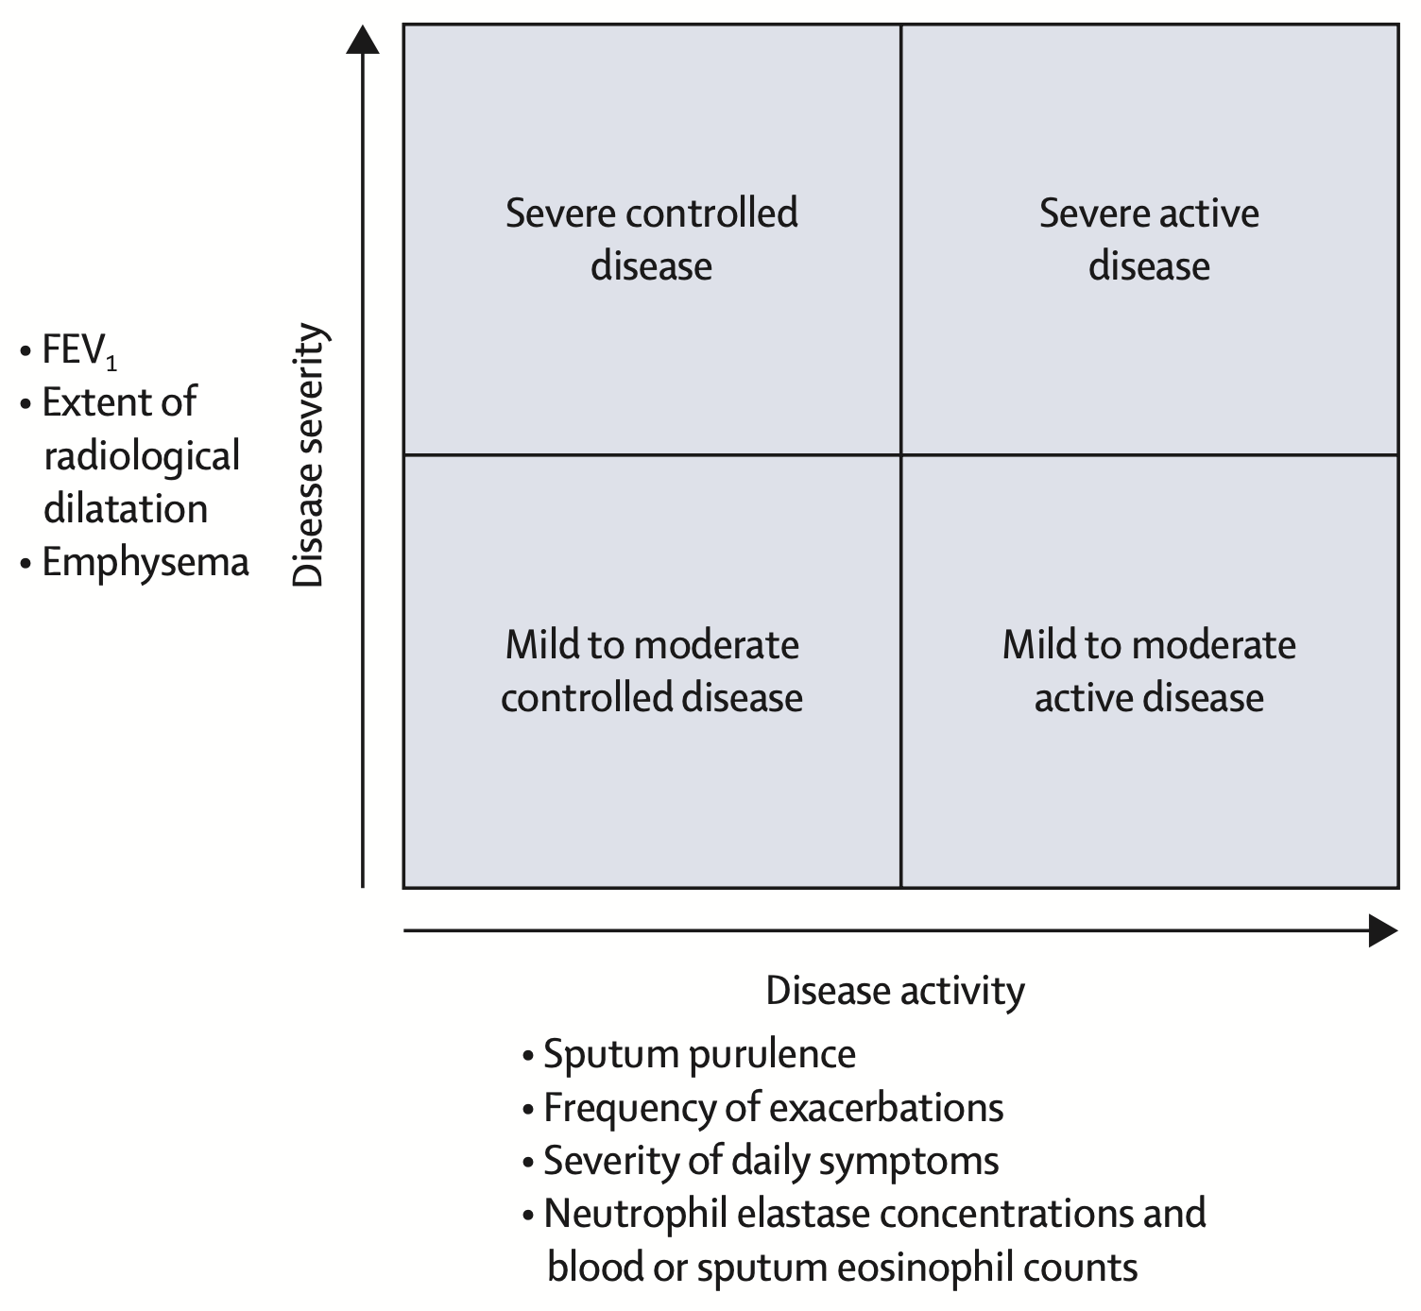
Disease severity vs. disease activity
Bronchiectasis management is currently heavily focused on established late-stage disease in patients with extensive lung destruction and chronic infection with pathogens […] Recognition of bronchiectasis as an inflammatory disease should encourage the development of earlier interventions that can prevent disease progression.
Long MB et al. Lancet Respir Med. 2024;12(11):901-914.
Im Y et al. Tuberc Respir Dis (Seoul). 2025;88(1):109-119
Notes:
Disease severity indices exist for bronchiectasis but are based on features such as age, low FEV₁, radiological extent, and infection, which are predominantly markers of long-term lung damage. Furthermore, these indices are heavily influenced by age and therefore underestimate severity in patients younger than 50 years who might have very active disease. Relying only on severity indices will inevitably lead to under recognition of patients who are young, have mild radiological disease or preserved lung function, but who are at high risk of future disease progression (figure 2). Assessment of the inflammatory status of patients, and therefore disease activity, is possible in routine clinical practice through a combination of clinical and radiological features. Sputum colour is a reflection of neutrophilic inflammation and is readily assessed at bedside.110 CT evidence of mucus plugging, bronchial wall thickening, and other clinical features (including high levels of chronic bronchitis symptoms and frequent exacerbations) can indicate patients with high levels of inflammation in clinical practice (figure 2)

Slide 9
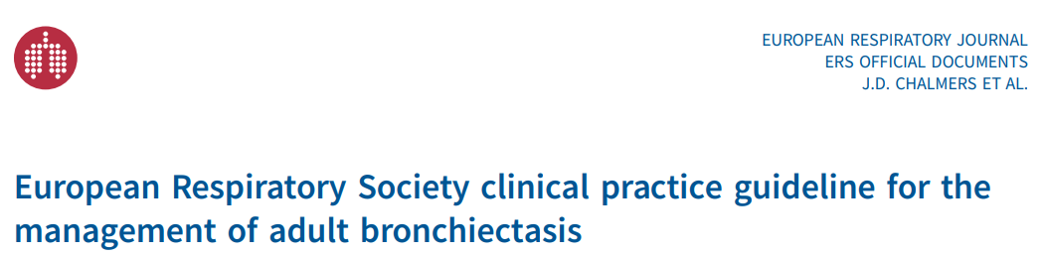
L’importanza dell’attività di malattia
Patients at high risk of future exacerbation:
⩾2 exacerbations per year
1 exacerbation per year plus severe symptoms
⩾1 severe exacerbation requiring hospitalisation per year
Establishing clear definitions of disease activity and disease control will be helpful in future to guide treatment strategies.
Chalmers JD et al. Eur Respir J. 2025;66(6):2501126. Published 2025 Dec 18.

Slide 10
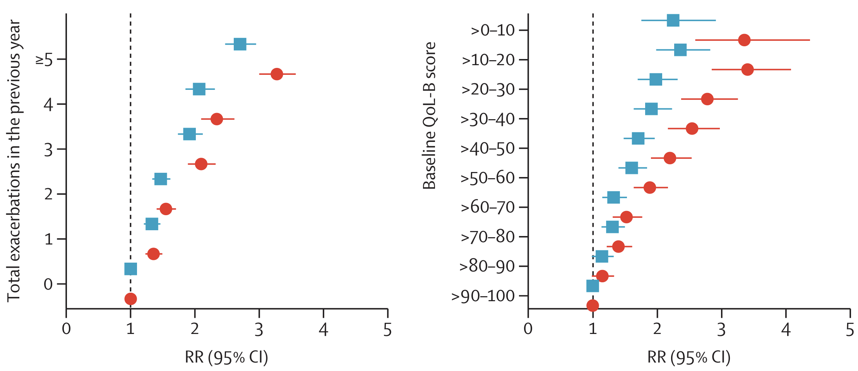
L’importanza dell’attività di malattia
Symptoms are an independent risk factor for future exacerbations
EMBARC registry (n=9466)
Patients with no or minimal exacerbations with high symptoms show comparable risk to those with frequent exacerbations and average symptoms
Patients who are highly symptomatic derive a similar benefit from macrolide treatment as patients with a high baseline exacerbation frequency (post-hoc BLESS, BAT, and EMBRACE RCTs)
Sibila O et al. Symptoms, risk of future exacerbations, and response to long-term macrolide treatment in bronchiectasis: an observational study. Lancet Respir Med. 2025
Notes:
The current wording of the recommendation reflects the understanding that the number of exacerbations in the previous year is an important risk factor for future exacerbations but is not the only risk factor [8, 46, 47, 51, 95]. Patients with a high burden of daily symptoms are also at high risk of future exacerbations, and the threshold to commence long-term treatments may be lower in patients with other important prognostic features [51, 55]. Clinical features associated with a higher risk of future exacerbations include P. aeruginosa infection, PCD, COPD, RA and sputum purulence [35, 36, 52, 57, 96]. The present recommendation, therefore, suggests that patients with ⩾2 exacerbations are likely to be at high risk of future exacerbations, but that some patients with a lower number of exacerbations with a high symptom burden may also benefit from preventative treatment. The threshold to commence treatment should be individualised taking into account the key risk factors in each individual patient as well as considerations around the risk–benefit balance, availability, cost and the burden of treatment.

Slide 11
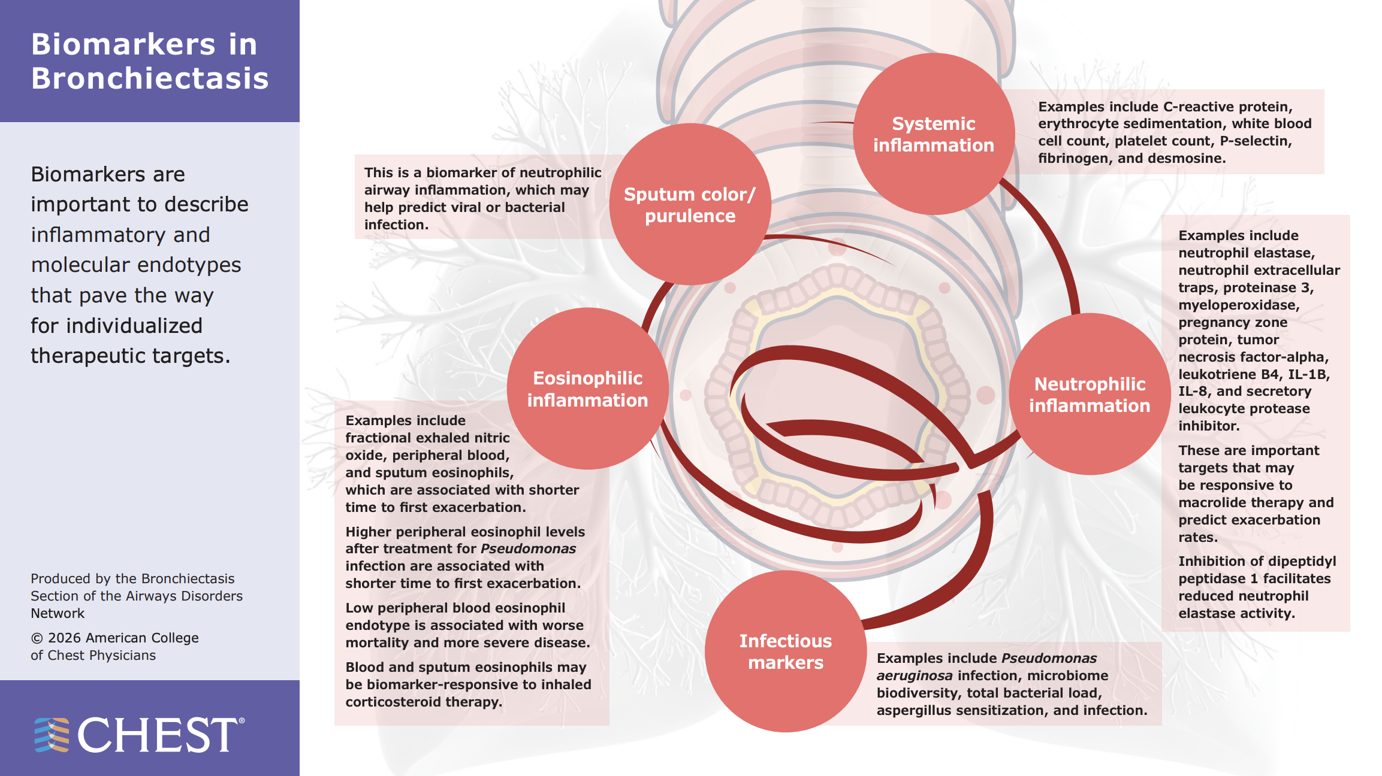

Slide 12
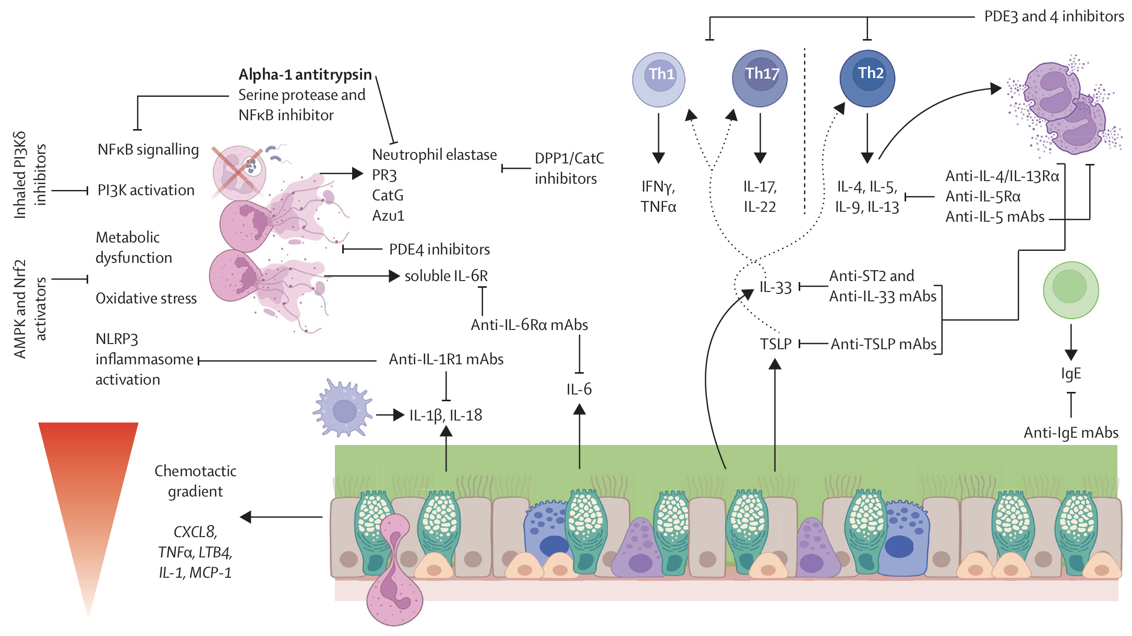
Target infiammatori nelle bronchiectasie
Long MB et al. Lancet Respir Med. 2024;12(11):901-914.
Notes:
Given the heterogeneity of causes, clinical manifestations, and treatment responses in bronchiectasis,16 it is unsurprising that several inflammatory endotypes (disease subtypes defined by distinct biological mechanisms and profiles) have been identified in bronchiectasis. A previous study identified four inflammatory endotypes:
milder neutrophilic inflammation with lower inflammatory marker concentrations and exacerbation rates and lesser airway microbiome dysbiosis;
mixed neutrophilic and Th2 inflammation (characteristic markers included IL-5, IL-8, and NE);
severe neutrophilic inflammation (eg, IL-8, NE, NETs), which were both associated with increased exacerbation risk and Pseudomonas infection; and
mixed epithelial and Th2 inflammation (eg, IL-5, MCP-1, IL-6, and VEGF) associated with Streptococcus-dominated microbiome and the presence of systemic inflammation.72 These links between specific inflammatory endotypes, infections, and outcomes are supported by previous evidence of associations with NE and microbial infections, and worse outcomes, as well as severe disease in those with eosinophilia but with a different microbiome profile.

Slide 13
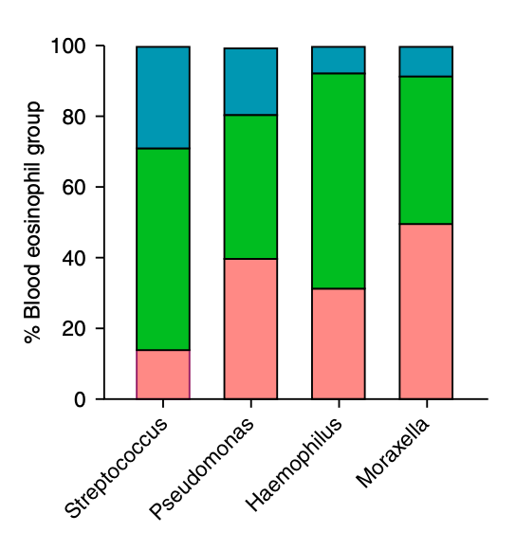
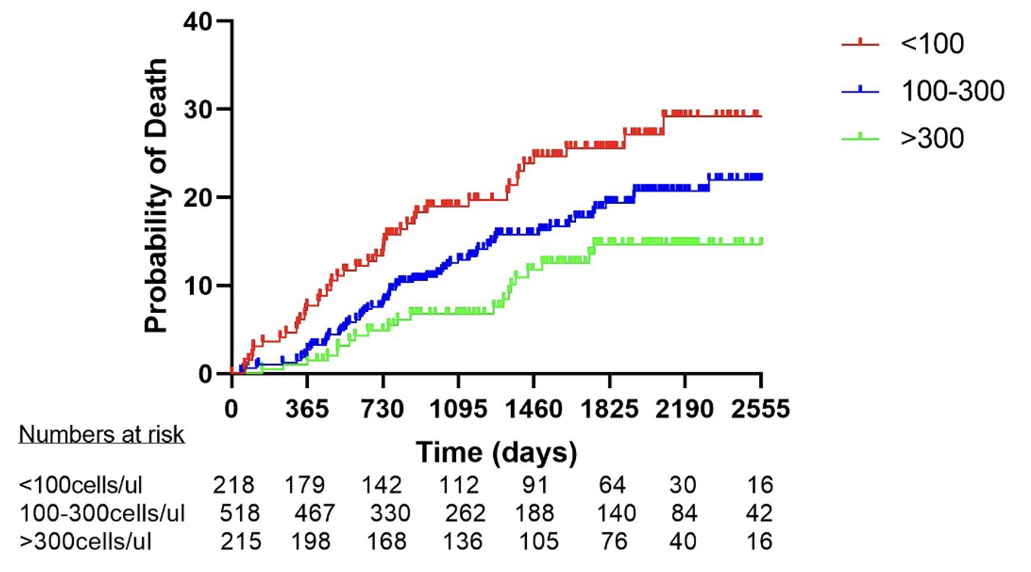
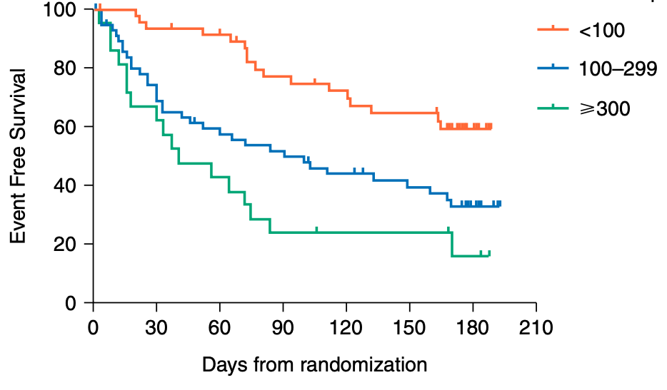
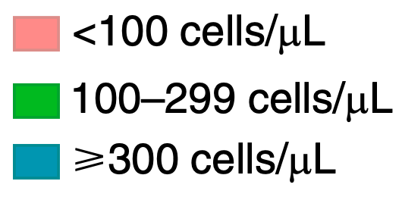
Infiammazione eosinofila
n=1007, di cui 22.6% eosinofili ≥ 300 cells/μl in assenza di asma e altre condizioni (es. ABPA)
Eosinofili <100 cells/μl si associano con maggiore gravità delle bronchiectasie e maggiore mortalità
Eosinofili ≥300 cells/μl si associano con microbioma dominato da Streptococco e Pseudomonas
Dopo trattamento anti-Pseudomonas (n=144), eosinofili correlano con minor tempo alla riacutizzazione
Shoemark A et al. Characterization of Eosinophilic Bronchiectasis: A European Multicohort Study. Am J Respir Crit Care Med. 2022

Slide 14
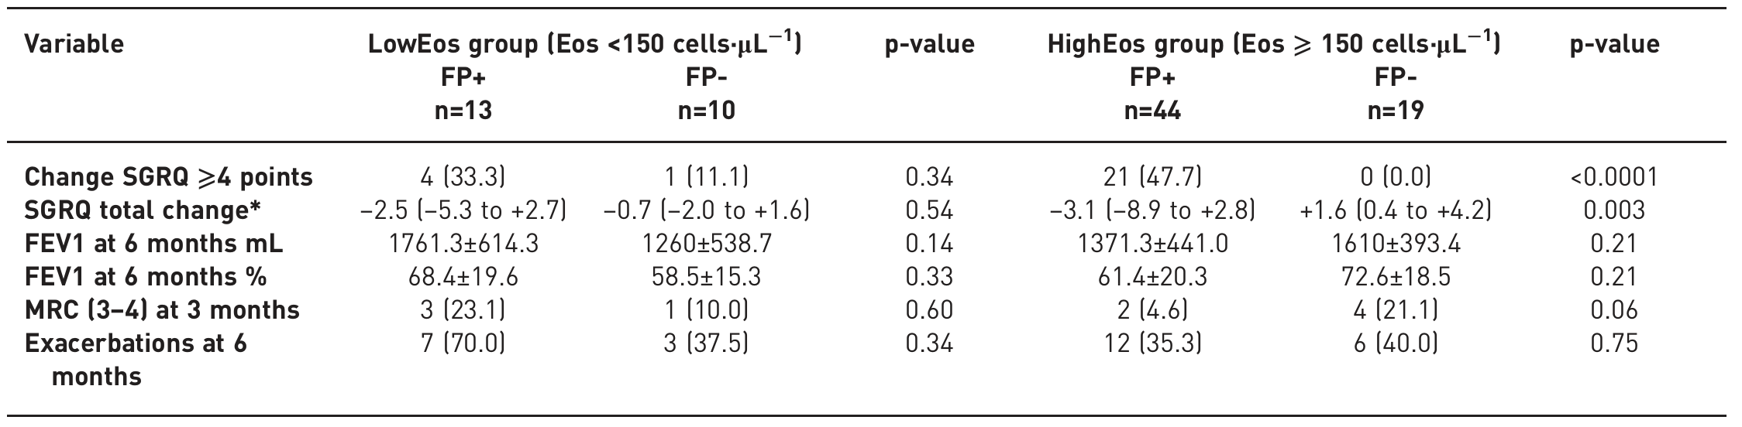
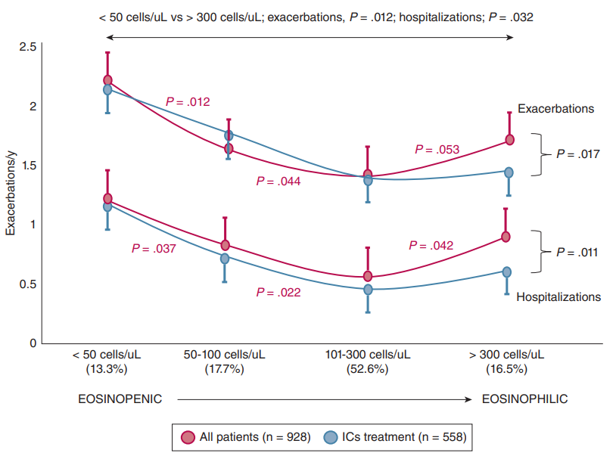

Ruolo degli ICS
There is limited evidence suggesting that ICS may be beneficial in improving quality of life and reducing exacerbations in a subset of individuals with elevated blood eosinophils whom do not have asthma or other eosinophilic conditions, but these data are from post hoc analyses and observational studies only and prospective trials are needed […]
Aliberti S et al. Blood eosinophils predict inhaled fluticasone response in bronchiectasis. Eur Respir J. 2020
Martínez-García MÁ et al. Chest. 2023;164(3):606-613.

Slide 15
Ruolo degli ICS
We suggest not to offer long term inhaled corticosteroids to patients with bronchiectasis who do not have coexisting COPD or asthma […]
The presence of bronchiectasis does not alter them recommendation to use inhaled corticosteroids (ICS) in patients with asthma […]
The use of ICS should be reevaluated in patients without a clear indication. Discontinuation of ICS may be appropriate in some patients.
Chalmers JD et al. European Respiratory Society Clinical Practice Guideline for the Management of Adult Bronchiectasis. Eur Respir J. 2025

Slide 16

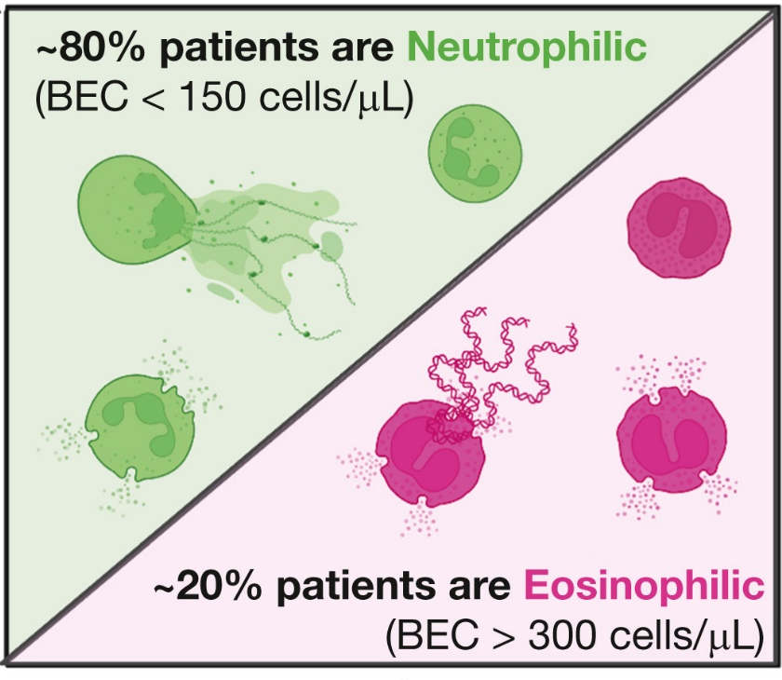
Asma e bronchiectasie
Sintomi comuni (tosse, espettorato, riacutizzazioni) possono complicare la DD
Bronchiectasie
Asma
~ 30% presenta asma concomitante
infiammazione neutrofila prevalente ma in ~20% dei casi infiammazione eosinofila
~ 5-70% presenta bronchiectasie concomitanti (▲in asma grave)
infiammazione eosinofila prevalente (~60%), ma sottogruppo con infiammazione neutrofila (forme più gravi, ridotta risposta ai corticosteroidi, maggiore rischio infettivo e alterazioni del microbiota)
Cause/comorbidità comuni: RGE, deficit immunitario (es. CVID), rinosinusite cronica, ABPA
Matsumoto H. Bronchiectasis in severe asthma and asthmatic components in bronchiectasis. Respir Investig. 2022
Crimi C et al. The Link between Asthma and Bronchiectasis: State of the Art. Respiration. 2020
Notes:
Overlap between the two diseases is common. Around 20% of patients with bronchiectasis display eosinophilic inflammation, 34% show wheezing, and 7–46% have comorbid asthma. Conversely, 25–68% of patients with severe asthma have coexisting bronchiectasis. Two main bronchiectasis phenotypes are observed in this context: eosinophilic bronchiectasis and chronic infectious bronchiolitis/bronchiectasis. A classic example of the eosinophilic phenotype is allergic bronchopulmonary aspergillosis (ABPA).
L’ingombro bronchiale è tratto trattabile sia nell’asma+b che nelle b+asma perché aumenta l’incidenza di riacutizzazioni

Slide 17
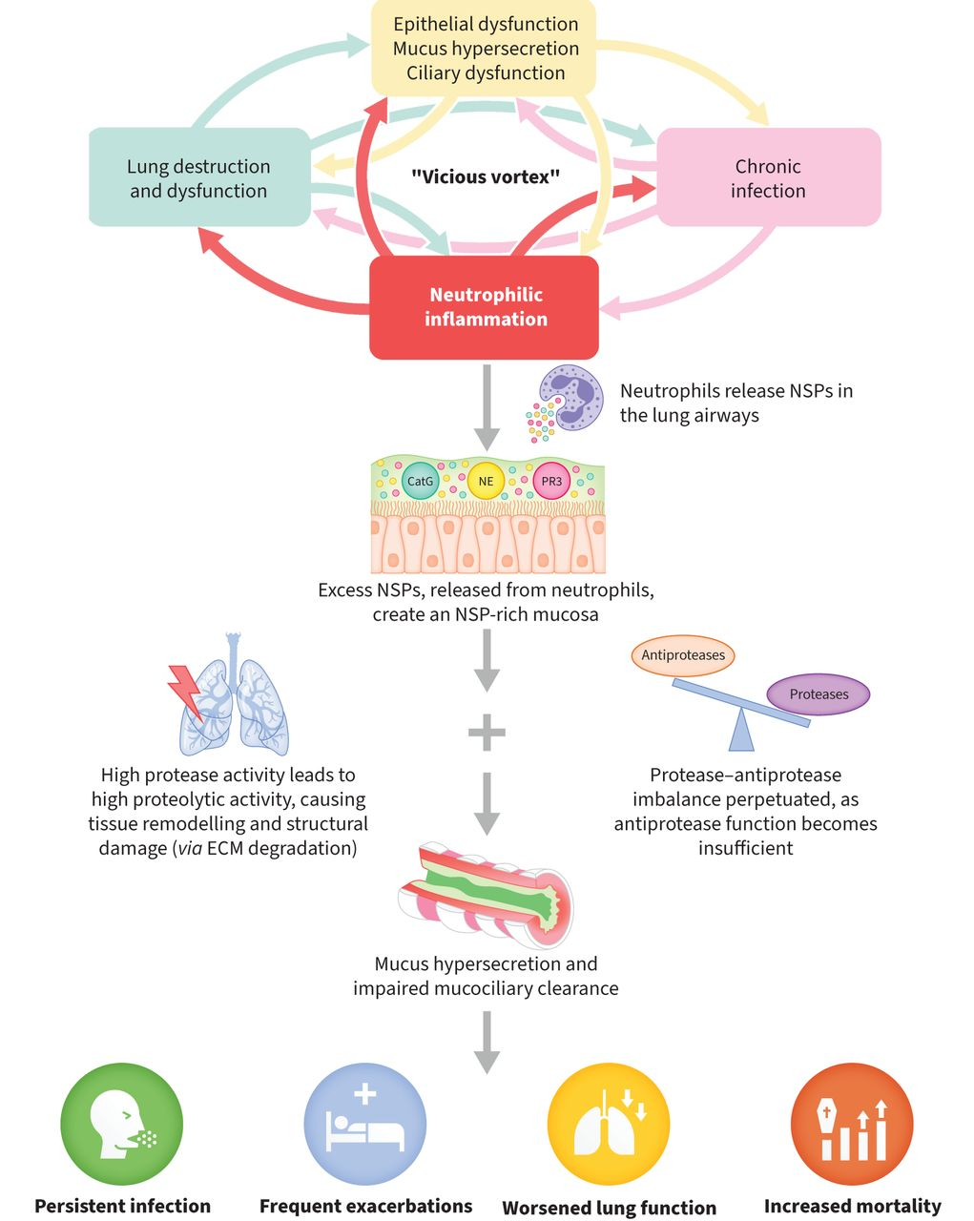
Infiammazione neutrofilica nelle bronchiectasie
Principali serin-proteasi attivate:
Elastasi neutrofila (NE)
Proteinasi 3 (PR3)
Catepsina G (CatG)
Chalmers JD et al. Eur Respir J. 2025;65(1):2401050
Notes:
The imbalance between neutrophil serine proteases (NSPs) (neutrophil elastase (NE), proteinase 3 (PR3) and cathepsin G (CatG)) and their antiproteases, as caused by neutrophilic inflammation, can promote and maintain a pathogenic environment in the bronchiectasis lung. High NSP activity can affect multiple components of the “vicious vortex” in bronchiectasis, impairing mucociliary clearance, promoting infection and degrading functional lung tissue in the process. Sustained and unresolved, these effects are known to contribute to pulmonary exacerbations, which are critical events in bronchiectasis that are highly associated with mortality. In turn, worsened disease promotes more inflammation, forming a cycle of health deterioration with associated morbidity and mortality. Cathepsin C (CatC) inhibition may be the most appropriate intervention point in this cycle, since inhibition of CatC may suppress NSP activity, thereby suppressing the persistent neutrophilic inflammation seen in bronchiectasis.

Slide 18
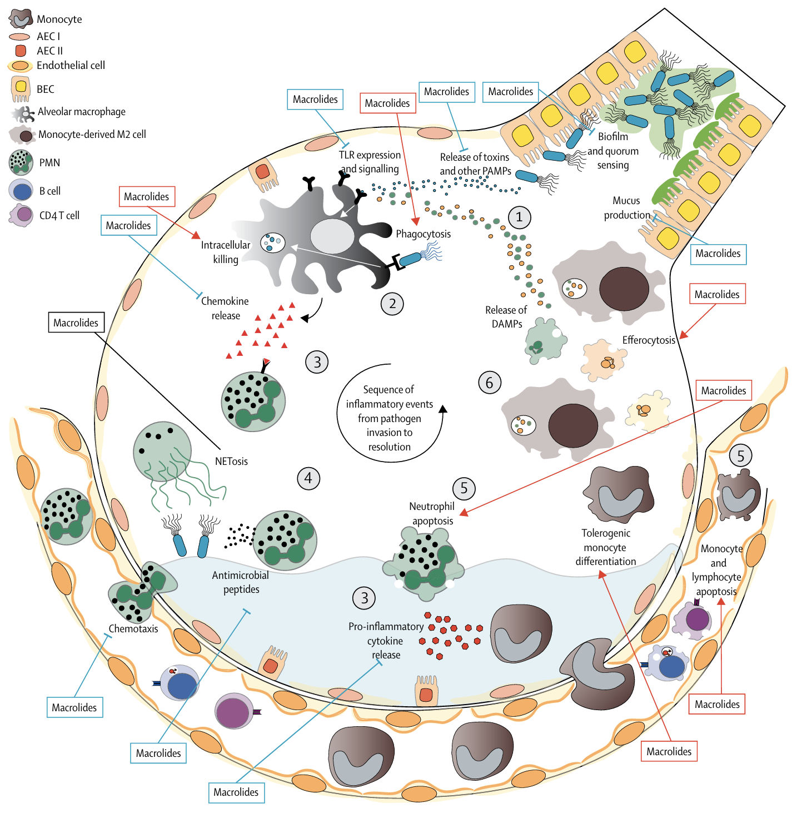
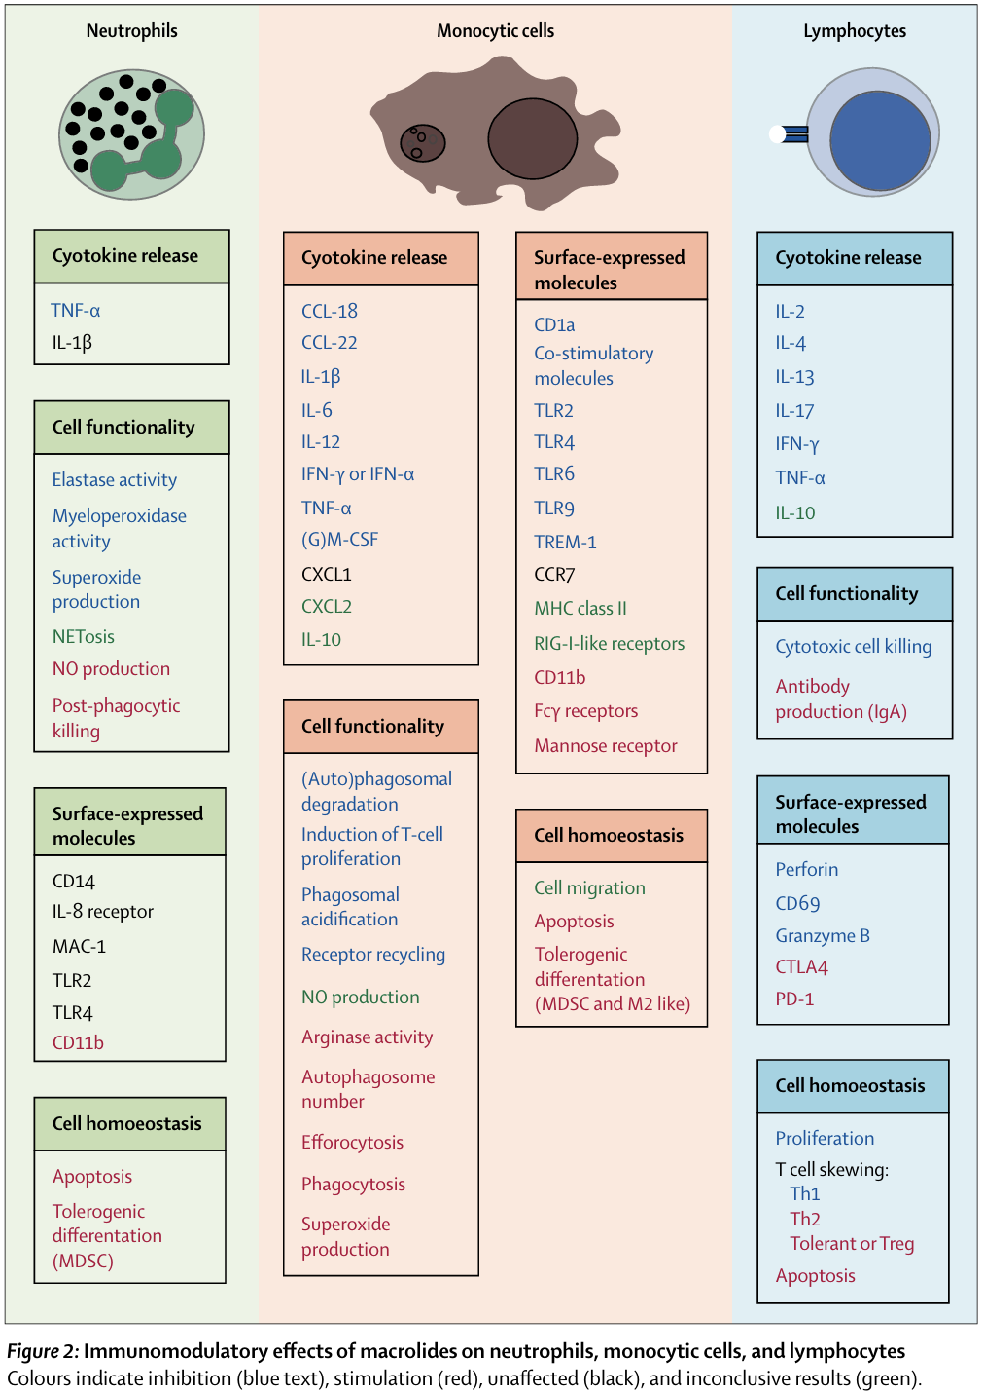
Effetto immunomodulante dei macrolidi
Reijnders TDY et al. Immunomodulation by macrolides: therapeutic potential for critical care. Lancet Respir Med. 2020
Notes:
Long-Term Macrolides
Mechanistic Rationale
After the landmark paper by Kudoh et al in 1998, which first proposed the use of macrolides as anti-inflammatory agents for treating diffused panbronchiolitis, the molecular rationale of this treatment has been broadly explored⁶ Over the years, macrolides have proved to be effective in modulating inflammation by disrupting pro-inflammatory signaling pathways of airway epithelial cells, monocytes, macrophages, and dendritic cells. At the intracellular level, they inhibit key signaling cascades such as Nuclear Factor kappa B (NF-κB), Extracellular signal-Regulated Kinase (ERK1/2), and c-Jun N-terminal Kinase (JNK), thereby reducing transcription and release of pro-inflammatory cytokines such as interleukin-1 beta (IL-1β), interleukin-6 (IL-6), interleukin-8 (IL-8), and tumor necrosis factor-alpha (TNF-α).^{7,8} They can also impair pattern recognition receptor (PRR) signaling by reducing toll-like receptor (TLR) surface expression in dendritic cells and macrophages and they can hamper inflammasome activation by inhibiting endosome acidification.^{8,9} From an extracellular perspective, macrolides decrease neutrophil chemotaxis and infiltration by inhibiting the production of chemokines, adhesion molecules, and Granulocyte-Macrophage Colony-Stimulating Factor (GM-CSF).¹⁰ Timely apoptosis of neutrophils is induced, and macrophage differentiation is shifted toward an anti-inflammatory phenotype.⁷ Azithromycin and erythromycin also proved to interfere with the process of Gram-negative bacteria biofilm formation, such as in the case of Pseudomonas aeruginosa. At sub-inhibitory concentrations they suppress the transcription of key quorum sensing genes (lasI, rhlI) decreasing the production of Acyl-Homoserine Lactone (AHL), which determines population density and coordinates bacterial group behaviors including biofilm formation, production of virulence factors, and antibiotic resistance.¹¹ Finally, by downregulating mucin gene expression (particularly MUC5AC) and reducing goblet cell hyperplasia, they also decrease mucus viscosity and stagnation.¹²
The effects of chronic macrolide therapy go therefore far beyond the simple antimicrobial action and target several pillars of the vicious cycle of bronchiectasis, resulting in a reduction in exacerbation frequency.¹³

Slide 19
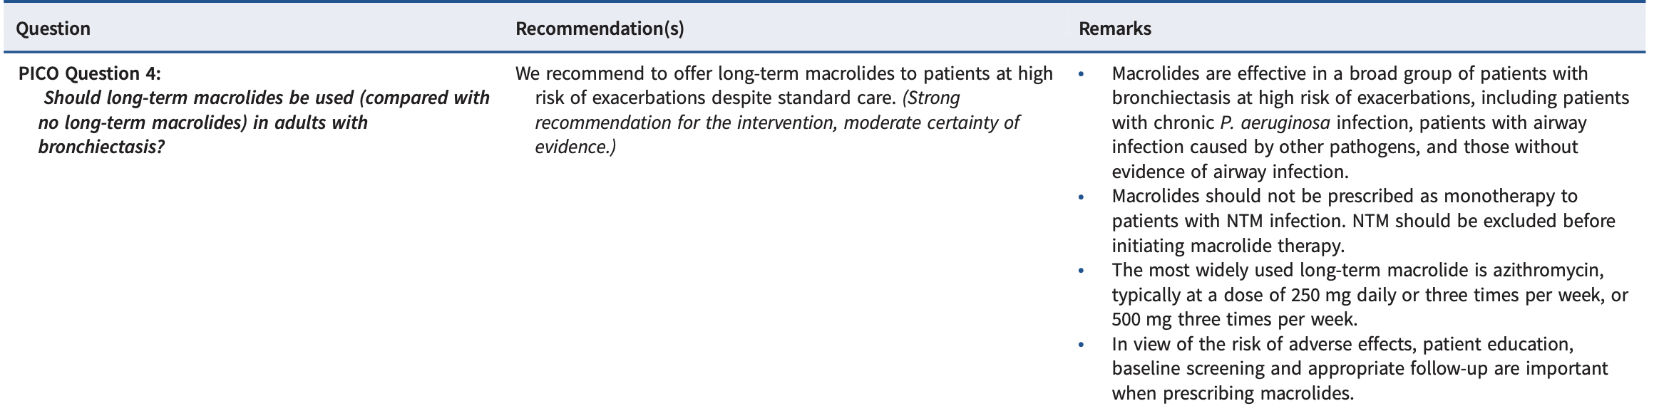
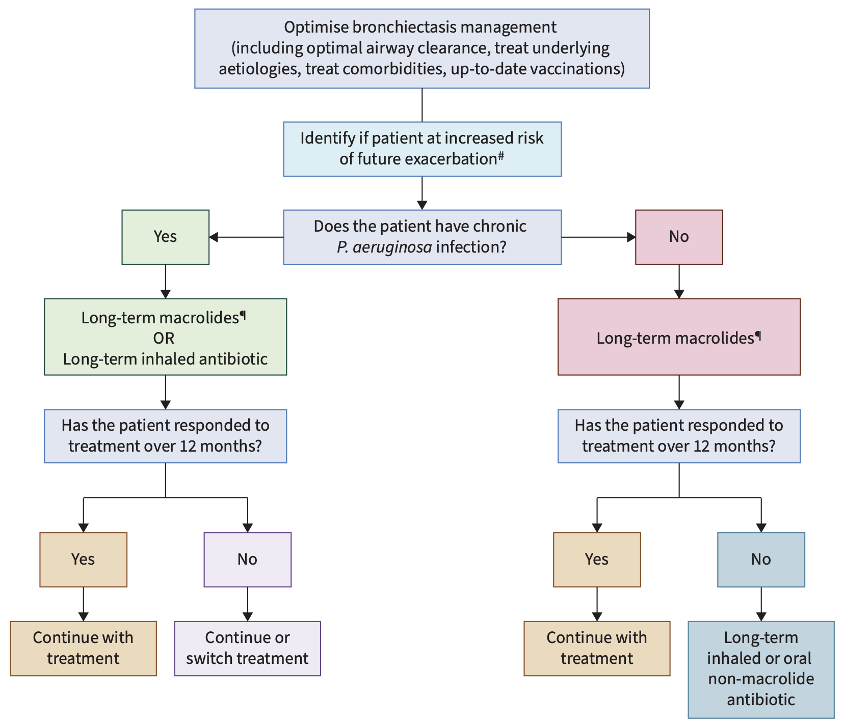
Macrolidi a lungo termine: efficacia e raccomandazioni
  ▼ 52% frequenza riacutizzazioni
  ▼ 36% rischio di nuove riacutizzazioni
  ▲ tempo alla prima riacutizzazione
  ▲ della qualità di vita (SGRQ)
Chalmers JD et al. European Respiratory Society Clinical Practice Guideline for the Management of Adult Bronchiectasis. Eur Respir J. 2025
Notes:
We recommend to offer long-term macrolides to patients at high risk of exacerbations despite standard
care. (Strong recommendation for the intervention, moderate certainty of evidence.)
Macrolides are effective in a broad group of patients with bronchiectasis at high risk of exacerbations,
including patients with chronic P. aeruginosa infection, patients with airway infection caused by other
pathogens and those without evidence of airway infection.
• Macrolides should not be prescribed as monotherapy to patients with NTM infection. NTM infection
should be excluded before initiating macrolide therapy.
• The most widely used long-term macrolide is azithromycin, typically at a dose of 250 mg daily or
three times per week, or 500 mg three times per week.
• In view of the risk of adverse effects, patient education, baseline screening and appropriate follow-up
are important when prescribing macrolides.
We included nine RCTs. Meta-analysis found a significant and highly clinically relevant 52% reduction in
exacerbation frequency/rate (HR 0.48 (95% CI 0.37–0.62)) in those receiving macrolides compared with
those who did not from four randomised trials [100–104]. In five randomised trials, a significant 36%
lower risk of having exacerbations (risk ratio 0.64 (95% CI 0.46–0.89)) was found [100–103, 105, 106].
Two trials reported a significantly longer time to first exacerbation (HR 0.32 (95% CI 0.21–0.47)) [101,
102]. A clinically meaningful, significant improvement in SGRQ total score was found in seven studies,
with an average improvement of 7.26 (MD−7.26 (95% CI−10.94– −3.59)) [100–102, 104, 106–108] in
participants receiving long-term macrolides versus those in the comparator groups. There were no
differences in the frequency of identification of antimicrobial-resistant organisms between participant
groups across two studies (OR 1.08 (95% CI 0.22–5.19)) or in the odds of isolating a new pathogen (OR
0.82 (95% CI 0.41–1.63)) within two trials. In data from six studies, there was no significant increase in
adverse events in those receiving macrolides (OR 0.86 (95% CI 0.53–1.39)) [100–102, 105, 107, 108].

Slide 20
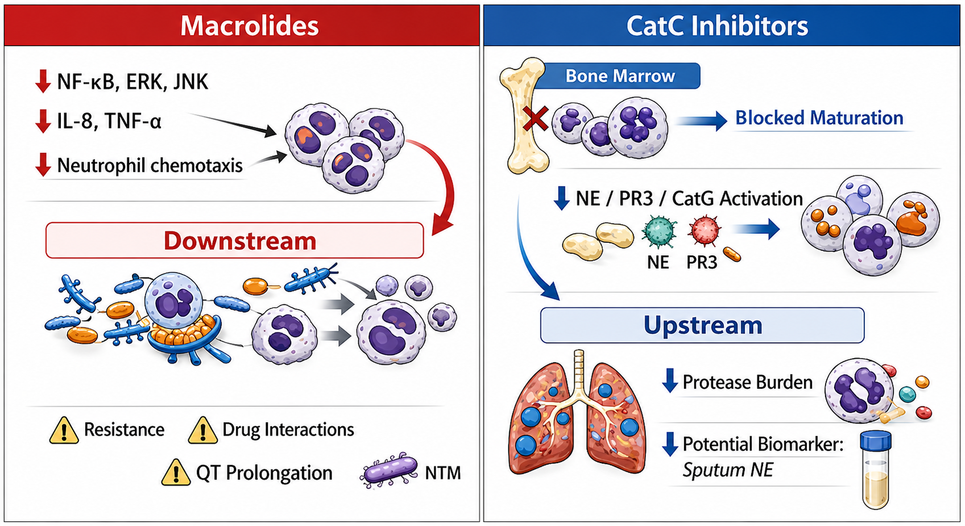

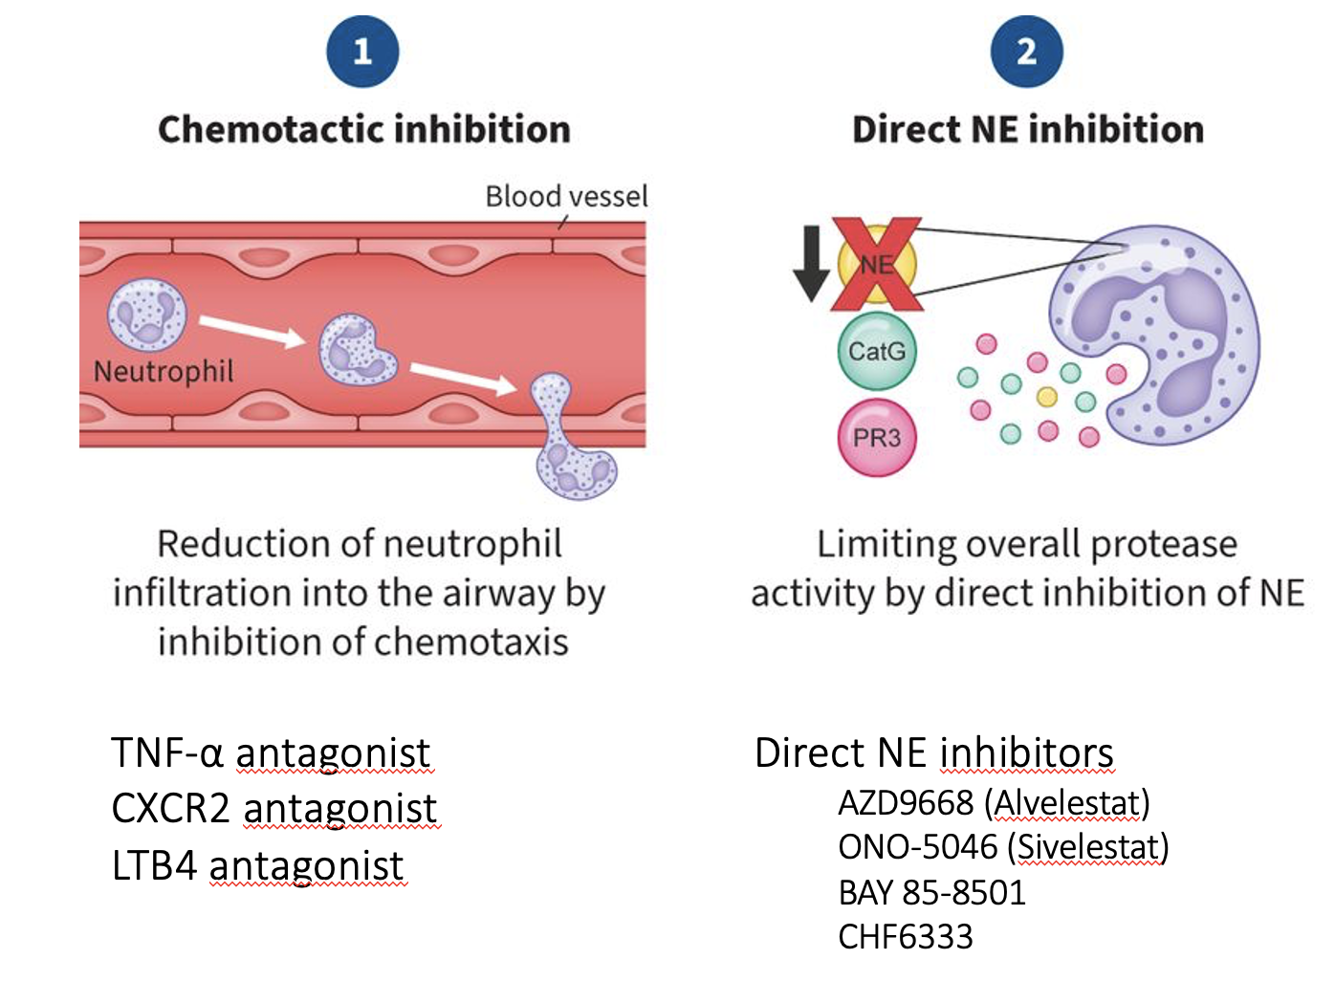
Infiammazione neutrofilica come target: CatC/DPP1 inh
Durante lo sviluppo dei neutrofili, la CatC attiva le
serin-proteasi neutrofile (NSP) contenute nei granuli azzurrofili
CatC/DPP1 inhibitors
▼ elastasi neutrofila (NE)
▼ proteinasi 3 (PR3)
▼ catepsina G (CatG)
→ senza CatC i neutrofili maturano ma contengono enzimi inattivi
Gramegna A. et al. Tackling Neutrophilic Inflammation in Bronchiectasis: From Macrolides to Cathepsin C Inhibitors. Journal of Inflammation Research 2026
Chalmers JD et al. Eur Respir J. 2025;65(1):2401050.
Notes:
Pharmacological strategies that can modulate the inflammatory cascade. Two main therapeutic routes have gained prominence in this context. The first is long-term macrolide therapy, which has established anti-inflammatory and immunomodulatory properties in addition to its antimicrobial actions, and is now recommended for patients at high risk of exacerbations.⁵ More recently, a second approach has emerged: the inhibition of Cathepsin C (CatC - also known as dipeptidyl peptidase 1, DPP-1), an upstream regulator responsible for the activation of NSPs. By targeting this early step in neutrophil maturation, DPP-1 inhibitors offer a novel, host-directed strategy aimed at reducing the proteolytic burden that contributes to airway injury.

Slide 21
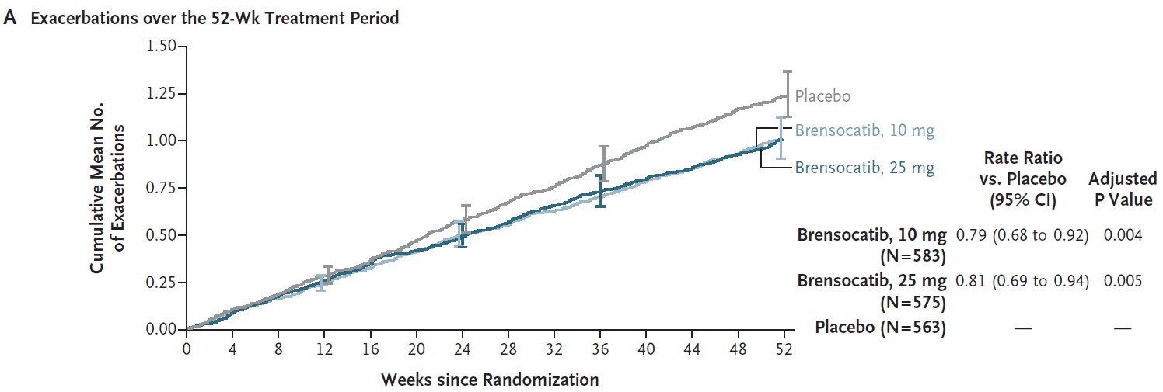
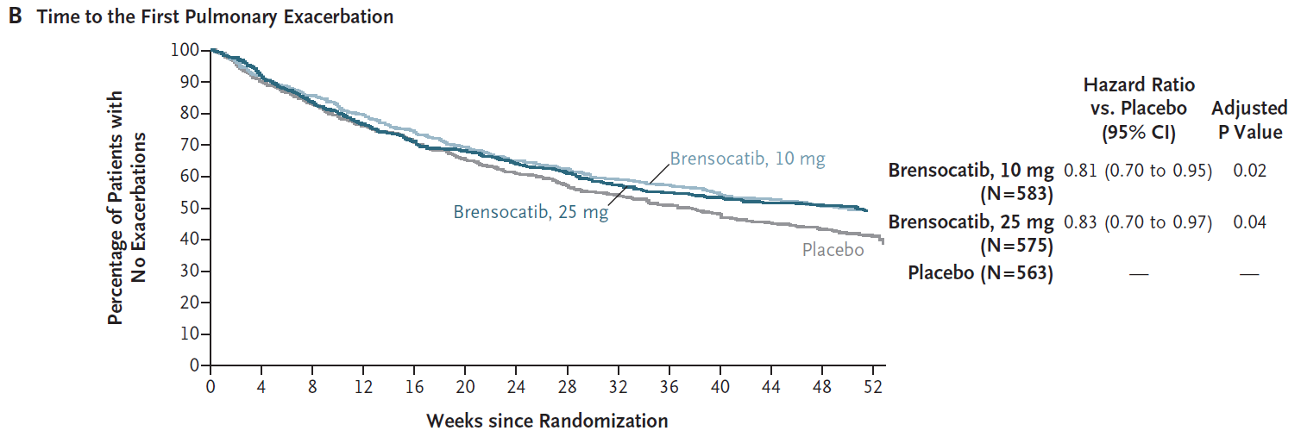

Infiammazione neutrofilica come target - ASPEN RCT
Chalmers JD et al. Phase 3 Trial of the DPP-1 Inhibitor Brensocatib in Bronchiectasis. N Engl J Med. 2025
Notes:
A total of 1721 patients (1680 adults and 41 adolescents) underwent randomization and received brensocatib or placebo. The annualized rate of pulmonary exacerbations was 1.02 in the 10-mg brensocatib group, 1.04 in the 25-mg brensocatib group, and 1.29 in the placebo group (rate ratio, brensocatib vs. placebo, 0.79 [95% confidence interval {CI}, 0.68 to 0.92; adjusted P=0.004] with the 10-mg dose and 0.81 [95% CI, 0.69 to 0.94; adjusted P=0.005] with the 25-mg dose). The hazard ratio for the time to the first exacerbation was 0.81 (95% CI, 0.70 to 0.95; adjusted P=0.02) with the 10-mg dose and 0.83 (95% CI, 0.70 to 0.97; adjusted P=0.04) with the 25-mg dose. In each brensocatib group, 48.5% of patients remained exacerbation-free at week 52, as compared with 40.3% in the placebo group (rate ratio, 1.20 [95% CI, 1.06 to 1.37; adjusted P=0.02] with the 10-mg dose and 1.18 [95% CI, 1.04 to 1.34; adjusted P=0.04] with the 25-mg dose). At week 52, FEV₁ had declined by 50 ml with the 10-mg dose, 24 ml with the 25-mg dose, and 62 ml with placebo (least-squares mean difference vs. placebo, 11 ml [95% CI, −14 to 37; adjusted P=0.38] with the 10-mg dose and 38 ml [95% CI, 11 to 65; adjusted P=0.04] with the 25-mg dose). The incidence of adverse events was similar across groups, except for a higher incidence of hyperkeratosis with brensocatib.

Slide 22
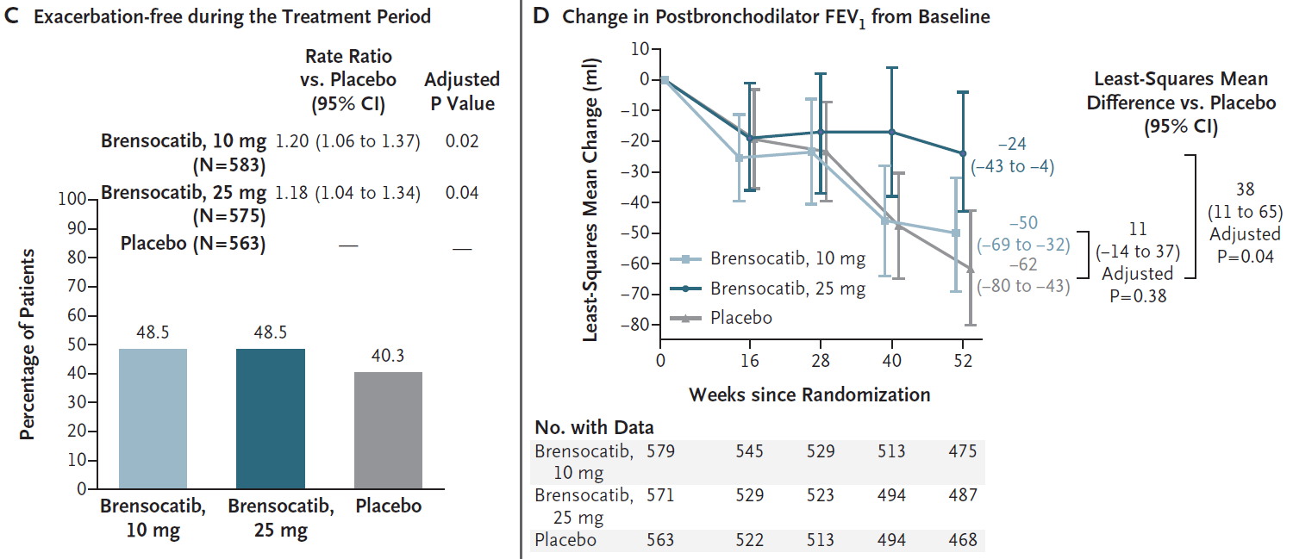

Infiammazione neutrofilica come target - ASPEN RCT
Chalmers JD et al. Phase 3 Trial of the DPP-1 Inhibitor Brensocatib in Bronchiectasis. N Engl J Med. 2025
Notes:
A total of 1721 patients (1680 adults and 41 adolescents) underwent randomization and received brensocatib or placebo. The annualized rate of pulmonary exacerbations was 1.02 in the 10-mg brensocatib group, 1.04 in the 25-mg brensocatib group, and 1.29 in the placebo group (rate ratio, brensocatib vs. placebo, 0.79 [95% confidence interval {CI}, 0.68 to 0.92; adjusted P=0.004] with the 10-mg dose and 0.81 [95% CI, 0.69 to 0.94; adjusted P=0.005] with the 25-mg dose). The hazard ratio for the time to the first exacerbation was 0.81 (95% CI, 0.70 to 0.95; adjusted P=0.02) with the 10-mg dose and 0.83 (95% CI, 0.70 to 0.97; adjusted P=0.04) with the 25-mg dose. In each brensocatib group, 48.5% of patients remained exacerbation-free at week 52, as compared with 40.3% in the placebo group (rate ratio, 1.20 [95% CI, 1.06 to 1.37; adjusted P=0.02] with the 10-mg dose and 1.18 [95% CI, 1.04 to 1.34; adjusted P=0.04] with the 25-mg dose). At week 52, FEV₁ had declined by 50 ml with the 10-mg dose, 24 ml with the 25-mg dose, and 62 ml with placebo (least-squares mean difference vs. placebo, 11 ml [95% CI, −14 to 37; adjusted P=0.38] with the 10-mg dose and 38 ml [95% CI, 11 to 65; adjusted P=0.04] with the 25-mg dose). The incidence of adverse events was similar across groups, except for a higher incidence of hyperkeratosis with brensocatib.

Slide 23
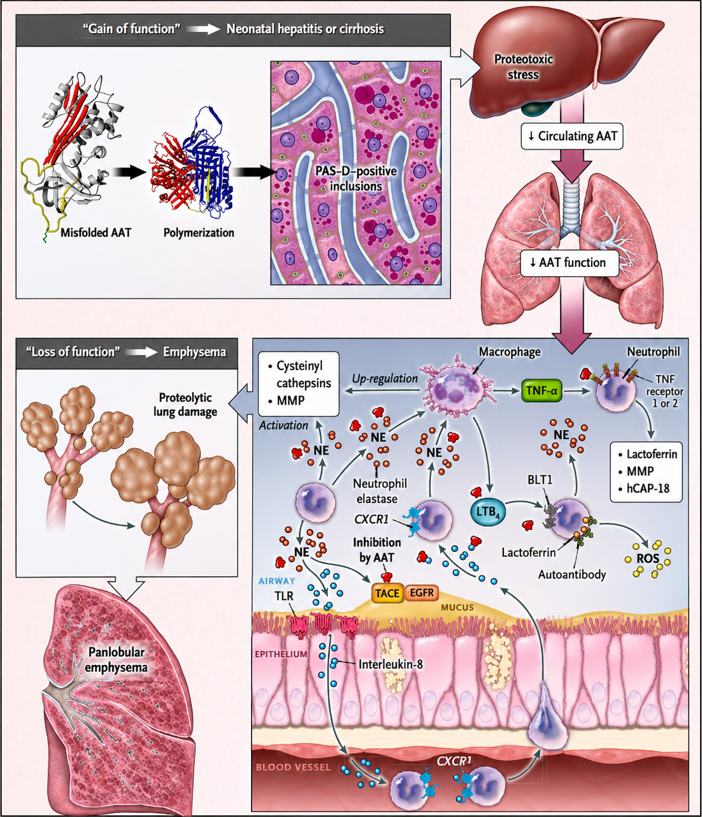
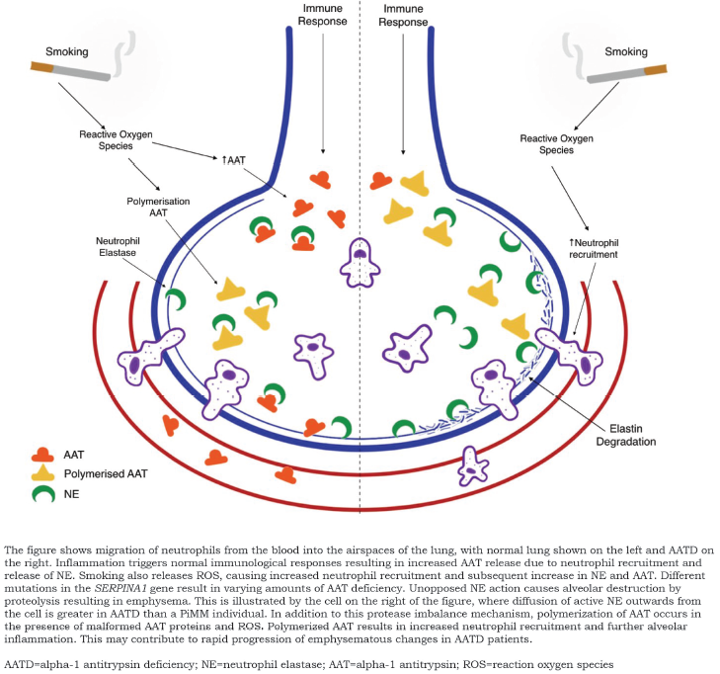
Deficit di alfa-1 AT
95
Asn
Asn
46
41
356
357
173
His
Ile
Pro
358
Ser
88
Met
Asp
359
Ser
144
360
Asn
361
Ile
247
Pro
Asn
NE
AAT
Asn
83
2
AAT is the prototype of the endogenous inhibitor of serine proteases such as neutrophil elastase (NE)
AAT is present in lung tissue, with extracellular lung fluid levels of about 10% serum concentration
AAT deficiency would promote bronchial wall inflammation and damage, leading to bronchiectasis
Rangaraju M, Turner AM.. Chronic Obstr Pulm Dis. 2020;7(3):280-289.
Feitosa PHR et al. Recommendations for the diagnosis and treatment of alpha-1 antitrypsin deficiency. J Bras Pneumol. 2024
Strnad P, McElvaney NG, Lomas DA. Alpha₁-Antitrypsin Deficiency. N Engl J Med. 2020;382(15):1443-1455.
Notes:
Gli individui con AAT non rilevabile associata a alleli nulli possono sviluppare enfisema, anche in assenza di una storia di fumo, così come quelli con deficit marcato (concentrazioni di AAT < 11 µM) associato agli alleli Z, ai genotipi PiZZ omozigoti o a varianti rare.(3,9) Tuttavia, l’esposizione al fumo di tabacco aumenta il numero di neutrofili e macrofagi nei polmoni e incrementa la produzione di elastasi per singola cellula, accelerando l’insorgenza, la gravità e la progressione dell’enfisema in questi soggetti.(9, 34, 35, 36)
Anche gli individui eterozigoti, in particolare quelli con alleli PiMZ e PiSZ, possono sviluppare enfisema in relazione al grado di esposizione al fumo; sebbene tale rischio sia basso nei non fumatori, rimane tuttora oggetto di dibattito.(31,39) In uno studio su fumatori con AATD,(31) il rischio di BPCO è risultato 5,2 volte più elevato nei soggetti con genotipo PiMZ rispetto a quelli con genotipo PiMM.(31)

Slide 24

Deficit di alfa-1 AT
Routine screening for AATd in bronchiectasis is recommended in patients with early onset airway obstruction or lower lobe predominant emphysema.
Radiographic bronchiectasis is present in 90% of ZZ individuals. There should be a strong index of clinical suspicion for AATd especially in a patient with repeated lower respiratory tract infections whose lung imaging shows bronchiectasis alone with no other pathology and with a positive family history.
AAT augmentation is not indicated in patients with bronchiectasis who have no airflow obstruction as in our case with relatively healthy respiratory reserve.
Sridhar P et Al. Alpha-1 Antitrypsin Deficiency-associated Bronchiectasis Without Emphysema. Chest 2023
Sanduzzi A et al. Alpha-1-Antitrypsin Deficiency and Bronchiectasis: A Concomitance or a Real Association? Int J Environ Res Public Health. 2020
Chalmers JD et al. European Respiratory Society Clinical Practice Guideline for the Management of Adult Bronchiectasis. Eur Respir J. 2025

Slide 25
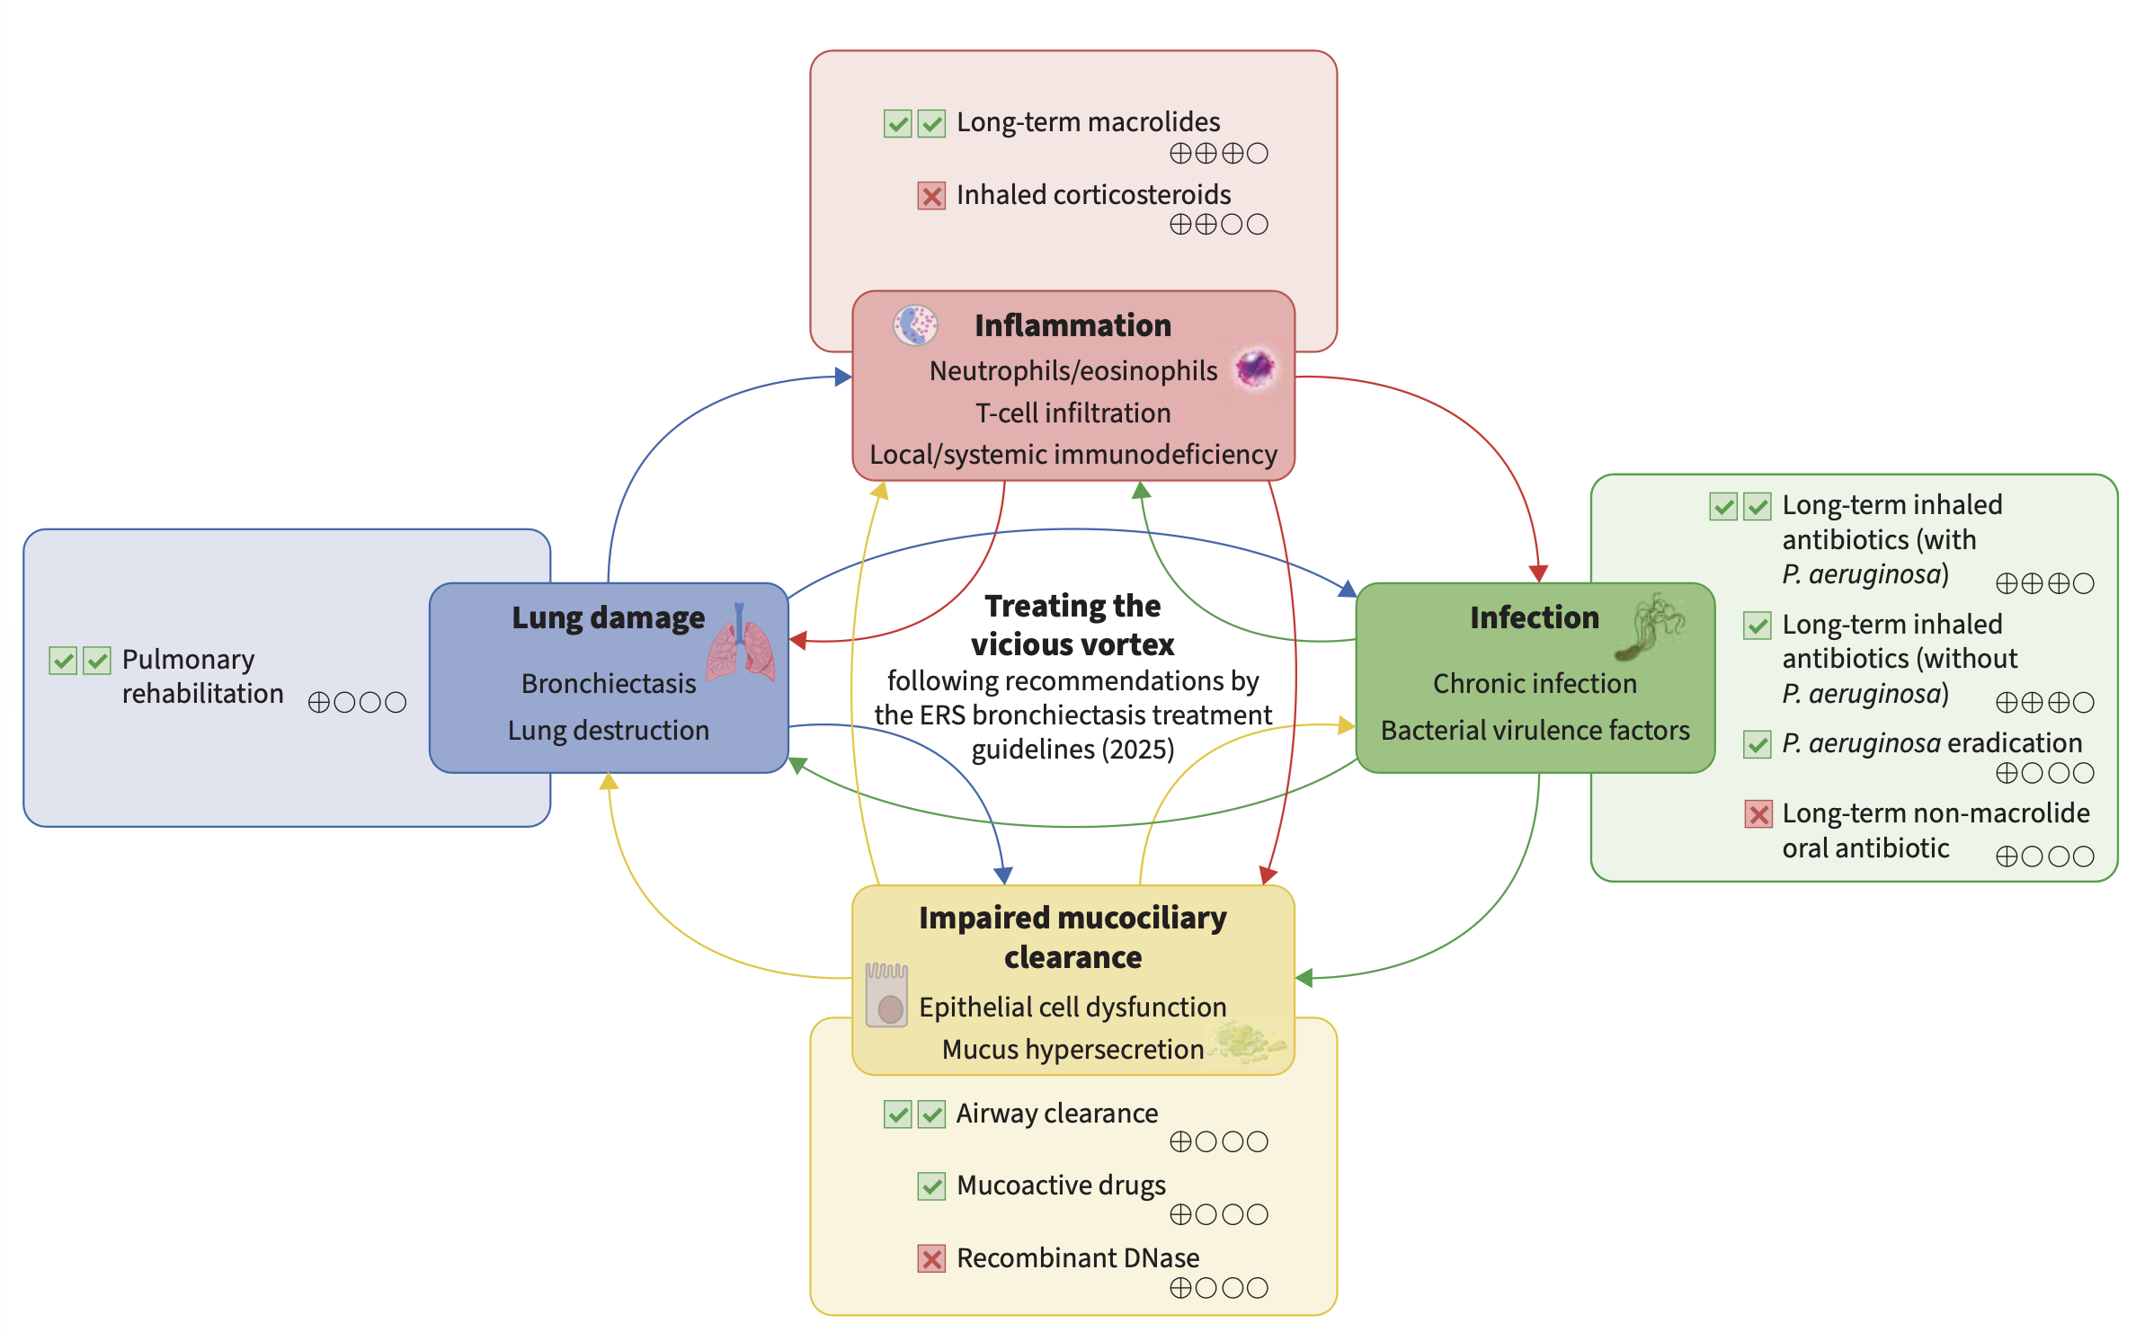

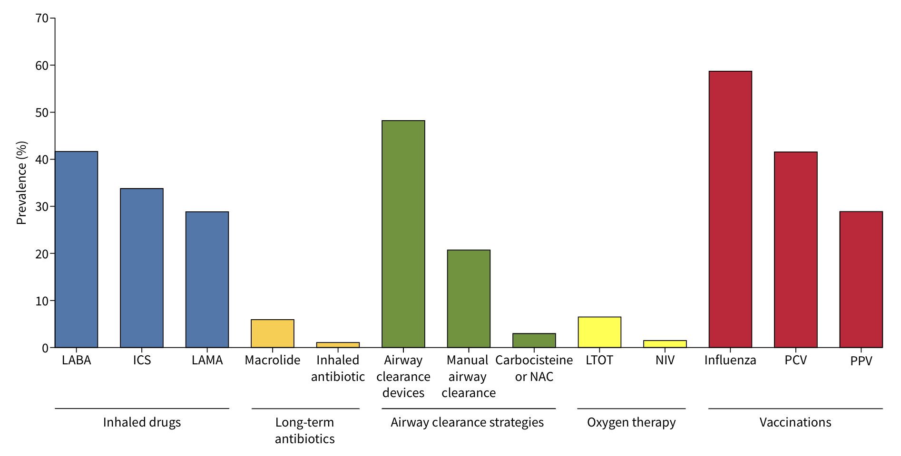
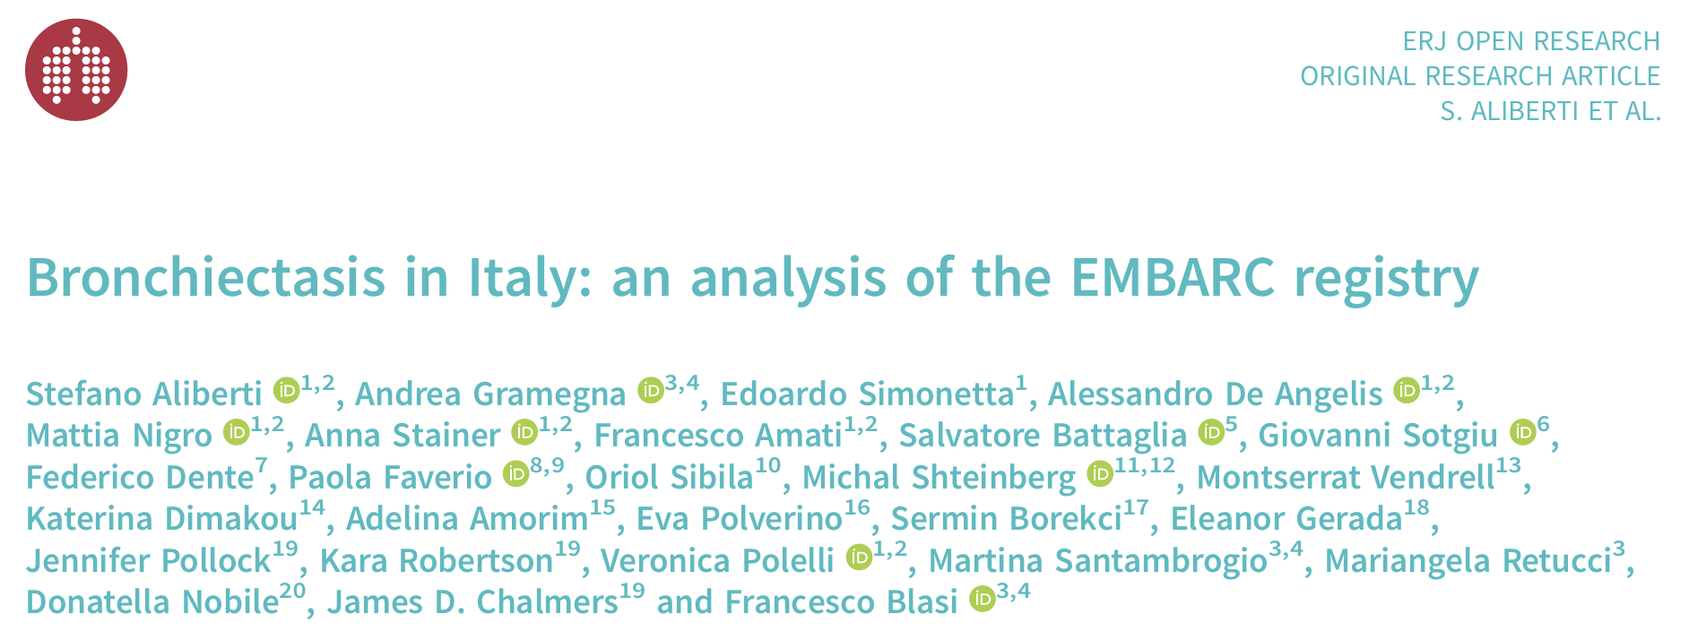
Terapia multimodale e unmet needs

Slide 26
Take-home messages
Le bronchiectasie non-CF non sono (solo) una malattia infettiva, ma una patologia infiammatoria cronica in cui infezione, infiammazione, danno strutturale e alterata clearance mucociliare si autoalimentano nel “vicious vortex”.
La gestione deve spostarsi dalla gravità all’attività di malattia, identificando precocemente i pazienti a rischio di progressione, riacutizzazioni e danno irreversibile.
L’infiammazione è un tratto trattabile, ma non è uguale per tutti: l’endotipizzazione può guidare meglio le scelte terapeutiche.
I macrolidi a lungo termine restano una strategia cardine nei pazienti ad alto rischio di riacutizzazioni, grazie a un effetto che va oltre l’azione antimicrobica e include immunomodulazione, riduzione dell’infiammazione e impatto sul biofilm.
Gli ICS non vanno usati routinariamente, ma possono avere un ruolo nei pazienti con indicazioni concomitanti (es. asma) o in sottogruppi con infiammazione eosinofilica, sempre rivalutando rischio-beneficio.
L’inibizione di CatC/DPP-1 rappresenta il più importante avanzamento terapeutico recente, perché agisce a monte sull’attivazione delle serin-proteasi neutrofile, riducendo il burden proteolitico responsabile del danno bronchiale.
Brensocatib apre un possibile cambio di paradigma, dimostrando che colpire l’infiammazione neutrofilica può ridurre le riacutizzazioni e modificare l’evoluzione clinica della malattia.
La strategia vincente resta una terapia integrata e personalizzata, combinando airway clearance, controllo dell’infezione, trattamento dell’infiammazione e gestione delle comorbidità, con un posizionamento sempre più preciso di ciascun intervento.

Slide 27


You are here

