Slide 1
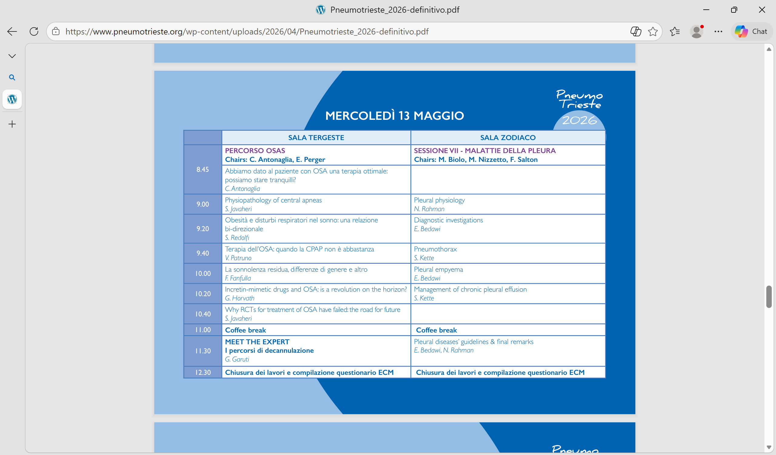

8.50
9.10
9.40
10.00
Gender medice in sleep breathing disorders
E. Perger

Slide 2
Abbiamo dato al paziente con OSA una terapia ottimale: possiamo stare tranquilli?
After providing the patient with optimal OSA treatment:
can we rest assured?

Slide 3

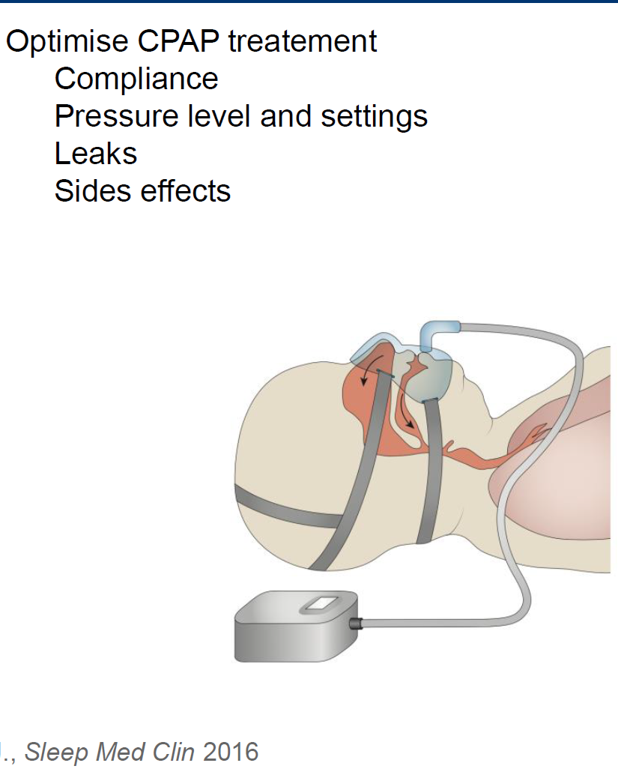
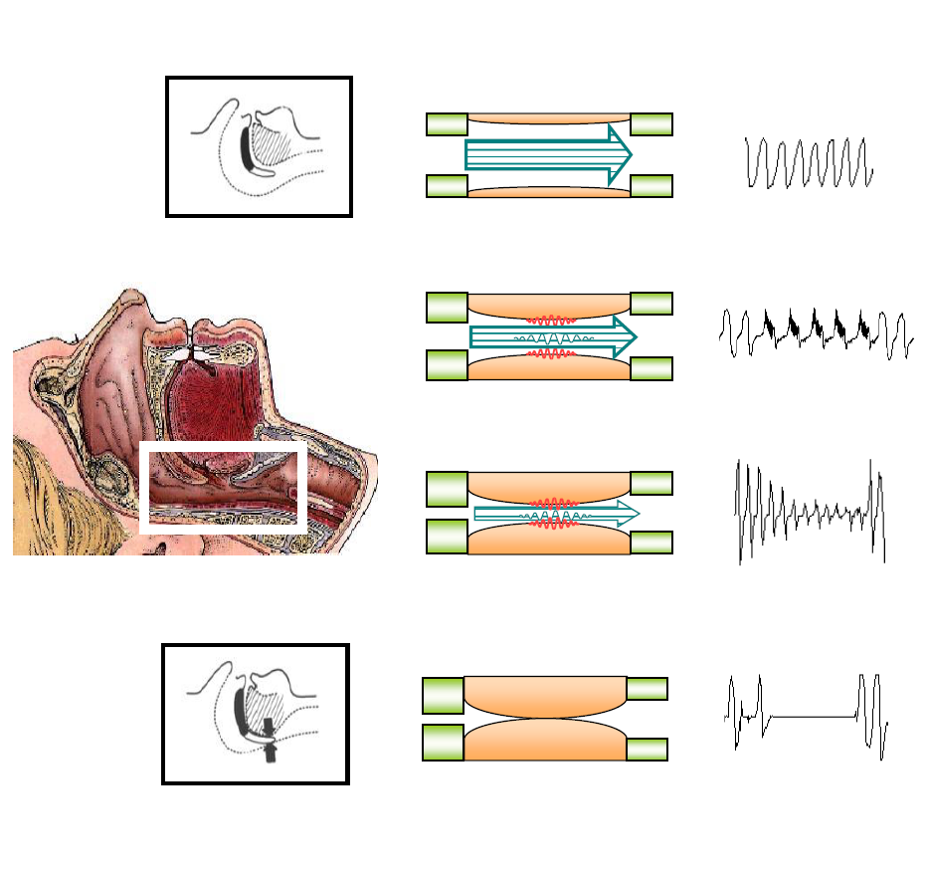
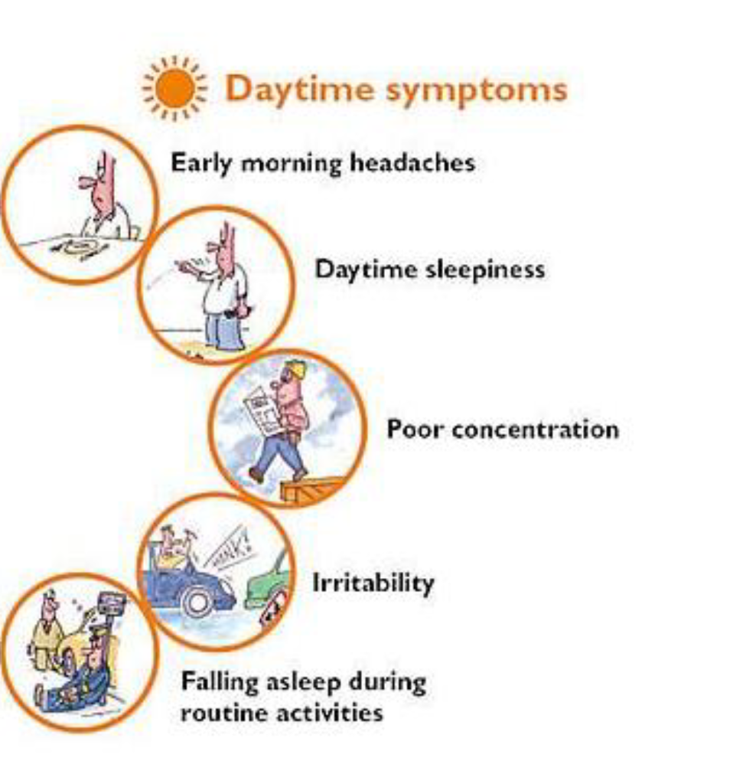

Slide 4
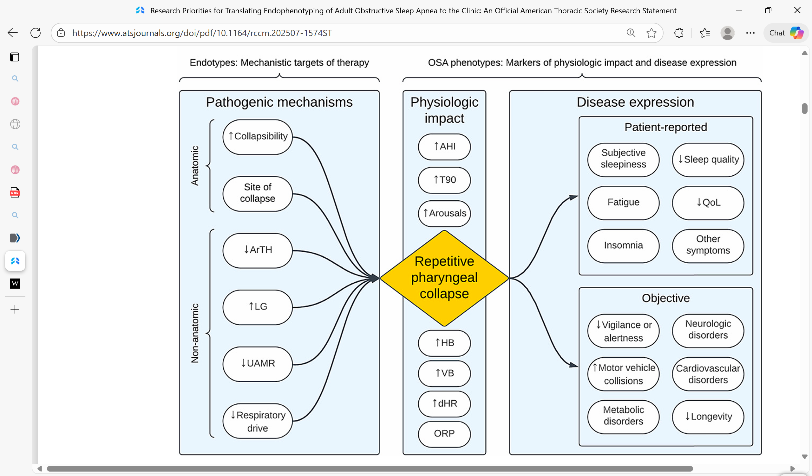
American Journal of Respiratory and Critical Care Medicine Volume 211 Number 9 | September 2025

Slide 5
What does « optimal therapy» mean?
For the patients
Quality of life and quality of sleep

Slide 6

Two sides of the same coin:
quality of life and quality of sleep

Slide 7
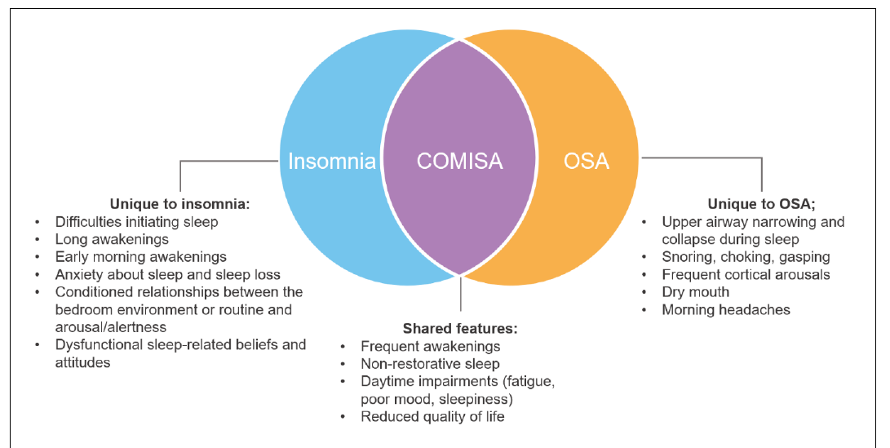
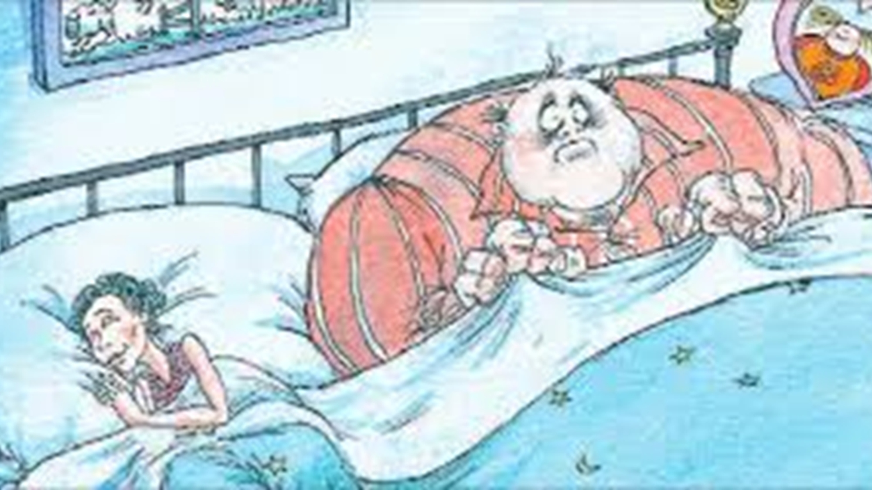
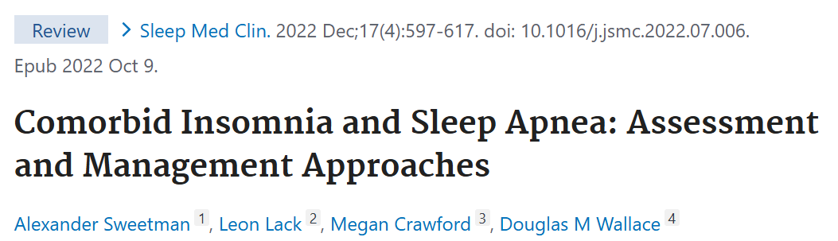
While OSA is the most common sleep-related breathing disorder,
insomnia is the most common sleep disorder overall
30% to 50% of patients with OSA have insomnia
30% to 40% of patients with insomnia have OSA
Notes:
Insonnia è disturbo del sonno più frequente, OSA il respiratorio più frequente
Dal 30 al 50% dei pazienti con OSA ha l’insonnia
Dal 30 al 40% dei paziente con insonnia ha l’OSA

Slide 8
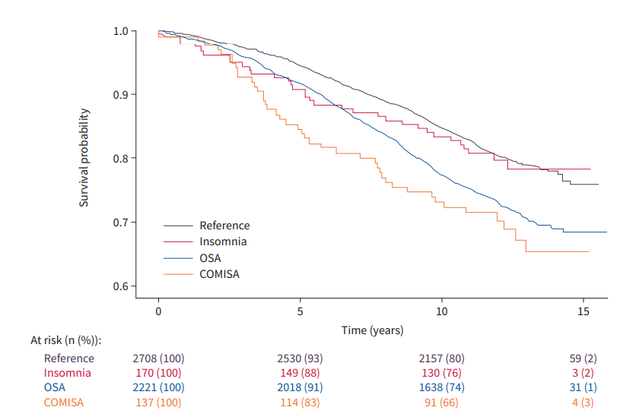
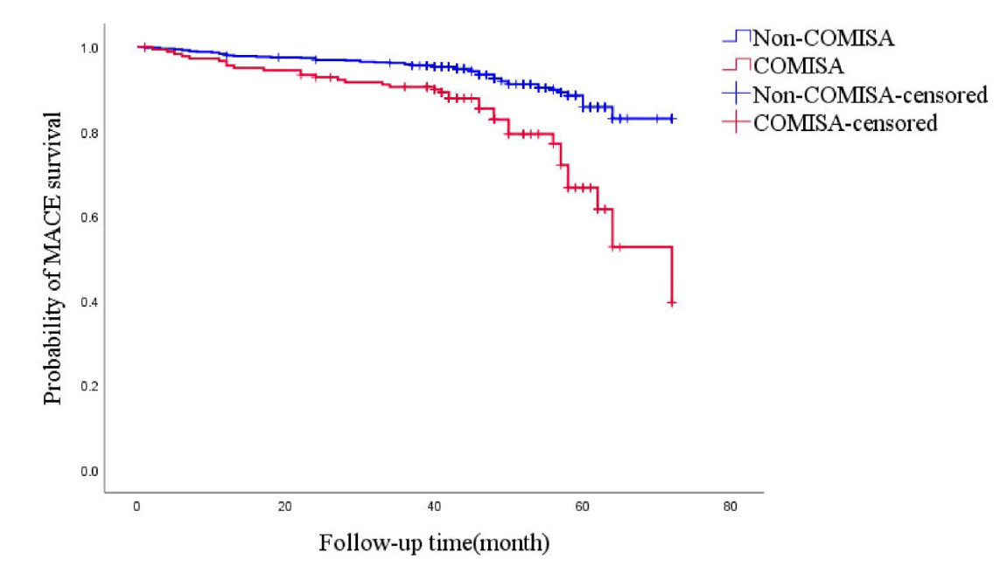
Why check for insomnia?
Lechat et al ERJ 2022; 60: 2101958 (all cause mortality)
Fang et al. BMC Geriatrics (2024) 24:622
Cardiovascula risk and CPAP adherence!

Slide 9
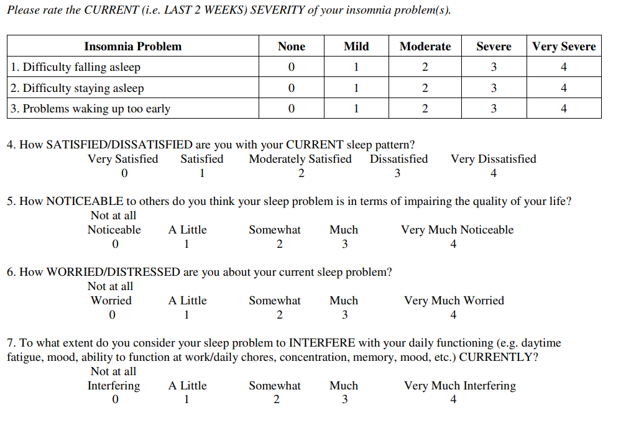
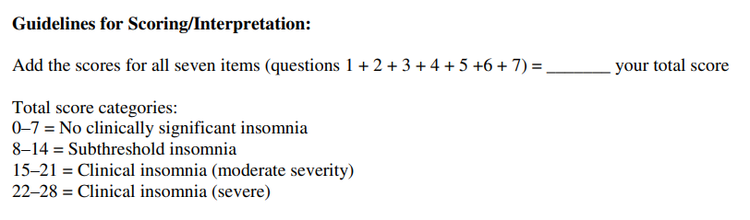
Insomnia Severity Index (ISI)
SLEEP DIARY: Identify any problematic behaviors (typically seen in patients with insomnia)
ISI:
OSA-related insomnia: maintained insomnia, resolves or improves with treatment
Insomnia in OSA: difficulty falling asleep, early awakening, and persistent maintained insomnia
ISI
OSA-related insomnia: high score
Insomnia in OSA: lower score
Notes:
La diagnosi di insonnia è una diagnosi clinica.
ISI è un indice validato su scala nazionale ed internazionale, valuta 5 domini – ottima correlazione tra punteggio ISI e insonnia, ottima predittività
Considerare insonnia perché possiamo inquadrarla già noi
In primis igiene del sonno, poi terapia cognitivo comportamentale ed eventuale farmacologica

Slide 10
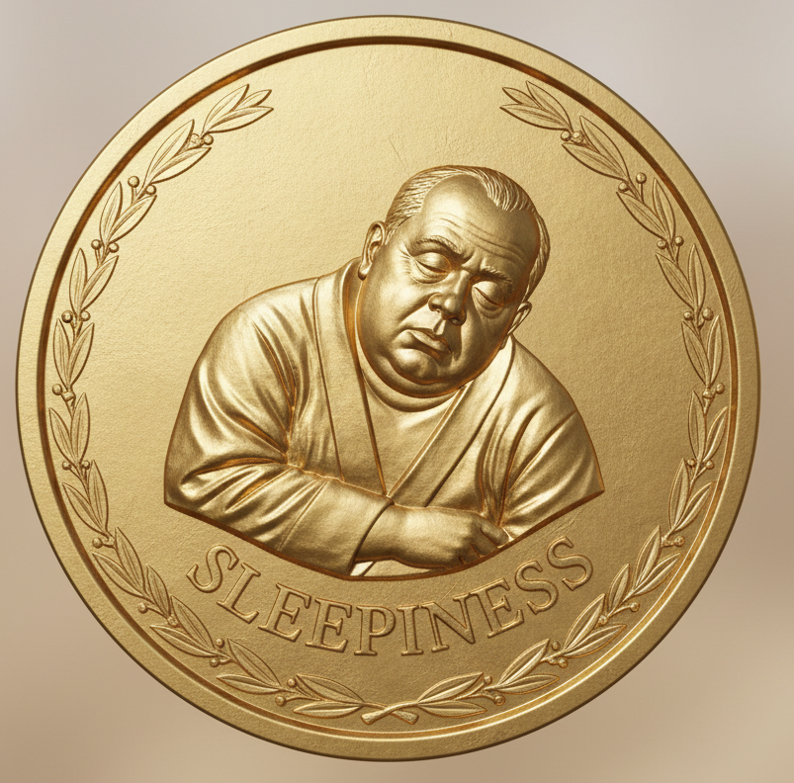
Excessive Daytime Sleepiness ICSD-3
«The inability to remain awake and alert during the day, resulting in periods of an irrepressible need for sleep or involuntary episodes of sleepiness or sleep.»
«Daily episodes of an irrepressible need to sleep or daytime lapses into sleep for at least 3 months.»

Slide 11
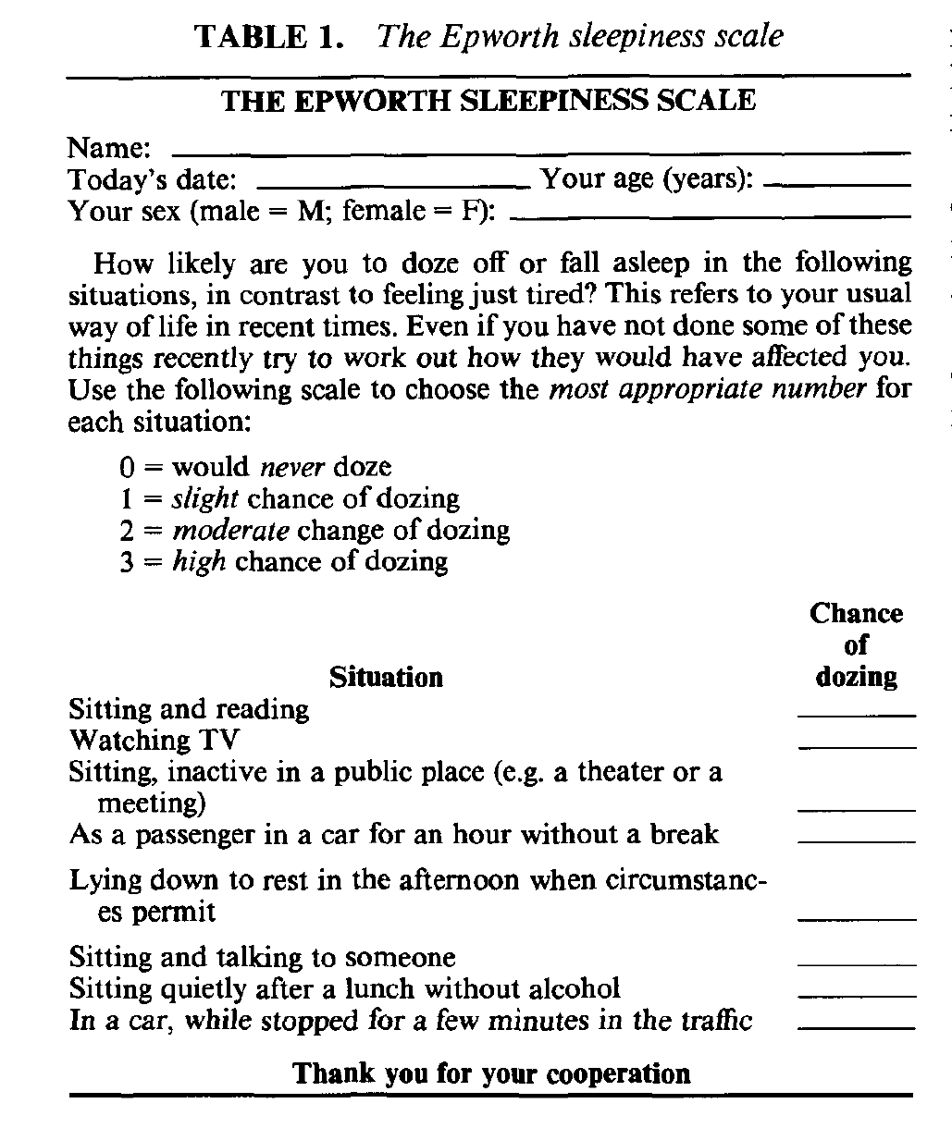
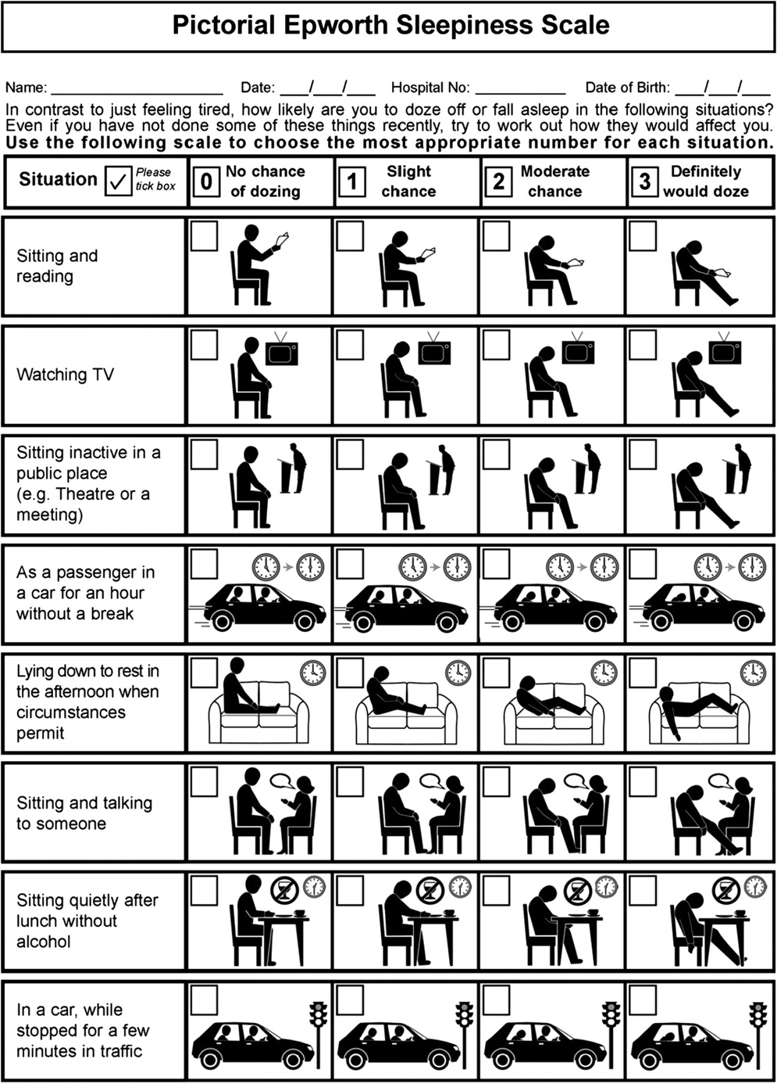
The Epworth questionnaire was originally designed to be self-administered
“If the patients have not experienced such situations, they should imagine them”
Subsequent studies have demonstrated its superiority when administered by a clinician compared to when self-administered
In the French validation study, scores were lower when administered by a physician
Can Respir J 2010;17(2):e27-e34.
This tool is also useful for monitoring the effectiveness of therapy on the symptom of sleepiness; changes are considered significant when greater than 25% (improvement in 3 items)
Sleep Medicine 112 (2023) 104–115
Not surprising that the ESS scores depend on the mode of administration,
being both higher and more predictive of illness
when administered by a physician, or when used in its modified pictorial form
CHEST 2013; 143(6):1569–1575

Slide 12
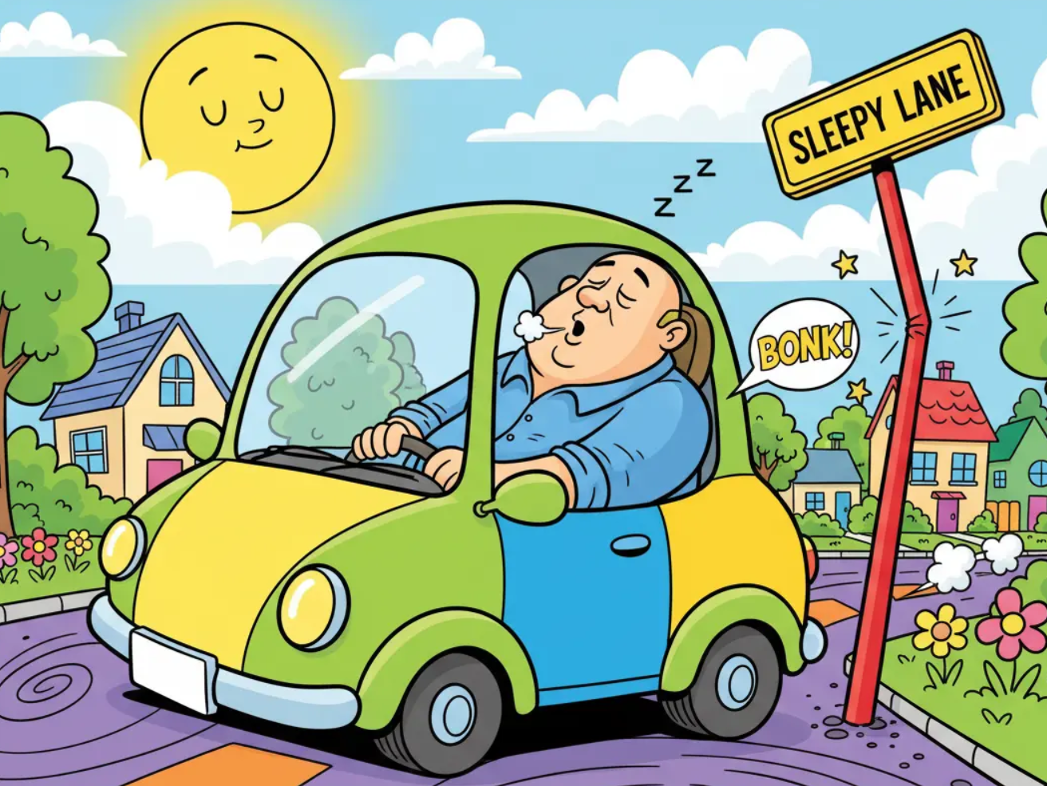

“Over the last few years, have you ever experienced episodes of severe drowsiness that made it difficult for you to drive or forcing you to pull over?”
EDS is the cause of accidents in cars and at work

Slide 13
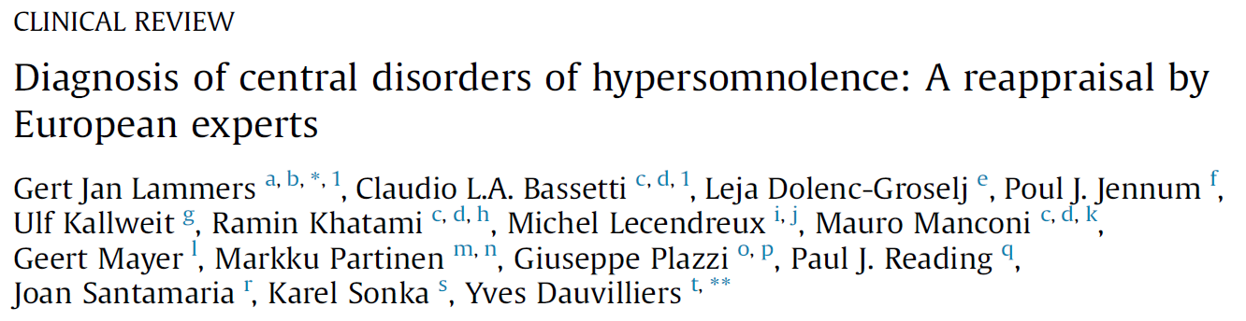
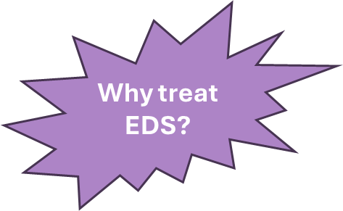
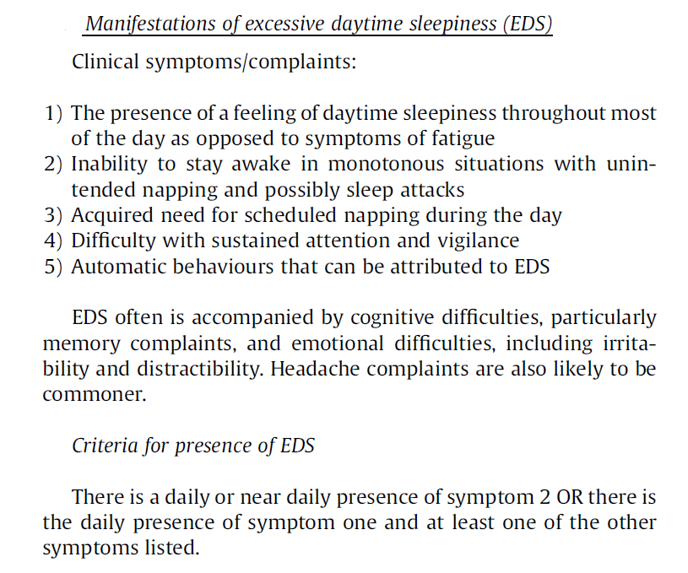

EDS is the cause of a worsing quality of life
Life and quality of life
Notes:
In questa review di Sleep Medicine del 2020. Impatto importante slla qualità della vita: impatto negativo sulla sicurezza, funzionamento, produttività, umore, cognitivo e qualità della vita in generale EDS in OSA si associa ad un aumentato rischio di incidenti d’auto e sul lavoro + disturbi dell’umore come ansia e depressione (articolo focused review xhitra Lal pag 1)
MI CHIEDO SE NELLE PAZIENTI DONNE QUESTO ASPETTO DELLE DIFFICOLTà EMOZIONALI NON SIA ESPRESIONE DI

Slide 14
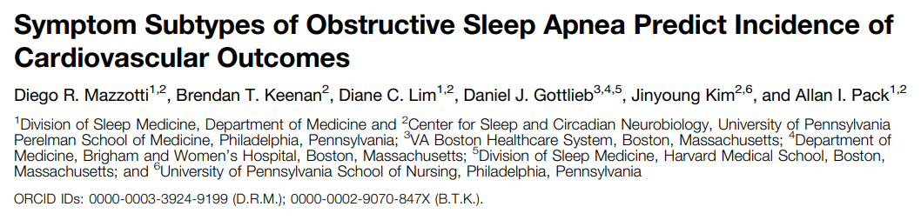
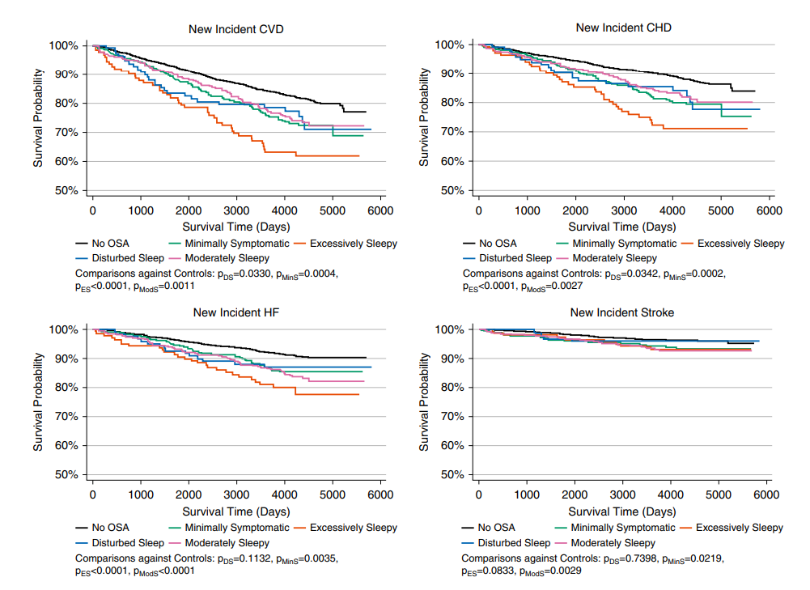
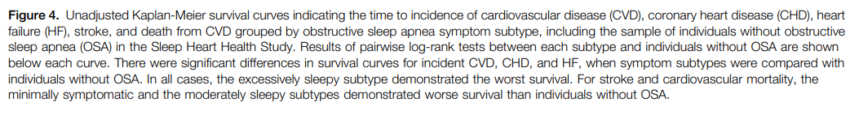
Why treat EDS?
Patients with excessive sleepiness are at an increased risk of CVD compared not only to patients without OSA, but also relative to other patients with similar AHI without sleepiness
AM J RESPIR CRIT CARE MED 2019
Notes:
Studio su AM J RESPIR CRIT CARE MED del 2019
ESS 13.7 vs 10.6

Slide 15
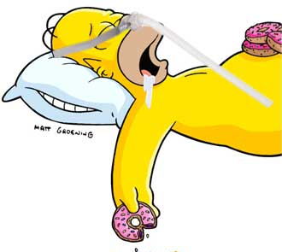
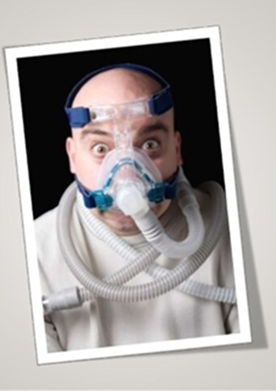
Residual Excessive Daytime Sleepiness
«EDS is often improved by correcting respiratory events but can sometimes persist despite optimal treatment. This is referred to as residual EDS (rEDS)»
Residual excessive daytime sleepiness can only be diagnosed after 6 months of optimal CPAP therapy (≥6 hours per night).
After 3 months of treatment, EDS resolved in 66% of patients with sleepiness.
Further improvement if continued for 3 to 6 months.
Weaver TE et al, Sleep 2007; 30(6): 711-9
Bonsignore MR et al, Front Neurol 2021; 12:690008
Steier et al, Sleep Medicine, Oct 2023

Slide 16
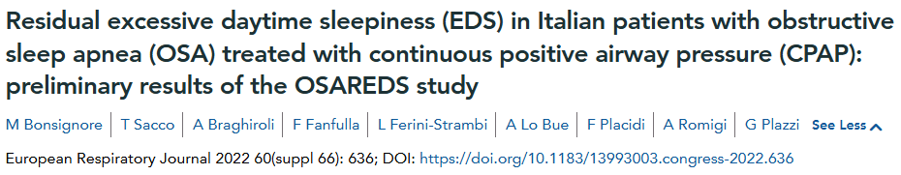
Residual Excessive Daytime Sleepiness
Prevalenza: 5-22%
Pepin JL et al Eur Respir J 2009;33:1062-1067
Retrospective study
7 Italian centers
EDSr if ESS > 10
EDS before CPAP in 36.5% – after CPAP in 6.6%
rEDS accounted for 18% of baseline EDS
OSAREDS
Despite an effective treatment, residual sleepiness is about
6% to 13% of OSA patients using CPAP
10 to 28% in other recent data
Steier et al, Sleep Medicine, Oct 2023
Notes:
Ha prevalenza variabile dal 5 al 22% (Studi di Pepin Eur resp L 2009 e Gasa J Slepp Res 2013), e la riconosciamo in primis effettuando ESS assieme ad anamnesi appropriata
rimane non chiaro il meccanismo per cui chi fa CPAP adeguatamente possa avere sonnolenza residua – una spiegazione potrebbe essere appunto che i meccanismi di danno di cui sopra sono in parte irreversibili, ma ancora non abbiamo evidenze chiare
Una volta escluse altre cause di EDS, rimane l’ipotesi che l’ipossia cronica possa causa disfunzione nei circuiti di controllo della veglia, aumento dello stress ossidativo e persino apoptosi cellulare e gliosi

Slide 17
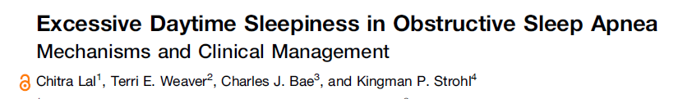
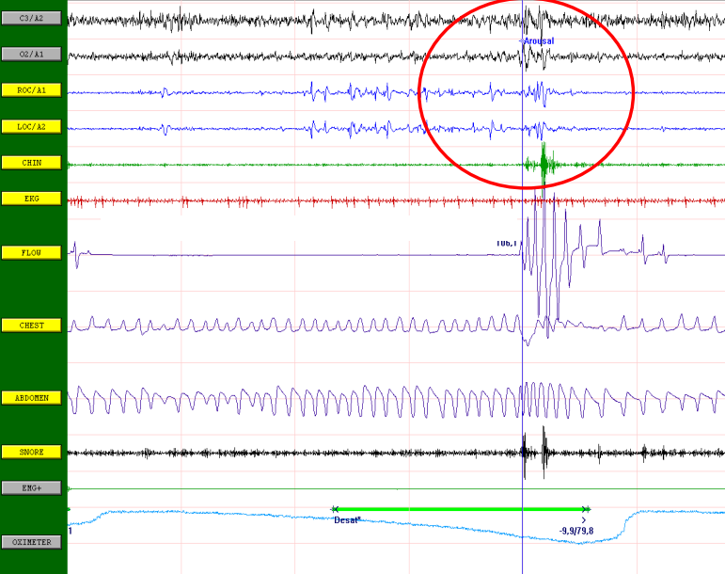

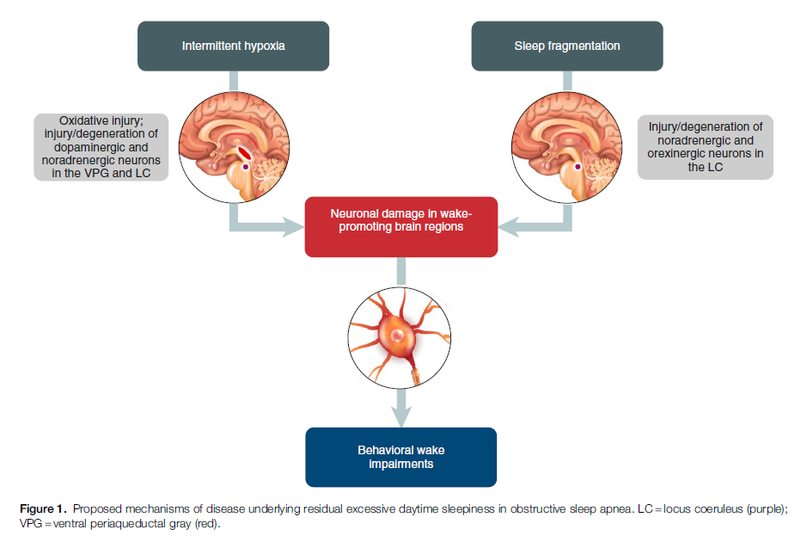
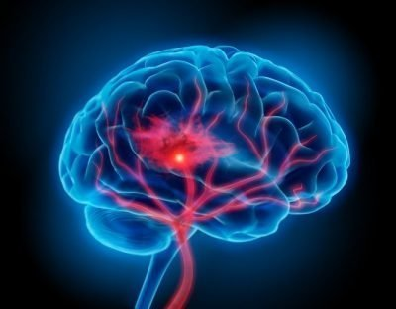
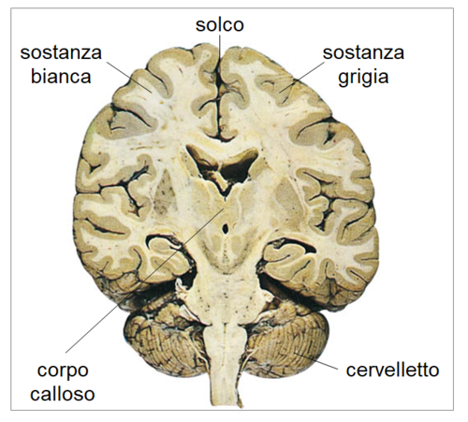
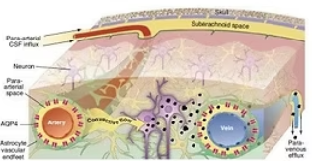
Pathophysiology
OXIDATIVE STRESS causing injury to various brain cells and the brainstem wake-promoting neurons
STRUCTURAL (ISCHEMIC?) brain changes in both white and gray matter
Lower efficiency of the LYMPHATIC SYSTEM (N3)
OSA-related hypoxia reoxygenation, hypercapnia, and sleep fragmentation
promote specific alterations in MICROBIOTA
The 24-hour synthesis and secretion of MELATONIN, a
sleep-promoting neurohormone
Notes:
Ipossia intermintente determina danno a lillo degli oligodendrociti oltre che alle strutture adrenergie e dopaminergiche ed intolre alterazioni a luvello del sistema glifantico che non esercita più il suo effetto di clearance sulle sostanze neurotossiche
Lavoro del 2020– danno delle aree che promuovo la veglia
Da studi su modelli murini questo è uno dei meccanismi che si ritiene responsabile ossia:
Mechanisms underlying residual EDS in
patients with treated OSA are likely
confounded by the unknown length of time an
individual has been exposed to the condition
and differences in individual susceptibility to
the consequences of OSA, as well as comorbid
conditions such as mood disorders and
neurologic conditions. Animalmodels of sleep
apnea, exposure to hypoxia, and sleep
fragmentation as well as neuroimaging studies
in humans are beginning to provide evidence
for plausible explanations

Slide 18
Factors associated with rEDS prevalence
The younger patients
Higher sleepiness pre-treatment,
Lower pre-treatment AHI,
Comorbidities: mood disorders, diabetes, cardiovascular disease and chronic pain
Lower CPAP use

Slide 19
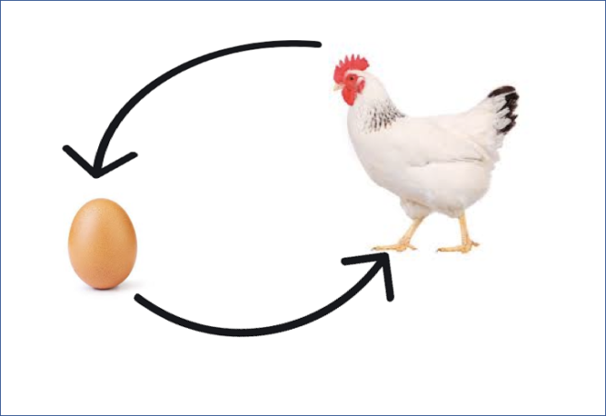
Does rEDS treatment change adherence?
CPAP-treated OSA patients with rEDS are more likely to have a lower BMI and AHI, more severe EDS and depressive at baseline, and lower CPAP adherence compared to those without rEDS.
Is rEDS a cause of low CPAP adherence?
Feng X. ERJ Open Res. 2025 Apr 14;11(2)

Slide 20
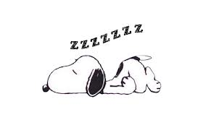

Residual Excessive Daytime Sleepiness
Sleep Hygiene and lifestyle
Check your therapy
Check other causes

Slide 21
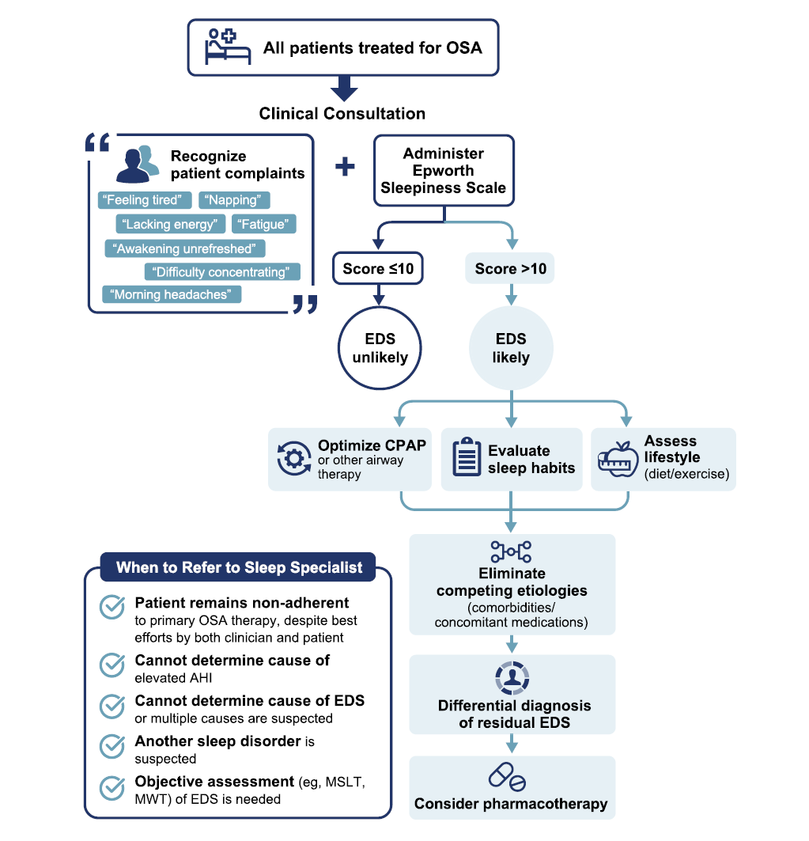
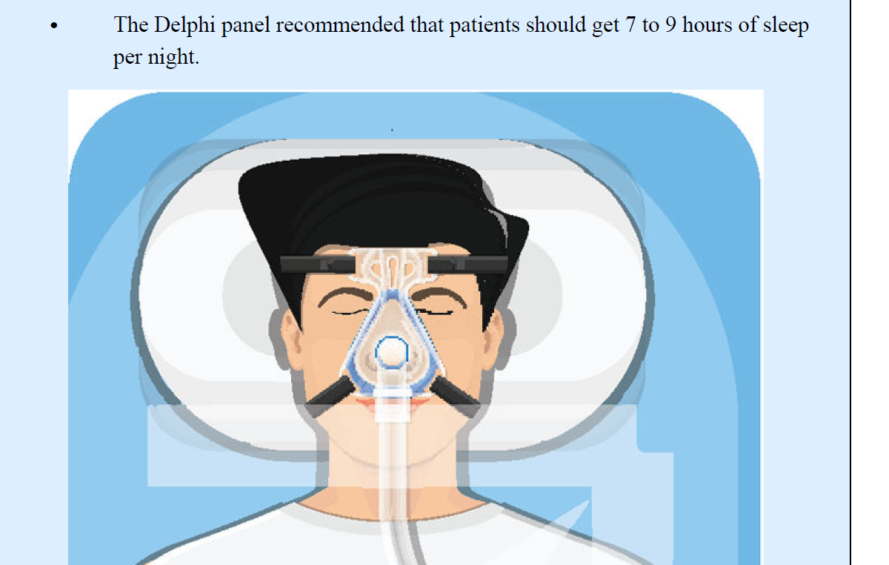
Curr Med Res Opin. 2025 March ; 41(3): 549–558
Things that healthcare providers should consider are
poor sleep
Diet (alcohol) and exercise
other sleep disorders like narcolepsy,
other illnesses that may make a person sleepy (such as depression or hypothyroidism),
the patient’s current medications or recreational drug use
Sleep diary or sleep habits first of all!!
R. Rosenberg et al (2021) Postgraduate Medicine, 133:7, 772-783

Slide 22
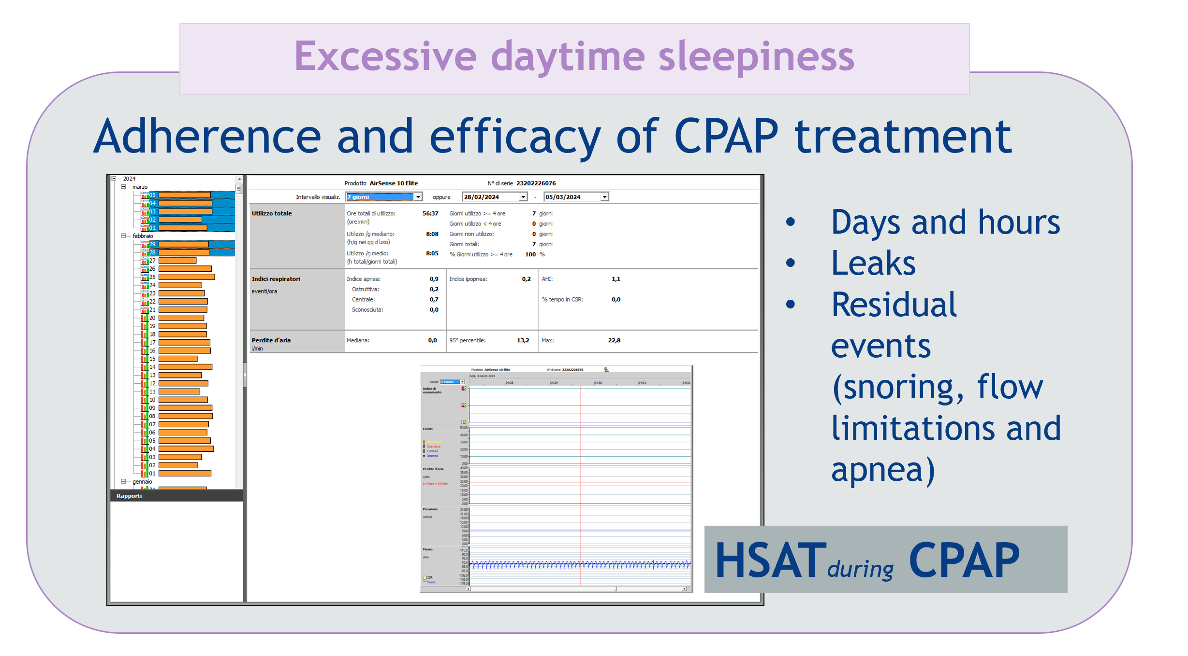
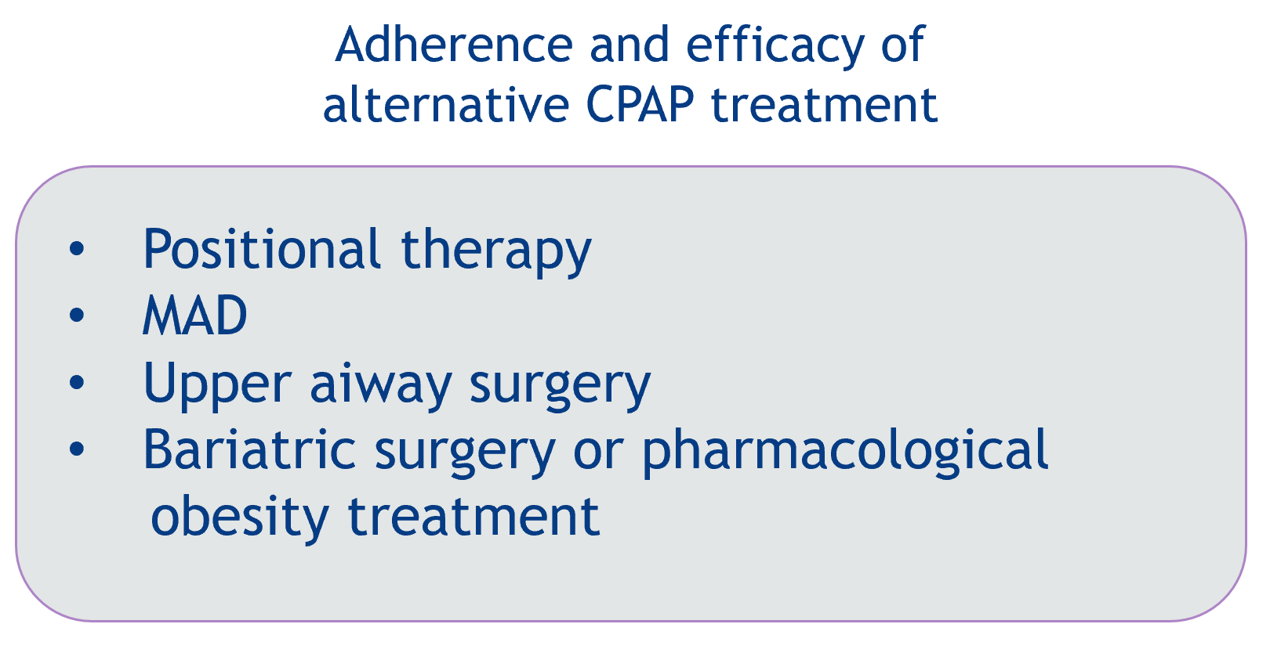
R. Rosenberg et al (2021), 133:7, 772-783
Curr Med Res Opin. 2025 March ; 41(3): 549–558

Slide 23
Things that healthcare providers should consider are
poor sleep
diet and exercise
other sleep disorders like narcolepsy,
other illnesses that may make a person sleepy (such as depression or hypothyroidism),
the patient’s current medications or recreational drug use
R. Rosenberg et al (2021), 133:7, 772-783
Sogol Javaheri, MD, MPH; and Shahrokh Javaheri, MD CHEST AUGUST 2 0 2 0

Slide 24

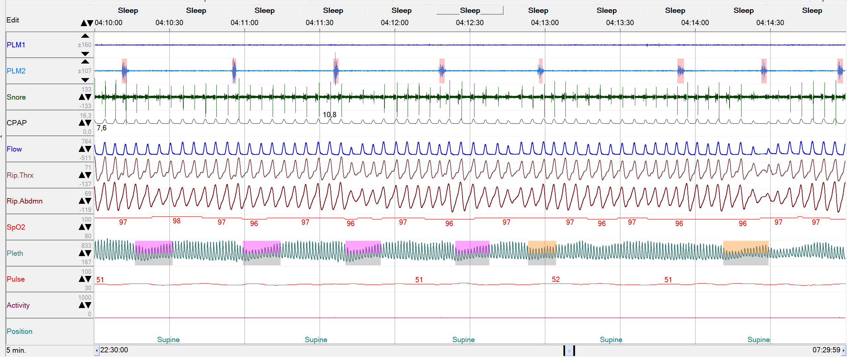
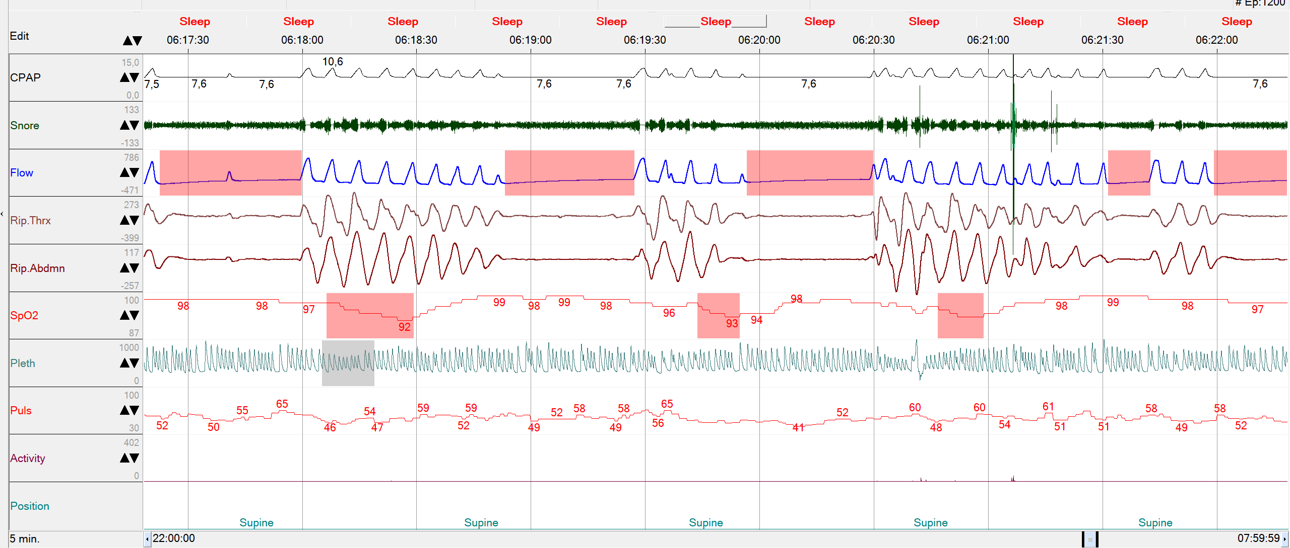
Check other causes
Don’t forget...!!!
Periodic Limb Movements
RLS
Central sleep apnea (other causes)
TECSA
Curr Med Res Opin. PMC 2025 September 30.

Slide 25
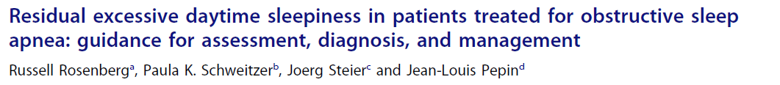
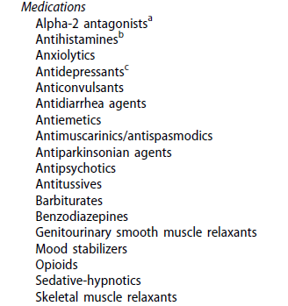
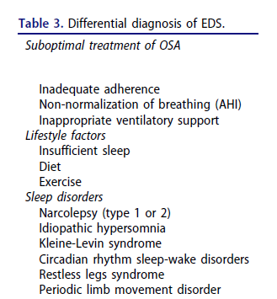
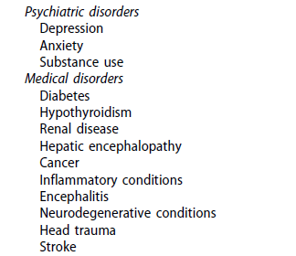


Notes:
Review del 2021

Slide 26
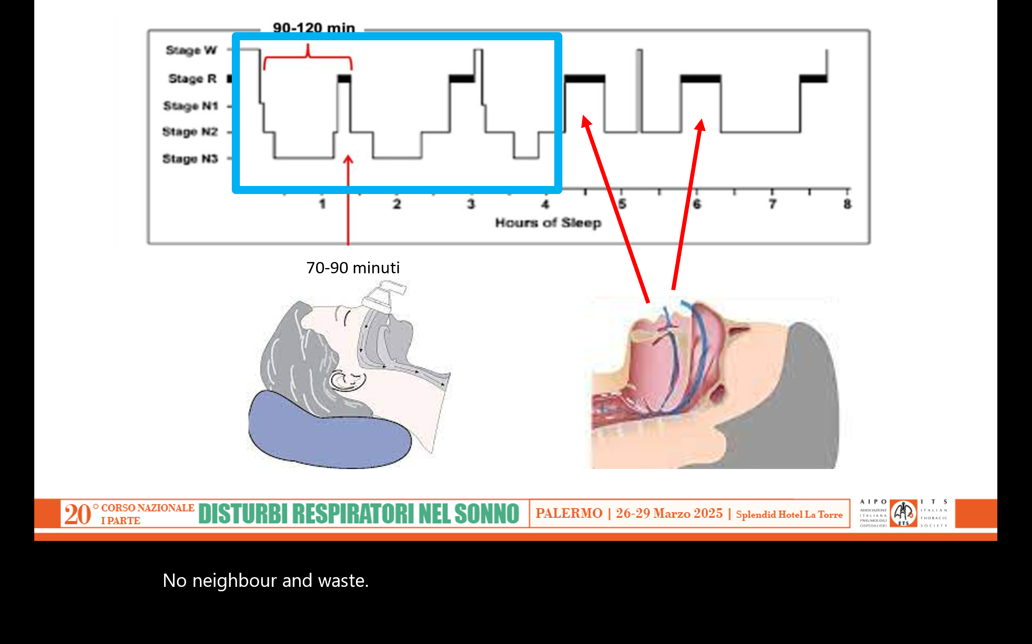
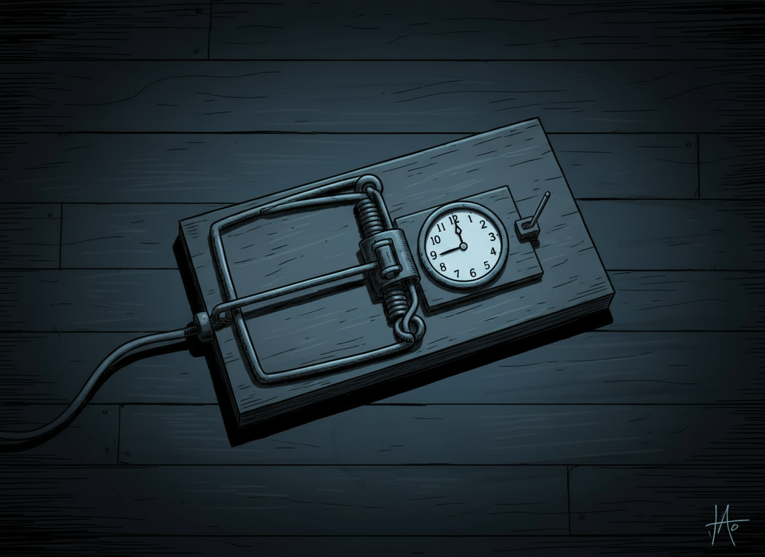
REM-predominant OSA could contribute to rEDS
The trap of 4 hours of CPAP per night
The burden of sleep apnea may increase as the night progresses, particularly in REM -predominant OSA.
During REM sleep, the length of apneas or hypoxic burden may increase.
Patients with undertreated REM-predominant OSA: they remove their CPAP partway through the night when REM sleep occurs.
Sogol Javaheri, MD, MPH; and Shahrokh Javaheri, MD CHEST AUGUST 2 0 2 0
Notes:
hypnotics like z-drugs, benzodiazepines
and trazodone can promote sleep without reducing
upper airway muscle activity or worsening hypoxemia, the
increase in the respiratory arousal threshold is modest at best
[38, 147–154]. Thus, most hypnotic studies show no systematic
changes in OSA severity
In addition to the
lack of consistent therapeutic benefit, there is also concern
over residual next-day impairment.
Accordingly, currently,
the use of hypnotics as monotherapy for OSA is not
recommended clinically [155]. While there may be a role for
hypnotic use as adjunct therapy in the presence of comorbid
insomnia or as part of combination therapy in people with a
very low arousal threshold, this requires further investigation
to assess the potential harm-versus-benefit profile
cognitive behavioural therapy for insomnia
may increase the respiratory arousal threshold and reduce
OSA severity in the target COMISA population [158]. However,
access to trained psychologists is a barrier to widespread
uptake of this non-pharmacological approach.

Slide 27
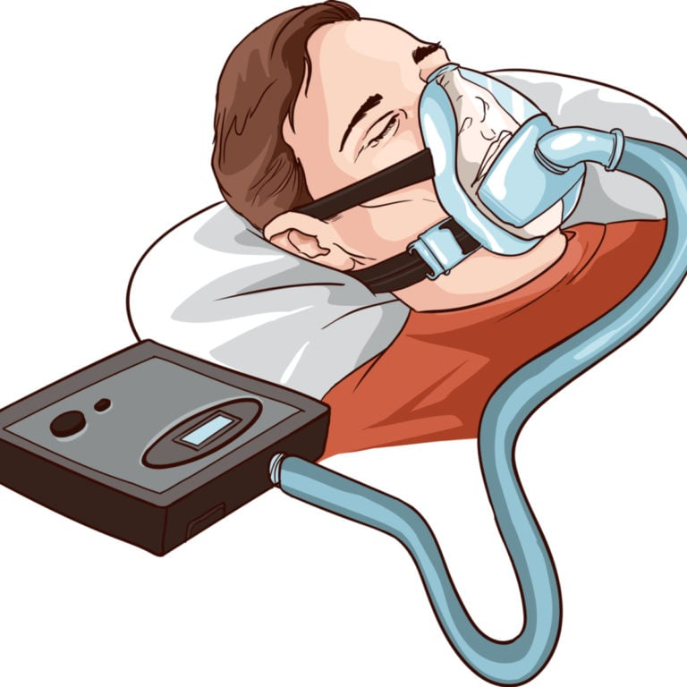
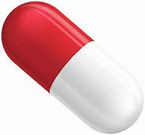



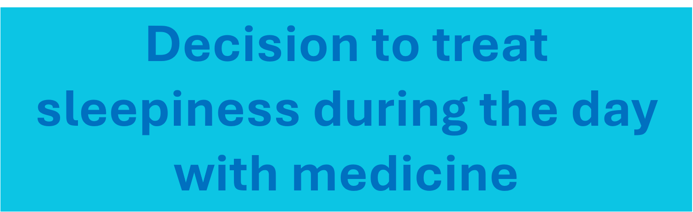

Slide 28
When and how pharmacological treatment for rEDS in OSA should be initiated
After 6 months of CPAP therapy without sleepiness improvement and exclusion of other causes of sleepiness
Some patients who are partially or incompletely treated (such as patients who poorly adhere to CPAP treatment)
The second recommendation was prompted by the significant adverse consequences of EDS (higher risk of motor vehicle and occupational accidents, poor quality of life, and cognitive impairment) and favourable safety profiles of newer wake-promoting agents.
Curr Med Res Opin. 2025 March ; 41(3): 549–558
Sleep Medicine 112 (2023) 104–115

Slide 29


Excessive daytime sleepiness
ESS>10
WAKE-PROMOTING AGENTS
SOLRIAMFETOL
PITOLISANT
Notes:
In generale ESS > 10 significa che EDS impatta sulla qualità della vita, tuttavia la soglia non è assoluta.
Inoltre monitorare uso CPAP dopo inizio del farmaco per confermare l’aderenza

Slide 30
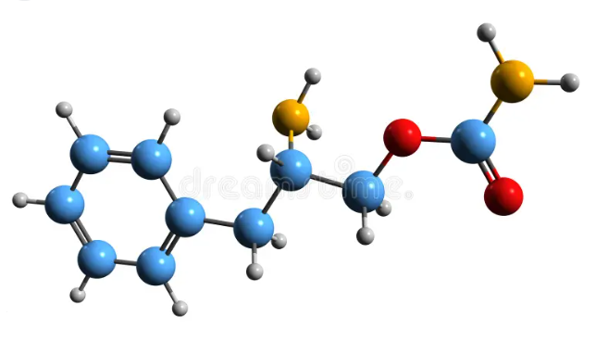
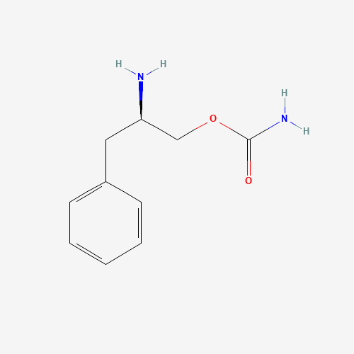
SOLRIAMFETOL
It inhibits the reuptake of dopamine and norepinephrine, but does not facilitate their release: no risk of dependence.
Approved as an addition to primary therapy for OSA.
It is approved for use starting at a dose of 37.5 mg once daily upon waking, which can be doubled after at least three days up to a maximum of 150 mg.
C₁₀H₁₄N₂O₂
Nome IUPAC:
[(2R)-2-amino-3-phenylpropyl] carbamate

Slide 31





TONES 3
Notes:
Alla 12 esima settimana i pz in solriamfetolo hanno evidenziato miglioramenti statisticamente significativi all’MWT e all’ESS per tutte le dosi rispetto al placebo con effetto dose dipendente

Slide 32



TONES 5
Notes:
Questo dato è confermato in uno studio a lungo termine (un anno di trattamento-52 settimane), nel quale nei pazienti OSA trattati il punteggio totale alla ESS è passato dal valore basale di 15 a 6.3

Slide 33


PITOLISANT
C₁₇H₂₆ClNO
IUPAC: 1-[3-[3-(4-chlorophenyl)propoxy]propyl]piperidine

Slide 34

Pitolisant
Reverse agonist/selective antagonist of the histamine H3 receptor
Binding to the H3 receptor inhibits the reuptake of histamine.
It crosses the blood-brain barrier and stimulates the release of histamine throughout the central nervous system (CNS).
It does not affect dopamine release in the nucleus accumbens, unlike amphetamines.
Harwell and Fasinu, Medicines 2020, 7, 55
Notes:
Tramite il blocco degli auto-recettori dell’istamina, innesca un’attivazione di lunga durata dei neuroni istaminergici del cervello = un sistema neuronale coinvolto nel mantenimento della veglia, dell’attenzione e della vigilanza.
Attraversa la BEE e stimola il rilascio di H in tutto il sistema nervoso centrale, accompagnato dal rilascio di altri NT che promuovono la veglia (dopa, nora, acetilcolina)
Non influenza il rilascio di dopa nel nucleo accumbens, il chè lo differenzia da altri psicostimolanti come le amfetamine.

Slide 35


HAROSA I
Multicenter, randomized, double-blind, placebo-controlled 12 weeks
Moderate or severe OSAS treated with CPAP for at least 3 months and for at least 4 hours per night, with excessive daytime sleepiness (ESS ≥ 12)
Dosage titrated from 5 mg up to 20 mg
Notes:
La ESS è diminuita significativamente nel gruppo pitolisant rispetto al placebo
L’effetto sull’EDS è stato testato mediante due studi di fase 3
Aumento dose 1 v a settimana, mantenuta la dose meglio tollerata

Slide 36


HAROSA II
International, multicenter, randomized, double-blind, placebo-controlled 12 weeks
Moderate or severe OSAS, patients who refused or did not adhere to CPAP, with rEDS (ESS ≥ 12)
Titrated from 5 mg up to 20 mg
p<0.001
The HAROSA studies did not examine differences in efficacy based on gender
Notes:
L’endopoint primario era la variazione del punteggio della ESS: che è stata -3.34 nel placebo e -6.63 nel pitolisant con p<0.001
È stata significativamente maggiore nel gruppo pitolisant

Slide 37


HAROSA II
Efficacy:
“ESS response” if the ESS was ≤ 10 or a reduction in ESS of ≥ 3 points was observed in 80.6% of patients receiving pitolisant and in 53.7% of patients receiving placebo, resulting in a statistically significant difference
Safety:
No differences in blood pressure and heart rate in the two groups
Notes:
Inoltre i responder alla terapia considerado una «ESS response» se ESS ≤ 10 o riduzione dell’ESS ≥3 punti è stata osservata nell’ 80.6% dei pazienti in pitolisant e nl 53.7% dei pazienti in placebo risultando in una diff statisticamente significativa

Slide 38



no statistically significant difference between the two sexes
Notes:
L’esito primario di efficacia era la variazione del punteggio ESS tra il basale e la settimana 52
Questo studio ha confermato l’efficacia e la sicurezza del pitolisant a lungo termine in tutti gli adulti inclusi in HAROSA I e HAROSA II, a 52 settimane

Slide 39

MAIN SIDE EFFECTS:
Headaches
Insomnia
Nausea
Dizziness
Note: Interacts with CYP3A4 substrate drugs (including contraceptives) and CYP2D6 inducer drugs. Do not use in cases of severe liver disease.
Notes:
A 52 settimane non sono stati segnalati problemi di sicurezza cardiovascolare

Slide 40


Notes:
Review europea del 2022

Slide 41
Choosing a pharmacologic agent
should be individualized to the patient, taking into account the evidence available regarding an agent’s efficacy and safety profile, cost, and patient characteristics
During follow-up visits check
Efficacy with the ESS
Tolerability with adverse events
Blood pressure (every 6 months) and heart rate (a 12-lead ECG annually)
Adherence to primary OSA therapy

Slide 42


What about gender differences?
Notes:
Quando parliamo della medicina di genere facciamo riferimento non solo alle differenze di sesso e quindi cromosomiche o ormonali ma anche differenze legate ai fattori esogeni, allo stile di vista ed ai bias culturali. In particolare la mia relazione farà riferimento alle differenze di genere nei disturbi respiratori ma durante il sonno
Ovviamente il focus sarà soprattutto sulla donna la cui complessità è spesso poco considerata
Le differenze tra uomo e donna si riflettono anche sul sonno propriamente detto
Meno qualitativo per la donna sebbene il tempo di sonno ed il tempo in N3 sia maggiore. Le donne sono maggiormente predisponste all’insonnia
Presentano delle differenze anche sul cronotipo. Le donne sono delle allodole, soffrono meo il jet lag, ma hanno un ciclo di sonno anticipato rispetto all’uomo

Slide 43


SleepEpidemiology4(2024)100077
P. Tondo et al
rEDS was found in 25% of males and 13% females (p= 0.03)
Females were more adherent to night time treatment than males
(83% vs 67% respectevely, p=0.008)
sleepy females reported more cognitive impairment
The only polysomnographic difference found in sleepy patients was the presence of a higher T90
females were more elderly (67% over 65 yr vs. 46 % of males)
had a higher BMI than sleepy males (46,19 vs 34,37)
Sleepy males had history of more comorbidities and symptoms
Baseline sleepiness in a risk factor for rEDS for both sexes
Notes:
The only polysomnographic difference found in sleepy patients was the presence of a higher T90. This is an interesting finding, which shows that more than the severity of sleep apnea, it is nocturnal hypoxemia that contributes to the pathogenesis of EDS. Studies in murine models have shown that OSA’s intermittent hypoxia causes irreversible brain damage in the wake-active regions underlying the development of EDS that does not appear to improve with CPAP treatment

Slide 44



ESS > 10
2663 patients
EDS=39.5%
EDS at diagnosis was associated with severity of nocturnal hypoxemia but not with AHI
Patients with EDS were on average more symptomatic than patients without EDS
Predictors of EDS :
Fatigue and subjectively impaired cognitive function
Insalaco G. et al Sleep Medicine 136 (2025) 106819
Notes:
EDS secondo ESS >10

Slide 45


«OSA women may refer their sleepiness differently, and emphasize lack of energy, fatigue, or tiredness more than sleepiness”
daytime sleepiness as the symptom for which the patient sought medical advice was reported more often by women than by men (27 vs 19 %).
while mean ESS scores were similar in men (9.2 ± 5.1) and women (9.1 ±5.1).
Insalaco et al. Sleep Medicine 136 (2025) 106819
Sleep and Breathing (2020) 24:533–540
Notes:
daytime sleepiness as the symptom for which the patient sought medical advice was reported more often by women than by men (27 vs 19 %). Such discrepancy between self-reported symptom and results of ESS ques tionnaire may be at least partially accounted for by the higher preva lence of depression/anxiety symptoms reported by women compared to men.
it is possible that women have a different threshold
for feeling sleepy and/or complain differently about sleepiness
compared with men
Sleepiness as the driving symptoms to seek medical advice was more frequented reported by women than men (p<0.01)
27% vs 19% c’è differenza tra ESS e sonnolenza riferita che potrebbe essere attribuita alla depression anche se ma in queto studio la percentuale di pazienti depressi era simile tra quelli con o senza sonnolenza
Overweight is more common in men, while obesity is more common in women
AHI is lower in women and desaturation is worse in men

Slide 46



Sleepiness
Gender and Measures of Daytime Somnolence—Baldwin et al
Women reported feeling sleepy as often as men did, but women were less likely to have an ESS score > 10 and more likely to report feeling unrested than men
SLEEP, Vol. 27, No. 2, 2004
Notes:
Women reported feeling sleepy as often as men did (odds ratio [OR] = 1.06; confidence interval [CI], 0.86-1.32), but women were less likely to have an ESS score > 10 (adjusted OR = 0.77; CI, 0.66-0.90) and more likely to report feeling unrested (adjusted OR = 1.39; CI, 1.14-1.69) than men. In men, the ESS score was more strongly correlated with reports of feeling unrested or sleepy compared to women. Conclusions: Men and women answer questions on sleepiness differ ently. Findings indicate that using the ESS to detect subjective sleepiness is more likely to identify men with sleepiness. Since the ESS is more strongly related to other subjective measures in men, the ESS may be a more sensitive measure of subjective sleepiness in men than in women

Slide 47



Differences in patient–spouse (PT-S)-paired ESS responses as they relate to gender and race and propose modifications that can be helpful in the analysis of adult ESS scores.
female PTs reported significantly higher total ESS scores than male PTs (12.16 vs 9.64, p = 0.002)
female PTs scored their sleepiness higher
AA males higher total ESS compared with C males (11.3 vs 9.04,p < 0.05),
AA females lower total ESS compared with C females (11.4 vs 13.7, p < 0.05).
Epilepsy & Behavior 114 (2021) 107272
Notes:
that demonstrates gender specific sensitivity of
certain questions in the Epworth sleepiness questionnaire. ‘‘Sitting
and reading”, ‘‘as a passenger in a car”, ‘‘sitting and talking to
someone”, and ‘‘in a car while stopped for a few minutes in traffic”
were all more soporific scenarios for female than male PTs.

Slide 48





Neutral items
Female items
Female patients complain of mood disturbance (depression)
Sleep disturbance, or drugs that could explain sleepiness
Male PTs scored their sleepiness lower when compared with scores given by their Ss: total ESS
DPT-S was 2.44 for females and 3.1 for males, (p < 0.0001)
Epilepsy & Behavior 114 (2021) 107272

Slide 49
Take Home messages
Optimal treatment means quality of life, and sleep quality
Treating EDS is one of the primary goals for our OSA patients
The treatment of OSA patients includes follow-up: adherence and efficacy of our treatment
Residual Excessive Daytime Sleepiness should and can be treated
We need to know and do more about the sleepiness phenotype

