Slide 1
Physiopathology of Central Sleep Apneas
Shahrokh Javaheri, MD, FCCP, FAASM, FABSM
Division of Pulmonary and Sleep Medicine
Bethesda North Hospital, Cincinnati, OH
Professor Emeritus of Pulmonary and Sleep Medicine
University of Cincinnati, Cincinnati, Ohio
Adjunct Professor of Medicine, Division of Cardiology
The Ohio State University, Columbus Ohio
Recipient of Excellence –In-Research Award by the AASM for the year 2024
Recipient of The Richard A. Perritt Lectureship Award from Loyola University Stritch School of Medicine for the year 2025
Recipient of Life Achievement Award from Indian Sleep Society,2025
Trieste, Italy, May, 2026

Slide 2
ICSD-3 provides the following classification of central apnea
Central sleep apnea with Cheyne-Stokes breathing(CSB)
Central sleep apnea due to a medical disorder without CSB
Central sleep apnea due to high altitude periodic breathing
Central sleep apnea due to a medication or substance
Treatment-emergent central sleep apnea
Primary central sleep apnea

Slide 3
  Spectrum of cardiac and noncardiac causes of CSA
Medications
Stroke/brain tumors,
Chiari malformation,
NMD, NDD,
MS,
SCI,
BDP
Cardiac disorders
Acromegaly
TECSA
High Altitude
Hypoventilation
Syndromes
PHOX2B Gene
CRF
ICSA

Slide 4
Central Sleep Apnea Hypopnea (CSAH)
Recent Publications
Javaheri S. Badr SM. Central sleep apnea: pathophysiologic classification SLEEP 2023;46: 1-14
Javaheri et al. Distinguishing Central from Obstructive Hypopneas
on a Clinical Polysomnogram. J Clin Sleep Med 2023;19 :823-834
Javaheri et al. Medication-Induced Central Sleep Apnea:
A Unifying Concept. SLEEP 2024; 47:1-13
4. Javaheri et al. Central Sleep Apnea and Cardiovascular Disease.
State-of-the-Art. SLEEP 2025;48: 1–20
5. Brown and Javaheri. Idiopathic Central Sleep Apnea . SLEEP 2026.
Javaheri et al. Central sleep apnea in heart failure: What now?
Archivos de Bronconeumologia. 2025

Slide 5
Cardiac Disorders Associated with CSA
Symptomatic and asymptomatic
LVSD/LVDD
AF
LAE
Pacemaker placement
PAH
CTEPH

Slide 6
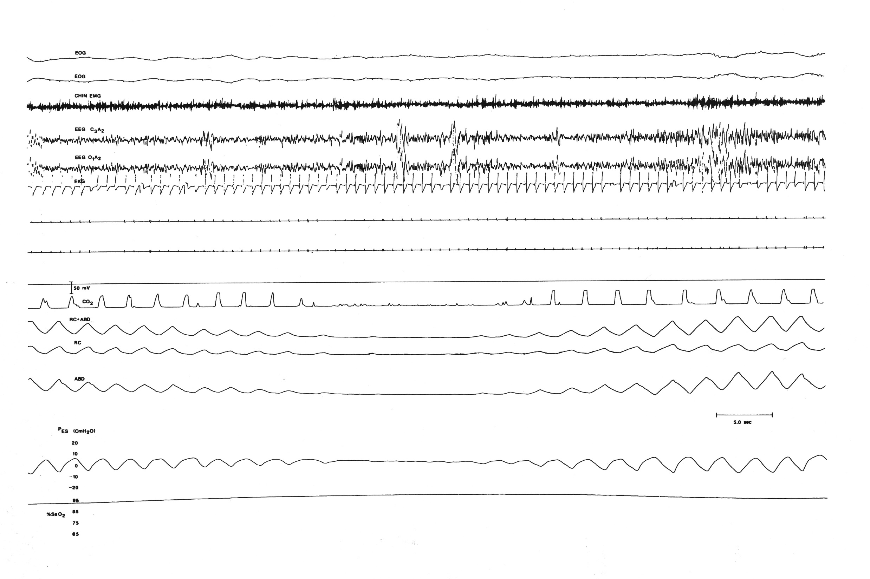
Central apnea in a patient with HFrEF - stage 2 sleep
Arousal
Central apnea
Hyperventilation

Slide 7
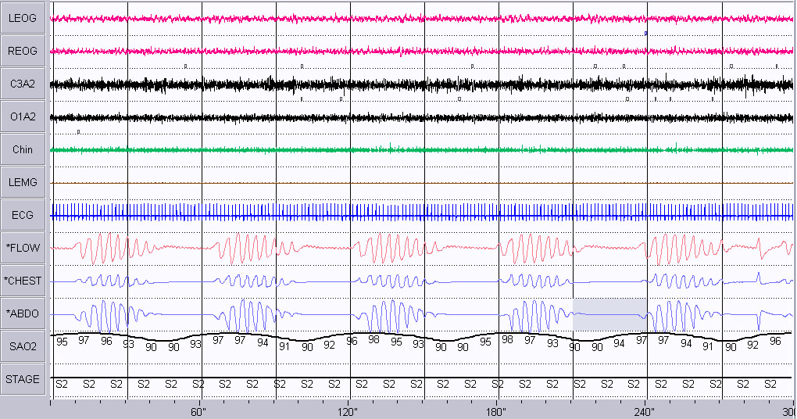
Central sleep apneas in a patient with HFrEF - N2 sleep
LEOG
REOG
C3A2
O1A2
Hunter-Cheyne-Stokes breathing
Chin
Central apneas are of the same duration, and each cycle of ventilation is prolonged, reflecting prolonged circulation time of HF
LEMG
ECG
FLOW
CHEST
ABDO
SAO2
STAGE
Notes:
This pt is 80 years old
M/H: HTN, Heart surgery in 1993
AHI = 69/hr
Lowest oxygen = 87%
D O T= 11/21/04

Slide 8
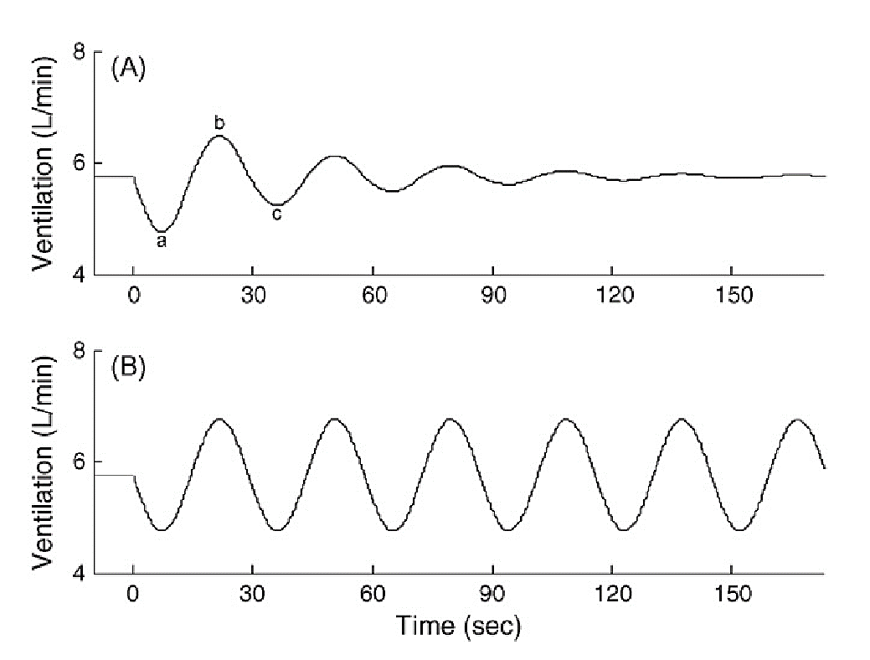
LOOP Gain
Driving sober
DRIVING SOBER
Miles per Hour
Driving drunk
DRIVING DRUNK
Miles per Hour

Slide 9
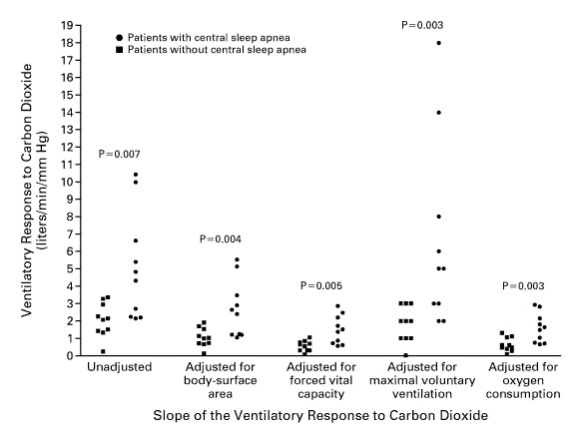
High LG in HF(Javaheri, NEJM, 1999)
5.1
2.1
5.1±3.1 vs. 2.1± 1.0

Slide 10
PB/CA begets PB/CA
Periodic chemoreceptor stimulation and inhibition
  CA/hypopnea PCO₂ and PO₂
  Chemoreceptor stimulation Hyperventilation/Arousal
  PCO₂ and PO₂
  chemoreceptor inhibition
  CA and hypopnea

Slide 11
Central sleep apneas in a patient with HFrEF - N2 sleep
LEOG
REOG
C3A2
O1A2
Hunter-Cheyne-Stokes breathing
Chin
Central apneas are of the same duration, and each cycle of ventilation is prolonged, reflecting prolonged circulation time of HF
LEMG
ECG
FLOW
CHEST
ABDO
SAO2
STAGE
Notes:
This pt is 80 years old
M/H: HTN, Heart surgery in 1993
AHI = 69/hr
Lowest oxygen = 87%
D O T= 11/21/04

Slide 12
Sleep apnea is quite prevalent in left ventricular dysfunction
Javaheri et al, J Am Coll Cardiol 2024
%

Slide 13
Prevalence of sleep apnea 963 HFrEF patients Oldenburg et al, EHJ 2016 (10 y study)
Age, years 65
BMI, kg/m² 27
Male, % 81
Ischemic, % 51
DM, % 32
II, III , IV, % 34, 57, 8
LVEF, % 30
AF , % 25
Paced, % 9
PM, ICD, CRT-P, CRT-D% 8, 14 ,2, 13
ACE-I/ARB 94%, β-Blockers 89 %, Diuretics 91%, Spironolactone/eplerenone 61%, Digitalis glycosides 49%

Slide 14
Prevalence of sleep apnea in HFrEF
N= 560/963
403/963
156/963
Oldenburg et al, EHJ, 2016

Slide 15
Central Sleep Apnea with Heart Failure,
Two Bad Bed Fellows
Javaheri et al. Am Thorac Soc 2023; 20:367-370
CSA is associated with increased sympathetic activity
CSA is associated with hospitalization
CSA is associated with impaired quality of life
CSA is associated with premature death
CSA is prevalent in HF, but occult and underdiagnosed

Slide 16
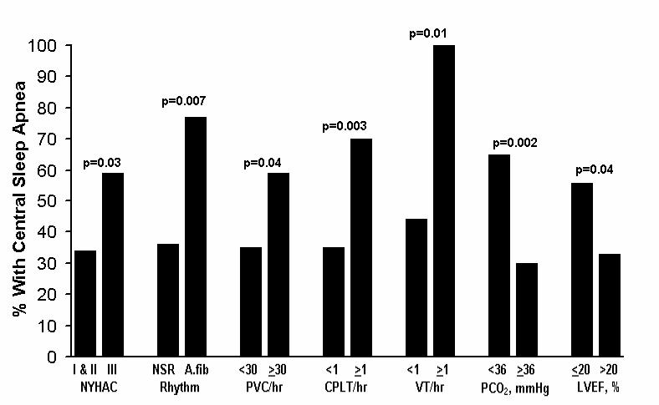
Hallmarks of CSA in SHF

Slide 17
CSA is a Predictor of Mortality in HFrEF
Increased mortality associated with CSA in HFrEF:
Merit Rev Program, VAMC
24 covariates
100
AHI < 5/h, mean = 2, n=32
AHI ≥5/h, mean = 34, CAI = 23
n=56
90
80
70
60
Survival %
50
40
30
HR =2.14
P=0.02
20
10
0
0
10
20
30
40
50
60
70
80
90
100
110
120
130
140
150
160
170
Months
Javaheri et al. J Am Coll Cardiol 2007

Slide 18
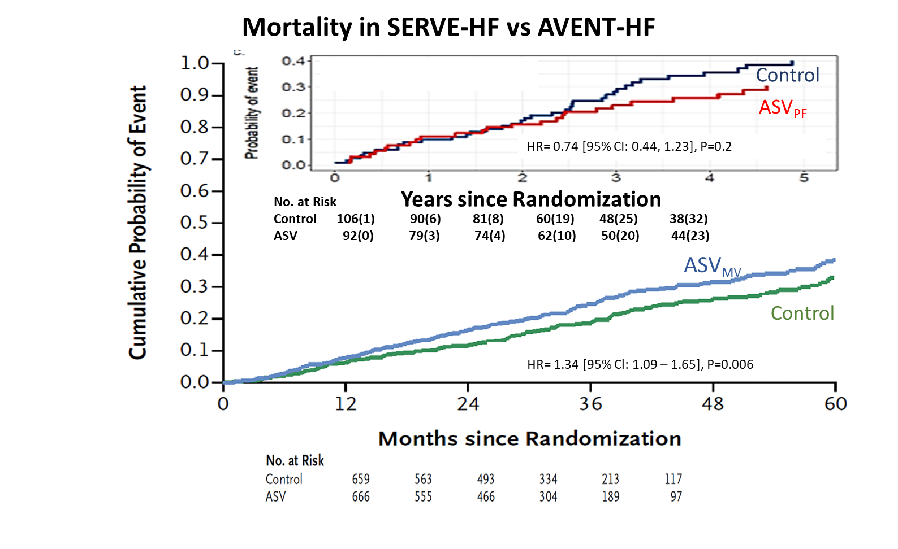
Mortality in SERVE-HF vs ADVENT-HF
Javaheri et al . CSA and CVD SLEEEP 2025

Slide 19
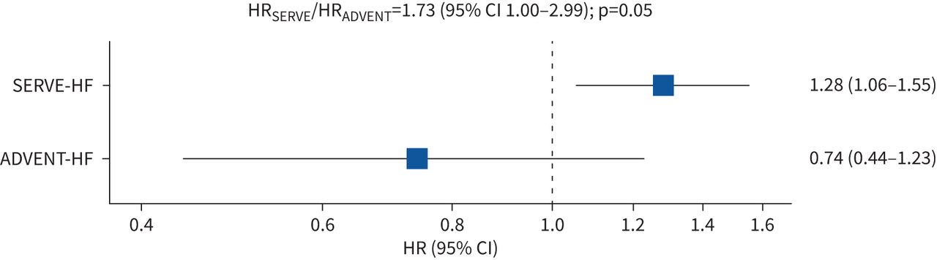
Comparison of HR for all-cause mortality in HFrEF patients with CSA treated with ASVmv n SERVE-HF and ASVpf in ADVENT-HF
.
p-value of 0.05, suggests qualitatively different effects

Slide 20
  Medications-Induced CSA
Opioids including tramadol
Baclofen
Beta-hydroxy butyrate
Valproic acid
Gabapentinoids
Ticagrelor

Slide 21
Death Due to Opioids
The United States is in the middle of
a devastating opioid epidemic
Drug poisonings are a leading cause of death for Americans ages 18-45, with nearly 70% of these deaths in 2022 caused by fentanyl and other synthetic opioids
70% of all deaths involving benzodiazepines in 2021 also involved fentanyl, highlighting the
co-occurrence of these substances

Slide 22
12 Month-ending Provisional Counts of Drug Overdose Deaths: United States
Most found dead in bed,
with no known cause ,except opioids in blood
Apnea and
hypoventilation
Torsade
70,630 101,035
33,000
• Nationally 101,035 reported deaths
Ohio – 5,344 reported deaths
2015 2017 2019 2022

Slide 23
For Immediate Release: May 15, 2024
Contact: CDC, National Center for Health Statistics, Office of Communication (301) 458-4800
Provisional data from CDC’s National Center for Health Statistics indicate there were an estimated 107,543 drug overdose deaths in the United States during 2023—a decrease of 3% from the 111,029 deaths estimated in 2022. This is the first annual decrease in drug overdose deaths since 2018.

Slide 24

Papaver somniferum
somnus, “sleep”, and ferre, “bring”
No relevant COI

Slide 25
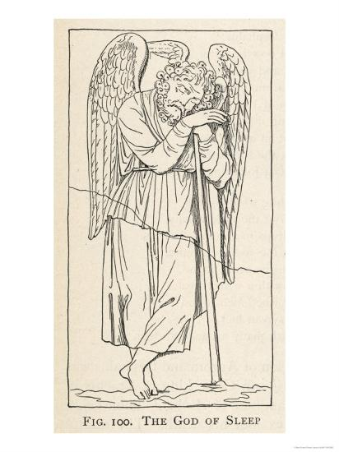
somnus, “sleep”, and ferre, “bring”
Papaver somniferum
The God of Sleep
Somnus (Latin)
Hypnos (Greek)

Slide 26
Death in Bed Syndrome (DIBS)
His maid heard him snoring at 12:00 p.m. and he was found dead 3 hours later.
The medical examiner spokeswoman said:
"Mr. Heath Ledger died as a result of acute intoxication by the combined effects of oxycodone, hydrocodone, diazepam, temazepam, alprazolam, and doxylamine "
The only abnormality found was the drug levels noted.
Mr. Heath Ledger died from opioid-induced respiratory depression and sleep apnea

Slide 27
Sleep apnea
Respiratory Depression
Although acute use of opioids may cause CO₂ retention, chronic respiratory acidosis, a reflection of long-term respiratory depression is not common or is mild in most cases.
However, respiratory depression in the form of sleep apneas and hypopneas, both obstructive and central, and hypoventilation are prevalent in patients who are chronically using opioids.

Slide 28
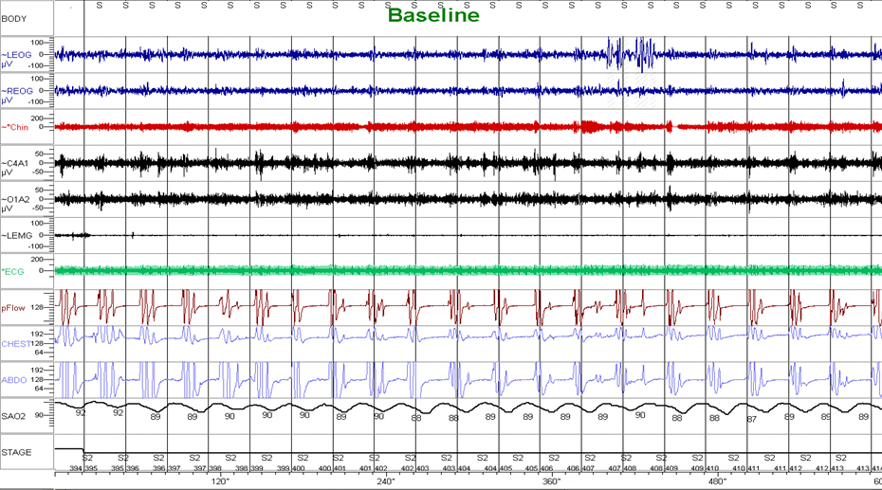
Sleep apnea associated with opioids
(Javaheri,JCSM,2008)

Slide 29
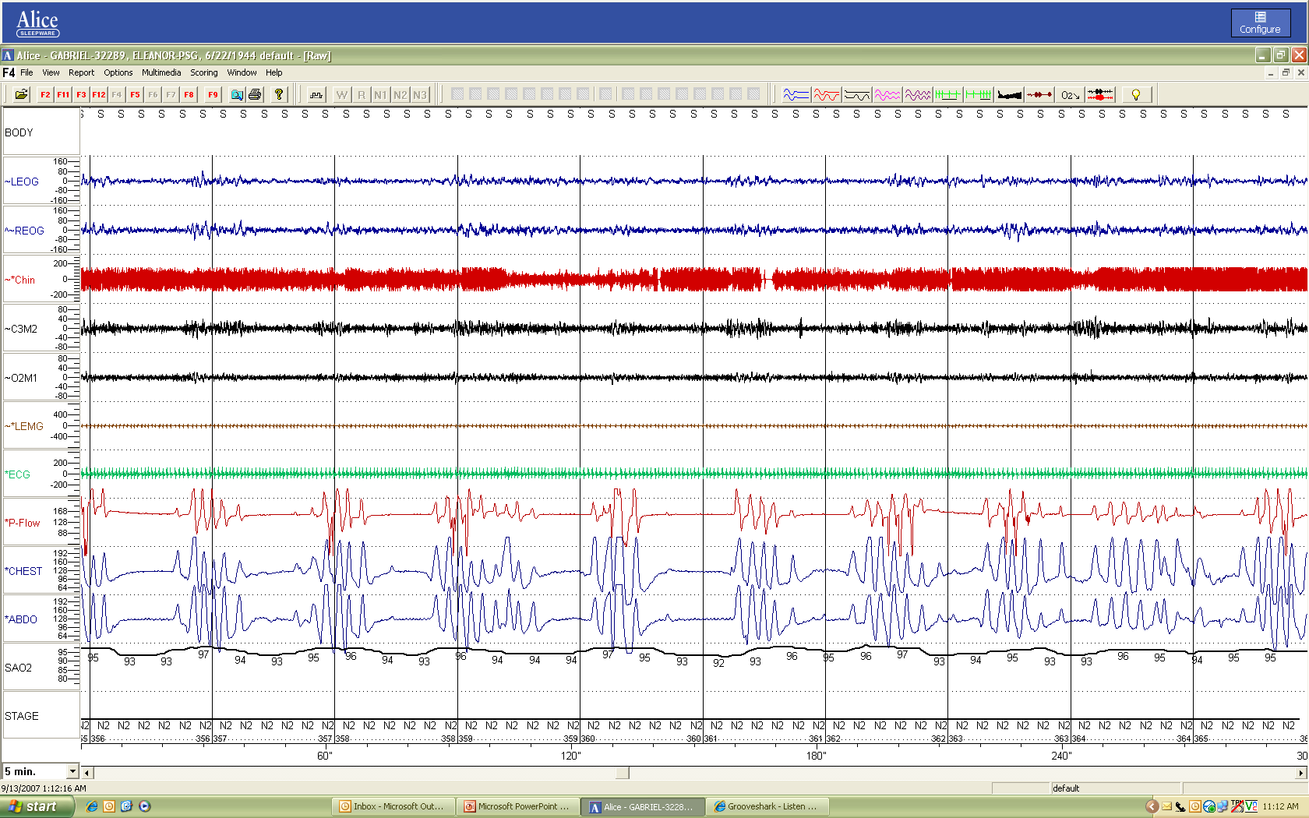
Opioids and sleep apnea
Javaheri et al, JCSM,2014
CSA OSA CSA/OA OSA CSA OSA OSA Hyp Hyp

Slide 30
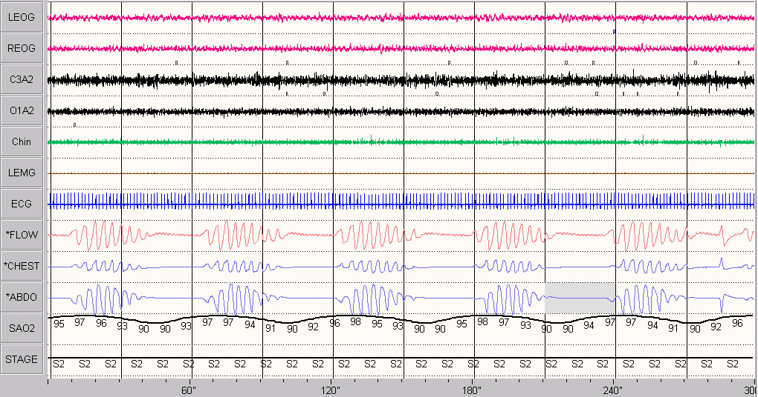
HCSB
Notes:
This pt is 80 years old
M/H: HTN, Heart surgery in 1993
AHI = 69/hr
Lowest oxygen = 87%
D O T= 11/21/04

Slide 31
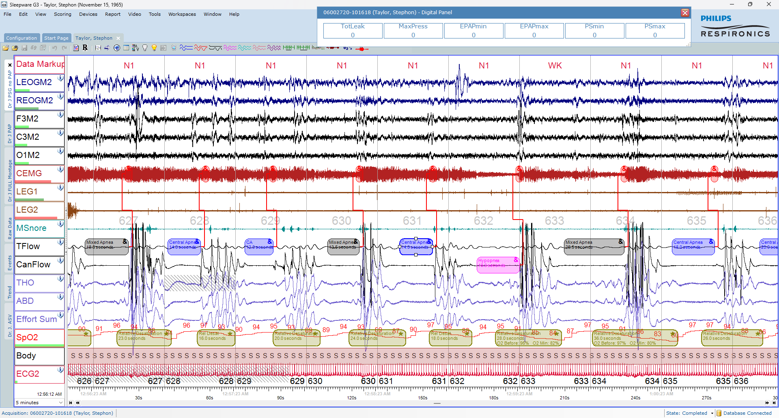

Slide 32
Opioids and sleep apnea( n=20)
Symptoms: snoring, EDS, Witnessed Apnea
Javaheri et al, JCSM,2014
CSA OSA CSA/OA OSA CSA OSA OSA Hyp Hyp

Slide 33
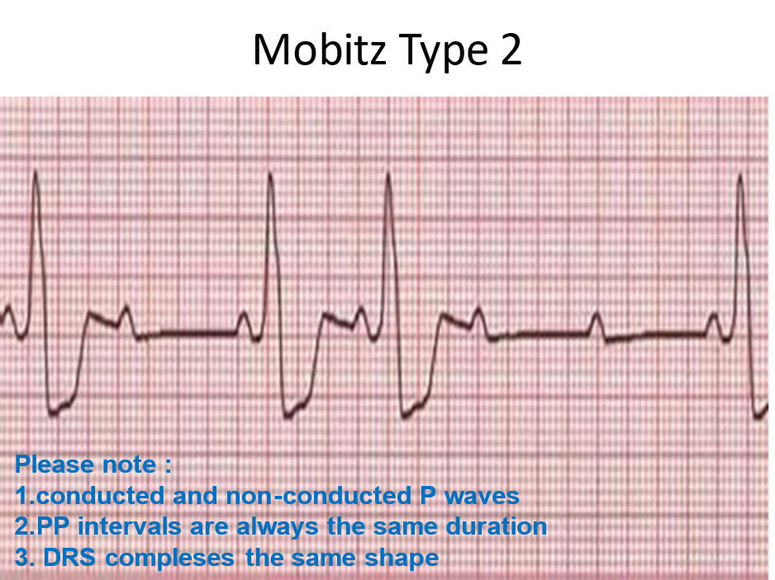
Second degree heart block

Slide 34
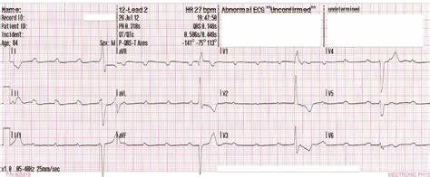
Mobitz (Type 2)

Slide 35
Opioids and sleep apnea( n=20)
Symptoms: snoring, EDS, Witnessed Apnea
Javaheri et al, JCSM,2014
CSA OSA CSA/OA OSA CSA OSA OSA Hyp Hyp

Slide 36
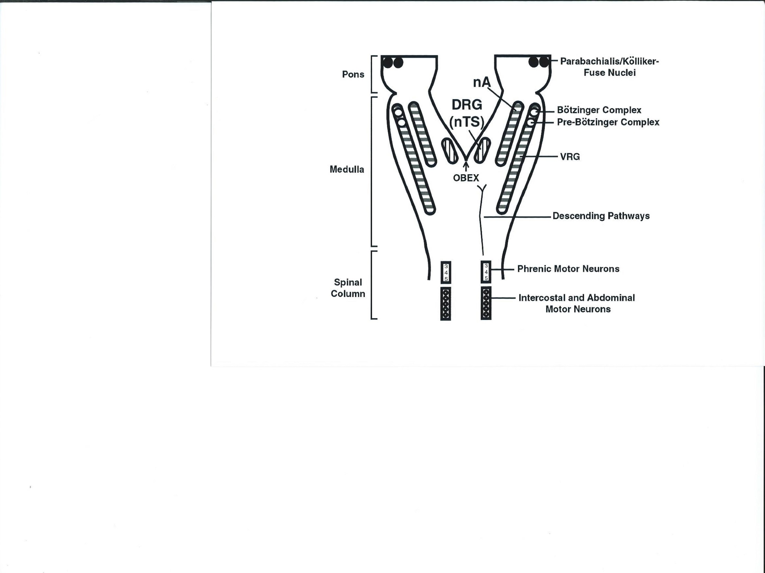
Javaheri
Determinants of carbon dioxide tension
In: Acid-Base Disorders and Their Treatment
2005; 47-77
Organization of Brainstem Respiratory
Centers

Slide 37
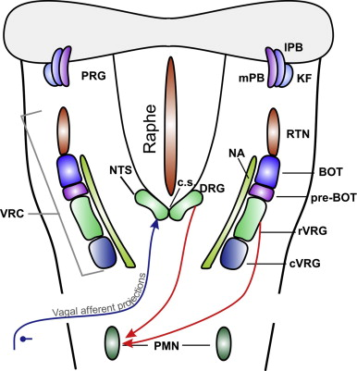
The Brainstem Respiratory Network
Bautista T G, Pitts TE, Pilowsky PM, Morris KF
.
. The Florey Institute of Neuroscience and Mental Health, Melbourne, VIC, Australia

Slide 38
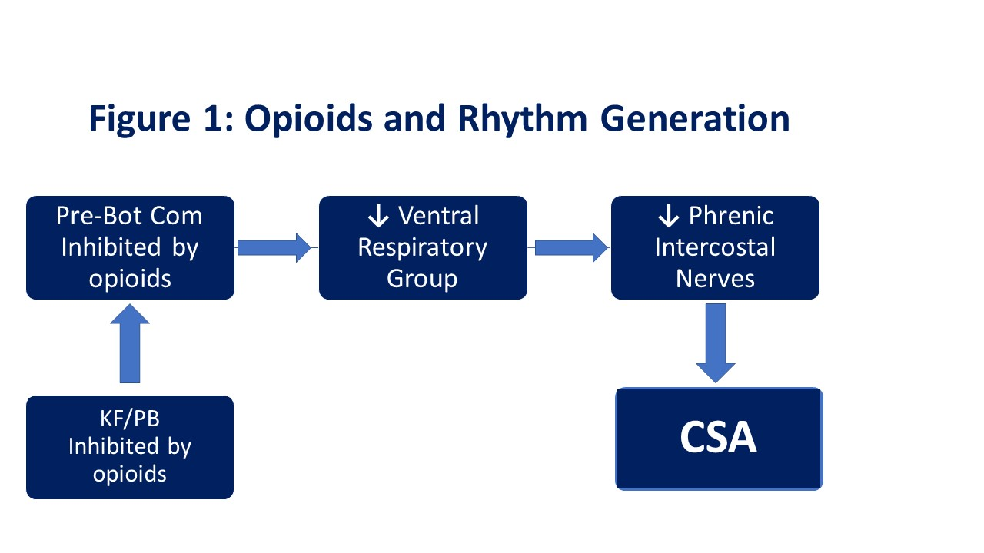
Opioids-Induced CSA
Javaheri et ak SLEEP J –2024

Slide 39
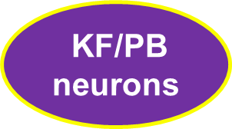








The Brainstem Respiratory Network
Pre-Bot com
Inspiratory rhythm generator
Hypoglossal
Motoneurons
rVRG
(RTN/pFRG)
Expiratory rhythm generator
Phrenic/Intercostal
Nerves
GG muscle

Slide 40
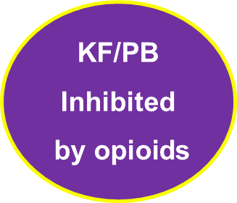



Effects of Opioids on Rhythm Generation
Pre-Bot com
Inhibited by opioids
rVRG
Hypoglossal
Motoneurons
RTN/pFRG
Not inhibited by opioids
Phrenic
intercostal nerve
GG muscle
OSA CSA

Slide 41
Opioids Cause Central and Complex Sleep Apnea in Humans: Reversal with Discontinuation: A Plea for Detoxification.
J Clin Sleep Med , 2017
On opioids Off opioids

Slide 42
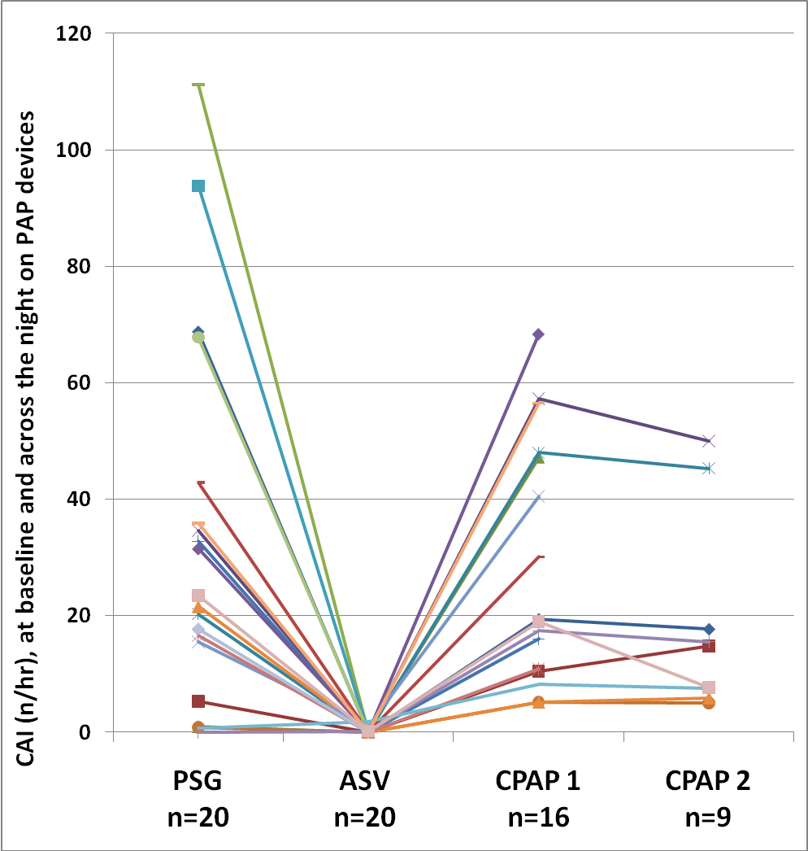
CAI across in 20 patients on opioids
Javaheri et al, Sleep 2014

Slide 43
  Medications-Induced CSA
Opioids including tramadol
Baclofen
Beta-hydroxy butyrate
Valproic acid
Gabapentinoids
Javaheri et al. Medication-Induced Central Sleep Apnea:
A Unifying Concept. SLEEP 2024; 47:1-13

Slide 44
Baclofen-Induced CSA
Olivier et al. CHEST 2016; 149(5):e127–e131

Slide 45
Opioids and sleep apnea
Javaheri et al, JCSM,2014
CSA OSA CSA/OA OSA CSA OSA OSA Hyp Hyp

Slide 46
Unifying mechanism mediating CSA with Baclofen and opioids
Chemical neuroanatomy of the preBöt Complex and KF neurons μ-opioid receptors and GABA_{B} receptors are colocalized on preBötC and KFneurons
Alheid GF, McCrimmon DR. The chemical neuroanatomy of breathing.
Respir Physiol Neurobiol. 2008;164(1-2):3-11.

Slide 47
Inhibition of Rhythm Generation by Opioids and GAB-B agonists
Pre-BotC inhibited by µopioids/GABA-B agonists
KF/PB inhibited by µopioids/GABA-B agonists
Hypoglossal motoneurons
Phrenic/Intercostal
Nerves
GG muscle
OSA
CSA

Slide 48
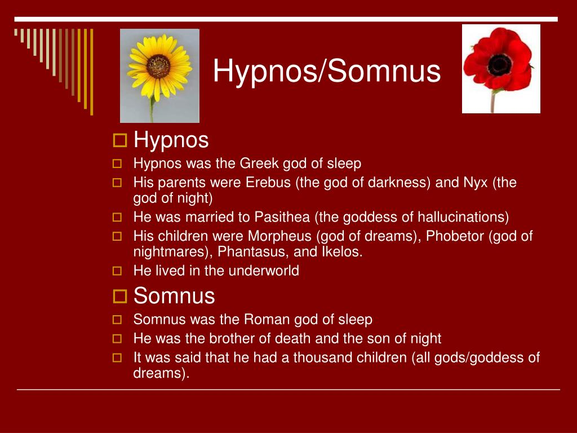
Thanatos

Slide 49

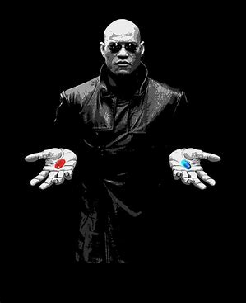
Gods of Dreams
Phobetor (Frightener)
Morpheus
by zacky7avenged on DeviantArtMorpheos

Slide 50
Thanatos
Had a brother Thanatos, the personified spirit of
the god of non-violent death. ...

Slide 51
Neurochemistry
mu-opioid receptors are prevalent in
Pre Botz C neurons and
KF-PB nuclei

Slide 52
Destruction of preBötC
In adult rats, selective destruction of preBötC neurons causes disruption of breathing eventually to increased mortality during sleep
This latter finding in animals is relevant to opioids associated mortality in human as many individuals on opioids are found dead in bed, during sleep with no cause found at autopsy except opioids in the blood leading

Slide 53
One hundred and seventy-eight individuals using opioids were matched to 534 controls (median [IQR] age 59 [50,65] years,
BMI 33 [29,41] kg/m2, 57% female, and daily morphine equivalent 30 [20,80] mg). Compared with controls, opioids were associated with
increased central apneas (2.8 vs. 1.7 events/hr; p = .001) and worsened hypoxemia (5 vs. 3% sleep with SpO2
< 88%; p = .013), with sim
ilar overall apnea–hypopnea index. The use of opioids was associated with higher loop gain, a lower respiratory rate (RR), and higher
RR variability. Higher loop gain and increased RR variability mediated the effect of opioids on central apnea, but did not mediate the
effect on hypoxemia.
Orr JE, Malhotra A, Gruenberg E, MarinT, Sands SA , Alex RM, Robert L. Owens RL and Schmick CN. Pathogenesis of sleep-disordered breathing in the
setting of opioid use: a multiple mediation analysis
using physiology. Sleep J 2024

Slide 54
In models incorporating estimated daily morphine equivalent dose, increasing dose was associated with a significant increase in both central apneas (β = 0.01 events/hr per mg; 95%CI: 0.01 to 0.01;
p < .001) and %SpO2 < 88% (β = 0.06 % per mg; 95% CI: 0.05 to 0.07; p < .001

Slide 55
12 Month-ending Provisional Counts of Drug Overdose Deaths: United States
The new data show overdose deaths involving opioids decreased from an estimated 84,181 in 2022 to 81,083 in 2023
Most found dead in bed,
with no known cause ,except opioids in blood
Apnea and
hypoventilation
Torsade
70,630 101,035
33,000
• Nationally 101,035 reported deaths
Ohio – 5,344 reported deaths
2015 2017 2019 2022

Slide 56
Treatment of Sleep Apnea Associated with the Use of Opioids
Withdrawal of opioids
PAP devices
CPAP/bilevel (treats OSA), CSA may emerge: Comp SA
Bi-level with back up rate (treats both)
ASV(treats both)
O₂, acetazolamide, theophylline, ampakines
Phrenic N stimulation

Slide 57

Opioids Cause Central and Complex Sleep Apnea in Humans: Reversal with Discontinuation: A Plea for Detoxification. Javaheri and Patel, JCSM, 2017
A 44-year-old female was referred for evaluation of possible sleep apnea. She complained of habitual snoring, witnessed apnea, frequent nocturnal awakenings, nocturia, non-restorative sleep, and excessive daytime sleepiness. She scored 17 our of 24 on the Epworth Sleepiness Scale.
She was on OxyContin® 40 mg TID and Vicodin® up to 4 times daily for chronic pain stemming from a craniotomy and decompression for Chiari malformation six years ago.
She was also on Cymbalta® 20 mg daily for depression.
at the initial visit.

Slide 58
  Medications-Induced CSA
Opioids including tramadol
Baclofen
Beta-hydroxy butyrate
Valproic acid
Gabapentinoids
Ticagrelor

Slide 59
Baclofen and CSA
Gamma-aminobutyric acid-B agonist (GABA B agonist)
Muscle-relaxant with antispasmodic properties
Used to treat severe spasticity associated with spinal cord lesions or neurologic disorders
Used for the treatment of alcohol dependence

Slide 60
Baclofen-Induced CSA
Olivier et al. CHEST 2016; 149(5):e127–e131

Slide 61
Opioids and sleep apnea
Javaheri et al, JCSM,2014
CSA OSA CSA/OA OSA CSA OSA OSA Hyp Hyp

Slide 62
Unifying mechanism mediating CSA with Baclofen and opioids
Chemical neuroanatomy of the preBöt Complex and KF neurons μ-opioid receptors and GABA_{B} receptors are colocalized on preBötC and KFneurons
Alheid GF, McCrimmon DR. The chemical neuroanatomy of breathing.
Respir Physiol Neurobiol. 2008;164(1-2):3-11.

Slide 63
Inhibition of Rhythm Generation by Opioids and GAB-B agonists
Pre-BotC inhibited by µopioids/GABA-B agonists
KF/PB inhibited by µopioids/GABA-B agonists
Hypoglossal motoneurons
Phrenic/Intercostal
Nerves
GG muscle
OSA
CSA

Slide 64
  Medications-Induced CSA
Opioids including tramadol
Baclofen
Beta-hydroxy butyrate
Valproic acid
Gabapentinoids
Ticagrelor

Slide 65
Sodium oxybate and CSA
Frase L, Schupp J, Sorichter S, Randelshofer W, Riemann D,
Nissen C. Sodium oxybate-induced central sleep apneas.
Sleep Med. 2013;14(9):922–924.
Heshmati A. Central sleep apnea with sodium oxybate in a pediatric patient. J Clin Sleep Med. 2019;15(3):515–517
Sachdeva A, Dunn AE, Kaplish N. Central sleep apnea with
Cheyne-Stokes respiration associated with sodium oxybate use.
Sleep. 2018;41(Suppl. 1):A411.

Slide 66
GHB and CSA
Sodium oxybate is the sodium salt of gamma-hydroxybutyrate (GHB), an endogenous compound and metabolite of the neurotransmitter GABA
It is hypothesized that the therapeutic effects of Xyrem on cataplexy and excessive daytime sleepiness are mediated through GABA_{B} actions at noradrenergic and dopaminergic neurons, as well as at the site normal cortical neurons
GHB cause CSA through GABA_{B} located in preBötC

Slide 67
Sodium oxybate and CSA
Frase et al.Sleep Medicine 14 (2013) 922–924

Slide 68
Opioids and sleep apnea
Javaheri et al, JCSM,2014
CSA OSA CSA/OA OSA CSA OSA OSA Hyp Hyp

Slide 69
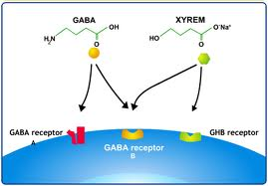
Sodium oxybate
Sodium oxybate

Slide 70
Unifying mechanism mediating CSA
Baclofen, opioids and beta-hydroxy butyrate
Chemical neuroanatomy of the preBöt Complex essential for respiratory rhythm generation μ-opioid receptors and GABAB receptors are colocalized on preBötC neurons
Alheid GF, McCrimmon DR. The chemical neuroanatomy of breathing.
Respir Physiol Neurobiol. 2008;164(1-2):3-11.

Slide 71
  Medications-Induced CSA
Opioids including tramadol
Baclofen
Beta-hydroxy butyrate
Valproic acid
Gabapentinoids
Ticagrelor

Slide 72
Valproic acid and CSA
The anticonvulsant effect has been attributed to the blockade of voltage-gated sodium channels and increased brain levels of gamma-aminobutyric acid (GABA)
In animals, sodium valproate raises cerebral and cerebellar levels of the inhibitory synaptic neurotransmitter, GABA, possibly by inhibiting GABA degradative enzymes, such as GABA transaminase, succinate-semialdehyde dehydrogenase and by inhibiting the re-uptake of GABA by neuronal cells
Valpro sodium valproate" (PDF). TGA eBusiness Services. Alphapharm Pty Limited. 16 December 2013. Retrieved 14 February 2014

Slide 73
Association of Valproic Acid With Central Sleep Apnea Syndrome Two Case Reports
Guichard K, Micoulaud-Franchi JA(Journal of Clinical Psychopharmacology 2019 )

Slide 74
  Medications-Induced CSA
Opioids including tramadol
Baclofen
Beta-hydroxy butyrate
Valproic acid
Gabapentinoids
Ticagrelor

Slide 75
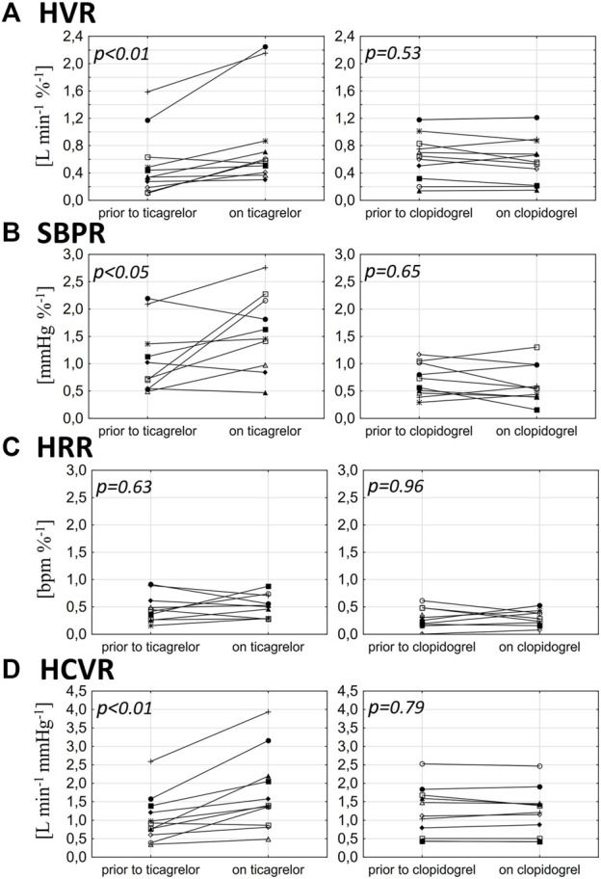
Ticagrelor but not clopidogrel
Increases chemosensitivity
hypoxic ventilatory response
(HVR) (A),
SBP response to hypoxia (B),
heart rate response to hypoxia (C),
and hypercapnic hyperoxic ventilatory
response (D)
Tubek S, Niewinski P, Langner-Hetmanczuk A, Jura M, Kuliczkowski W, Reczuch K, Ponikowski P. The effects of P2Y12 adenosine receptors' inhibitors on central and peripheral chemoreflexes. Front Physiol. 2023 Jul 19;14:1214893. doi: 10.3389/fphys.2023.1214893. PMID: 37538377; PMCID: PMC10394699.

Slide 76
On Ticagrelor
One week after Ticagrelor
discontinuation
One month after Ticagrelor
discontinuation
(a)
20 min
(b)
20 min
(c)
20 min
Flow (au)
Thorax (au)
Abdomen (au)
SaO2 (%)
Diurnal AHI: 6; Nocturnal AHI: 28
Diurnal AHI: 5; Nocturnal AHI: 19
Diurnal AHI: 3; Nocturnal AHI: 7

Slide 77
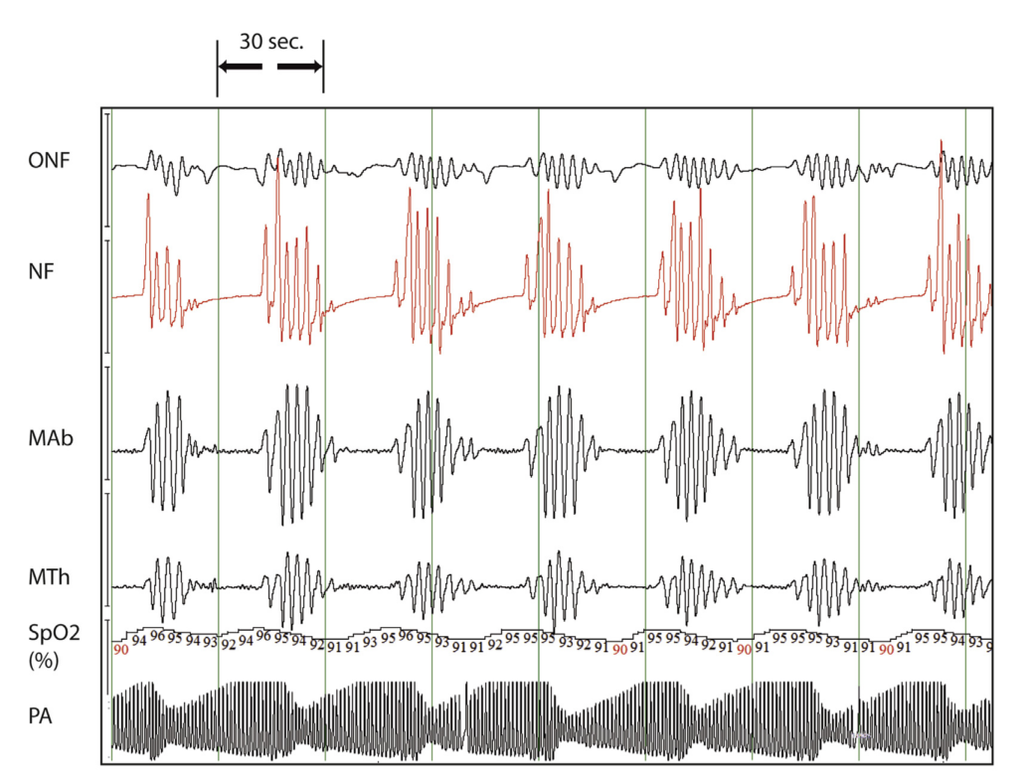
Medication-Induced CSA

Slide 78
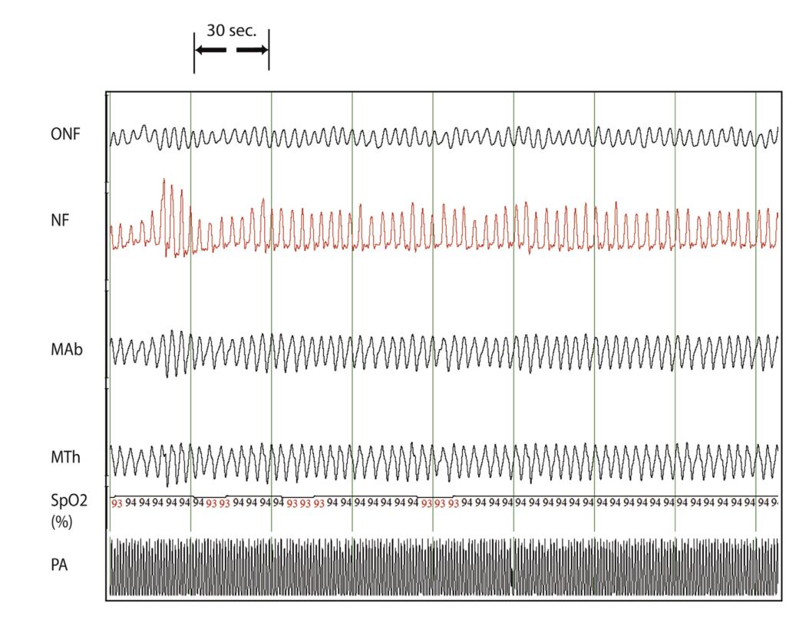
CSA Associated with Ticagrelor
and reversal with substitution with clopidogrel
Ticagrelor treatment for 2 months
Ticagrelor withdrawal
Modified from Lamberts et al. Sleep Med 2018;43:4-6

Slide 79
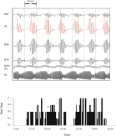

Slide 80
Hunter-Cheyne-stokes breathing associated with Ticagrelor
and reversal with substituion with clopidogrel
Ticagrelor treatment for 2 months
Ticagrelor withdrawal
Modified from Lamberts et al. Sleep Med 2018;43:4-6

Slide 81
Ticagrelor inhibits adenosine

Slide 82
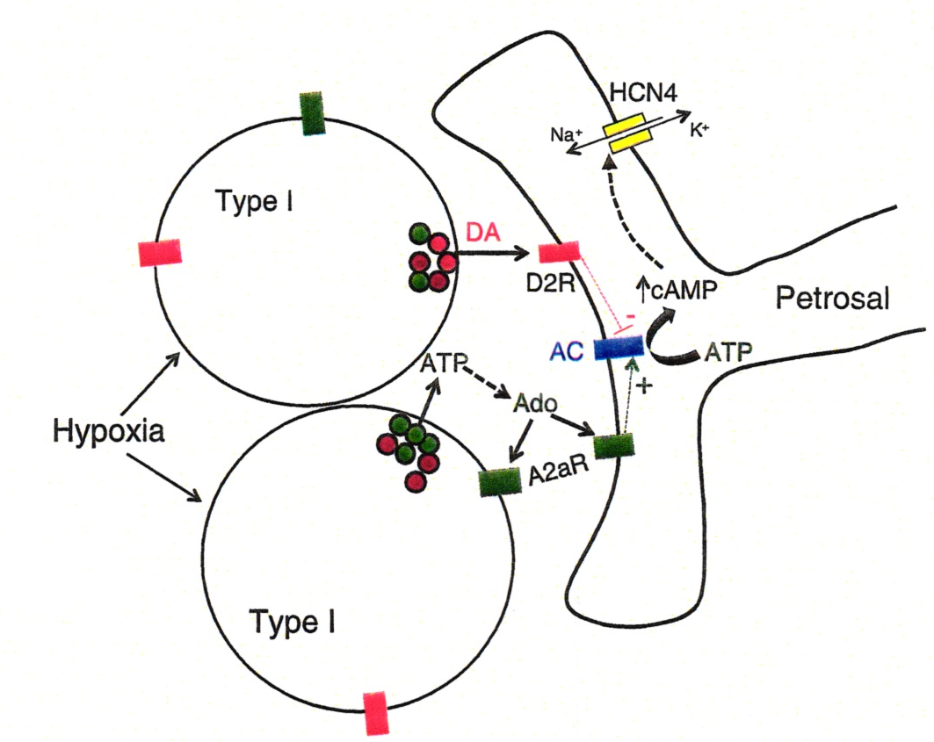
Ticagrelor inhibits adenosine uptake into erythrocytes, leading to changes in regional blood ﬂow similar to those obtained with dipyridamole
Increase in ventilation

Slide 83
Effects of various RX options on CAHI in HFrEF
variable
AHI
O₂
O₂
O₂
ACTZ
CPAP
CPAP
CPAP
PNS
Benzo
Benzo
Baseline
8
45
38
38
55
45
40
51
50
21
Placebo
12
-
38
-
57
-
-
-
-
23
gabapentin
22*
28* BJ
25* EHJ
18 * Sleep
34* BJ
27* BJ
20 * NEJM
37 Circ
22 Lancet
21 Sleep
20 Sleep

Slide 84
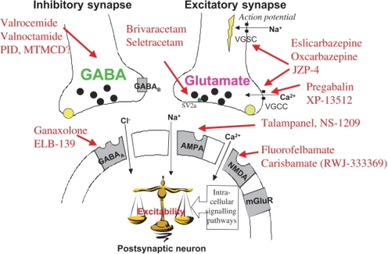

Slide 85
Gabapentin is a synthetic analogue of the neurotransmitter gamma-aminobutyric acid
The primary mode of action appears to be at the auxillary α2δ-1 subunit of voltage-gated calcium channels (though a low affinity for the α2δ-2 subunit has also been reported)

Slide 86
Gabapentin is a synthetic analogue of the neurotransmitter gamma-aminobutyric acid
Revol B, Jullian-Desayes I, Cracowski JL, et al.
Gabapentinoids and sleep apnea syndrome: a
safety signal from the WHO pharmacovigilance
database. Sleep. 2019;42.
Piovezan RD, Kase C, Moizinho R, et al.
Gabapentin acutely increases the
apnea-hypopnea index in older men: data from a
randomized, double-blind, placebo-controlled
study. J Sleep Res. 2017;26:166–170.

Slide 87
Ng GY, Bertrand S, Sullivan R, Ethier N, Wang J, Yergey J, Belley M, Trimble L, Bateman K, Alder L, Smith A, McKernan R, Metters K, O'Neill GP, Lacaille JC, Hébert TE. Gamma-aminobutyric acid type B receptors with specific heterodimer composition and postsynaptic actions in hippocampal neurons are targets of anticonvulsant gabapentin action. Mol Pharmacol. 2001 Jan;59(1):144-52. PMID: 11125035.

Slide 88
(Neurontin) is a 3-alkylated GABA analog with an unknown mechanism of action. Here we report that gabapentin is an agonist at the GABA(B) gb1a-gb2 heterodimer coupled to Kir 3.1/3.2 inwardly rectifying K+ channels in Xenopus laevis oocytes. Gabapentin was practically inactive at the human gb1b-gb2 heterodimer, a novel human gb1c-gb2 heterodimer and did not block GABA agonism at these heterodimer subtypes. Gabapentin was not an agonist at recombinant GABA(A) receptors as well. In CA1 pyramidal neurons of rat hippocampal slices, gabapentin activated postsynaptic K+ currents, probably via the gb1a-gb2 heterodimer coupled to inward rectifiers, but did not presynaptically depress monosynaptic GABA(A) inhibitory postsynaptic currents. Gabapentin is the first GABA(B) receptor subtype-selective agonist identified providing proof of pharmacologically and physiologically distinct receptor subtypes. This selective agonism of postsynaptic GABA(B) receptor subtypes by gabapentin in hippocampal neurons may be its key therapeutic advantage as an anticonvulsant.

Slide 89
The anticonvulsant actions of gabapentin in hippocampal cells may thus involve GABA(B) receptor coupling to G-proteins and modulation of Kir3 and N-type Ca(2+) channels. Moreover, gabapentin and baclofen activation of GABA(B) receptors may couple to distinct cellular targets.
Bertrand S, Nouel D, Morin F, Nagy F, Lacaille JC. Gabapentin actions on Kir3 currents and N-type Ca2+ channels via GABAB receptors in hippocampal pyramidal cells. Synapse. 2003 Nov;50(2):95-109. doi: 10.1002/syn.10247. PMID: 12923812.

Slide 90
Rhythm Generation
Pre-Bot com
KF/PB
rVRG
Hypoglossal
Motoneurons
RTN/pFRG
Not inhibited by opioids
Phrenic
intercostal nerve
GG muscle
OSA CSA

Slide 91
Opioids and Rhythm Generation
Pre-Bot com
KF/PB
rVRG
Hypoglossal
Motoneurons
RTN/pFRG
Phrenic
intercostal nerve
GG muscle
OSA CSA

Slide 92
Valproic acid and CSA
The anticonvulsant effect has been attributed to the blockade of voltage-gated sodium channels and increased brain levels of gamma-aminobutyric acid (GABA)
In animals, sodium valproate raises cerebral and cerebellar levels of the inhibitory synaptic neurotransmitter, GABA, possibly by inhibiting GABA degradative enzymes, such as GABA transaminase, succinate-semialdehyde dehydrogenase and by inhibiting the re-uptake of GABA by neuronal cells
Valpro sodium valproate" (PDF). TGA eBusiness Services. Alphapharm Pty Limited. 16 December 2013. Retrieved 14 February 2014

Slide 93
Association of Valproic Acid With Central Sleep Apnea Syndrome Two Case Reports
Guichard K, Micoulaud-Franchi JA(Journal of Clinical Psychopharmacology 2019 )

Slide 95
Opioids and Rhythm Generation
KF/PB inhibited by opioids
Pre-Bot com
Inhibited by opioids
rVRG
Hypoglossal
Motoneurons
RTN/pFRG
Not inhibited by opioids
Phrenic
intercostal nerve
GG muscle
OSA CSA

Slide 96
Sleep apnea
Respiratory Depression
Although acute use of opioids may cause CO₂ retention, chronic respiratory acidosis, a reflection of long-term respiratory depression is not common or is mild in most cases.
However, respiratory depression in the form of sleep apneas and hypopneas, both obstructive and central, and hypoventilation are prevalent in patients who are chronically using opioids.

Slide 97
2. Respiratory Depression
Terminal apnea is sine qua non of death due to opioids
OSA, CSA, hypoventilation, impairment of arousal, combo drugs

Slide 98
Opioid Receptors
Opioid receptors are members of the G-protein coupled receptors (GPCRs) superfamily, consisting of seven trans-membrane subunits.
Stimulation of GPCR by agonists, such as beta 2 agonists used to treat bronchospasm, activates the G-proteins and initiates an intracellular signaling cascade starting with increased level of cyclic adenosine monophosphate (CAMP).
In contrast, binding of opioid ligands activates inhibitory intracellular pathways decreasing CAMP and reduced neuronal excitability.
There are 4 classes of opioid receptors, consisting of μ, κ, δ, and nociceptin/orphanin FQ peptide receptors with endogenous ligands such as endorphins and enkephalins.
The μ receptor is the main inhibitory receptor abundant in pontomedullary respiratory neurons

Slide 99
Guanine nucleotide-binding regulatory proteins
G proteins
GPCRs superfamily members have been identified in organisms as evolutionarily distant as yeast and man
G-proteins are composed of α, β, and γ subunits
Upon agonist binding, GPCRs increase the exchange of GDP bound on the Gα subunit with GTP.
This leads to the dissociation of Gα subunit from Gβγ dimer resulting in two functional subunits (Gα and Gβγ). G-proteins are identified by their Gα subunits.
Gα proteins are grouped into four families:
Gαs, Gαi, Gαq, and Gα12

Slide 100
G Proteins
G-proteins are identified by their Gα subunits. Based on the sequence and functional similarities, Gα proteins are grouped into four families: Gαs, Gαi, Gαq, and Gα1
Both Gαs and Gαi families regulate adenylyl cyclases
Gαs stimulates adenylyl cyclase to convert ATP into cyclic AMP (cAMP) Elevated cAMP results in the activation of cAMP-regulated proteins
Gαi proteins can inhibit certain isotypes of adenylyl cyclases, leading to reduced intracellular cAMP levels

Slide 101
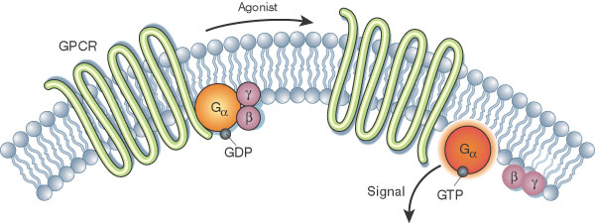
G protein couple receptor(G PCR)
7 transmembrane domain receptors
Gαs stimulates adenylyl cyclaseto convert ATP into cyclic AMP (cAMP) Elevated cAMP results in the activation of cAMP-regulated proteins. In contrast Gαi proteins inhibit adenylyl cyclases, leading to reduced intracellular cAMP levels

Slide 102
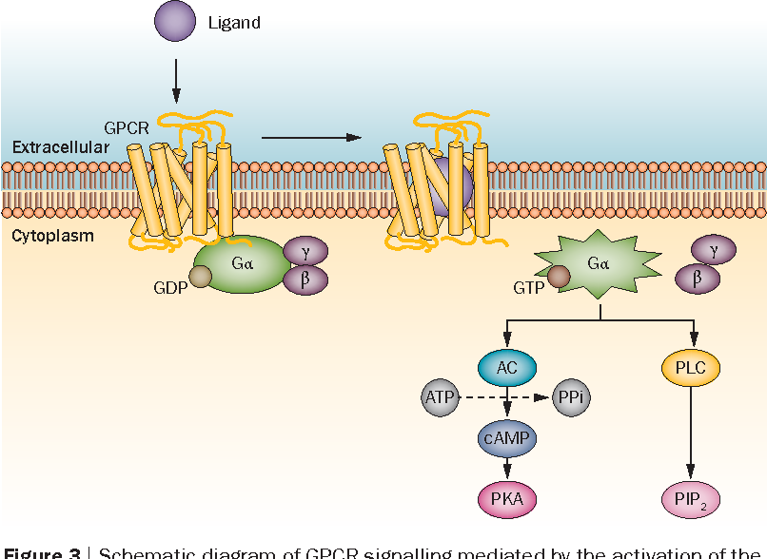

Slide 103
Opioid Receptors
Opioid ligand binding
► activates Gαi(inhibitory): The classical signaling mechanism for G alpha (i) is inhibition of the cAMP dependent pathway through inhibition of adenylate cyclase (Dessauer C W et al. 2002). Decreased production of cAMP from ATP results in decreased activity of cAMP-dependent protein kinases.
▼cAMP
Neuronal depression

Slide 104
Opioid receptors in ponto-medullary respiratory neurons
The pontine neurons are located within the Kolliker-Fuse (KF) and the lateral and medial parabrachial (PB) neurons (KF/PB)
The medullary neurons are located in the pre-Botzinger complex, Botzinger complex and the retrotrapezoid/parafacial nucleus (RTN/pFRG)
Opioid receptors present in all except RTN/pFRG

Slide 105
Baclofen and CSA
Gamma-aminobutyric acid-B agonist (GABA B agonist)
Muscle-relaxant with antispasmodic properties
Used to treat severe spasticity associated with spinal cord lesions or neurologic disorders
Used for the treatment of alcohol dependence

Slide 106
Valproic acid and CSA
The anticonvulsant effect has been attributed to the blockade of voltage-gated sodium channels and increased brain levels of gamma-aminobutyric acid (GABA)
In animals, sodium valproate raises cerebral and cerebellar levels of the inhibitory synaptic neurotransmitter, GABA, possibly by inhibiting GABA degradative enzymes, such as GABA transaminase, succinate-semialdehyde dehydrogenase and by inhibiting the re-uptake of GABA by neuronal cells
Valpro sodium valproate" (PDF). TGA eBusiness Services. Alphapharm Pty Limited. 16 December 2013. Retrieved 14 February 2014

Slide 107
Unifying mechanism mediating CSA
Baclofen, opioids and beta-hydroxy butyrate
Chemical neuroanatomy of the preBöt Complex essential for respiratory rhythm generation μ-opioid receptors and GABAB receptors are colocalized on preBötC neurons
Alheid GF, McCrimmon DR. The chemical neuroanatomy of breathing.
Respir Physiol Neurobiol. 2008;164(1-2):3-11.

Slide 108
GHB and CSA
Sodium oxybate is the sodium salt of gamma-hydroxybutyrate (GHB), an endogenous compound and metabolite of the neurotransmitter GABA
It is hypothesized that the therapeutic effects of Xyrem on cataplexy and excessive daytime sleepiness are mediated through GABA_{B} actions at noradrenergic and dopaminergic neurons, as well as at the site normal cortical neurons
GHB cause CSA through GABA_{B} located in preBötC

Slide 109
Unifying mechanism mediating CSA with Baclofen and opioids
Chemical neuroanatomy of the preBöt Complex essential for respiratory rhythm generation μ-opioid receptors and GABA_{B} receptors are colocalized on preBötC neurons
Alheid GF, McCrimmon DR. The chemical neuroanatomy of breathing.
Respir Physiol Neurobiol. 2008;164(1-2):3-11.

Slide 110
Baclofen-Induced CSA in NON-REM sleep
Perogamvros et al. Respiration, 2015

Slide 111
Medication-Induced CSA

Slide 112
CSA Associated with Ticagrelor
and reversal with substitution with clopidogrel
Ticagrelor treatment for 2 months
Ticagrelor withdrawal
Modified from Lamberts et al. Sleep Med 2018;43:4-6

Slide 113
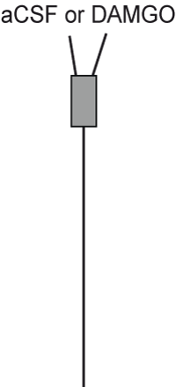
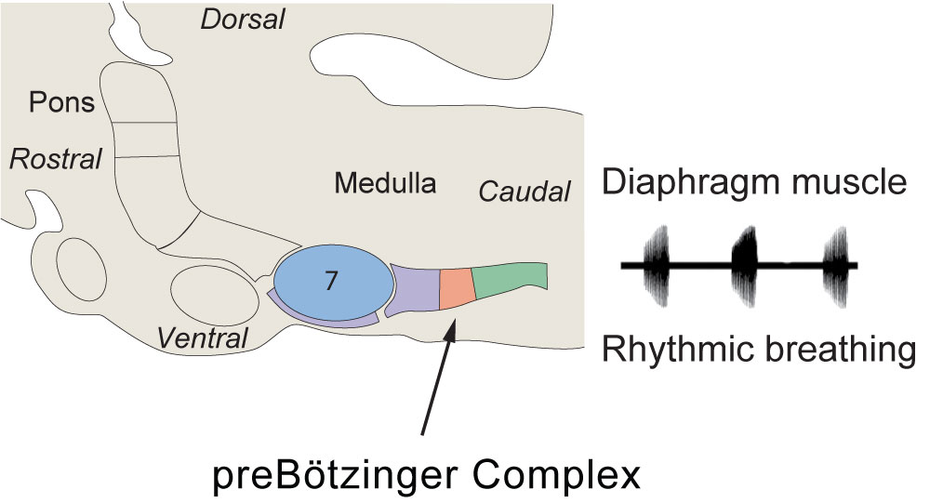
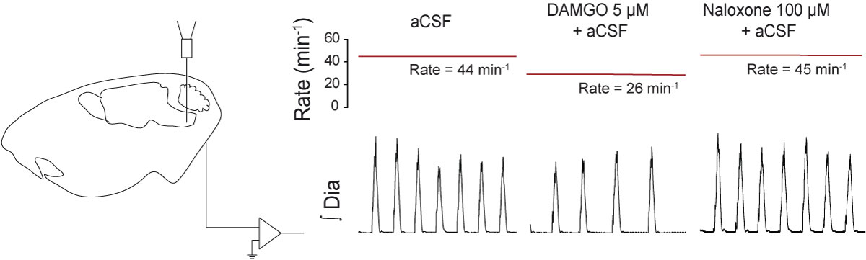
µ receptors in Pre-Botzinger complex mediate opioids-related CSA
(μ opioid
receptor
Agonist)
From: Montandon et al., J Neuroscience, 2011

Slide 114
Location of the KF in the adult mouse brain
Aq=Aqueduct; IC=inferior colliculus; dtg=dorsal tegmental nucleus
VARGA et al. Journal of Neurochemistry. 2021;156:16–37

Slide 115
Opioids-Induced Respiratory Depression During Sleep
Terminal apnea is sine qua non of death due to opioids
OSA, CSA, hypoventilation, impairment of arousal, combo drugs

Slide 116
Destruction of preBötC
Neurochemically, preBötC neurons contain NK1 receptor and substance P is the endogenous agonist
In adult rats, selective destruction of preBötC neurons containing NK1 receptor causes disruption of breathing eventually to increased mortality during sleep
This latter finding in animals is relevant to opioids associated mortality in human as many individuals on opioids are found dead in bed, during sleep with no cause found at autopsy except opioids in the blood

Slide 117
What are the potential causes of death while asleep in patients on opioids?
1. Arrhythmias/ cardiac arrest
2. Respiratory depression
“ Terminal apnea”

Slide 118
CAI across in 20 patients on opioids
Javaheri et al, Sleep 2014

Slide 119
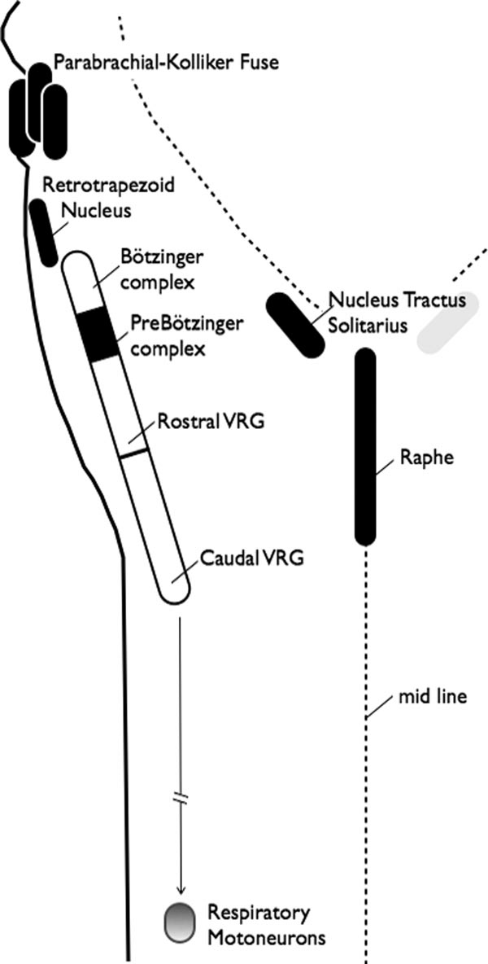
Sagittal view
of the brainstem
Modified from:
Dallan et al
Anesthesiology
2010
Ventral
Anterior

Slide 120
Opioids-induced Death in Bed
Individuals on opioids are discovered dead in in bed and in most cases the cause of death is unexplained, except opioids in the blood
what is the potential cause?
1. SDB (hypoventilation, CSA,OSA)
2. Torsade
3. both

Slide 121
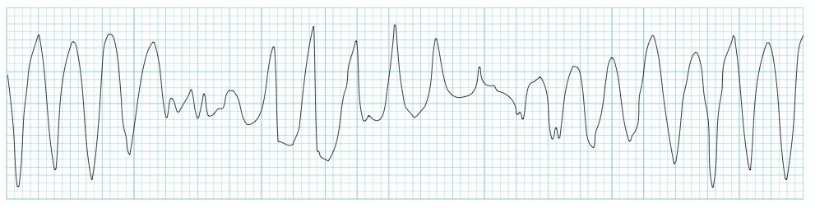
Torsades de pointes (TdP) is a specific form of polymorphic ventricular tachycardia occurring in the context of QT prolongation
Polymorphic ventricular tachycardia (PVT) is a form of ventricular tachycardia in which there are multiple ventricular foci with the resultant QRS complexes varying in amplitude, axis and duration
Tdp has a characteristic morphology in which the QRS complexes “twist” around the isoelectric line.
For TdP to be diagnosed, the patient has to have evidence of both PVT and QT prolongation.

Slide 122
Arrhythmogenic death
Drugs which reduce the magnitude of outward repolarizing K+ currents, enhance inward depolarizing Na+ or Ca2+ currents, or both, thereby triggering the development of early afterdepolarizations that initiate the tachyarrhythmia
An association between methadone and torsade de pointes was first described in 2002
This is mediated by a blockade of the human ion channel responsible for the delayed rectifier potassium current

Slide 123
Arrhythmogenic death
FDA added a boxed warning for methadone in 2006 about arrhythmia risk followed by a clinical practice guideline in 2009 recommending QTc interval screening
Katchman et al. Influence of opioid agonists on cardiac human
ether-a-go-go related gene K(+) currents. J Pharmacol Exp Ther 2002;303:688-94

Slide 124
µ receptors in Pre-Botzinger complex mediate opioids-related CSA
(μ opioid
receptor
Agonist)
From: Montandon et al., J Neuroscience, 2011

Slide 125
Identification of Mechanisms Mediating Opioid-Induced Respiratory Depression
(μ opioid
receptor
Agonist)
From: Montandon et al., J Neuroscience, 2011

Slide 126
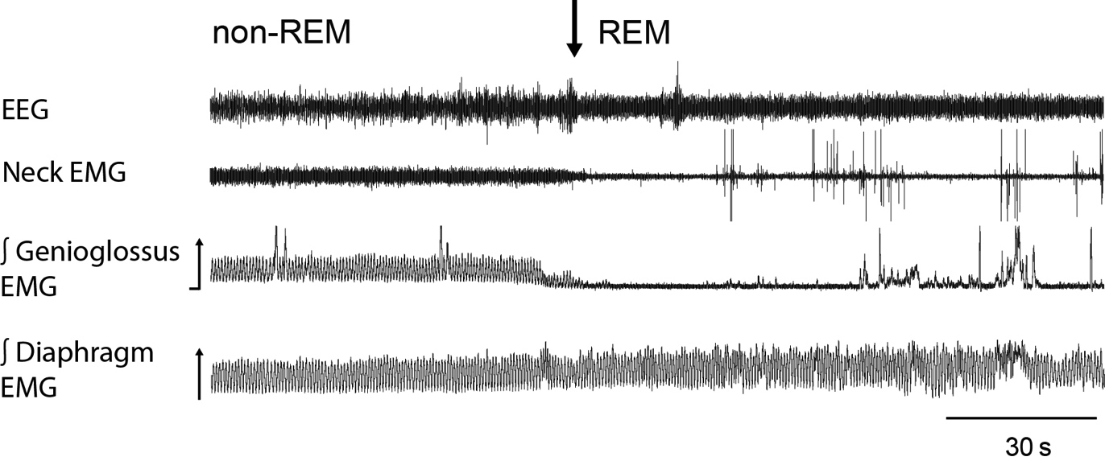
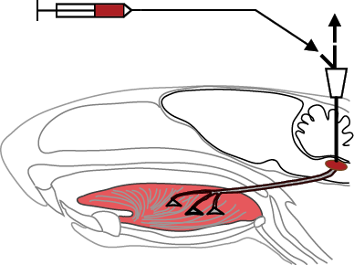
Identification of Mechanisms Controlling Upper Airway Motor Activity in Sleep
From Horner RL, Philos Trans R Soc B, 2009
4
Notes:
Normal sleep and breathing
Obstructive sleep apnea (in REM sleep) - Disturbed breathing, O₂ and sleep
Central apneas related to opiates- Disturbed breathing, O₂ and sleep

Slide 127
Opioids-Induced CSA
Javaheri et ak SLEEP J –In Press

Slide 128
Severe Central Sleep Apnea Associated With Chronic Baclofen Therapy Olivier et al. CHEST 2016; 149(5):e127–e131
Four male patients aged 46 to 70 years treated with baclofen
for alcohol withdrawal
Symptoms : snoring, nocturnal choking, and daytime sleepiness
Dosage, 40, 150 180 and 190 mg/d
2 underwent overnight polysomnography and 2 polygraphy

Slide 129
Severe Central Sleep Apnea Associated With Chronic Baclofen Therapy
Patients
Variable
BMI
Duration, m
PaCO₂, mmHg
AHI, no/h
Ap I, n/h
Central Apnea%
1
29
6
47
59
35
90
2
30
9
37
74
57
98
3 4
31 31
10 3
37 42
100 73
100 46
100 98
3 patients were treated with ASV
1 Patient dced Baclofen: at 6 mo AHI decreased to 2

Slide 130
Severe Central Sleep Apnea Associated With Chronic Baclofen Therapy Olivier et al. CHEST 2016; 149(5):e127–e131

Slide 131
Pilot Study Assessing the Impact of Intrathecal Baclofen
Administration Mode on Sleep-Related Respiratory Parameters
Bensmail et al. Arch Phys Med Rehabil 2012; 93:96-99
No. Age men Pathology Clinical Presentation BMI
11 28-69 9 SCI = 6 Paraplegia 22-31
MS = 3 Tetraplegia
SCD=1 Tetraplegia
Stroke=1

Slide 132
Severe Central Sleep Apnea Associated With Chronic Baclofen Therapy
PSG data before and after intrathecal baclofen injection
Before
injection
13
9
13
21
12
10 days
Bolus
54
68
70
26
16
12 days
Continuous
33
40
17
25
17
Variable
OAI, n/h
CAI, n/h
MAI, n/h
ArI, n/h
% time below 90%

Slide 133
Severe Central Sleep Apnea Associated With Chronic Baclofen Therapy Olivier et al. CHEST 2016; 149(5):e127–e131

Slide 134
Sagittal view
of the brainstem
Modified from:
Dallan et al
Anesthesiology
2010
Ventral
Anterior

Slide 135
Valproic acid and CSA
The anticonvulsant effect has been attributed to the blockade of voltage-gated sodium channels and increased brain levels of gamma-aminobutyric acid (GABA)
In animals, sodium valproate raises cerebral and cerebellar levels of the inhibitory synaptic neurotransmitter, GABA, possibly by inhibiting GABA degradative enzymes, such as GABA transaminase, succinate-semialdehyde dehydrogenase and by inhibiting the re-uptake of GABA by neuronal cells
GABA aminotransaminase (GABA-T) is an important enzyme in the termination of action of GABA. The enzyme is irreversibly inactivated by vigabatrin at therapeutic plasma levels and can also be inhibited by valproic acid at very high concentrations.
Valpro sodium valproate" (PDF). TGA eBusiness Services. Alphapharm Pty Limited. 16 December 2013. Retrieved 14 February 2014

Slide 136
Effect of sodium valproate on the sleep structures of epileptic patients Exp Ther Med. 2014;7:1227-1232.
Revol B, Jullian-Desayes I, Cracowski JL, et al. Gabapentinoids and sleep apnea syndrome: a safety signal from the WHO pharmacovigilance database. Sleep. 2019;42
Piovezan RD, Kase C, Moizinho R, et al. Gabapentin acutely increases the apnea-hypopnea index in older men: data from a randomized, double-blind, placebo-controlled study. J Sleep Res. 2017;26:166-170.
Baillieul S, Revol B, Jullian-Desayes I, et al. Diagnosis and management of central sleep apnea syndrome. Expert Rev Respir Med. 2019;13:545-557

Slide 137
  Opioids-Baclofen,- Beta-hydroxy butyrate- Valproic- acid induced CSA: A unifying mechanism
Opioid Mu receptor, preBötC
Baclofen
GABA_{B} receptor
preBötC
Beta-hydroxy butyrate
GABA_{B} receptor preBötC
Valproic acid
GABA_{B} receptor preBötC

Slide 138
  Drug-induced CSA
Opioid Mu receptor, preBötC
Baclofen
GABA_{B} receptor
preBötC
Beta-hydroxy butyrate
GABA_{B} receptor preBötC
Valproic acid
GABA_{B} receptor preBötC
Ticagrelor

Slide 139
Purinoceptors
P1 ( adenosine, G protein-coupled receptors: 4 subtypes)
( CB: Adenosine involved in HVR)
( Brain: Adenosine inhibits release of NE, ACh, GABA probably involving A1 and A3 receptors and for glutamate release A1 and A2A receptors)
P2 (for ATP/ADP)
P2X : Family of ligand-gated ion channel receptors ( 7 subtypes)
P2X1–P2X7
ATP in the CB involved in HVR via P2X2/3
P2X2 and P2X3 receptor subunits in the rat carotid body afferents
P2X2 receptor deficiency dramatically reduces responses of the CSN to hypoxia
P2Y: Family of G protein-coupled receptors ( 8 subtypes)
P2Y1, P2Y2, P2Y4, P2Y6, P2Y11, P2Y12, P2Y13, and P2Y14
ADP is the natural agonist of this receptor
A1, A2A, A2B, and A3

Slide 141
Adenosine increases ventilation
Increase in ventilation

Slide 142
Purinoceptors
P1 ( adenosine, G protein-coupled receptors: 4 subtypes)
( CB: Adenosine involved in HVR)
( Brain: Adenosine inhibits release of NE, ACh, GABA probably involving A1 and A3 receptors and for glutamate release A1 and A2A receptors)
P2 (for ATP/ADP)
P2X : Family of ligand-gated ion channel receptors ( 7 subtypes)
P2X1–P2X7
ATP in the CB involved in HVR via P2X2/3
P2X2 and P2X3 receptor subunits in the rat carotid body afferents
P2X2 receptor deficiency dramatically reduces responses of the CSN to hypoxia
P2Y: Family of G protein-coupled receptors ( 8 subtypes)
P2Y1, P2Y2, P2Y4, P2Y6, P2Y11, P2Y12, P2Y13, and P2Y14
ADP is the natural agonist of this receptor
A1, A2A, A2B, and A3

Slide 143
Ticagrelor is an oral, reversible, direct-acting inhibitor of the adenosine diphosphate receptor P2Y12 with pronounced platelet inhibition, used in patients with ACS (Storey et al. JACC 2010 )
A 3 arm RCT in patients with stable coronary artery disease receiving ticagrelor, clopidogrel, or placebo in the ONSET/OFFSET study.
dyspnea incidence: 39%, 9%, and 8% of patients in the ticagrelor, clopidogrel and placebo groups, respectively (ticagrelor vs. clopidogrel,
p ˂ 0.001; ticagrelor vs. placebo, p ˂ 0.05; clopidogrel vs. placebo, p = NS
Ticagrelor inhibits adenosine uptake into erythrocytes, leading to changes in regional blood ﬂow similar to those obtained with dipyridamole

Slide 144
Ticagrelor and Dyspnea
HEMIS Study
Ticagrelor+ Aspirin Aspirin + Placebo
no./total 2049/9562 (21%) 700/9531 (7%)
Requiring discontinuation 3% 1%
PLATO Study
Ticagrelor Clopidogrel
Any 1270/9235 (14) 721/9186 (8) <0.001
Requiring discontinuation 0.9 0.1 <0.001

Slide 145
Ticagrelor and Dyspnea
HEMIS Study
Ticagrelor+ Aspirin Aspirin + Placebo
no./total 2049/9562 (21%) 700/9531 (7%)
Requiring discontinuation 3% 1%
PLATO Study
Ticagrelor Clopidogrel
Any 1270/9235 (14) 721/9186 (8) <0.001
Requiring discontinuation 0.9 0.1 <0.001
ONSET/OFFSET study
57 54 12 (Placebo)
39% 9% 8%
Total

Slide 146
Ventilation Parameters in ONSET/OFFSET study
Ticagrelor(n =57) Clopidogrel (n= 54) Placebo(n =12)
Baseline 6 w Baseline 6 w Baseline 6w
VE, l/min 12.9 4.0 13.7 3.6 12.2 3.6 13.1 5.5 12.1 4.1 11.5 3.5
VT, l/min 0.96 0.33 0.92 0.26 0.89 0.32 0.93 0.39 0.89 0.27 0.83 0.33
RR/min 15 2 15 3 14 3 15 2 16 2 15 1
Storey et al. Incidence of Dyspnea and Assessment of Cardiac and Pulmonary Function in Patients With Stable Coronary Artery Disease Receiving Ticagrelor, Clopidogrel, or Placebo in the ONSET/OFFSET Study. J Am Coll Cardiol 2010;56:185–93

Slide 147
Papaver somniferum
Commonly known as the opium poppy or bread seed poppy, is a species of flowering plant in the family Papaveraceae
It is the species of plant from which both opium and poppy seeds are derived and is also a valuable ornamental plant grown in gardens
Its native range was east of the Mediterranean Sea, but now is naturalized across much of Europe and Asia

Slide 148
Papaver somniferum
Poppy is grown as an agricultural crop on a large scale, for several purposes
to produce seeds that are eaten by humans, commonly known as poppy seed
to produce opium for use mainly by the pharmaceutical industry
to produce thebaine and oripavine, that are processed by pharmaceutical companies into drugs such as hydrocodone and oxycodone
A comparatively small amount of P. somniferum is also produced commercially for ornamental purposes

Slide 149
The Brainstem Respiratory Network
Bautista T G, Pitts TE, Pilowsky PM, Morris KF
.
. The Florey Institute of Neuroscience and Mental Health, Melbourne, VIC, Australia

Slide 150
Mu receptors in Pre-Botzinger complex mediate opioids-related CSA
(μ opioid
receptor
Agonist)
From: Montandon et al., J Neuroscience, 2011

Slide 151
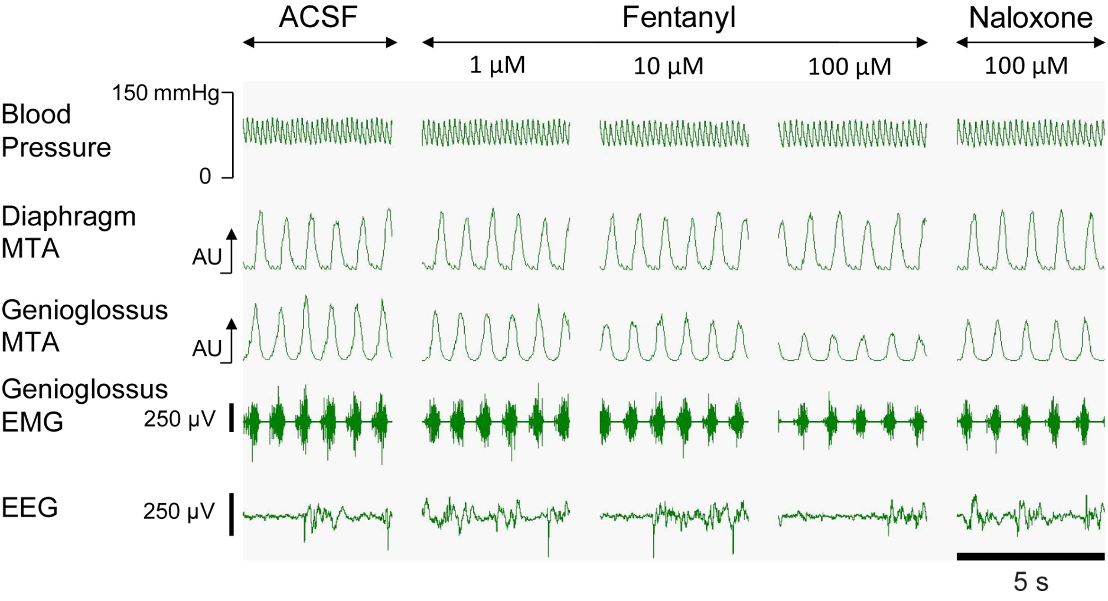
In adult rats, application of opioids at the hypoglossal motor neuron pool diminishes the activity of the GG
Hajiha et al. J Physiol, 2009
Notes:
Figure 2. Modulation of GG activity by μ-opioid receptor mechanisms at the hypoglossal motor pool . Example in one rat showing selective depression of respiratory-related genioglossus activity with localized microdialysis perfusion of the μ-opioid receptor agonist fentanyl into the hypoglossal motor pool, and the subsequent reversal of this suppression with application of the μ-opioid receptor antagonist naloxone. Abbreviations: MTA, Moving Time Average.

Slide 152
Brainstem respiratory network
Tara G.Bautista, Teresa E. Pitts, Paul M. Pilowsky ,Kendall F. Morris.
.The Brainstem Respiratory Network
Tara G. Bautista The Florey Institute of Neuroscience and Mental Health, Melbourne, VIC, Australia

Slide 153
Baclofen-Induced CSA
Locatelli F, Formica F, Galbiati S, Avantaggiato P, Beretta E, Carnovale C, Pozzi M, Clementi E, Strazzer S. Polysomnographic analysis of a pediatric case of baclofen-induced central sleep apnea. J Clin Sleep Med. 2019;15(2):351–354
Olivier PY, Joyeux-Faure M, Gentina T, et al. Severe central sleep apnea associated with chronic baclofen therapy: a case series. Chest. 2016;149(5):e127–e131
Bensmail D, Marquer A, Roche N, Godard AL, Lofaso F, Quera-Salva MA.
Pilot study assessing the impact of intrathecal baclofen administration mode on sleep- related respiratory parameters. Arch Phys Med Rehabil.2012;93(1):96–99.

Slide 154
Neurochemical identity and origin of afferent projections to KF. Purple font indicates neurotransmitters and neuropeptides produced locally in the KF. Origins listed in gray font indicate potential neuropeptide and neurotransmitter release from regions with known anatomical projections to the KF. The specific neurochemical identity of these projections has not been functionally addressed

Slide 155
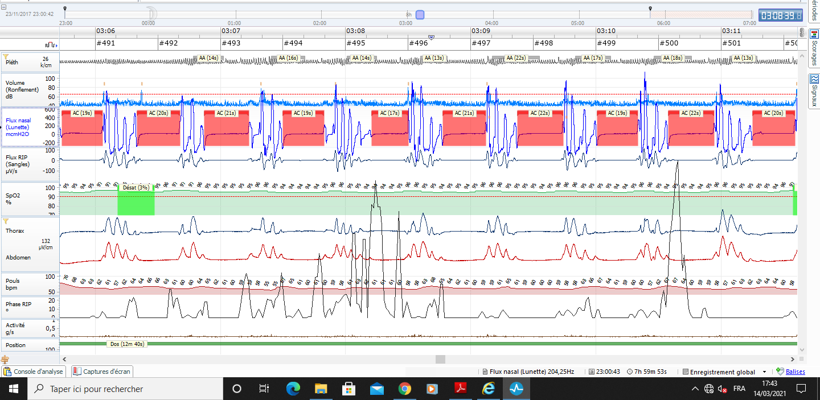

Slide 156
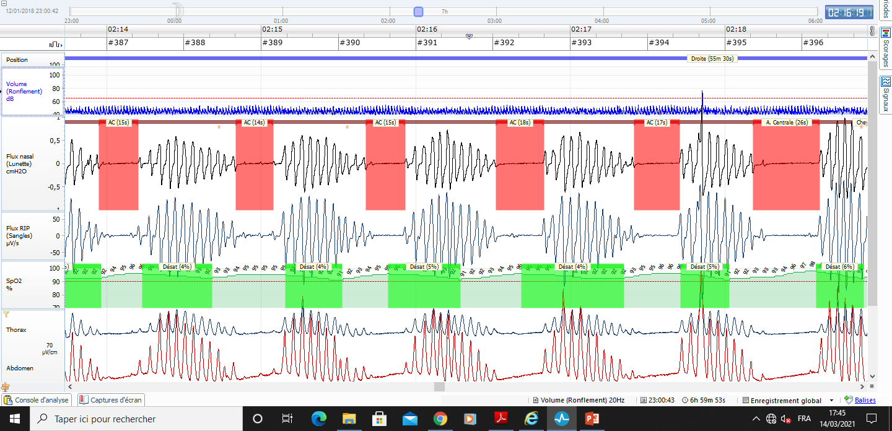
Central Sleep Apnea with ticagrelor

Slide 157
On Ticagrelor
One week after Ticagrelor
discontinuation
One month after Ticagrelor
discontinuation
(a)
20 min
(b)
20 min
(c)
20 min
Flow (au)
Thorax (au)
Abdomen (au)
SaO2 (%)
Diurnal AHI: 6; Nocturnal AHI: 28
Diurnal AHI: 5; Nocturnal AHI: 19
Diurnal AHI: 3; Nocturnal AHI: 7
120
(d)
(e)
(f)
SaO2 (%)
80
Ventilation
(L/min)
40
10
PetCO2
(mmHg)
50
40
HCVR: 2.96 L/min/mmHg
HCVR: 1.95 L/min/mmHg
HCVR: 1.09 L/min/mmHg
40
40
40
Ventilation
(L/min)
Ventilation
(L/min)
Ventilation
(L/min)
10
10
10
40
PetCO2(mmHg)
50
40
PetCO2(mmHg)
50
40
PetCO2(mmHg)
50

Slide 158
Ticagrelor but not clopidogrel
Increases chemosensitivity
hypoxic ventilatory response
(HVR) (A),
SBP response to hypoxia (B),
heart rate response to hypoxia (C),
and hypercapnic hyperoxic ventilatory
response (D)
Tubek S, Niewinski P, Langner-Hetmanczuk A, Jura M, Kuliczkowski W, Reczuch K, Ponikowski P. The effects of P2Y12 adenosine receptors' inhibitors on central and peripheral chemoreflexes. Front Physiol. 2023 Jul 19;14:1214893. doi: 10.3389/fphys.2023.1214893. PMID: 37538377; PMCID: PMC10394699.

Slide 159
Prevalence of sleep apnea in 962 well treated patients with HFrEF
AHI 22 ± 17 events/h
No SDB (AHI <5/h), n (%) 192 (20%)
Mild SDB (AHI 5–14/h), n (%) 211 (22%)
Moderate SDB (AHI 15–29/h), n (%) 263 (27%)
Severe SDB (AHI ≥30/h), n (%) 297 (31%)
Type of SDB, n (%)
CSA (AHI ≥5/h), n (%) 464 (48%)
CSAH, AHI ≥15/h, n (%) 403 (42%)
OSA (AHI ≥5/h), n (%) 295 (31%)
OSAH, AHI ≥15/h, n (%) 156 (16%)
Oldenburg et al, EHJ 2016

Slide 160
somnus, “sleep”, and ferre, “bring”
Papaver somniferum
The God of Sleep
Somnus (Latin)
Hypnos (Greek)

