Slide 1

Obesità e disturbi respiratori nel sonno: una relazione bi-direzionale
Stefania Redolfi
Università degli Studi di Cagliari
Notes:
1

Slide 2
Learning objectives
Obesity definition
Obesity and OSA: Epidemiology
Obesity-related OSA:
  Pathophysiology
  Endotypes
  Gender differences
  Leptin
  Detrimental effects of obesity + OSA
Obesity hypoventilation syndrome (OHS)
Impact of weight loss on OSA
Notes:
2

Slide 3
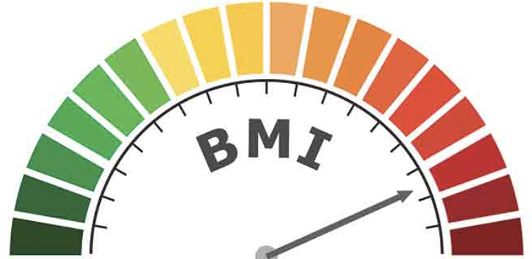
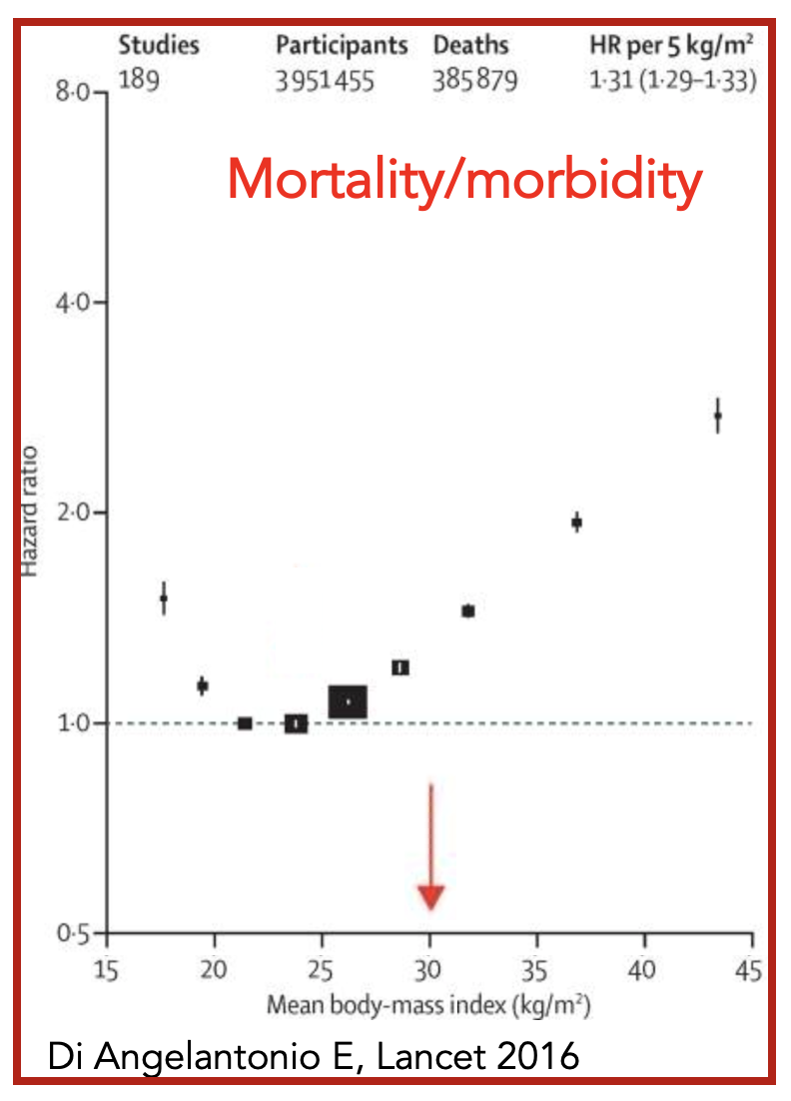
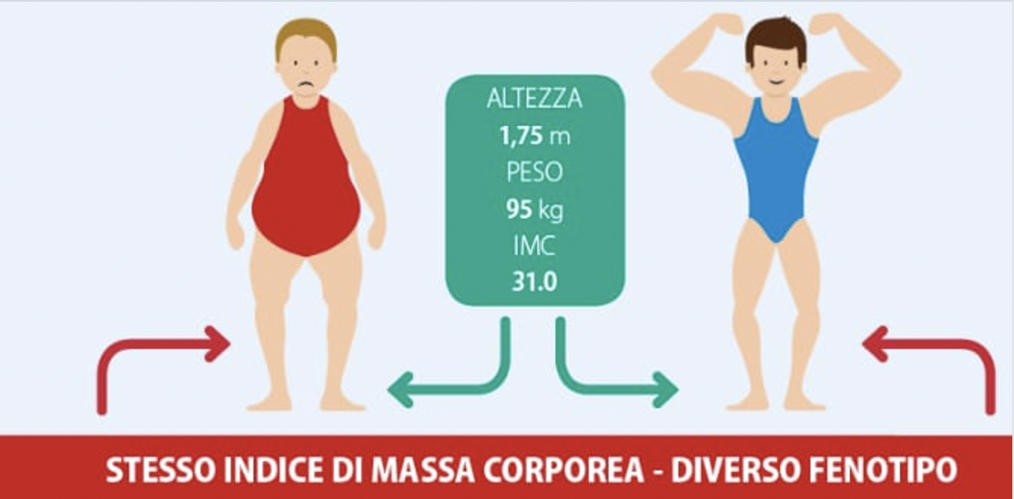
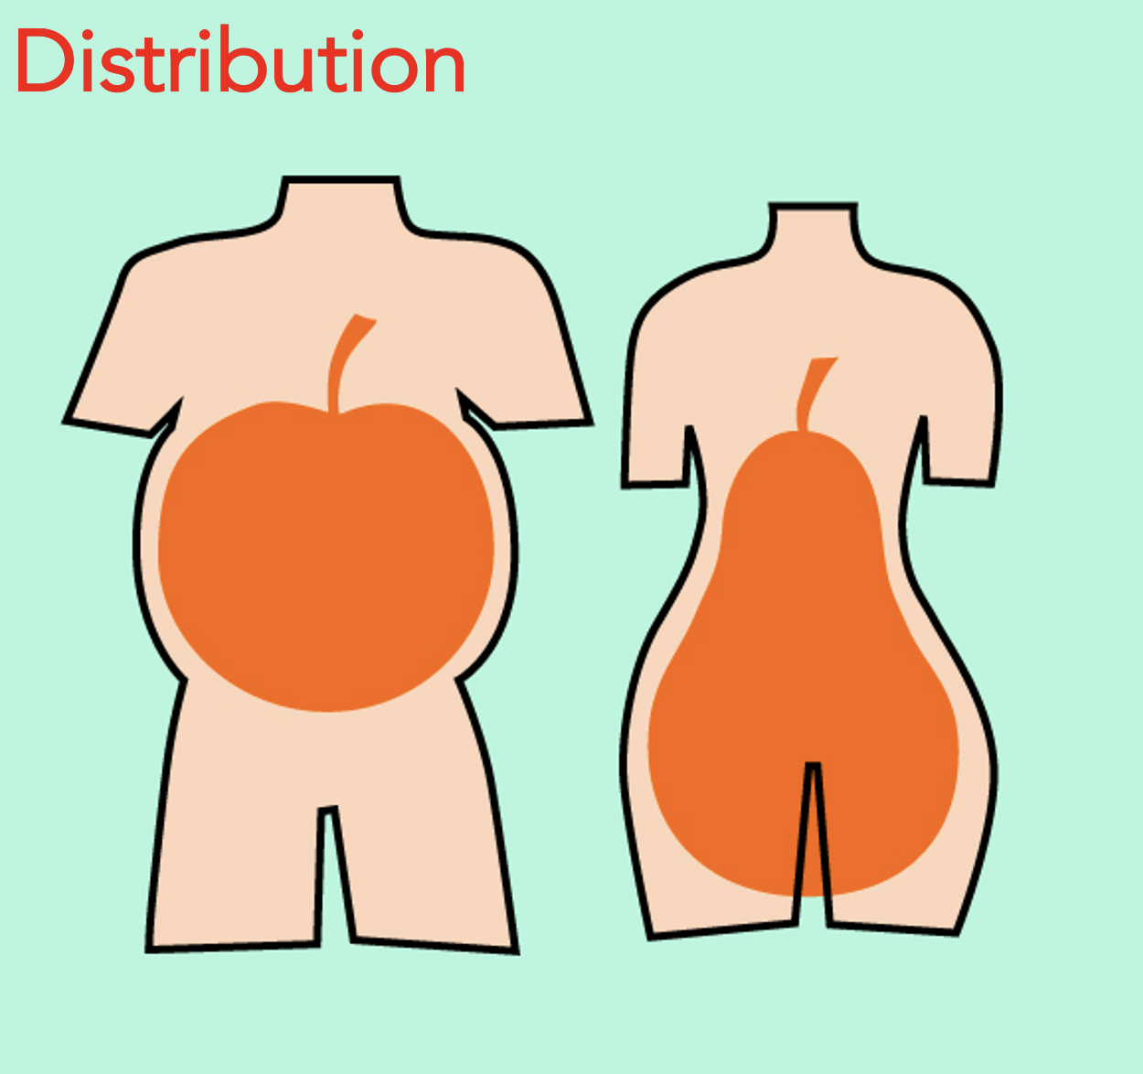
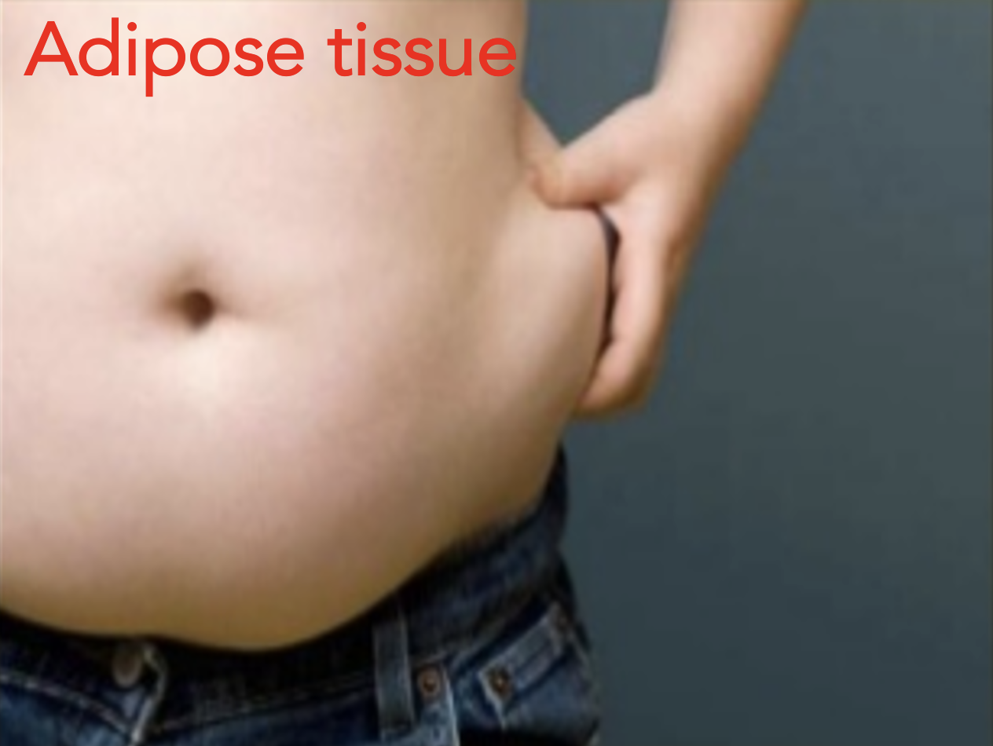
Obesity: Definition
Body Mass Index (body weight/height²) >30 kg/m²
DISTRIBUZIONE
COMPOSIZIONE
Notes:
3

Slide 4
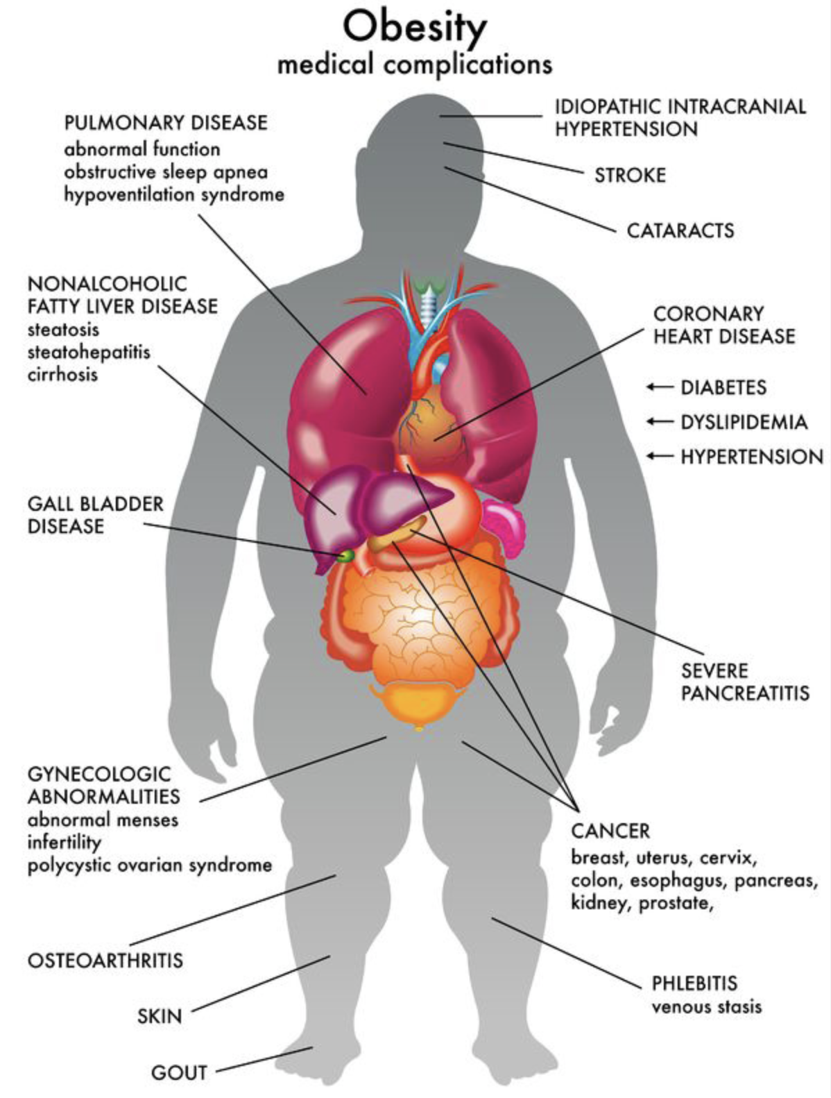
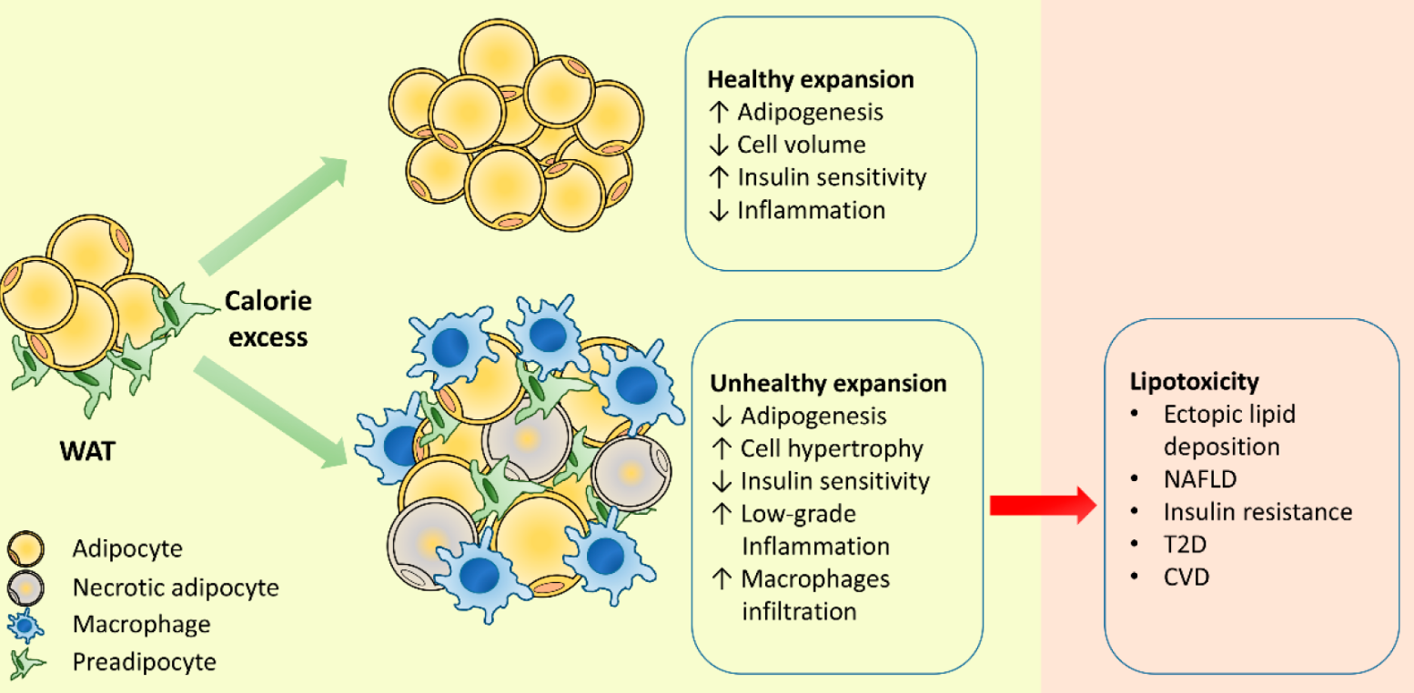

Obesity: Definition
Risk factor related to excessive adipose tissue accumulation
Disorder of adipose tissue (endocrine organ)
Chronic systemic disease
Obesity
metabolic
complications
Notes:
4

Slide 5

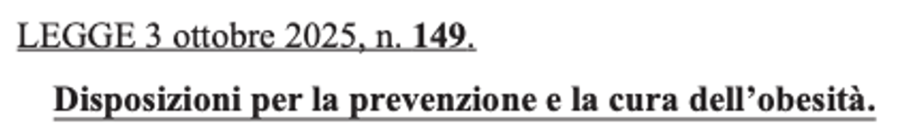
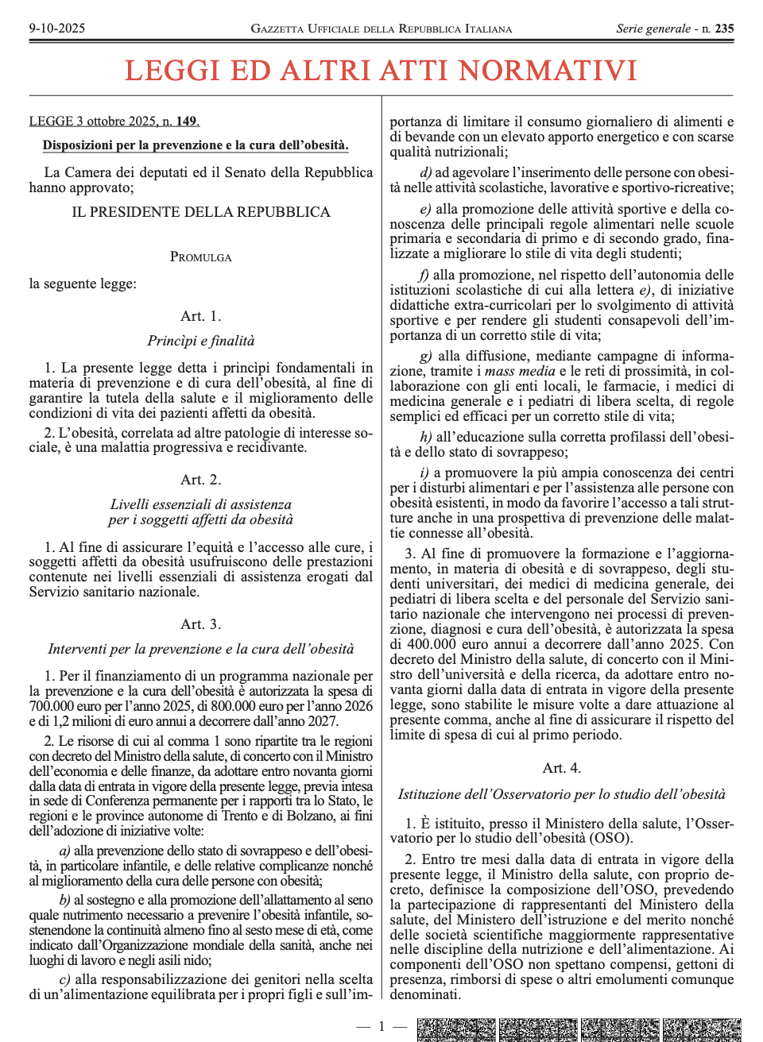
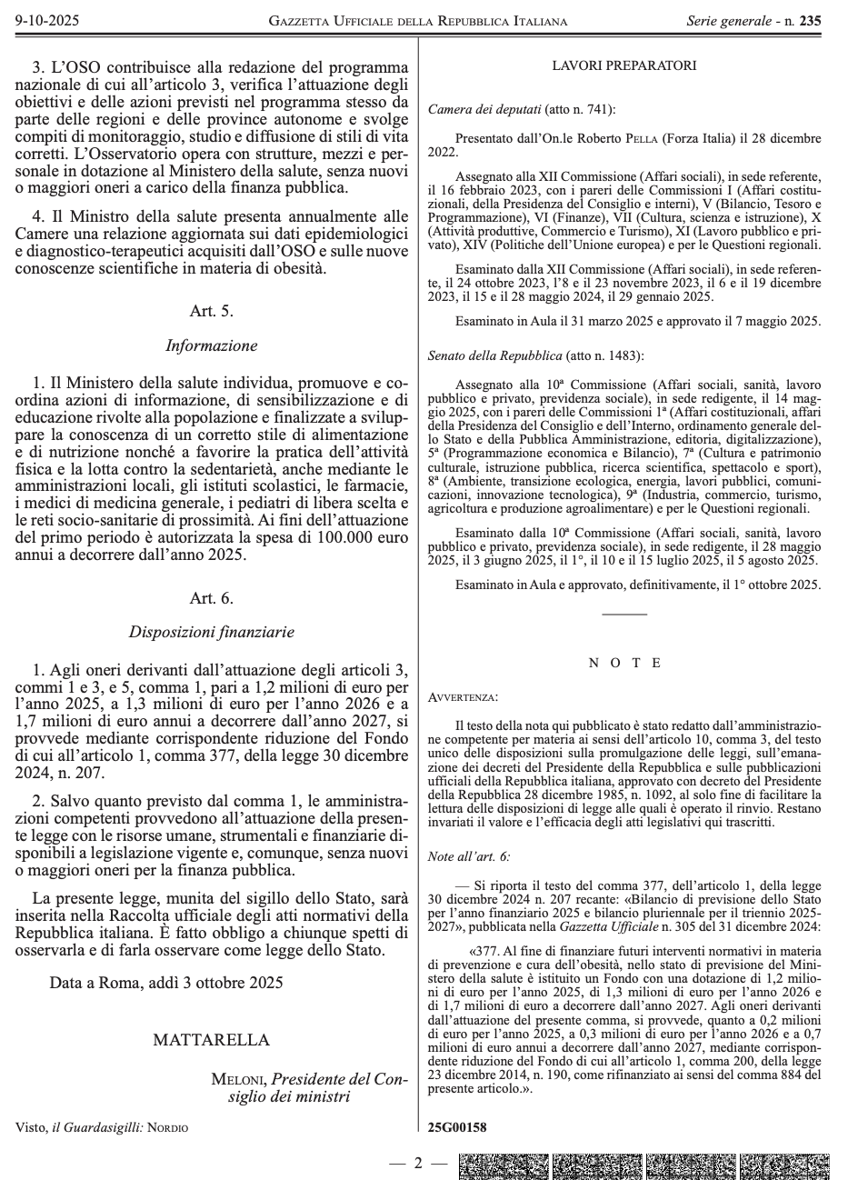

Riconosce l’obesità come:
  cronica
  progressiva
  recidivante
Istituisce programmi nazionali di prevenzione
Promuove approccio multidisciplinare
Prevede formazione del personale sanitario
Istituisce un Osservatorio nazionale
Punta all’inserimento strutturato nei percorsi del SSN e nel Piano Nazionale della Cronicità
Notes:
5

Slide 6
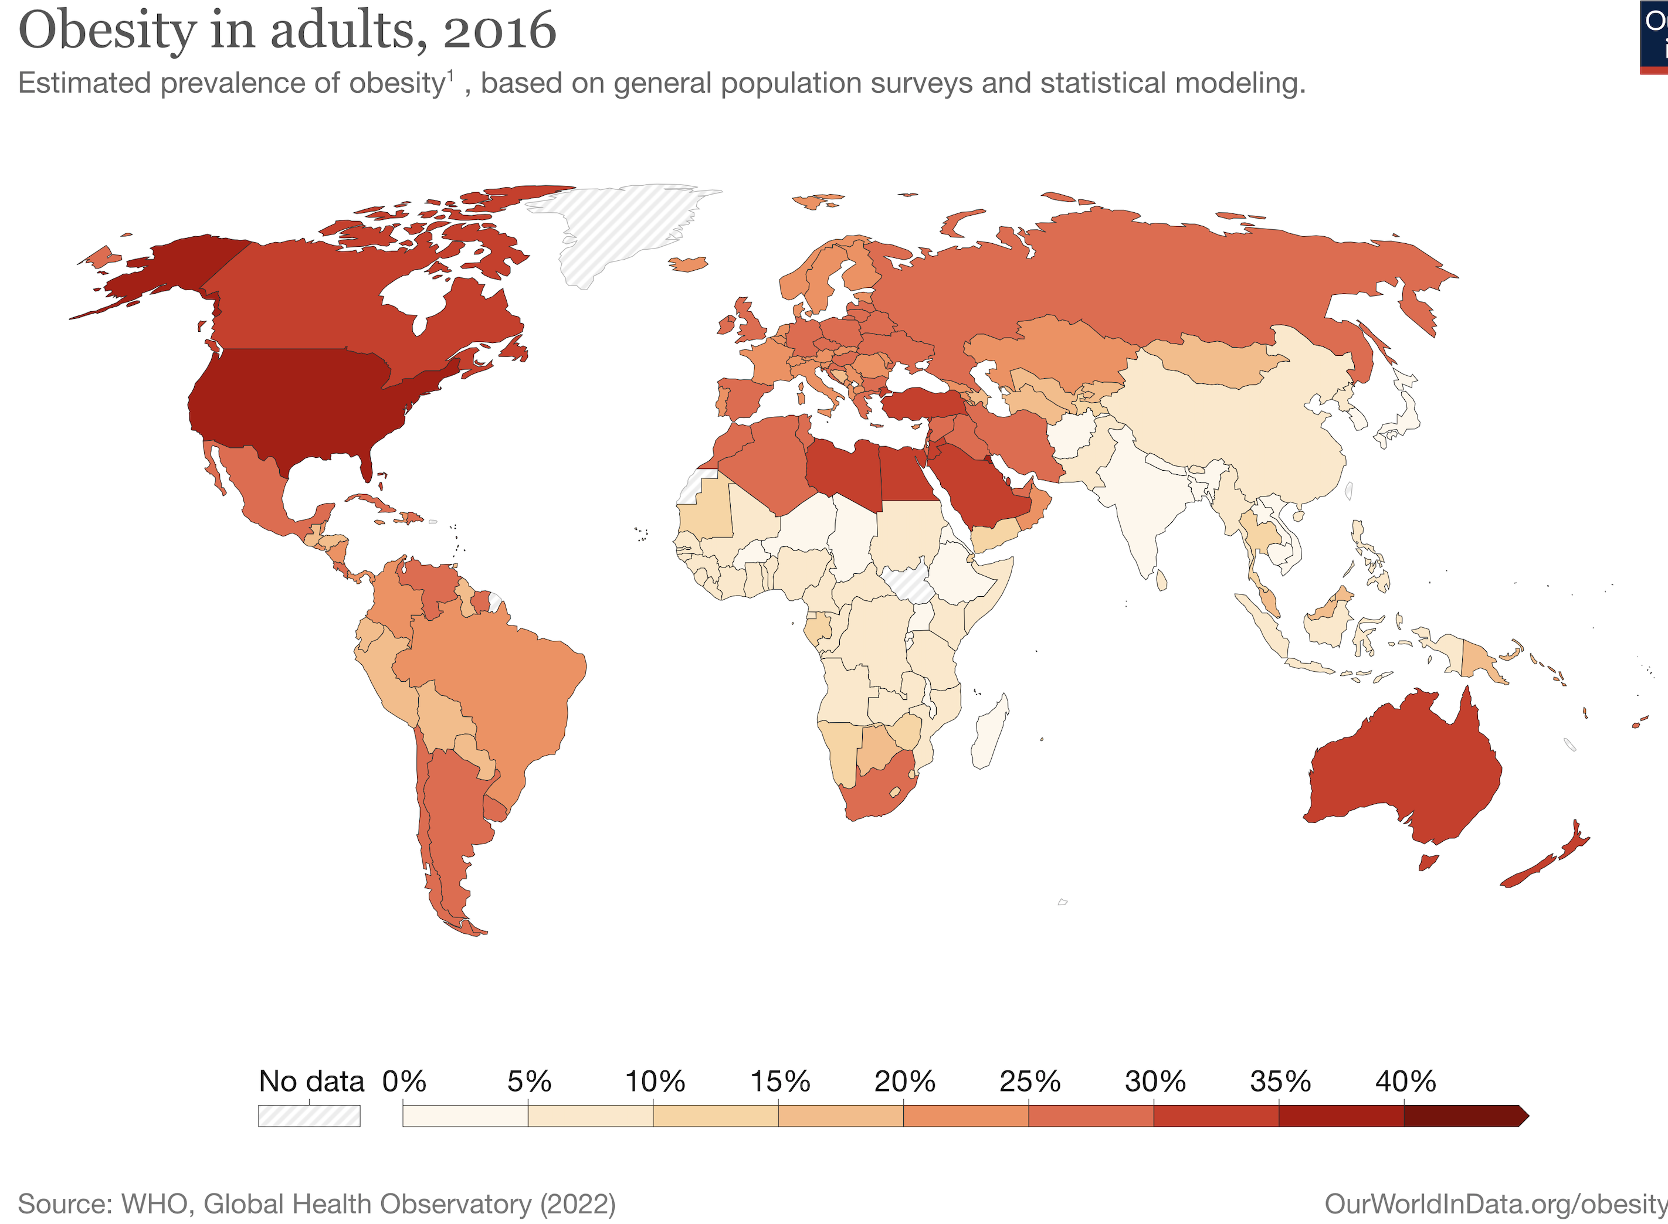
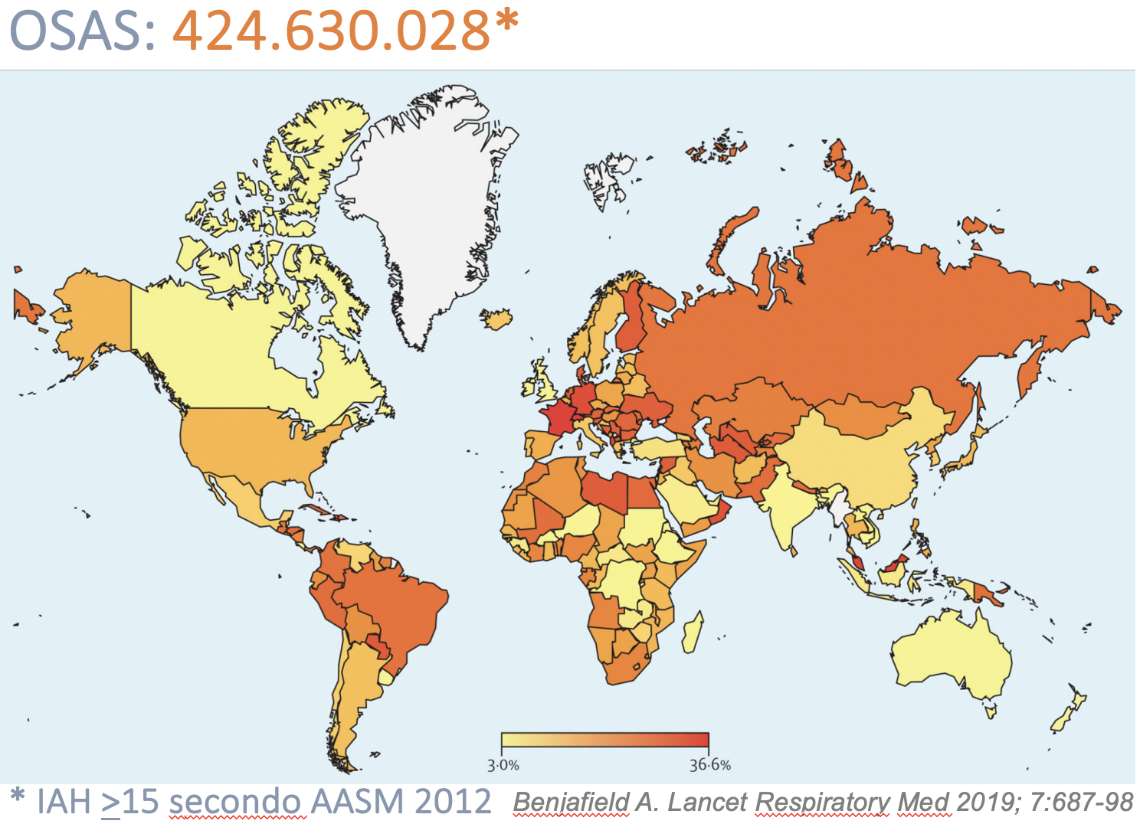
Obesity and OSA: Epidemiology
OBESITY, 2022: 890.000.000
650.000.000
Notes:
6

Slide 7
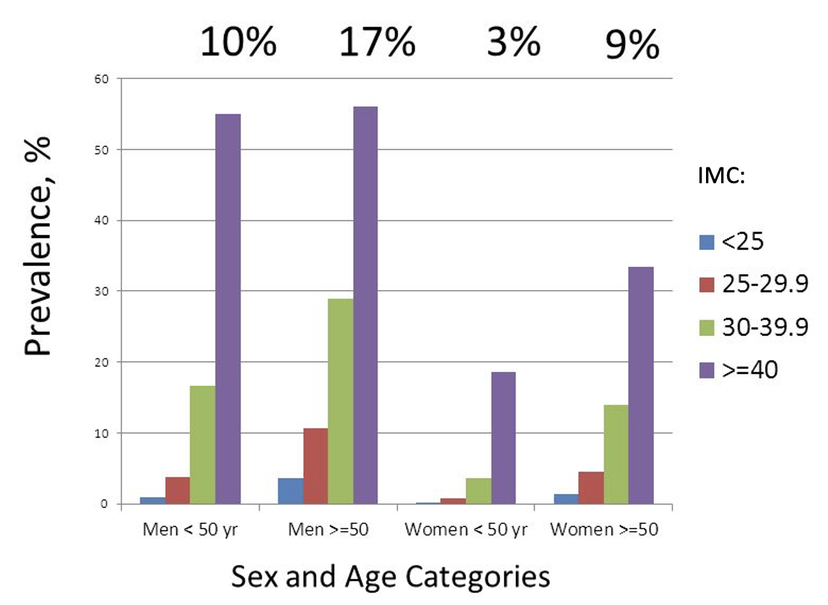

Obesity and OSA: Epidemiology
Wisconsin Sleep Cohort
H: flow reduction with $≥\text{4\%}$ desaturation
Peppart PE. Am J Epidemiol, 2013
Notes:
7

Slide 8
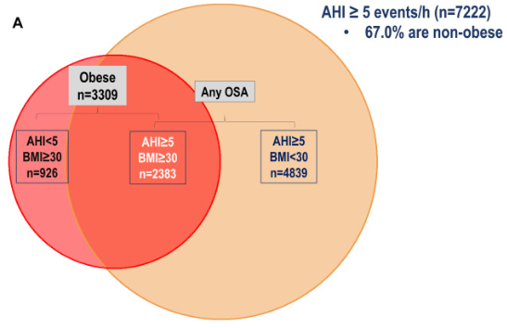
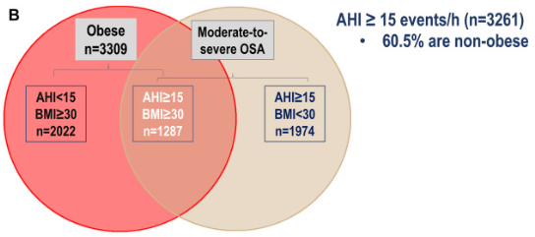
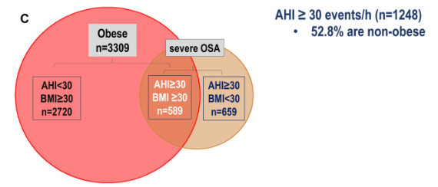
Obesity and OSA: Epidemiology
Mild to Severe OSA
Moderate to Severe OSA
40%
30%
Severe OSA
50%
Esmaeili, eClin Med 2025 (modified)
Notes:
8

Slide 9
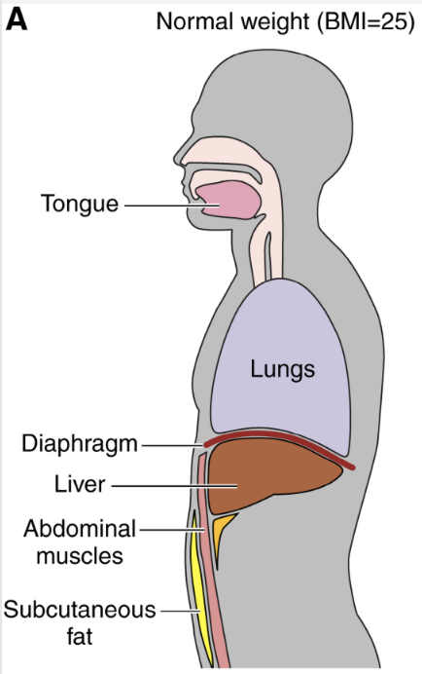
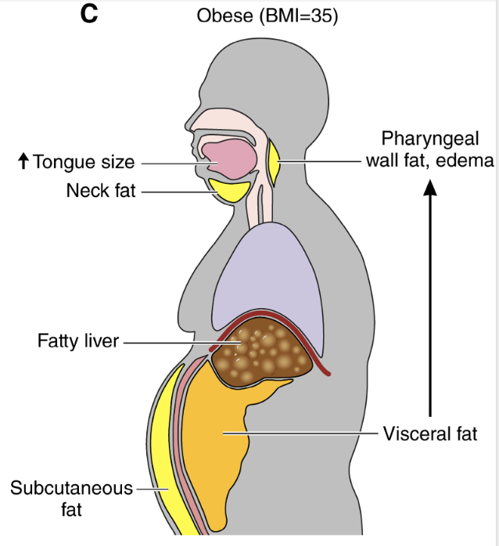
Obesity-related OSA: Pathophysiology
Tasali E. Circulation Research 2025
Notes:
9

Slide 10
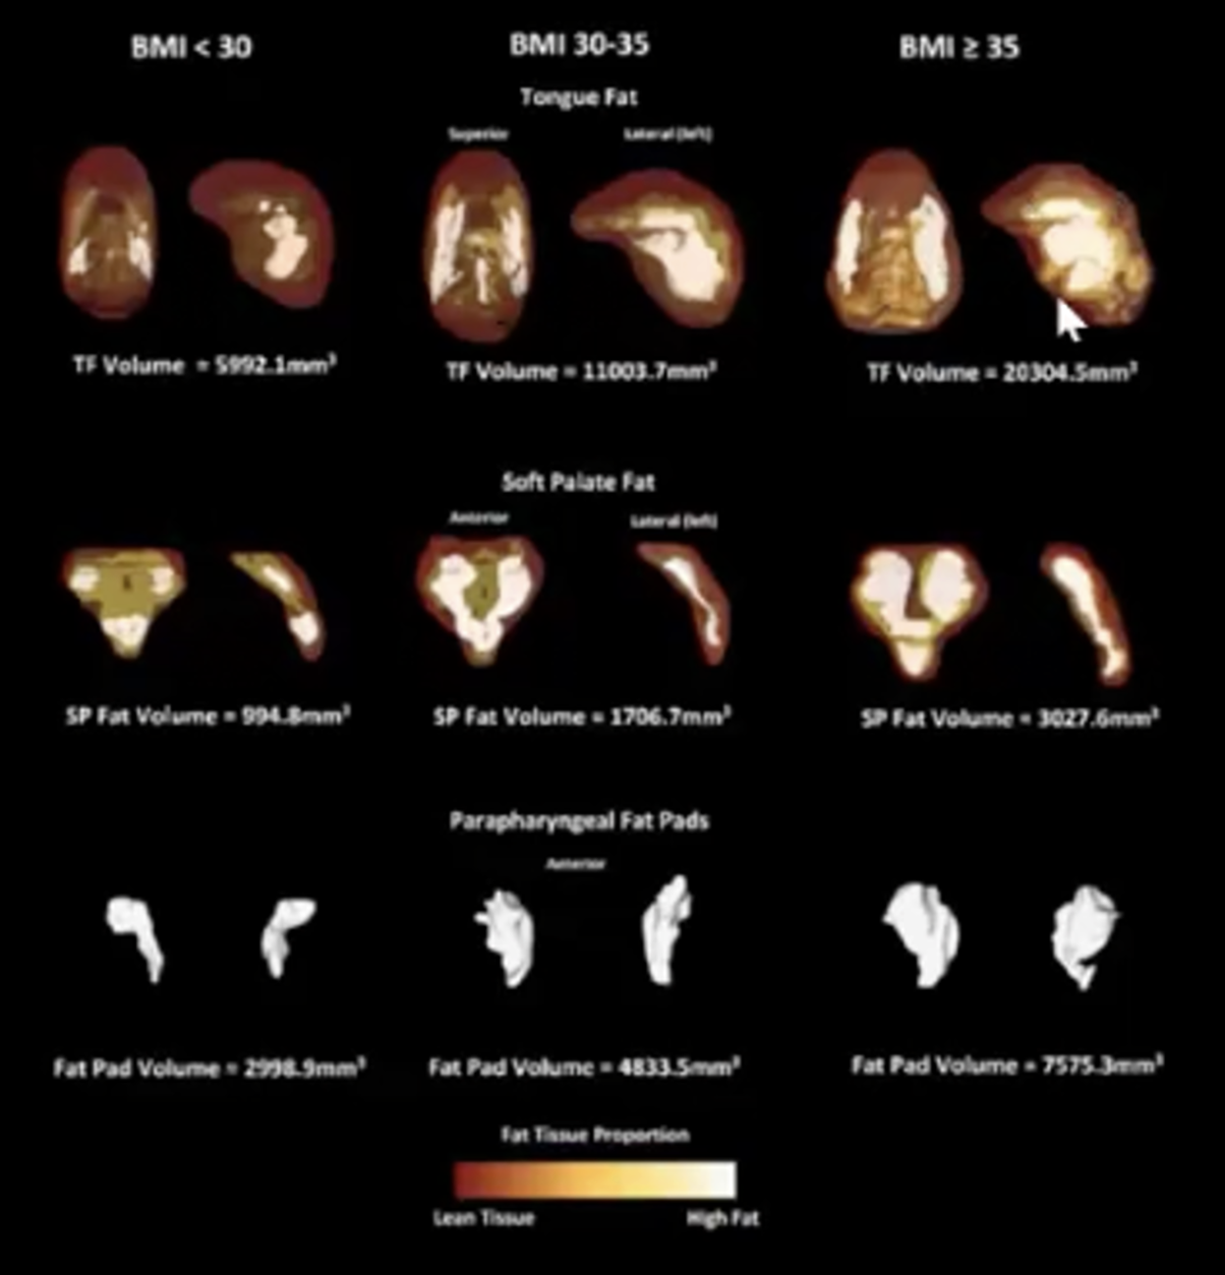
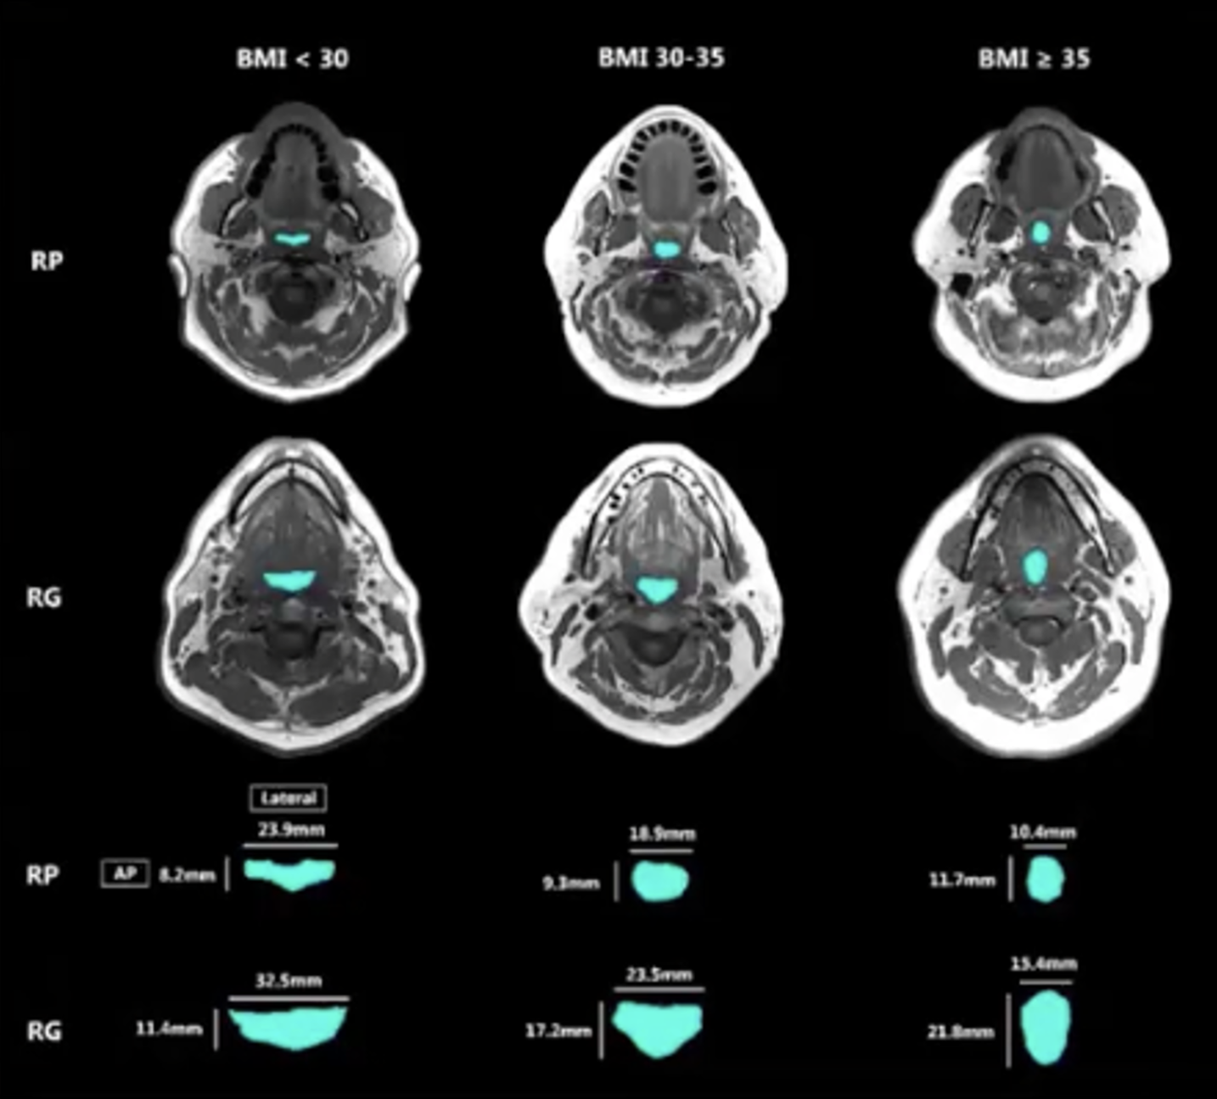
Obesity-related OSA: Pathophysiology
Fat infiltration of UA soft tissues
UA size and shape alterations
Xu L, Ann Am Thoras Soc 2025
Notes:
10

Slide 11
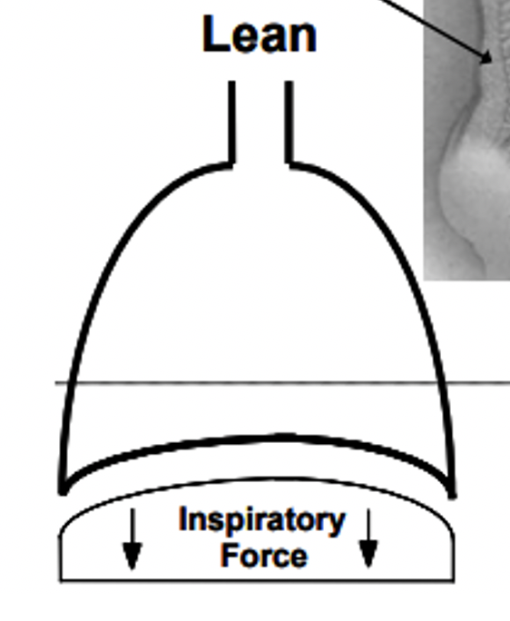
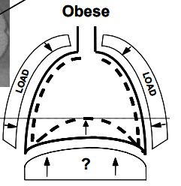
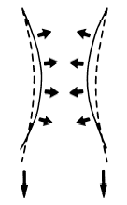
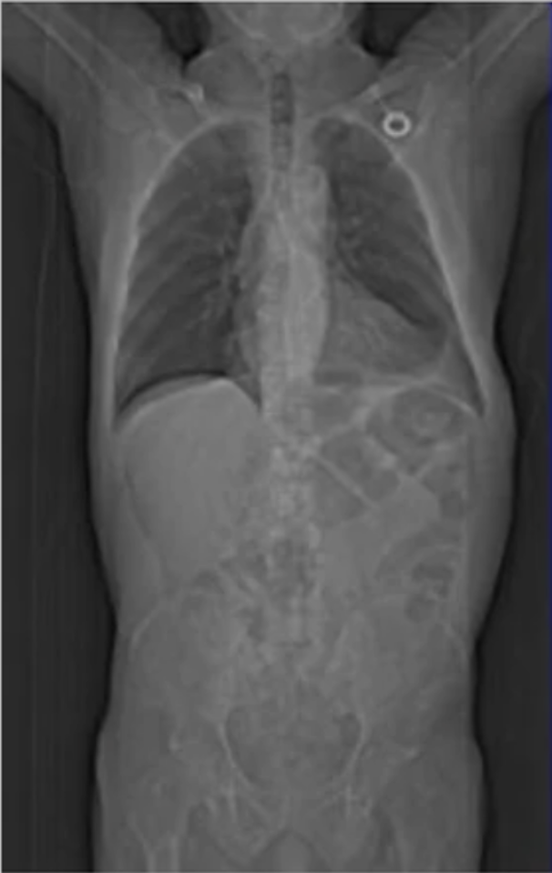
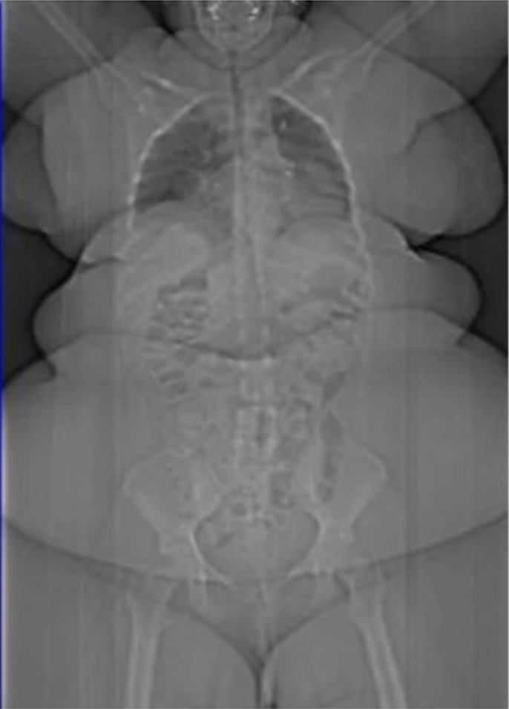
Obesity-related OSA: Pathophysiology
Upper Airway
BMI <30
BMI >30
Abdominal fat accumulation reduce lung volumes decreasing UA caudal traction
Jones RL, Chest 2006
Notes:
11

Slide 12
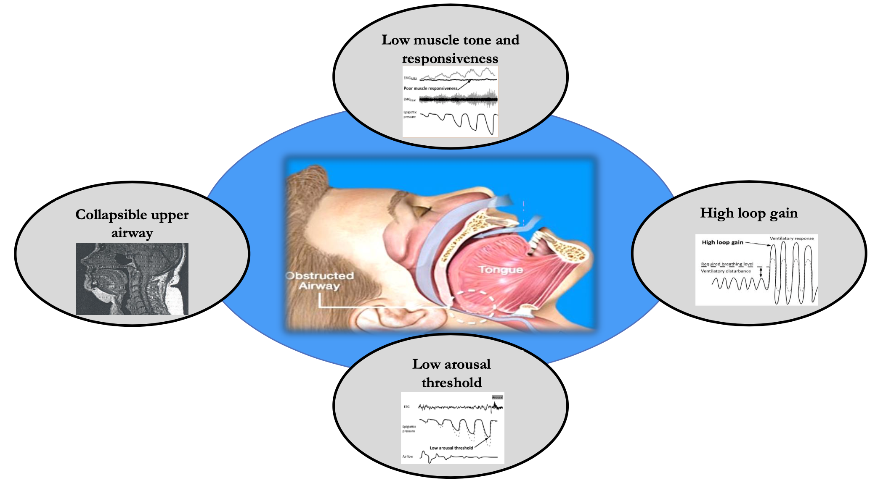
Obesity-related OSA: Endotypes
Perger E. Current Opinion Resp Med 2021
Notes:
12

Slide 13
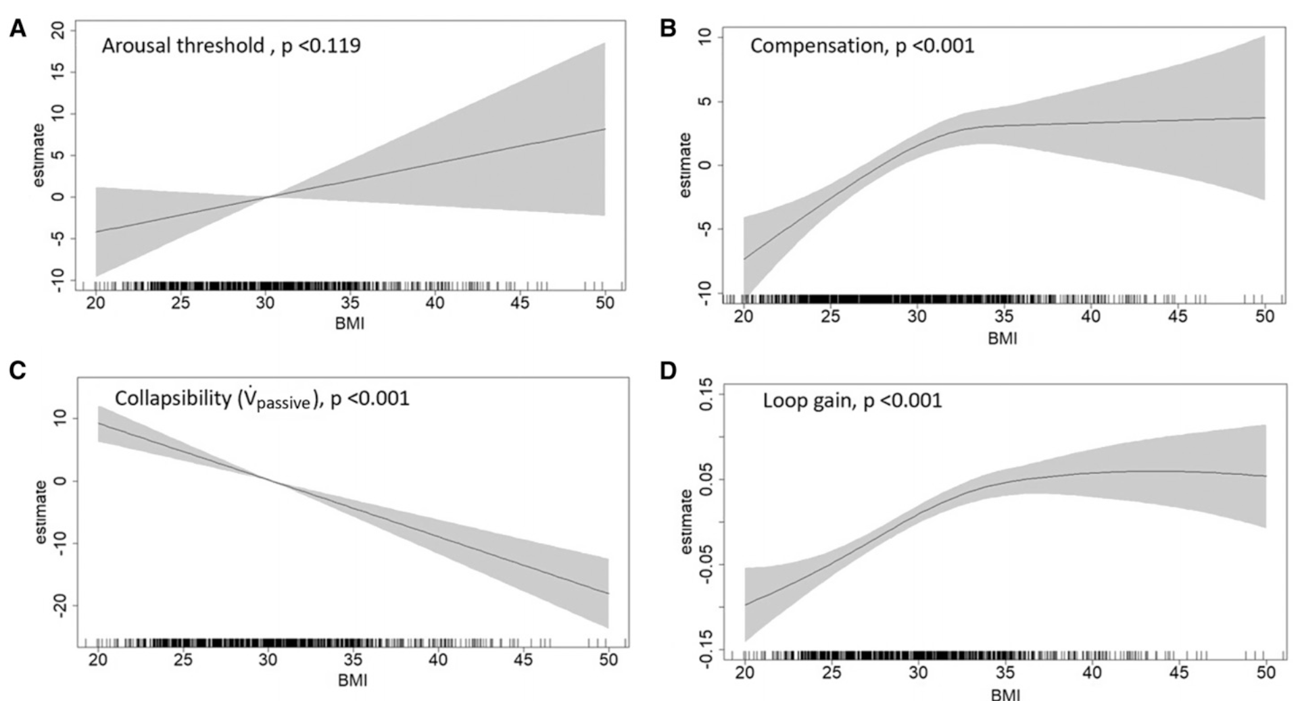
Obesity-related OSA: Endotypes
Increased arousal threshold
Maximal muscle compensation
Increased collapsibility
Increased loop gain
Liang-Wen Hang. Ann Am Thorac Soc. 2025
Notes:
13

Slide 14
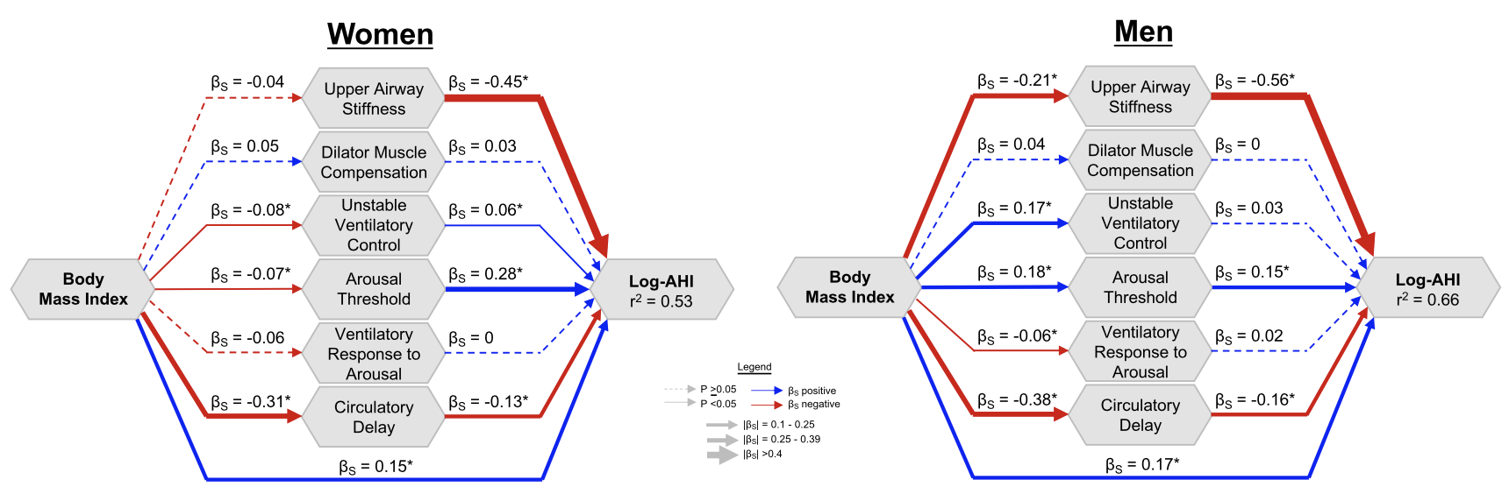
Obesity-related OSA: Gender differences
Premenopausal women: estrogen + progesterone provide partial protection (better airway stability and ventilatory control)
Postmenopausal women: hormonal decline + shift toward central obesity → increased OSA risk
Men: central fat accumulation → ↑ upper-airway collapsibility
Nokes B. J Appl Physiol. 2024
Notes:
14

Slide 15
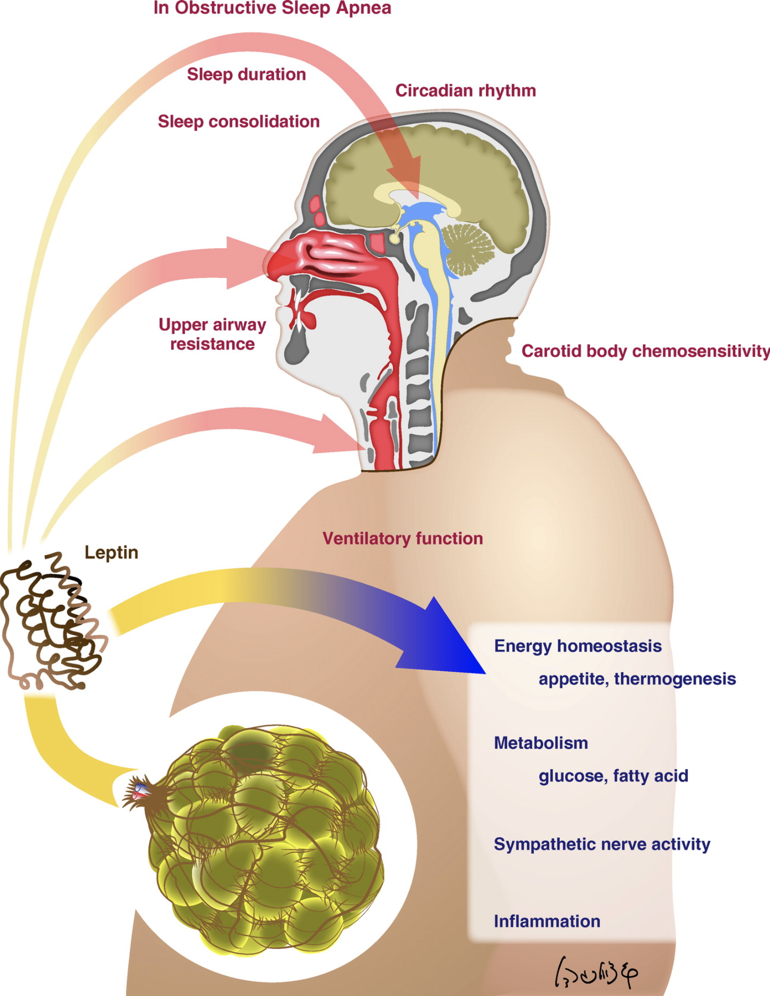
Obesity-related OSA: Leptin
High leptin levels in obesity
Leptin resistance in obesity + OSA
Impaired leptin signaling on sleep, upper airway and breathing control > OSA
Imayama I. Ann Am Thorac Soc. 2017
Notes:
15

Slide 16
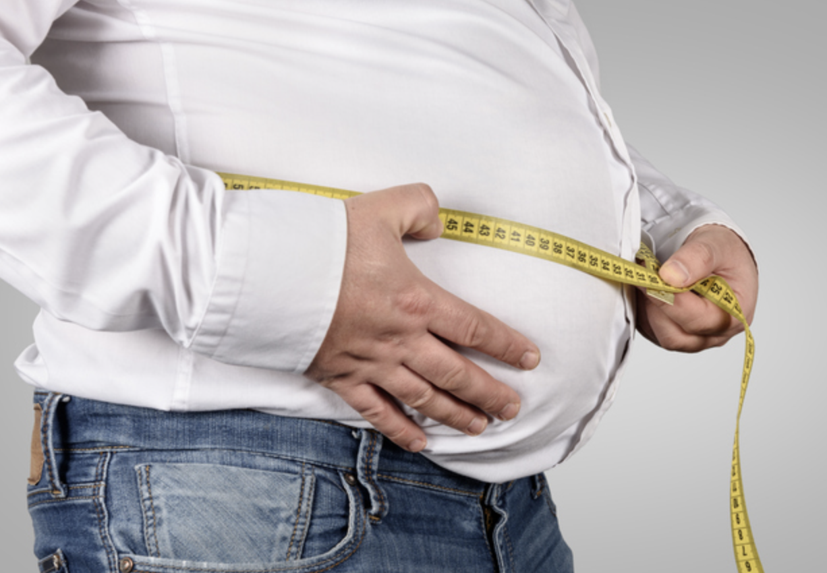
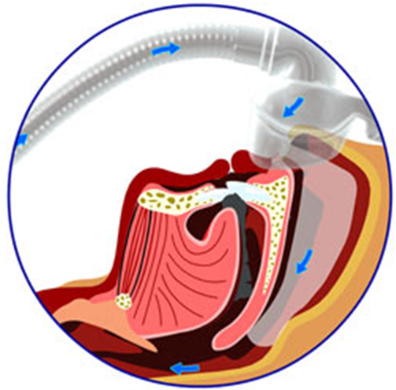
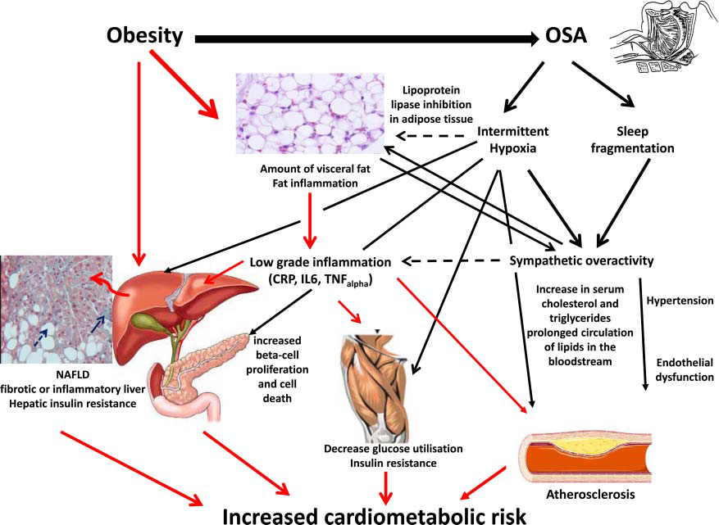
Detrimental effects of obesity + OSA
Pepin JL, Thorax 2012
Notes:
16

Slide 17
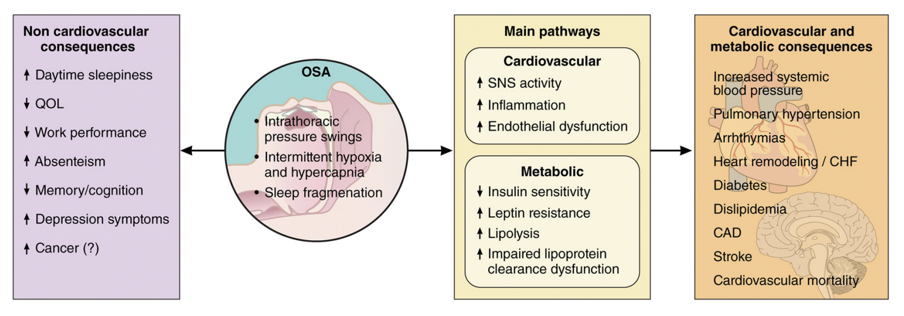
Detrimental effects of obesity + OSA
Drager LF. Circulation 2017
Notes:
17

Slide 18
Obesity Hypoventilation Syndrome - OHS
Definition:
  Obesity
  Awake hypercapnia (PaCO₂ >45mmHg)
  Absence of any other causes of alveolar hypoventilation
Associated sleep-disordered breathing:
  90% OSA with AHI >5
  70% OSA with AHI >30
  10% sleep hypoventilation (AHI <5)
Prevalence:
  10-20% of patients with obesity + OSA
  1% of ambulatory patients with obesity
ICSD-3; Mokhlesi B. Chest 2007, AJRCCM 2019; Piper A. Chest 2016
Notes:
18

Slide 19
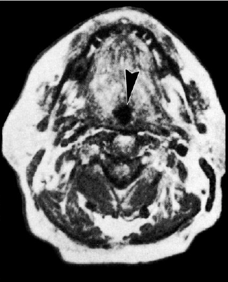
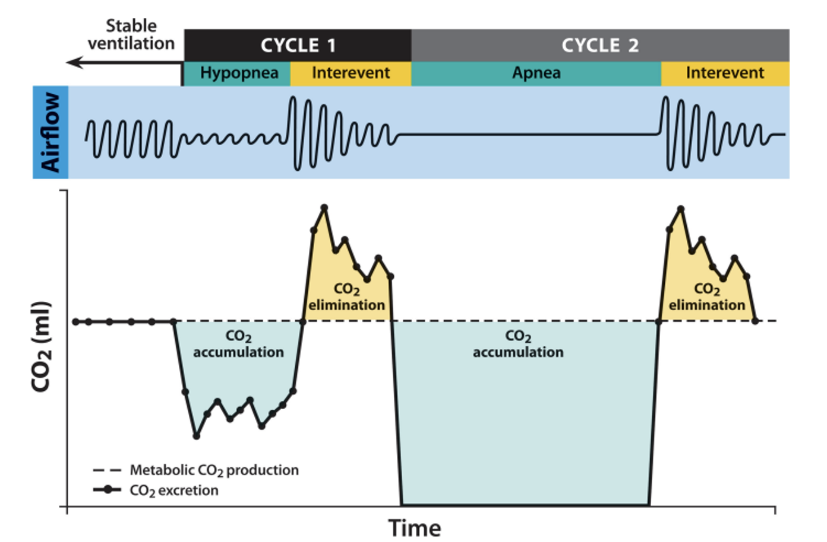
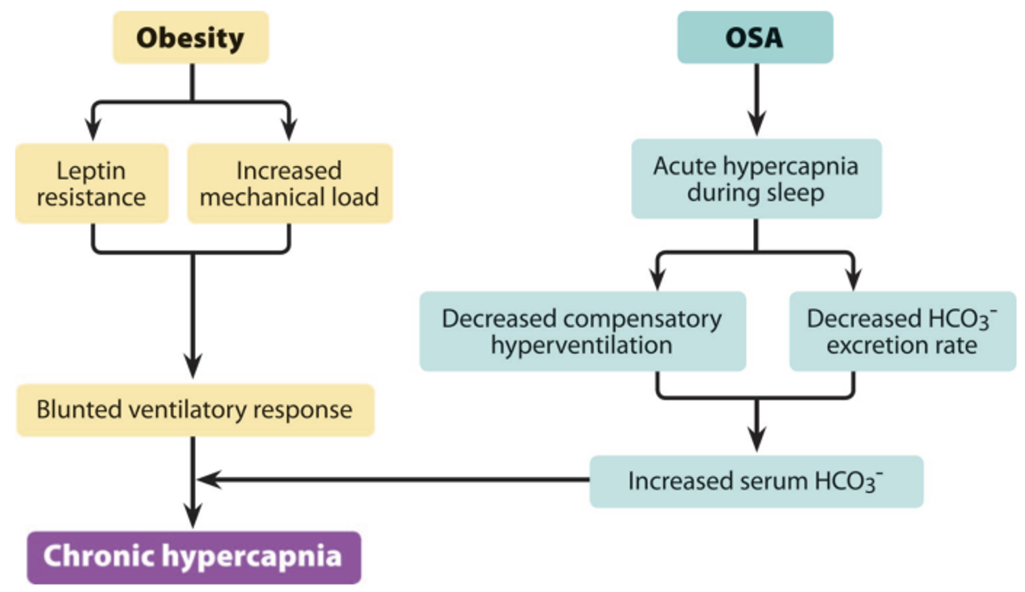
OSA-OHS
Notes:
19

Slide 20
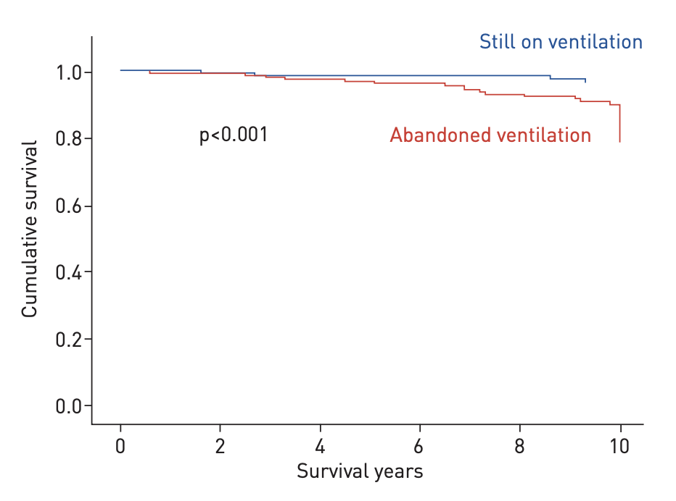
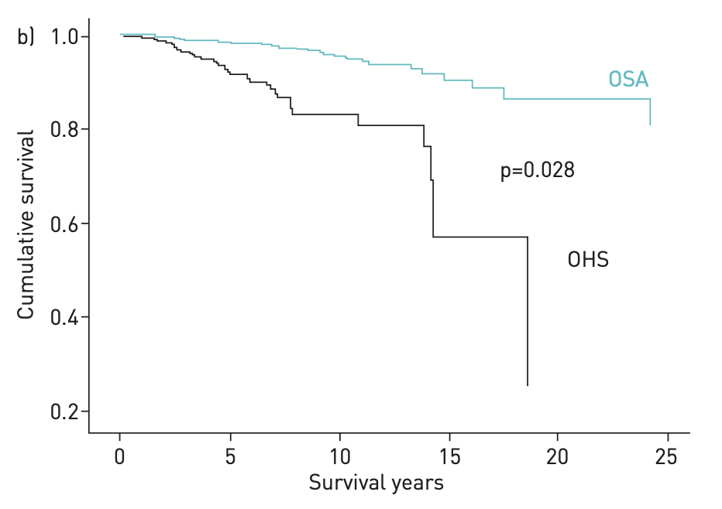
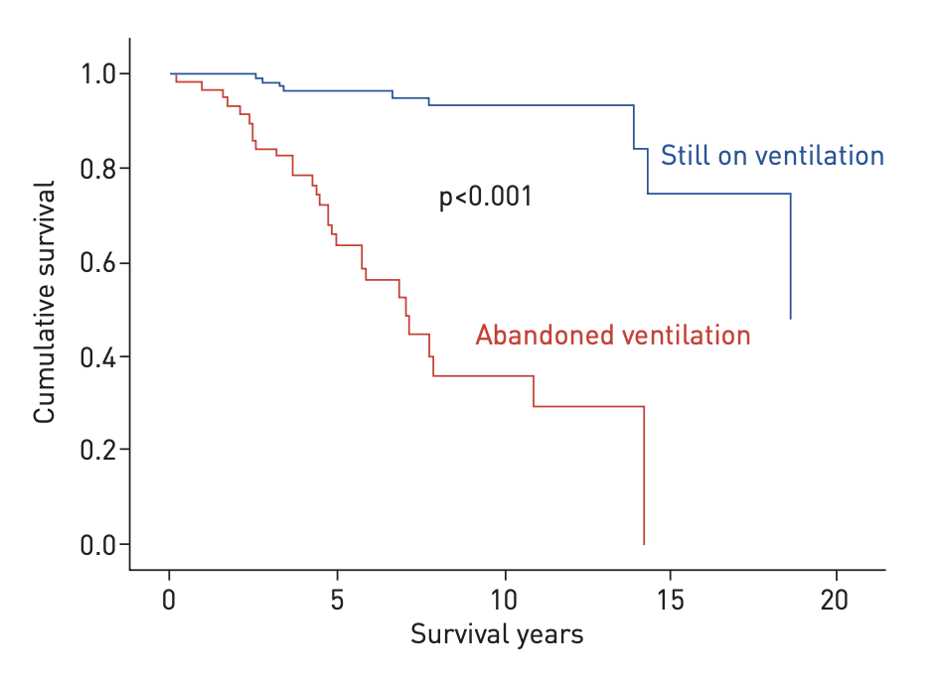
OHS - Mortality
OSA
OSA
OHS
OHS
Critical role of early diagnosis and effective ventilatory treatment in improving survival
Kreivi H-R. ERJ Open Res 2020
Notes:
20

Slide 21
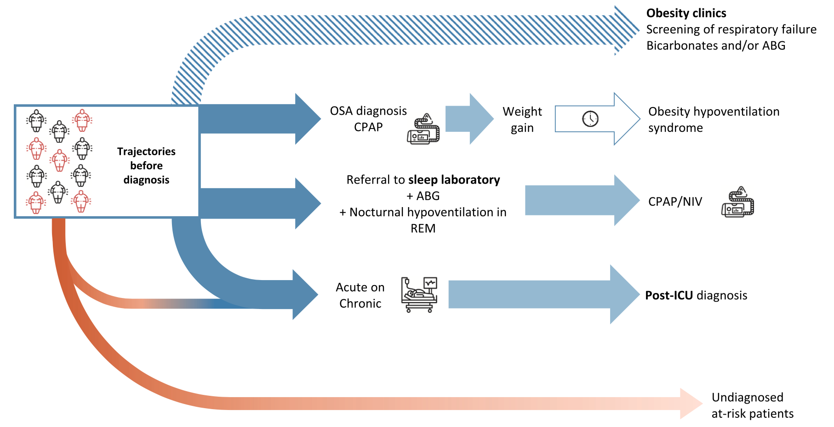
Trajectories leading to OHS diagnosis
50-60%
Pepin JL. Sleep Medicine 2025 (modified)
Notes:
21

Slide 22
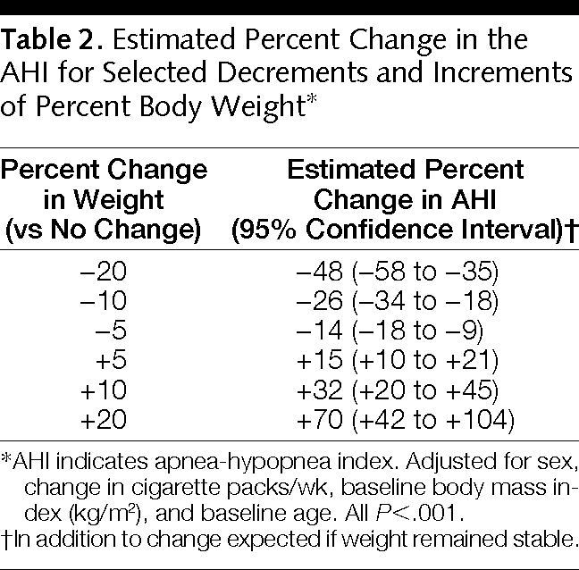
Impact of weight change on AHI
Peppard. JAMA 2000
Notes:
22

Slide 23
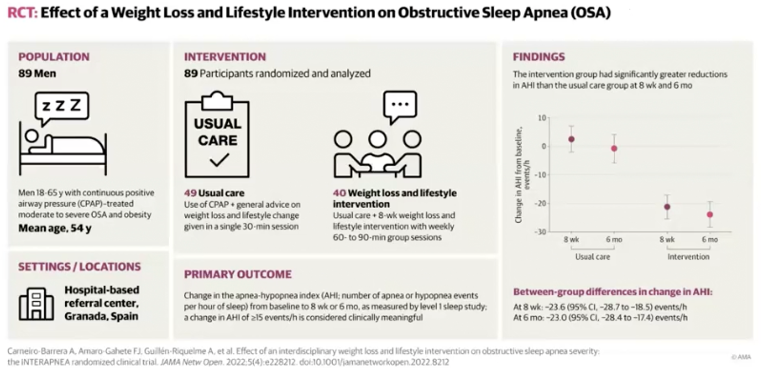
Lifestyle intervention
Carneiro-Barrera A. JAMA Netw Open 2022
Notes:
23

Slide 24
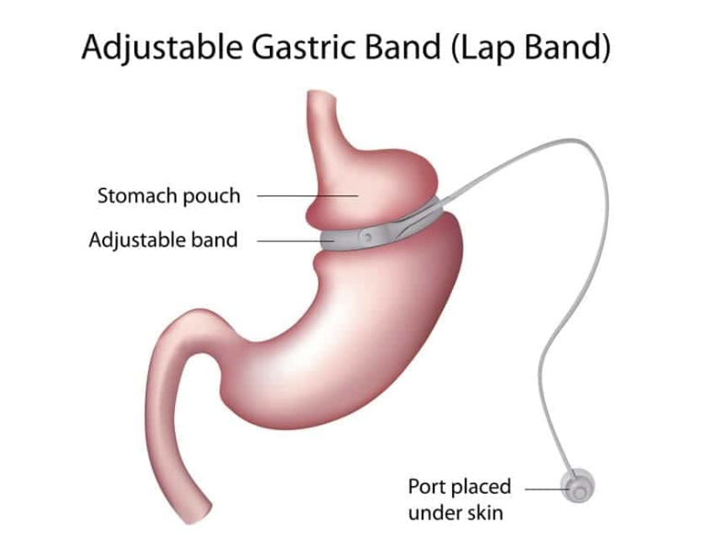
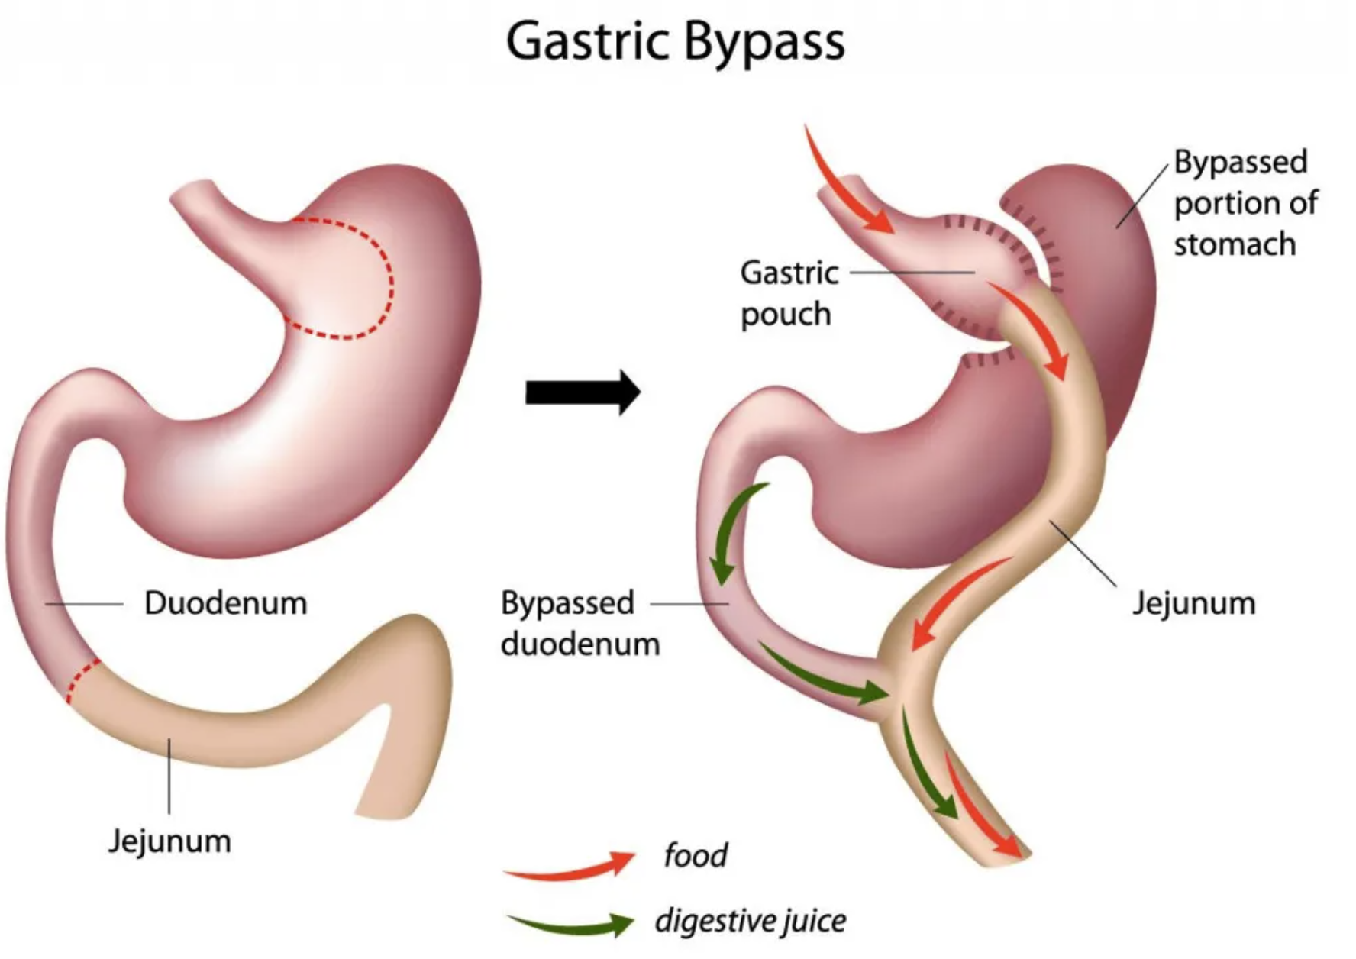
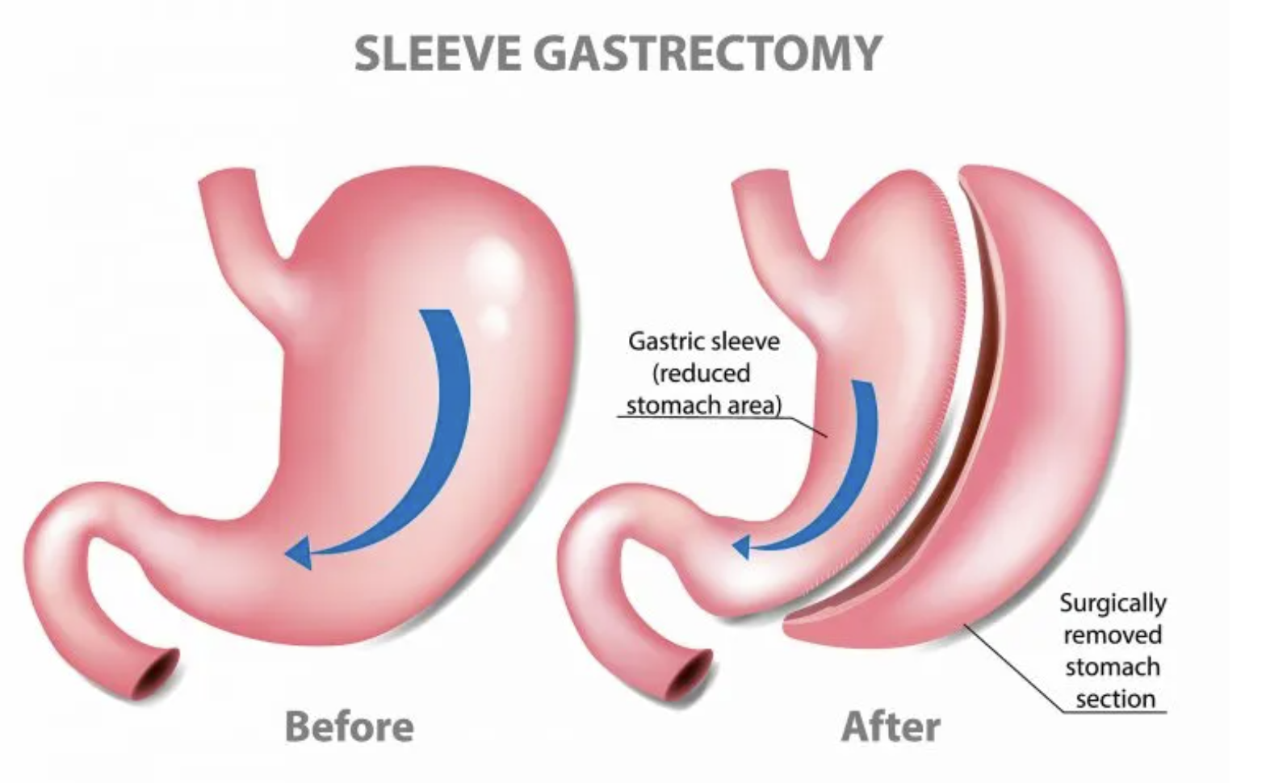
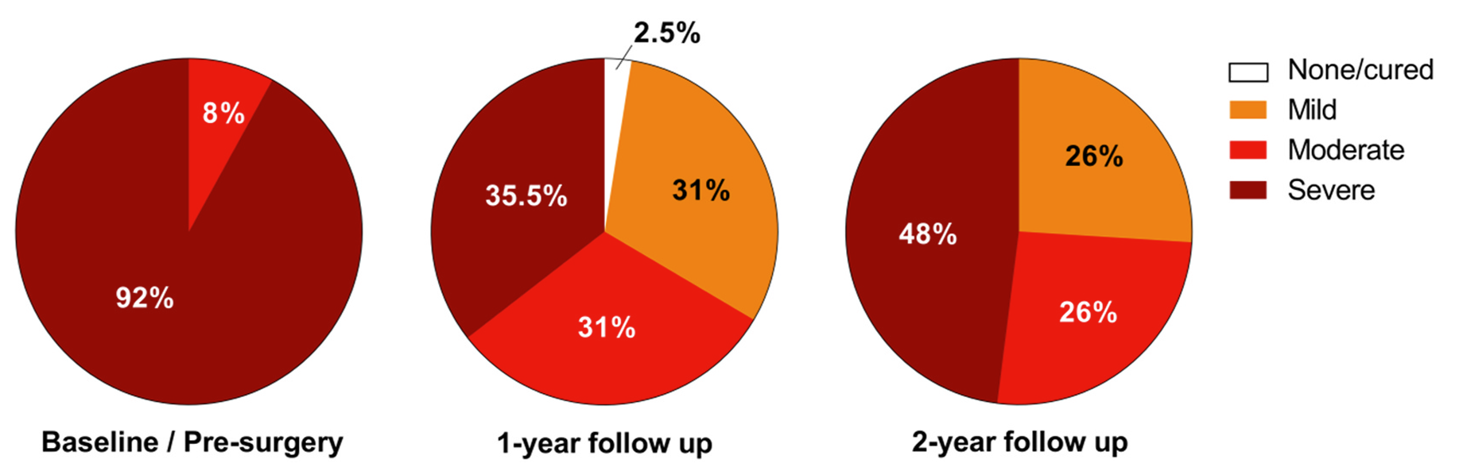
Bariatric surgery
Wong. Sleep Med Rev 2014
Notes:
24

Slide 25
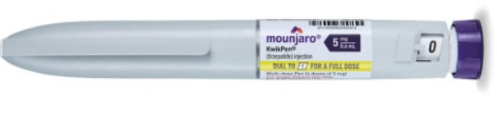
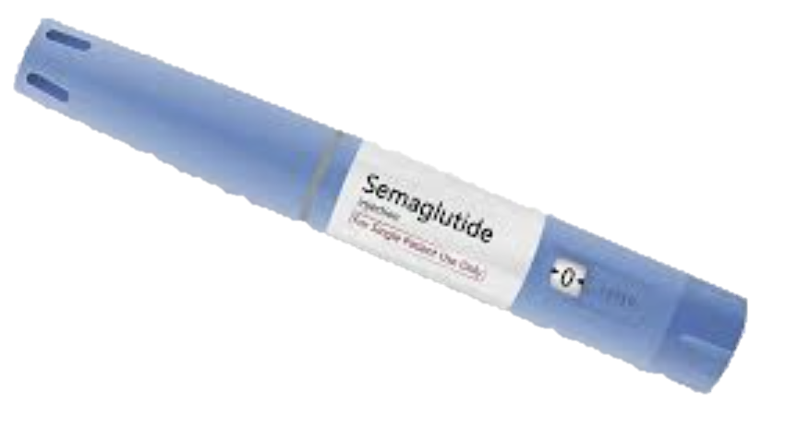
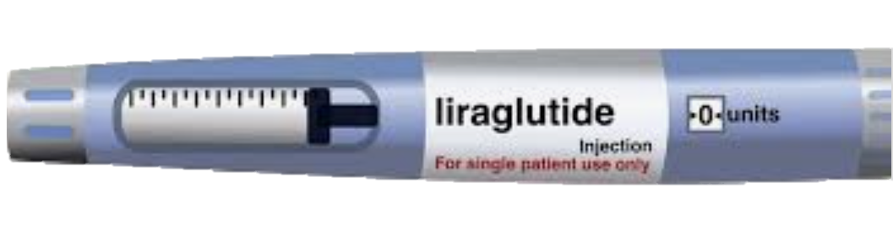
Pharmacological therapy
SURMOUNT TRIALS
12-18 % average weight loss across 2 trials
Placebo adjusted
(JAstreboff, 2022, NEJM)
STEP TRIALS
11 % average weight loss across 6 trials
Placebo adjusted
(Davies, 2021, Lancet)
SCALE TRIAL (Blackman)
4 % weight loss
6 events/h AHI drop
Placebo adjusted
Notes:
25

Slide 26

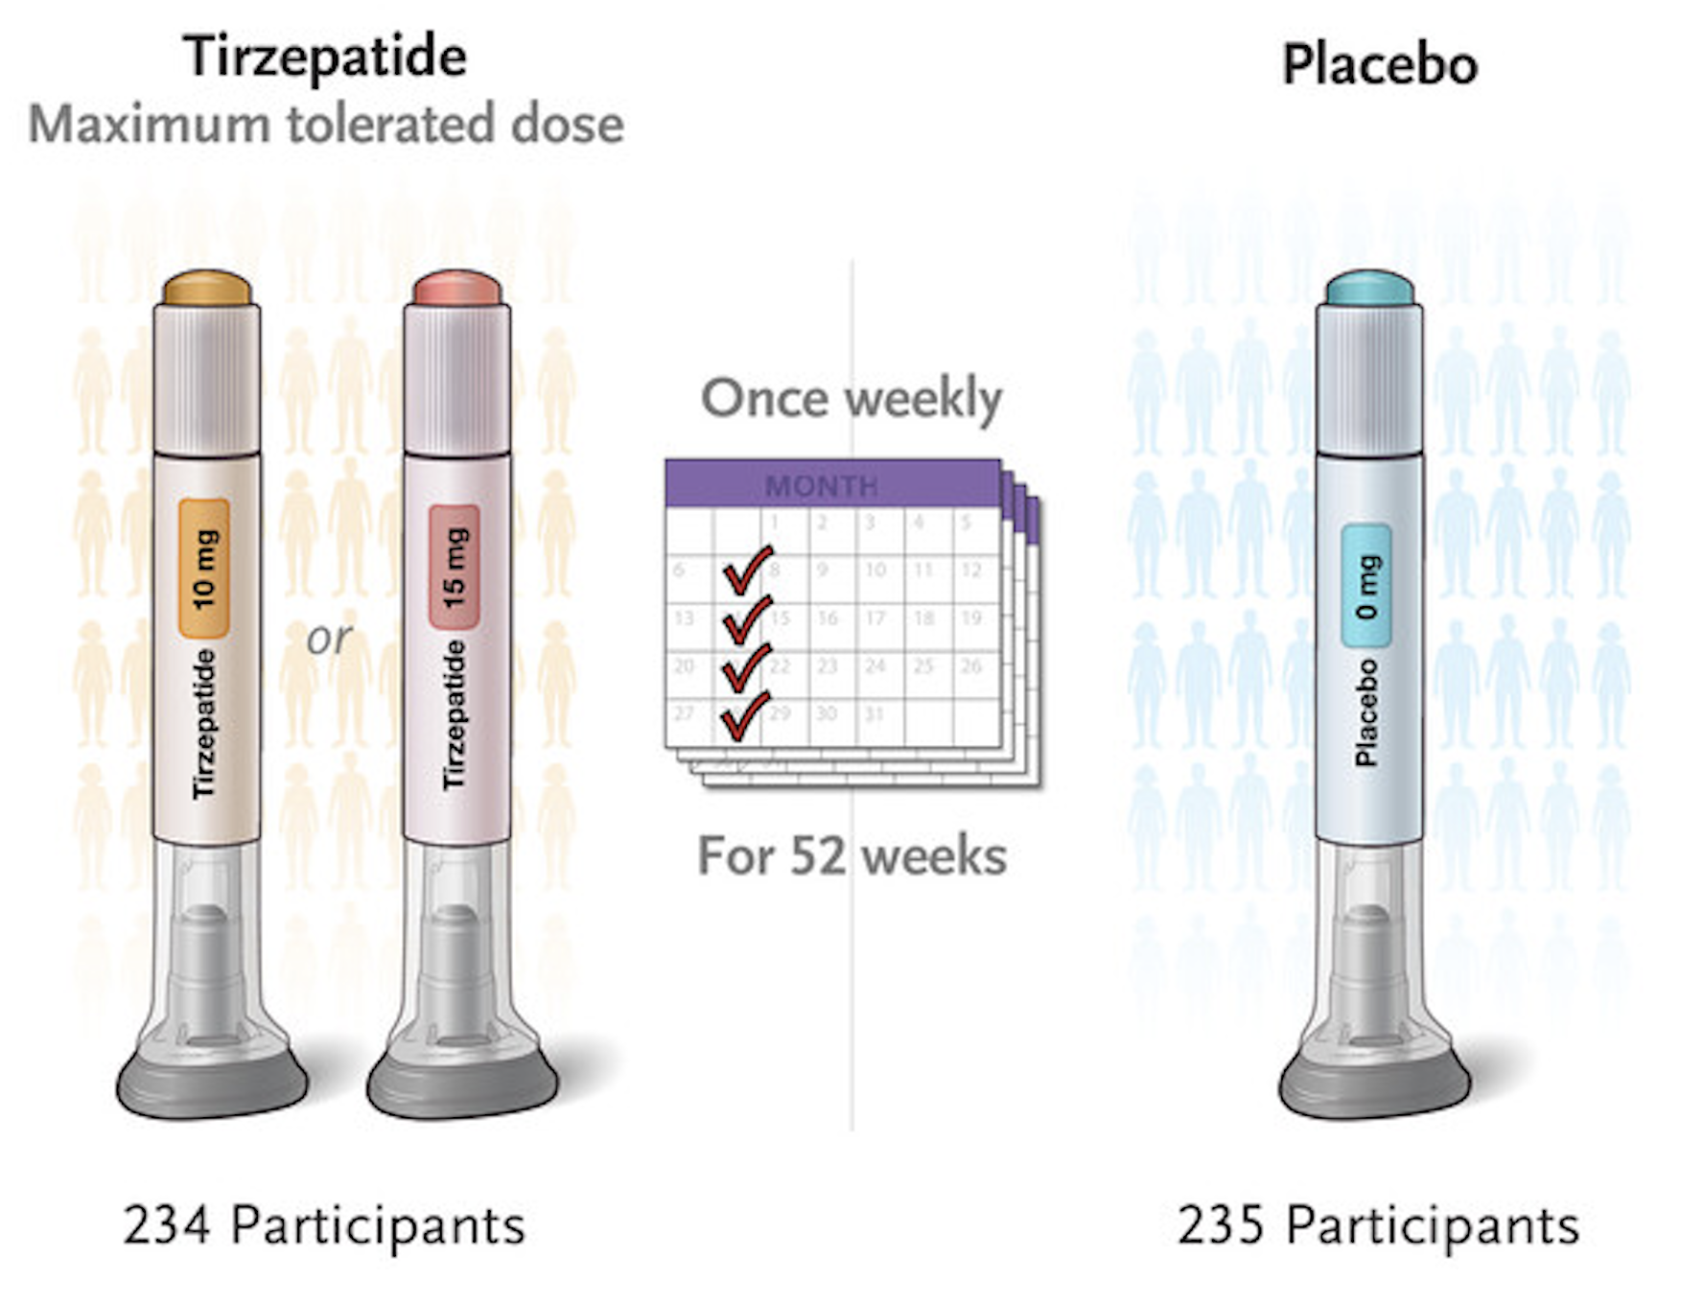






Tirzepatide reduces OSA severity, but also BP and patients related outcome measures
Malhotra A, NEJM 2024
Notes:
26

Slide 27

Impact of weight change on OSA
Malhotra A. Sleep Med. 2024
Notes:
27

Slide 28

Take home messages
Obesity is the main modifiable driver of OSA
Mechanisms are multifactorial: airway fat, reduced lung volumes, hormonal and ventilatory dysregulation
Obesity shapes specific OSA endotypes that worsen collapsibility and breathing instability
Combined obesity + OSA greatly amplifies cardiometabolic and systemic risk
CPAP helps symptoms, but weight loss is essential to improve OSA severity and metabolic health
Lifestyle, bariatric surgery, and new drugs (e.g., tirzepatide) offer powerful weight-loss options
Multidisciplinary care is mandatory for optimal long-term outcomes
Image created with artificial intelligence

Slide 29
Look beyond the machine… and focus on the whole patient!
Image created with artificial intelligence
Notes:
29

