Slide 1

Thorax

Slide 2
Pneumothorax
Dr. Stefano Kette
13/05/2026 - Pneumotrieste 2026
Università degli Studi di Trieste
Azienda Sanitaria Universitaria Friuli Centrale

Slide 3
No conflicts of interest

Slide 4
Agenda
Primary Spontaneous Pneumothorax (PSP) and Secondary Spontaneous Pneumothorax(SSP)
Aetiology
Management
Ambulatory device
Surgery
Persistent Air Leak (PAL)
Suction

Slide 5
Pneumothorax Classification
Spontaneous:
Primary (PSP)
Secondary (SSP)
Non-Spontaneous:
Traumatic
Iatrogenic
Notes:
refers to patients with no underlying lung disease; while those with established lung pathology are classified as secondary spontaneous pneumothorax (SSP).

Slide 6
Spontaneous Pneumothorax
Primary: ”normal lungs” but emphysema-like changes
PSP: 10% have familial history
Management: conservative, needle aspiration, chest drain, Heimlich valve device
Secondary: underlying lung disease (COPD, ILD, CF)
Management: usually requires chest drain
[1] Hallifax R. et al, JAMA 2018
Notes:
Spontaneous pneumothorax is caused by air escaping the lung and passing through a visceral pleural defect into the pleural space.

Slide 7
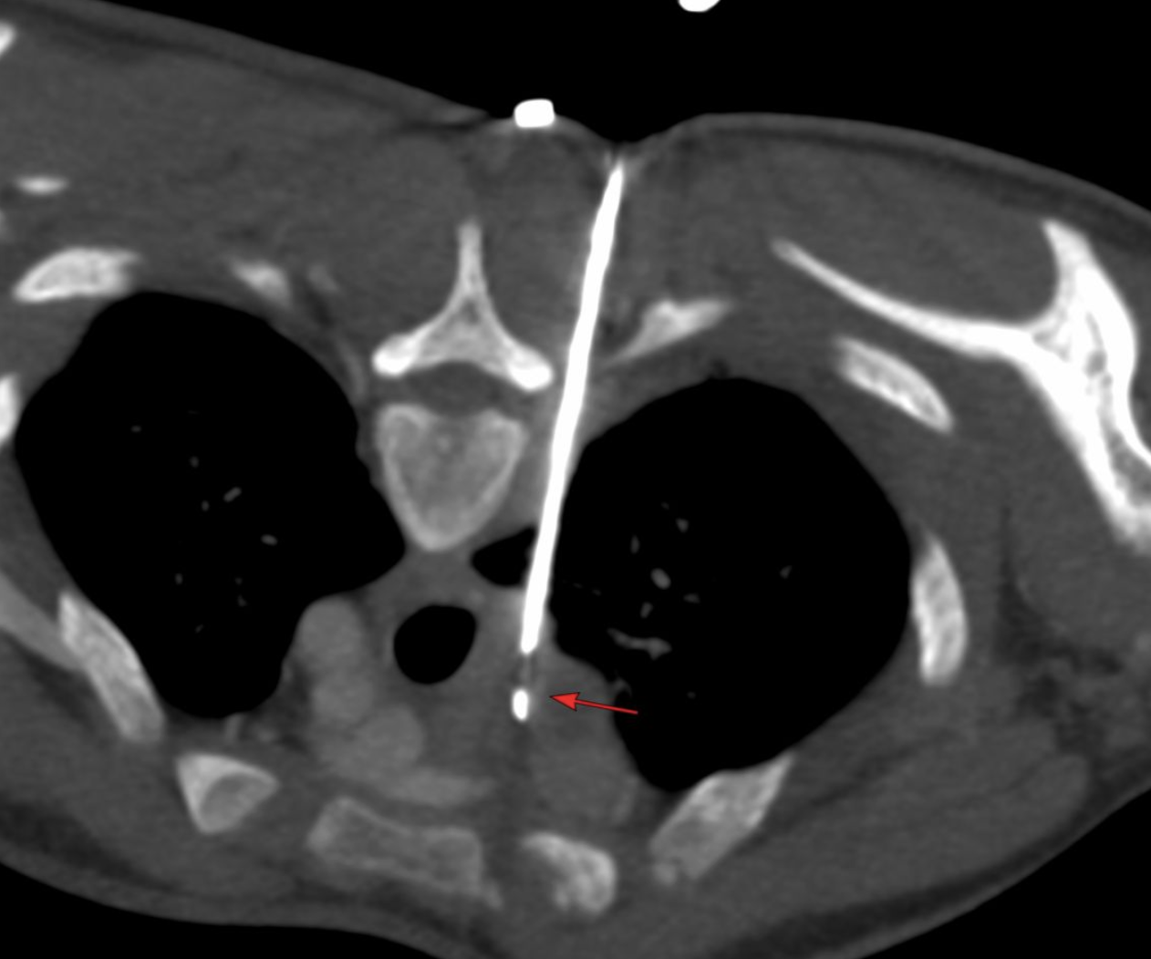
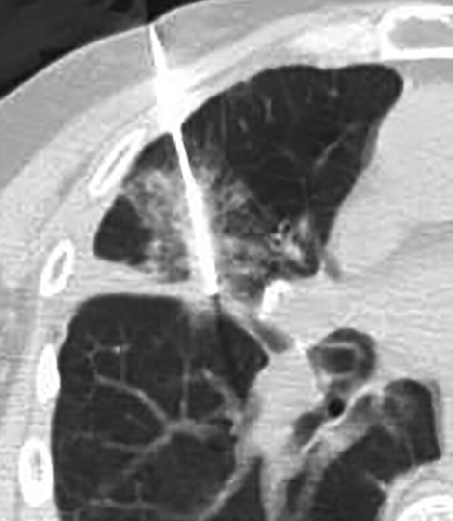
Non Spontaneous Pneumothorax
Traumatic: large bore chest drain
Iatrogenic: combined incidence unknown
CT-guided lung biopsy (∼26 %, reported up to 61 %)
Lung ablation (16–52 %)
Pacemaker and central venous catheters (<1 %)
Managed either conservatively, or with chest drain

Slide 8
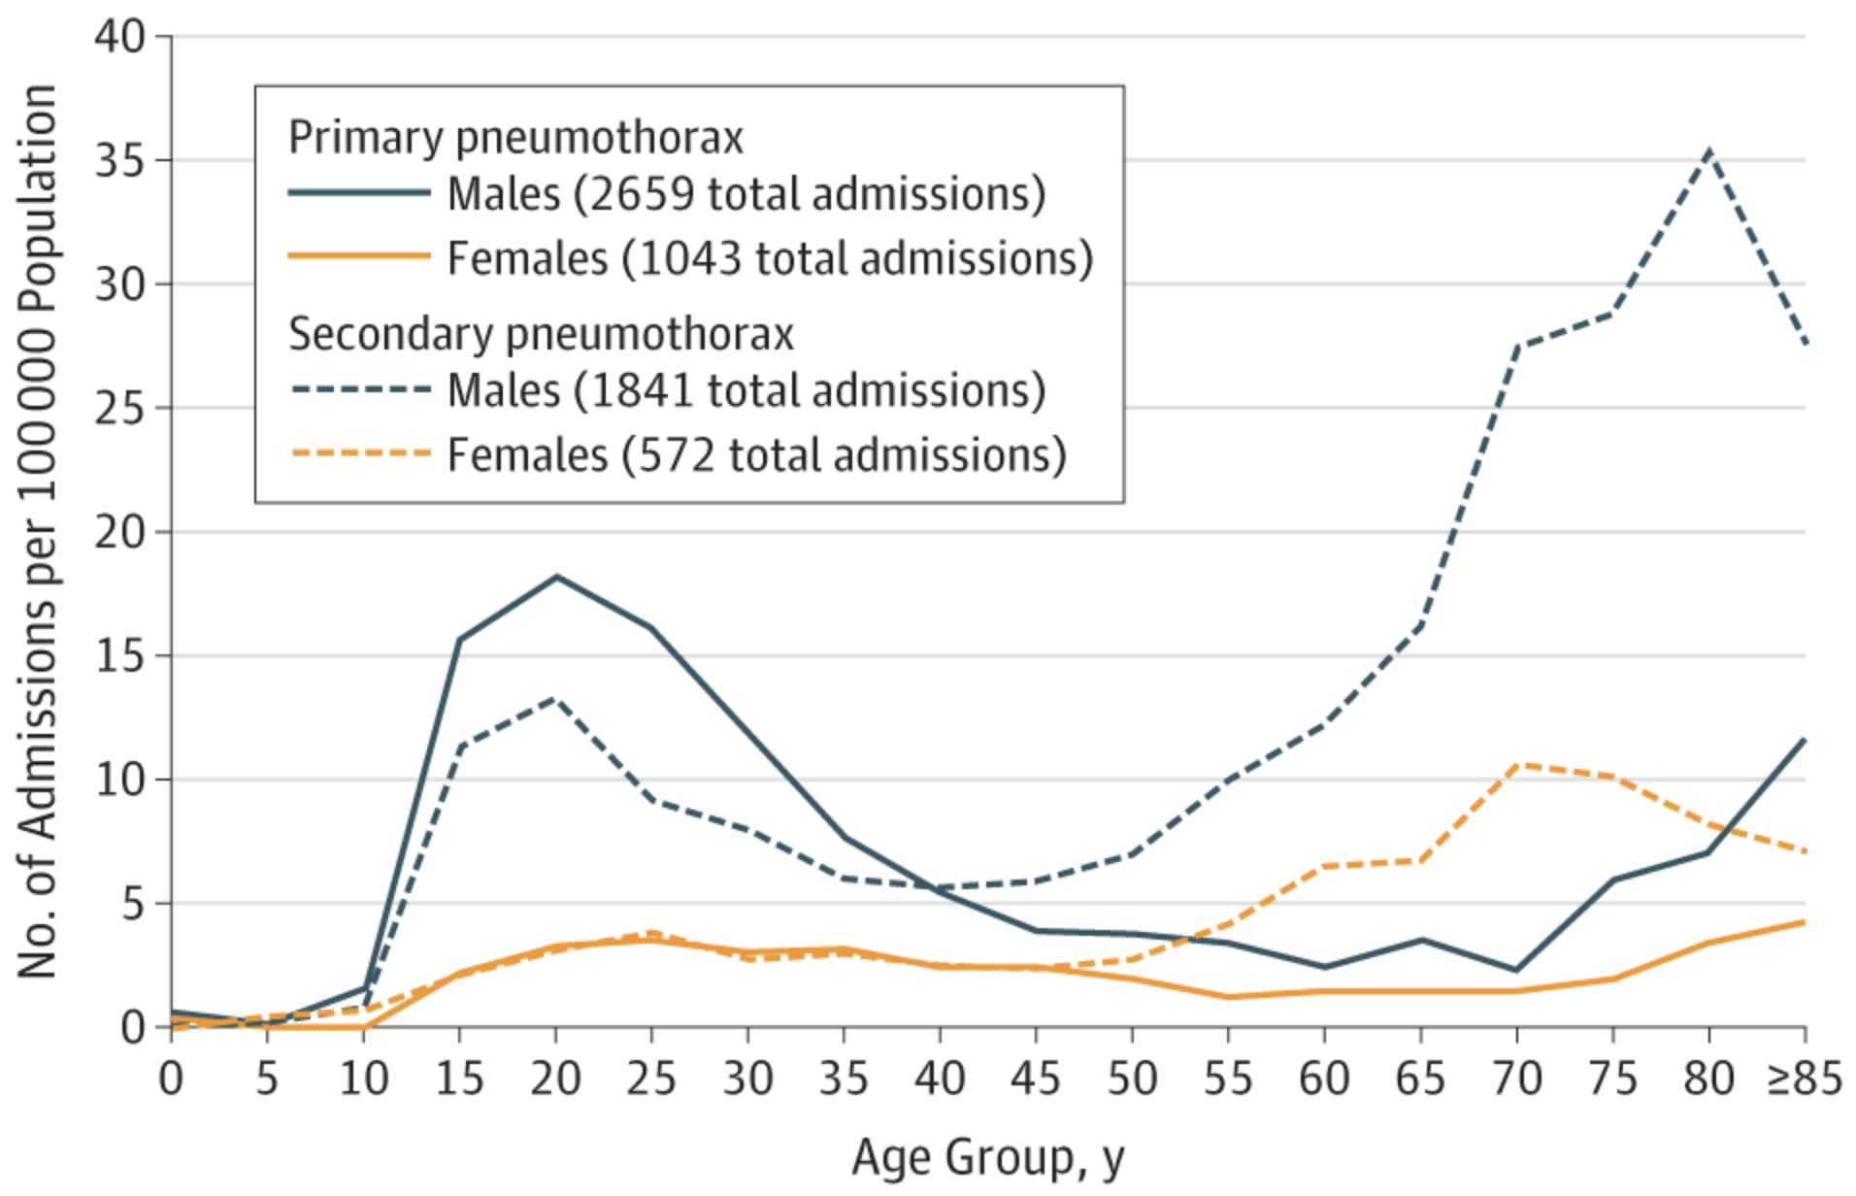
Primary and Secondary Spontaneous Pneumothorax Admissions by Age-Specific Population And Sex in England, 2015
Hallifax R et al. Jama 2018

Slide 9
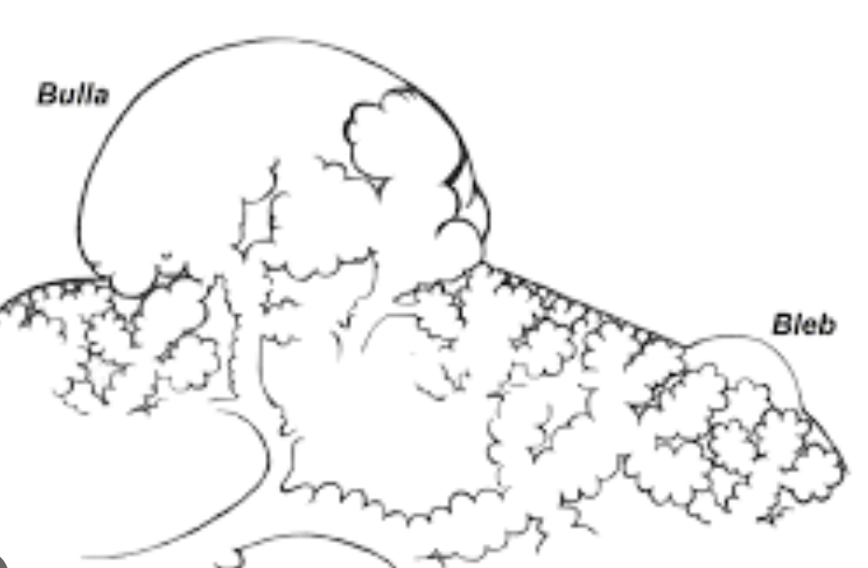
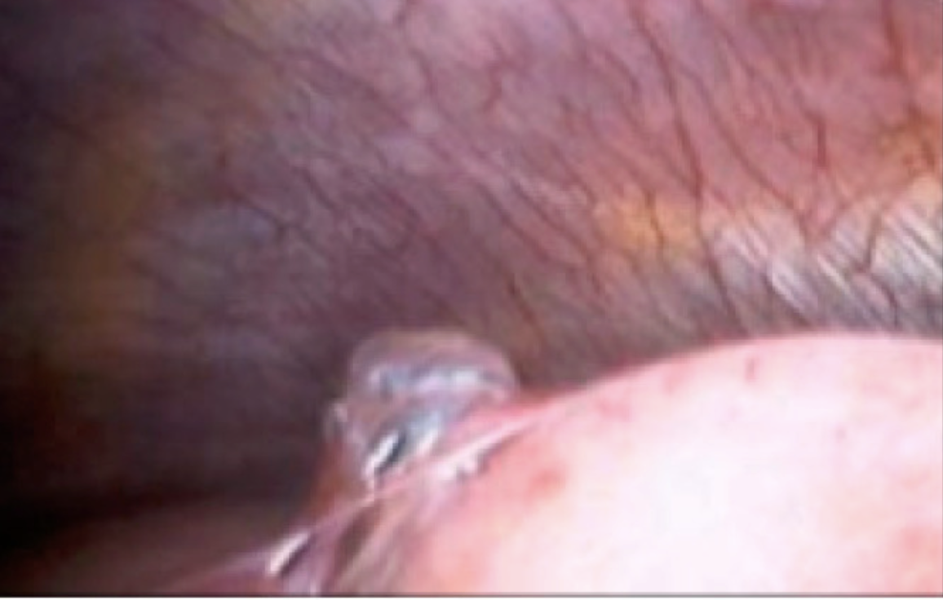
Aetiology of Primary Pneumothorax
BMI
Smoking
Blebs and bullae
Microscopic abnormalities – inflammation
Pleural porosity
Abnormal elastolysis (MMP2 – MMP9)
Familial causes
Ruppert AM et al. Diagn Inter Imaging 2018
Noppen M et al. AJRCCM 2006
Rob Hallifax et al. J Clin Med 2022

Slide 10
Pleural Porosity
Reid type I bullae (blebs) lack mesothelial cells and have small pores (10–20 μm)
Type II (and giant) bullae retain relatively preserved mesothelium
The smaller type I blebs are more prone to air leakage than larger type II bullae.
The damaged pleural surface is replaced by an inflammatory elastofibrotic layer, increasing air leak risk

Slide 11
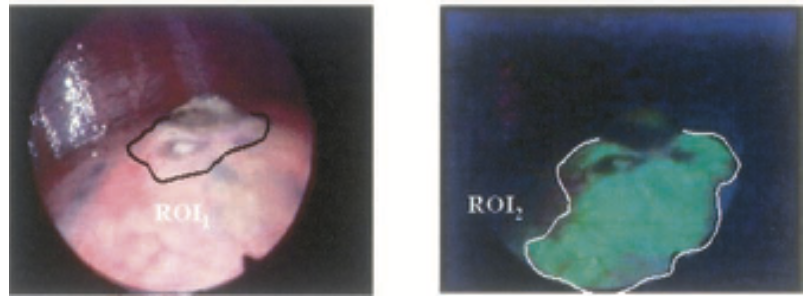
Pleural Porosity
12 PSP vs 17 controls (symphatectomy-normal lung) using fluorescein-enhanced autofluorescence
The control subjects underwent sympathectomy and had no lung disease or prior pneumothorax
Significant parenchymal abnormalities are not limited to lesions visible during white light thoracoscopy, such as blebs and bullae.
ROI: 2x3 cm
ROI: 5x7 cm
Noppen et al AJRCCM 2006

Slide 12
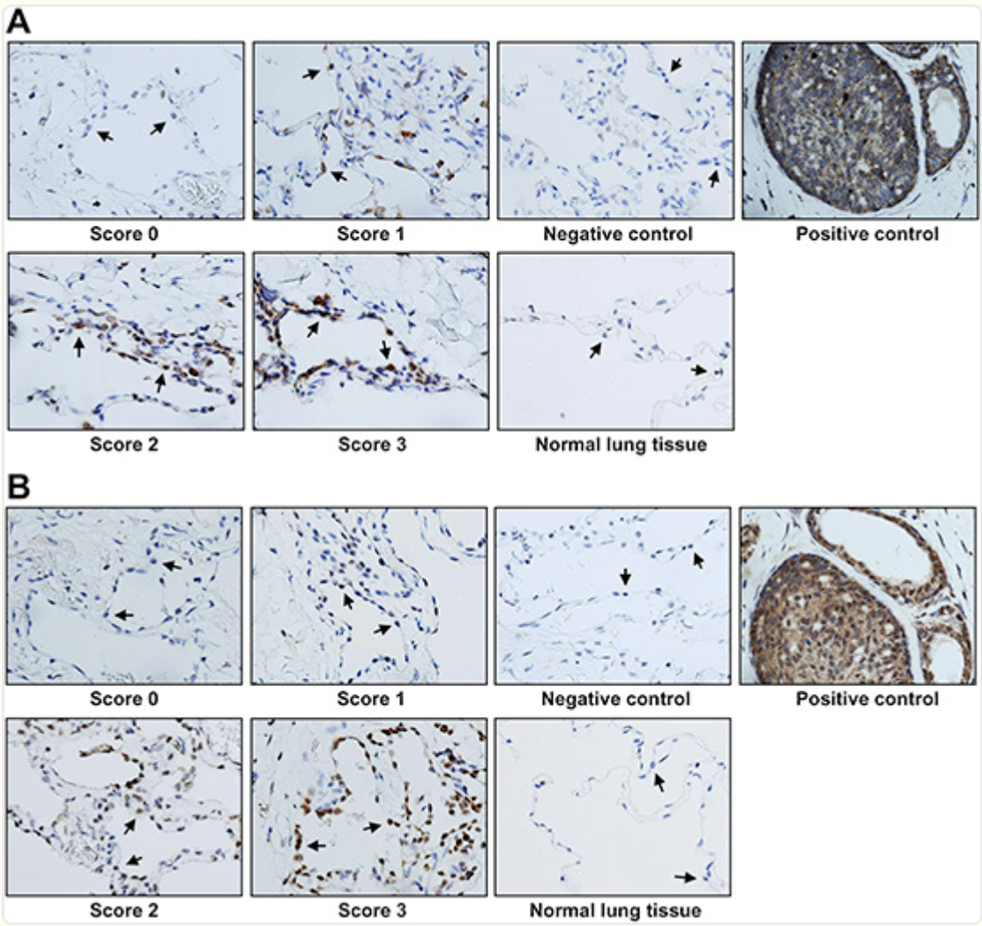
Abnormal Elastolysis
MMP-2
MMP-2 and MMP-9 are thought to be pathogenic in other lung diseases including asthma and COPD ^{[1]}
Two studies of surgical resection specimens of patients undergoing surgery for PSP demonstrated overexpression of MMPs ^{[2,3]}
MMP-9
1 Suzuki R. et al Treat. Respir. Med. 2004
2 Chen C et al. Respiration 2014
3 Huang Y.-F et al. Kaohsiung J Med Sci
2017

Slide 13

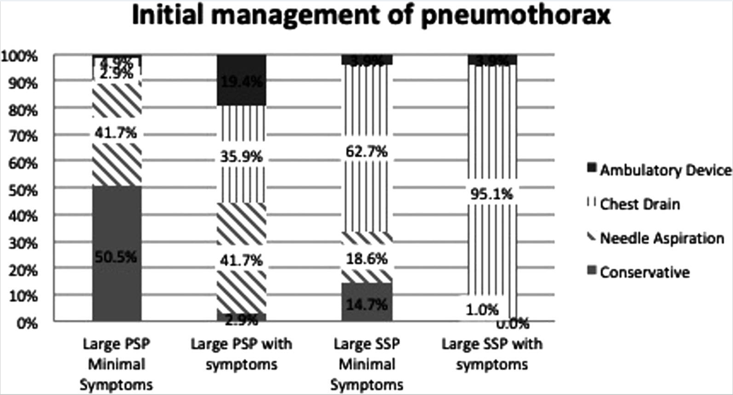
64% use suction after 2 days
15% always clamp drain prior to removal
30% never clamp drain prior to removal
23% use digital suction for resolution

Slide 14
How important is the size?

Slide 15
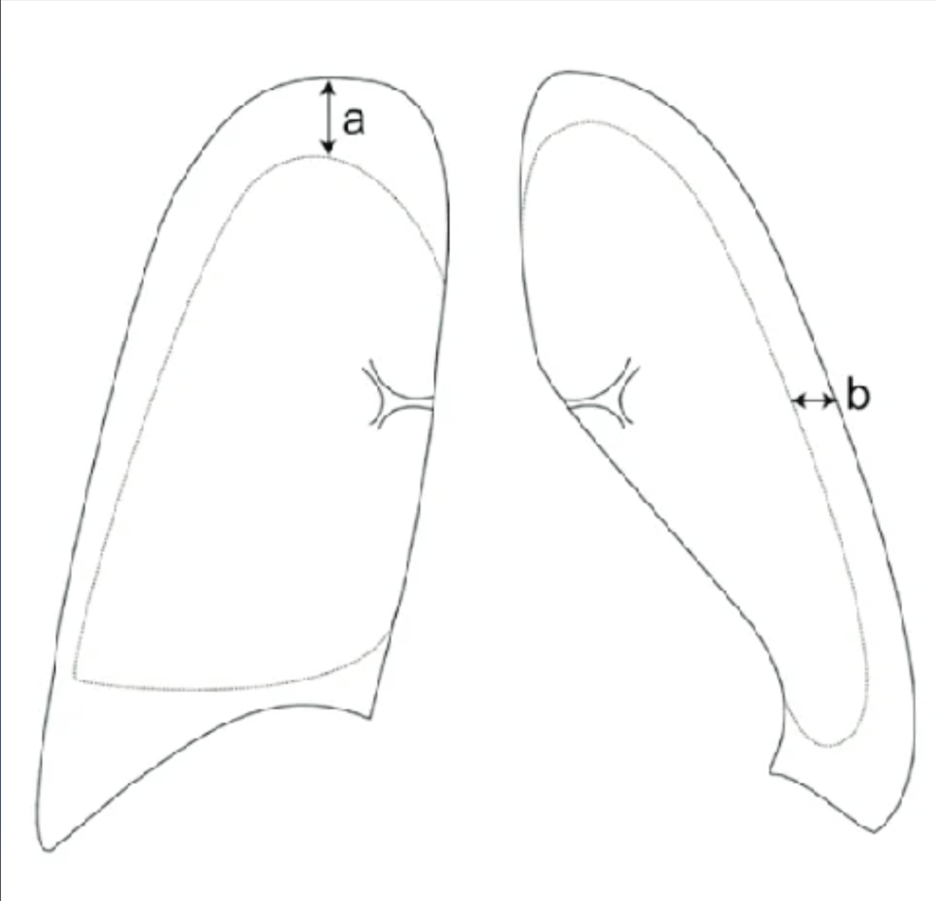
ACCP 🇺🇸: apex to cupola
Belgian 🇧🇪: circumferential edge
French 🇫🇷: >2 cm circumferential edge from hilar level
BTS🇬🇧: >2 cm
There is no international consensus size

Slide 16
Should we have an Italian one as well?

Slide 17
Today
Size alone is not an indication
  High risk characteristics^{[1]}:
tension ptx, significant hypoxia, bilateral ptx, underlying lung disease, >50 years with significant smoking history, haemoptx
        Symptom-driven approach
                Follow-up is more important
1 ME Roberts et al. BTS - Thorax 2023

Slide 18
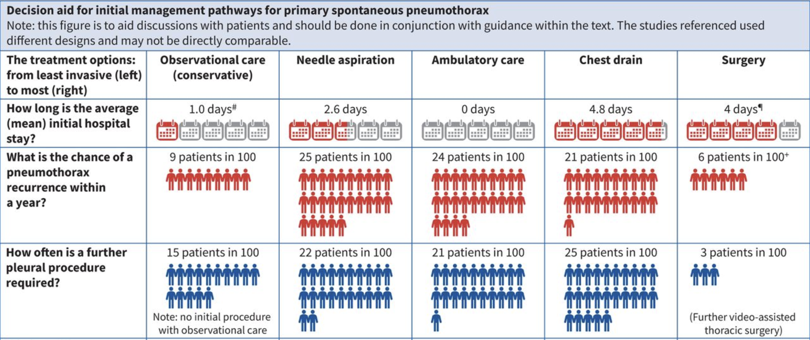
Pneumothorax management
ERS/EACTS/ESTS Guidelines.
Walker S. et al– ERJ 2024

Slide 19
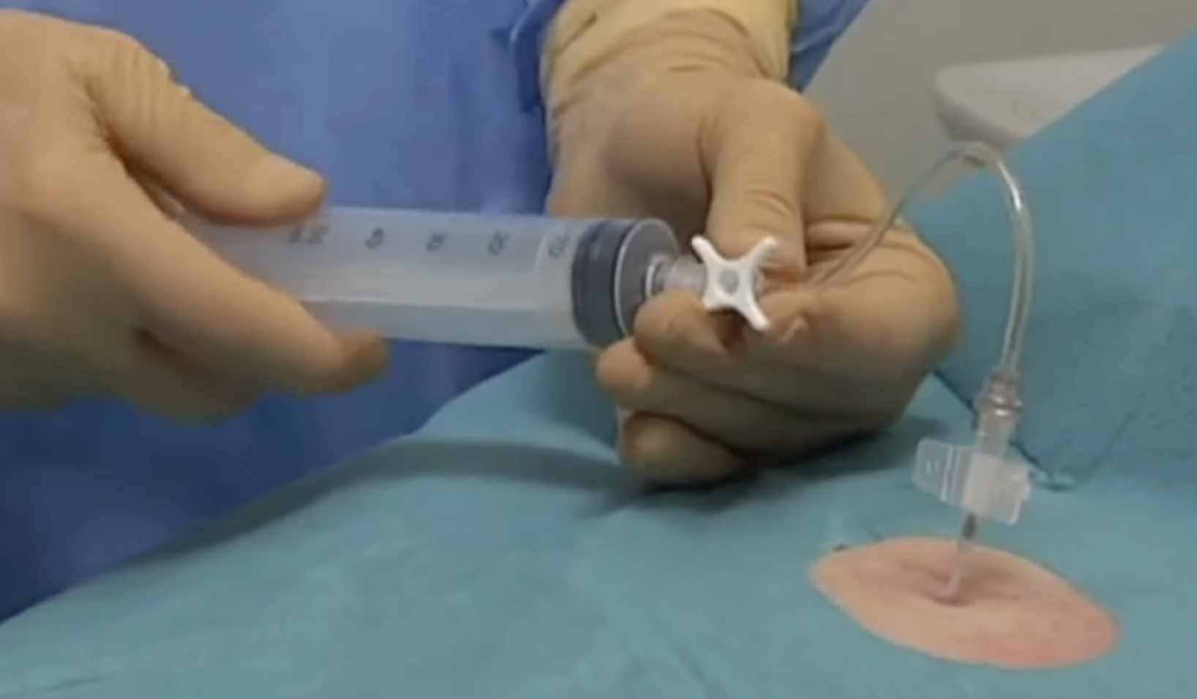
Needle aspiration
Success rate 60-67%
Single procedure in 2/3 cases
Lower complication
Better tolerability
Not definitive – may need further intervention
Reserved for PSP, not for SSP

Slide 20
Management
1. Clinically unstable patient
2. Minimally symptomatic
3. Clinically stable symptomatic

Slide 21
1. Clinically unstable
High-risk characteristics for clinical deterioration^{[1]}
1. Tension pneumothorax (clinical instability)
2. >50 years of age with significant smoking history (ie >20 pack years)
3. Known underlying lung disease
4. Significant hypoxia
5. Bilateral pneumothorax
6. Haemopneumothorax
The most important factor in the acute management of pneumothorax is the clinical stability of the patient. If there are concerns of clinical deterioration, urgent chest drainage is required
1 ME Roberts et al.
BTS 2023 - Thorax

Slide 22
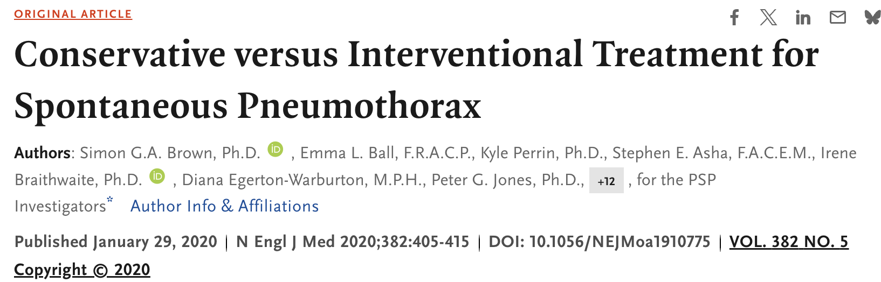
2. Minimally symptomatic
with minimal/no symptoms, conservative care (ie no drainage and monitoring only) is non-inferior to chest drain for radiological resolution of pneumothorax in 8 weeks, irrespective of the size of pneumothorax
Notes:
https://www.nejm.org/doi/10.1056/NEJMoa1910775
Methods: In this open-label, multicenter, noninferiority trial, we recruited patients 14 to 50 years of age with a first-known, unilateral, moderate-to-large primary spontaneous pneumothorax. Patients were randomly assigned to immediate interventional management of the pneumothorax (intervention group) or a conservative observational approach (conservative-management group) and were followed for 12 months. The primary outcome was lung reexpansion within 8 weeks.
Results: A total of 316 patients underwent randomization (154 patients to the intervention group and 162 to the conservative-management group). In the conservative-management group, 25 patients (15.4%) underwent interventions to manage the pneumothorax, for reasons prespecified in the protocol, and 137 (84.6%) did not undergo interventions. In a complete-case analysis in which data were not available for 23 patients in the intervention group and 37 in the conservative-management group, reexpansion within 8 weeks occurred in 129 of 131 patients (98.5%) with interventional management and in 118 of 125 (94.4%) with conservative management (risk difference, −4.1 percentage points; 95% confidence interval [CI], −8.6 to 0.5; P=0.02 for noninferiority); the lower boundary of the 95% confidence interval was within the prespecified noninferiority margin of −9 percentage points. In a sensitivity analysis in which all missing data after 56 days were imputed as treatment failure (with reexpansion in 129 of 138 patients [93.5%] in the intervention group and in 118 of 143 [82.5%] in the conservative-management group), the risk difference of −11.0 percentage points (95% CI, −18.4 to −3.5) was outside the prespecified noninferiority margin. Conservative management resulted in a lower risk of serious adverse events or pneumothorax recurrence than interventional management.

Slide 23
Conservative vs interventional treatment for spontaneous pneumothorax
Non-inferiority, RCT comparing conservative vs interventional treatment for moderate-large ptx in 316 patients
Primary outcome: Re-expansion at 8 weeks
Results:
Re-expansion in 98.5% in intervention group vs 94.4% in the conservative group (-4.1%, p=0.02 for non inferiority)
Twenty-five (15.4%) patients failed conservative management and required intervention
Higher recurrence rate, need for surgery, longer LOS/time off from work, and more adverse events (pain) with intervention group
S. Brown et al. NEJM 2020

Slide 24
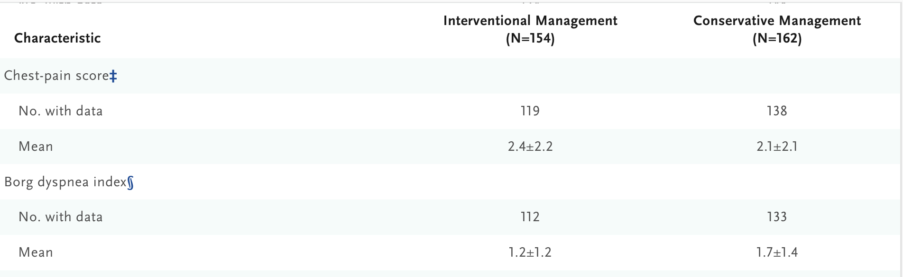
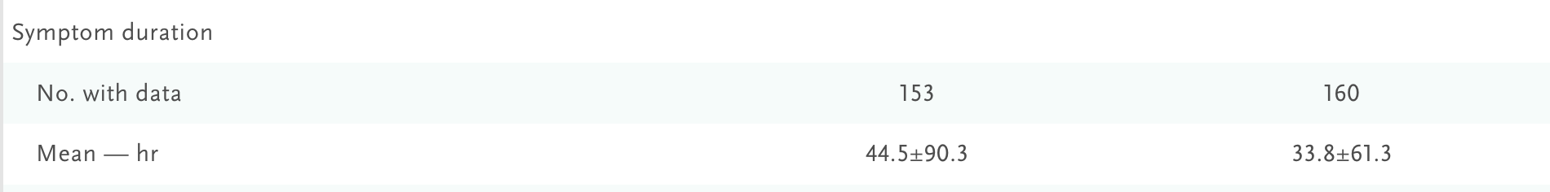
Perhaps cohort who are less likely to require intervention and can be managed conservatively?

Slide 25
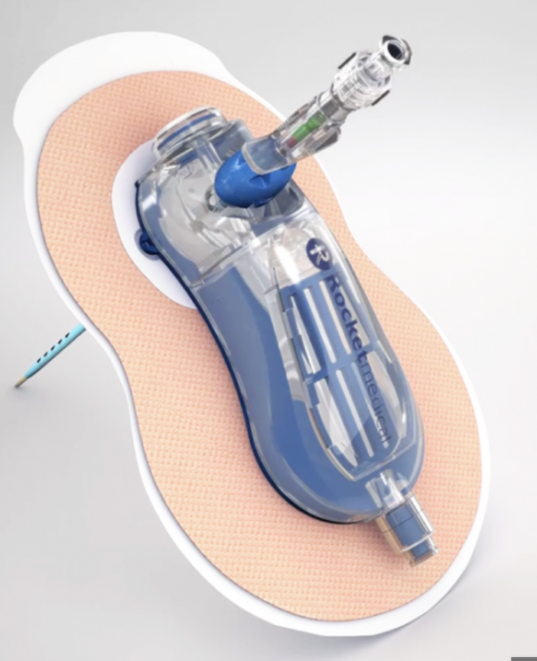
RAMPP trial: Ambulatory management of primary spontaneous pneumothorax: an open-label, randomised controlled trial
Large pneumothorax (≥2 cm at the level of the hilum) or significant symptoms, or both
Randomly assigned (1:1) to either insertion of an ambulatory device (Rocket Pleural Vent – 8Fr) or standard care (aspiration, standard chest tube insertion, or both) as per BTS 2010 guidelines.
Primary outcome: hospital stay over 30 days & 12 months follow-up
Rob Hallifax et al – The Lancet 2020

Slide 26
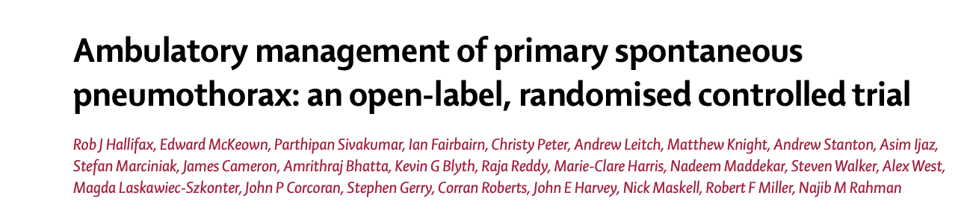
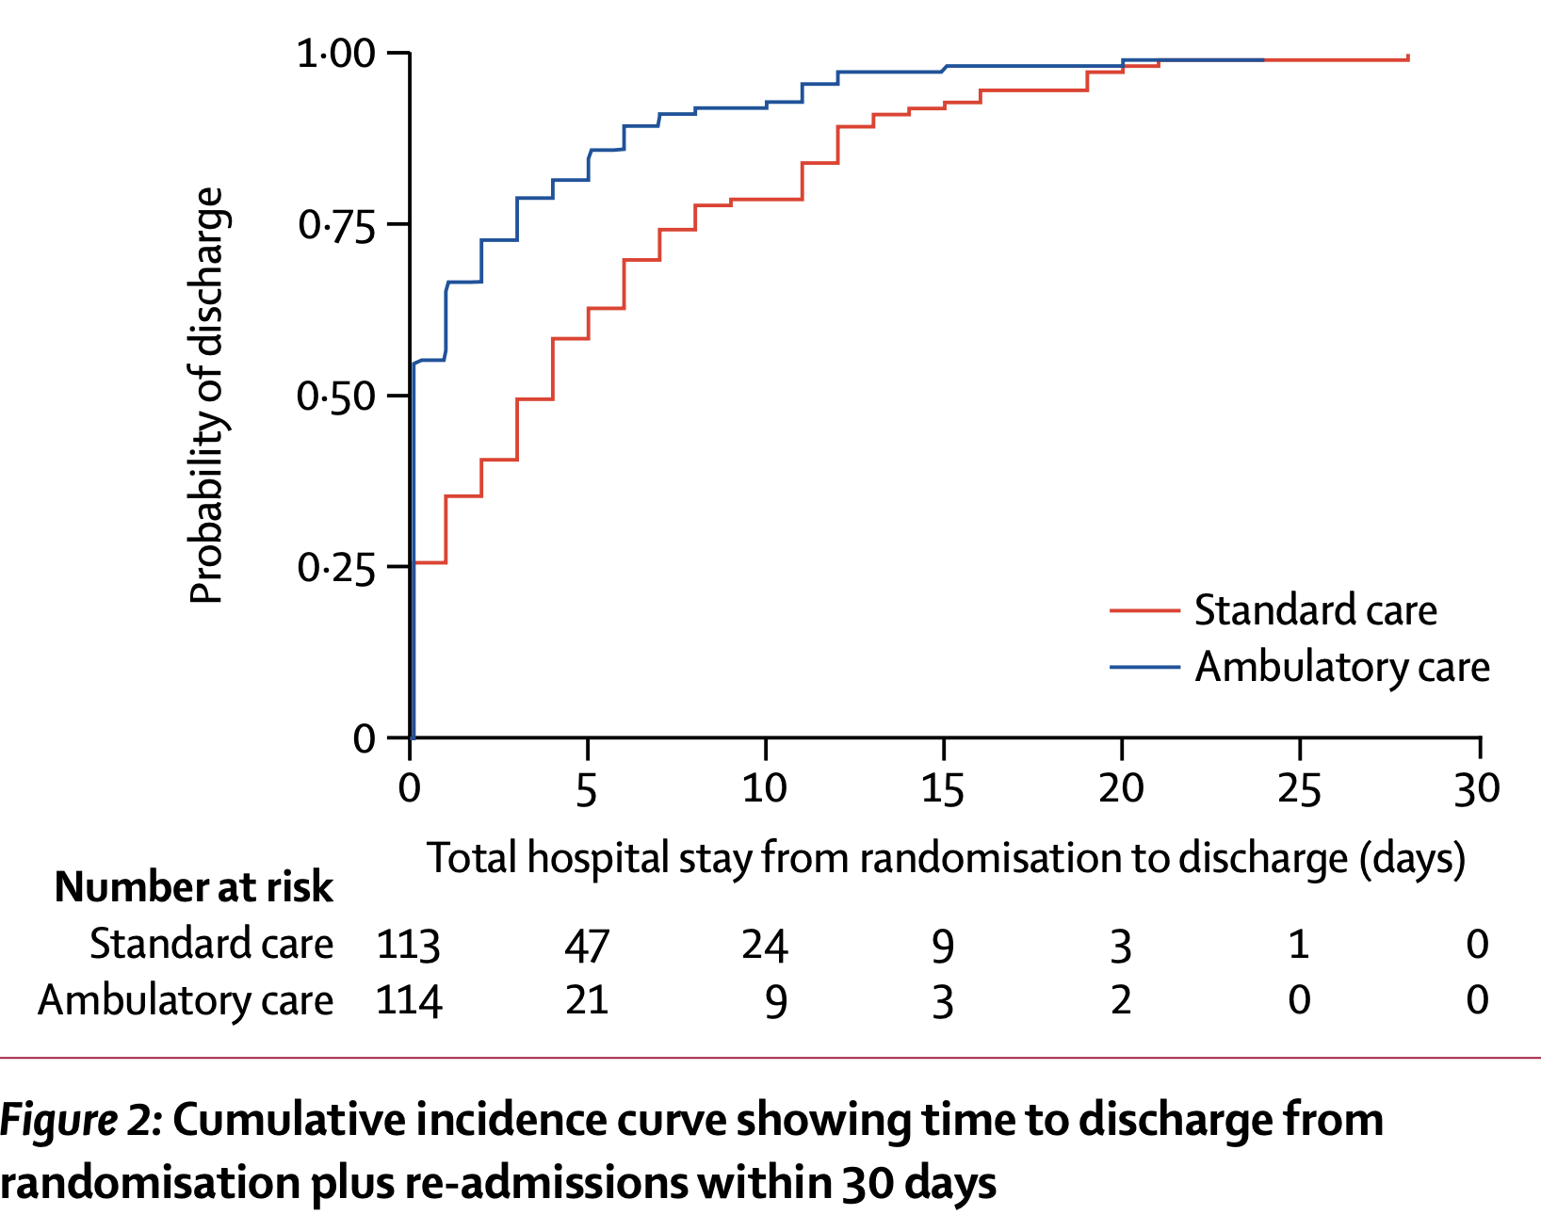
Rob Hallifax et al – The Lancet 2020

Slide 27
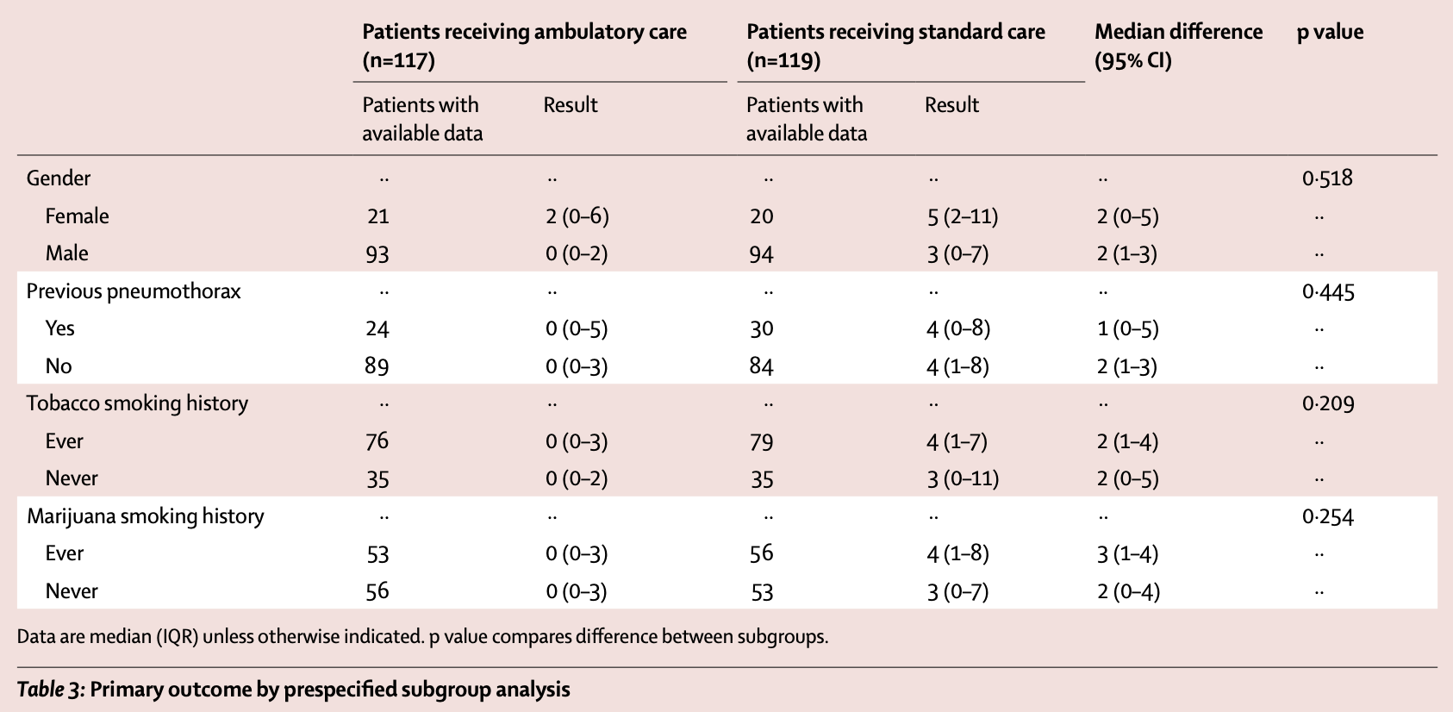
30%
Rob Hallifax et al – The Lancet 2020

Slide 28

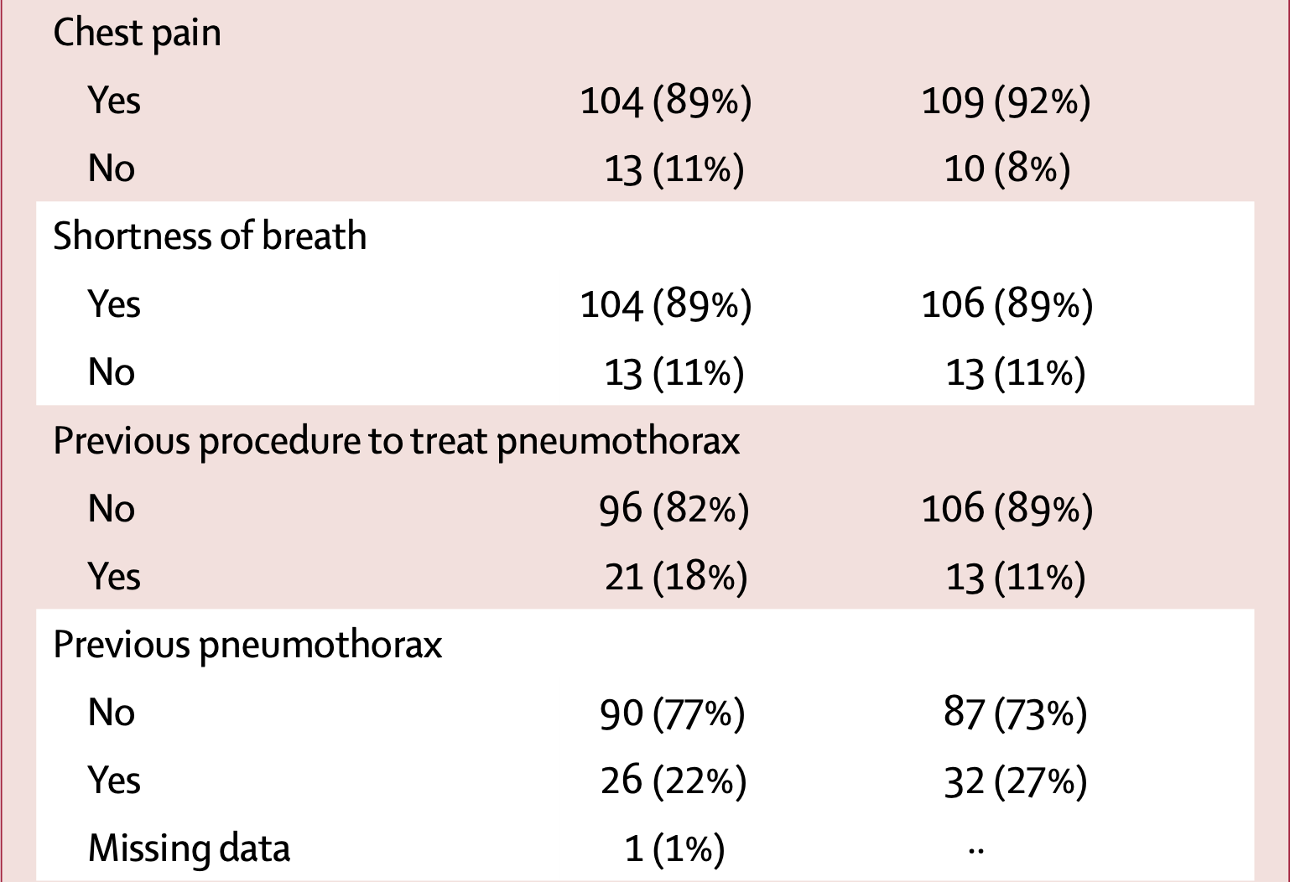
Rob Hallifax et al – The Lancet 2020

Slide 29
Hi-SPEC TRIAL: Ambulatory management of secondary spontaneous pneumothorax
Randomised controlled trial Heimlich valve vs standard care (12 Fr drain)
Difficult to recruit – drain inserted in ED department
If no drain = pleural vent
If drain in situ= attached pneumostat
Urgent safety review in pleural vent group after 6/12 (46%) required chest drain within 1 week
This study demonstrates that ambulatory management in cases of secondary spontaneous pneumothorax is not advisable, particularly discouraging the use of small-bore portable devices in this patient population-> Risk of subcutaneous emphysema (6/13); device blockage/enlarging pneumothorax (4/13)

Slide 30
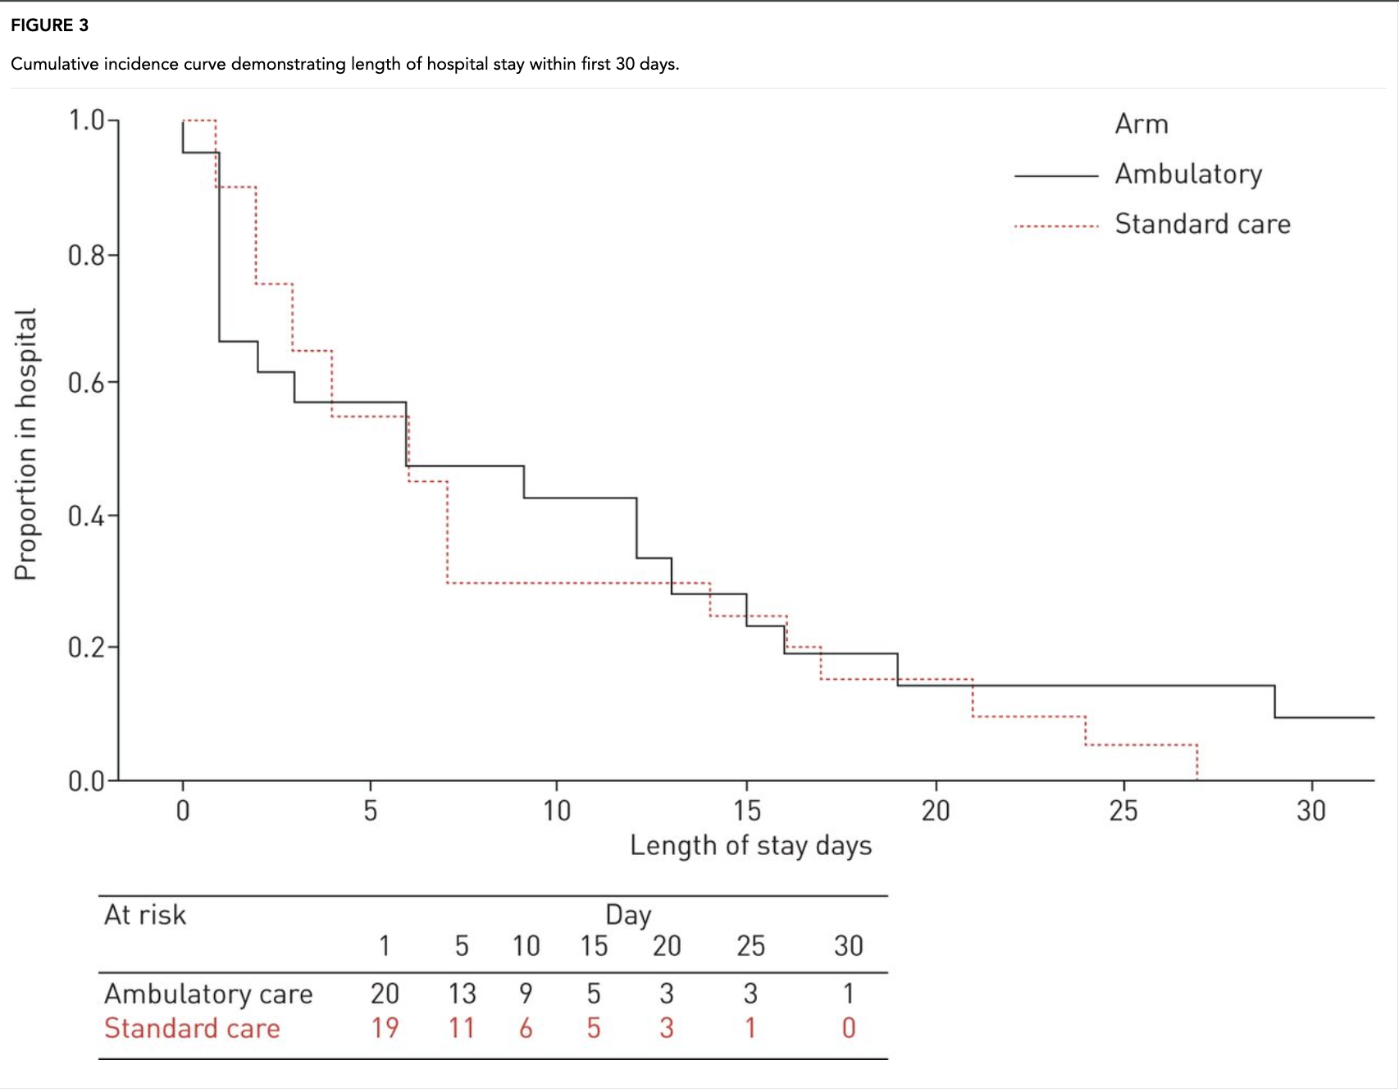
Hi-SPEC TRIAL: Ambulatory management of secondary spontaneous pneumothorax
Ambulatory management with a flutter valve does not shorten overall length of stay in patients with SSP compared to standard management.
This was due to increased risk of treatment failure with ambulatory management.
S. Walker et al – ERJ 2021

Slide 31
What is the risk of recurrence?
Systematic review & meta-analysis
29 studies, >13 thousands patients
Overall (ipsilateral and contralateral) recurrence rate = 32%
Greatest risk in 1st year
The risk of recurrence is more likely if you are a female (OR 3.03)
Smoking cessation = 4-fold reduction OR 0.28
Walker S et al ERJ 2018

Slide 32


Role of surgery
During the episode of ptx:
Persistent air leak
First pneumothorax presenting with tension pneumothorax
Synchronous bilateral pneumothorax
Elective procedure after ptx resolution:
2nd ipsilateral pneumothorax/1st contralateral ptx
High-risk occupations (airline pilots, deep sea
divers, military personnel)
B. Iqbal et al - Clin Med (Lond) 2025
BTS Clinical statement on Air Travel 2022

Slide 33
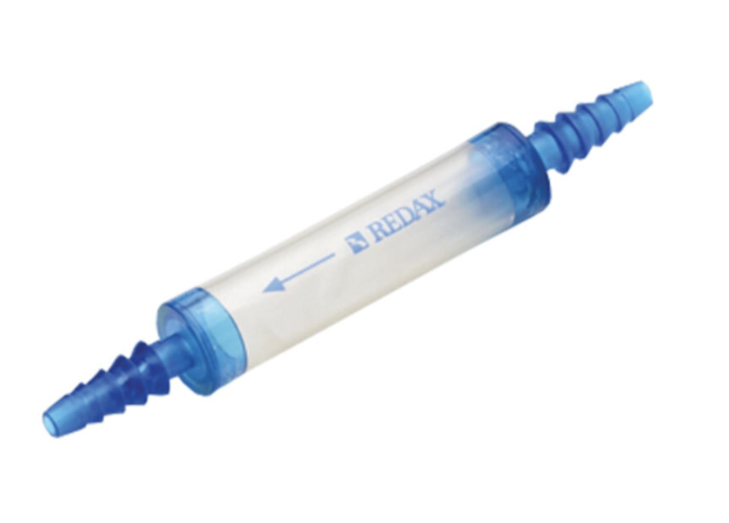
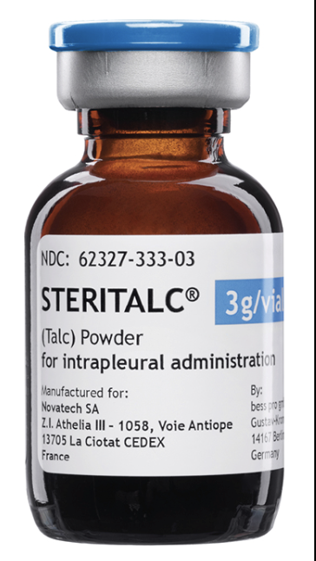
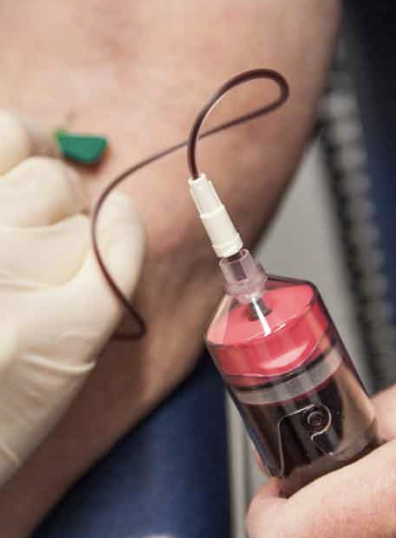
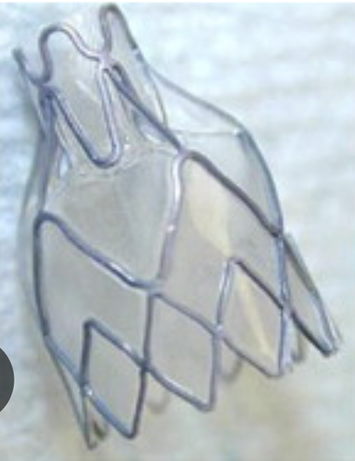
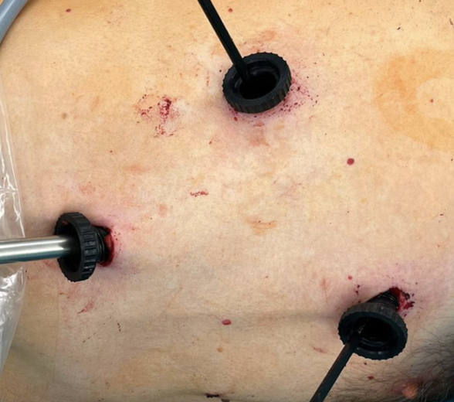
Chemical pleurodesis
Conservative: ICD + Heimlich valve/ambulatory bag
PSP resolution: 75% by 7 days & 100% by 15 days
SSP resolution: 61% by 7 days & 79% by 14 days^{[1]}
Persistent Air Leaks
Autologous blood patch
Endobronchial valve
Thoracic surgery/VATS
[1] Chee C B et al, Resp med 1998

Slide 34
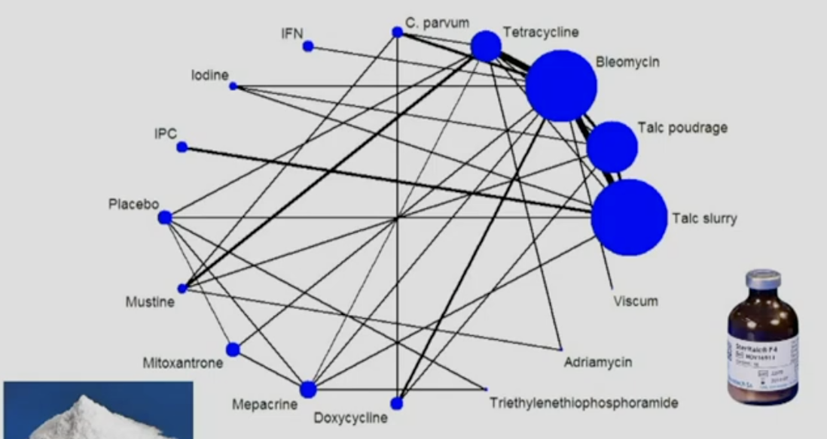
Chemical Pleurodesis
If the lung
re-expands, talc is the best pleurodesis agent
Cochrane Library, 2016

Slide 35
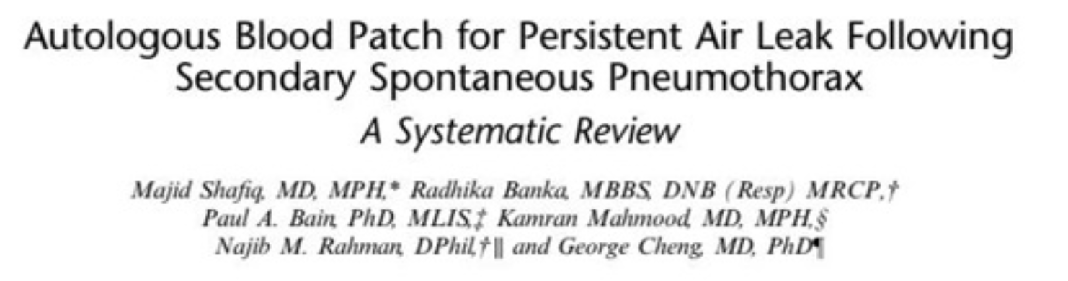
Autologous blood patch pleurodesis
ABP Dose: 50 mL (without heparin), 60 mL / 120 mL (followed by saline; no heparin), 0.5 mL/Kg, 1 mL/Kg
Repeat ABP: Yes/No
ABP Success rate: the longer the air leak was present, chances of success are diminished
PAL<5 days= better; whether PAL>5 days <50%
No tension ptx as >20Fr drains used

Slide 36

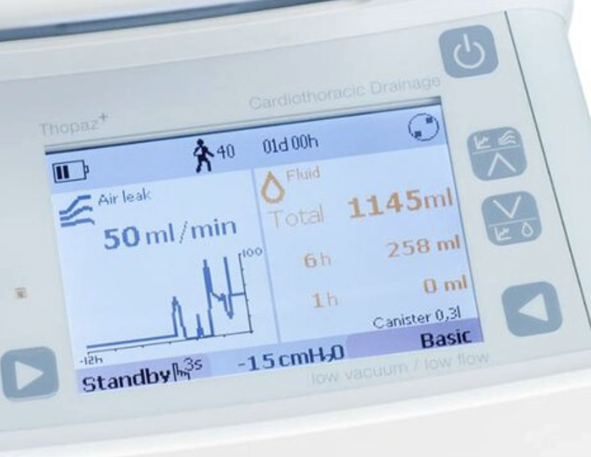
Role of suction
Theory is to remove air quicker than visceral pleural breach
Routine use is not recommended by guidelines
Risk of RPE or could delay healing of visceral breach
Digital suction device:
Continuous real time air leak data
Air leak quantified
Reduce inter-observer variability
More accurate than wall suction
Freedom to ambulate

Slide 37
Take home message:
Stable patients can be managed conservatively
Size does not determine treatment
Consider high-risk characteristics
Intervention based symptoms not size

Slide 38

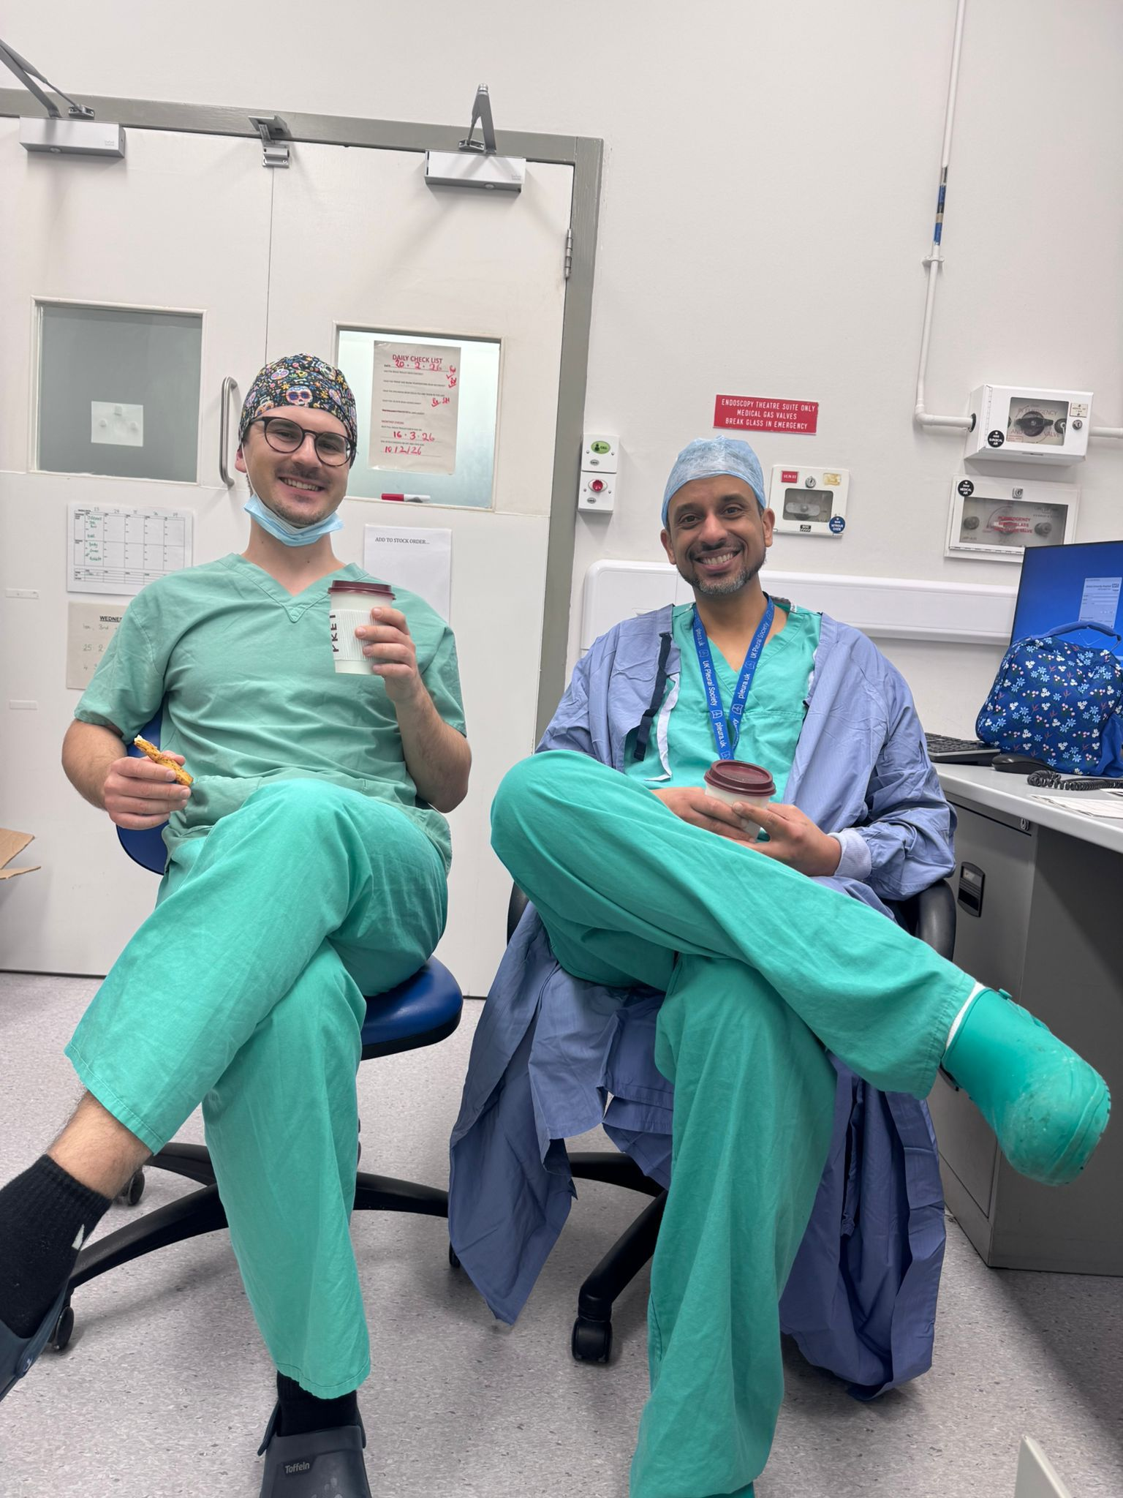
Thanks for your kind attention

