Slide 1

Pleural empyema infection
PneumoTrieste 2026
Wednesday 13th May 2026
Dr. Eihab Bedawi PhD FRCP
Consultant in Respiratory Medicine & Pleural Disease
Clinical Lead, Oxford Pleural Unit
Visiting Professor, Dept of Biomedical Sciences & Public Health
Universita Politecnica Delle Marche

Slide 2
Outline
Epidemiology
Aetiopathogenesis and microbiology
Biomarkers – current and in development
Treatment
Outcome prediction

Slide 3
Epidemiology
Bedawi et al ERS/ESTS Pleural Infection Taskforce Statement
ERJ 2023

Slide 4
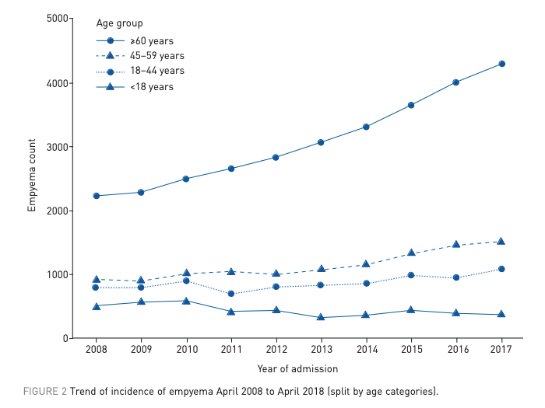
Arnold et al ERJ 2018
Notes:
ageing population within England is likely to be increasing susceptibility to respiratory infections – only a slight increase in average age of the cohort so unlikely to be the main factor
Increased prescribing of immunosuppressive agents and a rise in the prevalence of diabetes – both well recognized risk factors for pleural infection
Overdetection bias with widespread use of CT but unlikely as management and mortality have no changed significantly
Read the discussion from the Bender paper

Slide 5
15% one year mortality:
    Unchanged over last 20 years
    5.6% in acute MI²
    Similar to acute ischaemic stroke rates³
Highest average cost/case among pleural disease and acute lung illness
      $38,591 (US data)⁴
      €21,822 (European data)⁵
4. Mummadi et al CHEST 2021
5. Bobbio et al Thorax 2021
1. Corcoran et al ERJ 2020
2. Pasupathy et al Circulation 2021
3. Fang et al Neurology 2014

Slide 6
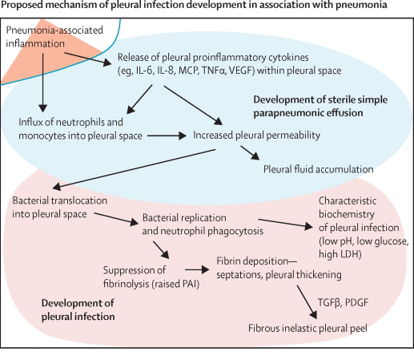
Corcoran et al Lancet Resp 2017
Notes:
Conventional wisdom has been that this you get a pneumonia hit which if not controlled causes a release So can we do anything about it – so this is the key step that we want to try and avo
2.5x your 30d mortality

Slide 7
Is it all pneumonia gone rogue?
Notes:
IS pleural infection all pneumonia gone rogue

Slide 8
Feature |  | Frequency (%)
Empyema Size | Small | 46
 | Moderate | 40
 | Large | 14
Volume change in hemithorax | Decreased | 25
 | Normal | 69
 | Increased | 6
Visible Septa |  | 24
Loculation |  | 17
Microbubbles |  | 58
Parietal Pleura (PP) Changes
Abnormal PP Enhancement |  | 99
PP Thickness | <2mm | 14
 | 2-5mm | 80
 | >5mm | 6
Parenchymal Changes
Passive Atelectasis |  | 95
Parenchymal Bands |  | 63
Pneumonia/Consolidation |  | 63
- Position relative to empyema: | Adjacent | 87
 | Remote | 13
- Associated cavitation |  | 29
Small Airway Nodularity |  | 17
Tree-in-bud Changes |  | 12
Bronchial Wall Thickening |  | 33
Frequency (%) of CT features:
97 patients with pleural infection from the MIST-2 study
CT’s triple scored by independent radiologists
Blind to clinical outcome and treatment
Franklin et al, Clin Rad 2021
Franklin et al, Clin Rad 2021
Notes:
This study was also from our radiology colleagues in Oxford and what they did was take 97 patients from the MIST-2 study which we will touch on when we talk about intrapleural therapy later on but essentially these were prospectively collected patinets as part of a randomised controlled trial so had a confirmed diagnosis of pleural infection

Slide 9
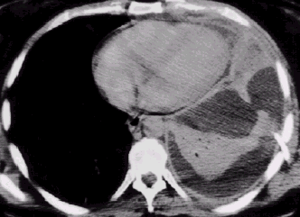
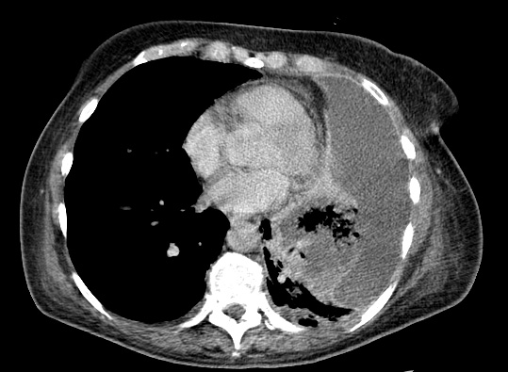
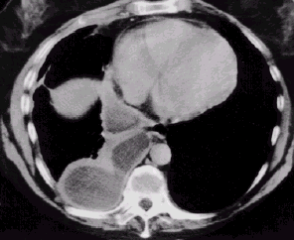
Empyema with associated
parenchymal consolidation + air bronchograms
Empyema with associated
cavitating consolidation
Empyema with no associated
parenchymal consolidation
Franklin et al, Clin Rad 2021
Notes:
Fast forward to the late 1990s and came the
However, up to 40% of empyema may be secondary to a non-pneumonic process, such as systemic infection with hematogenous spread or abdominal etiology. Independent risk factors for the development of empyema include diabetes, immunosuppression, gastro-esophageal reflux disease, alcohol and intravenous drug abuse, aspiration, and poor oral hygiene (18).
And hence probably improves aids the treatment of non responding pleural infection

Slide 10

Prospectively collected repository of pleural fluid samples from pleural infection (PILOT study; n=243 samples)
Adjudicated clinical outcomes up to 12 months
Kanellakis et al TORPIDS Lancet Microbiome Feb 2022
Notes:
Using NGS a metagenomic approach
atory metagenomics analysis through NGS that used a prospectively collected repository of PF samples from the PILOT study to a. define.. And b. correlate…
16S expansion of bacterial proteins

Slide 11
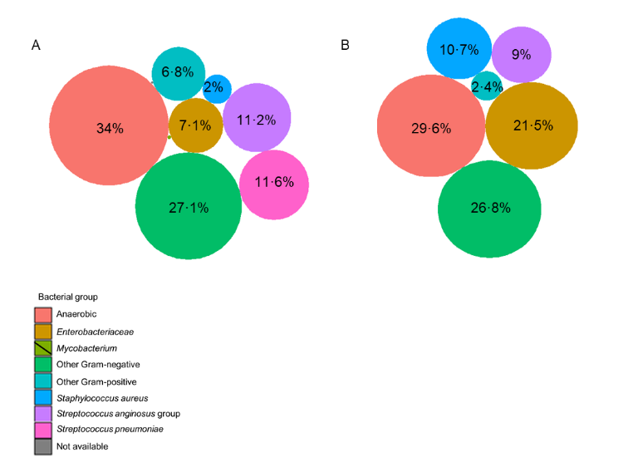
1. Bacteriology different to pneumonia
2. Anaerobic bacteria are dominant
Community acquired
Hospital acquired
Notes:
Micorbiology is different to pneumonia Again anaerobic bacteria are dominant and has been shown previously the microbiology is v different to pneumonia and is dominated by
Most abdundant pleural anaerobic pathogens are commonly found in the oral cavity and dental microbiome. Members of the s anginosus group are part of the normal oral flora and ofc we know that strep pneumoniae is known to colonise the upper respiratory tract
facultative and anaerobic oral bacteria, able to spread via deoxygenated venous blood to establish purulent infections in brain tissue, right Sided haematogenous spread is a plausible route of infection in oral-type bacterial pleural empyema.

Slide 12
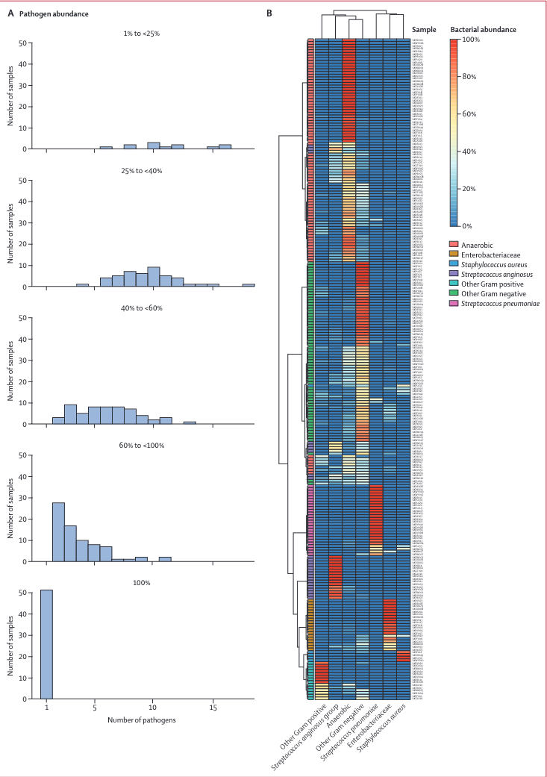
3. Pleural infection is polymicrobial (~ 80%)
S pneumoniae partakes in monomicrobial pleural infection (approx. 20% of all cases)
Notes:
S pneumoniae was the most abundant pathogen in the MM group, by contrast
with all PM groups, which showed a low abundance of S pneumoniae (3.8%, 16).
Does the degree of polymicrobiolaity determine your clinical outcome – and the answer is no it does not
Patients with a dominance of S aureus and Enterobacteriaceae in samples were at higher risk of death, perhaps due to these bacteria being more resistant to antibiotics. This suggests a need for more focused treatment in these patients.

Slide 13
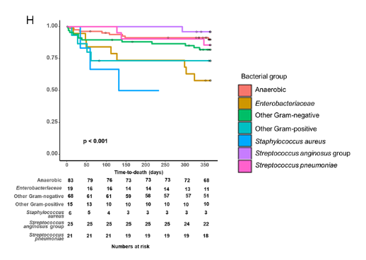
4. Dominance of bacteria associates with survival
Kanellakis et al TORPIDS Lancet Microbiome Feb 2022
Notes:
And while polymicrobiality in itself does not affect outomes – dominance of bacteria indeed does
These are Kaplan-Meier survival curves presenting one-year mortality
The samples were separated based on the dominant bacterial group in each sample. Samples with dominance in Enterobacteriaceae and Staphylococcus aureus exhibited poorer survival and increased risk of one-year mortality.
Anaerobes and milleri 5%. Staph aureus and gram negative 30-50%)
The presence of anaerobic and S anginosus group bacteria were associated with significantly better survival, whereas survival with S aureus infection was poorer, and these results were independent of the only known predictive score for pleural infection survival (RAPID)
Patients with a dominance of S aureus and Enterobacteriaceae in samples were at higher risk of death, perhaps due to these bacteria being more resistant to antibiotics. This suggests a need for more focused treatment in these patients.

Slide 14
Treatment

Slide 15
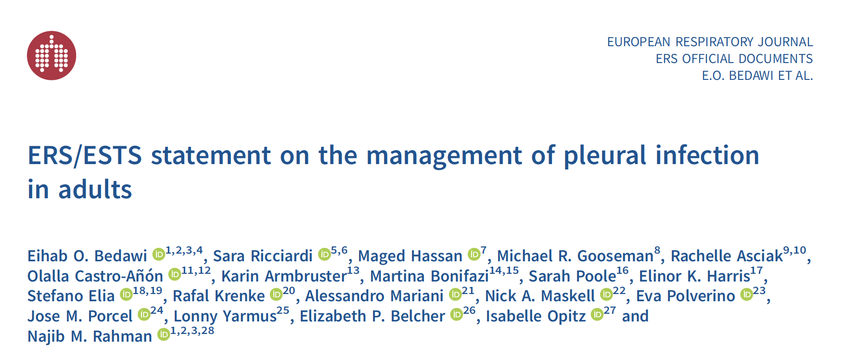
Bedawi et al ERJ February 2023

Slide 16
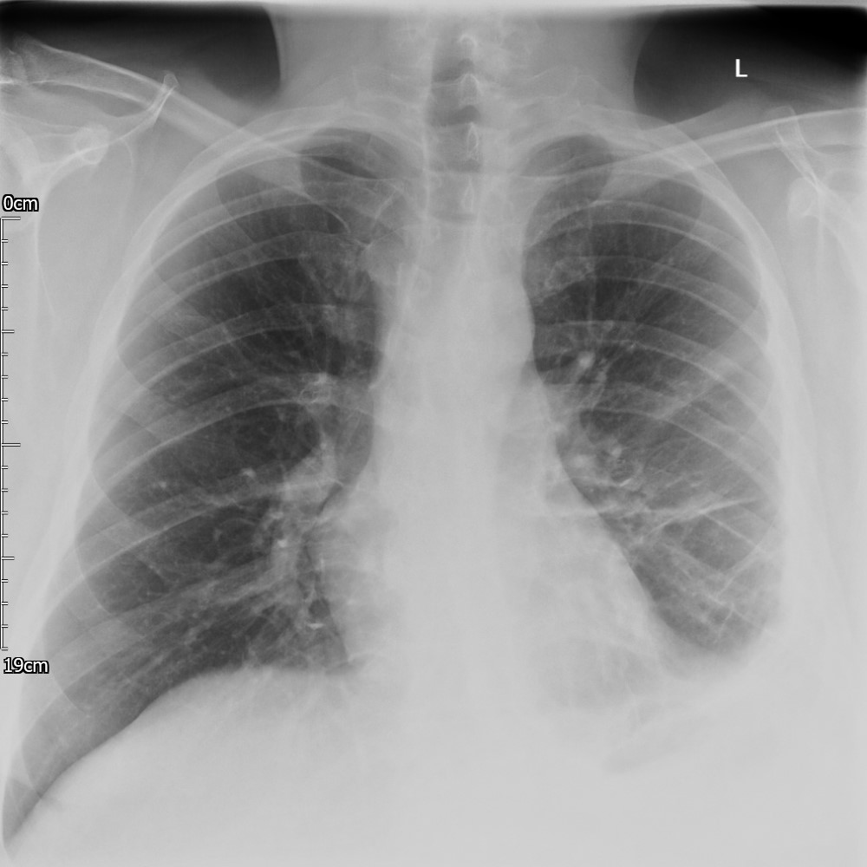
Basic principles
High index of suspicion
Early admission and initiation of intravenous antibiotic therapy
Early diagnostic sampling and drainage
Nutritional support
VTE prophylaxis
Notes:
The principles remain unchanged but what I think is most challenging is its indolent and subacute presentations meaning delated presentation and what the literature has shown time and time again is that treatment delays are associated with worse outcomes

Slide 17
The sun shall not set?
Danish Pleural Empyema Group;
  Retrospective clinical outcome study
  9 hospitals in East Denmark
  n=437
  HES data
  Pleural drainage delay > 2 days independently predicted increased 30-day and 90-day mortality
Meyer et al BMC Pulm Med 2018
Notes:
And so the first question is does it matter?
This was one of the first studies that really brought this to light, this was data from the Danish pleural empyema group, this was a large study using HES data across Eastern Denmaek and what they found was

Slide 18
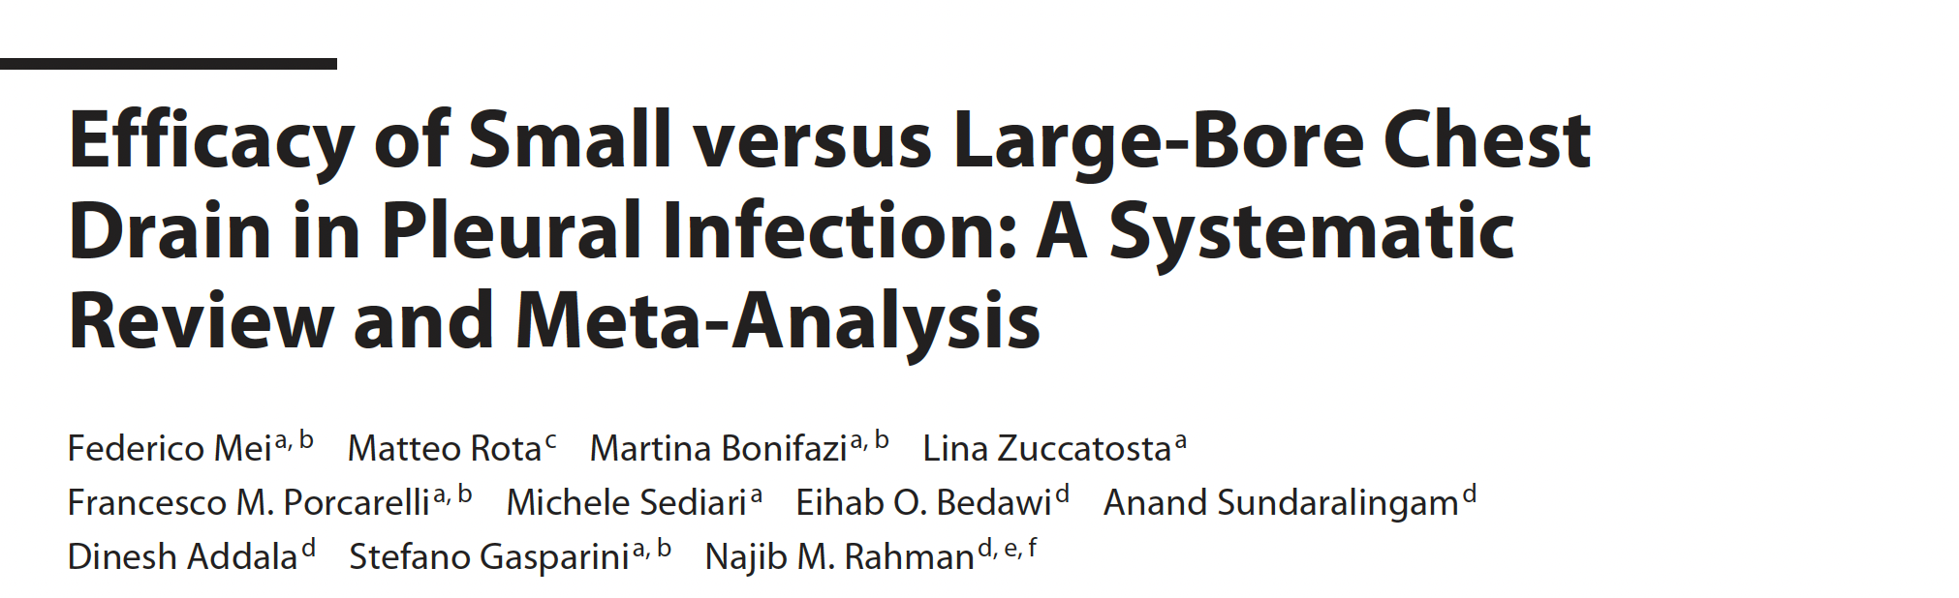
Chest tube size – is bigger better?
Mei et al Respiration 2023
Notes:
The scientists William S. Tillett and Sol Sherry were responsible for the introduction of intrapleural fibrinolytics as therapeutic agents, thus supplementing antimicrobial therapy in the treatment of empyema.
Used a partially purified streptococcal concentrate containing streptokinase and streptococcal DNase intrapleurally in patients with empyema and concluded that the reduction in fibrinogen levels and increase in markers of proteolysis of the bacteria was probably a representation of fibrin bacteria by streptokinase within the pleural space

Slide 19

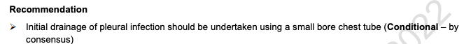

Chest tube size – is bigger better?
Small-bore (12-14F) chest tubes using
  optimally placed targeting the deepest site/largest locule under US guidance
  Secured using sutures and bespoke dressings
  Regular saline flushes
Notes:
The scientists William S. Tillett and Sol Sherry were responsible for the introduction of intrapleural fibrinolytics as therapeutic agents, thus supplementing antimicrobial therapy in the treatment of empyema.
Used a partially purified streptococcal concentrate containing streptokinase and streptococcal DNase intrapleurally in patients with empyema and concluded that the reduction in fibrinogen levels and increase in markers of proteolysis of the bacteria was probably a representation of fibrin bacteria by streptokinase within the pleural space

Slide 20
Optimal antibiotic strategy
Often empirical
Duration
  ODAPE² and SLIM³ underpowered
  Total duration min. 4 weeks
IV/oral switch guided by clinical improvement (prolonged IV not routinely required)
Liaise with local microbiologists
²Porcel et al Pleural & Peritoneum 2020
³Hassan et al ERJ Open Research 2023
Notes:
The duration of antibiotic treatment in pleural infection has not been specifically assessed in adequately powered RCTs
This is a description of TF members‟ practice and is not intended as a clinical practice recommendation.
Local microbiology guidelines where available should always take precedence.
% Even if an anaerobic organism is not identified on microbiological tests, most TF members would include anaerobic coverage in antibiotic regimens given the difficulty in culturing these organisms that commonly infect the pleural space.
# Clindamycin and metronidazole have comparable anti-anaerobic spectrum, although the latter may have a lower incidence of bacterial resistance and better penetration into the pleura.
$ These agents possess anaerobic coverage and some TF members would consider for use as single agents in community-acquired infection (especially if needed to improve tolerance/compliance) but higher-than-standard doses may be required for some agents. In most cases, TF members would prefer anaerobic cover with a specific agent.

Slide 21

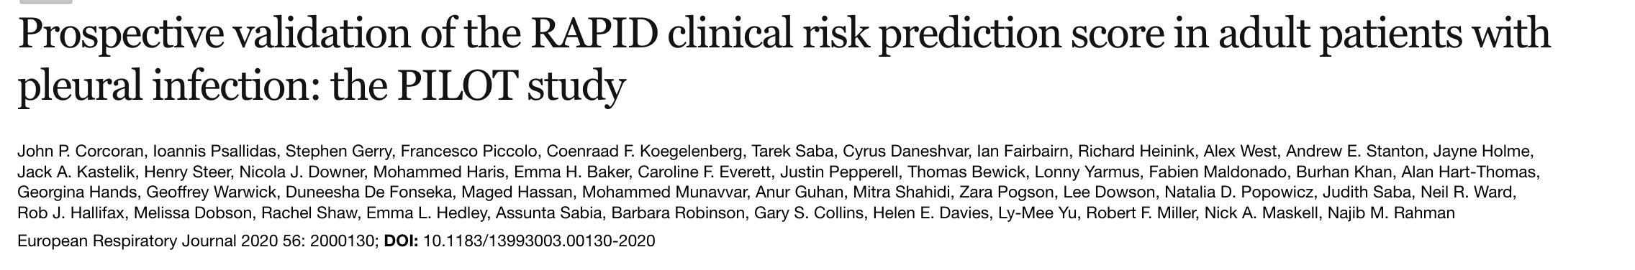
Rate of medical treatment failure = 33.5%
n = 546
29 centres
Corcoran et al ERJ 2020
Notes:
… the PILOT study which was primarily designed to validate the RAPID clinical risk prediction score but is also to date the largest observational study evaluating longitudinal outcomes in pleural infection to date, including medical treatment failure

Slide 22
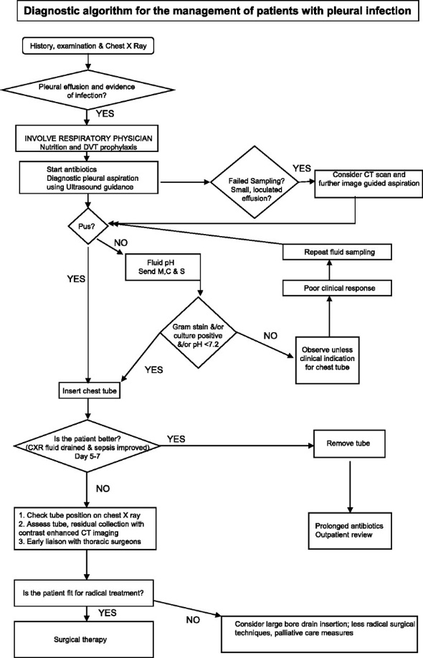

Guidelines
Based on expert consensus
Helen E Davies et al. Thorax 2010;65:ii41-ii53

Slide 23
Why is early assessment of medical treatment failure important?
Notes:
So we know it’s a common problem in 1 in 3 patints, we know how to assess it, when do we assess for it? We recently carried out a survey of practice in pleural infection amongst UK pleural physicians

Slide 24
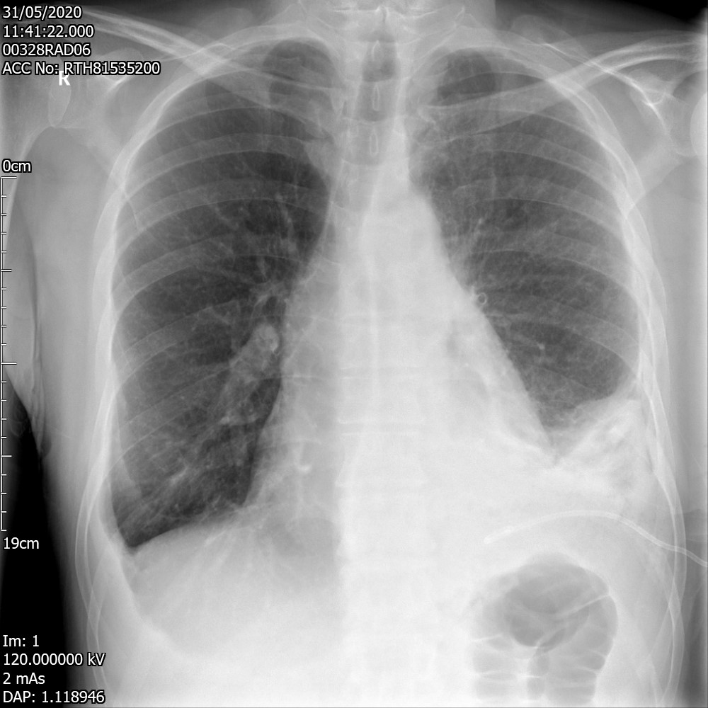
Notes:
In terms of radiology..

Slide 25
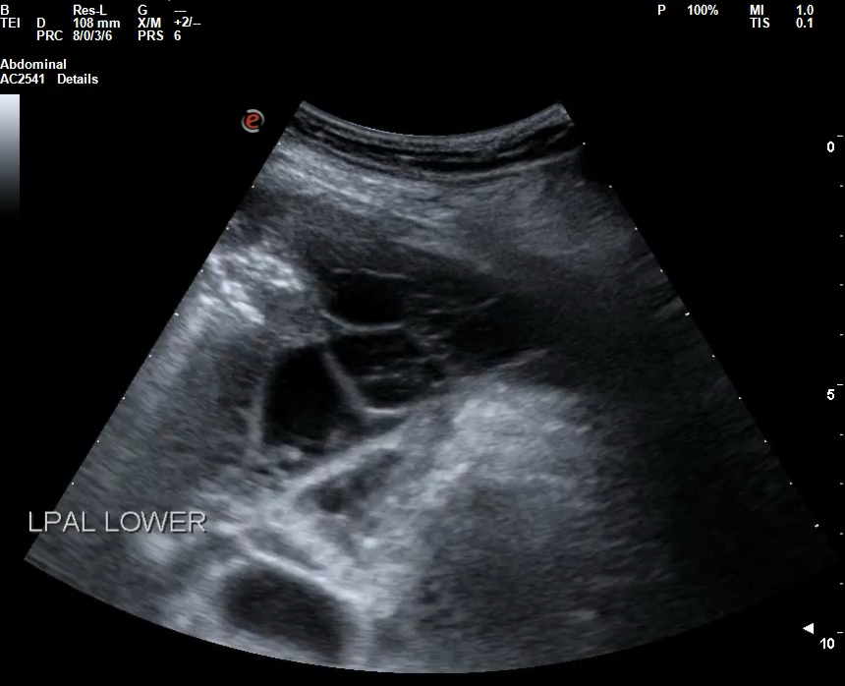
Notes:
Nowadays we have easy access to ultrasound – and just to quickly orientate those who may not do ultrasound.. obviously .. but I think we should be aware of its limitations..

Slide 26
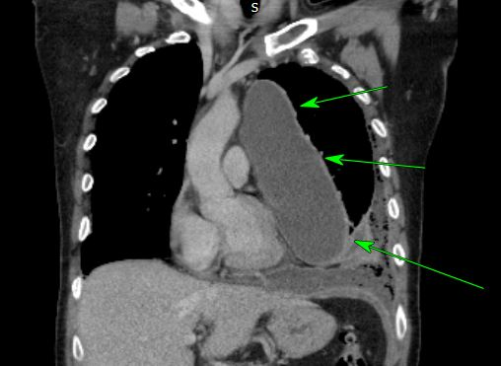
Notes:
A more medially positioned collection on the mediastinal pleural reflectionis gas free. This collection measures approximately 18 x 10x 7 cm and has some mild mass-effect on the heart and greatvessels. The heart is mildly displaced to the right.The
mild mass-effect on the heart and greatvessels. The heart is mildly displaced to the right

Slide 27
Early CT
Confirming chest tube placement position
Lung abscess / cavitating pneumonia
Bronchopleural fistula
Subdiaphragmatic collections
Malignancy
Surgical planning

Slide 28
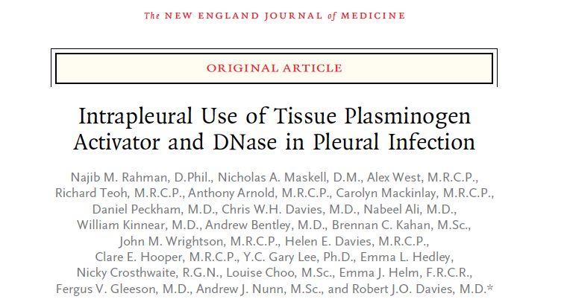
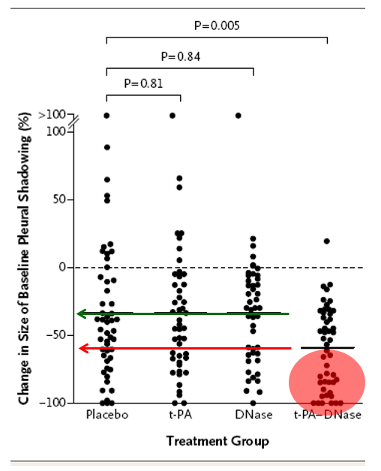
MIST-2
Rahman et al NEJM 2011

Slide 29
Combination tPA/DNase
tPA (Alteplase)
Break up septations (PAI-1 driven inflammation → depressed fibrinolytic activity)
Lavage effect (predominantly MCP-1 driven pathway)
DNase (Dornase alfa)
Viscosity (extracellular uncoiled DNA liberated from dead leucocytes)
Biofilm formation (incorporating fibrin and DNA)
MIST-2
Rahman et al NEJM 2011
Notes:
A quick reminder about the mechanism
tPA exerts a direct fibrinolytic effect to break down septations – so it bypasses the need for streptokinase to combine with plasminogen in vivo possibly depleting its levels in the pleural space and that may be part of the reason why it was less effective in MIST-1 study
Dnase targets uncoiled DNA to reduce both fluid viscosity and biofilm formation that might otherwise encourage retention of infected material in the pleural space and relapsing sepsis

Slide 30
tPA / DNAse experience
Author | Study Type | No. of pts. treated with active combination
Rahman et al – 2011 | RCT | 52 / 210
Piccolo et al – 2014 | Prospective observational | 107 / 107
Majid et al – 2016 | Retrospective | 73 / 73
McClune et al - 2016 | Retrospective | 101 / 101
Mehta et al – 2016 | Retrospective | 55 / 55
Popowicz et al – 2017 | Prospective observational | 61 / 61
Kheir et al – 2018 | Prospective observational | 38 / 38
Khemasuwan et al – 2018 | Retrospective analysis | 84 / 84
Jiang et al - 2020 | Retrospective cohort | 56 / 56
Current state of MIST-2 in the literature
Pooled treatment success (i.e surgery sparing) rate of 90%
Improves CXR opacification
Reduces LOS
Bedawi et al ERS/ESTS Pleural Infection Taskforce ERJ 2022

Slide 31
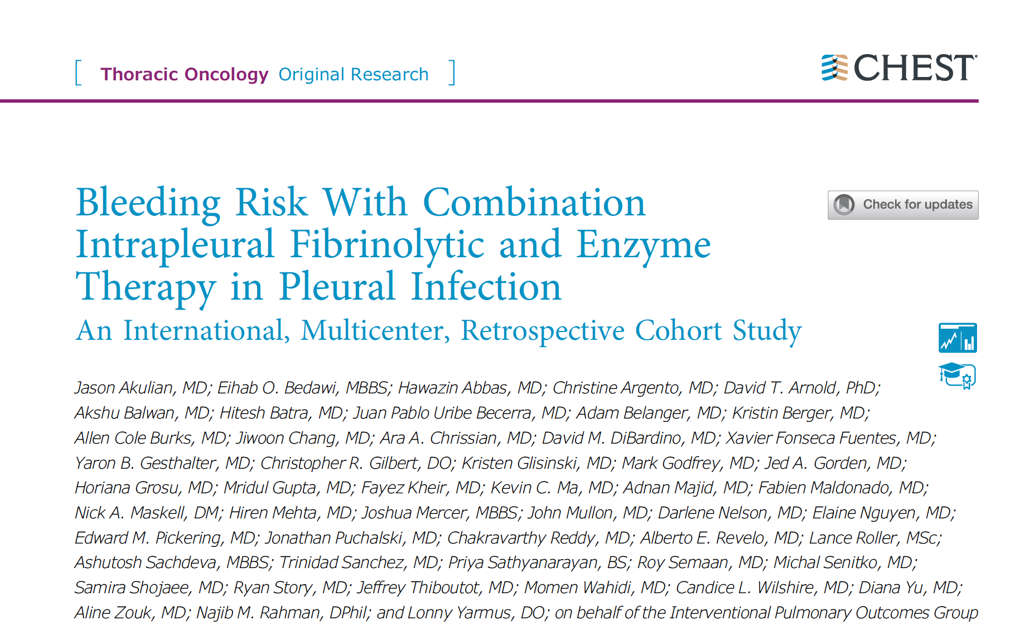
Akulian and Bedawi et al, Chest 2022 Jun 15;S0012-3692(22)01089-3

Slide 32
RETROLYSIS
tPA + DNase
25 centres over 8 years
    1850 cases
Results
    Bleeding risk = 4.1%
    Bleed requiring intervention = 1.3%
    Increased with:
        Anticoagulation
        Renal impairment
        Increased RAPID score (urea)
Akulian and Bedawi et al, Chest 2022 Jun 15;S0012-3692(22)01089-3

Slide 33
RETROLYSIS
Akulian & Bedawi et al CHEST 2022

Slide 34
RETROLYSIS
Adverse event | n | % of all adverse events (n=561) | % of study population (n=1833)
Pain requiring escalation of analgesics | 224 | 39.9 | 12.2
Increased level of care | 44 | 7.8 | 2.4
Death | 16 | 2.8 | 0.9
Hemoptysis | 7 | 1.2 | 0.4
Chest wall haematoma | 8 | 1.4 | 0.4
Fever | 4 | 0.7 | 0.2
Akulian & Bedawi et al CHEST 2022

Slide 35
tPA / DNAse experience
Author | Study Type | No. of pts. treated with active combination
Rahman et al – 2011 | RCT | 52 / 210
Piccolo et al – 2014 | Prospective observational | 107 / 107
Majid et al – 2016 | Retrospective | 73 / 73
McClune et al - 2016 | Retrospective | 101 / 101
Mehta et al – 2016 | Retrospective | 55 / 55
Popowicz et al – 2017 | Prospective observational | 61 / 61
Kheir et al – 2018 | Prospective observational | 38 / 38
Khemasuwan et al – 2018 | Retrospective analysis | 84 / 84
Jiang et al - 2020 | Retrospective cohort | 56 / 56
Current state of MIST-2 in the literature
627 patients from 9 series
Pooled treatment success (i.e surgery sparing) rate of 90%
Improves CXR opacification
Reduces LOS
Why have we decided that surgery is bad outcome?
Bedawi et al ERS/ESTS Pleural Infection Taskforce ERJ 2022

Slide 36
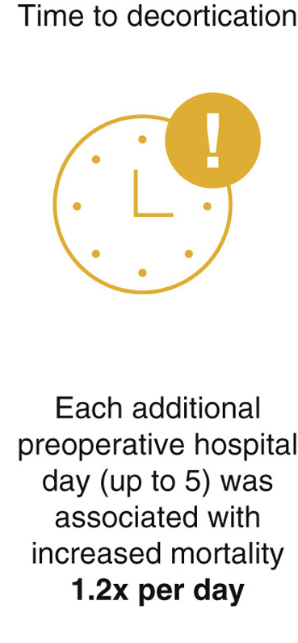
Large series showing success rates of 80-90% with VATS
VATS
  Conversion to open – 14%
  30d mortality - 2.8%
RF for conversion- delayed referral, late stage disease
Outcomes overall better when surgery performed within 4 weeks of symptom onset
Towe et al Morbidity and 30 day mortality after decortication for parapneumonic empyema and pleural effusion among patients in the Society of Thoracic Surgeons’ General Thoracic Surgery Database J Thorac Cardiovasc Surg 2019
Notes:
The surgeons have upped their game recently using this prospectively collected registry data
Within 4 week of symptom onset – which as we all know is particularly challenging as these patients often present late
When pre-operative hospitalization extended beyond 5 days – associated with more adverse outcomes in terms of readmission, major morbidiy, prolonged LOS, discharge to transitional care

Slide 37
IET vs VATS - Existing data on treatment failure rates
VATS (Pan et al JTD 2019)
5 studies (VATS vs open thoracotomy)
606 cases
Failure rate 7.2% (95% CI 5.3 to 9.6)
IET (RETROLYSIS) (Akulian & Bedawi et al, CHEST 2022)
1830 patients
Failure rate 18.0% (95% CI 16.3 to 19.8)

Slide 38
MIST3

Slide 39
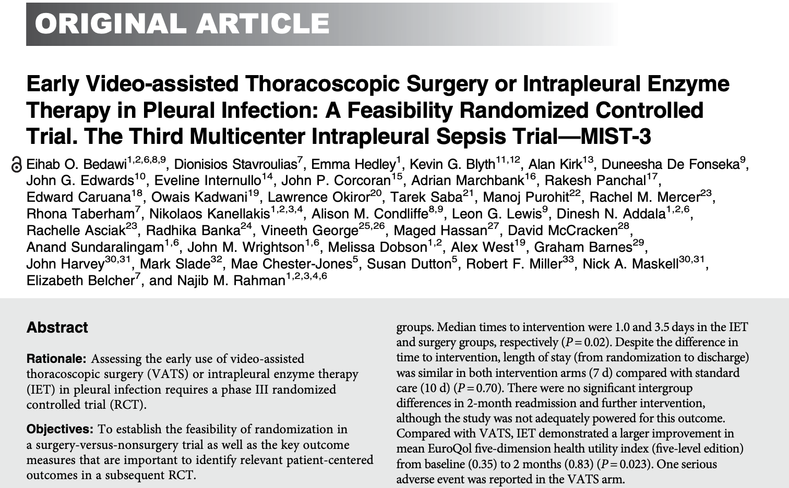
Bedawi et al, AJRCCM, 2023 Dec 15;208(12):1305-1315

Slide 40
MIST3
Purulent pleural fluid
Acidic, pH<7.2
Bacteria positive
RANDOMISATION
Early VATS
25
Standard Care
25
DNase & tPA
25
Outcomes:
Feasibility of recruitment
Acceptance of randomisation
Feasibility of data collection
Bedawi et al, AJRCCM, 2023 Dec 15;208(12):1305-1315
Notes:
Define medical treatment failure

Slide 41
MIST3 - Summary
1. Feasibility criteria met ✅
    High levels of patient acceptability
2. Convincing evidence to remove standard care arm but
  initial 24-hour drainage important
  12% require no further treatment
3. Surgical compliance
  Only 10% refused due to ‘anaesthetic risk’
  35% did not receive surgery due to a ‘perceived’ improvement
Bedawi et al AJRCCM 2023

Slide 42
MIST3 - Outcomes
Length of stay
    No difference in overall LoS (7 days post randomisation)
    Time to IET = 1 day, surgery = 3.5 days
    Surgery likely to accelerate discharge once occurs
PROMS
    Potential lower pain with IET at 2 months
    Potential higher QOL with IET at 2 months
    IET may be more effective for PROMS
Bedawi et al AJRCCM 2023

Slide 43
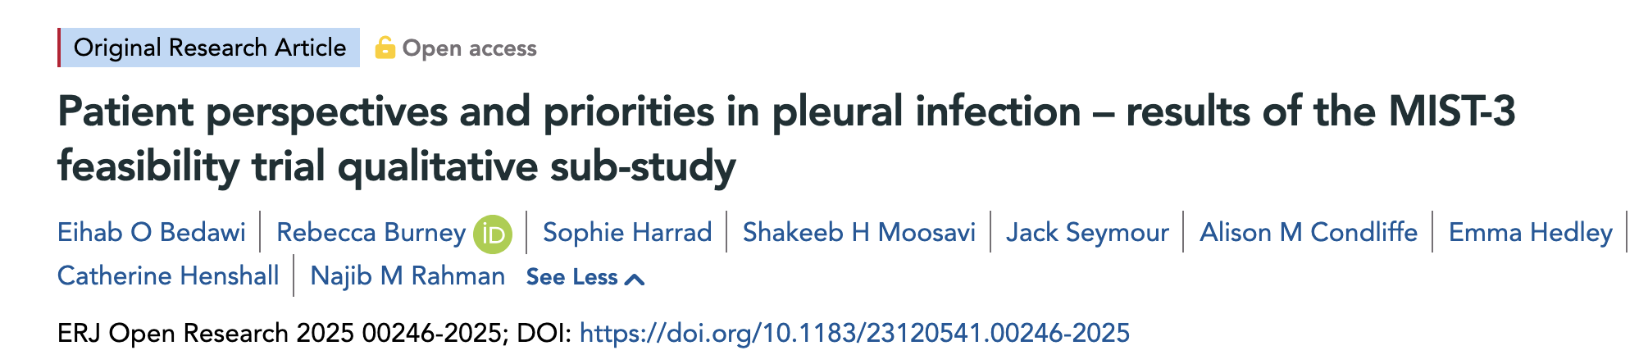

Slide 44
Prospective multicentre qualitative study using semi-structured interview methodology
Purposive sampling until data saturation (n=15)
Thematic analysis using Framework method
No clear patient preference between interventions
Pain is a significantly under treated symptom of pleural infection
Bedawi et al 2025 in press
Notes:
So we clearly need a new standard of care

Slide 45


MIST-4?

Slide 46
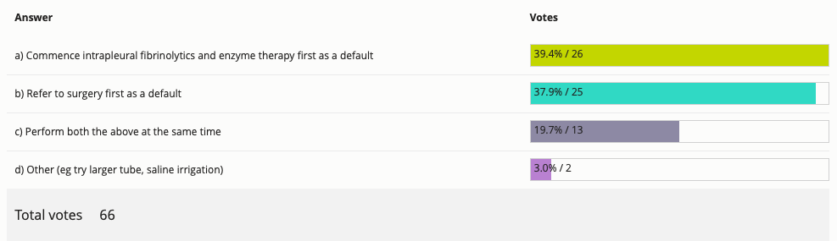
Current UK practice and equipoise
In a patient with pleural infection not responding to standard care, which of the following would represent your current practice?

Slide 47

MIST-4
Pleural infection as per standard diagnostic criteria
Standard care (upto 24 hours)
RANDOMISATION
Early VATS
debridment
Early
IET
Outcomes:
Treatment failure
Length of stay
Patient PROMS
Cost effectiveness

Slide 48
Medical Thoracoscopy
Case series data reporting success rates of 79.3-97.7% ^{1,2,3}
Recent meta-analysis⁴
- pooled treatment success rate of 85% when utilized as first line therapy after chest tube failure
- Complication rate 9%
RCT of MT vs MIST-2⁵
- shorter LOS with MT (1º outcome in favour of MT)
- small numbers
No adequately powered comparative or randomized data
1. Ravaglia et al Respiration 2012
2. Ohuchi et al Gen Thorac Cardio Surg 2014
3. Hardavella et al JOBIP 2017
4. Mondoni et al BMC Pulm Med 2021.
5. Kheir et al Annals ATS 2020
Notes:
What about comparative data?

Slide 49
Medical Thoracoscopy
Can be occasionally considered as an option in elderly, frail patients considered high surgical risk where there is local expertise including sufficient access to thoracic surgery and anaesthetic support
Notes:
BTS did not discuss medical thoracoscopy

Slide 50
Intrapleural saline irrigation
Notes:
Saline irrigation

Slide 51
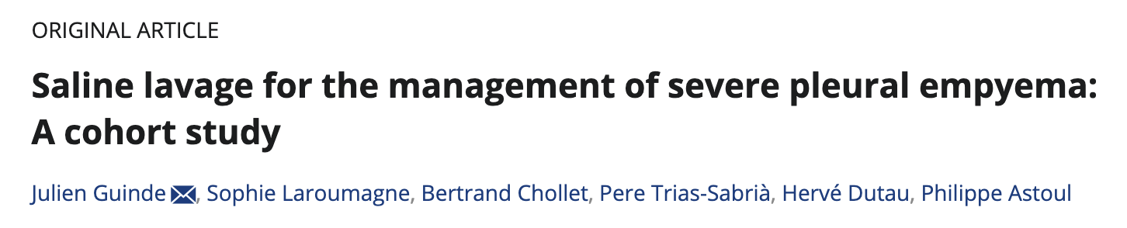
Retrospective analysis; n=30
Primary outcome: treatment failure at 3 months
4/30 (13.3%) failed
No surgical referrals
Prolonged hospital stay = 17 days
10% required additional pleural procedures
No control group
Guinde et al CRJ 2021
Notes:
markers of proteolysis of the bacteria was probably a representation of fibrin bacteria by streptokinase within the pleural space

Slide 52
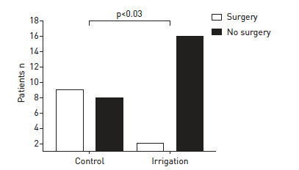
PIT – Pleural Irrigation Trial
RCT (n=35) comparing:
Standard care
250mls normal saline tds (“irrigation”)
Conclusions:
High surgical rate in control arm (53%)
Positive initial data
RCT needed to consolidate the evidence
Hooper et al ERJ 2015
Notes:
demonstrated a superior resolution of CT pleural fluid volume (primary outcome) over the course of the treatment compared to standard care alone, as well as a reduction in surgical referrals (secondary outcome)
Guinde J, Laroumagne S, Chollet B, et al. Saline lavage for the management of severe pleural empyema: a
cohort study. Clin Respir J 2021; 15: 1097–1103.
129 Porcel JM, Valencia H, Bielsa S. Manual intrapleural saline flushing plus urokinase: a potentially useful
therapy for complicated parapneumonic effusions and empyemas. Lung 2017; 195: 135–138.

Slide 53

Saline irrigation
Until larger multicentre RCTs consolidate the evidence base, TF members would consider saline irrigation in pleural infection on a case-by-case basis where there are strong contraindications to IET (e.g., therapeutic anticoagulation which cannot be stopped), and where surgery is not a viable option
Notes:
on a case-by-case basis where there are strong contraindications to IET (e.g., therapeutic anticoagulation which cannot be stopped), and where surgery is not a viable option. BUT should not be seen as an alternative to MIST-2
Saline irrigation (250 ml saline TDS) may reduce the need for thoracic surgery (Ungraded) but appears to 1267 have no impact on mortality (Ungraded), length of hospital stay (Ungraded) or time to resolution of fever 1268 (Ungraded) when compared with saline flushes

Slide 54
Outcome prediction and a precision medicine approach
Notes:
So on that note im now going to seg way into biomarkers and outcome prediction

Slide 55
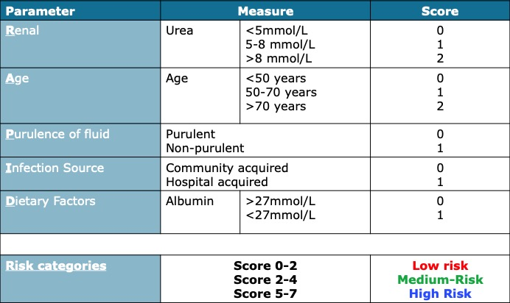
RAPID score
- the ‘CURB-65’ of pleural infection
Rahman et al CHEST 2014
Notes:
Of course we do have a clinical outcome prediction tool that has been externally validated – this is the rapid score
And remember that each of these are independently predictive

Slide 56
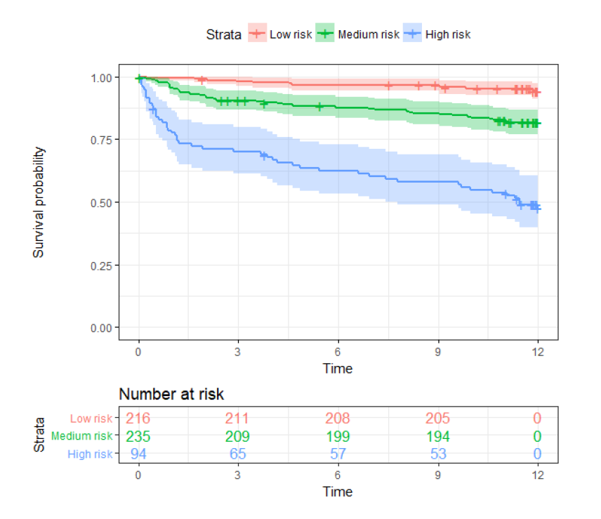
Financial disclosures
2.3%
9.2%
29.3%
Corcoran et al ERJ 2020
Notes:
Now one of the issues about the RAPID score is because as it was derived from MIST-1 and MIST-2, it was constructed before the era of commonplace ultrasound..

Slide 57
RAPTOR-f
The future?
Robust outcome and mortality prediction tool
RAPTOR-f feasibility study triaging patients to varying levels of aggression based on RAPID score – in recruitment
Confirmed pleural infection
Low RAPID
Moderate RAPID
High RAPID
Consider aspiration and oral antibiotics with early outpatient review
Chest tube + early IET/surgery
Consider directly to IET or surgery
Bedawi & Rahman Pleural Infection; ERS Monograph 2019

Slide 58
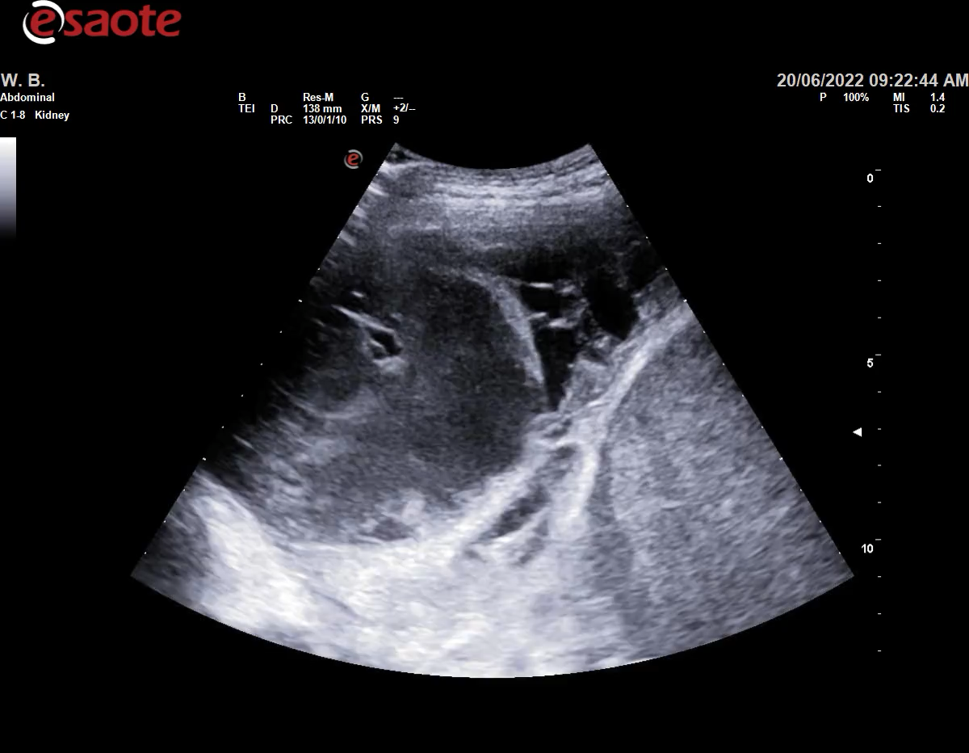
Notes:
But we have another biomarker that we use every day and that is of course our ultrasound and while we know this is v sensitive as a diagnostic parameter its prognostic ability has never been shown
Neutrophil elastase (NE) inhibits fibrinolysis by degrading plasminogen

Slide 59


Notes:
PAI-1 (plasminogen activator inhibitor-1) is the key inhibitor of fibrinolysis, blocking tPA and uPA activity and promoting fibrin persistence in the pleural space,
whereas suPAR (soluble urokinase plasminogen activator receptor) reflects immune activation and increased fibrinolytic potential in pleural infection.

Slide 60
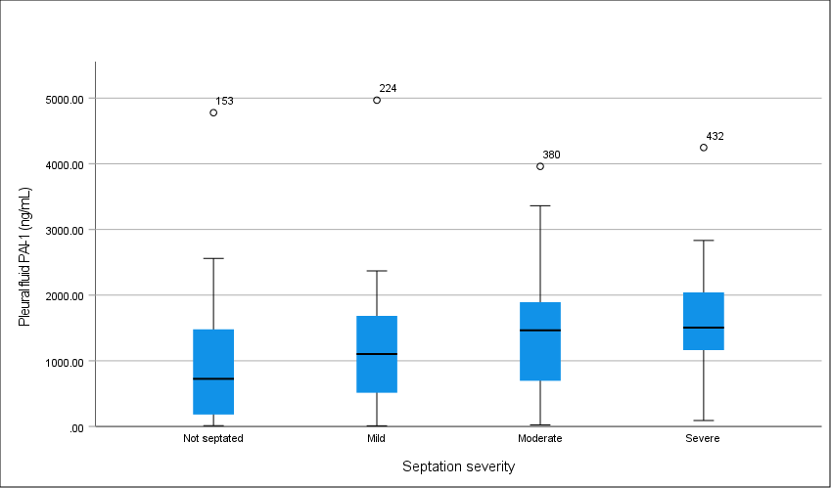
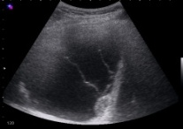
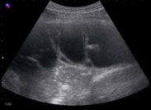
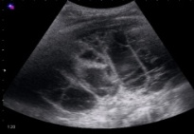
PAI-1 and
septation
severity
PF fibrinolytic protein | Septation Score |  |  |  | p-value
 | Nil (n=46) | Mild (n=28) | Moderate (n=39) | Severe (n=53)
PAI-1, ng/mL; median (IQR) | 725.2 (182-1480) | 1104.1 (513-1685) | 1464.9 (696-1893) | 1573.7 (1212-2111) | 0.003
Bedawi EO et al. Am J Respir Crit Care Med. 2022
Notes:
And what we found was that compared to a number of other inflammatory of fibrinolysis associated proteins that we looked at, the levels of PAI-1 correlated best with presence and severity of septations using an objective validated septation score

Slide 61
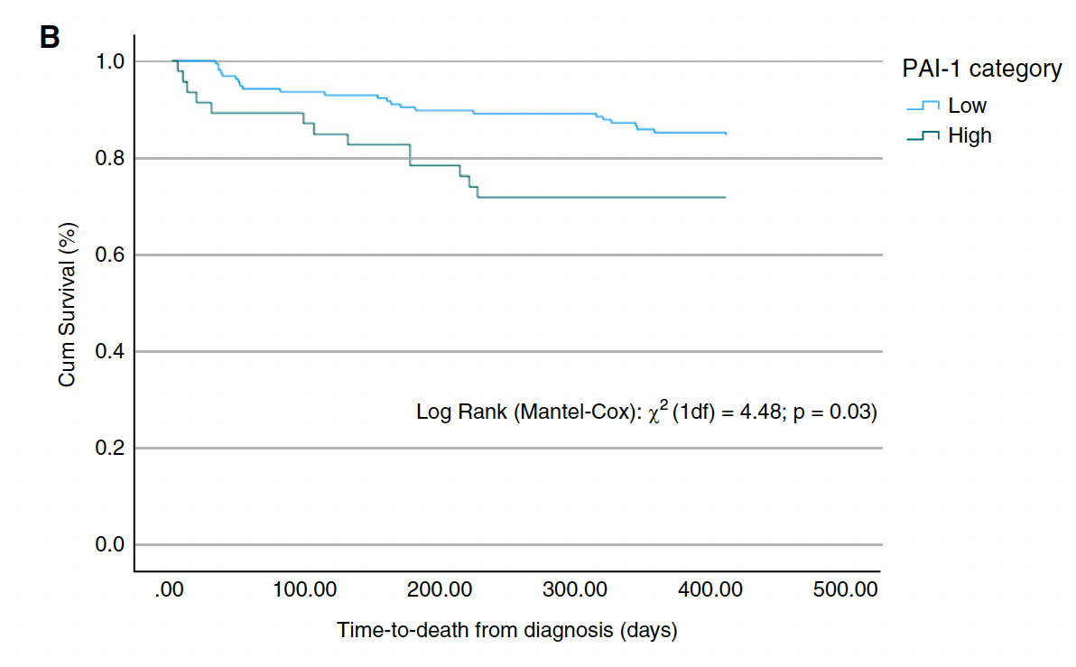
Pleural fluid PAI-1 predicts length of stay (F[1,214]=1.99; p=0.048)
1 year mortality in pleural infection
PAI-1 and suPAR now require external validation
First biological predictor of mortality
Bedawi et al. Am J Respir Crit Care Med. 2022
Notes:
Can we predict who is going to do badly with their pleural infection?
Although the optimal agents, dose, and schedules by which IPFT should be delivered remain unclear (13), the findings challenge the use of empirically delivered relatively low doses of either uPA or tPA, which could be quickly inactivated by endogenous PAI-1 within infected pleural fluids.
w PAI-1 affects pleural infection pathophysiologic and clinical outcomes and strengthens the rationale for further investigation of PAI-1–targeted management strategies

Slide 62
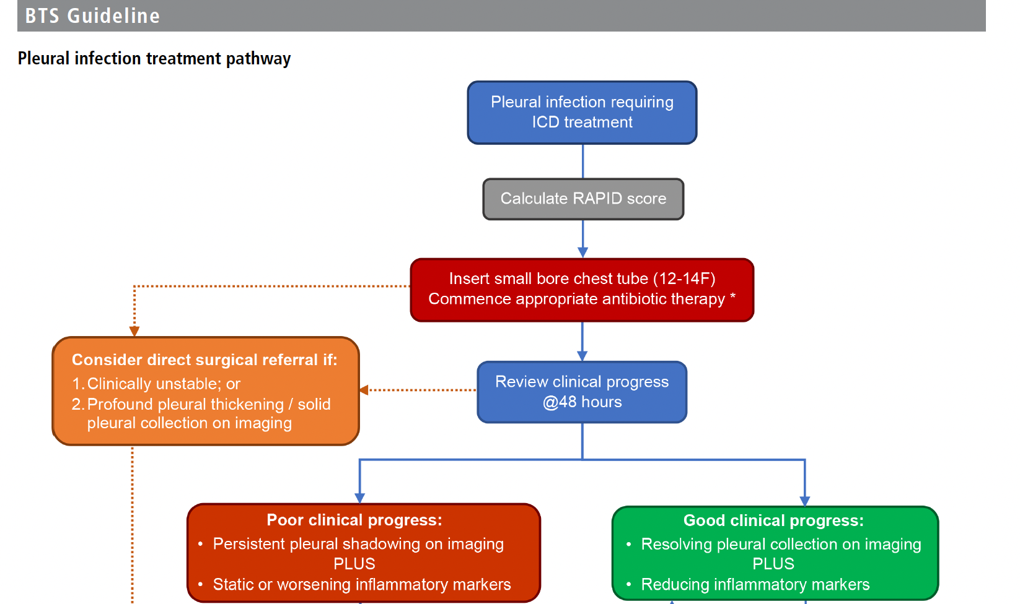

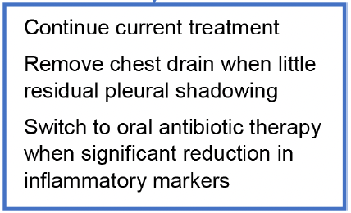

Notes:
Preexisting therapeutic approaches inadequate approaches inadequate as seen by the unchanged high morbidity and mortality
Concurrent preffered due to convenience and decreased risk of iatrogenic infection but the evidence doesn’t favour one over the other
Individualised risk approach, multidisciplinary discussions with surgeons, haematologists and of course the patient and important to consider not

Slide 63
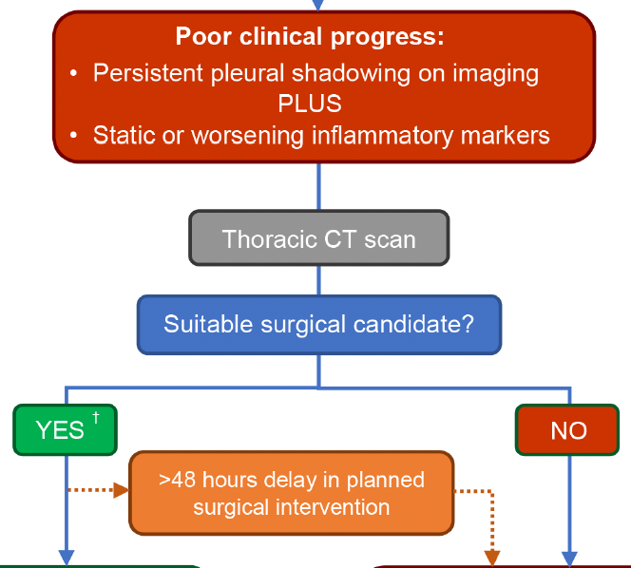
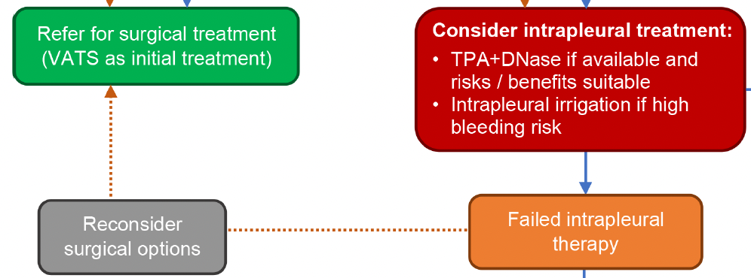
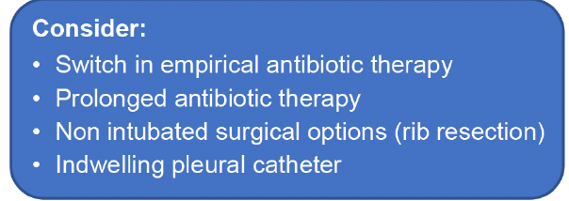
Notes:
Preexisting therapeutic approaches inadequate approaches inadequate as seen by the unchanged high morbidity and mortality
Concurrent preffered due to convenience and decreased risk of iatrogenic infection but the evidence doesn’t favour one over the other
Individualised risk approach, multidisciplinary discussions with surgeons, haematologists and of course the patient and important to consider not

Slide 64
Summary
Pleural infection incidence is rising
Distinct phenotypes – parapneumonic / primary pleural infection
Polymicrobial disease dominated by anaerobes
Early diagnosis and recognition of medical treatment failure are key
Definitive head to head trials of VATS vs IET are underway
Newer diagnostic and prognostic biomarkers are needed to drive a precision medicine approach

Slide 65
Thank you
eihab.bedawi@ndm.ox.ac.uk

