Slide 1

Guidelines: BTS Clinical Statement on Pleural Procedures
PneumoTrieste 2026
Wednesday 13th May 2026
Dr. Eihab Bedawi PhD FRCP
Consultant in Respiratory Medicine & Pleural Disease
Clinical Lead, Oxford Pleural Unit
Visiting Professor, Dept of Biomedical Sciences & Public Health
Universita Politecnica Delle Marche

Slide 2
What I will cover
Scope of the BTS Procedures Statement
Patient safety
Anticoagulation
Ambulatory Devices
Suction
Blood Patch

Slide 3
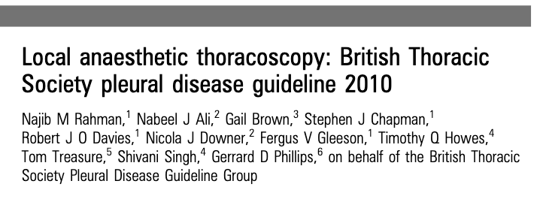
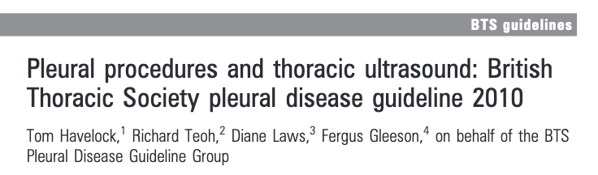
Pleural aspiration
Seldinger chest drain insertion
Ultrasound guidance
Notes:
This was obviously shortly following the famous 2008 NPSA safety alert

Slide 4
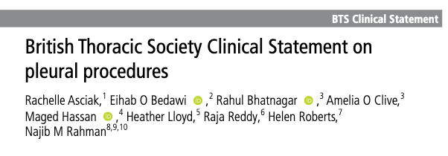
Safety and preparation for pleural procedures
Pleural aspiration (dx and therapeutic)
Intercostal drains (seldinger and blunt dissection)
IPC insertion, management and removal
Ultrasound guided pleural biopsy
Medical Thoracoscopy
Notes:
Reflects the breadth of current practice and how far we’ve come as physician led and delivered pleural intervention
While BTS guidelines follow the (GRADE) methodology for guideline development which includes a full systematic review of the literature, BTS clinical statements focus on a narrative review of the literature to give a ‘snapshot in time’ of current knowledge and best practice. Following discussions of broad statement content, individual sections were drafted by group members.

Slide 5
Procedures
Review of the evidence
Patient selection
Indications and contraindications
Troubleshooting
Clinical practice points
Complications (and rates)
‘How to’ guide (appendix)
Informed consent
Peri-procedural care
Notes:
CPPs summarized at beginning of document
Particular areas where we expand e.g. management of surgical emphysema, re-expansion pulmonary oedema

Slide 6
Appendices
Suction and digital drain devices
Ambulatory devices
Intrapleural therapies
  Talc slurry
  Autologous blood patch
  Fibrinolytics
  Pleural irrigation
‘How to’ target LA for pleural procedures
‘How to’ set up a chest drain and underwater seal
‘How to’ drain an IPC with vacuum
Sample patient information leaflets and consent forms

Slide 7
Patient Safety

Slide 8
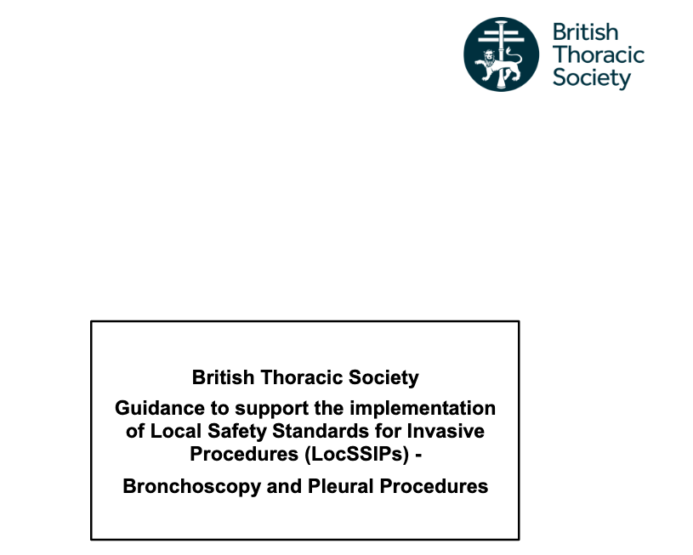
Right patient
Right procedure
Right operator
Right time
Right supporting staff
Right environment
BTS LocSSIPs November 2020
Notes:
Not just as in identity but also checking whether they are suitable for this procedure, have they been able to understand the procedure and provide written informed consent to go ahead can they handle complications, is the risk/benefit assessment in favour of proceeding
Is this the right procedure for this clinical scenario?
Am I the right operator, do I have the appropriate training/experience, am I aware of all the complications
IS this the right time – out of hours, if its 4.45 now by the time I finish do I know who’s in the consultant offices who could come and give me a hand which leads to..
Right supporting staff – both senior staff to get me out of trouble,
Right environment – ultrasound machine, sterile trollies and space for sample processing, is the oxygen supply within reach, patient monitoring equioment, access to the crash

Slide 9
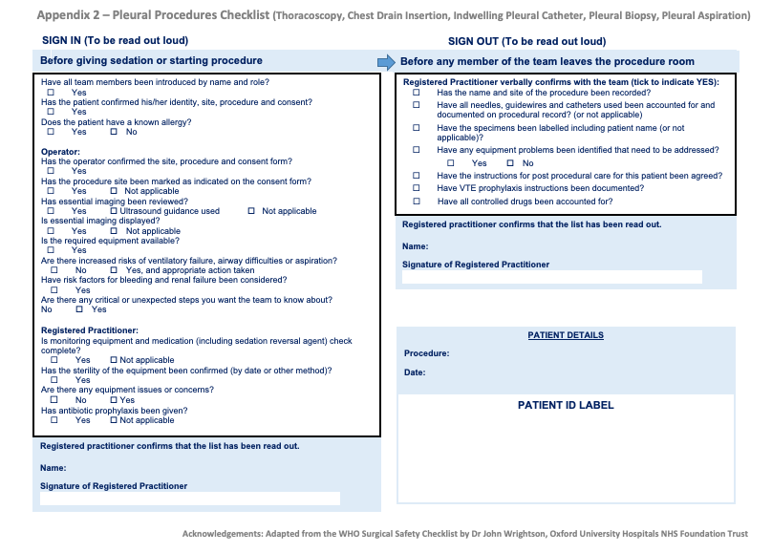

Notes:
SAFETY CHECKLISTS AND DOING YOUR PRE-PROCEDURE CHECKS, BLOODS, IMAGING, MEDICATIONS
AND POST PROCEDURE CHECKS JUST AS IMPORTNAT

Slide 10
Minimum documentation
  Intervention performed
  Recovery plan and observations required
  Any medication given
  Any immediate complications
BTS LocSSIPs November 2020
Notes:
And we have some recommendations on appropriate observations and aftercare

Slide 11
Procedure environment
Bedside procedures should be avoided
Clean, dedicated procedure room
Equipment/stock lists for specific procedures
Notes:
Helping prople build and develop safe pleural services, avoid bedside procedures, if in the middle of my thoracscopy I discover something faulty or something becomes desterilized do I have a back up tray

Slide 12
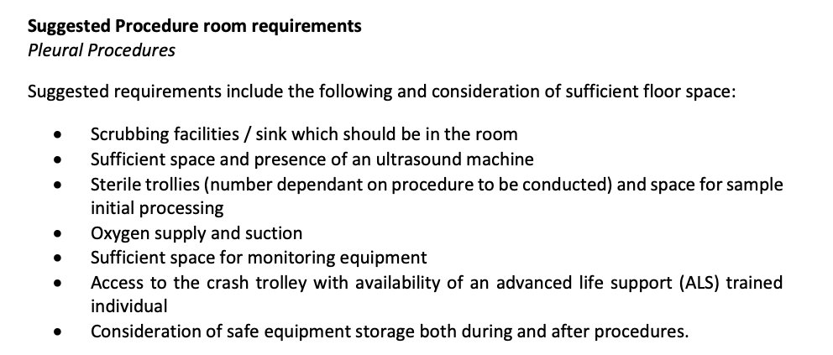
Notes:
And if someone needs a minimum standard to help writing a business case for a new procedure room

Slide 13
Anticoagulation

Slide 14
Elective pleural procedures
Warfarin – stopped 5 days and INR <= 1.5
DOAC 24-48h*
Clopidogrel and prasugrel 5 days
Ticagrelor 7 days
Dipyridamole* 24h
Bleeding risk of the procedure and patient’s individual risk factors for bleeding and thrombosis should be evaluated
Notes:
We consulted with the antiplatelet and anticoagulation guidelines published by the Britsih Society of Haematology
The guidance is based on drug half life, and in the case of dabigatran creatinine clearance as well
No specific guidance for phosphodiesterase inhibitor but most local guidance suggested at least 24 hours
But important to not that bleeding risk of the procedure and patient’s individual risk factors such as recent VTE, cardiac stents, factor deficiencies etc should be taken into account

Slide 15
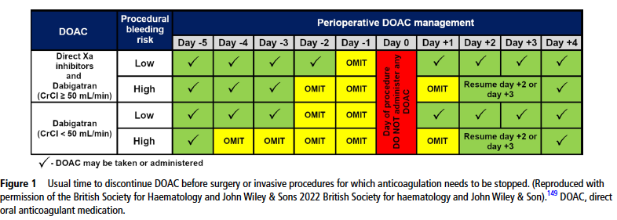
Daily prophylactic heparin should be considered for patients at high risk of venous thrombosis prior to DOAC recommencement
Notes:
So with regards to perioperative DOAC management
Most DOACs can be safely resumed 1 day after a low risk procedure and 2-3 days after a high risk procedure

Slide 16
Ambulatory Devices

Slide 17
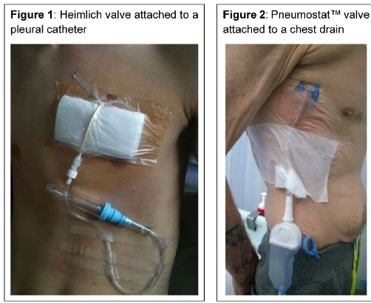
Notes:
Atrium Pneumostat - Small holding chamber approx. 30ml can be used in primary and secondary pTX
Heimlichs – inability to hold any fluid, limited role in prolonged air leak – best used in iatrogenic post biopsy PTX where the air leak is expected to be short lived

Slide 18
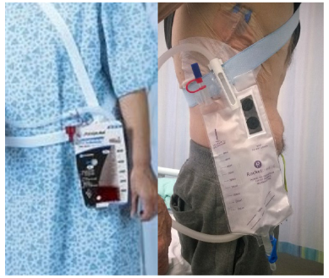
Notes:
Atrium express mini dry seal 500ml and Rocket ambulatory bag
Easy to attach to any existing drains but important that staff are well trained to monitor, care and identify complications

Slide 19
Ambulatory Devices
Allow a period of observation as an inpatient and make sure staff trained
No written consent required but provide PIS
Ensure appropriate aftercare and follow up in place
Notes:
Post CT guided biopsy FU 1-2 days (tend to heal quickly)
PAL initially every 2-3 days with a CXR, F2F or telephone – patients should know who to contact out of hours

Slide 20
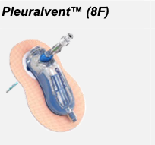
Integrated Devices – Pleural Vent (for PSP only)
Designed for 2nd ICS ant insertion but not necessary
Similar insertion to any ICD
Self-adhesive but ideally suture
Good aftercare essential
Follow up
Notes:
(clear verbal and written instructions, how to perform daily checks

Slide 21
Integrated / Ambulatory devices
Conclusion
Build expertise by using for early ambulation on the ward before establishing a ‘fully’ ambulatory service
Pleural Nurse is an essential component of an ambulatory PTX pathway
Notes:
And if your hospital wants to benefit on admission avoidance pneumothorax then they’ll need to support you to get a pleural nurse

Slide 22
Suction
Notes:
The theory that underpins the role of suction is that air might be removed from the pleural cavity at a rate that exceeds the egress of air through the breach in the visceral pleura and to subsequently promote healing by apposition of the visceral and parietal pleural layers

Slide 23
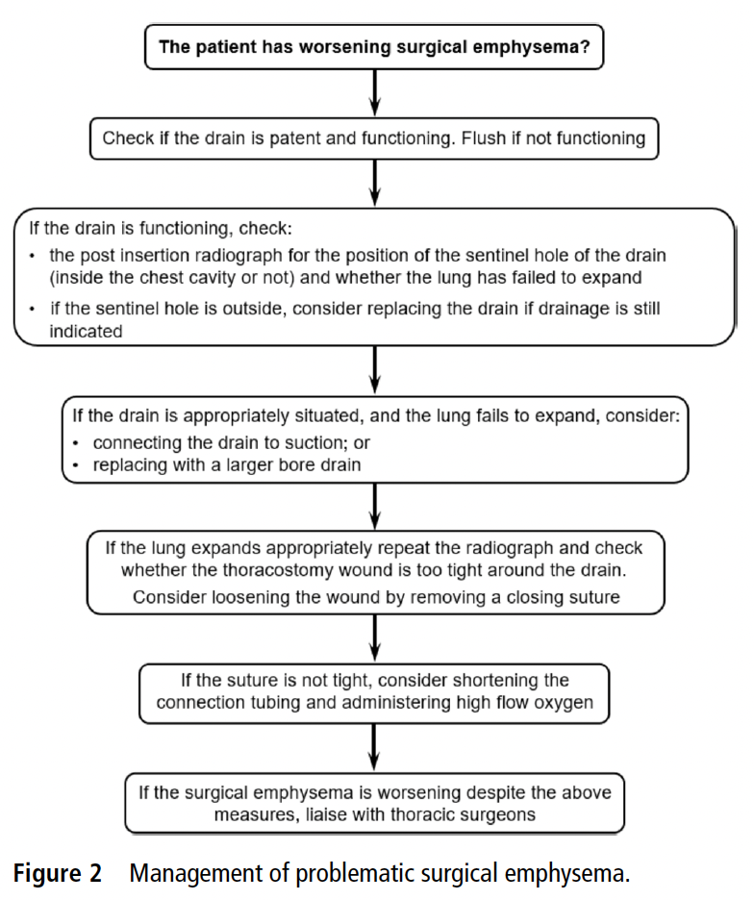
Suction
Evidence base lacking (except post thoracic surgery)
Recommend waiting at least 24h before starting in context of PSP (risk of RPO)
Notes:
The most established indication for suction is in pneumothorax with such a large air leak that there is insufficient flow through the chest wall to keep up.

Slide 24
Suction
Evidence base lacking (except post thoracic surgery)
Recommend waiting at least 24h before starting in context of PSP (risk of RPO)
Notes:
There is a concern that applying suction too soon after drain insertion may increase the risk of re-expansion pulmonary oedema (RPO), particularly if the lung has been deflated for some time.1 In the context of primary spontaneous pneumothorax (PSP), the risk of RPO may be highest in young patients, with a complete pneumothorax. REPO Lancet 2018

Slide 25
Digital suction devices
Ambulatory device
Deliver suction
Accurate air leak measurement
NICE recommendation based on post-operative patients
Only one small RCT including PTX
Notes:
The majority of data evaluating electronic chest drain devices relate to post-operative patients who have undergone thoracic surgery, which has led to NICE guidance advocating their use as a cost-effective intervention to reduce drainage time, length of hospital stay and improve safety.
The clinical statement group agreed that data regarding the use of suction for persisting air leak was beyond the scope of this document

Slide 26
Digital suction devices
Digital suction vs chest drain and wall suction¹
  Reduced duration of drainage LOS
  Similar surgical rates for PAL
Digital drain device vs chest drain and UWS²
  Reduced duration of drainage and LOS in post hoc evaluation of patients who didn’t require surgery for PAL
1. Jablonski S et al Thorac Cardiovas Surg. 2014
2. Ruigrok D et al. BMC Pulm Med. 2020
Notes:
The majority of data evaluating electronic chest drain devices relate to post-operative patients who have undergone thoracic surgery, which has led to NICE guidance advocating their use as a cost-effective intervention to reduce drainage time, length of hospital stay and improve safety.6
The clinical statement group agreed that data regarding the use of suction for persisting air leak was beyond the scope of this document

Slide 27
Suction: Conclusions
Avoid too soon after drain insertion
Documentation with clear instructions (units)
Routine use should be avoided given lack of data
If used – low pressure, high volume
Digital suction devices a useful alternative given their advantages over wall suction
Notes:
-10 to -20cmH2O (compred to normal intrapleural pressures of -4 to -8) which allows airflow capacity increase upto 15-20L/min – and theory is that this reduces the risk of barotrauma
I would add that suction should be started in hours with medics on site within first hour and remember safer to have a working drain without suction than mismanaged suction
Some nice data published from a post-hoc analysis of RAAMP showing that air leak >100ml/min on day 1 may predict treatment failure and need for surgery

Slide 28
Autologous Blood Patch ‘Pleurodesis’

Slide 29
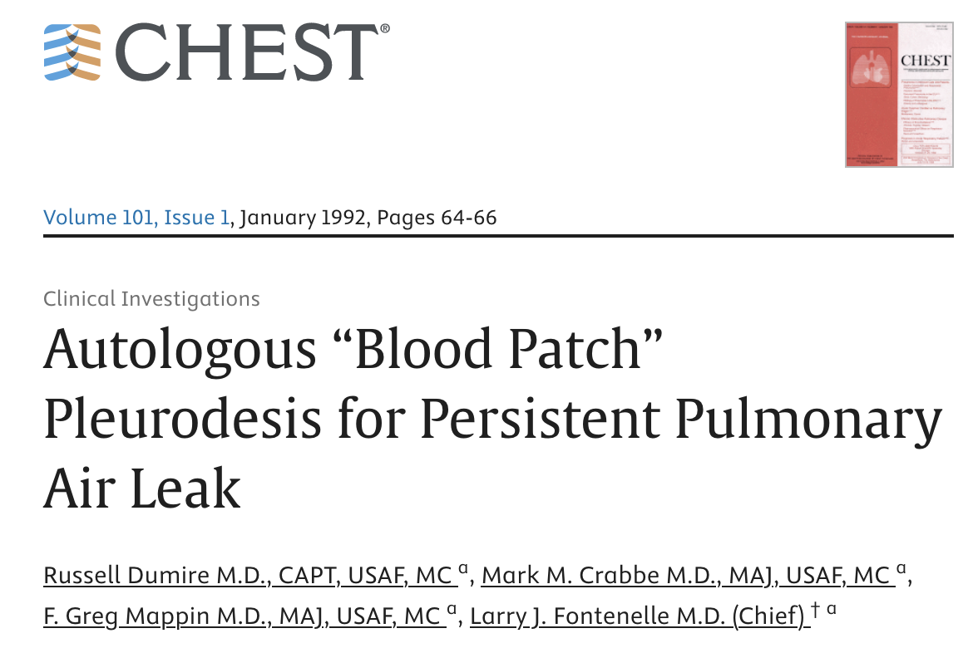
Notes:
Was first described by Dumire The instillation of autologous blood into the pleural cavity to obliterate an air leak is thought to work by two methods: (1) coagulated blood adheres to the lung as a patch and seals the air leak directly; and (2) blood causes inflammation and subsequent adhesions between the lung and pleura, and the adhesions are responsible for sealing the air leak.
The latter of these methods has proved to be incorrect in an animal model [5]. We therefore suggest the term “blood pleurodesis” should not be used to describe this technique, as it does not work by causing a pleural symphysis.

Slide 30
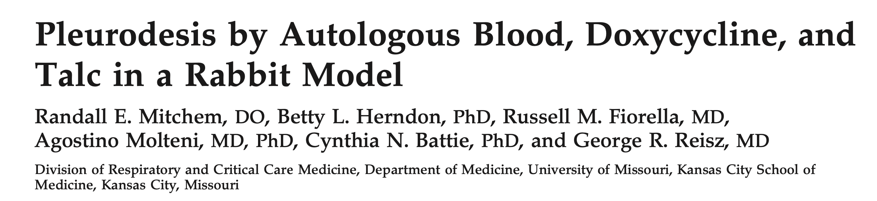
Autologous Blood Patch Pleurodesis
(Ann Thorac Surg 1999;67:917–21)
Notes:
The latter of these methods has proved to be incorrect in an animal model where they put for rabbits drained their effusions, then put blood in one, doxyxycline in a second and talc in a third and could see macroscopic evidence of adhesions and mediastinal thickening [5]. We therefore suggest the term “blood pleurodesis” should not be used to describe this technique, as it does not work by causing a pleural symphysis.

Slide 31
Blood Patch “Pleurodesis”:
Shackloth et al Ann Thorac Surg 2006
UK RCT (Liverpool)
n=319 lobectomies over 18 months
n=22 (6.9%) PAL at 5 days post op randomised to 2 treatment pathways
  Intervention – 120ml ABPP on D5 post op and again at D7 and D9 if PAL persisted
  Control – chest tube alone – ABPP at D10 if PAL
Time to chest drain removal (median 6.5d vs 12d), LOS (median 8d vs 13.5d) (p<0.001)
ABPP success = 58.6% (air leak sealed)
Notes:
120 mL blood compared with the 50 mL described by Dumire and coworkers [4] in an attempt to increase the chances of the damaged part of the lung becoming covered with blood
To aid in the distribution of blood throughout the pleural cavity, Cagirici describes the positioning of the patient in the left decubitus, right decubitus, Trendelburg, and Fowler po- sitions for 30 minutes each. We adopted a similar proto- col for our study. However, we are unsure of the neces- sity of this, as it has been shown with radiolabelled tetracycline that distribution of this substance is uniform within seconds of instillation within the pleural cavity [8]. Also given that the clotting time of blood is 3 to 8 minutes, any further distribution is unlikely to occur after this time.

Slide 32
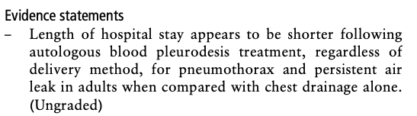
Blood Patch Pleurodesis:
Conclusions
Risk of empyema probably overestimated based on recent data but avoid in active wound/chest infection
Optimal timing and volume of blood remain unknown
Notes:
Data suggests the earlier the better -D5 probably about right (the duration of a PAL itself appears to be associated with increase pleural infection)
Recommend against if any evidence of wound or chest infection
Optimum timing and volume of blood remain unknown
Earlier the better – D5 if no surgical option

Slide 33
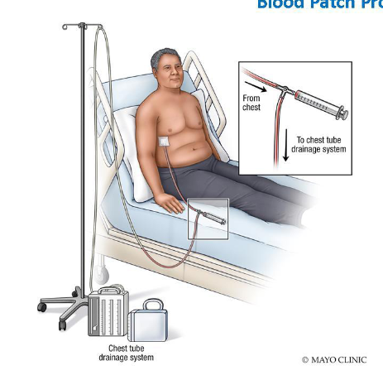
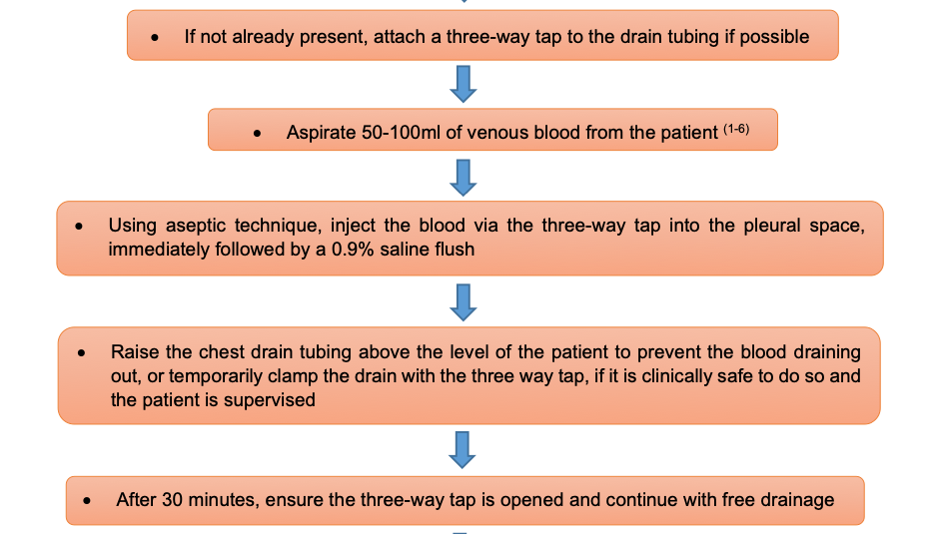
Blood Patch - technique
IS Hasan et al J Thorac Dis 2021
BTS Clinical Procedures Statement 2023
Notes:
This is in the

Slide 34
Other highlights from the BTS statement
  Pleural fluid diagnostics and sample collection guidance
  Optimal speed and method of drainage in therapeutic aspiration
  Management of REPO and surgical emphysema
  Management of IPC related complications
  IPCs in patients undergoing systemic chemotherapy with possible neutropenic side effects
  IPC use in transudative non-MPE
  LAT troubleshooting guidance (Appendix 4)

Slide 35
Conclusion
In the year 2019/20, we collectively undertook 21,659 pleural aspirations in England
We now have an abundance of data to drive high quality practice
In the context of NPSA’s related to pleural procedures the onus is on us as operators and physicians responsible for services that we run them to the highest standards
The BTS 2023 clinical statement provides a comprehensive pleural intervention guide
Notes:
The GIRFT national specialty report for respiratory medicine published in 2021 found that

Slide 36
Thank you for your attention

